Slide 1
Supply Chain Performance – Executive Overview
Our supply chain analysis reveals critical operational opportunities across delivery, inventory, and supplier management. While gross margins remain robust at approximately 99%, operational execution presents significant improvement potential.
On-time delivery performance stands at 76%, positioning delivery reliability as our primary operational risk. This translates to nearly one in four shipments arriving late, impacting customer satisfaction and operational predictability.
Inventory exposure represents 42% of revenue, with cosmetics showing disproportionate overstock risk. This capital allocation challenge presents immediate working capital optimization opportunities. Additionally, delivery and quality risks are concentrated among specific carriers and suppliers, enabling targeted intervention strategies.

Slide 2
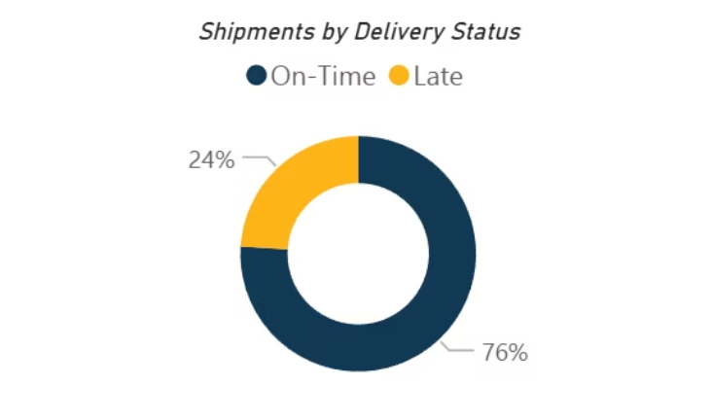
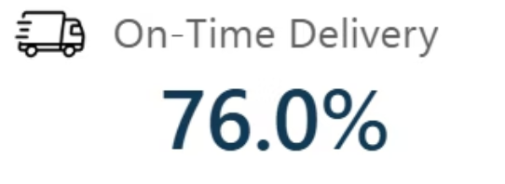
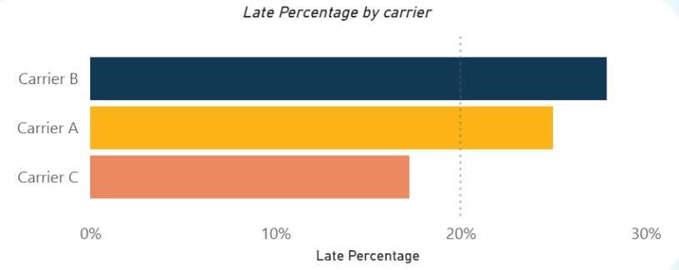
Delivery Reliability Is the Main Operational Constraint
24%
2
30%
Shipments Late
Average Days Delayed
Carrier B Late Rate
Nearly one quarter of all deliveries miss committed dates
Typical delay duration when shipments are late
Highest late delivery percentage among all carriers
Late shipments represent a systemic operational issue rather than isolated disruptions. With 24% of shipments arriving late and an average delay of 2 days, we face a structural reliability challenge that impacts customer commitments and downstream operations.
Carrier B emerges as the primary contributor, accounting for approximately 28–30% late delivery rates. This concentration of underperformance suggests specific carrier relationship issues requiring immediate executive attention and potential contract renegotiation.

Slide 3
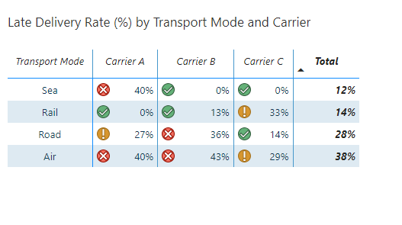
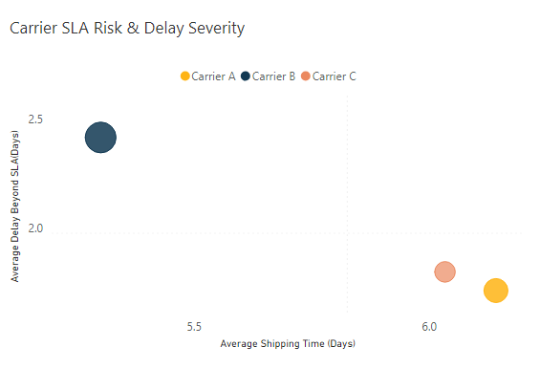
Carrier–Transport Mode Combinations Drive SLA Failures
Highest-Risk Combinations
Stable Performance Areas
Air transport: 38% late delivery rate across carriers
Rail transport generally demonstrates reliability, though Carrier C on Rail shows elevated late risk at 33%, warranting monitoring.
Road transport: 28% late delivery rate, concentrated with Carrier B
Carrier B + Air: Worst-performing SLA combination overall
Carrier B + Road: Secondary high-risk pairing requiring intervention
The data reveals that transport mode selection significantly impacts delivery performance, with air and road showing systematic challenges that compound when paired with underperforming carriers.
These carrier–mode combinations represent actionable intervention points. By rebalancing volume away from high-risk pairings, we can immediately improve overall delivery performance without requiring systemic operational changes.

Slide 4
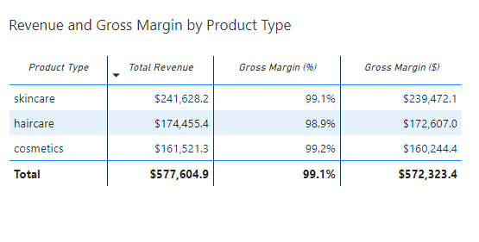

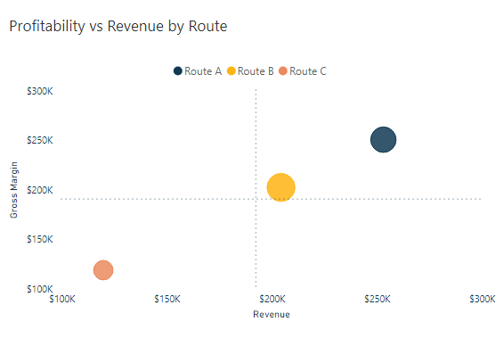


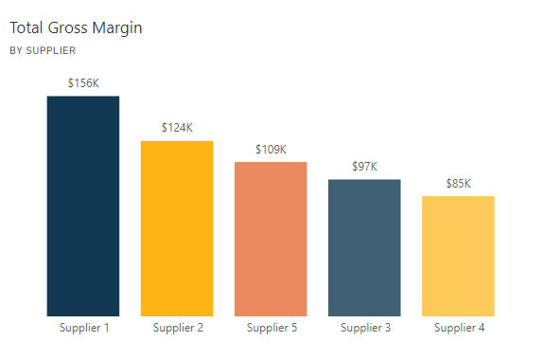
Profitability Is Strong but Operationally Exposed
Our profitability foundation is solid, with gross margins near 99% indicating strong pricing power and cost management. However, operational execution gaps create unnecessary risk exposure that threatens this financial performance.
Route A Performance
Revenue: ~$250K
Margin: ~$250K
Highest-performing route requiring protection through optimized carrier selection and inventory allocation
Route C Concerns
Status: Underperforming
Generates lower margin while consuming significant inventory resources, requiring strategic reassessment
Supplier 1 Paradox
Gross Margin: $156K
Contributes highest margin but shows delivery delays—quality strong, timeliness needs improvement
Route A represents our strategic crown jewel, delivering exceptional revenue and margin performance. Protecting this route through enhanced carrier partnerships and inventory optimization should be our highest operational priority.

Slide 5
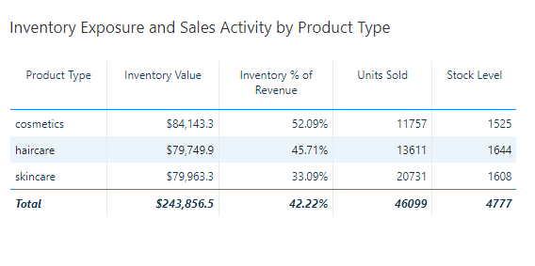
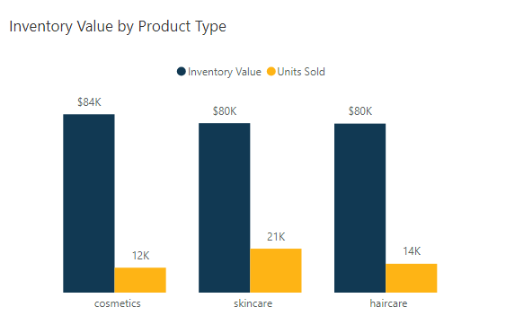
Inventory Is Not Fully Aligned with Sales Velocity
Total inventory exposure stands at 42% of revenue, indicating substantial working capital tied up in stock. This represents both a financial opportunity and an operational efficiency challenge.
Cosmetics Category Risk
Cosmetics holds the highest inventory exposure at 52% of revenue, suggesting either overstock conditions or slower sales velocity relative to inventory investment. This category presents the most significant working capital optimization opportunity.
Skincare Excellence
Skincare demonstrates the strongest alignment between inventory levels and demand patterns, serving as a benchmark for other categories.

Slide 6
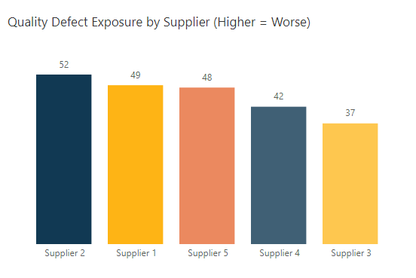
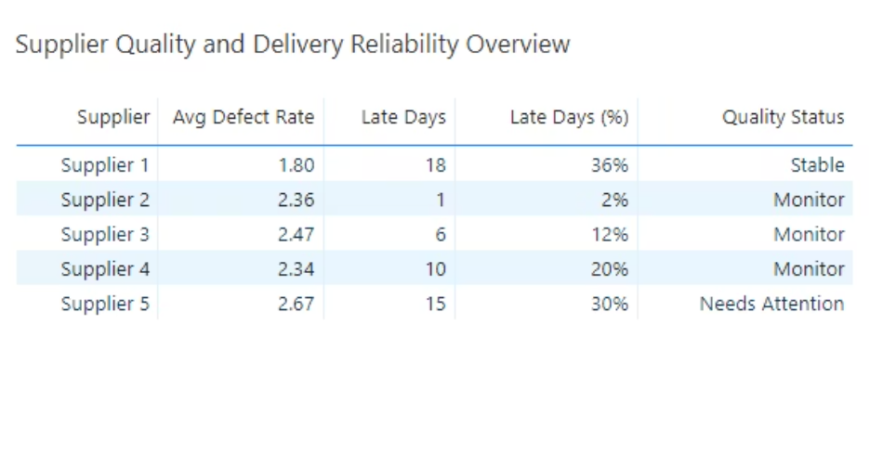

Supplier Quality and Delivery Risk Are Concentrated
Supplier risk is not evenly distributed across our supply base. Three suppliers require differentiated management strategies based on their specific risk profiles, enabling targeted resource allocation and corrective action plans.
Supplier 5 – Highest Risk
Supplier 1 – Quality Leader
Supplier 2 – Early Warning
Defect Rate: 2.67 (elevated)
Gross Margin: $156K contribution
Delivery: Performing well
Late Days: 15 average
Challenge: Delivery delays
Quality: Early risk signals
Dual risk profile combining quality and delivery issues requiring immediate corrective action and enhanced inspection protocols
Maintains strong quality standards but requires engagement on delivery reliability improvements to protect margin contribution
Proactive monitoring needed to prevent quality escalation while maintaining strong delivery performance

Slide 7
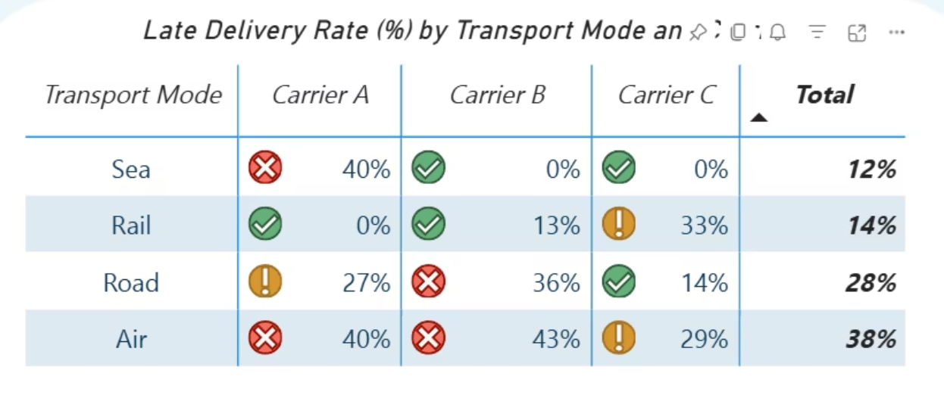

Recommendations: Improve Delivery and SLA Performance
DELIVERY OPTIMIZATION
01
02
03
Rebalance Carrier Volume
Prioritize Route A Protection
Implement SLA Scorecards
Shift volume away from Carrier B for Air and Road shipments where late rates exceed 35%. Target 20–30% volume reduction over next quarter.
Allocate highest-performing carrier–mode combinations exclusively to Route A shipments to protect our most profitable route from delivery risk.
Deploy carrier-level performance dashboards tracking late percentage and delay severity, with monthly executive reviews and quarterly contract adjustments.
These three initiatives form an integrated delivery improvement strategy addressing both immediate tactical adjustments and longer-term performance management capabilities. Implementation can begin immediately with existing systems and data.
Expected Impact: Estimated 8–12% improvement in on-time delivery. Reduced customer escalation and expedited shipping costs.

Slide 8






Recommendations: Optimize Inventory and Working Capital
Working capital optimization represents immediate financial benefit without requiring revenue growth or cost reduction. By right-sizing inventory to demand patterns, we unlock capital while improving operational efficiency and reducing obsolescence risk.
Reduce Cosmetics Inventory
Target 10–15% reduction in cosmetics inventory levels, freeing approximately $8K–$12K in working capital for higher-velocity categories or debt reduction.
Reallocate to Skincare
Redirect freed inventory capacity toward skincare due to demonstrated higher sales velocity and better inventory-to-revenue alignment.
Reassess Route C Strategy
Conduct comprehensive Route C profitability analysis to determine whether to improve operational efficiency, reduce exposure, or reallocate resources to higher-performing routes.

Slide 9
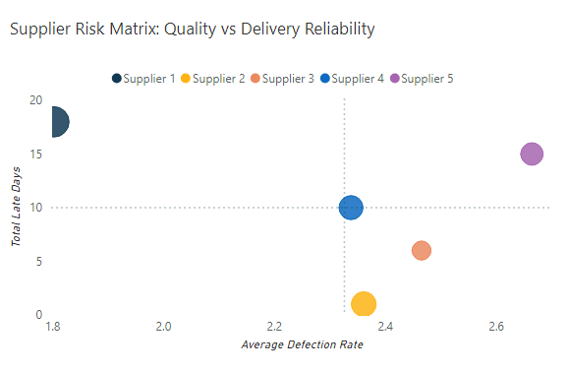



Recommendations: Strengthen Supplier Risk Management
Supplier risk management requires differentiated strategies rather than uniform policies. By tailoring our approach to each supplier's specific risk profile, we maximize improvement impact while optimizing management resources and maintaining critical supply relationships.
Supplier 5
Supplier 1
Corrective Action
Partnership Enhancement
Enhanced inspection protocols
Focus on delivery reliability
Increase quality sampling frequency
Maintain quality standards
SLA enforcement with penalties
Collaborative improvement planning
Contingency sourcing development
Protect margin contribution
Supplier 2
Proactive Monitoring
Early warning system activation
Monthly performance reviews
Prevent risk escalation
Maintain delivery excellence

Slide 10

Decisions and Next Steps
Approve Carrier Rebalancing
Set Inventory Thresholds
Launch Risk Review Cadence
Executive approval needed for carrier volume shifts and SLA renegotiation strategy, with implementation target of 30 days
Align on inventory exposure limits by product category, establishing clear guidelines for working capital allocation
Establish monthly operational risk reviews covering delivery, inventory, and quality metrics with executive steering
"Operational excellence is the foundation of sustained profitability. These recommendations transform identified risks into competitive advantages through disciplined execution."
Next steps (30–60 days):
Pilot carrier changes on Route A
Adjust inventory targets for cosmetics
Track financial impact of delivery improvements

