Slide 1
Solution.md
This application can be use in two ways
Browser based UI
Endpoint URL
This application have following functionality.
Register a user
Login user
Check if movie won a category “Best Picture” based on title
Show rating of any movie
Submit rating of any movie
Show a list of 10 top-rated movies ordered by box office value
After login/register a user , token will get created which is required and be part of request to access the rest api for other four functionality.

Slide 2
how_to_run.md
How to run : There are two ways to run the application
1st : There is executable jar file. you need to place academy_awards.csv in the same directory and run with command: java –jar movieapi-0.0.1-SNAPSHOT.jar
it will create app.log for application logs and h2 folder for DB
2nd : Import the project in vscode and run the MovieapiApplication.java
I have used h2 database for this test task and I used file mode there so data will persist in a folder and i have created that folder in application package itself. However, folder location can be changed by application.properties.
Appliaction logs folder location also there in application package itself and can be changed by application.properties.
academy_awards.csv is also placed in application package itself and can be changed by application.properties.
There are few more properties that can be configure by application.properties.
I have developed and tested this application with :
Windows
Chrome
Postman
4. VS Code

Slide 3
how_to_test.md
How to test : Apart from Junit it can be tested with:
Browser
Postman or http://localhost:8080/swagger-ui/index.html
Static data will get populated by start of the application. I added sample data to test 10 top-rated movies ordered by box office value.
However, there is a check to see if its already populated.
With Browser: user need to register first and then he will land on home page and do following functions:
Check if movie won a category “Best Picture” based on title
Show rating of any movie
Submit rating of any movie
Show a list of 10 top-rated movies ordered by box office value
Once registration is done, login page can also be used for above functions.
With Postman : it can be directly tested by following URL as well : http://localhost:8080/swagger-ui/index.html
Function : Register user to get JWT token
URL : http://localhost:8080/movieApi/v1/auth/register
Sample request:
{
"firstName":"Sonu",
"lastName":"gupta",
"email":"toamardeepgupta@gmail.com",
"password":"1234"
}
It will return a jwt token which can be used to other services

Slide 4
Once registration is done, user can also use login URL also to get token with following request:
Function : Login with credential to get JWT token
URL : http://localhost:8080/movieApi/v1/auth/authenticate
Sample request:
{
"email":"a@a.com",
"password":"1234"
}
For below calls user need token first with one of above ways and send in request
Function : Get Movie info with title and category
URL : http://localhost:8080/movieApi/v1/getMovieByTitleCategory
Sample request:
{
"title": "Titanic",
"category": "Best Picture"
}

Slide 5
Function : Mark movie rating
URL : http://localhost:8080/movieApi/v1/markMovieRating
Sample input :
{
"title": "Titanic",
"rating": "4",
"nominationYear": "1997 (70th)"
}
Function : Get movie rating
URL : http://localhost:8080/movieApi/v1/getMovieRatingByTitle
Sample input :
{
"title": "Titanic"
}
Function : Get top rated movie
URL : http://localhost:8080/movieApi/v1/topRatedMovies

Slide 6
to_do.md :
When I am populating static data there is no provision to add delta file of static data
Browser base application with login function should be stateful, however in this case it’s stateless so I think it should be two different application
UI of quite simple and tested only on chrome
I have used relational database, however NOSQL database can be a good option of this type of data.
I haven’t done profiling for production, QA and Development

Slide 7
scale.md : Within the application code itself, there is no provision to handle load. It can be taken care by increasing number of node with cell on server or by increasing the cell itself.

Slide 8
Login sequential flow
Client
JwtAuthenticationFilter
Authentication
Service
Authentication
Manager
UserRepository
JwtService
/authenticate with username & password
Check if request have token
If no token
call /authenticate
Validate username & password with authenticate()
If user is not valid throw exception
Load user Details with username from DB
Return User
call generateToken() to generate a valid token
Return a valid Token
Postman : Return a valid Token
Browser : landed on home page

Slide 9
Registration sequential flow
Client
JwtAuthenticationFilter
Authentication
Service
UserRepository
JwtService
/register with user details
Check if request have token
If no token
call /register
Save user in DB
call generateToken() to generate a valid token
Return a valid Token
Postman : Return a valid Token
Browser : landed on home page

Slide 10
API call sequential flow
Client
JwtAuthenticationFilter
JwtService
UserDetailsService
MovieApiController
MoviesService
AcademyAwardsRepository
Call /getMovieByTitleCategory
Check if request have token
If yes than extract username from token
Load userdetails by username
Return userdetails
Validate token
Return true if token is valid
Configure Spring security for the user if token is valid
Call getMovieByTitleAndCategory() method `with /getMovieByTitleCategory mapping
Call getMovie()
Call findByTitleAndCategory
Return List<AcademyAwards>
Return List<AcademyAwards>
Return List<AcademyAwards>

Slide 11
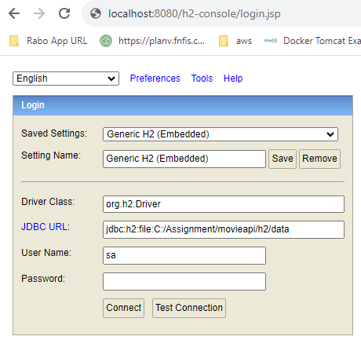
DB : As I mentioned I have used H2 database in file mode so it can be access only when application is up. However, data will not lose if application will stop as I used file mode. It can be access with following URL : http://localhost:8080/h2-console/login.jsp
In JDBC URL: you must provide the path of h2 folder till data like in below screen shot.
Username : sa
Password : password

