Slide 1
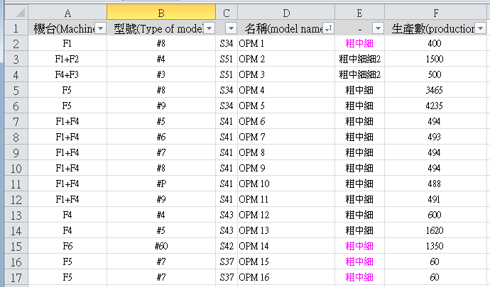
Machine selection analysis
This is daily production plan

Slide 2
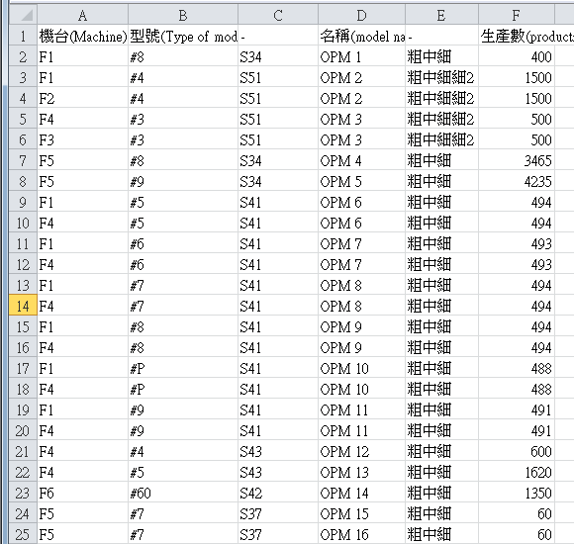
Machine selection analysis
Stretch the data base on machine

Slide 3
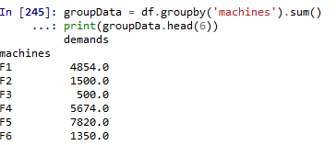
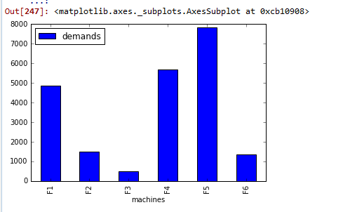
Machine Analysis
Some machine is used extensive other is less!
We need to investigate more! And get more information.

Slide 4
My study:
I study The concept of company ERP system.
C sharp and get difficulty in UI.
Chinese.

