Slide 1
Báo Cáo Lần 1 Đồ Án Cơ Sở
Đề tài : Xây dựng ứng dụng quản lý cửa hàng giày dép.
Giảng viên hướng dẫn : Phan Thị Thanh Nga

Slide 2


Giới Thiệu Thành Viên :
Nguyễn Quốc Toàn - 1812858
Lê Quốc Toàn -1812856

Slide 3
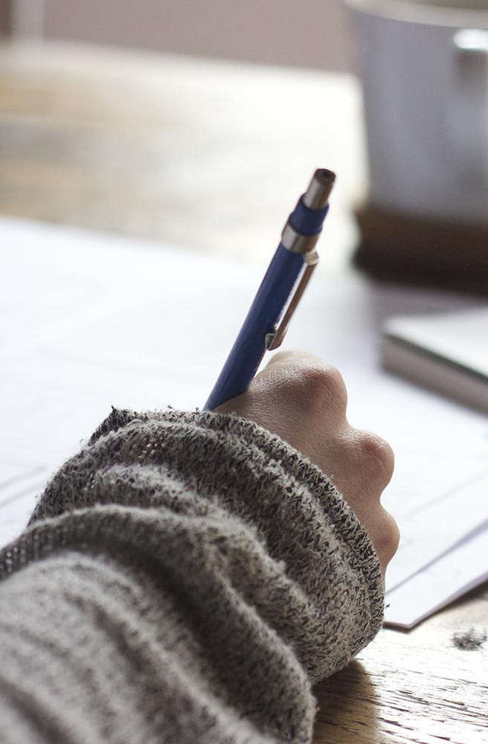
I.Giới thiệu đề tài :
-Mục đích : tạo ra một ứng dụng quản lý cửa hàng giày dép.

Slide 4

1.Đối Tượng sử dụng
- Đề tài bao gồm 2 đối tượng chính :
Quản lý (quyền truy cập tuyệt đối)
Nhân viên (quyền truy tương đối)

Slide 5
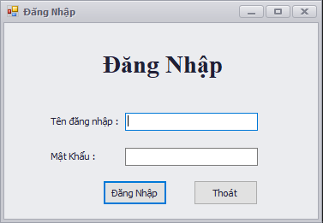
Success : Trả về trang làm việc chính .
Failed : Xuất thông báo lỗi đăng nhập hệ thống.
Form đăng nhập chính dùng chung cho cả hai đối tượng.

Slide 6
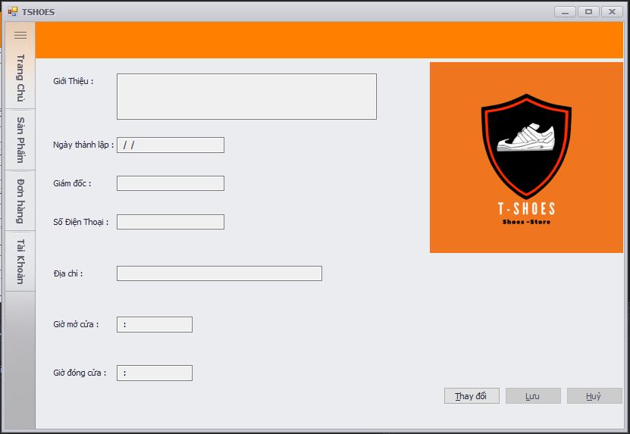
Form Home
Trang chủ sẽ hiện các thông tin về của hàng :
+ Một số thông tin cơ bản về cửa hàng.
+ Quản lý của cửa hàng.
+ Địa chỉ cửa hàng.
+ Số điện thoại của cửa hàng.
+ Giờ mở cửa và giờ đóng cửa

Slide 7
YOU CAN ALSO SPLIT YOUR CONTENT
White
Is the color of milk and fresh snow, the color produced by the combination of all the colors of the visible spectrum.
Black
Is the color of ebony and of outer space. It has been the symbolic color of elegance, solemnity and authority.

Slide 8
IN TWO OR THREE COLUMNS
Yellow
Is the color of gold, butter and ripe lemons. In the spectrum of visible light, yellow is found between green and orange.
Blue
Is the colour of the clear sky and the deep sea. It is located between violet and green on the optical spectrum.
Red
Is the color of blood, and because of this it has historically been associated with sacrifice, danger and courage.

Slide 9
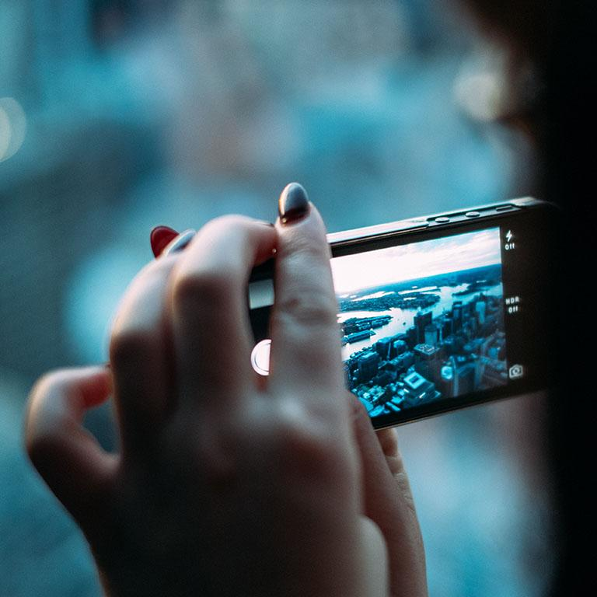
A PICTURE IS WORTH A THOUSAND WORDS
A complex idea can be conveyed with just a single still image, namely making it possible to absorb large amounts of data quickly.

Slide 10
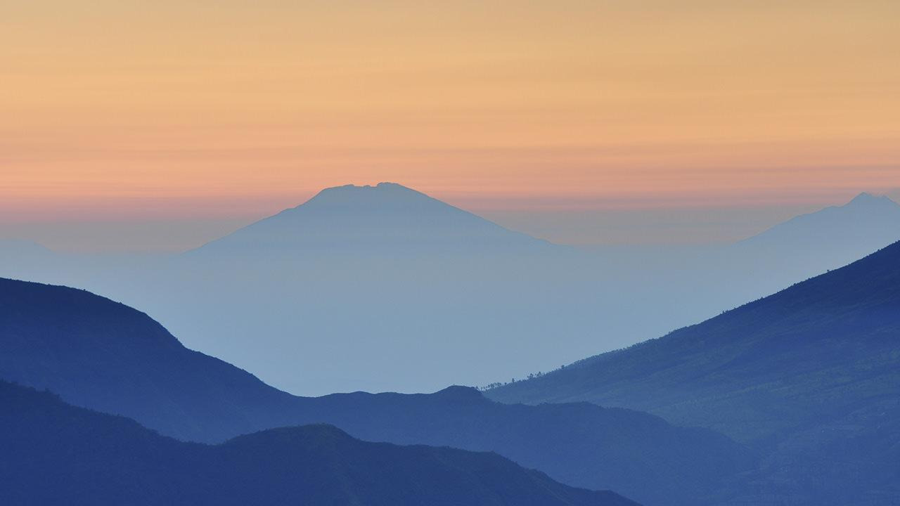
Want big impact?
USE BIG IMAGE.

Slide 11
USE CHARTS TO EXPLAIN YOUR IDEAS
White
Gray
Black

Slide 12
AND TABLES TO COMPARE DATA
 | A | B | C
Yellow | 10 | 20 | 7
Blue | 30 | 15 | 10
Orange | 5 | 24 | 16

Slide 13
MAPS
Our Office

Slide 14
89,526,124
Whoa! That’s a big number, aren’t you proud?

Slide 15
89,526,124$
185,244 USERS
100%
That’s a lot of money
And a lot of users
Total success!

Slide 16
OUR PROCESS IS EASY
first
second
last

Slide 17
LET’S REVIEW SOME CONCEPTS
Yellow
Is the color of gold, butter and ripe lemons. In the spectrum of visible light, yellow is found between green and orange.
Blue
Is the colour of the clear sky and the deep sea. It is located between violet and green on the optical spectrum.
Red
Is the color of blood, and because of this it has historically been associated with sacrifice, danger and courage.
Yellow
Is the color of gold, butter and ripe lemons. In the spectrum of visible light, yellow is found between green and orange.
Blue
Is the colour of the clear sky and the deep sea. It is located between violet and green on the optical spectrum.
Red
Is the color of blood, and because of this it has historically been associated with sacrifice, danger and courage.

Slide 18
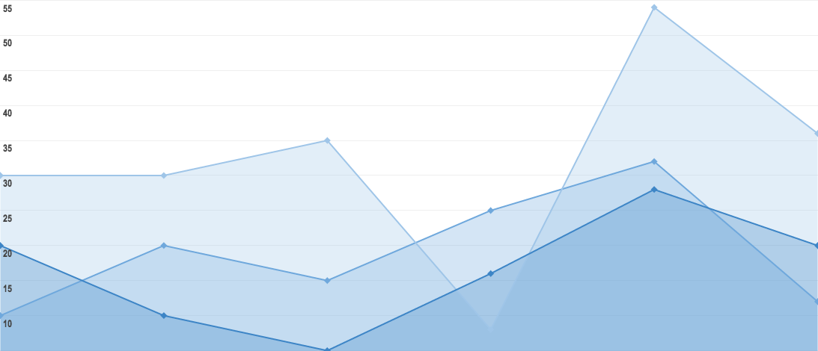
You can insert graphs from Google Sheets

Slide 19
ANDROID PROJECT
Show and explain your web, app or software projects using these gadget templates.
Place your screenshot here

Slide 20
iPHONE PROJECT
Show and explain your web, app or software projects using these gadget templates.
Place your screenshot here

Slide 21
TABLET PROJECT
Show and explain your web, app or software projects using these gadget templates.
Place your screenshot here

Slide 22
DESKTOP PROJECT
Show and explain your web, app or software projects using these gadget templates.
Place your screenshot here

Slide 23
THANKS!
Any questions?
You can find me at
@username
user@mail.me

Slide 24
CREDITS
Special thanks to all the people who made and released these awesome resources for free:
Presentation template by SlidesCarnival
Photographs by Unsplash

Slide 25
PRESENTATION DESIGN
This presentation uses the following typographies and colors:
Titles: Oswald
Body copy: Roboto Condensed
You can download the fonts on these pages:
https://www.fontsquirrel.com/fonts/oswald
https://www.fontsquirrel.com/fonts/roboto
Dark aqua #3796bf / Aqua #4bb5d9 / Light aqua #81d1ec
Yolk yellow #ff9900
You don’t need to keep this slide in your presentation. It’s only here to serve you as a design guide if you need to create new slides or download the fonts to edit the presentation in PowerPoint®

Slide 26
SlidesCarnival icons are editable shapes.
This means that you can:
Resize them without losing quality.
Change fill color and opacity.
Change line color, width and style.
Isn’t that nice? :)
Examples:

Slide 27
Diagrams and infographics

Slide 28
😉
Now you can use any emoji as an icon!
And of course it resizes without losing quality and you can change the color.
How? Follow Google instructions https://twitter.com/googledocs/status/730087240156643328
✋👆👉👍👤👦👧👨👩👪💃🏃💑❤😂😉😋😒😭👶😸🐟🍒🍔💣📌📖🔨🎃🎈🎨🏈🏰🌏🔌🔑 and many more...

Slide 29

Free templates for all your presentation needs
For PowerPoint and Google Slides
100% free for personal or commercial use
Ready to use, professional and customizable
Blow your audience away with attractive visuals

