Slide 1
Attributing Texts to an Author
using a Neural Network
1

Slide 2
Neural
Network
Network architecture
The Task: Six-Class Attribution
107 features
Input
64 units
Hidden (ReLU)
6 classes
Softmax
• 5 known authors + a 6th “none” class — the model can decline, not forced to pick
• 873 passages, each described by 107 stylometric features
• Neural network — ReLU hidden units, softmax over 6 classes
• Adam optimizer, cross-entropy loss, early stopping
• 60 / 20 / 20 split — train / validation / test, stratified by class
Grid search explores 4 depths (1, 3, 10, 50 hidden layers) and 3 feature subsets.
2

Slide 3
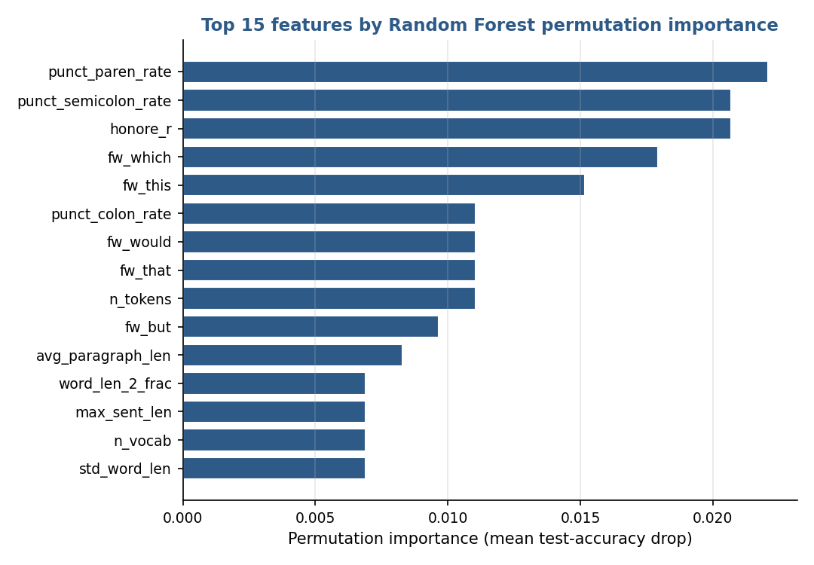
Neural
Network
Choosing the Features
• Random Forest permutation importance ranks all 107 features
• Shuffle one feature, measure the drop in held-out accuracy
• Multivariate — credits the feature the forest truly relies on, not redundant copies
• Top drivers: punctuation rates, Honoré's R, function words
• Top-30 / top-50 subsets feed the grid search
Figure 1. Most informative stylometric features (permutation importance).
3

Slide 4
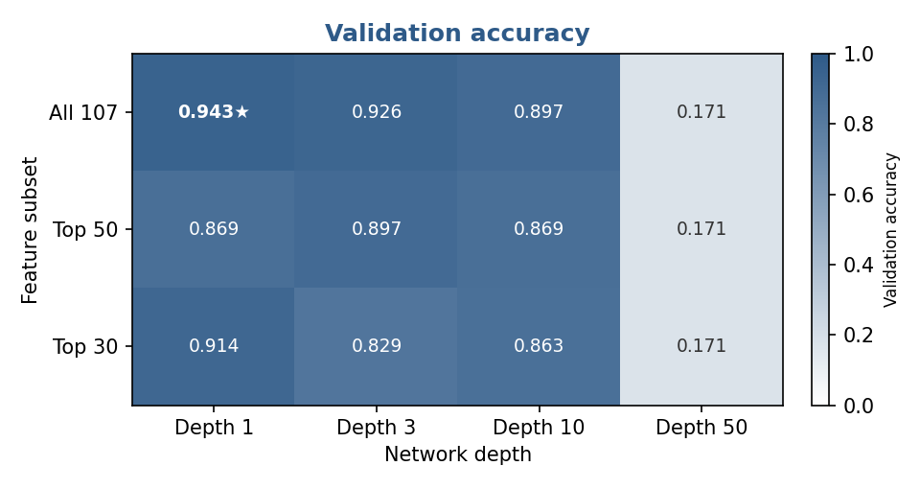
Neural
Network
Grid Search & Model Selection
• 12 configurations — 3 feature subsets (top 30 / 50 / all 107) × 4 depths
• Ranked on validation, not the training set
• Winner retrained on train + validation, then tested once
• Test set touched once — an honest generalization estimate
• Best: all 107 features, a single 64-unit hidden layer (validation 0.943)
Figure 2. Validation accuracy for every feature-subset × depth combination.
4

Slide 5
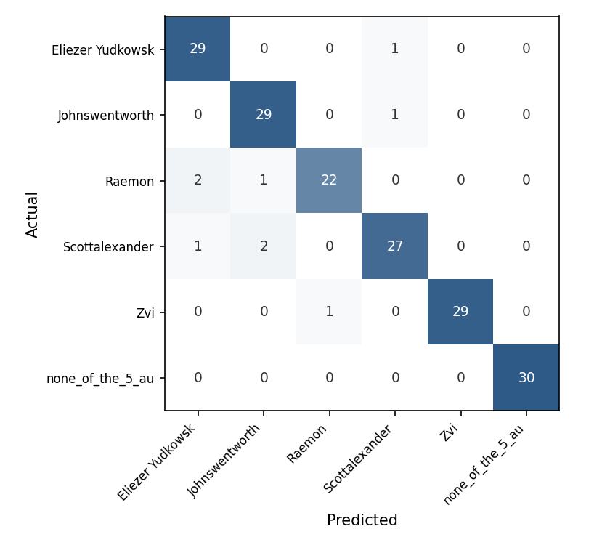
Neural
Network
Results — Six Classes
94.9%
Test accuracy
0.949
Weighted F1
6
Classes
1.00
None-class F1
The none class is recovered perfectly — no unknown passage leaks into a known author. The few errors are minor confusions among the five (Raemon recall 0.88, Scott Alexander 0.90).
Figure 3. Six-class confusion matrix, including the none class.
5

Slide 6
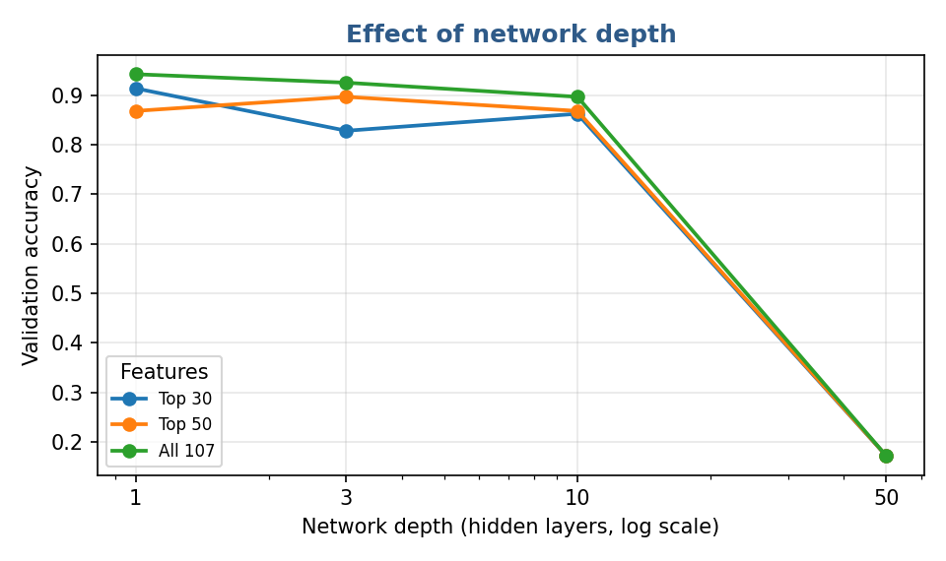
Neural
Network
How Deep Should the Network Be?
• Accuracy is flat from depth 1 to depth 10
• Depth 50 collapses to ≈ 0.17 — the 1-in-6 random baseline
• Not over-fitting — the deep net never starts learning
• Shallow wins: a single hidden layer is the right choice
Figure 4. Validation accuracy versus network depth.
6

Slide 7
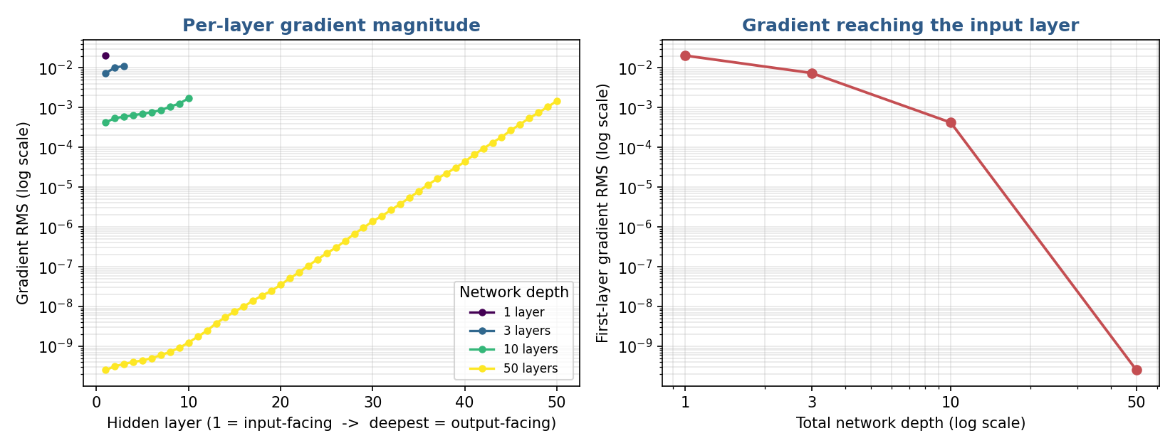
Neural
Network
Why Depth 50 Fails: Vanishing Gradients
• Measured at initialization — Glorot-uniform, sklearn's ReLU scheme
• First-layer gradient collapses as the network deepens
• At depth 50 it is ~8 orders of magnitude weaker
Depth
1st-layer grad
Ratio out/1st
1
2.0×10⁻²
3.5
3
7.4×10⁻³
4.2
Figure 5. Gradient RMS per layer (left) and at the input layer vs depth (right).
10
4.2×10⁻⁴
13.7
50
2.5×10⁻¹⁰
2.2×10⁷
7

Slide 8
Neural
Network
Takeaways
• A shallow NN attributes passages across six classes at ~95% accuracy
• 107 stylometric features carry enough signal — no deep network needed
• Random Forest permutation importance picks the most informative features
• Depth hurts: vanishing gradients stall the 50-layer net at initialization
• The “none” class works: unknown passages never leak into a known author
8

