Slide 1




Clinical GenAI Assistant
for Nova Health Tech
David Pham
Solutions Architect
Notes:
[10s opening]
Đề xuất kiến trúc trợ lý AI lâm sàng cho Nova Health Tech: AWS Singapore, Claude 4.5, tuân thủ PDPA và HCSA ngay từ thiết kế.

Slide 2
Agenda
▸
Context
▸
Solution
▸
Demo AWS with Claude & AWS with Qwen fine-tuning
▸
Estimate Cost
Notes:
[30s]
Bác sĩ Nova hiện đang mất niềm tin vào công cụ hỗ trợ lâm sàng vì câu trả lời chậm và thiếu cụ thể. Có 3 thách thức lớn nhất.
Một, cấp cứu cần dưới 2 giây, không có chỗ cho độ trễ. Hai, dữ liệu thử nghiệm nội bộ chứa thông tin bệnh nhân, không được rò rỉ ra ngoài Singapore. Ba, WHO cập nhật hàng tháng, ICD-11 hàng ngày, hệ thống phải tự đồng bộ.
Cộng thêm yêu cầu tuân thủ PDPA, HCSA, và sẵn sàng cho HIPAA khi onboard khách Mỹ.

Slide 3
Context
Customer’s challenge
Flagship clinical support tool struggling to meet physician expectations for speed & medical relevance
Solution: a Gen-AI assistant that can
▸ Answer complex medical questions in natural language
▸ Rely on internal trials, treatment protocols, external sources
▸ Be auditable, compliant, and fast enough for diagnosis
Requirements:
⚡
🔒
📅
Response Speed
Compliance & Privacy
Data Freshness
& Inconsistancy
Notes:
[30s]
Bác sĩ Nova hiện đang mất niềm tin vào công cụ hỗ trợ lâm sàng vì câu trả lời chậm và thiếu cụ thể. Có 3 thách thức lớn nhất.
Một, cấp cứu cần dưới 2 giây, không có chỗ cho độ trễ. Hai, dữ liệu thử nghiệm nội bộ chứa thông tin bệnh nhân, không được rò rỉ ra ngoài Singapore. Ba, WHO cập nhật hàng tháng, ICD-11 hàng ngày, hệ thống phải tự đồng bộ.
Cộng thêm yêu cầu tuân thủ PDPA, HCSA, và sẵn sàng cho HIPAA khi onboard khách Mỹ.

Slide 4
Compliance
PDPA
Personal Data Protection Act
HCSA
Healthcare Services Act 2020
Cybersecurity Act
Critical Info Infrastructure 2018
AI Verify
Responsible AI Framework
Authority
PDPC (Personal Data Protection Commission)
Authority
MOH (Ministry of Health)
Authority
CSA (Cyber Security Agency)
Authority
IMDA (Infocomm Media Development)
Scope
Patient data protection, consent, breach notification within 72 hours
Scope
Licensing for clinical decision support, replaces PHMC 1980
Scope
Healthcare CII protection, incident reporting, security audits
Scope
Transparency, fairness, accountability for AI systems
Our Implementation
Comprehend Medical PHI mask, KMS per-tenant CMK, audit trail
Our Implementation
Decision support only with human-in-the-loop, audit ready
Our Implementation
GuardDuty + Security Hub + Macie, Security Lake aggregation
Our Implementation
chat_trace audit log, citation validator, Bedrock Guardrails
Data Residency Commitment
100% deployment in ap-southeast-1 (Singapore) · Patient cleartext never leaves SG · 6-year audit retention via S3 Object Lock (HIPAA §164.530j)
Notes:
[45s, KEY SLIDE]
Đây là phần Nova Health Tech cần lưu ý nhất. Singapore có 4 quy định chính áp dụng trực tiếp cho hệ thống AI lâm sàng.
Một, PDPA do PDPC quản, bảo vệ dữ liệu cá nhân bệnh nhân, yêu cầu Data Protection Officer, thông báo vi phạm trong 72 giờ. Hai, HCSA do MOH ban hành 2020 thay PHMC, bắt buộc license cho dịch vụ y tế và clinical decision support. Ba, Cybersecurity Act 2018 cho Critical Information Infrastructure trong y tế. Bốn, IMDA AI Verify framework cho AI có trách nhiệm.
Tất cả deployment ở ap-southeast-1, dữ liệu bệnh nhân không bao giờ rời Singapore. AWS đã có signed BAA, ISO 27001, SOC 2 Type II, PDPA-compliant.

Slide 5
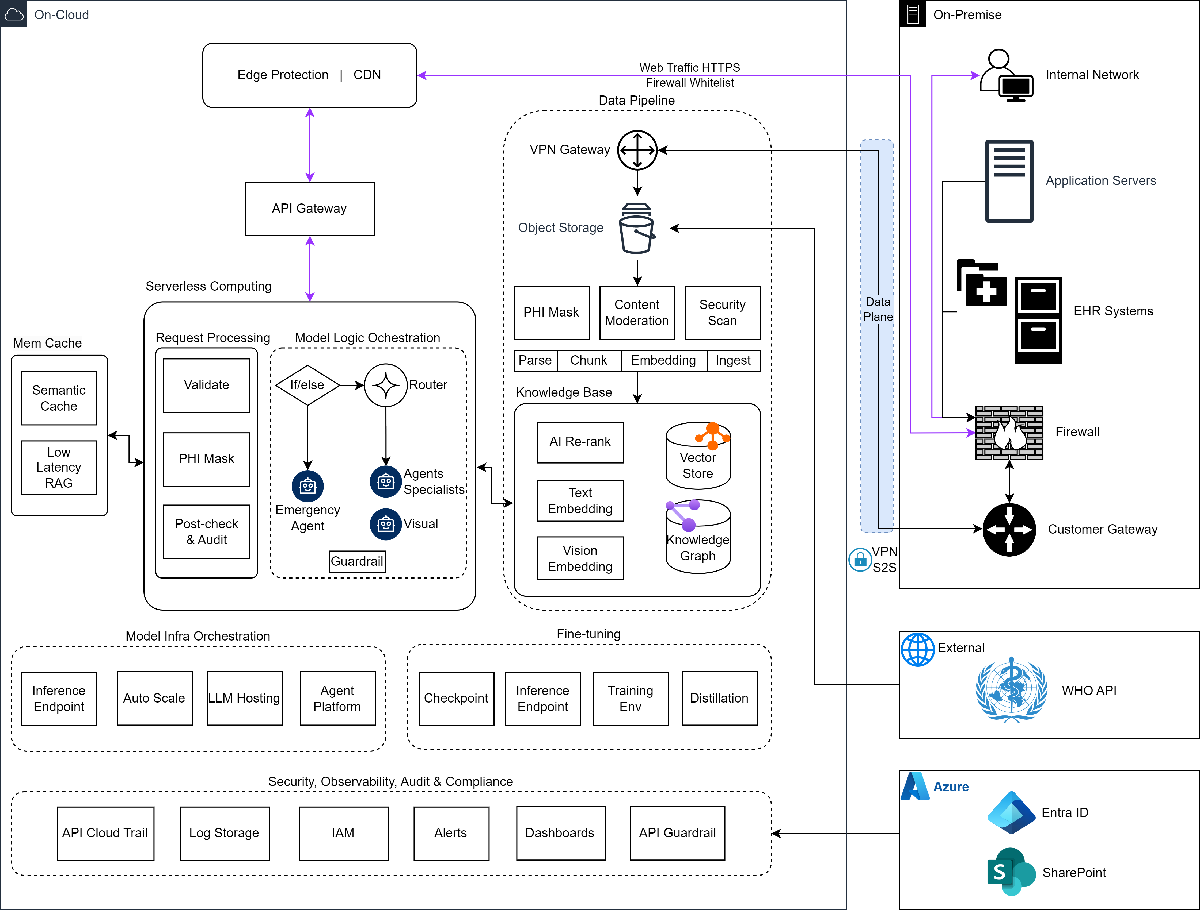
Solution
Notes:
[45s]
Giải pháp là kiến trúc 2 luồng. Cấp cứu đi thẳng Claude Haiku 4.5 với top-3 vector và top-2 graph, không qua router, không guardrails để đạt TTFT 2.5 giây. Phức tạp đi qua Nova Micro phân loại 12 phòng ban, rồi Sonnet 4.5 với top-15 vector và top-3 graph, có guardrails đầy đủ.
RAG dùng 2 loại: vector trên OpenSearch Serverless và GraphRAG trên Neptune Analytics. Cả 2 đều ở Singapore, dùng Cohere Embed v3 SG-native. Không có cross-region hop nào cho dữ liệu lâm sàng.
PoC đã chạy live trên EC2 Singapore, 100% pass SLA, 100% câu trả lời có citation.

Slide 6
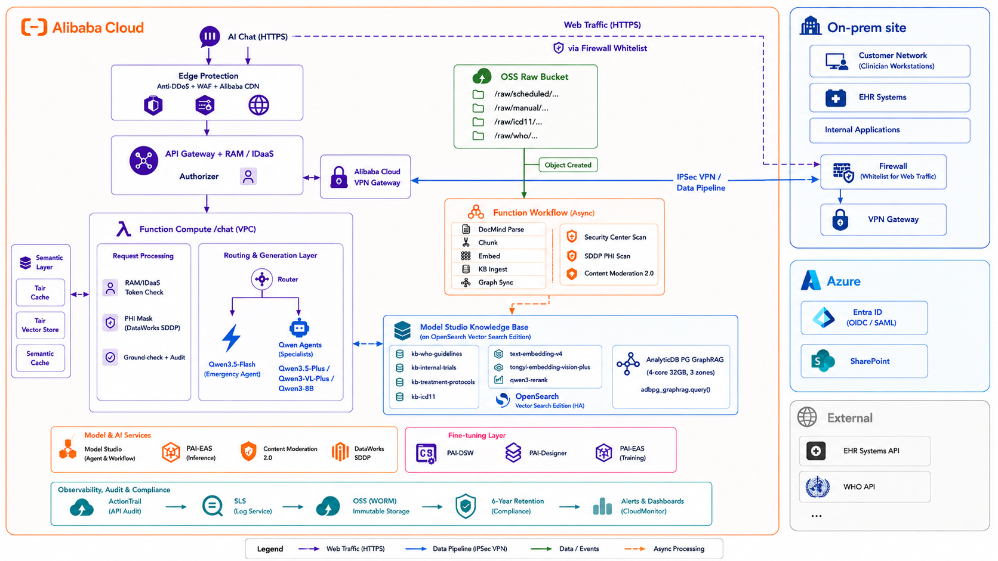
Solution - Alibaba Cloud
Notes:
[45s]
Giải pháp là kiến trúc 2 luồng. Cấp cứu đi thẳng Claude Haiku 4.5 với top-3 vector và top-2 graph, không qua router, không guardrails để đạt TTFT 2.5 giây. Phức tạp đi qua Nova Micro phân loại 12 phòng ban, rồi Sonnet 4.5 với top-15 vector và top-3 graph, có guardrails đầy đủ.
RAG dùng 2 loại: vector trên OpenSearch Serverless và GraphRAG trên Neptune Analytics. Cả 2 đều ở Singapore, dùng Cohere Embed v3 SG-native. Không có cross-region hop nào cho dữ liệu lâm sàng.
PoC đã chạy live trên EC2 Singapore, 100% pass SLA, 100% câu trả lời có citation.

Slide 7
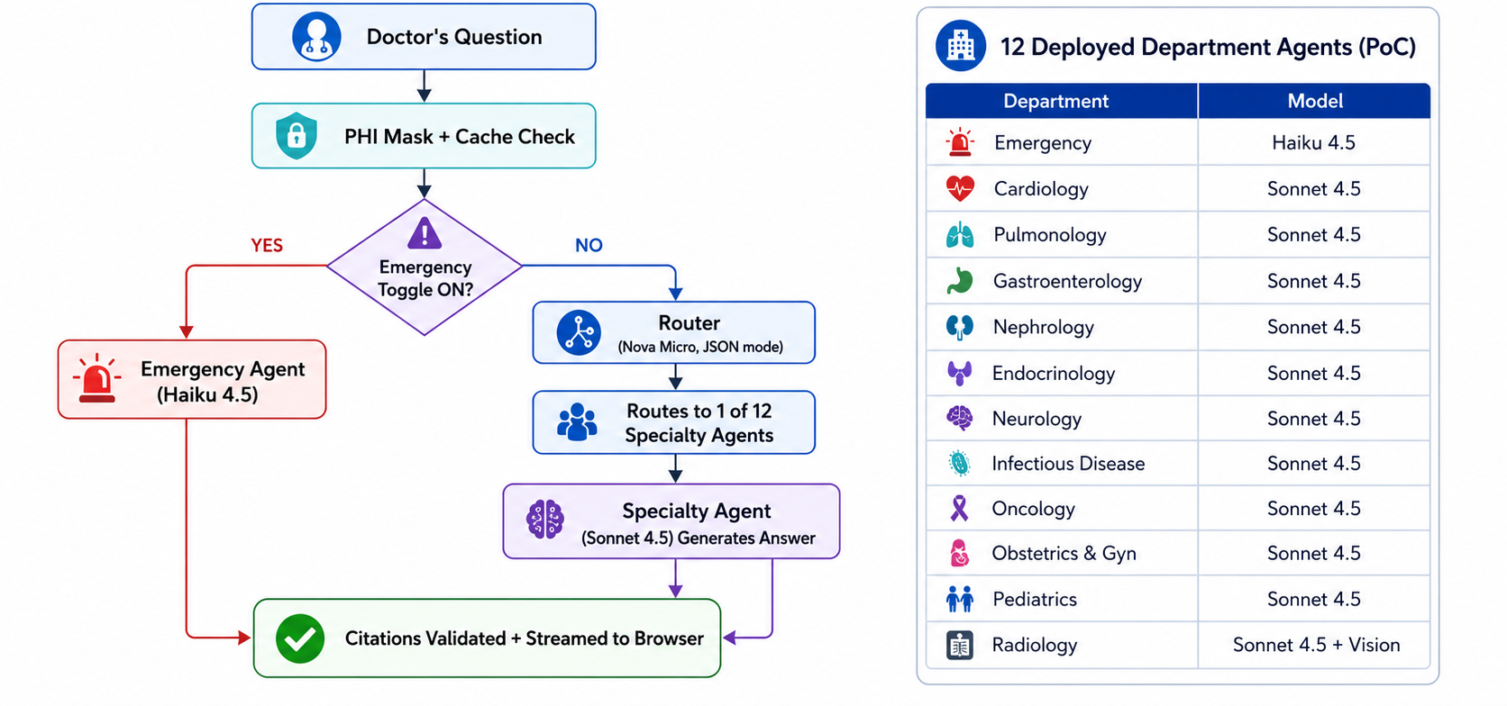
Multi-agent architecture

Slide 8
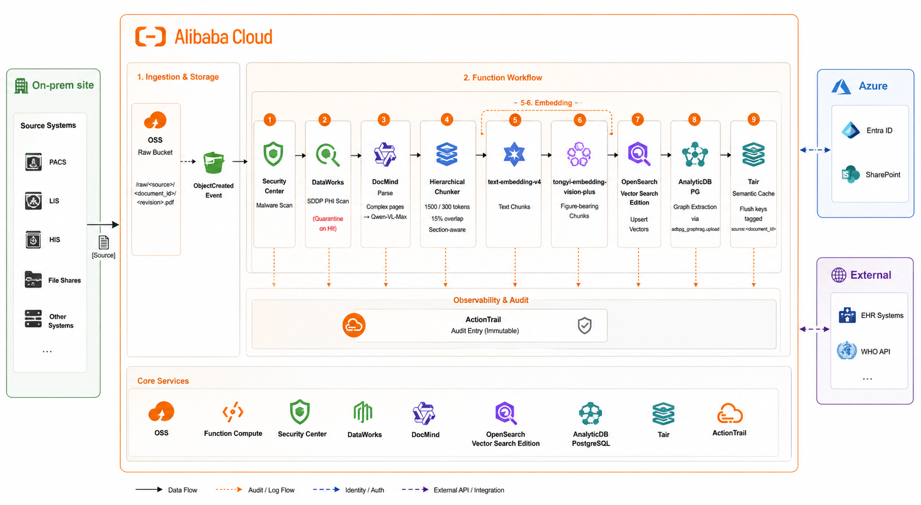
RAG

Slide 9
DEMO TIME
AWS with Claude: http://47.130.120.152/ui/index.html
AWS with Qwen: http://54.179.152.27/ui/index.html
Notes:
[15s closing]
Tóm lại: kiến trúc đã được PoC kiểm chứng, Singapore-native, tuân thủ PDPA HCSA sẵn, chi phí từ 2,800 USD một tháng. Lộ trình triển khai 6-10 tuần. PoC đang chạy live, có thể demo ngay. Cảm ơn quý vị.

Slide 10
Production Cost Comparison — 3 Versions
Monthly estimate · 500 clinicians · 150,000 queries/month · Singapore region · All prices USD list price
Assumptions: 500 clinicians | 10 queries/day | 150,000 queries/month (30k emergency + 120k complex) | Avg 3,000 in / 600 out tokens (complex) | 1,500 in / 300 out (emergency) | 1 fine-tuning run/month | Singapore region
Cost Category
Version A
Version B
Version C
What it covers
AWS + Claude
AWS + Qwen
Alibaba Cloud
$2,350–$2,600
$2,150–$2,350
$2,100–$2,300
LLM Inference
$1,455 / mo
$553 / mo
$107 / mo
Router + specialist agents + emergency model
Student Inference Endpoint
— (no student model)
$710 / mo (360hr, scale-to-0)
$918 / mo (min=1, 85% util)
Fine-tuned model (SageMaker scale-to-0 / PAI-EAS min=1 auto-scale)
RAG / Knowledge Base
$461 / mo
$461 / mo
$519 / mo
Vector store + GraphRAG (OpenSearch + Neptune/AnalyticDB)
Semantic Cache
$120 / mo
$120 / mo
$60 / mo
Redis/Tair in-memory cache (10min emergency / 24hr complex TTL)
Fine-tuning (monthly)
— (no fine-tuning)
$17 / mo
$9 / mo
Data generation + GPU training + model storage
Compute / Serverless
$67 / mo
$67 / mo
$27 / mo
API server EC2 / Function Compute + API Gateway
Storage + Logs
$7 / mo
$7 / mo
$8 / mo
S3/OSS corpus + audit logs + WORM archive
Security / Observability
$1 / mo
$1 / mo
$1 / mo
WAF + Guardrails + IAM + CloudWatch / ARMS
Network / VPN / CDN
$42 / mo
$42 / mo
$158 / mo
VPN Gateway (hospital S2S) + CDN + Anti-DDoS
IdaaS / SSO
—
—
$50 / mo
Hospital IdP federation (SAML/OIDC)
TOTAL / MONTH
$2,350 – $2,600
$2,150 – $2,350
$2,100 – $2,300

Slide 11
Version A — AWS + Claude | Cost Breakdown
Amazon Bedrock · ap-southeast-1 Singapore · 150,000 queries/month · No fine-tuning
Assumptions: 500 clinicians | 10 queries/day | 150,000 queries/month (30k emergency + 120k complex) | Avg 3,000 in / 600 out tokens (complex) | 1,500 in / 300 out (emergency) | 1 fine-tuning run/month | Singapore region
LLM INFERENCE (Bedrock on-demand, Singapore)
INFRASTRUCTURE & SERVICES (Singapore)
Component
Service / Model
Volume
Unit Price
Calculation
$/mo
Component
Service / Model
Volume
Unit Price
Calculation
$/mo
Emergency lane
Claude Haiku 4.5 (Bedrock)
30k calls
$1/$5 per 1M
30k×1.5k×$1 + 30k×0.3k×$5
$90
Vector KB
Bedrock KB OpenSearch Serverless
2 OCU × 720hr
$0.24/OCU-hr
2×720×$0.24
$346
Router
Nova Micro (Bedrock)
120k calls
$0.035/$0.14/1M
120k×0.5k×$0.035 + 120k×0.04k×$0.14
$3
GraphRAG KB
Neptune Analytics
1 m-NCU × 720hr
$0.16/m-NCU-hr
1×720×$0.16
$115
Specialist agents
Claude Sonnet 4.5 (Bedrock)
120k calls
$3/$15 per 1M
120k×3k×$3 + 120k×0.6k×$15
$2,160
Semantic cache
ElastiCache Redis OSS r7g.large
720 hr
$0.166/hr
720×$0.166
$120
Embeddings
Cohere Embed Multilingual v3
150k calls
$0.10 per 1M
150k×0.08k×$0.10
$1
API server
EC2 t4g.medium × 2 (HA)
720hr × 2
$0.046/hr
2×720×$0.046
$66
Guardrails
Bedrock Guardrails
120k calls
$0.15/1k units
120k×3.6 units×$0.15/1k
$65
API Gateway
AWS API Gateway REST
150k calls
$3.50/1M
0.15×$3.50
$1
Prompt cache
Auto (Claude 4.x, ~60% hit)
—
−90% cached tok
~40% reduction on Sonnet cost
−$864
CDN
CloudFront
~50GB transfer
$0.12/GB
50×$0.12
$6
LLM Subtotal (after prompt cache savings)
~$1,455 / mo
Storage
S3 Standard (corpus + logs)
~100GB
$0.023/GB-mo
100×$0.023
$2
FINE-TUNING — Not applicable in Version A (base Claude only)
Audit / Logs
CloudWatch Logs + S3 archive
~10GB/mo
$0.50/GB
10×$0.50
$5
Security
AWS WAF + Bedrock Guardrails
150k req
$0.60/1M
0.15×$0.60
$1
VPN Gateway
AWS VPN (1 IPsec tunnel)
720 hr
$0.05/hr
720×$0.05
$36
Infrastructure Subtotal
~$696 / mo
VERSION A TOTAL
~$2,350 – $2,600 / month

Slide 12
Version B — AWS + Qwen | Cost Breakdown
Amazon Bedrock Nova (Teacher) + Qwen3-4B SFT student · ap-southeast-1 Singapore · Monthly fine-tuning included
Assumptions: 500 clinicians | 10 queries/day | 150,000 queries/month (30k emergency + 120k complex) | Avg 3,000 in / 600 out tokens (complex) | 1,500 in / 300 out (emergency) | 1 fine-tuning run/month | Singapore region
LLM + STUDENT ENDPOINT (all Singapore)
INFRASTRUCTURE & SERVICES (Singapore)
Component
Service / Model
Volume
Unit Price
Calculation
$/mo
Component
Service / Model
Volume
Unit Price
Calculation
$/mo
Emergency lane
Nova Lite (Bedrock SG)
30k calls
$0.06/$0.24/1M
30k×1.5k×$0.06 + 30k×0.3k×$0.24
$5
Vector KB
Bedrock KB OpenSearch Serverless
2 OCU × 720hr
$0.24/OCU-hr
2×720×$0.24
$346
Router
Nova Micro (Bedrock SG)
120k calls
$0.035/$0.14/1M
120k×0.5k×$0.035 + 120k×0.04k×$0.14
$3
GraphRAG KB
Neptune Analytics
1 m-NCU × 720hr
$0.16/m-NCU-hr
1×720×$0.16
$115
Specialist agents
Nova Pro (Bedrock SG)
120k calls
$0.80/$3.20/1M
120k×3k×$0.80 + 120k×0.6k×$3.20
$518
Semantic cache
ElastiCache Redis OSS r7g.large
720 hr
$0.166/hr
720×$0.166
$120
Student model
Qwen3-4B SFT+LoRA SageMaker g5.xlarge scale-to-0 (re:Invent 2024)
360hr/mo (12hr/day active)
$1.97/hr
360hr × $1.97 (50% vs always-on $1,419)
$710
API server
EC2 t4g.medium × 2 (HA)
720hr × 2
$0.046/hr
2×720×$0.046
$66
Embeddings
Cohere Embed Multilingual v3
150k calls
$0.10 per 1M
150k×0.08k×$0.10
$1
API Gateway
AWS API Gateway REST
150k calls
$3.50/1M
0.15×$3.50
$1
Guardrails
Bedrock Guardrails
48k calls
$0.15/1k units
48k×3.6×$0.15/1k
$26
CDN
CloudFront
~50GB
$0.12/GB
50×$0.12
$6
LLM + Student Endpoint Subtotal
~$1,263 / mo
Storage
S3 Standard
~100GB
$0.023/GB-mo
100×$0.023
$2
MONTHLY FINE-TUNING (SageMaker + DeepInfra)
Audit / Logs
CloudWatch Logs + S3
~10GB/mo
$0.50/GB
10×$0.50
$5
Component
Service / Model
Volume
Unit Price
Calculation
$/mo
Security
AWS WAF + Guardrails
150k req
$0.60/1M
0.15×$0.60
$1
Data generation
Qwen3.5-397B via DeepInfra (HF)
10k Q&A/mo
$0.54/$3.40/1M
10k×0.5k×$0.54 + 10k×0.3k×$3.40
$4
VPN Gateway
AWS VPN (1 tunnel)
720 hr
$0.05/hr
720×$0.05
$36
Training job
SageMaker ml.g4dn.2xlarge
~3 hr/run
$1.32/hr
3×$1.32
$4
Scale-to-zero
SageMaker Serverless (alt.)
72k × 3s × 6GB
$0.00002/GB-s
72k×3×6×$0.00002
$26
Model storage
S3 checkpoint (~8GB)
720 hr
$0.023/GB-mo
8×$0.023
$0
~$696 / mo
Infrastructure Subtotal
Fine-tuning Subtotal
~$17 / mo
VERSION B TOTAL
~$2,150 – $2,350 / month

Slide 13
Version C — Alibaba Cloud | Cost Breakdown
Model Studio (DashScope Intl) + PAI-EAS · ap-southeast-1 Singapore International · Monthly fine-tuning included
Assumptions: 500 clinicians | 10 queries/day | 150,000 queries/month (30k emergency + 120k complex) | Avg 3,000 in / 600 out tokens (complex) | 1,500 in / 300 out (emergency) | 1 fine-tuning run/month | Singapore region
LLM + PAI-EAS STUDENT (Model Studio DashScope Intl)
INFRASTRUCTURE & SERVICES (Singapore International)
Component
Service / Model
Volume
Unit Price
Calculation
$/mo
Component
Service / Model
Volume
Unit Price
Calculation
$/mo
Emergency lane
Qwen3.5-Flash (Model Studio)
30k calls
$0.05/$0.20/1M
30k×1.5k×$0.05 + 30k×0.3k×$0.20
$4
Vector Store
OpenSearch Vector Search HA (2 OCU)
2 OCU × 720hr
$0.24/OCU-hr
2×720×$0.24
$346
Router
Qwen3.5-Flash JSON mode
120k calls
$0.05/$0.20/1M
120k×0.5k×$0.05 + 120k×0.04k×$0.20
$4
GraphRAG
AnalyticDB for PostgreSQL 4c/32GB
720 hr
$0.42/hr
720×$0.42
$302
Specialist agents
Qwen3.5-Plus (Model Studio)
120k calls
$0.115/$0.688/1M
120k×3k×$0.115 + 120k×0.6k×$0.688
$91
Semantic cache
Tair (Redis-compatible, Multi-AZ)
720 hr
$0.083/hr
720×$0.083
$60
Student model
Qwen3-8B SFT+LoRA PAI-EAS A10 GPU min=1 replica, auto-scale
720hr/mo (min=1, 85% util)
$1.50/hr avg
720hr × $1.50 × 0.85 (15% saving vs always-on $1,080)
$918
Compute
Function Compute 3.0 (serverless)
150k×2s×512MB
$0.0000167/GB-s
150k×2×0.5×$0.0000167
$26
Embeddings
text-embedding-v4
150k calls
$0.07 per 1M
150k×0.08k×$0.07
$1
API Gateway
Alibaba API Gateway
150k calls
$3.50/1M
0.15×$3.50
$1
Re-rank
qwen3-rerank
120k calls
$0.10 per 1M
120k×3.6k×$0.10
$43
CDN / Edge
Alibaba CDN + Anti-DDoS
~50GB
$0.10/GB
50×$0.10
$5
Context cache
Qwen Context Cache (L2, ~60%)
90k hits
−90% cached tok
~40% reduction on Plus cost
−$36
Storage
OSS Standard + WORM audit
~200GB
$0.02/GB-mo
200×$0.02
$4
LLM + PAI-EAS Subtotal
~$1,025 / mo
Audit / Logs
SLS + OSS WORM (6yr retention)
~10GB/mo
$0.35/GB
10×$0.35
$4
MONTHLY FINE-TUNING (PAI-DLC + Model Studio)
Security
WAF + Content Mod 2.0 + SDDP
150k req
~$0.50/1M
0.15×$0.50
$1
Component
Service / Model
Volume
Unit Price
Calculation
$/mo
VPN Gateway
Alibaba VPN Gateway 100Mbps
720 hr
$0.15/hr
720×$0.15
$108
Data generation
Qwen3.5-Plus as teacher (Model Studio)
10k Q&A/mo
$0.115/$0.688/1M
10k×0.5k×$0.115 + 10k×0.3k×$0.688
$8
IdaaS / SSO
IDaaS EIAM 2.0 Premium+
500 users
$0.10/user/mo
500×$0.10
$50
Training job
PAI-DLC A10 GPU, Qwen3-8B SFT+LoRA
~4 hr/run
$1.50/hr
4×$1.50
$6
Infrastructure Subtotal
~$881 / mo
Model storage
OSS checkpoint (~16GB)
720 hr
$0.02/GB-mo
16×$0.02
$0
~$2,100 – $2,300 / month
Fine-tuning Subtotal
~$9 / mo
VERSION C TOTAL

Slide 14
Ready to Deploy
Implementation Roadmap (6 to 10 weeks)
Wk 1-2
Foundation
SG provisioning, BAA, WHO+ICD-11 ingest
Wk 3-4
Customization
Bedrock Distillation: Nova Lite student
Wk 5-6
Integration
EHR FHIR, SharePoint, Cognito federation
Wk 7-8
Hardening
Red team, Guardrails tune, load test
Launch
Go-Live
All 12 departments, audit + cache live
Notes:
[15s closing]
Tóm lại: kiến trúc đã được PoC kiểm chứng, Singapore-native, tuân thủ PDPA HCSA sẵn, chi phí từ 2,800 USD một tháng. Lộ trình triển khai 6-10 tuần. PoC đang chạy live, có thể demo ngay. Cảm ơn quý vị.

