Slide 1
Build/deploy/run VIN Reference App
INVESTIGATION
Date
Name
Position, Department,
Unit
Renesas System Design Co., Ltd.

Slide 2
AGENDA
Write IPL Page 3
U-Boot Configuration Page 12
Setting Probe Page 16
Booting INTEGRITY Kernel via probe JTAG Page 22
Configure for camera Page 26
Run Vin Reference App Page 30

Slide 3
1.WRITE IPL

Slide 4
Data Wirte
File name | Program top address | Flash Save address | Description
bootparam_sa0.srec | 0xE6320000 | 0x000000 | Loader(Boot parameter)
bl2-<board_name>.srec | 0XE6304000 | 0x040000 | Loader
cert_header_sa6.srec | 0xE6320000 | 0x180000 | Loader(Certification)
bl31-<board_name>.srec | 0x44000000 | 0x1C0000 | ARM Trusted Firmware
tee-<board_name>.srec | 0x44100000 | 0x200000 | OP-Tee
u-boot-elf.srec | 0x69000000 | 0x640000 | U-boot

Slide 5
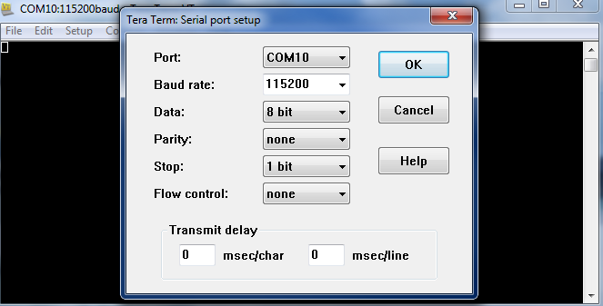
Download SPI loader and U-boot
Step 1: Connect cable
Step 2: Setting the terminal software
[Setting value] baud rate 115200, 8 bit data, parity none, stop 1 bit ,flow control none

Slide 6
Download SPI loader and U-boot
Step 3: Write data file to HyperFlash
Set dip switch
Switch Number | Switch Name | Pin 1 | Pin 2 | Pin 3 | Pin 4 | Pin 5 | Pin 6 | Pin 7 | Pin 8
SW1 | QSPI-A | ON | ON | ON | ON | ON | ON | - | -
SW2 | QSPI-B | ON | ON | ON | ON | ON | ON | - | -
SW3 | QSPI-C | OFF |  | - | - | - | - | - | -
SW10 | MODESW-A | ON | ON | ON | ON | ON | OFF | ON | ON
Refer to section 2.2 in RENESAS_RCH3M3_YoctostartupGuide

Slide 7
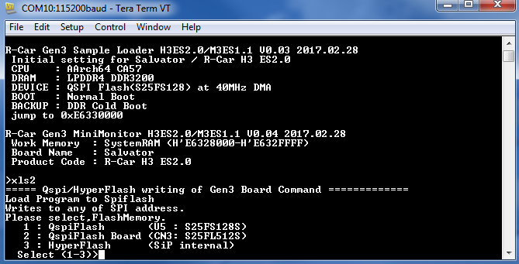
Download SPI loader and U-boot
Reset board then start monitor
Set dip switch : SW1, SW2 all OFF; SW3 ON
Execute xls2 command

Slide 8
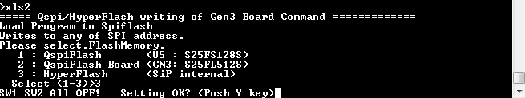

Download SPI loader and U-boot
Select HyperFlash.Input “3”.
Input “y”
Input “y”

Slide 9
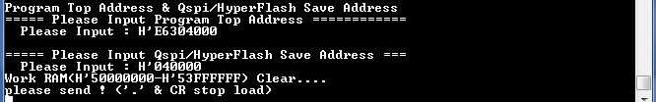
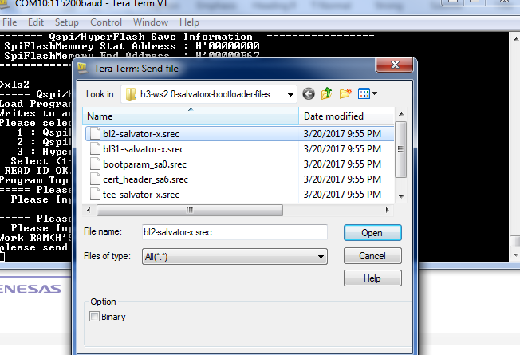
Download SPI loader and U-boot
Input Program Top Address & HyperFash Save Address (data write table)
Transmit U-Boot file “file->send file”

Slide 10

Download SPI loader and U-boot
If there are some data in writing area, "SPI Data Clear(H'FF) Check :H'00000000-0003FFFF Clear OK?(y/n)" is displayed. Then input "y“
Repeat the xls2 command, if other files are written
Power OFF

Slide 11
Set dip switch to “ Hyper Flash Mode”
Switch Number | Switch Name | Pin 1 | Pin 2 | Pin 3 | Pin 4 | Pin 5 | Pin 6 | Pin 7 | Pin 8
SW1 | QSPI-A | OFF | OFF | OFF | OFF | OFF | OFF | - | -
SW2 | QSPI-B | OFF | OFF | OFF | OFF | OFF | OFF | - | -
SW3 | QSPI-C | ON |  | - | - | - | - | - | -
SW10 | MODESW-A | ON | ON | ON | ON | ON | ON | OFF | OFF
Refer to section 2.2 in RENESAS_RCH3M3_YoctostartupGuide

Slide 12
2.U-Boot Configuration

Slide 13
env default -a
setenv bootdelay 1
setenv ipaddr <IP address>
setenv netmask <Netmask address>
setenv gatewayip <Gateway address>
setenv dnsip <Nameserver address>
setenv hostname <hostname>
setenv ethaddr <Ethernet address>
setenv serverip <Server IP address>

Slide 14
setenv dtbaddr '48000000'
setenv loadaddr '48080000'
setenv imagefile 'hang.bin'
setenv dtbfile r8a7795-es1-salvator-x-multivisor-a57_gen.dtb
setenv bootcmd1 'run setintargs; run bootcmd_kernel_sdcard'
setenv bootcmd_kernel_sdcard 'fatload mmc 0 ${loadaddr} ${imagefile}; fatload mmc 0 ${dtbaddr} ${dtbfile};'
setenv bootcmd2 'fdt addr ${dtbaddr}; fdt resize; fdt chosen; booti ${loadaddr} - ${dtbaddr}'
setenv bootcmd 'run bootcmd1; run bootcmd2'
setenv setintargs 'setenv bootargs device=0 ether=${ethaddr} ipaddr=${ipaddr} netmask=${netmask} gateway=${gatewayip} nameserver=${dnsip} hostname=${hostname}'
save

Slide 15
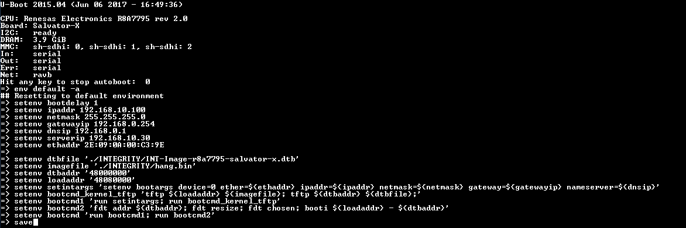

Slide 16
3.SETTING FOR PROBE

Slide 17
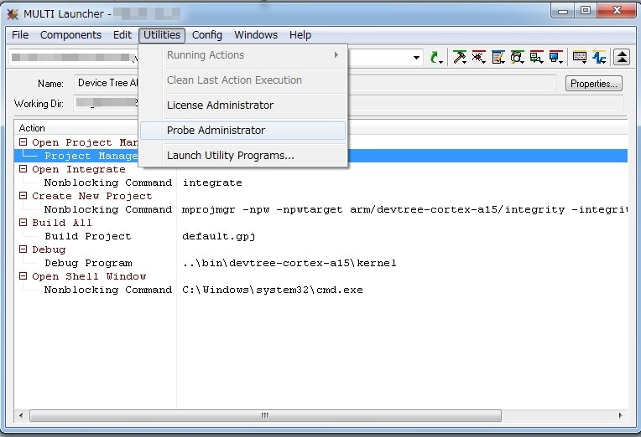
Probe firmware setting
Start MULTI (IDE)
Open “Probe Administrator” from “Utilities”.

Slide 18
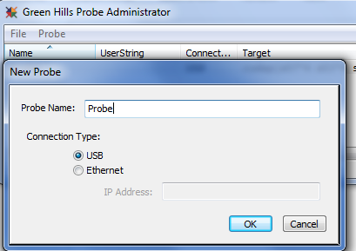
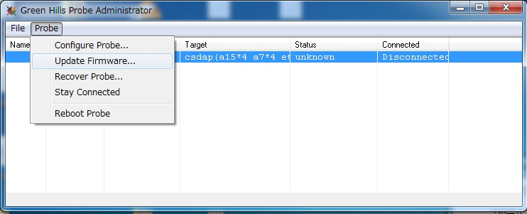
Probe firmware setting
File-> NewProbe
Select “Update Firmware” from “Probe”

Slide 19
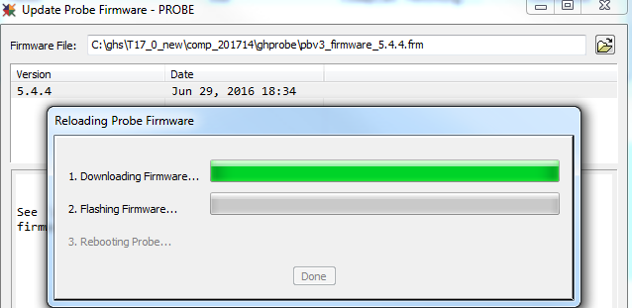
Probe firmware setting
Select pbv3_firmware_5.4.4.frm in C:\ghs\T17_0_new\comp_201714\ghprobe and push “Flash Probe” button.
The firmware update will be started.

Slide 20
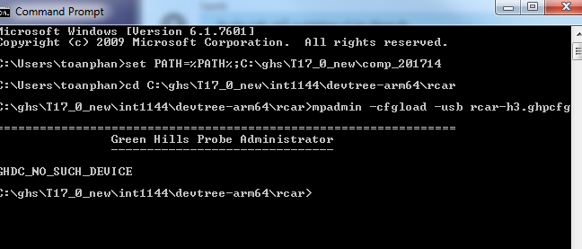
Probe configuration setting
Open “command prompt” window from “Start” -> “All programs”.
Set the path to mpadmin.exe ex)> set PATH=%PATH%; C:\ghs\T17_0_new\comp_201714
Change directory that has h3-salvatorx.ghpcfg. Typically, it is C:/GHS/intXXXX/devtree-arm64/rcar ex)> cd C:\ghs\T17_0_new\int1144\devtree-arm64\rcar
Enter the following command. >mpadmin -cfgload -usb rcar-h3.ghpcfg
Ex:

Slide 21
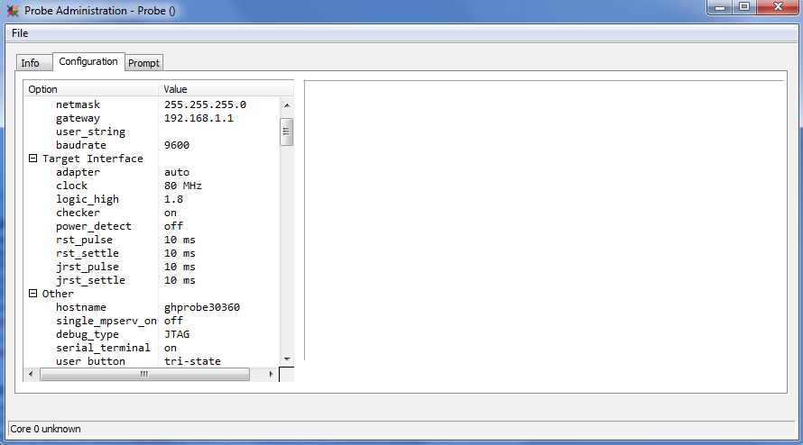
Probe firmware setting
Select “Configure Probe” from “Probe”.After that select “Configuration” to set clock = 80Mhz, power_detect off

Slide 22
Note
To run mode partner in IDE, you should request IT to “Configure USB to LAN “
Ex:
serverip 192.168.10.30
ipaddr 192.168.10.100
=>Subnet Mask USB to Lan following 192.168.10.1

Slide 23
4.Booting INTEGRITY Kernel via Probe JTAG

Slide 24
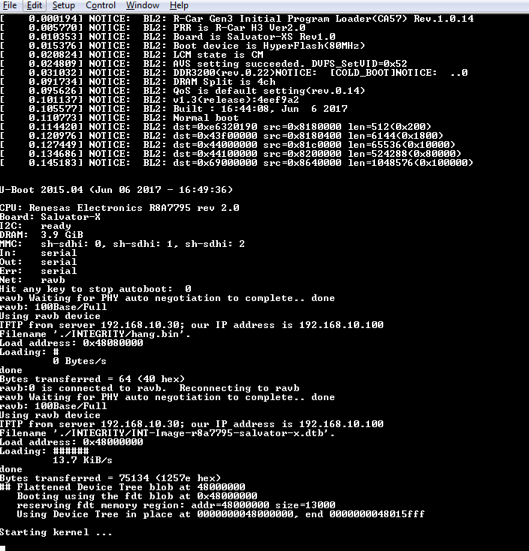
1) Configure the R-Car board to load the DTB and boot into the hang image upon power-up or reset, as outlined in the "Board and U-Boot Configuration“ section above.

Slide 25
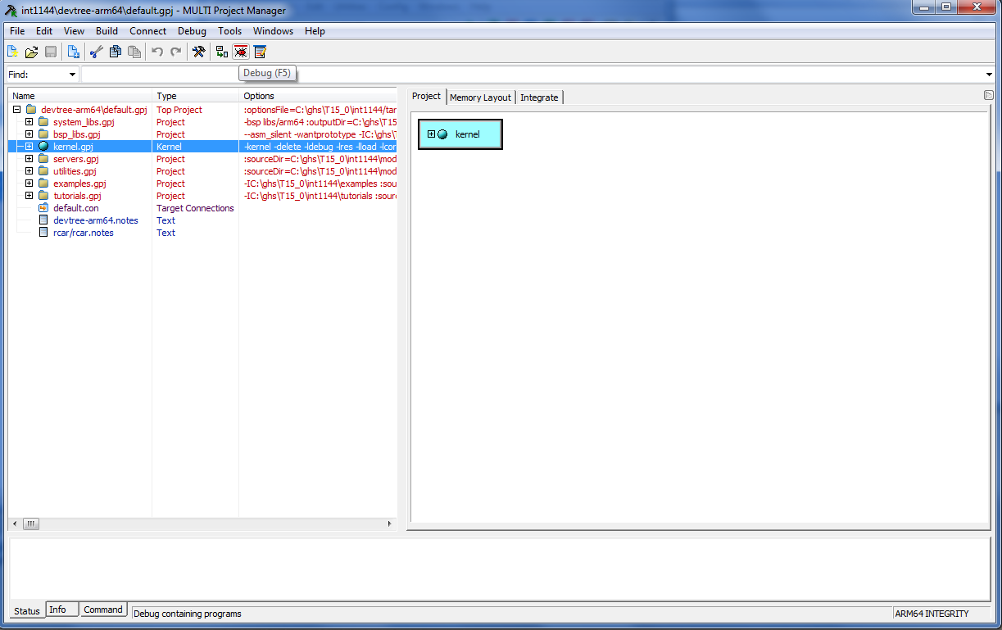
2) Configure GHS probe for operation with R-Car board.
3) Connect GHS probe to the R-Car board JTAG port.
4) Build kernel.gpj and open the MULTI debugger on 'kernel'

Slide 26
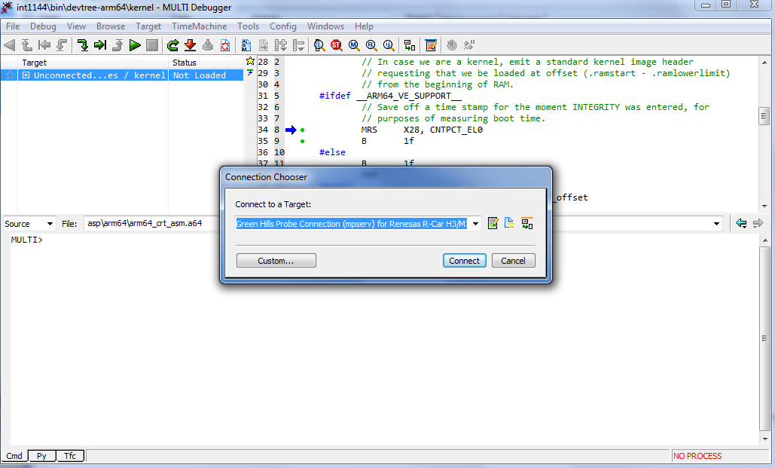
5) Connect to the GHS probe using the following connection method:
Green Hills Probe Connection (mpserv) for Renesas Salvator-X
6) Download and execute the kernel. You should observe console output similar to the following:

Slide 27
5.Configure for camera

Slide 28
Camera Board Setting
Swicth Number | Pin 1 | Pin 2 | Pin 3 | Pin 4 | Pin 5 | Pin 6 | Pin 7 | Pin 8
SW29 | OFF | OFF | - | - | - | - | - | -
Jumper Number | Pin Number
J9 | 1-2
J17 | 1-2
J18 | 2-3
J19 | 2-3
To connect H3 and Camera Board, refer to “RCARH3_camera_board_setup_guide_20151201” from https://socrm.dgn.renesas.com/repos/s679/trunk/hw/00_Gen3/99_Extended_Camera_Board/

Slide 29
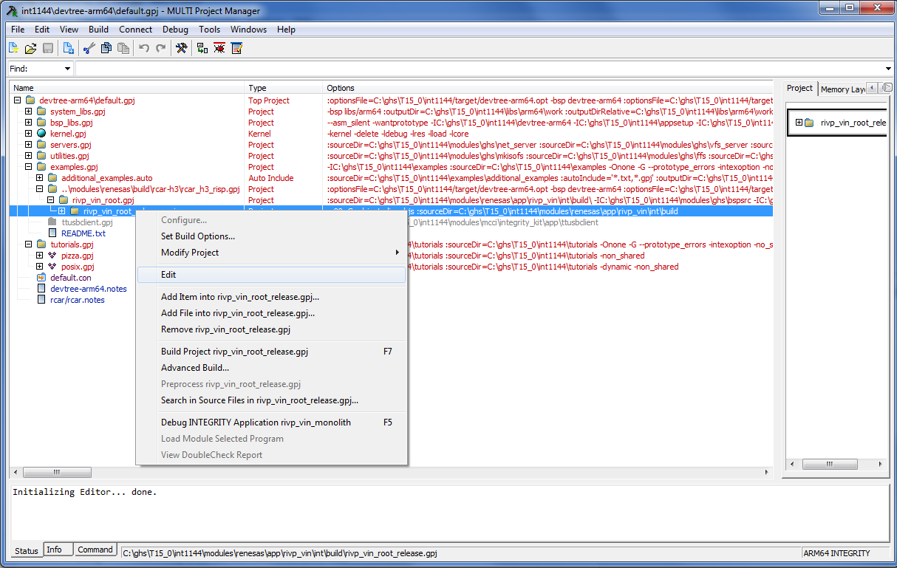
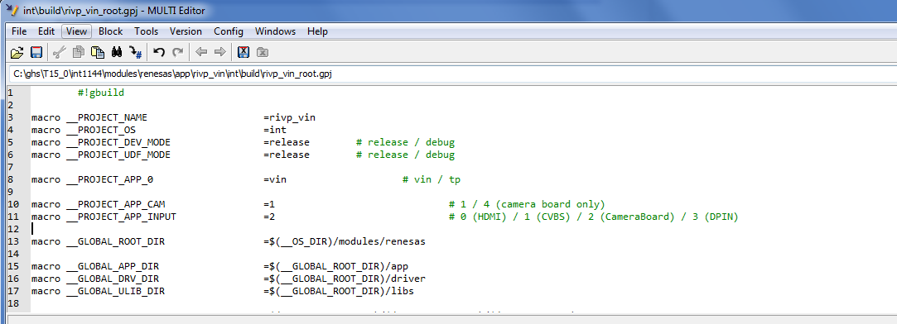
Build Option
To use camera you have to configure some macro in rivp_vin_root.gpj
macro __PROJECT_APP_CAM=1 # 1 / 4 (camera board only)
macro __PROJECT_APP_INPUT=2 # 0 (HDMI) / 1 (CVBS) / 2 (CameraBoard) / 3 (DPIN)

Slide 30
Build option
For more information, refer to “Appendix” section in “RIVPV_Reference_Application_03_body.doc”

Slide 31
6.Run Vin Preference App

Slide 32
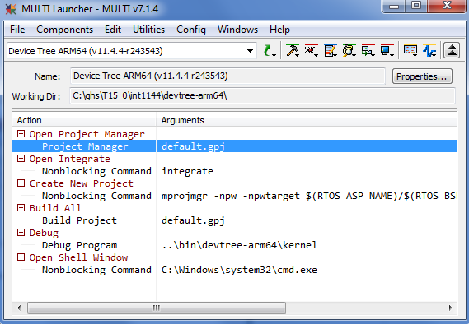
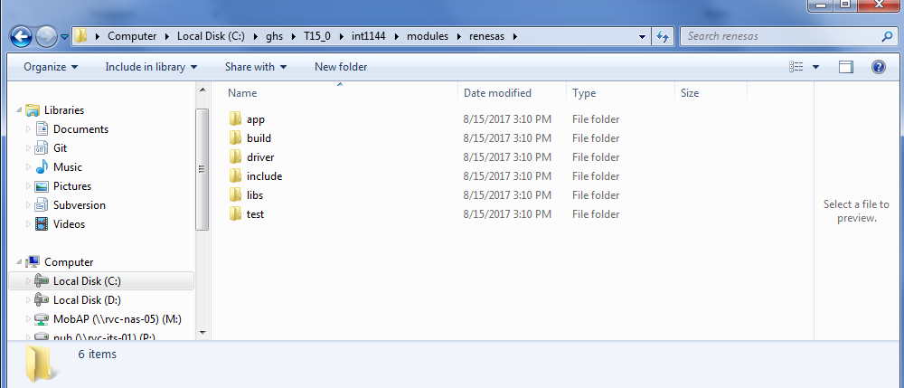
Create “renesas” folder in module folder.
Exact and copy Vin file to renesas folder
Start MULTI (IDE)
Select “Create Workspace” –> “Installed BSPs” -> “Device Tree ARM64” from “Files” of MULTI Launcher window
Device Tree project is created on the MULTI Launcher. Double click “Open Project Manager
Step 2
Step 5

Slide 33
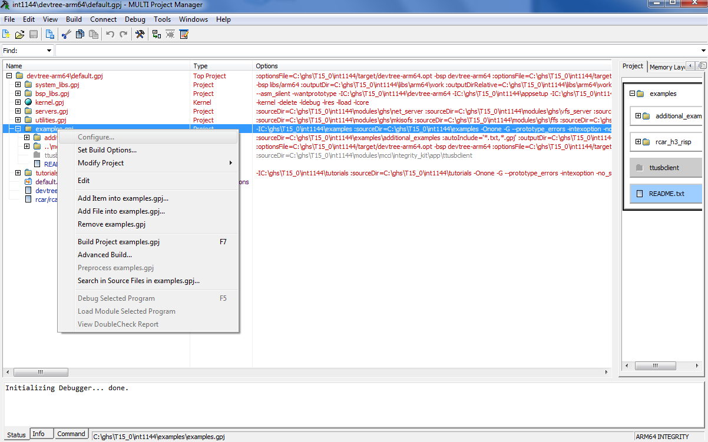
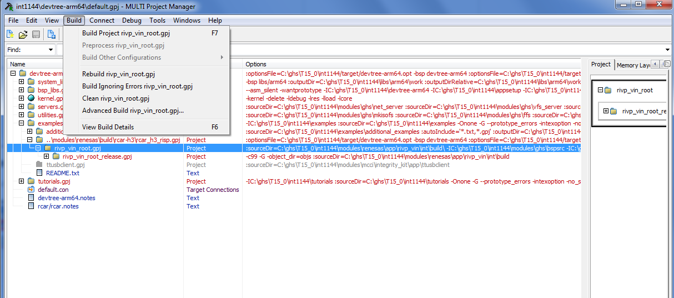
Add file “rcar_h3_risp.gpj” from “renesas” folder to example.gpj
Click to rivp_vin_root.gpj and build.
Step 5
Step 6

Slide 34
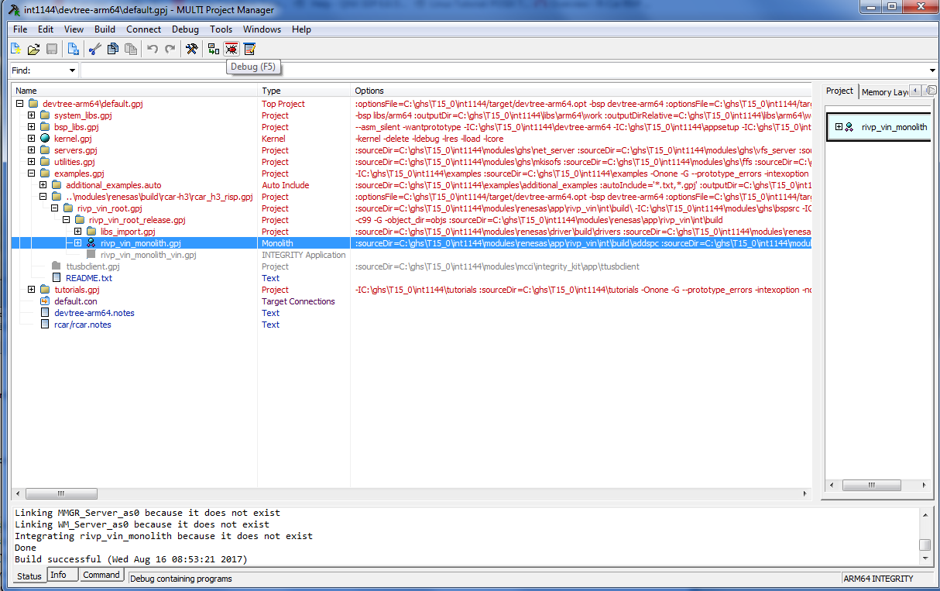
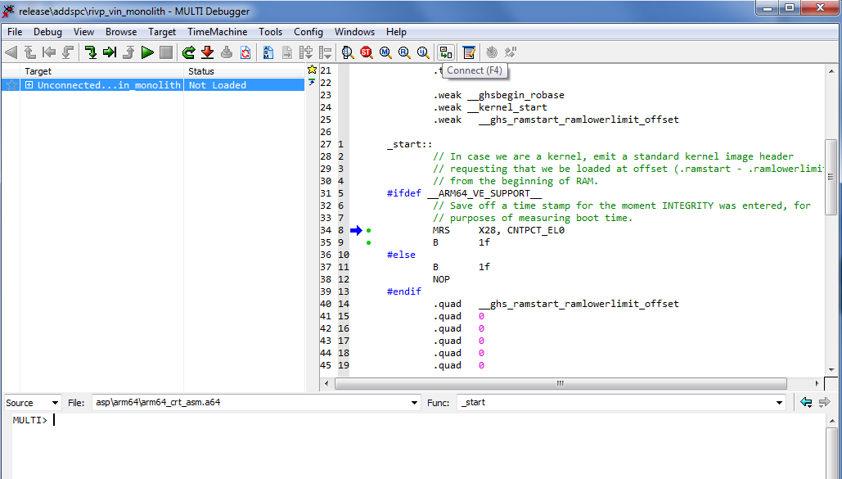
After building success, click “rivp_vin_monolith.gpj” and debug
Press “Connect” button
Step 7
Step 8

Slide 35
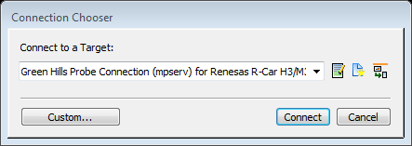
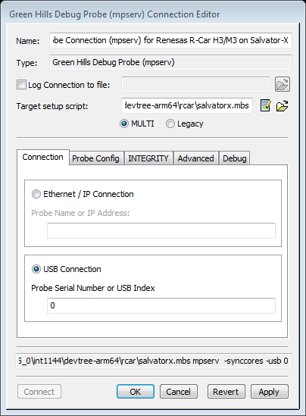
Click pull-down menu and select “Green Hills Probe Connection (mpserv) for Renesas R-Car H3/M3 on Salvator-X”. If there is no connection setting, you need to open devtree-arm64/default.con by Connection Organizer. Click “Edit” button

Slide 36
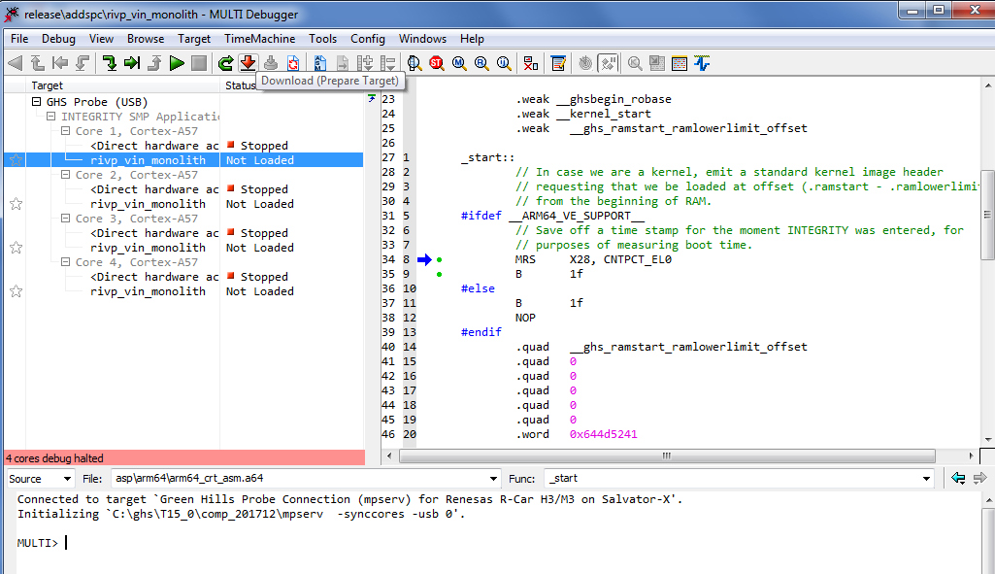
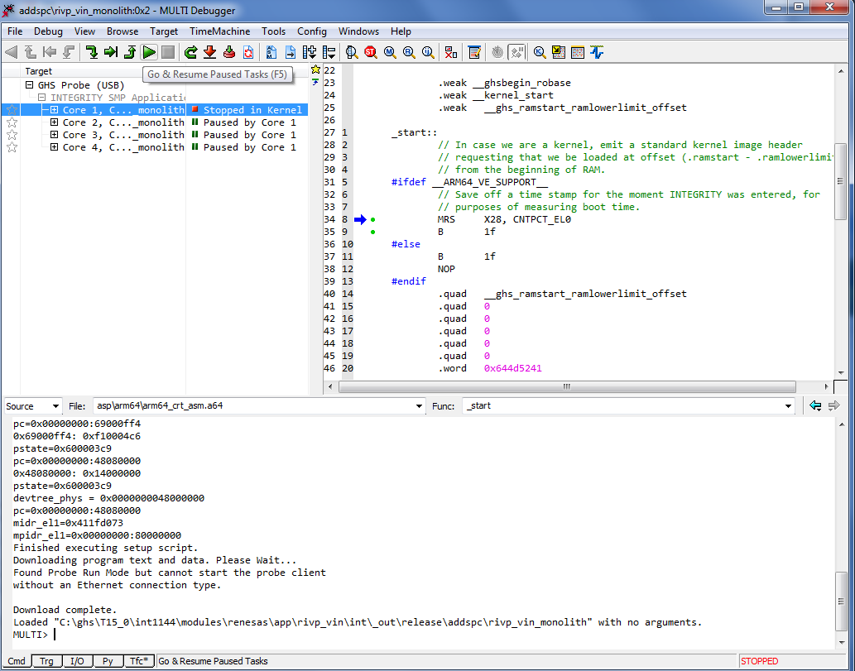
Press “Download” button
After finishing download, click “run” button.
Step 10
Step 11

Slide 37
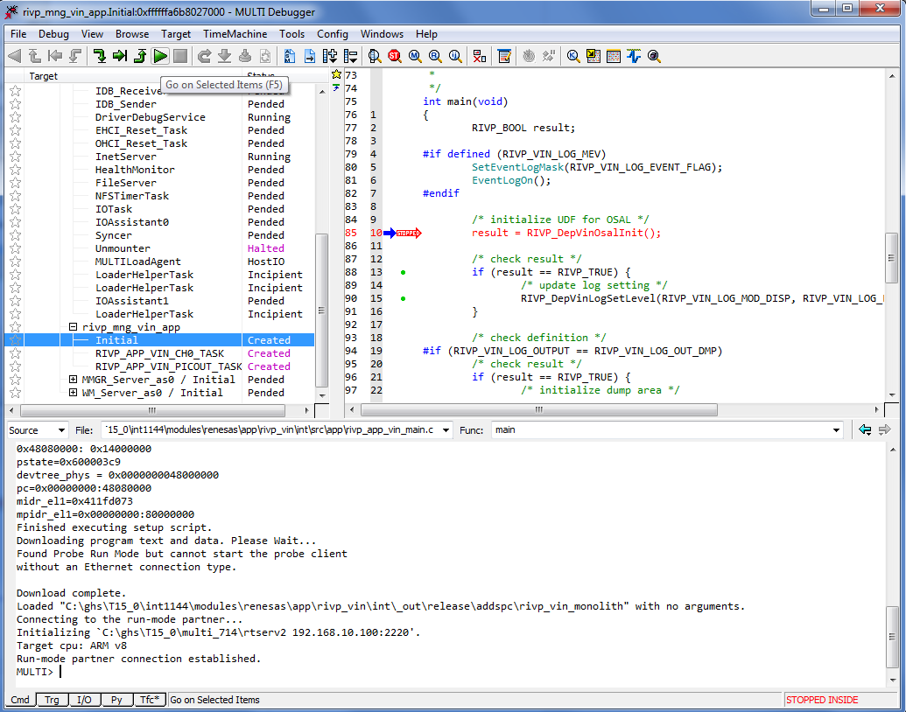
Select “Initial” and press “Go on selected items”

Slide 38
Renesas.com

