Slide 1

LINUX
APRIL 2017
GROUP 1

Slide 2
Agenda

Slide 3
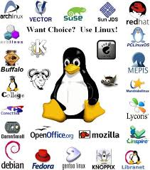

1. linux
Distribution of Linux

Slide 4
1. 1 Operating System (os)
Linux is an Operating System
Linux is derived from Unix and is one of the oldest operating systems
Linux is an Open Source software and is not owned by any company or person.
Linux is different but is similar in a user point of view to Microsoft Windows.
Linux has a desktop called KDE and be configured to look exactly like Windows.

Slide 5
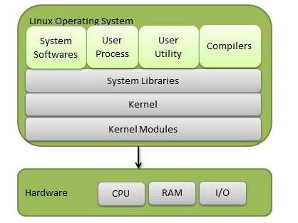
1.2 Components of linux
Kernel is the core part of Linux, responsible for all activities of this operating system.
System Library are special functions or programing using which application programs or system utilities accesses Kernel’s feature
System Utility are responsible to do specialized, individual level tasks.

Slide 6
1.3 WHY DO WE NEED OS ?
To run one single program is easy
To run two, or three program is called fine handling
OS is nothing but a program offering the functions nedded in all applications

Slide 7
5. WHAT IS LINUX KERNEL?
The Linux kernel is a Unix-like operating system kernel used by a variety of operating systems based on it, which are usually in the form of Linux distributions.
The Android operating system for tablet computers, smartphones and smartwatches is also based atop the Linux kernel.
Linux kernel main roles are:
Managing all the hardware resources.
Providing a set of portable, architecture and hardware independent APIs.
Handling concurrent access and usage.

Slide 8
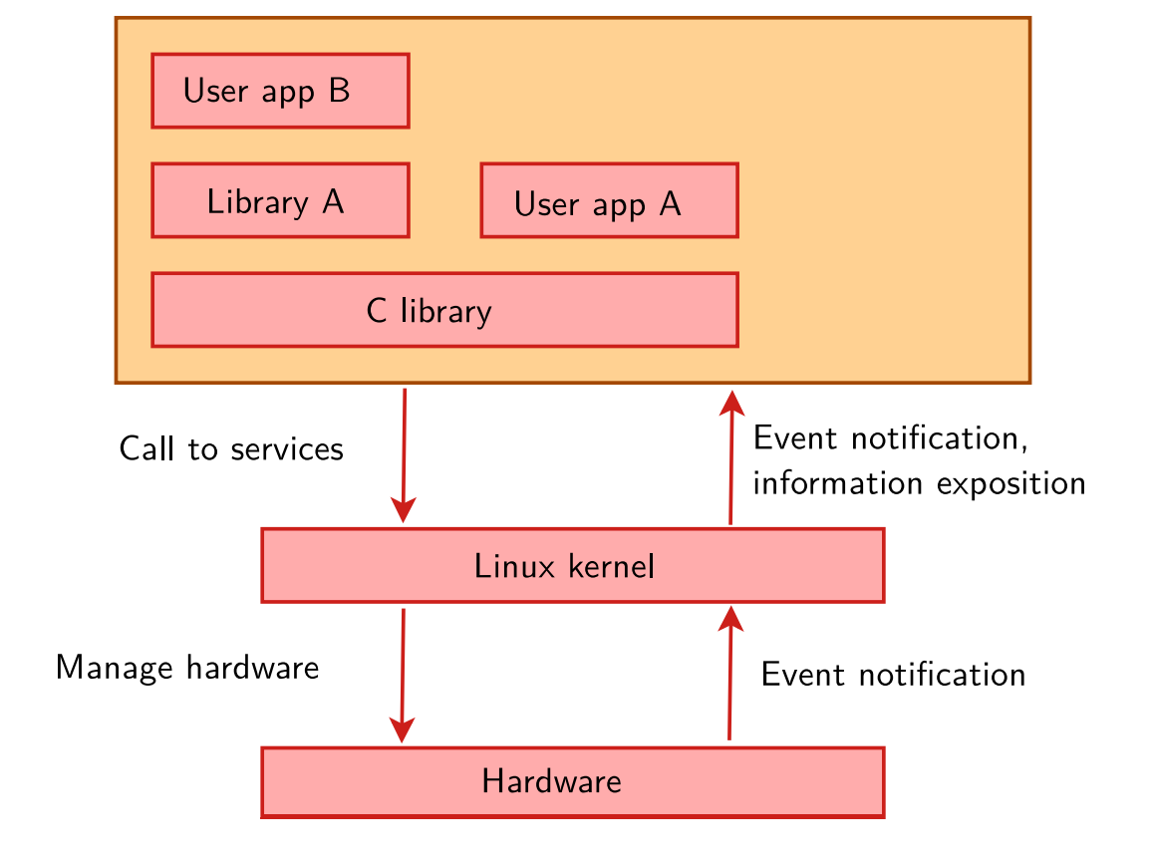
Role of linux kernel
Manage all the hardware resources: CPU, memory, I/O.
Provide a set of portable, architecture and hardware independent APIs (Application Programming Interface) to allow user space applications and libraries to use the hardware resources
Handle concurrent accesses and usage of hardware resources from different applications.

Slide 9
Why do we need kernel?

Slide 10
Linux device
What is a device?
What is a device tree?
The device tree is a simple tree structure of nodes and properties.
Properties are key-values pairs
Node may contain properties and child node.

Slide 11
Linux DEVICE
How can we / OS / Kernel use it?

Slide 12
device
What is a device driver?
The program that

Slide 13
device
Why would we need a device driver?

Slide 14
Device
How to create and use a device driver ?

Slide 15
Device
Relationship between device driver, device tree and kernel?

Slide 16
Filesystem
1.What is a Linux filesystem?

Slide 17
Filesystem
How many filesystem are there?

Slide 18
Filesystem
How many filesystem are there?

Slide 19
Filesystem
Why would we need a file system? What will happen without it?

Slide 20
Process, Thread, program
What is thread, process, program?

Slide 21
Process, Thread, program
Why do we need them?

Slide 22
Process, Thread, program
Why do we need them?

Slide 23
Process, Thread, program
What is the term multi-process and multi-thread?

Slide 24
Process, Thread, program
In which circumstance will we need them?

Slide 25
Process, Thread, program
What is IPC and why do we need it?

Slide 26
U-boot
What is a u-boot?

Slide 27
U-boot
Why do we need it?

Slide 28
U-boot
Why do we need it?

Slide 29
U-boot
What role does u-boot play in a booting sequence

