Slide 1

Application of the ECLAT Algorithm in Market Basket Analysis
Final report

Slide 2
1. LITERATURE REVIEW
Definition and Key Idea
ECLAT (Equivalence Class Clustering and bottom-up Lattice Traversal)
Introduced by Zaki et al. (1997)
Designed for association rule mining*
Goal: Discover all frequent itemsets in a transaction database
Constraint: Itemsets must satisfy a minimum support threshold
Key Idea of the ECLAT Algorithm in Frequent Itemset Mining
Vertical Database Representation: Each item is associated with a set of Transaction IDs (TIDs) where it occurs.
TID-List Intersection: Support is computed by intersecting TID-lists of candidate itemsets.
Recursive Expansion: Starting from 1-itemsets, recursively extend itemsets by combining them to generate larger k-itemsets.
*Association rule mining: Given a set of transactions, find rules that will predict the occurence of an item based on the occurences of other items in the transaction.
1

Slide 3
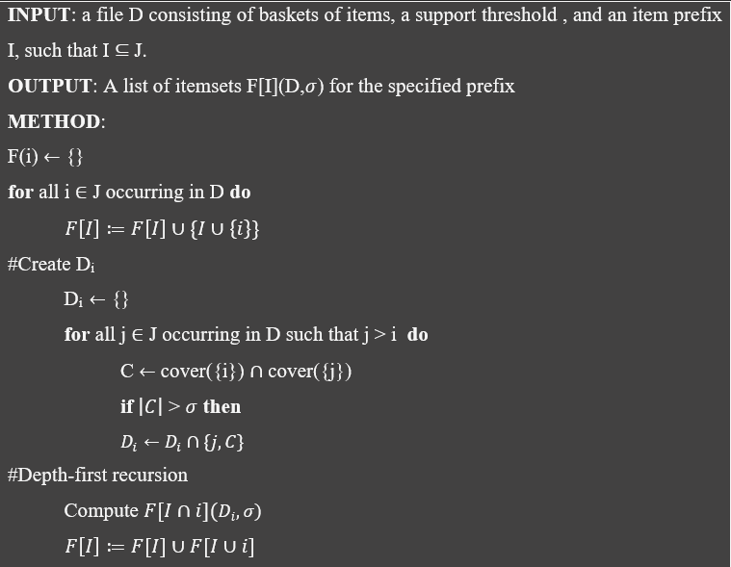
1. LITERATURE REVIEW
Pseudocode
2

Slide 4
2. ALGORITHM ILLUSTRATION-
Step-by-step demonstration
Sample data
Step 1: Data preparation
Step 2: Frequent itemset mining
Item | Transactions | Support
A | {1, 2, 3, 5} | 4
B | {1, 3, 4, 5} | 4
C | {1, 2, 5} | 3
E | {4, 5} | 2
Transaction | Items
1 | {A, B, C}
2 | {A, C}
3 | {A, B, D}
4 | {B, E, F}
5 | {A, B, C, E}
Item | Transactions
A | {1, 2, 3, 5}
B | {1, 3, 4, 5}
C | {1, 2, 5}
D | {3}
E | {4, 5}
F | {4}
Item | Transactions | Support
ABC | {1,5} | 2
With k = 1
Item | Transactions | Support
AB | {1,3,5} | 3
AC | {1,2,5} | 3
BC | {1,5} | 2
BE | {4,5} | 2
With k = 3
3
With k = 2

Slide 5
2. ALGORITHM ILLUSTRATION
Step-by-step demonstration
Result
Items | Recommendation
A | B
A | C
B | C
B | E
A, B | C
Association Rules with Minimum Support = 2
Given a minimum support threshold of 2, all frequent itemsets are identified.
From these frequent itemsets, association rules can be derived.
Ensures that only rules meeting the support constraint are retained.
4

Slide 6
3. ALGORITHM IMPLEMENTATION
Data Structures in ECLAT algorithm and Dataset information
Data structures
Dataset information
Dictionary: Stores the vertical database; key = item, value = set of TIDs. Enables fast lookup of item occurrences.
Set: Holds TIDs for each item; supports efficient intersection and removes duplicates.
List: Represents original transactions before vertical transformation; each transaction = list of items.
Tree (IT-tree): Node = itemset + its TID-set; built via depth-first search to organize and retrieve frequent itemsets efficiently.
Recursion: Expands itemsets recursively; each call explores larger itemsets and backtracks via stack.
Contains transaction records of store members from Jan 21, 2015 – Apr 30, 2015
Includes 38,765 rows and 3 attributes
Dataset is complete with no missing values
Variable | Type | Description | Unique | Blank
Member_number | Int64 | Member ID | 3989 | 0
Date | Object | Purchased date | 728 | 0
ItemDescription | Object | Product name | 167 | 0
5

Slide 7
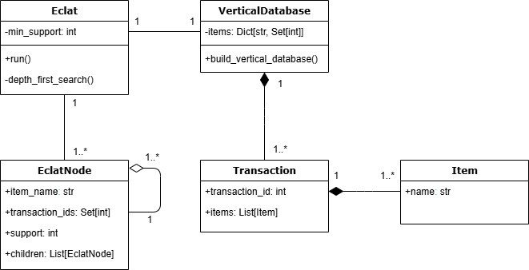
3. ALGORITHM IMPLEMENTATION
Class diagram
6

Slide 8
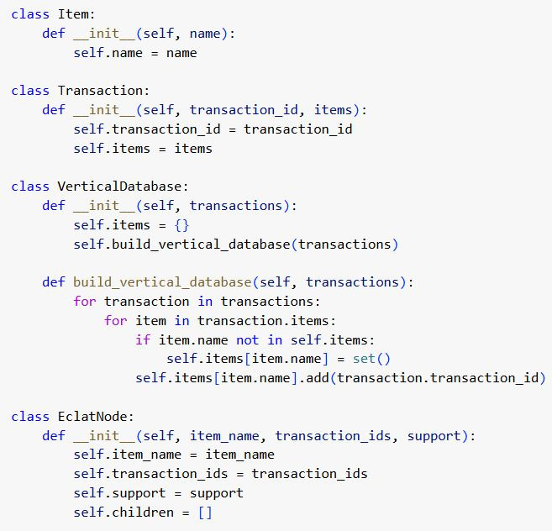
3. ALGORITHM IMPLEMENTATION
Class diagram (Implementation)
7

Slide 9
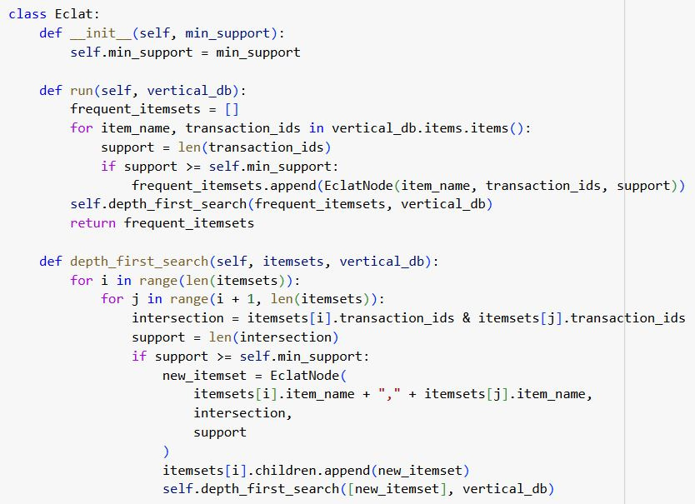
3. ALGORITHM IMPLEMENTATION
Class diagram (Implementation)
8

Slide 10
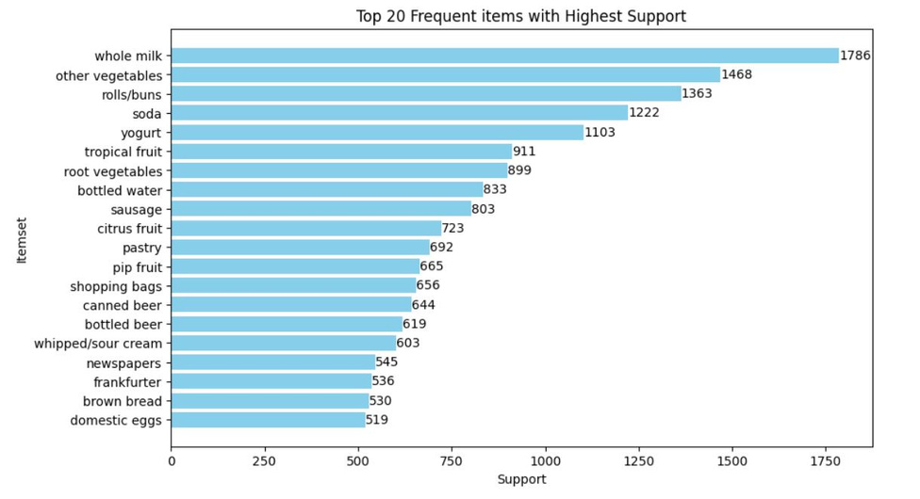
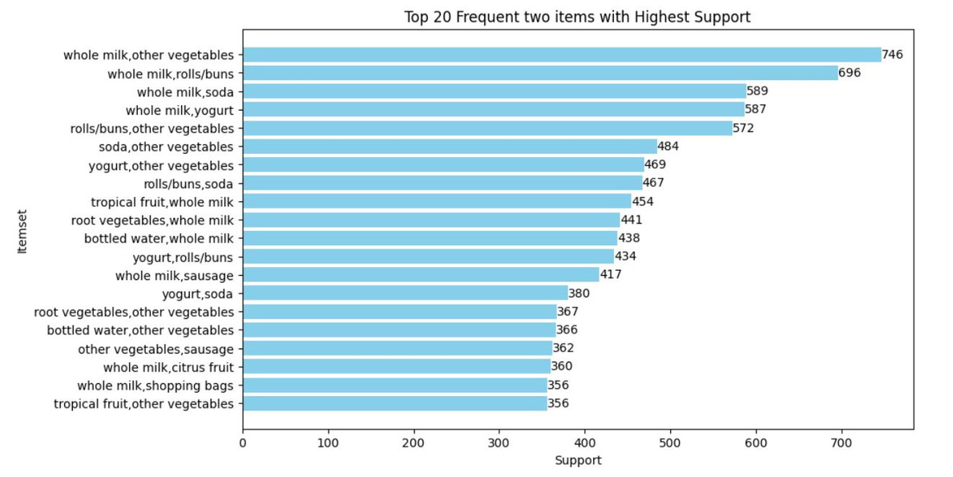
3. ALGORITHM IMPLEMENTATION
Find Frequent Items
k-itemsets with k = 1
k-itemsets with k = 2
9

Slide 11
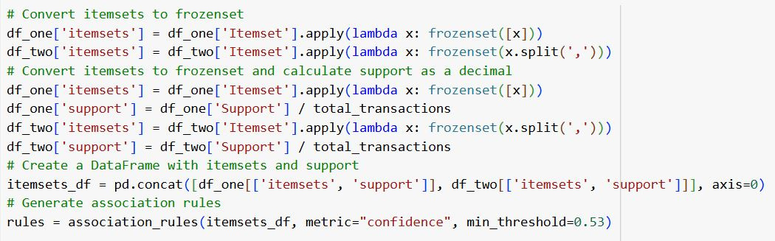
3. ALGORITHM IMPLEMENTATION
Generate Association Rules using the association_rules() Function
10

Slide 12
3. ALGORITHM IMPLEMENTATION
Threshold Setting & Rule Evaluation
Metric | Theshold
MinSup | 0.03
MinConf | 0.53
MinLift | 1.16
11

Slide 13
3. ALGORITHM IMPLEMENTATION
Threshold Setting & Rule Evaluation
Rules with highest Support
antecedents | consequents | support | confidence | lift
(yogurt) | (whole milk) | 0.150590 | 0.532185 | 1.161510
(shopping bags) | (whole milk) | 0.091329 | 0.542683 | 1.184422
(bottled beer) | (whole milk) | 0.085428 | 0.537964 | 1.174124
(beef) | (whole milk) | 0.064135 | 0.536481 | 1.170886
(frozen vegetables) | (whole milk) | 0.055156 | 0.537500 | 1.173110
12

Slide 14
3. ALGORITHM IMPLEMENTATION
Threshold Setting & Rule Evaluation
Rules with highest Confidence & Lift
antecedents | consequents | support | confidence | lift
(ham) | (whole milk) | 0.036942 | 0.582996 | 1.272407
(hamburger meat) | (whole milk) | 0.045408 | 0.565495 | 1.234211
(sugar) | (whole milk) | 0.036942 | 0.560311 | 1.222897
(chocolate) | (whole milk) | 0.047973 | 0.554896 | 1.211078
(waffles) | (whole milk) | 0.037968 | 0.550186 | 1.200798
13

Slide 15
3. ALGORITHM IMPLEMENTATION
Conclusions, limitations and future work
Conclusions
Limitations & Future Work
Whole milk emerges as the dominant product, strongly associated with multiple items
Lift values for rules (ham → whole milk), (hamburger meat → whole milk), (sugar → whole milk) range 1.22–1.27, exceeding the baseline 1.16
Interpretation: Presence of ham, hamburger meat, or sugar increases the likelihood of purchasing whole milk by 22–27% compared to random chance
Current study focuses only on 2-item association rules, potentially overlooking complex, multi-dimensional relationships among products.
Future research should explore multi-item association rules.
Integration with advanced techniques such as clustering, time-series analysis, and deep learning can provide more comprehensive and accurate recommendations.
14

Slide 16
THANK YOU

