Slide 1
Blog Application
Toan Quach
Instructor: Prof. Paymen Salek
Nov 19, 2015

Slide 2
Agenda
Overview
Tools & Technologies
Limitations
Demo

Slide 3
Overview
The domain is creating a blog application, user can see the list of entries in the home, show more information about specific entry.
Admin of the system can post new entry, edit or delete current entry.
Provide a form for user to contact with admin. This is handle by JMS and JavaMail.

Slide 4

Tools & Technologies
Java
JQuery
Spring MVC
JSP (Titles, Validation)
JSTL / EL
HTML, CSS, JQuery
Internationalization
JPA / Hibernate
Rest / Ajax
HornetQ JMS
Git / GitHub
MySQL

Slide 5
Limitations
Only admin can post a entry
No registration page for user
No comment system on the specific blog
No unit testing available.

Slide 6
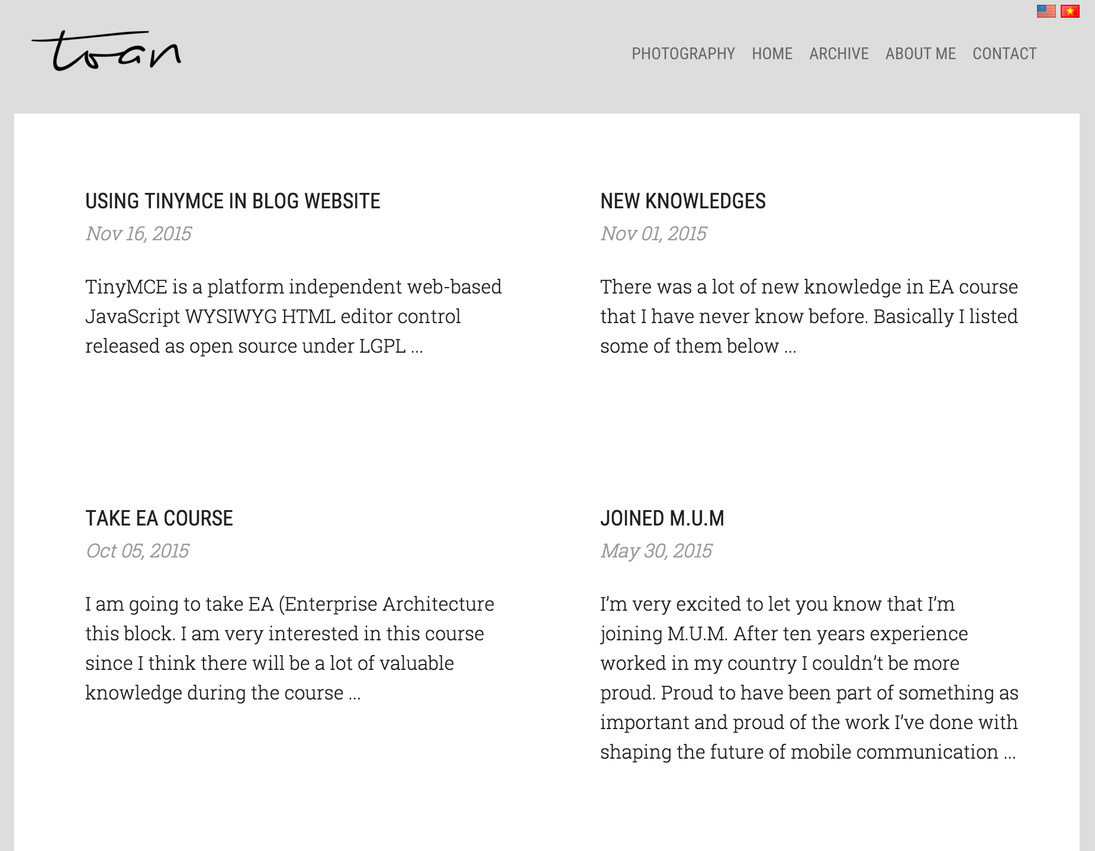
Demo

Slide 7
Thank You!

