Slide 1
Library Management System
Group 9
Bao Pham
Toan Quach
Anil KC
13. Jul 2015

Slide 2
Agenda
Overview
Tools & Technologies
Class Diagram
Database Diagram
Sequence Diagram
Lambda Library
Limitations
Demo

Slide 3
Overview
Checkout book/periodical for library member.
MVC Model:
Ease to maintenance
Reduce code redundancy
High extension
Object creation factory pattern aids to support multiple data access layers.
Lambda library reduces lines of codes for easy maintenance.
User friendly UI with icons/button.

Slide 4
Tools & Technologies
JavaFX
FXML
FX CSS
JavaDB
Lambda expression
Git / GitHub
Balsamiq

Slide 5
Class Diagram

Slide 6
Database Diagram

Slide 7
Sequence Diagram
Add library member
Search / edit library member
Add publication (book / periodical)
Add copy of publication (book / periodical)
Checkout publication (book / periodical)
Print checkout record
Display publication overdue

Slide 8
Add Library Member Diagram

Slide 9
Search / Edit Library Member Diagram

Slide 10
Add Publication Diagram

Slide 11
Add Copy of Publication Diagram

Slide 12
Checkout Publication Diagram

Slide 13
Print Checkout Record Diagram

Slide 14
Display Publication Overdue Diagram

Slide 15
Lambda Library
PUBLICATION_OVERDUE_RECORD_LAMBDA: return the list of publication overdue records from checkout record entries.
PRINT_CHECKOUT_RECORD: print to the console the list of checkout record for a specific member.
REGEX_MATCHER: checks if provided String matches with provided regular expression.
PANE_TEXTFIELD_CLEANER: clears text of every textfield inside provided pane.
GENERATE_LIST_OF_COPIES: creates and returns list of copies with provided copy number.
FILTER_PUBLICATION_OVERDUE_RECORD: filter overdue publication record by ISBN / issue number.

Slide 16
Limitations
Only support two types of publication: Book and Periodical
Only librarian can checkout the publication
Do not support authentication
Transaction handling is only implemented at some screens

Slide 17
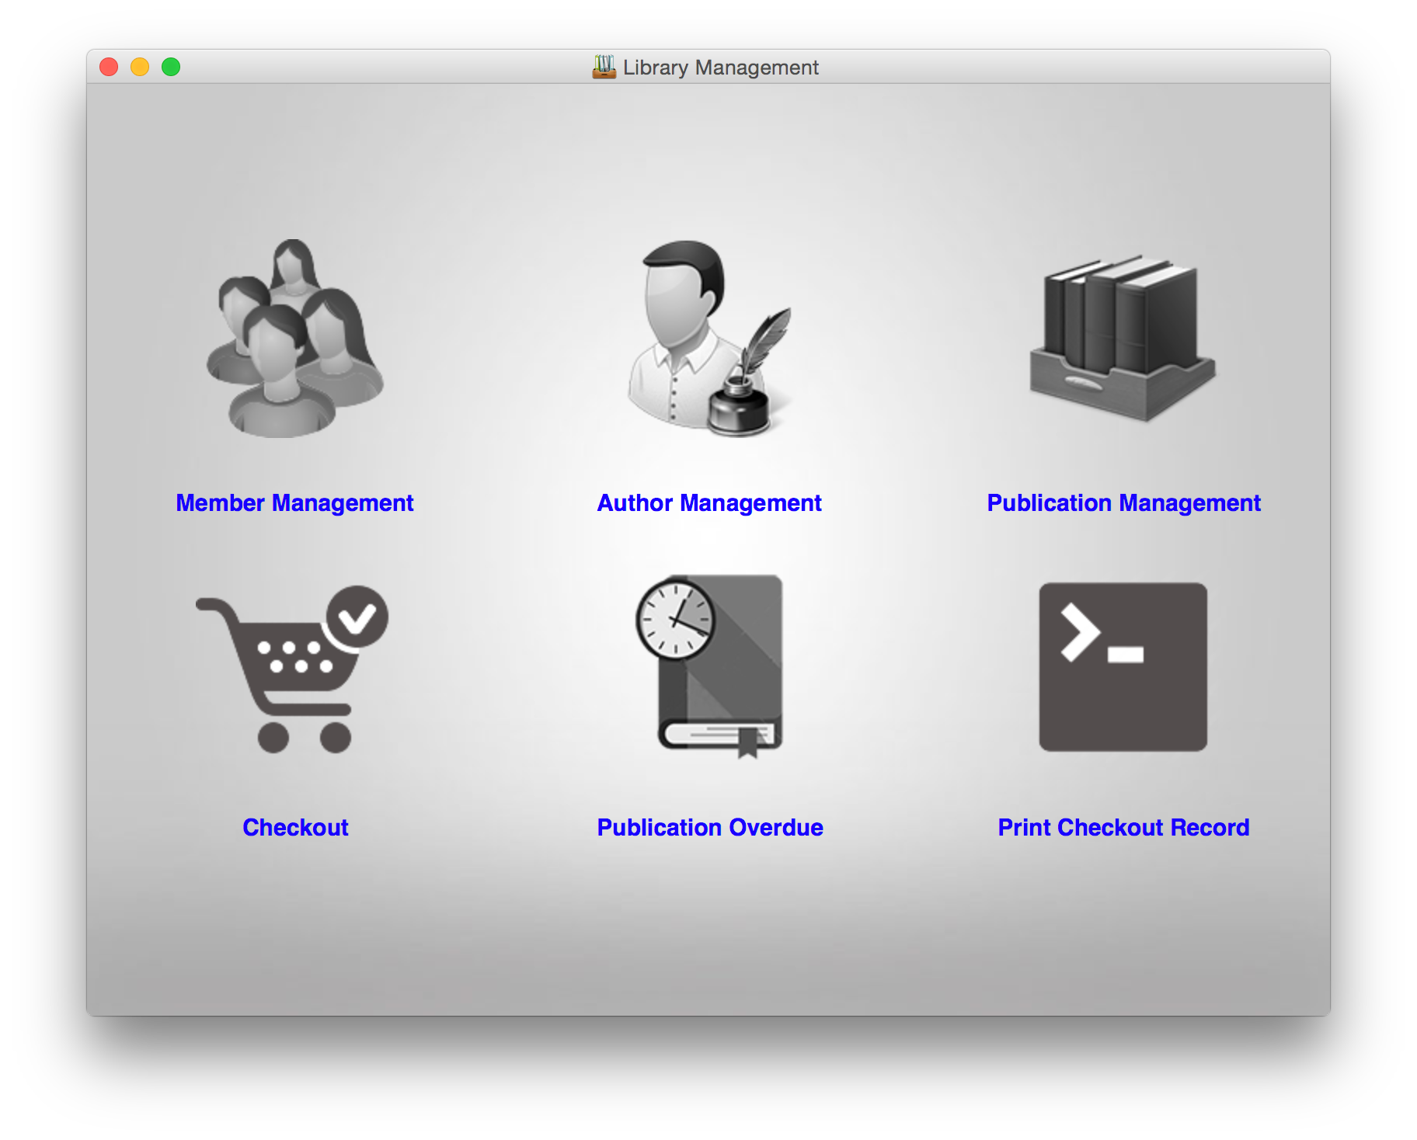
Live Demo

Slide 18
Thank You!

