Slide 1
Project: Tic-Tac-Tactics
Professor Mehdi Peiravi
CPSC 362
Toan Tran
Alejandro Galvan
Jay Gallardo

Slide 2
WHAT IS IT?
A top-down game where you explore a run down, mob ran world, where you play a rebel and battle opponents with a pop up game of tic-tac-toe.
For this project we used:
Python
Pygame
Tiled
Github

Slide 3
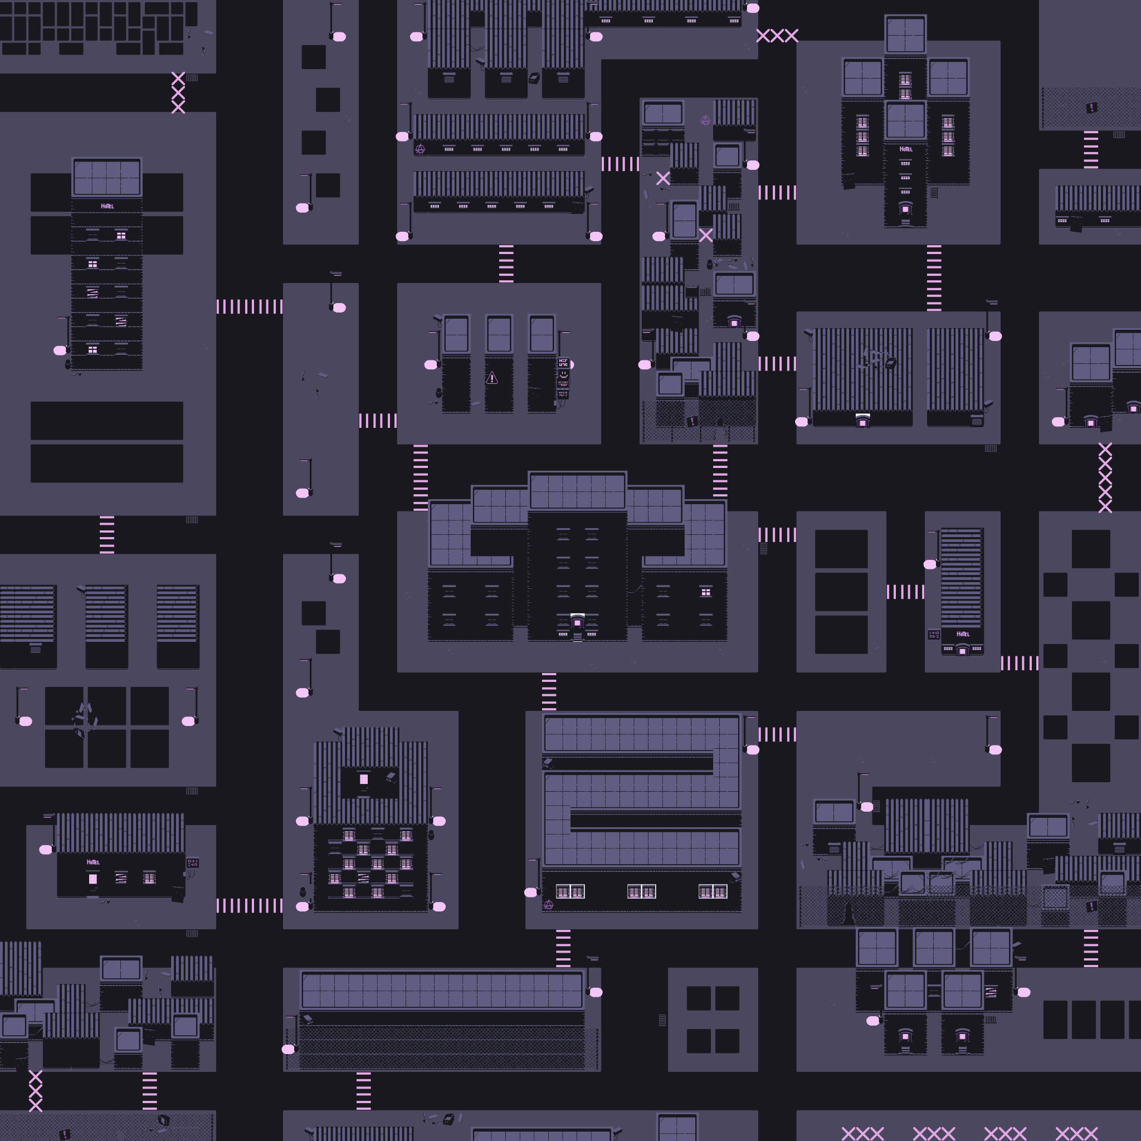
World Map

Slide 4


Characters:

Slide 5
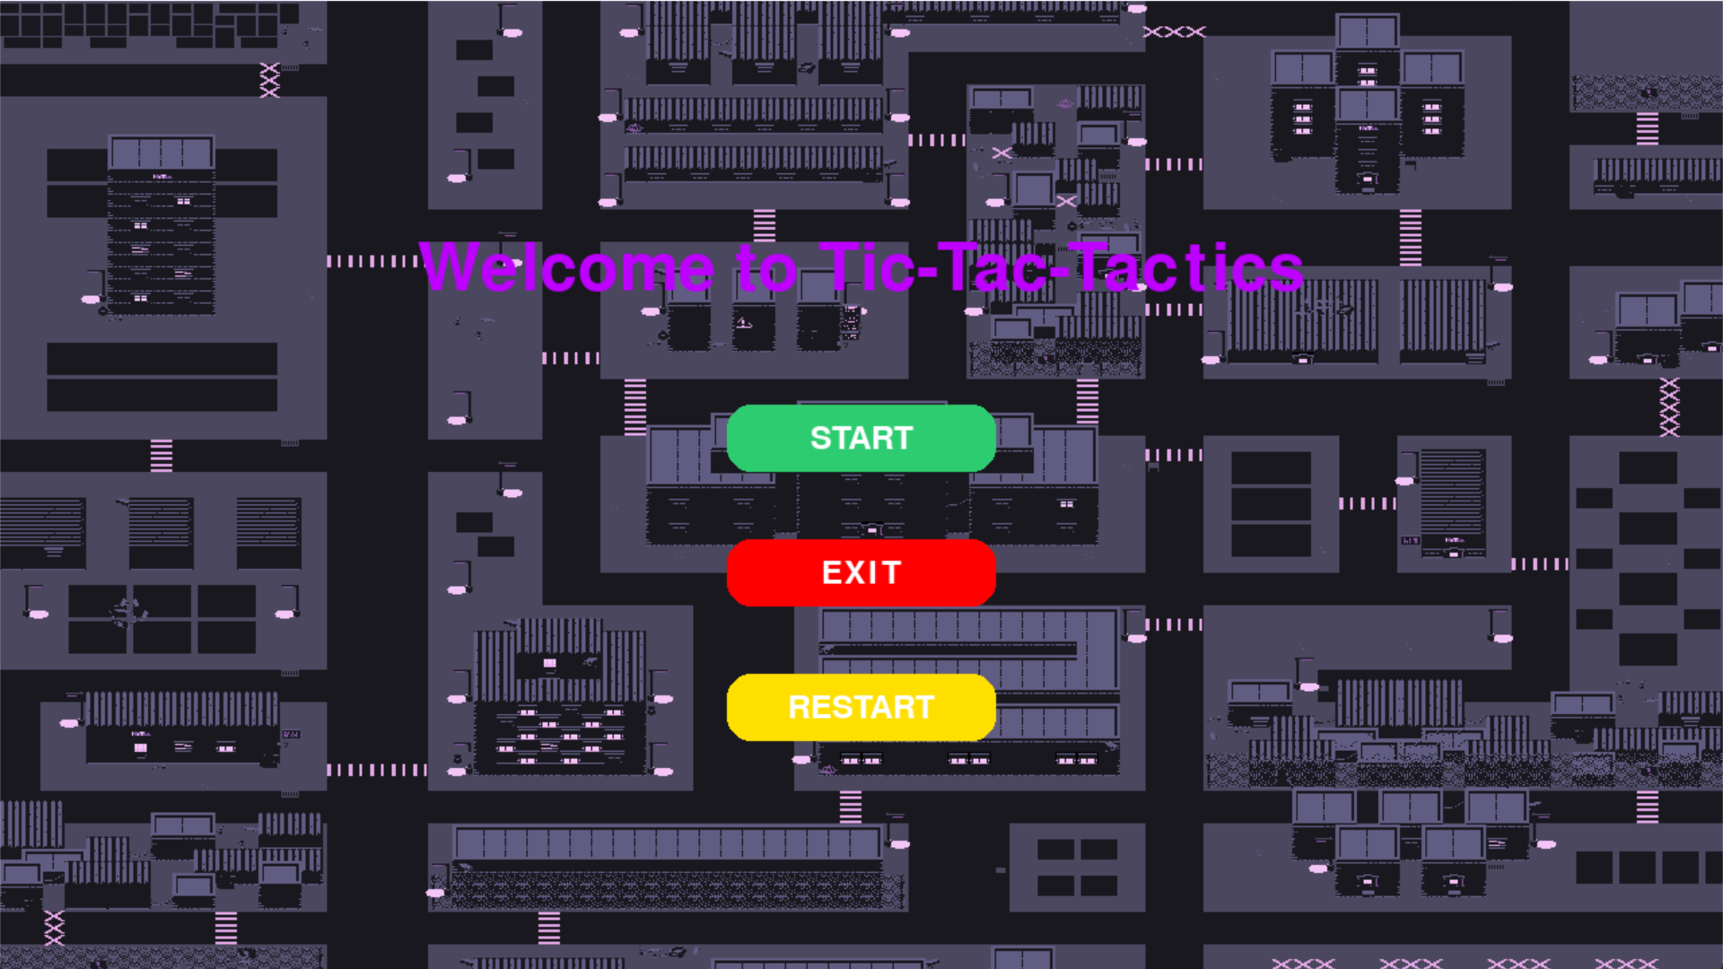
Start Screen

Slide 6
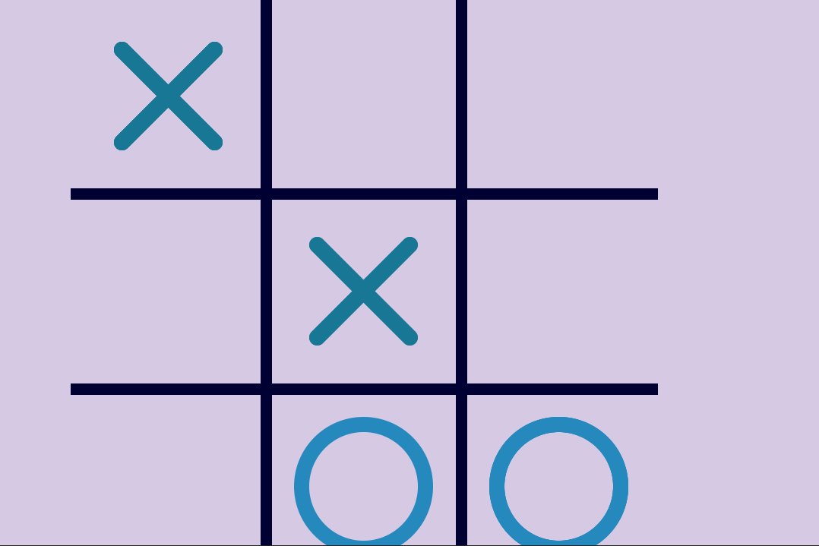
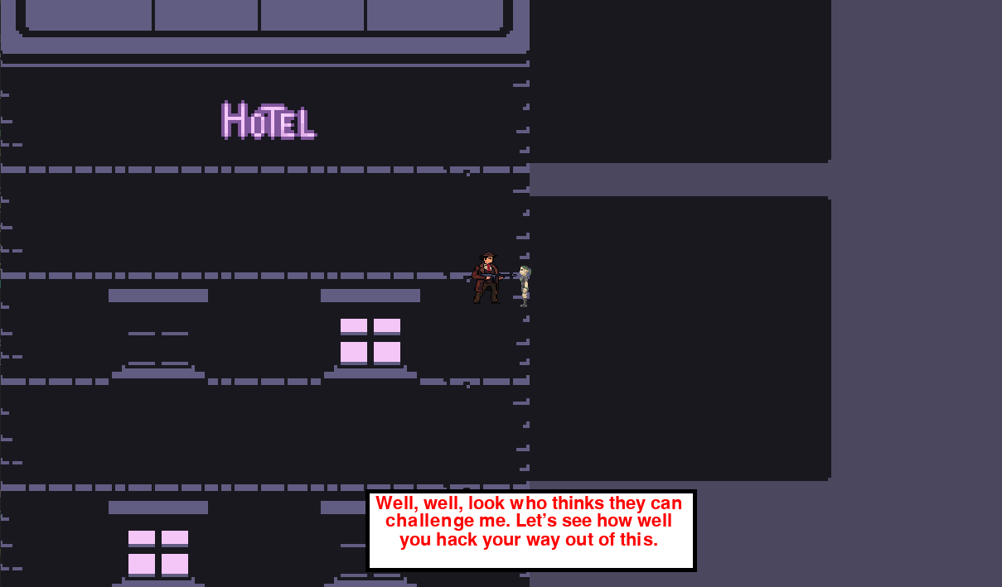
Gameplay

Slide 7
Functionalities Completed:
Created World Map
Camera Movement
Movement Handling
Character Animation
Tic-tac-toe Opponent AI
Tic-tac-toe gameplay
Collision Handling
NPCs interaction
Tic tac toe special abilities
Start Game Menu

Slide 8
Functionalities not completed:
Save state
Key inventory system

