Slide 1

EX3030/EM4012 Heat, Mass and Momentum Transfer Heat Exchangers 1
Originally by Dr Mark Stewart
Presented by Dr M. Bannerman

Slide 2
Week 8 Content
Content
Types and classifications of heat exchangers
Overall heat transfer coefficient (OHTC)
Analysis of heat exchangers
Log Mean Temperature Difference (LMTD) method
Effectiveness-NTU method
EX3030/EM40JN

Slide 3
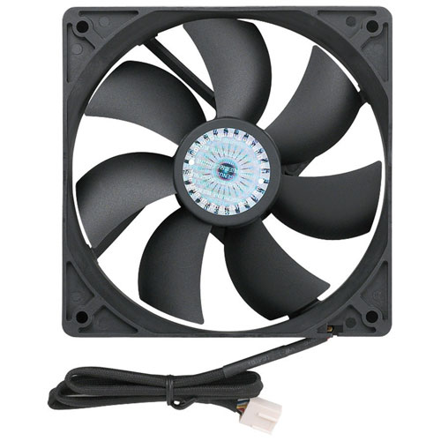
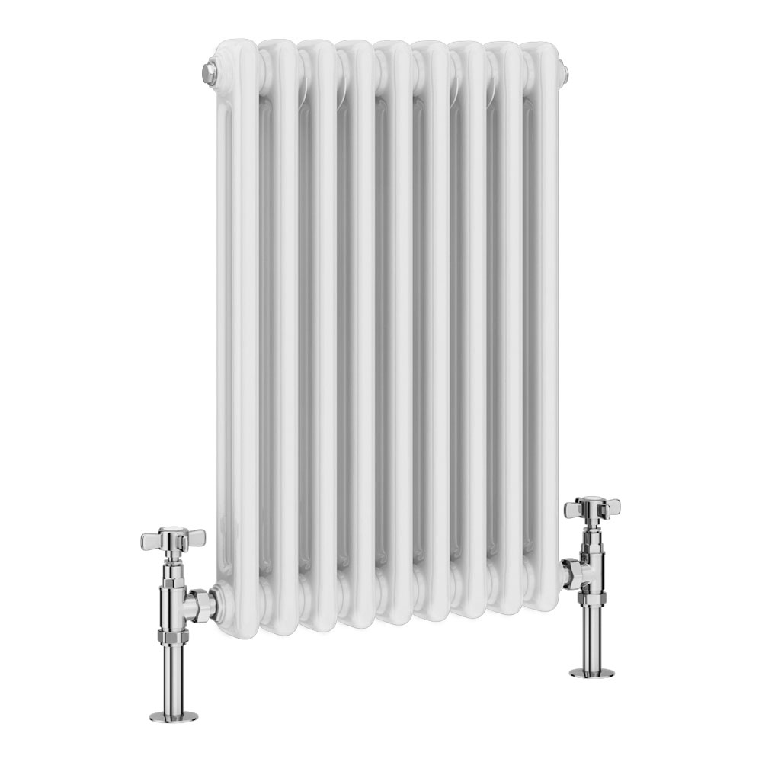
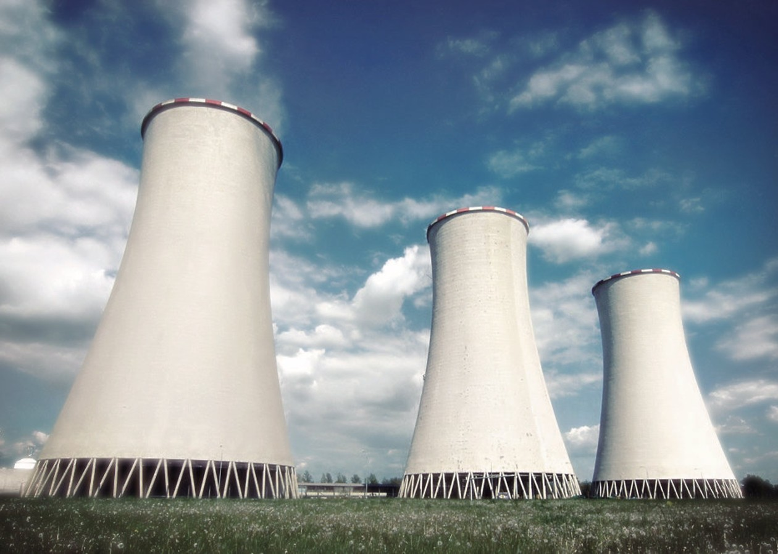
Heat Exchangers
Introduction
Heat exchangers are devices that allow thermal energy transfer between substances at different temperatures
They are a key element in most industrial processes e.g. power generation, electronics cooling, refrigeration, automotive, etc
EX3030/EM40JN

Slide 4
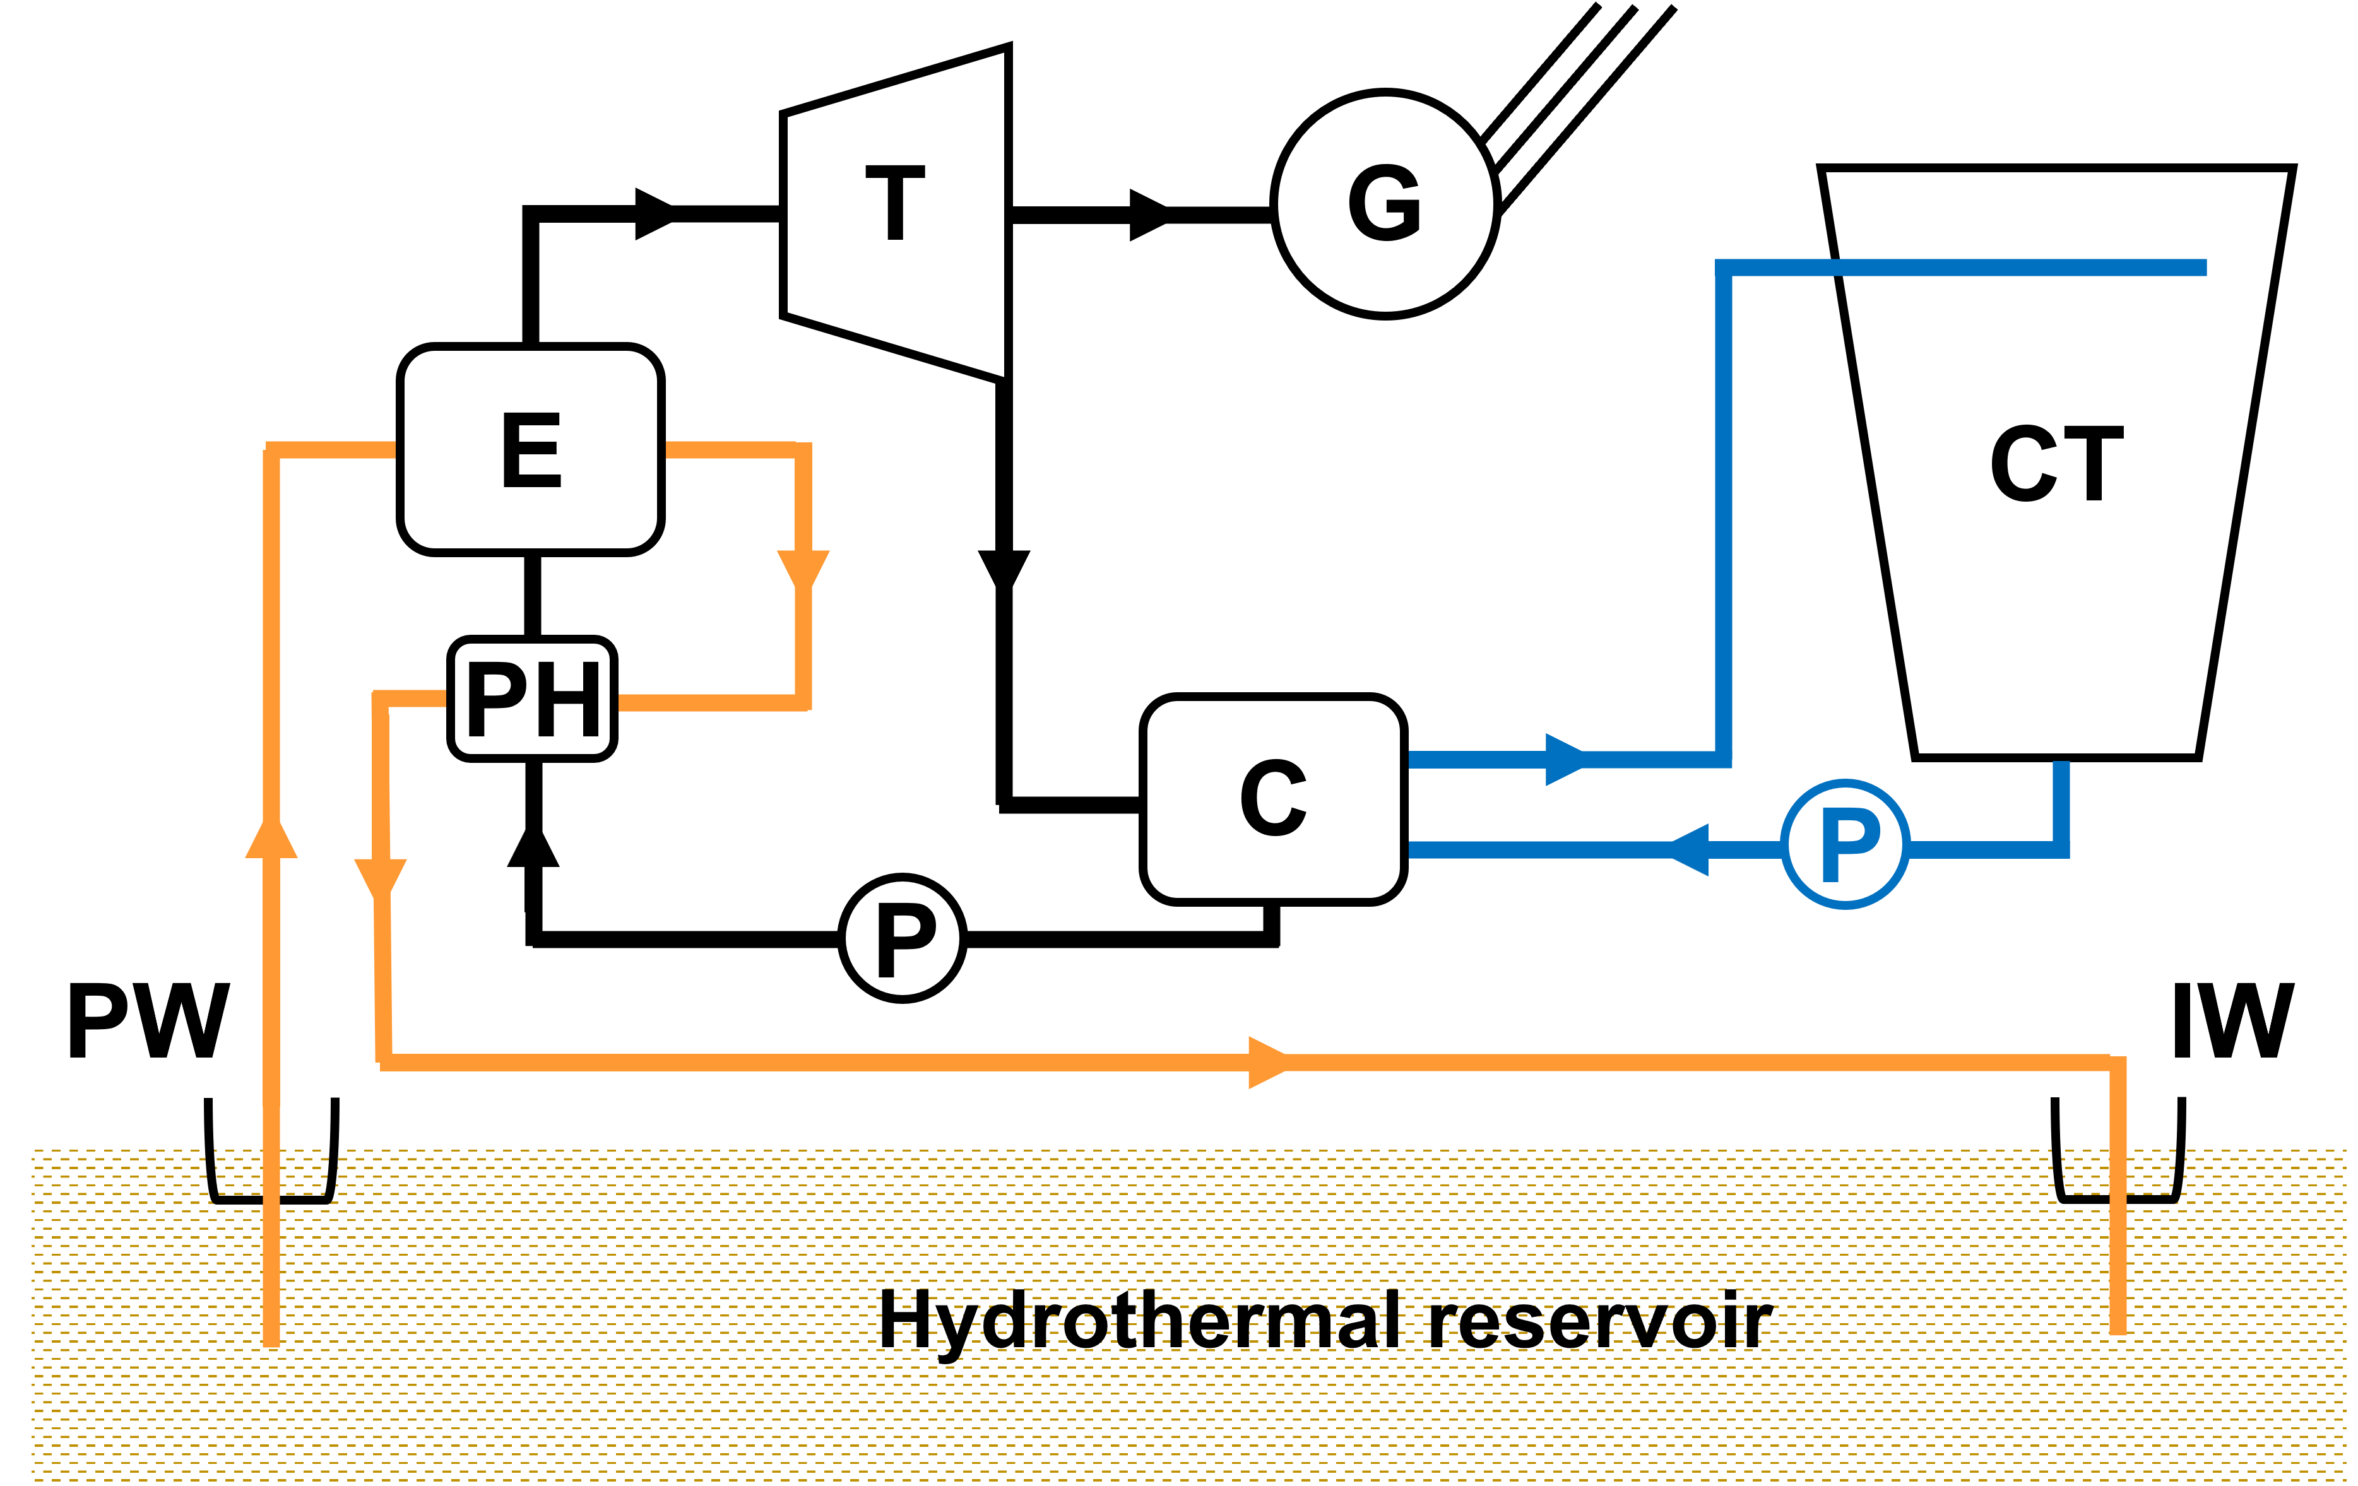
Geothermal Energy
An Example: Binary Cycle Power Plants
Binary cycle power plants use several heat exchangers in their operation
At the surface, heat transfer occurs from the ‘geothermal fluid’ to the ‘working fluid’
Working fluid undergoes standard vapor power cycle to generate electricity
Key:
PW – Production Well
IW – Injection Well | T – Turbine
CT – Cooling Tower | C – Condenser
G – Generator | E – Evaporator
PH – Pre-heater | P - Pump
EX3030/EM40JN

Slide 5
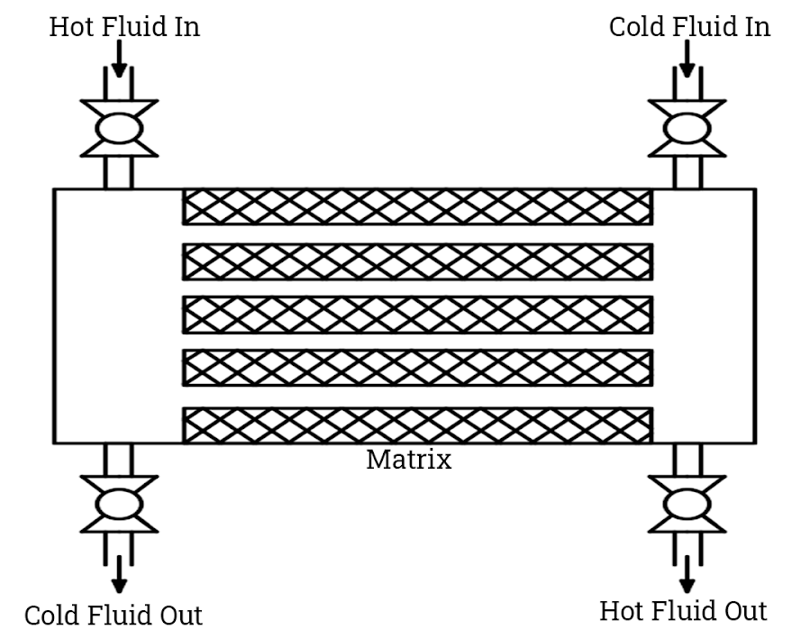
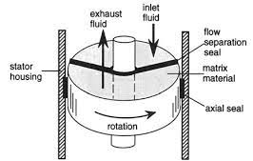
Classification 1
Regenerative Heat Exchangers
With regenerative, or storage, type devices the same flow chamber (matrix) is alternately occupied by the hot and cold fluid so heat transfer occurs indirectly via the matrix material
Static
Dynamic (Rotary)
EX3030/EM40JN

Slide 6
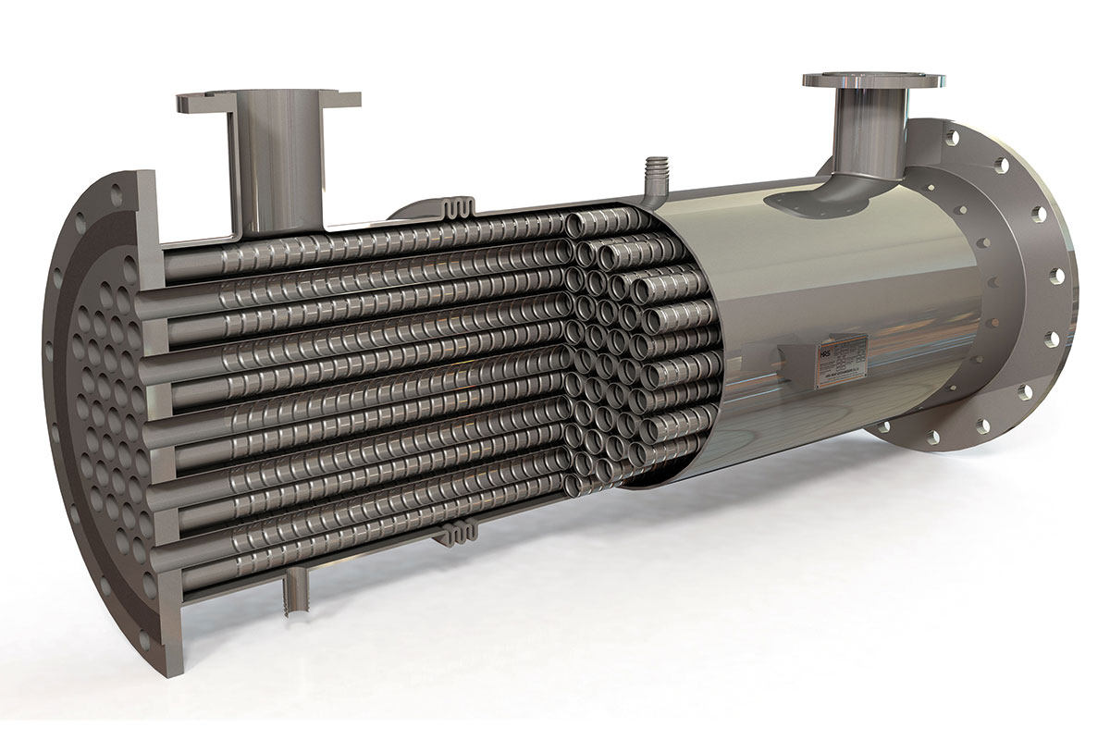
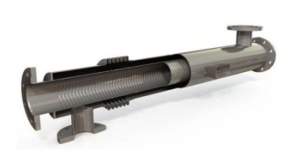
Classification 2
Recuperative Heat Exchangers
With recuperative devices, heat transfer occurs between different fluid streams through a separating surface such as a pipe wall – ideally no mixing or leaking of fluids too
Shell-and-tube type
Concentric (double) tube type
EX3030/EM40JN

Slide 7
Classification 3
Additional classification criteria
Heat exchangers are also commonly classified according to the following main criteria:
number of fluids (e.g. 2-fluid, 3-fluid, n-fluid);
transfer processes (e.g. direct versus indirect contact types);
heat transfer mechanisms (e.g. combined convective & radiative heat transfer);
flow arrangements (e.g. single pass, multi-pass, cross-flow, parallel flow) and;
construction (e.g. tubular, plate-type, extended surface)
Given the introductory nature of this section, we will limit our focus to two-fluid systems (usually hot and cold-water streams), of double-pipe and shell-and-tube construction, with both single- and multi-pass configurations
EX3030/EM40JN

Slide 8
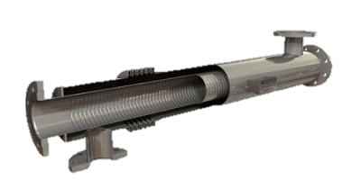
Double-Pipe Heat Exchangers
Parallel flow
Counter flow
T
T
Cold out
Cold in
Hot in
Hot out
Hot in
Hot out
Cold in
Cold out
EX3030/EM40JN

Slide 9
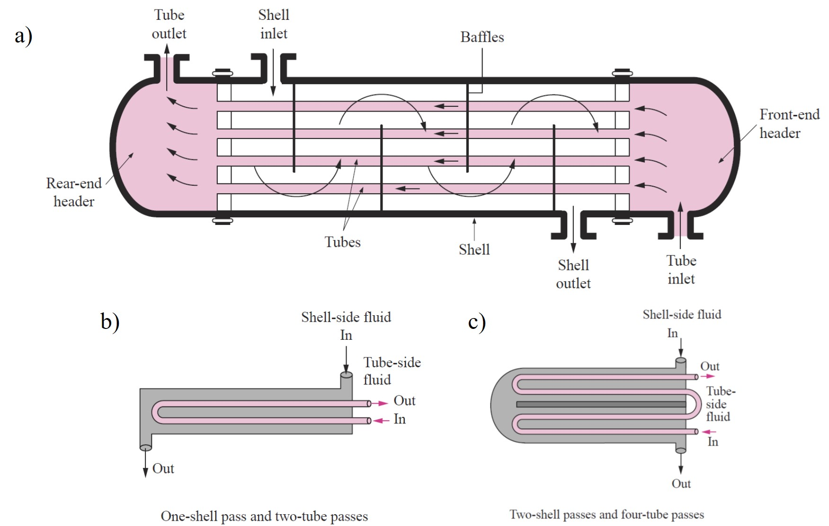
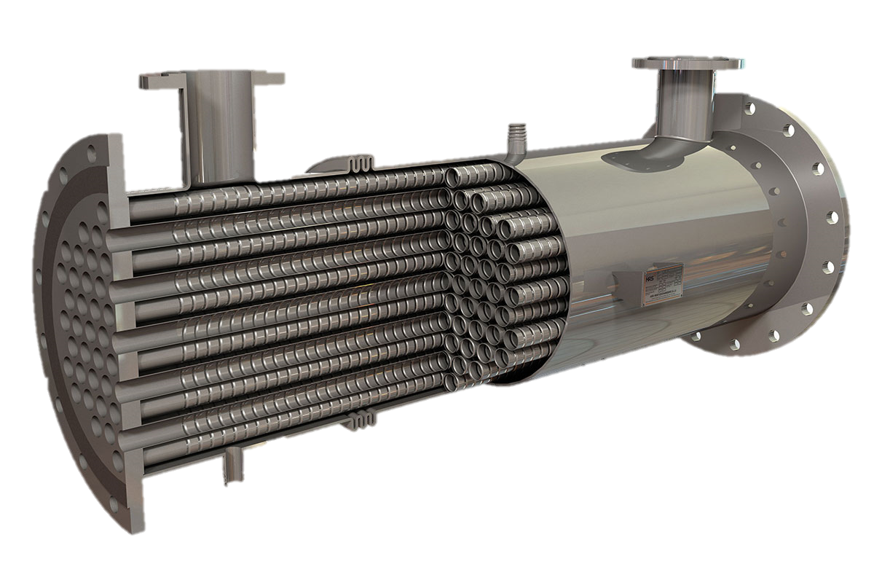
Shell-and-Tube Heat Exchangers
EX3030/EM40JN

Slide 10
Recuperative Heat Exchangers
Video
https://www.google.com/search?q=shell+and+tube+heat+exchanger&rlz=1C1CHBD_en-GBGB889GB889&source=lnms&tbm=vid&sa=X&ved=2ahUKEwiJrYjN5Zz7AhVXQEEAHdvmD4YQ_AUoA3oECAEQBQ&biw=1920&bih=961&dpr=1#fpstate=ive&vld=cid:0de5d024,vid:8rGLrhVeZvw
EX3030/EM40JN

Slide 11
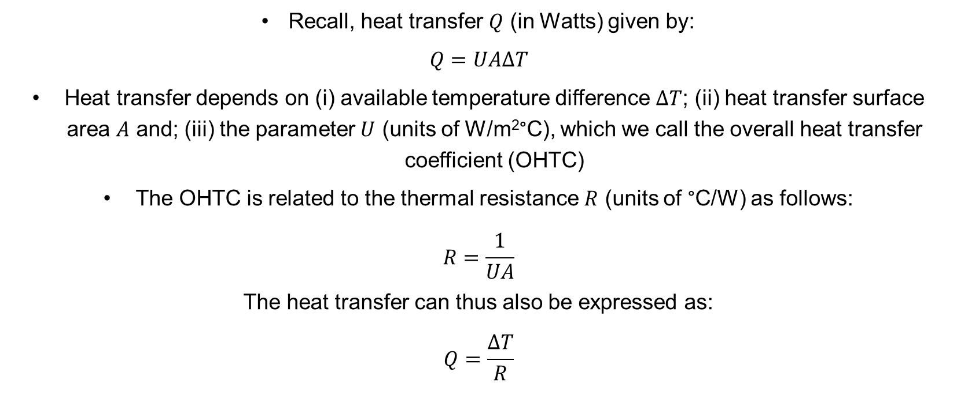
Overall Heat Transfer Coefficient
Overall Heat Transfer Coefficient (OHTC)
Recall, heat transfer $Q$ (in Watts) given by:
$$Q=UAΔT$$
Heat transfer depends on (i) available temperature difference $ΔT$; (ii) heat transfer surface area $A$ and; (iii) the parameter $U$ (units of W/m²°C), which we call the overall heat transfer coefficient (OHTC)
The OHTC is related to the thermal resistance $R$ (units of °C/W) as follows:
$$R=\frac{1}{UA}$$
The heat transfer can thus also be expressed as:
$$Q=\frac{ΔT}{R}$$
EX3030/EM40JN

Slide 12
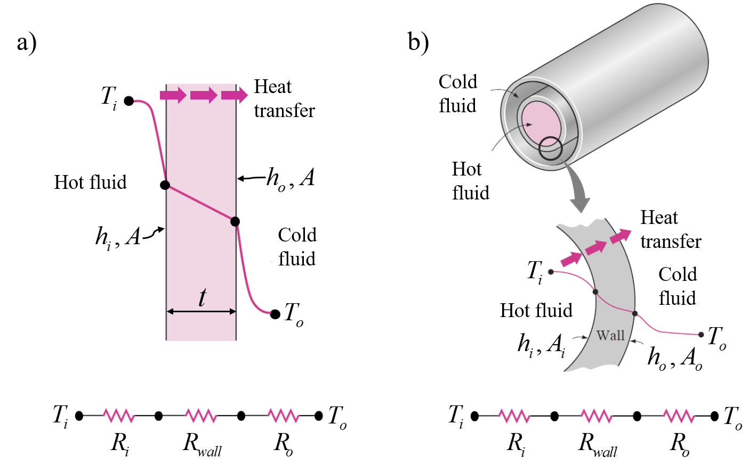
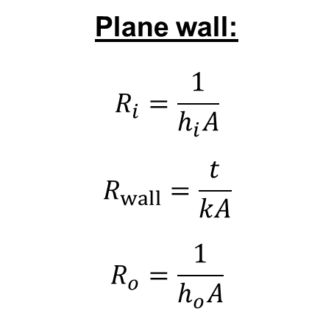
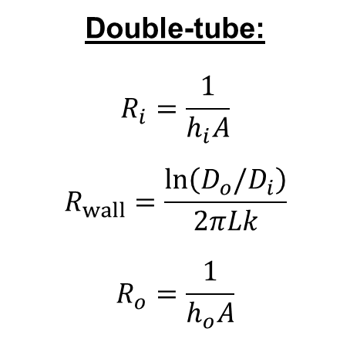
Thermal Resistance
Two cases of interest (i) plane wall and; (ii) concentric tube
Plane wall:
$$R_{i}=\frac{1}{h_{i}A}$$
$$R_{wall}=\frac{t}{kA}$$
$$R_{o}=\frac{1}{h_{o}A}$$
Double-tube:
$$R_{i}=\frac{1}{h_{i}A}$$
$$R_{wall}=\frac{\ln\left(D_{o}/D_{i}\right)}{2πLk}$$
$$R_{o}=\frac{1}{h_{o}A}$$
Combined total thermal resistance:
$$R_{T}=R_{i}+R_{wall}+R_{o}$$
EX3030/EM40JN

Slide 13
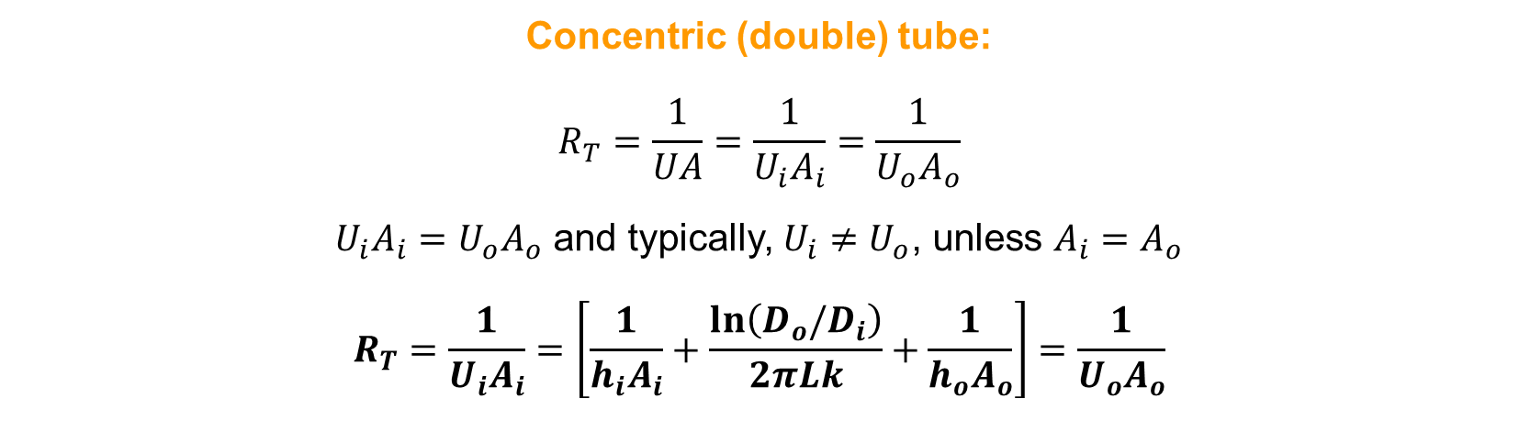

Calculating OHTC
Concentric (double) tube:
$$R_{T}=\frac{1}{UA}=\frac{1}{U_{i}A_{i}}=\frac{1}{U_{o}A_{o}}$$
$U_{i}A_{i}=U_{o}A_{o}$ and typically, $U_{i}≠U_{o}$, unless $A_{i}=A_{o}$
$$R_{T}=\frac{1}{U_{i}A_{i}}=\left[\frac{1}{h_{i}A_{i}}+\frac{ln\left(D_{o}/D_{i}\right)}{2πLk}+\frac{1}{h_{o}A_{o}}\right]=\frac{1}{U_{o}A_{o}}$$
Plane wall:
For plane wall, $A_{i}=A_{o}=A$, therefore:
$$\frac{1}{U}=\left[\frac{1}{h_{i}}+\frac{t}{k}+\frac{1}{h_{o}}\right]$$
EX3030/EM40JN

Slide 14
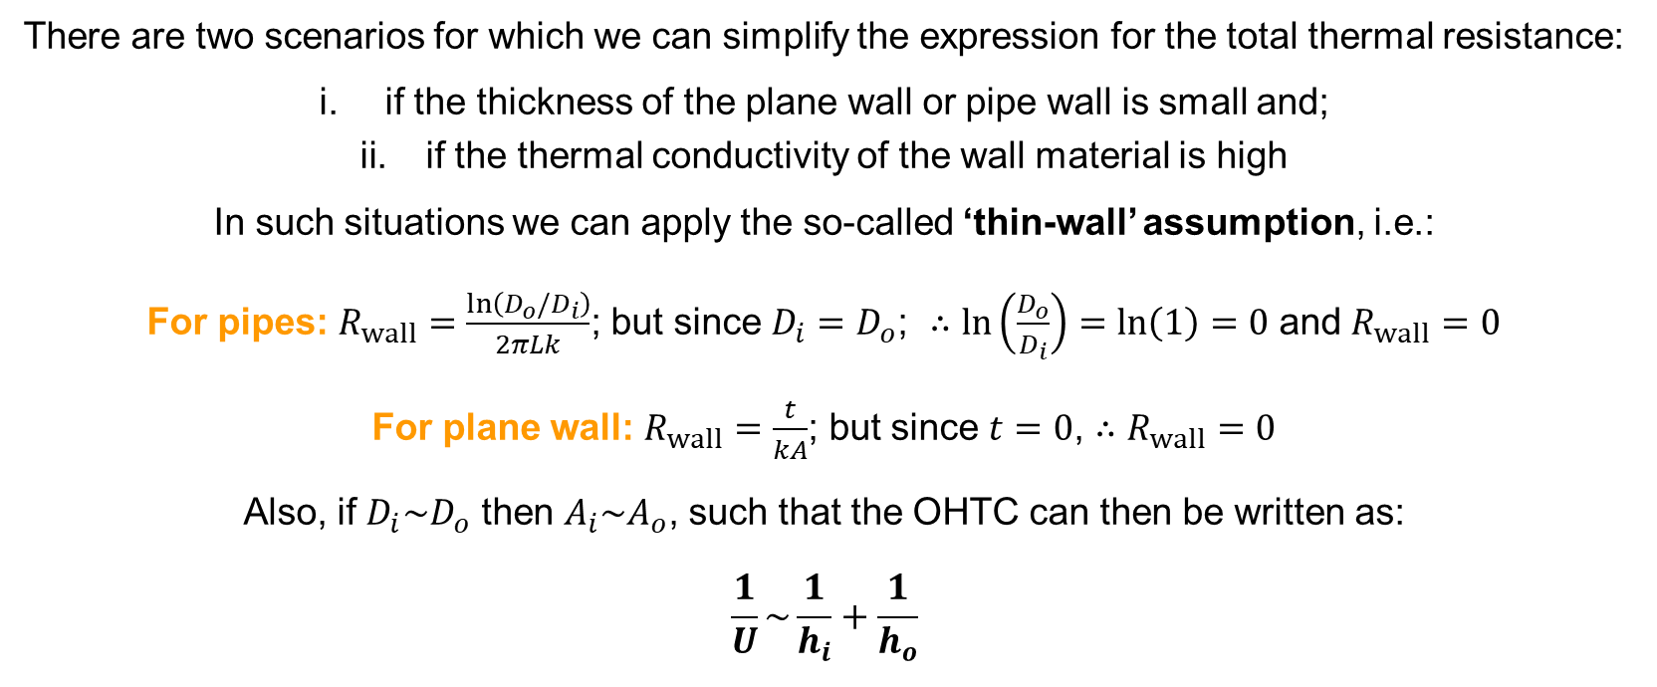
‘Thin-wall’ Assumption
There are two scenarios for which we can simplify the expression for the total thermal resistance:
if the thickness of the plane wall or pipe wall is small and;
if the thermal conductivity of the wall material is high
In such situations we can apply the so-called ‘thin-wall’ assumption, i.e.:
For pipes: $R_{wall}=\frac{\ln\left(D_{o}/D_{i}\right)}{2πLk}$; but since $D_{i}=D_{o}$; $∴\ln\left(\frac{D_{o}}{D_{i}}\right)=\ln\left(1\right)=0$ and $R_{wall}=0$
For plane wall: $R_{wall}=\frac{t}{kA}$; but since $t=0$, $∴R_{wall}=0$
Also, if $D_{i}\sim D_{o}$ then $A_{i}\sim A_{o}$, such that the OHTC can then be written as:
$$\frac{1}{U}\sim \frac{1}{h_{i}}+\frac{1}{h_{o}}$$
EX3030/EM40JN

Slide 15
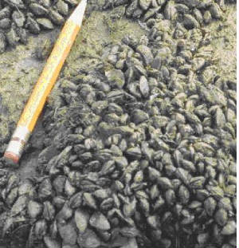
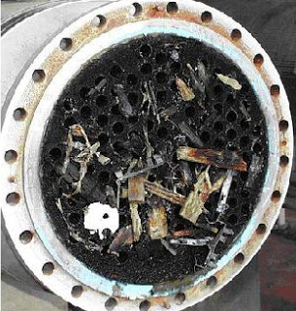
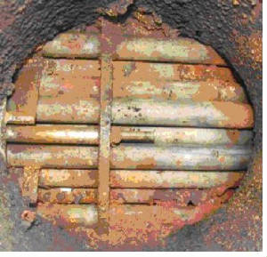
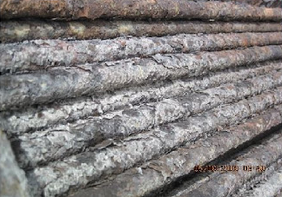
Fouling in Heat Exchangers
Four types of fouling:
Biological:
Sedimentation:
Corrosion:
Crystallisation:
EX3030/EM40JN

Slide 16
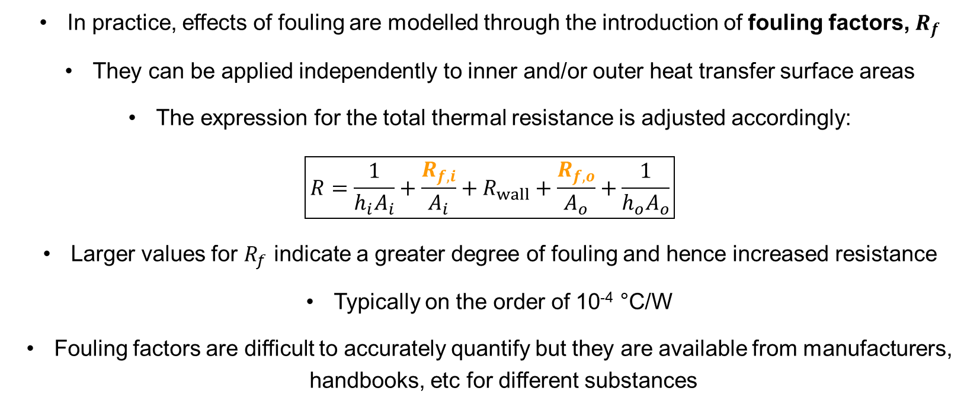
Fouling Factors
In practice, effects of fouling are modelled through the introduction of fouling factors, $R_{f}$
They can be applied independently to inner and/or outer heat transfer surface areas
The expression for the total thermal resistance is adjusted accordingly:
$$\boxed{R=\frac{1}{h_{i}A_{i}}+\frac{R_{f,i}}{A_{i}}+R_{wall}+\frac{R_{f,o}}{A_{o}}+\frac{1}{h_{o}A_{o}}}$$
Larger values for $R_{f}$ indicate a greater degree of fouling and hence increased resistance
Typically on the order of 10⁻⁴ °C/W
Fouling factors are difficult to accurately quantify but they are available from manufacturers, handbooks, etc for different substances
EX3030/EM40JN
Notes:
Can make the pipe wall thickness larger to simulate effects of fouling – if values are uncertain or unknown

Slide 17
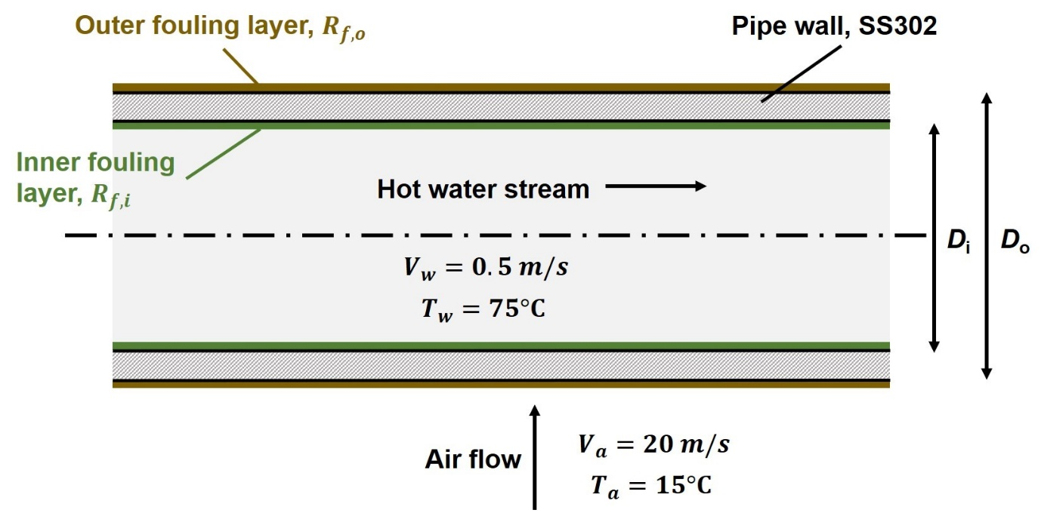
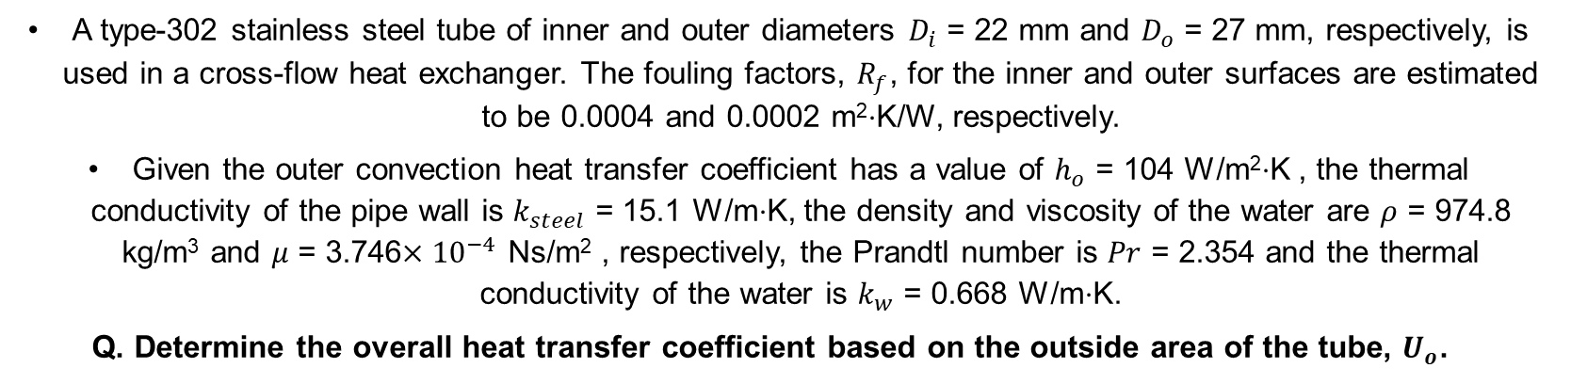
Worked Example
A type-302 stainless steel tube of inner and outer diameters $D_{i}$ = 22 mm and $D_{o}$ = 27 mm, respectively, is used in a cross-flow heat exchanger. The fouling factors, $R_{f}$, for the inner and outer surfaces are estimated to be 0.0004 and 0.0002 m²$⋅$K/W, respectively.
Given the outer convection heat transfer coefficient has a value of $h_{o}$ = 104 W/m²$⋅$K , the thermal conductivity of the pipe wall is $k_{steel}$ = 15.1 W/m$⋅$K, the density and viscosity of the water are $ρ$ = 974.8 kg/m³ and $μ$ = 3.746$×{10}^{−4}$ Ns/m² , respectively, the Prandtl number is $Pr$ = 2.354 and the thermal conductivity of the water is $k_{w}$ = 0.668 W/m$⋅$K.
Q. Determine the overall heat transfer coefficient based on the outside area of the tube, $U_{o}$.
EX3030/EM40JN

Slide 18
Summary
Summary of heat exchanger classification and the OHTC
We’ve started to get a sense of the variety and ubiquity of heat exchangers
We’ve seen some of the ways that they can be classified
Two popular configurations are concentric (double) tube and shell-and-tube
For these configurations we have demonstrated how to estimate their overall heat transfer coefficient
We’ve also seen how we can account for factors such as fouling in our estimates and how we can apply simplifying assumptions when the wall thickness of our heat exchanger is small
In the next part of the course we’ll look in more depth at the analysis of heat exchangers using the LMTD and effectiveness-NTU methods
EX3030/EM40JN

Slide 19
Thanks for your attention
EX3030/EM40JN

