Slide 1

EX3030/EM4012 Heat, Mass and Momentum Transfer Heat Exchangers 2
Originally by Dr Mark Stewart
Presented by Dr M. Bannerman

Slide 2
Week 8 Content
Content
Types and classifications of heat exchangers
Overall heat transfer coefficient (OHTC)
Analysis of heat exchangers
Log Mean Temperature Difference (LMTD) method
Effectiveness-NTU method
EX3030/EM40JN

Slide 3
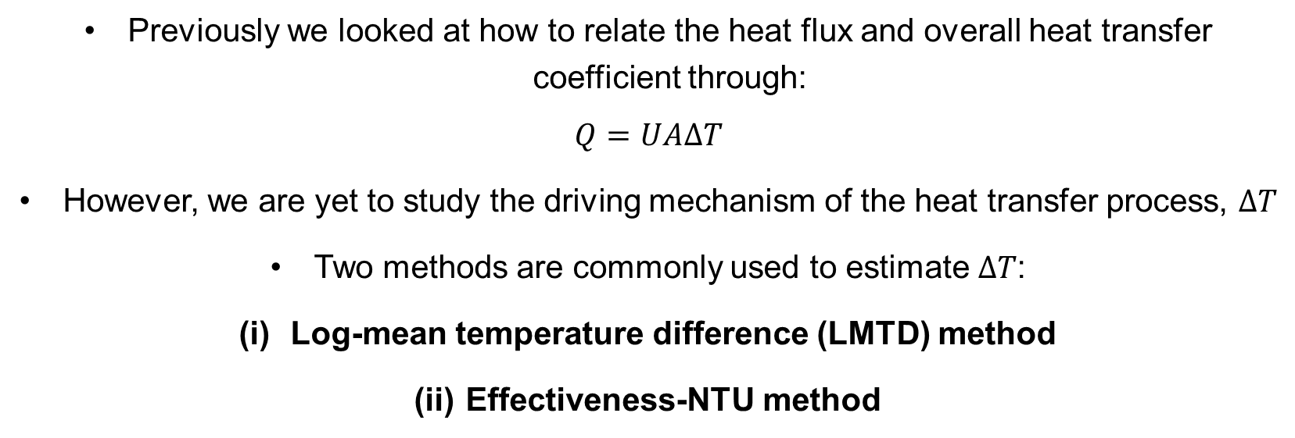
Heat Exchanger Analysis
Introduction
Previously we looked at how to relate the heat flux and overall heat transfer coefficient through:
$$Q=UAΔT$$
However, we are yet to study the driving mechanism of the heat transfer process, $ΔT$
Two methods are commonly used to estimate $ΔT$:
Log-mean temperature difference (LMTD) method
Effectiveness-NTU method
EX3030/EM40JN

Slide 4
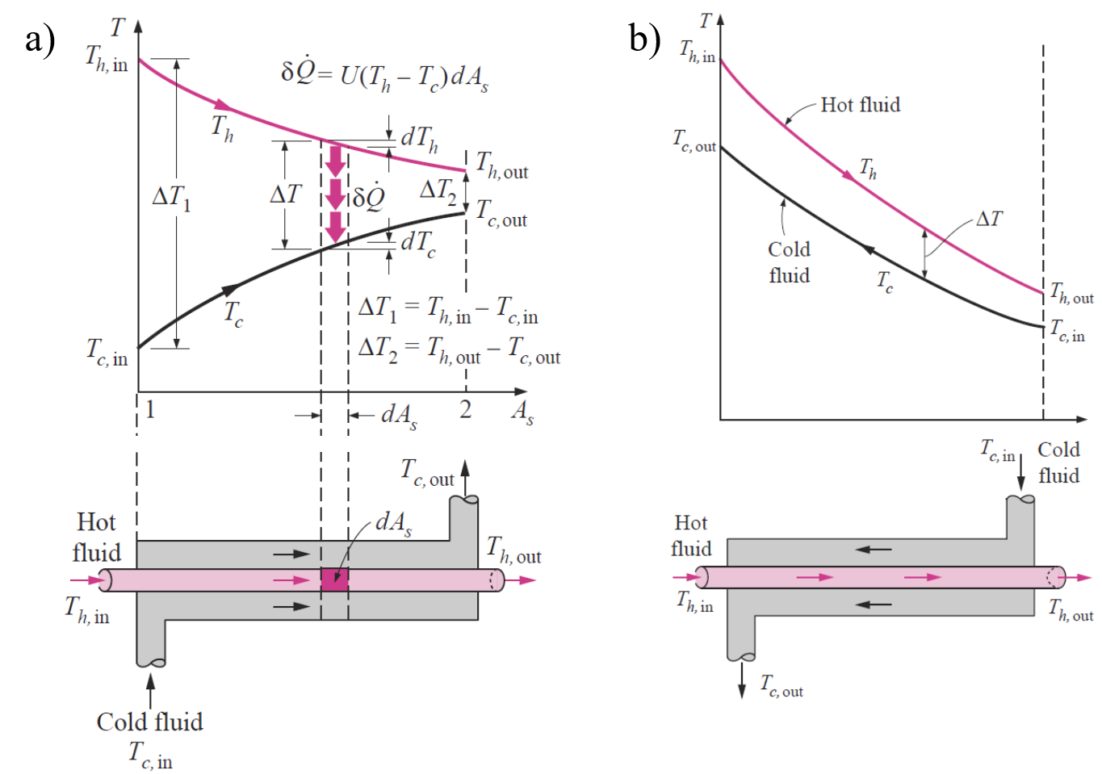
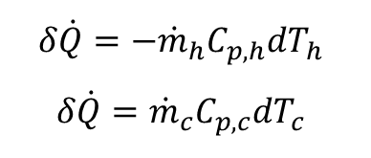
LMTD Method
Temperature variation along the heat exchanger
Parallel-flow
Counter-flow
$$δ\dot{Q}=−{\dot{m}}_{h}C_{p,h}dT_{h}$$
$$δ\dot{Q}={\dot{m}}_{c}C_{p,c}dT_{c}$$
EX3030/EM40JN

Slide 5
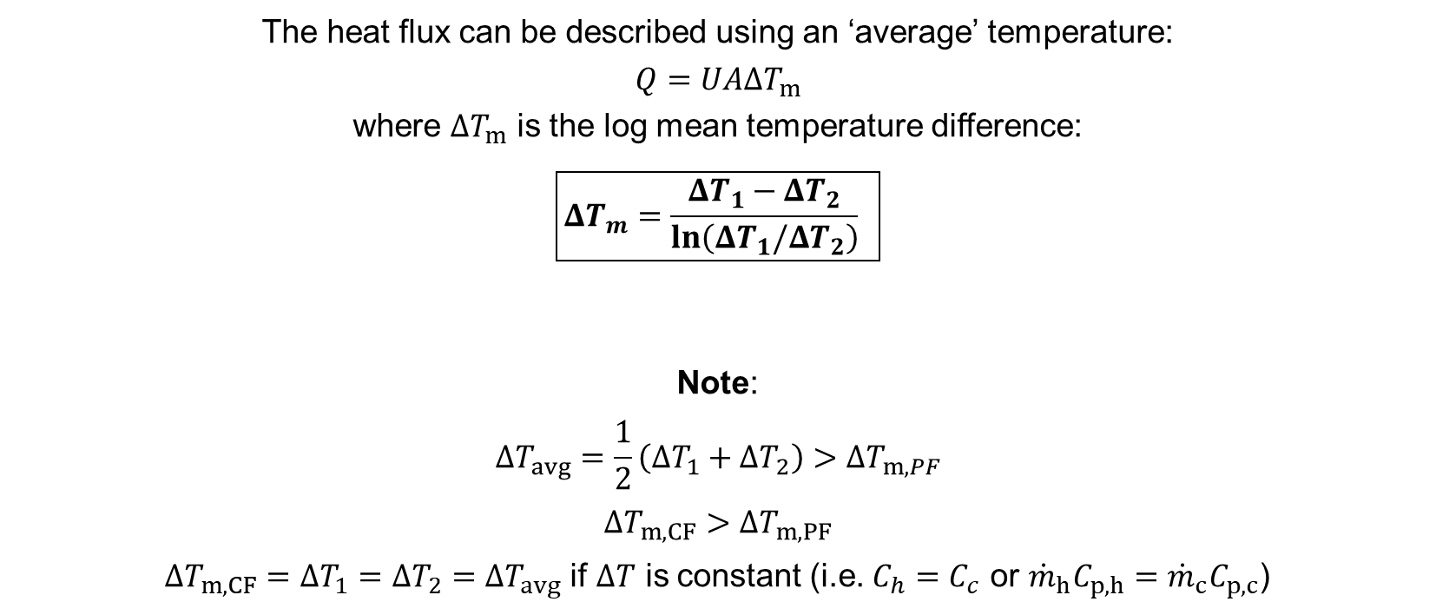
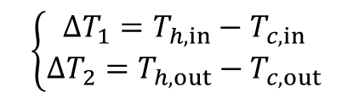
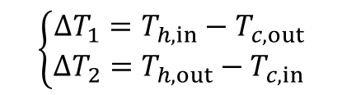
LMTD Method
Governing equations:
The heat flux can be described using an ‘average’ temperature:
$$Q=UAΔT_{m}$$
where $ΔT_{m}$ is the log mean temperature difference:
$$\boxed{ΔT_{m}=\frac{ΔT_{1}−ΔT_{2}}{\ln\left(ΔT_{1}/ΔT_{2}\right)} }$$
Note:
$$ΔT_{avg}=\frac{1}{2}\left(ΔT_{1}+ΔT_{2}\right)>ΔT_{m,PF}$$
$$ΔT_{m,CF}>ΔT_{m,PF}$$
$ΔT_{m,CF}=ΔT_{1}=ΔT_{2}=ΔT_{avg}$ if $ΔT$ is constant (i.e. $C_{h}=C_{c}$ or ${\dot{m}}_{h}C_{p,h}={\dot{m}}_{c}C_{p,c}$)
Parallel:
Counter-flow:
$$\left\{\begin{matrix}ΔT_{1}=T_{h,in}−T_{c,in} \\ ΔT_{2}=T_{h,out}−T_{c,out}\end{matrix}\right.$$
$$\left\{\begin{matrix}ΔT_{1}=T_{h,in}−T_{c,out} \\ ΔT_{2}=T_{h,out}−T_{c,in}\end{matrix}\right.$$
EX3030/EM40JN

Slide 6
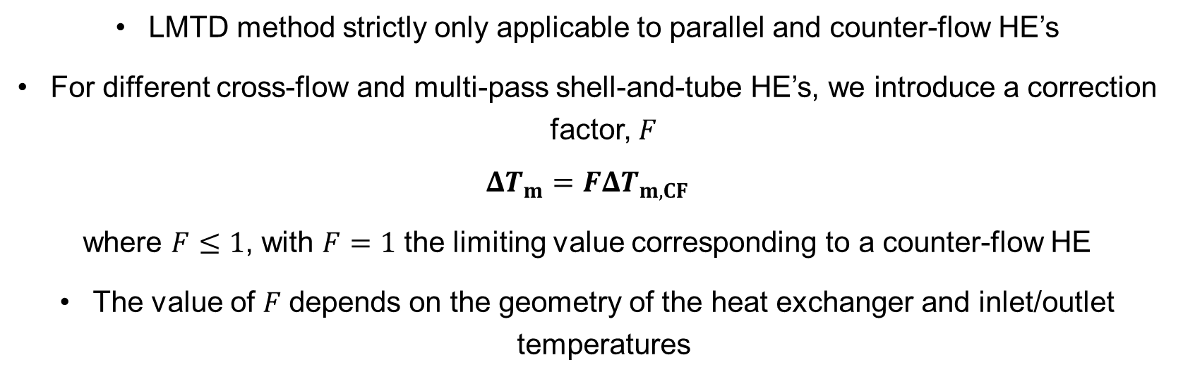
LMTD Method
Correction factor:
LMTD method strictly only applicable to parallel and counter-flow HE’s
For different cross-flow and multi-pass shell-and-tube HE’s, we introduce a correction factor, $F$
$$ΔT_{m}=FΔT_{m,CF}$$
where $F≤1$, with $F=1$ the limiting value corresponding to a counter-flow HE
The value of $F$ depends on the geometry of the heat exchanger and inlet/outlet temperatures
EX3030/EM40JN

Slide 7
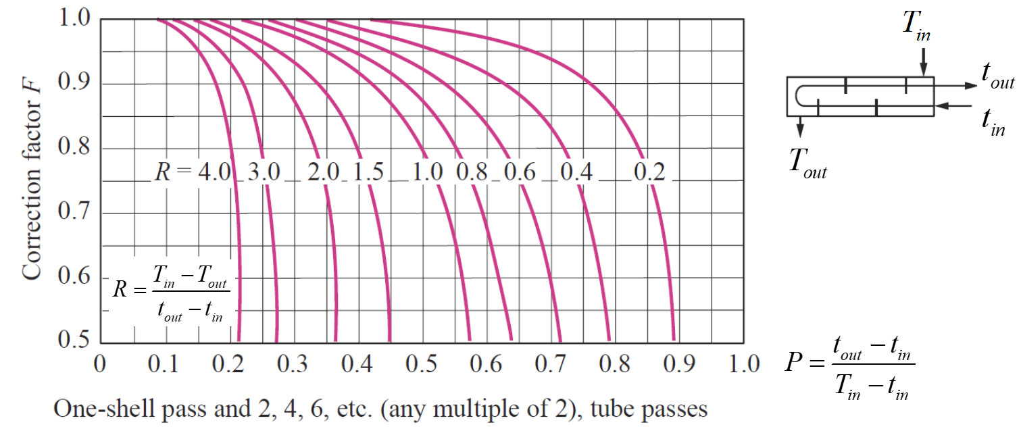
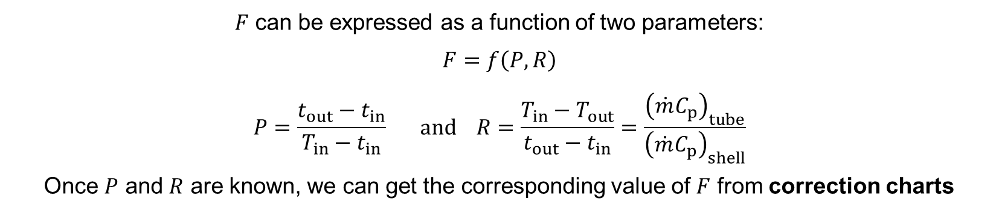
LMTD Method
Correction factor charts:
$F$ can be expressed as a function of two parameters:
$$F=f\left(P,R\right)$$
$$P=\frac{t_{out}−t_{in}}{T_{in}−t_{in}} and R=\frac{T_{in}−T_{out}}{t_{out}−t_{in}}=\frac{{\left(\dot{m}C_{p}\right)}_{tube}}{{\left(\dot{m}C_{p}\right)}_{shell}}$$
Once $P$ and $R$ are known, we can get the corresponding value of $F$ from correction charts
where
EX3030/EM40JN

Slide 8
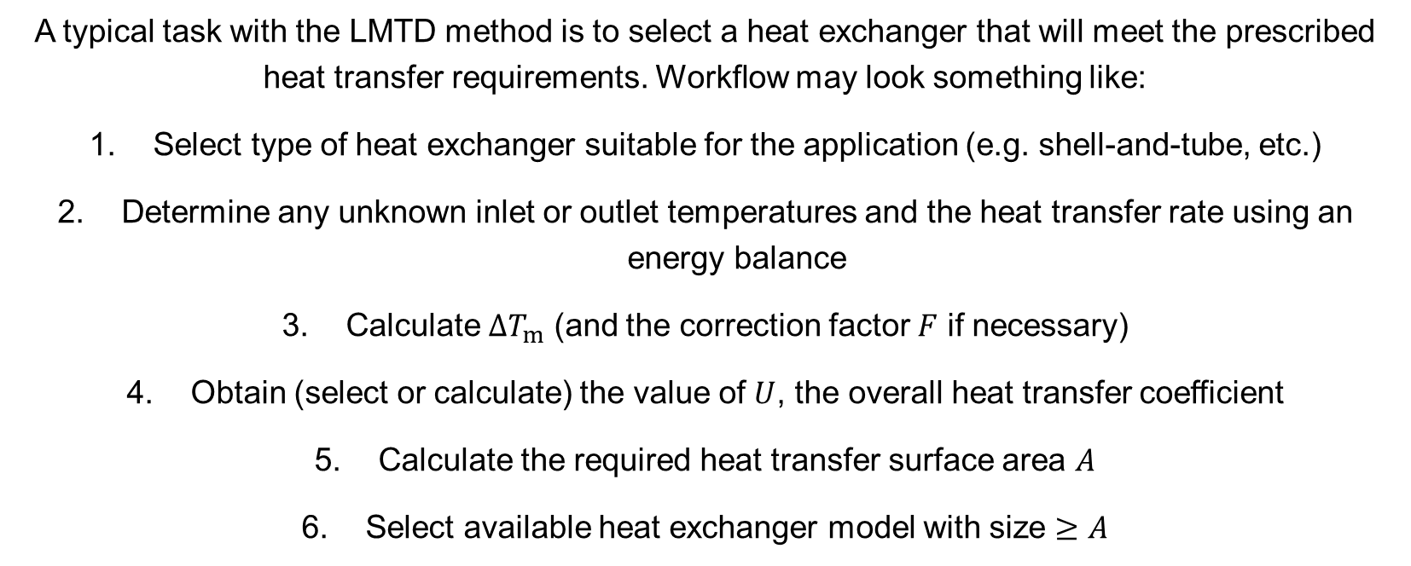
LMTD Method
Typical workflow for problems involving the LMTD method:
A typical task with the LMTD method is to select a heat exchanger that will meet the prescribed heat transfer requirements. Workflow may look something like:
Select type of heat exchanger suitable for the application (e.g. shell-and-tube, etc.)
Determine any unknown inlet or outlet temperatures and the heat transfer rate using an energy balance
Calculate $ΔT_{m}$ (and the correction factor $F$ if necessary)
Obtain (select or calculate) the value of $U$, the overall heat transfer coefficient
Calculate the required heat transfer surface area $A$
Select available heat exchanger model with size $≥$ $A$
EX3030/EM40JN

Slide 9
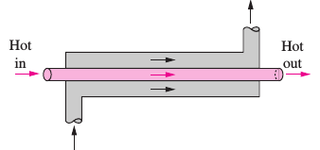
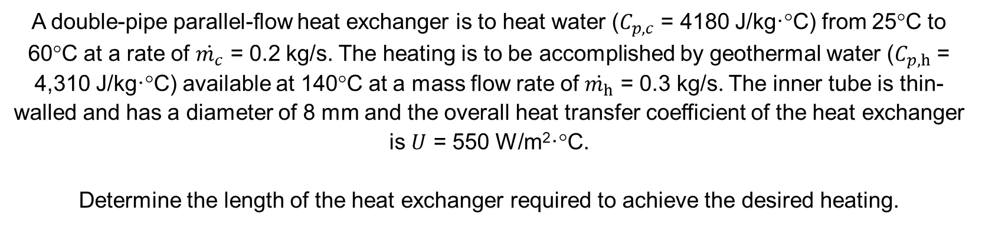
Worked Example 1
LMTD Method
A double-pipe parallel-flow heat exchanger is to heat water ($C_{p,c}$ = 4180 J/kg·°C) from 25°C to 60°C at a rate of $\dot{m_{c}}$ = 0.2 kg/s. The heating is to be accomplished by geothermal water ($C_{p,h}$ = 4,310 J/kg·°C) available at 140°C at a mass flow rate of $\dot{m_{h}}$ = 0.3 kg/s. The inner tube is thin-walled and has a diameter of 8 mm and the overall heat transfer coefficient of the heat exchanger is $U$ = 550 W/m²·°C.
Determine the length of the heat exchanger required to achieve the desired heating.
Cold out
Hot in
Hot out
Cold in
EX3030/EM40JN

Slide 10
ξ-NTU Method
Motivation behind the Effectiveness-NTU method:
LMTD method is straightforward to use when inlet/outlet temperatures are known
However, what if our task is to determine heat transfer rates and outlet temperatures for our hot/cold fluid streams when the heat exchanger type and size is already specified?
In this case, if the inlet/outlet temperatures are unknown then the LMTD method becomes iterative (and tedious)
The effectiveness-NTU method was developed by Kays and London in 1955 to help solve these types of problems
EX3030/EM40JN

Slide 11
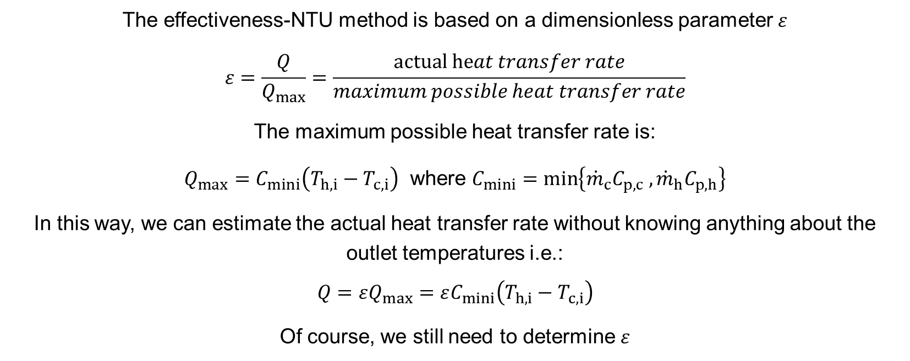
ξ-NTU Method
Heat transfer effectiveness:
The effectiveness-NTU method is based on a dimensionless parameter $ε$
$$ε=\frac{Q}{Q_{max}}=\frac{actual heat transfer rate}{maximum possible heat transfer rate}$$
The maximum possible heat transfer rate is:
$Q_{max}=C_{mini}\left(T_{h,i}−T_{c,i}\right)$ where $C_{mini}=\min\left\{{\dot{m}}_{c}C_{p,c} , {\dot{m}}_{h}C_{p,h}\right\}$
In this way, we can estimate the actual heat transfer rate without knowing anything about the outlet temperatures i.e.:
$$Q=εQ_{max}=εC_{mini}\left(T_{h,i}−T_{c,i}\right)$$
Of course, we still need to determine $ε$
EX3030/EM40JN

Slide 12
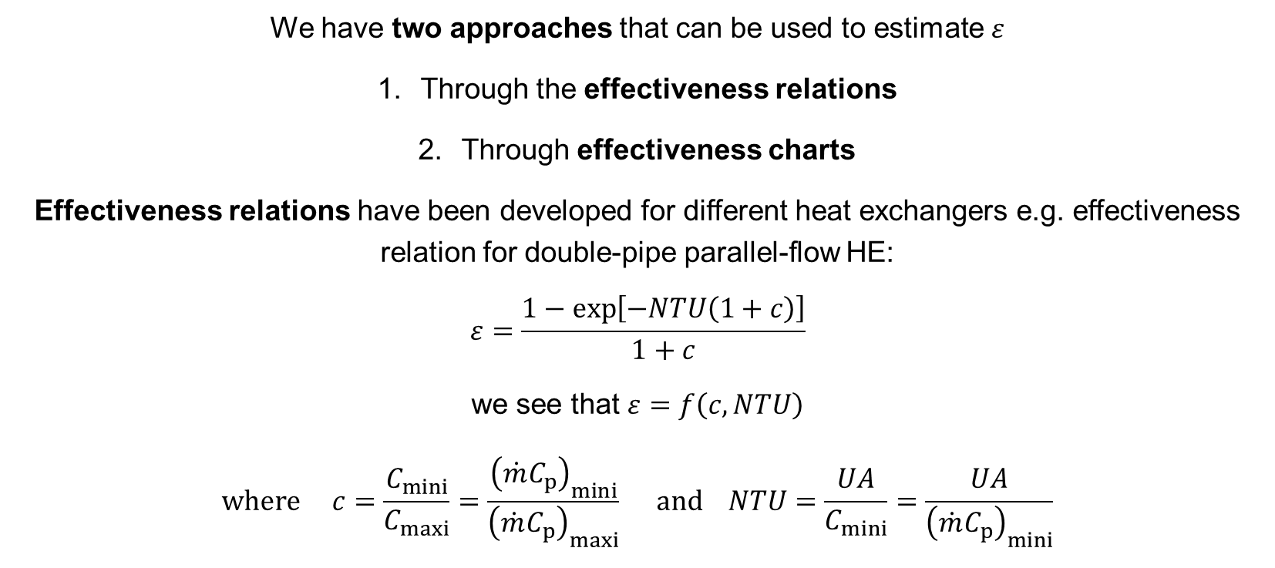
ξ-NTU Method
Estimating heat transfer effectiveness:
We have two approaches that can be used to estimate $ε$
Through the effectiveness relations
Through effectiveness charts
Effectiveness relations have been developed for different heat exchangers e.g. effectiveness relation for double-pipe parallel-flow HE:
$$ε=\frac{1−exp\left[−NTU\left(1+c\right)\right]}{1+c}$$
we see that $ε=f\left(c, NTU\right)$
$$where c=\frac{C_{mini}}{C_{maxi}}=\frac{{\left(\dot{m}C_{p}\right)}_{mini}}{{\left(\dot{m}C_{p}\right)}_{maxi}} and NTU=\frac{UA}{C_{mini}}=\frac{UA}{{\left(\dot{m}C_{p}\right)}_{mini}}$$
EX3030/EM40JN

Slide 13
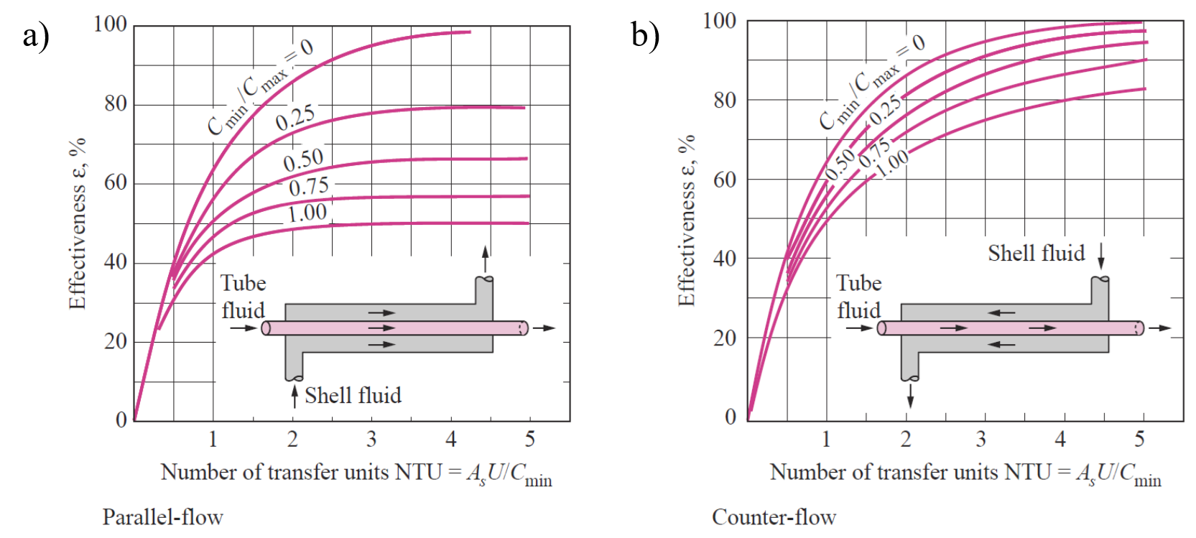
ξ-NTU Method
Effectiveness charts:
Second approach for estimating $ε$ is through the effectiveness charts:
EX3030/EM40JN

Slide 14
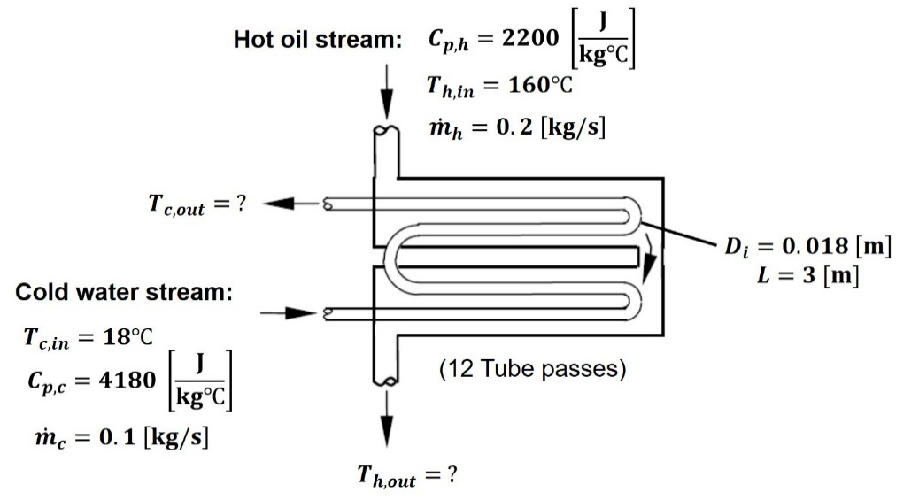
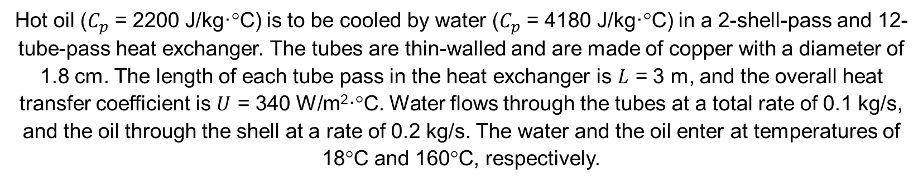
Worked Example 2
Effectiveness-NTU Method
Hot oil ($C_{p}$ = 2200 J/kg·°C) is to be cooled by water ($C_{p}$ = 4180 J/kg·°C) in a 2-shell-pass and 12-tube-pass heat exchanger. The tubes are thin-walled and are made of copper with a diameter of 1.8 cm. The length of each tube pass in the heat exchanger is $L$ = 3 m, and the overall heat transfer coefficient is $U$ = 340 W/m²·°C. Water flows through the tubes at a total rate of 0.1 kg/s, and the oil through the shell at a rate of 0.2 kg/s. The water and the oil enter at temperatures of 18°C and 160°C, respectively.
Objective:
Determine the rate of heat transfer in the heat exchanger and the outlet temperatures of the water and the oil
EX3030/EM40JN

Slide 15
Summary
Summary of week 8 on heat exchangers
We’ve started to get a sense of the variety and ubiquity of heat exchangers and some of the ways that they can be classified
Two popular configurations are concentric (double) tube and shell-and-tube
For these configurations we have demonstrated how to estimate their overall heat transfer coefficient, including how to account for effects such as fouling or thin-walls
We’ve also seen how to apply two common methods to determine the temperature gradient and associated heat transfer within a given heat exchanger:
(i) the LMTD method is straightforward to apply when we know the values of all inlet and outlet temperatures
(ii) the effectiveness-NTU method is preferred for solving problems where we are missing information on either the inlet or outlet temperatures
EX3030/EM40JN

Slide 16
Thanks for your attention
EX3030/EM40JN

