Slide 1

EX3030/EM4012 Heat, Mass and Momentum Transfer Heat Exchangers 2
Originally by Dr Mark Stewart
Presented by Dr M. Bannerman

Slide 2
Week 8 Content
Content
Types and classifications of heat exchangers
Overall heat transfer coefficient (OHTC)
Analysis of heat exchangers
Log Mean Temperature Difference (LMTD) method
Effectiveness-NTU method
EX3030/EM40JN

Slide 3
Heat Exchanger Analysis
Introduction
Previously we looked at how to relate the heat flux and overall heat transfer coefficient through:
$$Q=UAΔT$$
However, we are yet to study the driving mechanism of the heat transfer process, $$ΔT$$
Two methods are commonly used to estimate $$ΔT$$:
Log-mean temperature difference (LMTD) method
Effectiveness-NTU method
EX3030/EM40JN

Slide 4
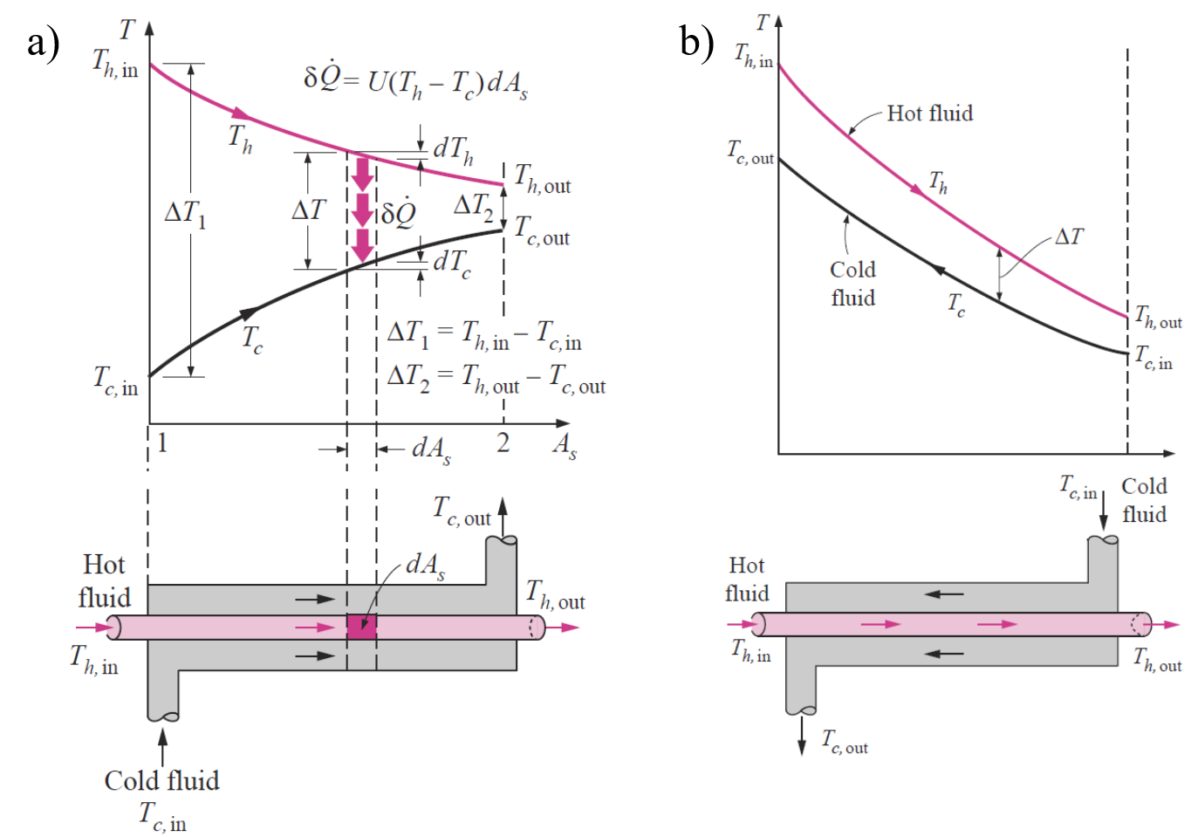
LMTD Method
Temperature variation along the heat exchanger
Parallel-flow
Counter-flow
$$δ\dot{Q}=−{\dot{m}}_{h}C_{p,h}dT_{h}$$
$$δ\dot{Q}={\dot{m}}_{c}C_{p,c}dT_{c}$$
EX3030/EM40JN

Slide 5
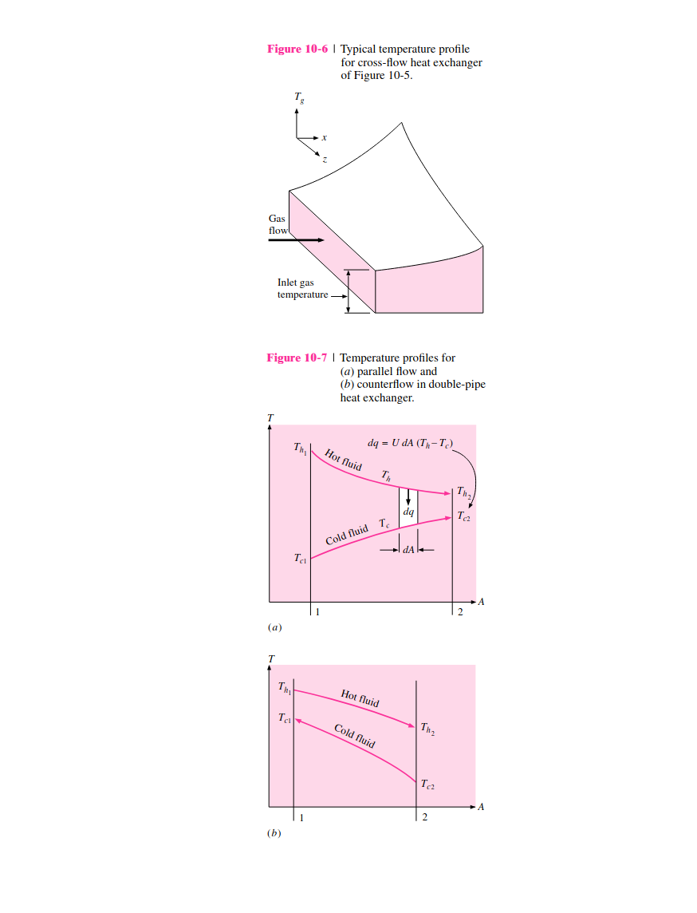
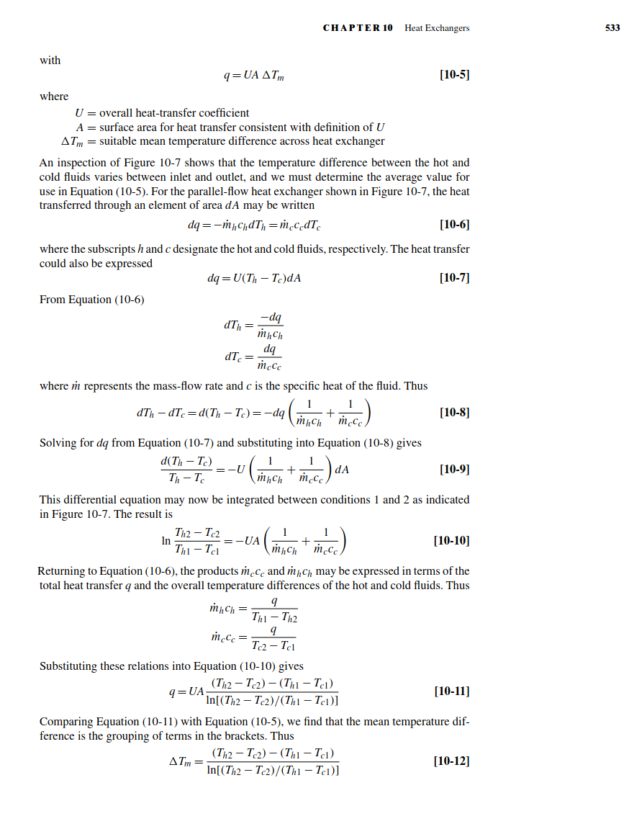
Derivation from JP Holman

Slide 6
LMTD Method
Governing equations:
The heat flux can be described using an ‘average’ temperature:
$$Q=UAΔT_{m}$$
where $$ΔT_{m}$$ is the log mean temperature difference:
$$\boxed{ΔT_{m}=\frac{ΔT_{1}−ΔT_{2}}{\ln\left(ΔT_{1}/ΔT_{2}\right)} }$$
Note:
$$ΔT_{avg}=\frac{1}{2}\left(ΔT_{1}+ΔT_{2}\right)>ΔT_{m,PF}$$
$$ΔT_{m,CF}>ΔT_{m,PF}$$
$$ΔT_{m,CF}=ΔT_{1}=ΔT_{2}=ΔT_{avg}$$ if $$ΔT$$ is constant (i.e. $$C_{h}=C_{c}$$ or $${\dot{m}}_{h}C_{p,h}={\dot{m}}_{c}C_{p,c}$$)
Parallel:
Counter-flow:
$$\left\{\begin{matrix}ΔT_{1}=T_{h,in}−T_{c,in} \\ ΔT_{2}=T_{h,out}−T_{c,out}\end{matrix}\right.$$
$$\left\{\begin{matrix}ΔT_{1}=T_{h,in}−T_{c,out} \\ ΔT_{2}=T_{h,out}−T_{c,in}\end{matrix}\right.$$
EX3030/EM40JN

Slide 7
LMTD Method
Correction factor:
LMTD method strictly only applicable to parallel and counter-flow HE’s
For different cross-flow and multi-pass shell-and-tube HE’s, we introduce a correction factor, $$F$$
$$ΔT_{m}=FΔT_{m,CF}$$
where $$F≤1$$, with $$F=1$$ the limiting value corresponding to a counter-flow HE
The value of $$F$$ depends on the geometry of the heat exchanger and inlet/outlet temperatures
EX3030/EM40JN

Slide 8
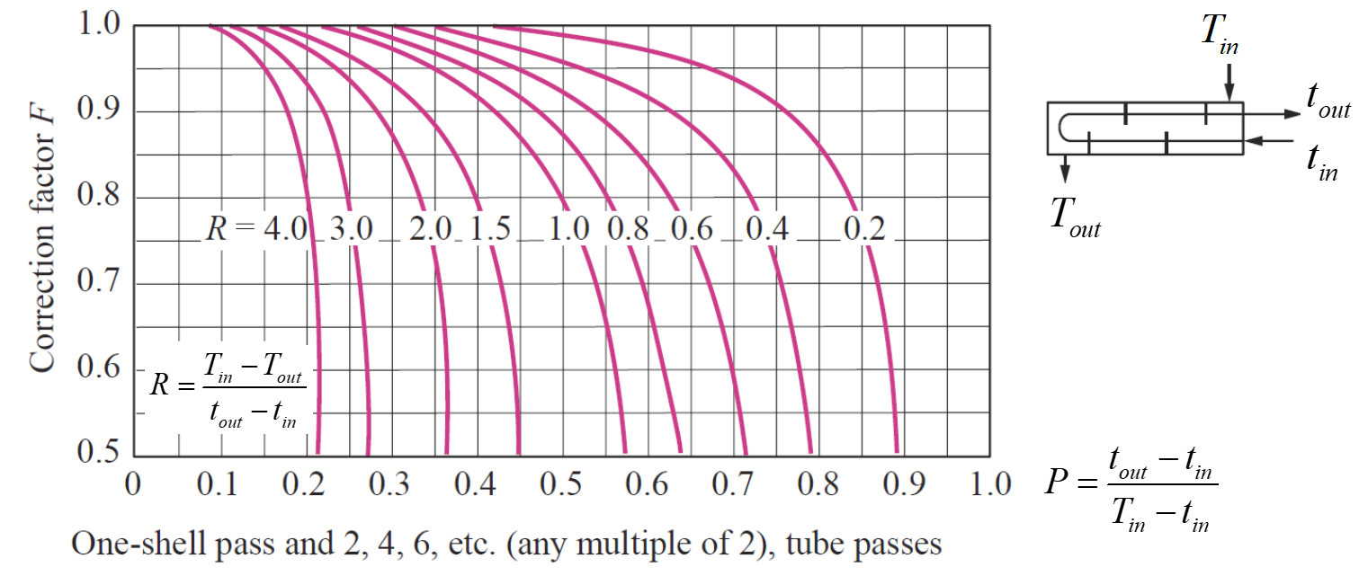
LMTD Method
Correction factor charts:
$$F$$ can be expressed as a function of two parameters:
$$F=f\left(P,R\right)$$
$$P=\frac{t_{out}−t_{in}}{T_{in}−t_{in}} and R=\frac{T_{in}−T_{out}}{t_{out}−t_{in}}=\frac{{\left(\dot{m}C_{p}\right)}_{tube}}{{\left(\dot{m}C_{p}\right)}_{shell}}$$
Once $$P$$ and $$R$$ are known, we can get the corresponding value of $$F$$ from correction charts
where
EX3030/EM40JN

Slide 9
LMTD Method
Typical workflow for problems involving the LMTD method:
A typical task with the LMTD method is to select a heat exchanger that will meet the prescribed heat transfer requirements. Workflow may look something like:
Select type of heat exchanger suitable for the application (e.g. shell-and-tube, etc.)
Determine any unknown inlet or outlet temperatures and the heat transfer rate using an energy balance
Calculate $$ΔT_{m}$$ (and the correction factor $$F$$ if necessary)
Obtain (select or calculate) the value of $$U$$, the overall heat transfer coefficient
Calculate the required heat transfer surface area $$A$$
Select available heat exchanger model with size $$≥$$ $$A$$
EX3030/EM40JN

Slide 10
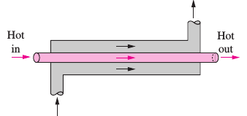
Worked Example 1
LMTD Method
A double-pipe parallel-flow heat exchanger is to heat water ($$C_{p,c}$$ = 4180 J/kg·°C) from 25°C to 60°C at a rate of $$\dot{m_{c}}$$ = 0.2 kg/s. The heating is to be accomplished by geothermal water ($$C_{p,h}$$ = 4,310 J/kg·°C) available at 140°C at a mass flow rate of $$\dot{m_{h}}$$ = 0.3 kg/s. The inner tube is thin-walled and has a diameter of 8 mm and the overall heat transfer coefficient of the heat exchanger is $$U$$ = 550 W/m²·°C.
Determine the length of the heat exchanger required to achieve the desired heating.
Cold out
Hot in
Hot out
Cold in
EX3030/EM40JN

Slide 11
Solution
See linked notes on site

Slide 12
ξ-NTU Method
Motivation behind the Effectiveness-NTU method:
LMTD method is straightforward to use when inlet/outlet temperatures are known
However, what if our task is to determine heat transfer rates and outlet temperatures for our hot/cold fluid streams when the heat exchanger type and size is already specified?
In this case, if the inlet/outlet temperatures are unknown then the LMTD method becomes iterative (and tedious)
The effectiveness-NTU method was developed by Kays and London in 1955 to help solve these types of problems
EX3030/EM40JN

Slide 13
ξ-NTU Method
Heat transfer effectiveness:
The effectiveness-NTU method is based on a dimensionless parameter $$ε$$
$$ε=\frac{Q}{Q_{max}}=\frac{actual heat transfer rate}{maximum possible heat transfer rate}$$
The maximum possible heat transfer rate (in an infinite counter-current exchanger):
$$Q_{max}=C_{mini}\left(T_{h,i}−T_{c,i}\right)$$ where $$C_{mini}=\min\left\{{\dot{m}}_{c}C_{p,c} , {\dot{m}}_{h}C_{p,h}\right\}$$
Minimum is used, as its the first stream to converge to the inlet that limits the process.
In this way, we can estimate the actual heat transfer rate without knowing anything about the outlet temperatures i.e.:
$$Q=εQ_{max}=εC_{mini}\left(T_{h,i}−T_{c,i}\right)$$
Of course, we still need to determine $$ε$$
EX3030/EM40JN

Slide 14
ξ-NTU Method
Estimating heat transfer effectiveness:
We have two approaches that can be used to estimate $$ε$$
Through the effectiveness relations
Through effectiveness charts
Effectiveness relations have been developed for different heat exchangers e.g. effectiveness relation for double-pipe parallel-flow HE:
$$ε=\frac{1−exp\left[−NTU\left(1+c\right)\right]}{1+c}$$
we see that $$ε=f\left(c, NTU\right)$$
$$where c=\frac{C_{mini}}{C_{maxi}}=\frac{{\left(\dot{m}C_{p}\right)}_{mini}}{{\left(\dot{m}C_{p}\right)}_{maxi}} and NTU=\frac{UA}{C_{mini}}=\frac{UA}{{\left(\dot{m}C_{p}\right)}_{mini}}$$
EX3030/EM40JN

Slide 15
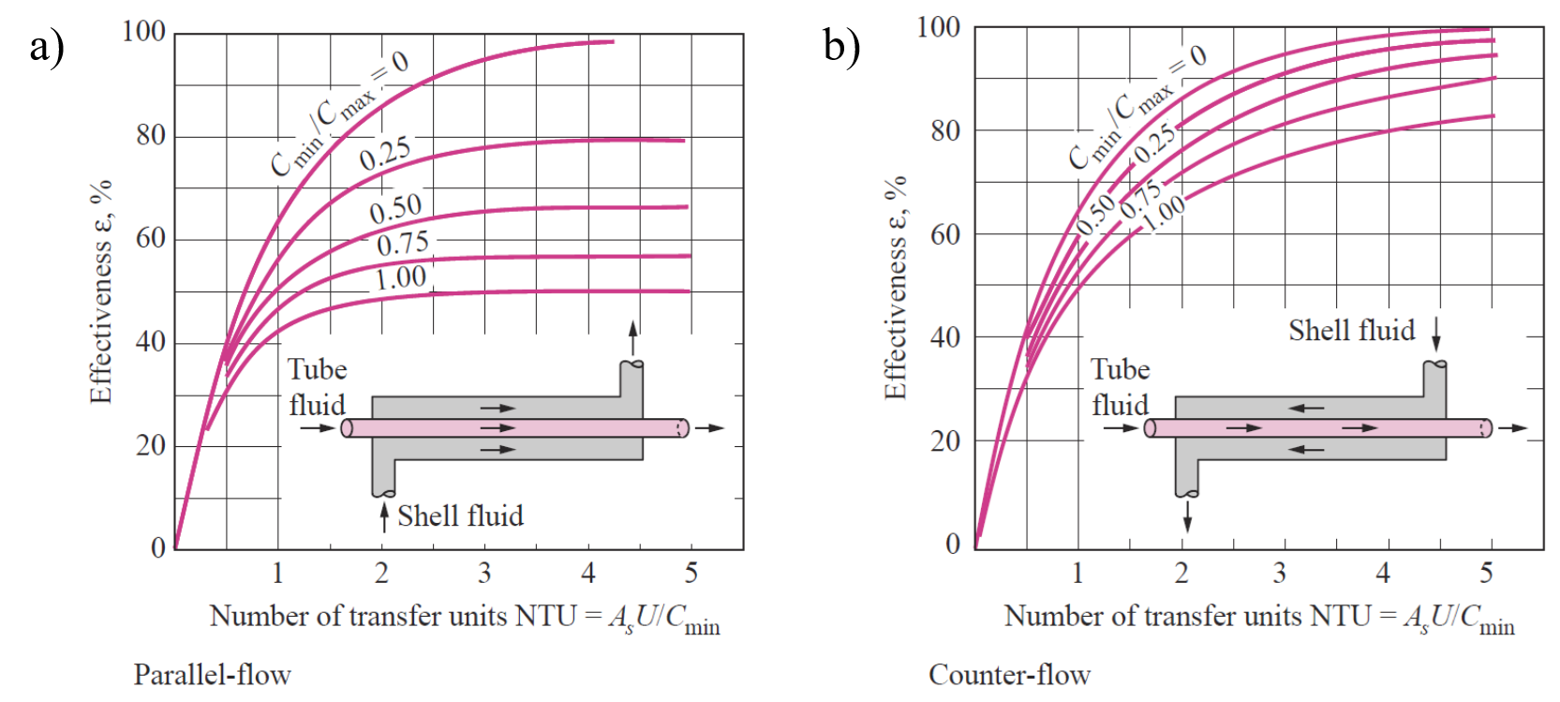
ξ-NTU Method
Effectiveness charts:
Second approach for estimating $$ε$$ is through the effectiveness charts:
EX3030/EM40JN

Slide 16
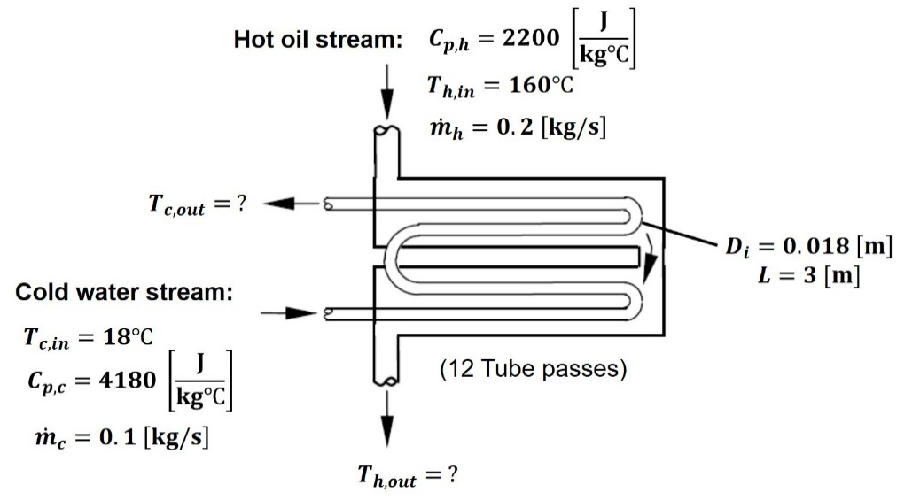
Worked Example 2
Effectiveness-NTU Method
Hot oil ($$C_{p}$$ = 2200 J/kg·°C) is to be cooled by water ($$C_{p}$$ = 4180 J/kg·°C) in a 2-shell-pass and 12-tube-pass heat exchanger. The tubes are thin-walled and are made of copper with a diameter of 1.8 cm. The length of each tube pass in the heat exchanger is $$L$$ = 3 m, and the overall heat transfer coefficient is $$U$$ = 340 W/m²·°C. Water flows through the tubes at a total rate of 0.1 kg/s, and the oil through the shell at a rate of 0.2 kg/s. The water and the oil enter at temperatures of 18°C and 160°C, respectively.
Objective:
Determine the rate of heat transfer in the heat exchanger and the outlet temperatures of the water and the oil
EX3030/EM40JN

Slide 17
Solution
See linked notes on site

Slide 18
Summary
Summary of week 8 on heat exchangers
We’ve started to get a sense of the variety and ubiquity of heat exchangers and some of the ways that they can be classified
Two popular configurations are concentric (double) tube and shell-and-tube
For these configurations we have demonstrated how to estimate their overall heat transfer coefficient, including how to account for effects such as fouling or thin-walls
We’ve also seen how to apply two common methods to determine the temperature gradient and associated heat transfer within a given heat exchanger:
(i) the LMTD method is straightforward to apply when we know the values of all inlet and outlet temperatures
(ii) the effectiveness-NTU method is preferred for solving problems where we are missing information on either the inlet or outlet temperatures
EX3030/EM40JN

Slide 19
Thanks for your attention
EX3030/EM40JN

