Slide 1

Machine Learning in Medicine: Hype and Reality
Tom Oates PhD MRCP
Royal London Hospital
@toates_19
toates19@gmail.com

Slide 2
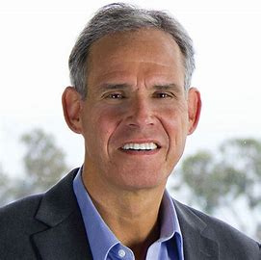

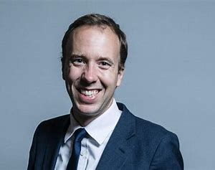
Notes:
Statistics draws population inferences from a sample, and machine learning finds generalizable predictive patterns

Slide 3
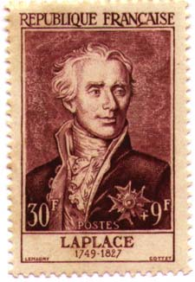
“An intellect which at a certain moment would know all forces that set nature in motion, and all positions of all items…were also vast enough to submit these data to analysis…nothing would be uncertain and the future just like the past would be present before its eyes”

Slide 4
“An intellect which at a certain moment would know all forces that set nature in motion, and all positions of all items…were also vast enough to submit these data to analysis…nothing would be uncertain and the future just like the past would be present before its eyes”
DATA + COMPUTATION = PREDICTION

Slide 5
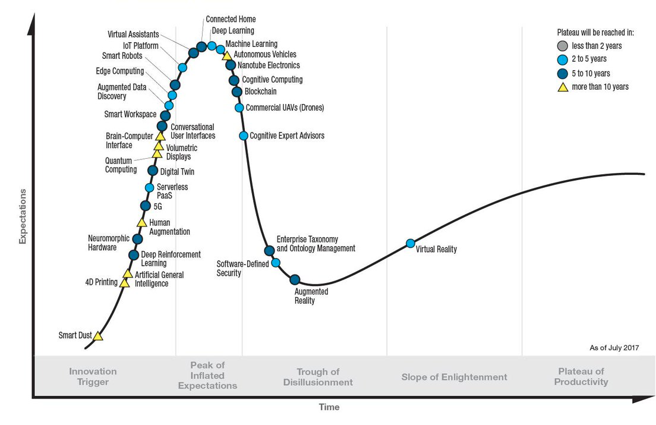
The Hype Cycle

Slide 6

Caution
Images of statistical concepts and light mathematics approaching
Viewers of a sensitive disposition are advised to proceed with caution

Slide 7
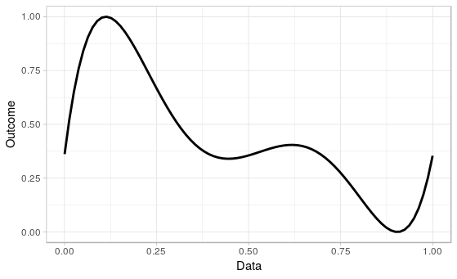
Machine Learning: An Extremely Brief Primer
Data is collected to examine relationships between predictors and outcomes

Slide 8
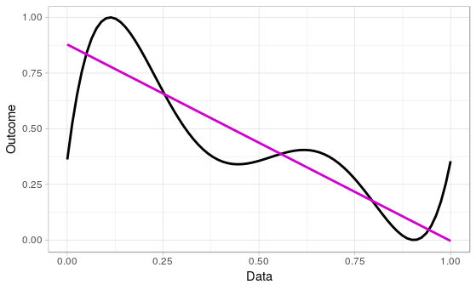
Machine Learning: An Extremely Brief Primer
Statistics
Build a project specific model
Compute measures of confidence in whether the discovered relationship is true

Slide 9
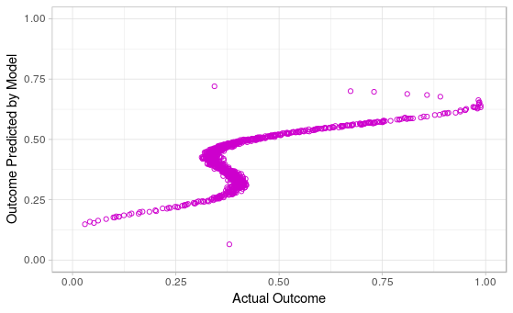
Machine Learning: An Extremely Brief Primer
Statistical inference may not be that good at prediction

Slide 10
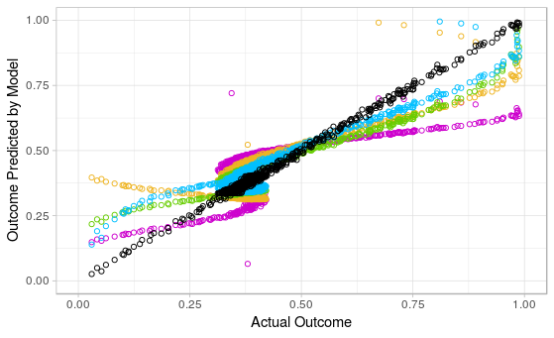
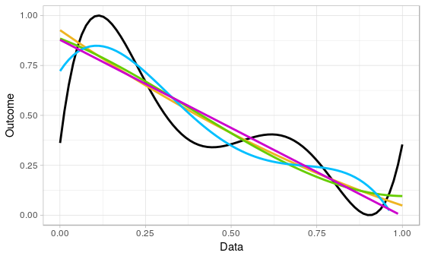
Machine Learning: An Extremely Brief Primer
Machine Learning
Concentrates on prediction
Lack of explicit models can be useful in routinely collected data but may be hard to interpret

Slide 11



A New Era in Healthcare?
Many Participants
Many Predictors
New Relationships
Notes:
1 – growth in data (90% of total in last 5yrs)
2 – inexorable growth of computing availability and power
3 – explosion of EHRs and ways to glean info from them e.g. NLP etc
4 – transformation agenda in the UK

Slide 12
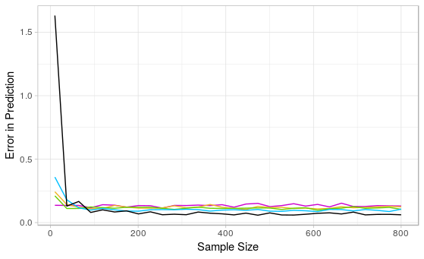
Is Machine Learning the Key to a New Era?
Minimum error
Participants

Slide 13
Summary
AI/ML approaches probably will change how we do highly replicable things
Advantages of ML over classical statistics probably won’t be realised until we address data accessibility and sharing
Big data usage in healthcare requires statistical rigour & methodological honesty

Slide 14
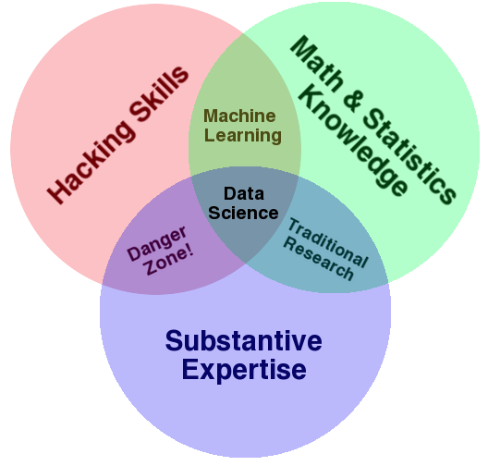
What Should the NHS do?

Slide 15
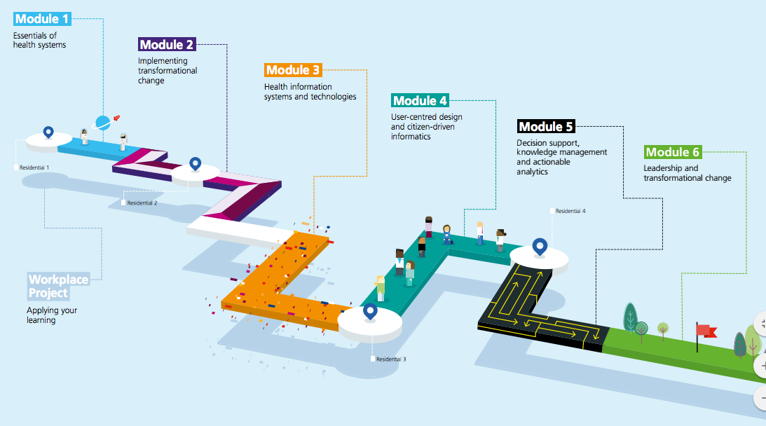
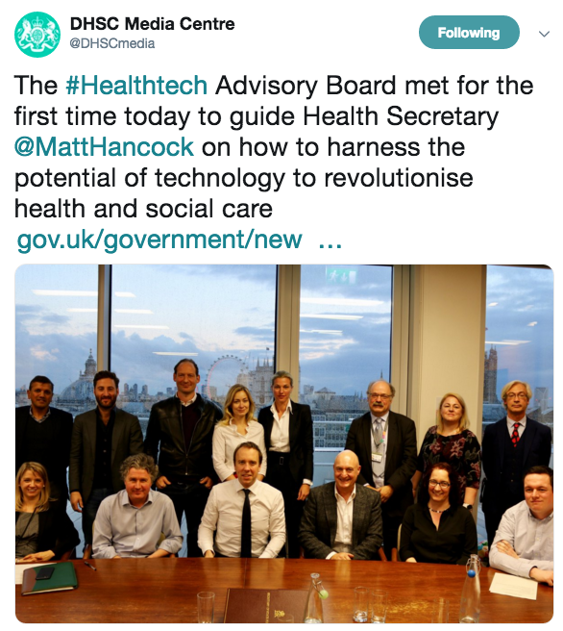
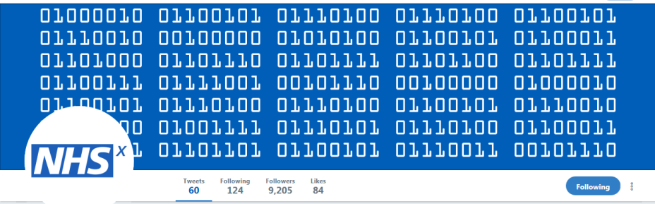

What is the NHS doing?

Slide 16
Summary
“A medical device with a plausible sales pitch is a very hard thing to counter with mere evidence” Richard Lehman June 2018
Many technological advances in healthcare are yet to achieve maturity
Are small increases in the precision of predictions what you agonise over?
Watch The Social Network

Slide 17
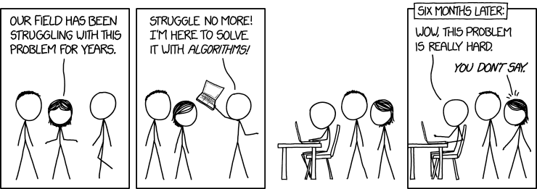
@toates_19
toates19@gmail.com

Slide 18
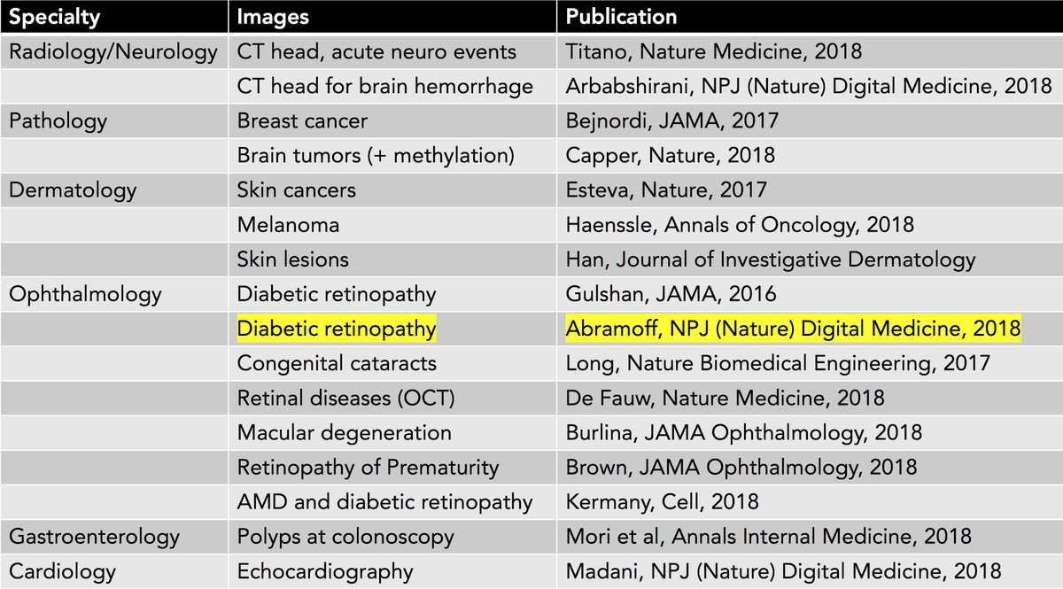
Clinical Medicine isn’t Classification
Medical decisions are:
not classification problems
made at the point of care
subject to change
Medical data has:
Biological variation
Sampling Variability
Measurement Errors
Different Treatments

