Slide 1
Capstone project
Choice of Restaurants for new students in Huntington
By Oluwatobiloba Ige

Slide 2

INTRODUCTION
As an international student, schooling at in Huntington, West Virginia has been fun and exciting but there was one problem. I had issues looking for the best restaurants around. It can be difficult finding restaurants that are worth going to and where they are since I am new in the environment.

Slide 3
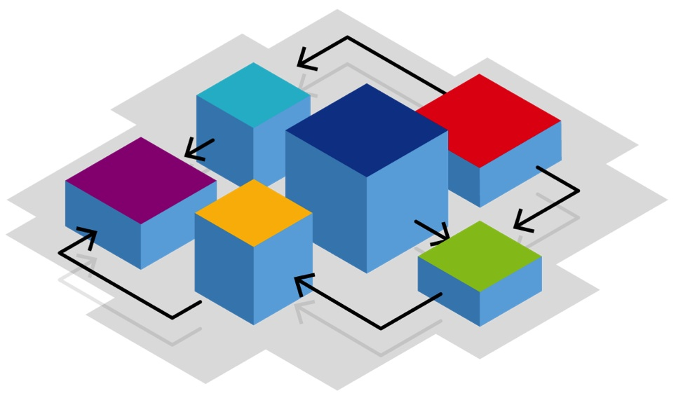
Business Problem
For this project, we will be using Foursquare to create a simple guide on where to eat based on Foursquare categories, likes and geographic location data for the restaurants in Huntington. Using clusters, we will then group similar restaurants based on Foursquare user feedbacks so that students can easily determine which type of restaurant is best for them based on these criteria.

Slide 4
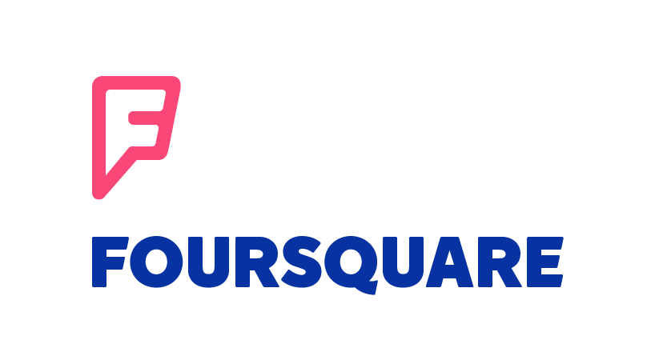
Data Requirements
For this project, I will be utilizing the Foursquare API to pull the following location data on restaurants in Huntington, WV:
Venue Name
Venue ID
Venue Location
Venue Category
Count of Likes

Slide 5
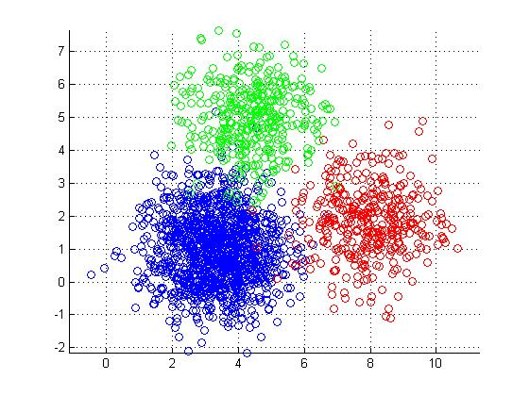
Methodology
We will take the gathered data (see above in Data Acquisition Approach and Data Required sections) and will create a k-means clustering algorithm that groups restaurants into 4-5 clusters so that people looking to eat in Huntington can easily see which restaurants are the best to eat at, what cuisine is available and where in Huntington they can look to eat.

Slide 6
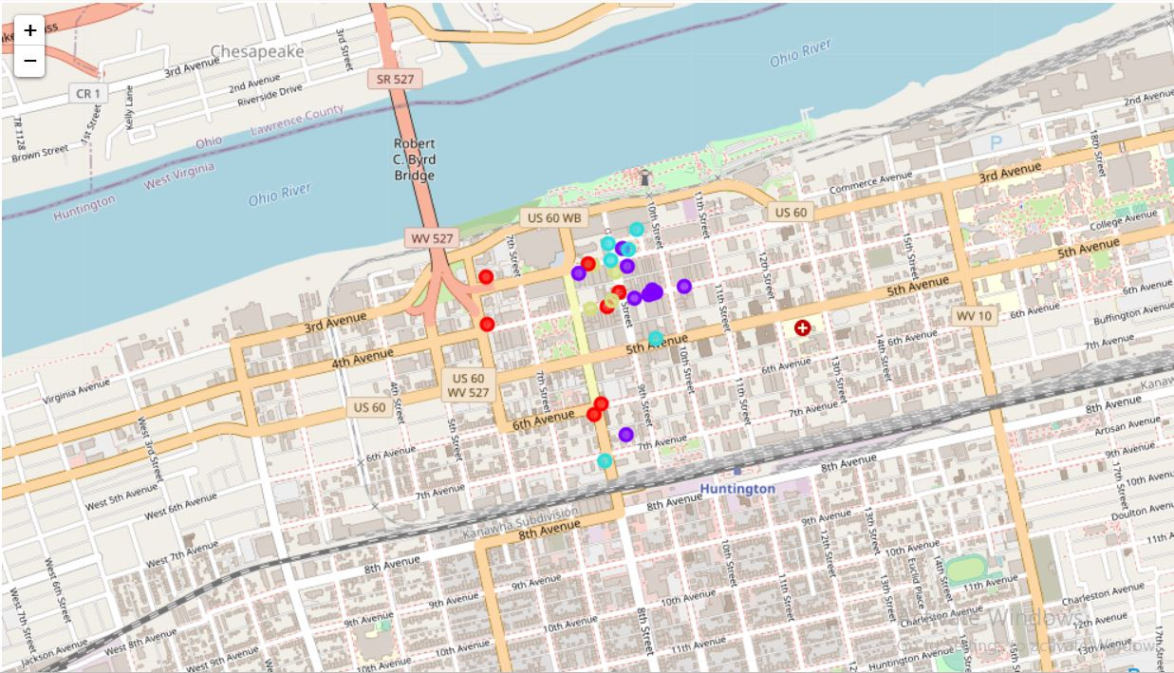
Results

Slide 7
Discussion
From these results we see that euro asian indian food make up the most for the above average rating category of restaurants.
Bars make up most of the poor rating category of restaurants.
American food make up most of the great rating category of restaurants.
Bars also make up the most of the below average rating category of restaurants.

Slide 8
Conclusion
From the analysis of the data of restaurants in Huntington, I would recommend an American restaurants to a friend who is new in the area. There is a high chance he would enjoy the food.
Thank you.

