Slide 1

Snap Cook
&
Snap. Detect. Cook.
AI-powered ingredient detection
and hands-free guided cooking
Ernest Ho · Lucas Yee · Tan Shun Zhi Tomy · Wong Woon Li · Yan Yu · Muhammad Zikry
CSD3156 Mobile and Cloud Computing | SIT

Slide 2
User Research
Survey of 5 home cooks
4 out of 5
surveyed regularly threw away ingredients because they did not know what to cook with them.
S
J
M
R
A
Sarah, 24
James, 31
Mei Ling, 28
Raj, 35
Alex, 22
Student
Working Professional
Home Cook
Parent
University Student
"I always end up throwing out vegetables
because I have no idea what to do with them."
"I buy groceries weekly but half of it
goes to waste before I cook it."
"Random bits of food just pile up and
expire in the back of my fridge."
"With a busy schedule I never know
what to make from leftover ingredients."
"Living alone means food expires before
I get a chance to use it all up."
Snap & Cook | CSD3156 Mobile and Cloud Computing | SIT

Slide 3
Problem Statement
Home cooks often struggle to decide what to make when they have leftover or mismatched ingredients, leading to food waste and unnecessary grocery trips.
Food Waste
Unnecessary Trips
No Guidance
Ingredients expire
before they are used
Buying items already
in the fridge
No hands-free help
while cooking
Primary Goal: Reduce food waste and simplify meal planning by helping users make the most of what they already have.
Snap & Cook | CSD3156 Mobile and Cloud Computing | SIT

Slide 4
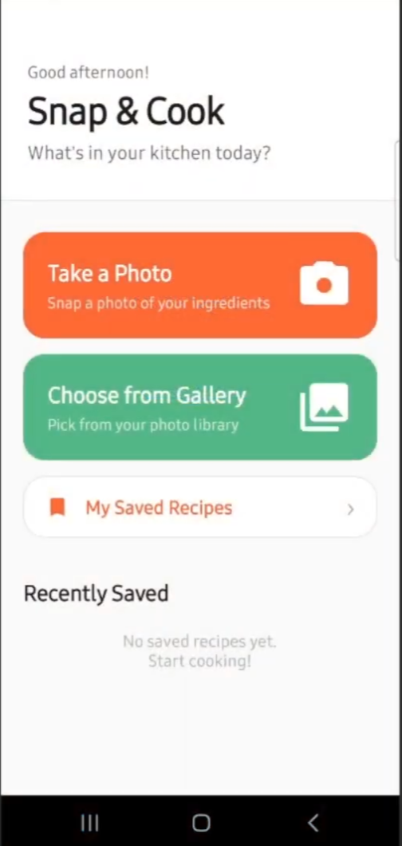
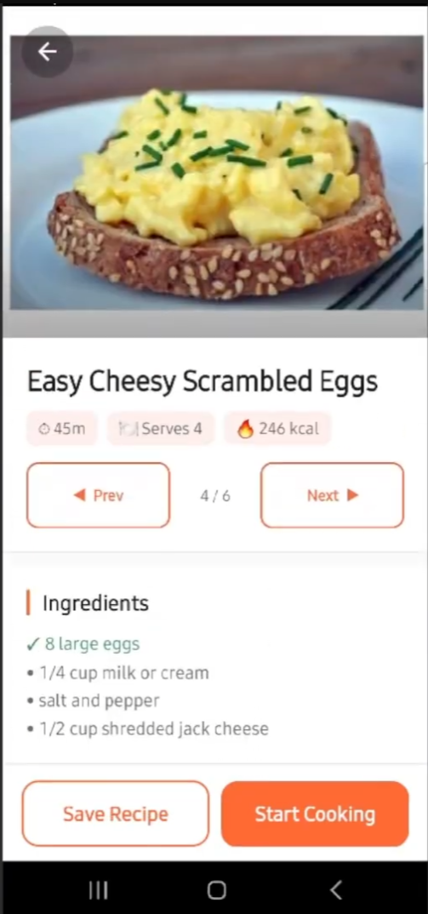
Our Solution
One app — from fridge to table
Snap & Cook solves this by:
Snap a photo
Gemini AI identifies your ingredients
Find recipes
Spoonacular matches what you have
Scan barcodes
ML Kit + Open Food Facts
Cook hands-free
TTS reads steps, voice controls
Save for later
Offline access via Room database
Snap & Cook | CSD3156 Mobile and Cloud Computing | SIT

Slide 5
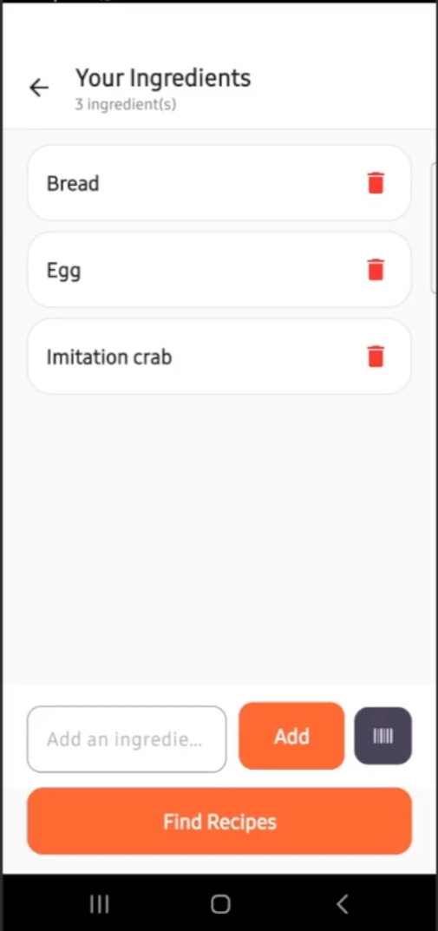
AI Ingredient Detection
Google Gemini 1.5 Flash
How it works
1. Take a photo or choose from gallery
2. Image sent to Gemini 1.5 Flash (cloud AI)
3. AI returns a list of specific ingredients
4. Review, edit, add or remove items
5. Hit Find Recipes
Behind the scenes
- Prompt bans generic labels (no 'vegetable', 'food')
- Multiple photos merged & deduplicated
- Returns empty list gracefully on failure
Snap & Cook | CSD3156 Mobile and Cloud Computing | SIT

Slide 6
Recipe Results
Spoonacular API
What you see
Up to 6 matched recipes returned
Paginate with Prev / Next
Green checkmark = ingredient you own
Bullet = ingredient you still need to buy
Cooking time, servings, calories displayed
YouTube cooking video embedded
Tap image for fullscreen view
Save recipe for offline access
API Key Rotation — multiple Spoonacular keys auto-swap on quota exhaustion. Zero interruption to the user.
Snap & Cook | CSD3156 Mobile and Cloud Computing | SIT

Slide 7
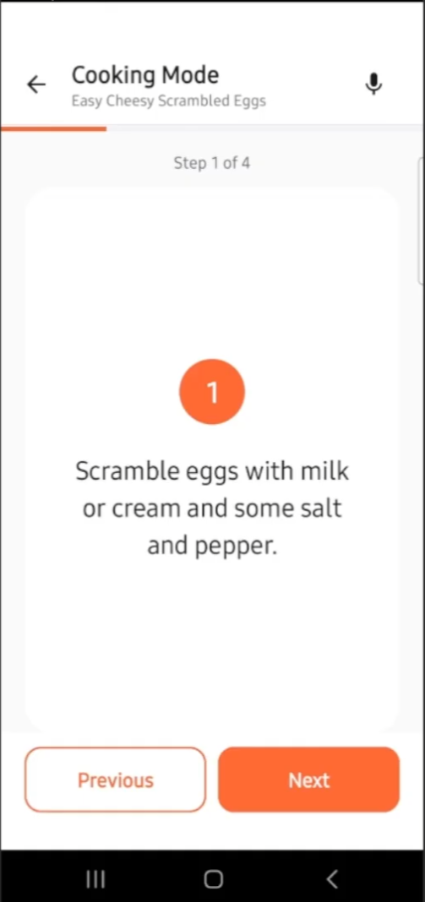
Hands-Free Cooking Mode
Text-to-Speech + Voice Commands
Text-to-Speech
Reads each step aloud automatically
Toggle narration on / off
Mic activates after TTS finishes
Completion message spoken at end
Voice Commands
"next" — advance step
"previous" / "back" — go back
"repeat" — re-read current step
Screen stays on during cooking
Snap & Cook | CSD3156 Mobile and Cloud Computing | SIT

Slide 8
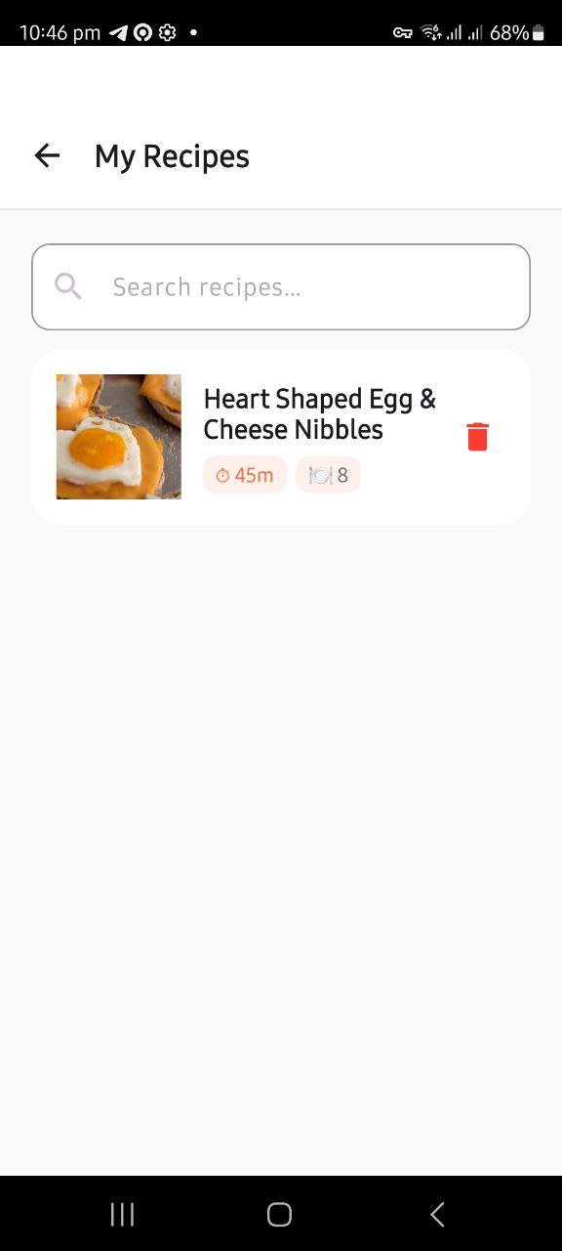
Barcode Scanning & Saved Recipes
Barcode Scanning
ML Kit scans barcode via camera
Open Food Facts resolves product name
Ingredient added automatically
Works on EAN/UPC packaged goods
Saved Recipes
Saved to Room (SQLite) — works offline
Search through saved recipes
Recently saved shown on home screen
Tap to open full recipe & cooking mode
Snap & Cook | CSD3156 Mobile and Cloud Computing | SIT

Slide 9
Architecture
MVVM + Repository Pattern
UI Layer
Key Decisions
7 Activities + 5 ViewModels + Adapters
LiveData
v
UI observes data — no polling
Repository
RecipeRepository — key rotation on HTTP 402
Coroutines
v
Non-blocking I/O on Dispatchers.IO
Remote APIs
Gemini | Spoonacular | Open Food Facts
Key Rotation
N API keys, auto-swap on HTTP 402
v
Room Database
SavedRecipe entity | RecipeDao | Gson converter
Singletons
GeminiClient, RetrofitClient, AppDatabase
v
ML Layer
IngredientDetector — Bitmap -> JPEG -> Gemini API
ViewBinding
Type-safe views, no findViewById
Snap & Cook | CSD3156 Mobile and Cloud Computing | SIT

Slide 10
Technology Stack
AI & Vision
Networking
Database
- Gemini 1.5 Flash
- Retrofit 2.11 + OkHttp 4.12
- Room 2.6.1 (SQLite)
- ML Kit Barcode
- Spoonacular API
- Gson serialisation
- CameraX 1.4.2
- Open Food Facts API
- LiveData
UI & UX
Language & Build
Voice & Audio
- Material Design 3
- Kotlin 2.0.21
- TextToSpeech
- ViewBinding
- Coroutines 1.8.1
- SpeechRecognizer
- Glide 4.16
- Min SDK 26
- Screen-on flag
- Dark Mode
Snap & Cook | CSD3156 Mobile and Cloud Computing | SIT

Slide 11
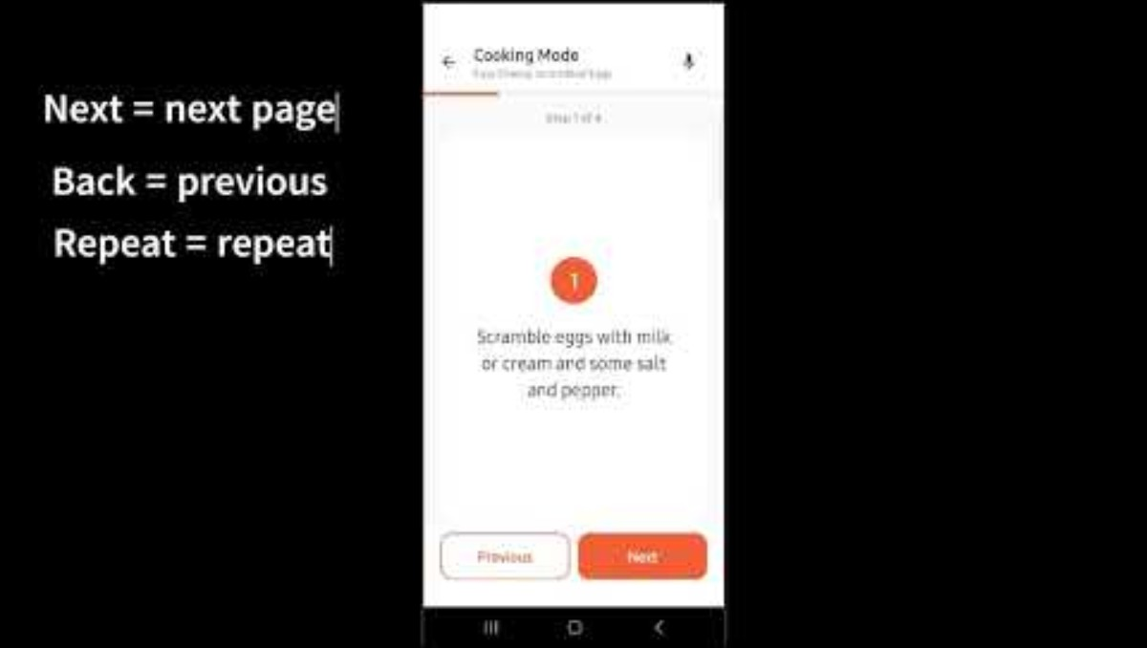
App Demo
Snap & Cook — End-to-End Walkthrough
Snap -> Detect -> Find Recipes -> Cook Hands-Free -> Save

Slide 12
Thank You
GitHub & App Demo

