Slide 1
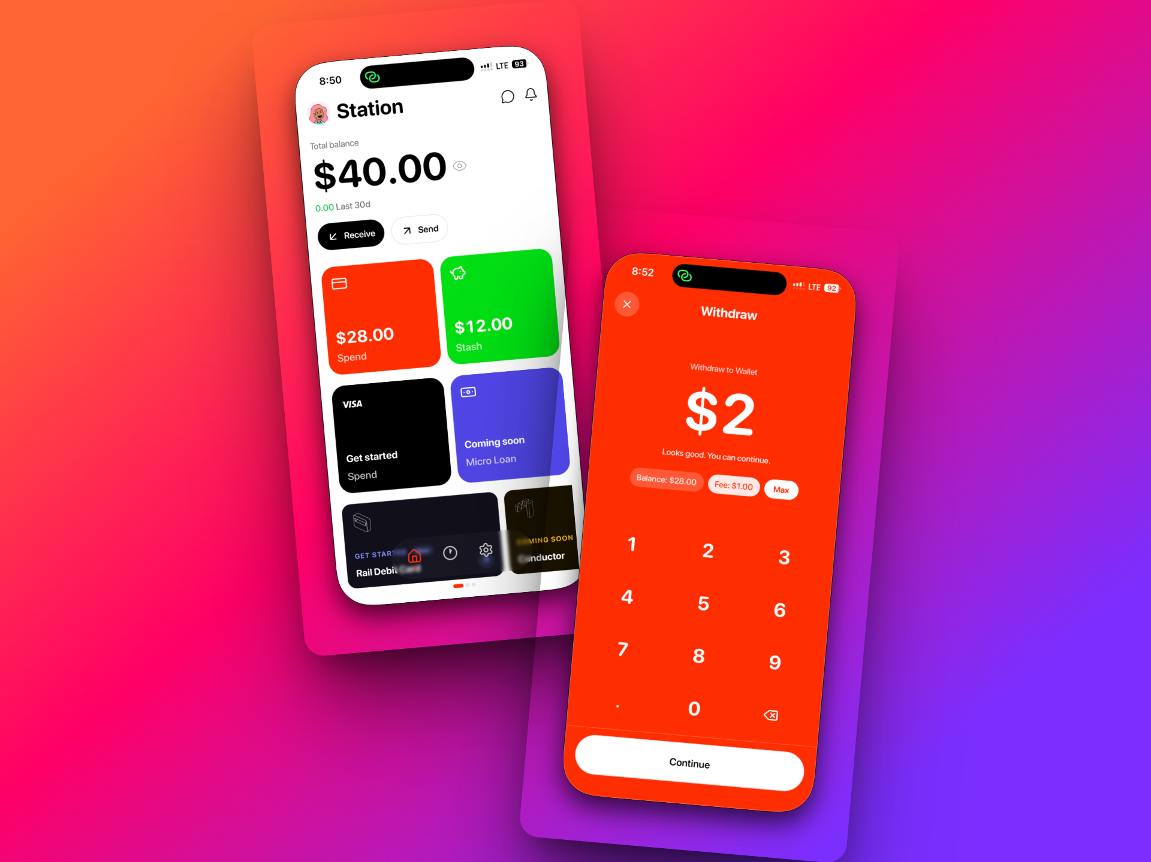
Rail
Your money account that invests for you — automatically.
invests for you
Spend normally. Rail allocates a portion of every deposit toward long-term investments in the background. No dashboards. No decisions. No discipline required.
Solana Mobile · Monolith Hackathon 2026
01 / 11

Slide 2
THE PROBLEM
Millions work for years but never build meaningful investments.
Saving requires constant discipline most people don't sustain
Investing requires decisions people avoid making
Most financial apps rely on users to stay consistent — they don't
If investing is not automatic, most people never do it consistently.
02 / 11

Slide 3
VALUE PROPOSITION
A primary money account where spending feels normal and investing happens automatically.
💸
⚡
🔄
No market tracking
Auto-allocation
Zero behavior change
Users never need to watch charts or manage dashboards.
Every deposit is automatically split between spending and investing.
Users spend normally. Rail builds wealth in the background.
03 / 11

Slide 4
HOW IT WORKS
Three steps. That's it.
01
Deposit funds into Rail
Via bank transfer, crypto, or card — money lands in your Rail account.
02
Rail splits automatically
A set percentage is allocated to your investment stash — no action needed.
03
Investments execute in the background
While you spend normally through your Rail card, your portfolio grows.
Users build long-term financial progress without changing their spending behavior.
04 / 11

Slide 5
PRODUCT DEMO
See it in action.
💳 Deposit funds
→
⚡ Rail allocates
→
📈 Investment grows
→
🛍️ Spend normally
SPENDING STASH
INVESTMENT STASH
AUTO-INVESTED
$840.00
$312.50
$1,152.50
Available to spend
+4.2% this month
Total, all time
💡 Every time money enters Rail, investing happens automatically. No manual action required.
05 / 11

Slide 6
MARKET
People whose income already flows digitally.
Remote workers
Freelancers
Creators
Global professionals
Crypto-native earners
$200B+
35M+
Stablecoin transaction volume in 2024 — growing fast
Digital nomads and remote workers globally
↑3×
$0
Stablecoin adoption growth over the last 2 years
Automated investing tools built for this audience
06 / 11

Slide 7
BUSINESS MODEL
Three clear revenue streams.
💳
Card Interchange
Revenue every time a user spends through their Rail card.
📊
Asset Management Fees
Small percentage on assets under management — scales with user growth.
⭐
Rail+ Premium
Advanced financial tools, higher allocation limits, priority support.
10,000 users × $1,000 invested = $10M AUM. A 0.5% management fee = $50K ARR — before interchange or premium revenue.
07 / 11

Slide 8
TRACTION
Early but real.
30+
✓
✓
Early testers ready to use the product on launch
Full product flow built and running on TestFlight
Investment automation system live end-to-end
Infrastructure partnerships in progress. Initial focus: controlled beta to validate user behavior and retention before scaling acquisition.
08 / 11

Slide 9
ROADMAP
Where we're going.
Q1 2026 — Now
Private beta launch with early testers. Core auto-invest flow live.
Q2 2026
Public product launch. Rail card rollout. User acquisition begins.
Q3 2026
Expanded automated investing strategies. Retention optimization.
Q4 2026
Lending, smart allocations, and advanced financial automation.
09 / 11

Slide 10
TEAM
Built by someone who lived this problem.
Tobi
FOUNDER & BUILDER
Several years building products and shipping to real users
Multiple hackathon participations — knows how to ship fast
Rail was inspired by growing up in a household where financial stability was difficult despite consistent work
"Build a system where financial progress happens automatically — for everyone, not just the disciplined."
10 / 11

Slide 11
Rail
Financial progress should be automatic.
Join the waitlist. Test the product. Tell us what you think.
Join the waitlist →
Try the app
rail.app
11 / 11

