Slide 1

SEAL
Seal
A personal agent that remembers everything and proves it on Midnight without revealing a word.
1
Notes:
Seal is a privacy-first personal agent you text on iMessage. Built on Midnight for the Midnight Buildathon.

Slide 2
SEAL
Your agent knows your secrets. You just have to trust it.
Medications, money and private notes sit in a cloud database some operator can read.
2
Notes:
The trust asked of personal agents today is total and unverifiable. The same goes for spending: you either trust the agent with your card or you don't.

Slide 3
SEAL
What changes with Seal
Agents today
With Seal
Your memories sit in an operator's database. Spending limits are a promise in code.
Memories stay on your device. A ZK circuit enforces every limit, even if the agent is tricked.
3
Notes:
Seal is Open Instinct plus a Midnight privacy layer built during the buildathon: memory-vault, allowance-registry, verifier and spend gate.

Slide 4
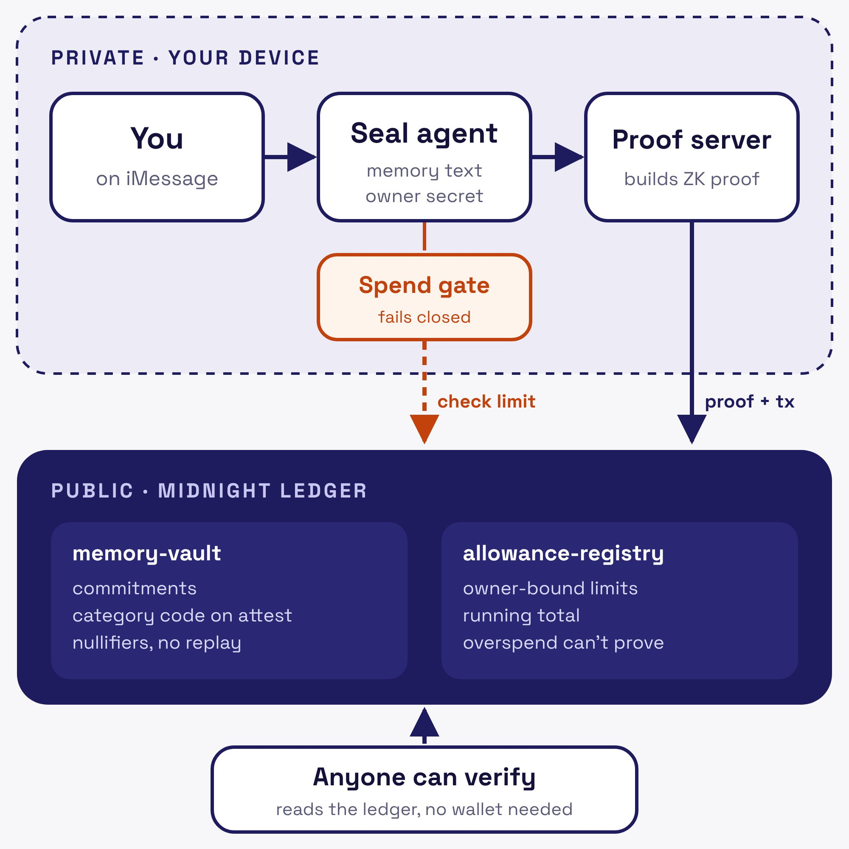
SEAL
How Seal works
Your memory never leaves your device. Midnight stores only commitments, and anyone can check a proof without trusting Seal.
4
Notes:
memory-vault.compact uses persistentCommit, owner binding from a private witness, category commitments and nullifiers. allowance-registry.compact enforces owner-bound limits in-circuit. Private: memory text, owner secret. Public: commitments, nullifiers, attestation category, limits. Steps: 1 Commit, 2 Prove, 3 Verify, 4 Spend.

Slide 5
SEAL
What Midnight sees
DATA
WHERE IT LIVES
WHO CAN READ IT
Memory text
Your device
Only you
Owner secret
Your device
Only you
Memory commitment
Midnight ledger
Anyone, reveals nothing
Category code
Midnight ledger
Anyone, only when you attest
Nullifier
Midnight ledger
Anyone, blocks replay
Spend limit and total
Midnight ledger
Anyone, owner stays hidden
5
Notes:
Dual-ledger model: private state via witnesses (ownerSecret) and local MEMORY.md; public state via persistentCommit commitments, category commitments, nullifiers, attestations, allowance limits. Allowance totals are deliberately public, like a card limit.

Slide 6
SEAL
Live on Preprod
962
2
30/30
Tests passing
Compact contracts
Sync drops recovered
6
Notes:
Preprod run completed Oct 16, 2026: memory-vault deployed block 3000850, commit block 3000856, health attestation block 3000862, allowance-registry deployed. main at 88ceffe with 962 tests passing.

Slide 7
SEAL
Next: Seal in real hands
Wave 3 turns a working agent into one people use every day.
WEB DEMO
BETA
SPEND GATE
Click-through proof flow with no wallet
First users texting Seal on iMessage
Allowances guarding real purchases
7
Notes:
Draft roadmap for Wave 3 (Oct 27 to Nov 16, 2026). Edit to match the real plan.

