Slide 1

NATIONAL INSTITUTE OF TECHNOLOGY, WARANGAL
DEPARTMENT OF ELECTRICAL ENGINEERING
EE449 – SUMMER INTERNSHIP/EPICS
IV-B.Tech. EEE(A) - INTERNSHIP PRESENTATION
Time Series Forecasting in Power systems using Deep learning techniques
National Institute of Technology Warangal
Presenter:
Name: Magam Vasista Sai
Roll No: 21EEB0A38
Duration: 2 months
From:20-05-24 to 10-07-24
Internship Supervisor:
Prof . Altaf Q H Badar
Assistant Professor
National Institute of Technology Warangal
altafbadar@nitw.ac.in
+91-9890068893
Tuesday, 8th October 2024
IV-B.Tech.-EEE-Internship/Magam Vasista Sai-21EEB0A38

Slide 2
CONTENTS OF THE PRESENTATION
Introduction
Literature
Problem Statement
Simulation/Hardware Experimentation
Results
Conclusion
Future Scope
References
Tuesday, 8th October 2024
IV-B.Tech.-EEE-Internship/Magam Vasista Sai-21EEB0A38

Slide 3
1. INTRODUCTION
Integration of Renewable Energy Sources (RESs) and Electric Vehicles (EVs) is growing in modern power systems.
Significance of RESs: Solar, wind, and hydro power are becoming key components of modern grids.
EVs as Mobile Energy Sources: Electric vehicles serve both as consumers and potential suppliers of energy through vehicle-to-grid (V2G) technology.
Key Benefits : Reduced carbon footprint ,Increased system efficiency, Minimised transmission losses.
Challenges : Intermittent energy production from RESs: Unpredictability in generation, especially wind and solar and Integration of DERs: Thousands of small-scale, distributed generation units add complexity to grid operations.
Forecasting : Accurate predictions of energy generation and consumption patterns are crucial to maintaining grid stability.
Tuesday, 8th October 2024
IV-B.Tech.-EEE-Internship/Magam Vasista Sai-21EEB0A38

Slide 4
1. INTRODUCTION
Time Series Forecasting in Power Systems Using BLSTM Networks
Forecasting Needs:
Wind speed prediction for wind energy generation.
Load demand forecasting to ensure supply meets demand.
Electricity prices prediction for market operations.
EV behaviour forecasting for load management and grid interaction.
Why BLSTM Networks?
Bi-directional LSTM (BLSTM): Enhances traditional LSTM by considering both past and future data in time series.
Superior performance:
Outperforms SVM, shallow neural networks, and traditional LSTMs.
Prediction accuracy: BLSTM achieves 1.47% error rate, lower than competing models.
Bidirectional structure : Provides more context, allowing for better forecasting accuracy.
Scalability : Effective for large-scale grid systems with numerous DERs.
Tuesday, 8th October 2024
IV-B.Tech.-EEE-Internship/Magam Vasista Sai-21EEB0A38

Slide 5
2. LITERATURE SURVEY
In this study, a comparison was conducted between various time series forecasting models, including Bi-directional Long Short-Term Memory (BLSTM), Long Short-Term Memory (LSTM), Gated Recurrent Units (GRU), and Bidirectional GRU (BGRU), to evaluate their performance in predicting key variables for power system management. The dataset used for this analysis consisted of Denmark city data collected over a 7-year period (2015-2021). The focus was on forecasting parameters such as wind speed, load demand, and electricity prices, which are critical in managing modern power systems integrated with renewable energy sources and electric vehicles.
The models were trained with a batch size of 32, a time step of 72, and a learning rate of 0.001. The BLSTM model demonstrated superior performance, achieving a Mean Absolute Error (MAE) of 0.00658 and a Root Mean Squared Error (RMSE) of 0.00841 in case Total Load(Similarly BLTSTM performed well in other features too). These results were compared against those of traditional LSTM and GRU models, as well as BGRU, which shares a similar architecture to BLSTM but differs in complexity.
Tuesday, 8th October 2024
IV-B.Tech.-EEE-Internship/Magam Vasista Sai-21EEB0A38

Slide 6
2. LITERATURE SURVEY
LSTM, while a well-established model for time series forecasting, showed higher error rates due to its inability to capture future dependencies in the data. GRU, being a simplified version of LSTM, was faster to train but exhibited slightly lower accuracy for the complex time series data used in this study.
BGRU performed similarly to BLSTM in terms of architecture but proved less effective in learning bidirectional dependencies, resulting in higher MSE and RMSE. Ultimately, BLSTM outperformed all other models, demonstrating its effectiveness in reducing prediction errors, which is critical for optimizing power system operations, particularly in the integration of renewable energy and electric vehicles.
Tuesday, 8th October 2024
IV-B.Tech.-EEE-Internship/Magam Vasista Sai-21EEB0A38

Slide 7
3. PROBLEM STATEMENT
Accurate forecasting of time series data related to renewable energy generation and Solar energy, Wind speed and cost poses a significant challenge in modern power systems. While various forecasting models, such as Bi-directional Long Short-Term Memory (BLSTM) networks, have shown promise in predicting stochastic parameters, optimizing their ability to capture both temporal dynamics and seasonal patterns remains complex.
Effective forecasting requires advanced techniques to model the inherent uncertainties associated with renewable energy sources and the unpredictable nature of electric vehicle charging and discharging behaviors. This study aims to enhance the performance of time series forecasting by leveraging hierarchical architectures that can extract robust features from historical data, thereby improving accuracy in predicting energy demand, generation, and pricing. By addressing these challenges, this research seeks to contribute to more efficient grid management and operational strategies in the integration of renewable energy sources and electric vehicles.
Tuesday, 8th October 2024
IV-B.Tech.-EEE-Internship/Magam Vasista Sai-21EEB0A38

Slide 8
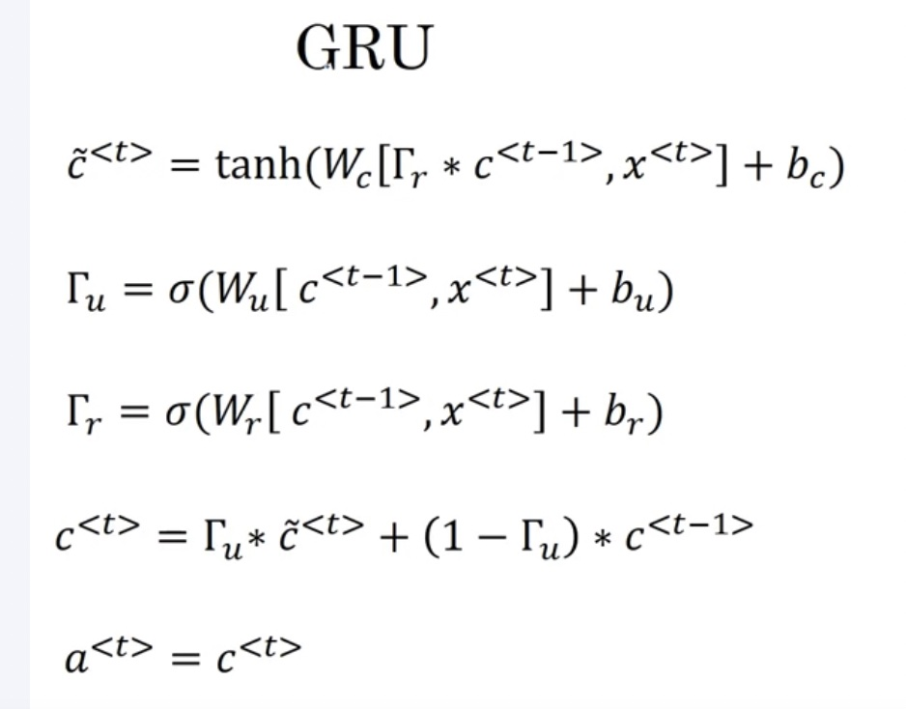
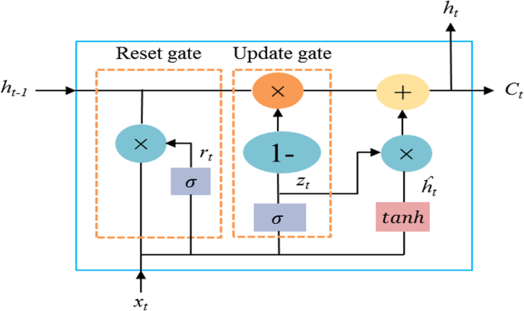
4. SIMULATION/HARDWARE EXPERIMENTATION
Tuesday, 8th October 2024
IV-B.Tech.-EEE-Internship/Magam Vasista Sai-21EEB0A38

Slide 9
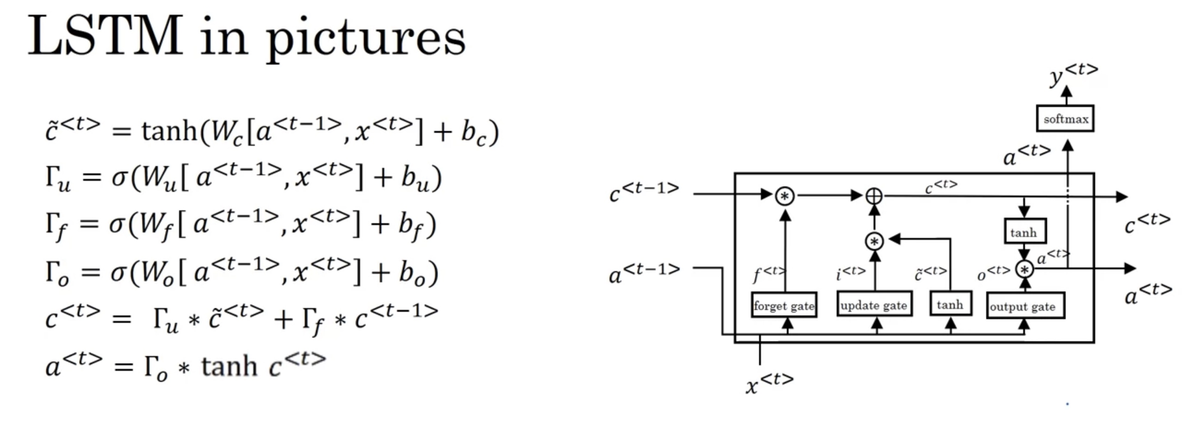
4. SIMULATION/HARDWARE EXPERIMENTATION
Tuesday, 8th October 2024
IV-B.Tech.-EEE-Internship/Magam Vasista Sai-21EEB0A38

Slide 10
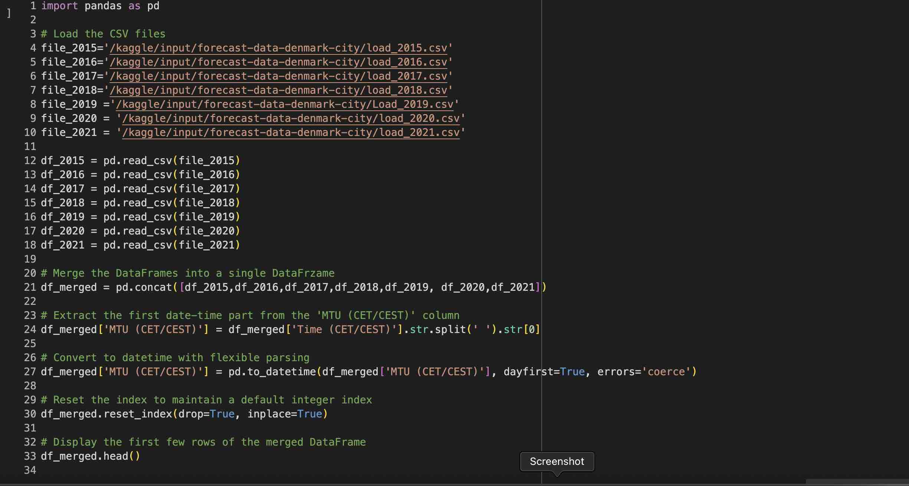
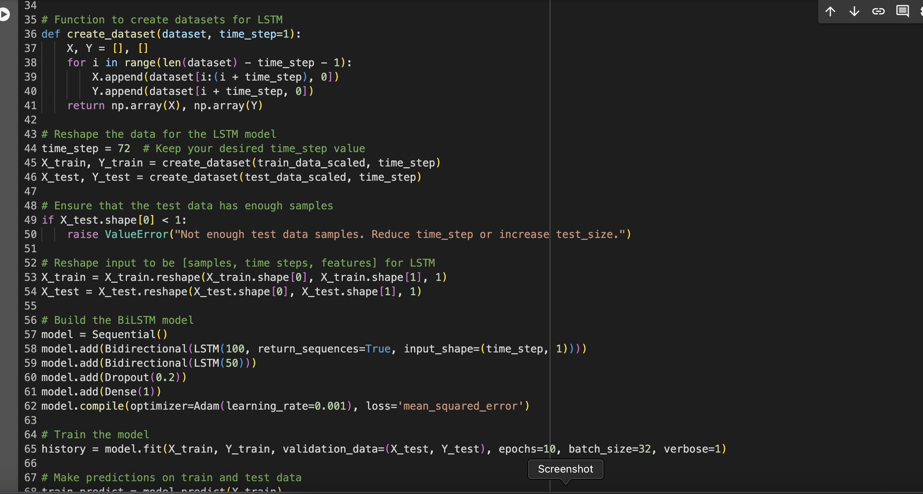
Tuesday, 8th October 2024
IV-B.Tech.-EEE-Internship/Magam Vasista Sai-21EEB0A38

Slide 11
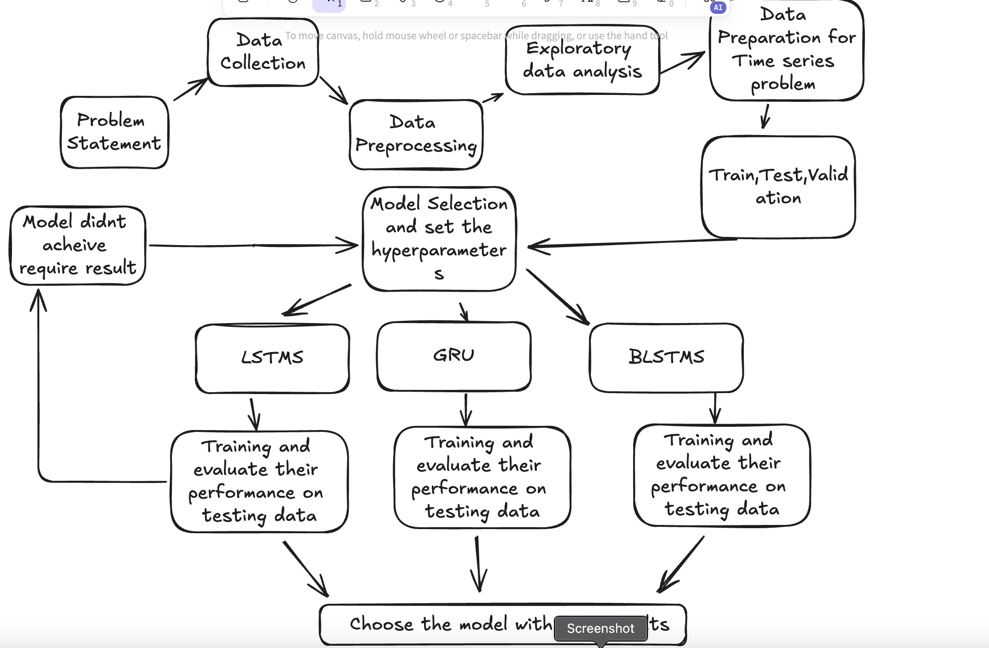
FlowChart/WorkFlow :
Tuesday, 8th October 2024
IV-B.Tech.-EEE-Internship/Magam Vasista Sai-21EEB0A38

Slide 12
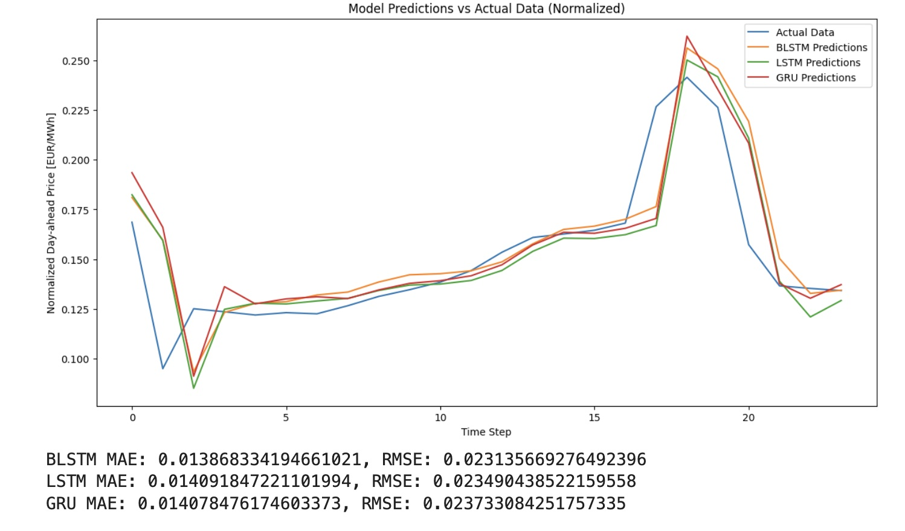
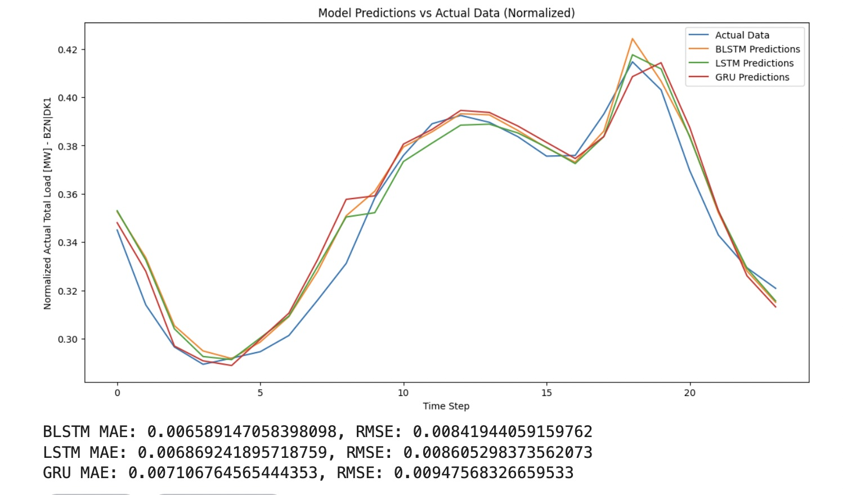
5. RESULTS
Figure . Test results for Electricity Price
Figure . Test results for Total load
Tuesday, 8th October 2024
IV-B.Tech.-EEE-Internship/Magam Vasista Sai-21EEB0A38

Slide 13
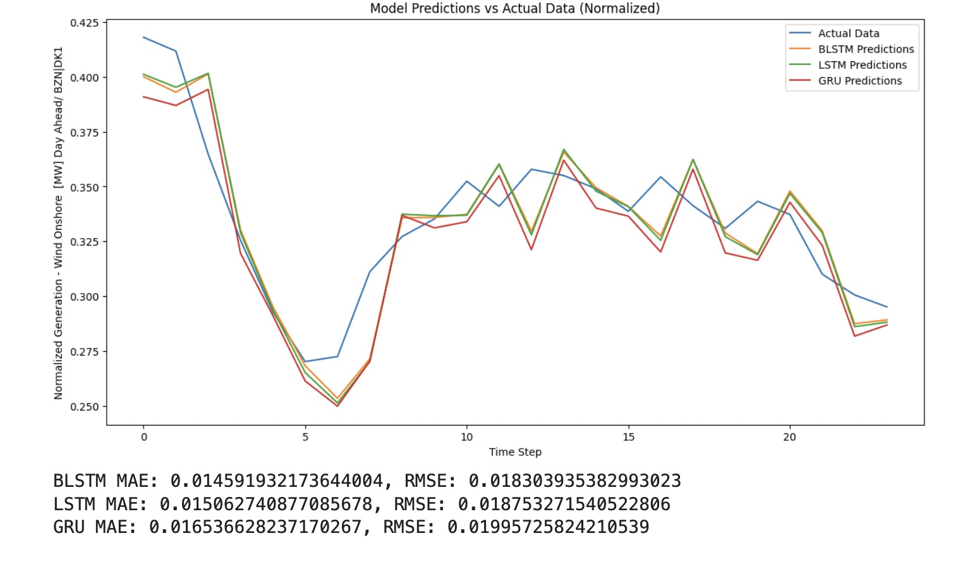
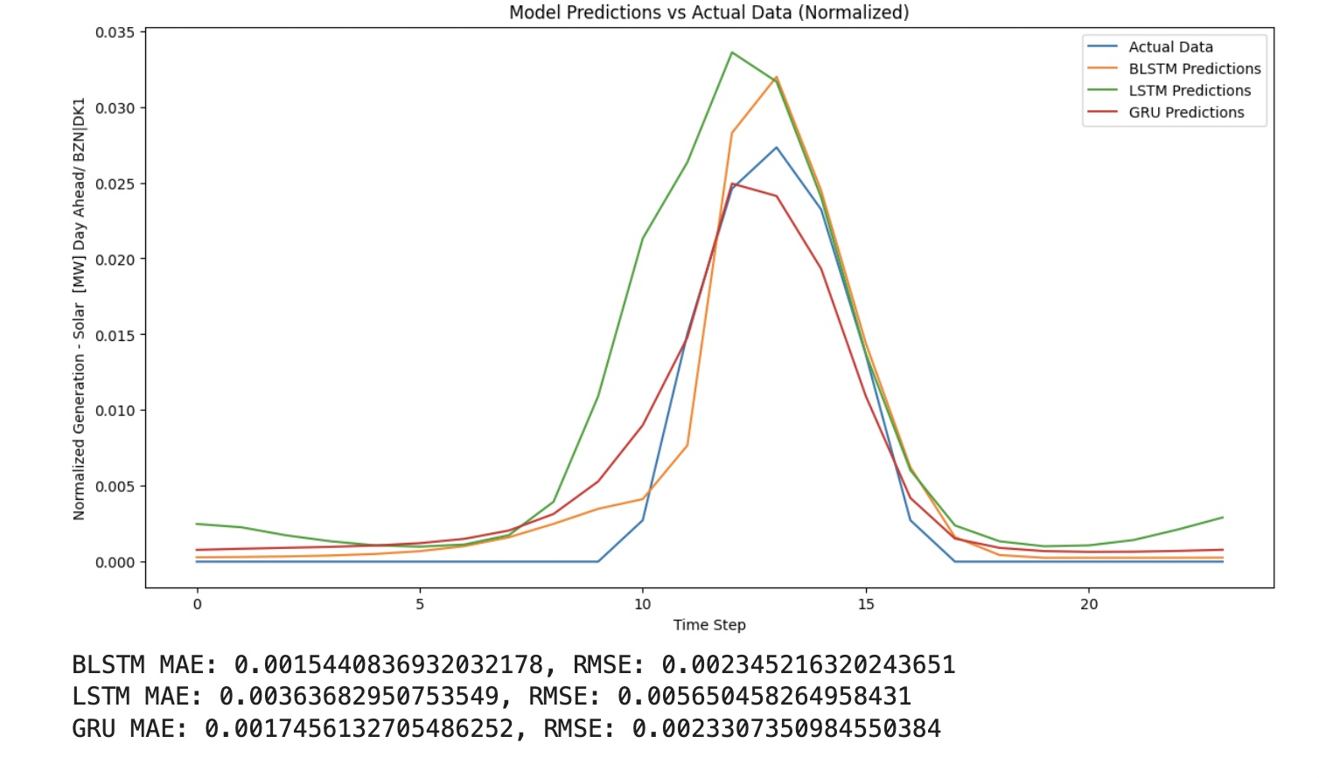
5. RESULTS
Figure . Test results for Solar Energy Generation
Figure . Test results for Wind Energy Generation
Tuesday, 8th October 2024
IV-B.Tech.-EEE-Internship/Magam Vasista Sai-21EEB0A38

Slide 14
5. RESULTS
 | BLSTM(MAE) | BLSTM(RMSE) | LSTM(MAE) | LSTM(RMSE) | GRU(MAE) | GRU(RMSE)
Electricity Price | 0.01386 | 0.023135 | 0.01409 | 0.02349 | 0.01407 | 0.02373
Total Load | 0.00658 | 0.00841 | 0.00686 | 0.00860 | 0.00710 | 0.00947
Solar Energy Generation Intraday | 0.15440 | 0.00234 | 0.00363 | 0.00565 | 0.00174 | 0.00233
Wind Energy Generation Intraday | 0.01459 | 0.01830 | 0.01506 | 0.01875 | 0.01653 | 0.01995
Tuesday, 8th October 2024
IV-B.Tech.-EEE-Internship/Magam Vasista Sai-21EEB0A38

Slide 15
6. CONCLUSION
Significance of Time Series Forecasting
Critical for efficient management of power systems and integration of renewable energy sources (RESs).
Enhances grid reliability and optimizes resource allocation.
Effectiveness of Deep Learning Techniques
Bi-directional Long Short-Term Memory (BLSTM) networks demonstrate superior performance in capturing temporal dependencies.
Achieved low prediction errors, validating their applicability in real-world scenarios.
Challenges Addressed
Mitigated complexities associated with the intermittent nature of RESs and Electric Vehicles (EVs).
Improved forecasting accuracy contributes to better decision-making in power system operations.
Implications for Future Research
Continued exploration of hybrid models and integration of diverse data sources.
Potential for real-time forecasting to enhance grid management strategies.
Overall Contribution
Provides a foundation for further advancements in predictive modeling in power systems.
Encourages sustainable practices through improved energy management.
Tuesday, 8th October 2024
IV-B.Tech.-EEE-Internship/Magam Vasista Sai-21EEB0A38

Slide 16
7. FUTURE SCOPE
Advanced Model Development
Explore hybrid architectures (e.g., CNN-LSTM, Transformers) for enhanced accuracy in forecasting.
Implement attention mechanisms to focus on significant features in the data.
Incorporation of External Variables
Integrate weather patterns, economic indicators, and market trends into forecasting models.
Utilize multi-variate time series analysis to capture complex interdependencies.
Real-Time Forecasting
Develop frameworks for dynamic, real-time predictions to improve grid stability.
Leverage IoT technologies for continuous data collection and processing.
Enhanced Model Interpretability
Apply techniques like SHAP and LIME to improve the transparency of model predictions.
Foster trust in AI-driven forecasts among stakeholders.
Collaboration with Industry
Partner with energy providers for model validation and refinement in real-world scenarios.
Engage in joint research initiatives to advance energy forecasting methodologies.
Tuesday, 8th October 2024
IV-B.Tech.-EEE-Internship/Magam Vasista Sai-21EEB0A38

Slide 17
8. REFERENCES
[1]Optimal Management of a Virtual Power Plant Consisting of Renewable Energy Resources and Electric Vehicles Using Mixed‐Integer Linear Programming and Deep Learning . Ali Ahmadian, Kumaraswamy Ponnambalam
[2] Sadeghi, S.; Jahangir, H.; Vatandoust, B.; Golkar, M.A.; Ahmadian, A.; Elkamel, A. Optimal bidding strategy of a virtual power plant in day‐ahead energy and frequency regulation markets: A deep learning‐based approach. Int. J. Electr. Power Energy Syst. 2021, 127, 106646.
[3]Ullah, Z.; Hassanin, H. Modeling, optimization, and analysis of a virtual power plant demand response mechanism for the internal electricity market considering the uncertainty of renewable energy sources. Energies 2022, 15, 5296.
[4]Zamani, A.G.; Zakariazadeh, A.; Jadid, S.; Kazemi, A. Stochastic operational scheduling of distributed energy resources in a large scale virtual power plant. Int. J. Electr. Power Energy Syst. 2016, 82, 608–620.
[5]Ju, L.; Li, H.; Zhao, J.; Chen, K.; Tan, Q.; Tan, Z. Multi‐objective stochastic scheduling optimization model for connecting a virtual power plant to wind‐photovoltaic‐electric vehicles considering uncertainties and demand response. Energy Convers Manag. 2016, 128, 160–177.
Tuesday, 8th October 2024
IV-B.Tech.-EEE-Internship/Magam Vasista Sai-21EEB0A38

Slide 18
THANK YOU
Tuesday, 8th October 2024
IV-B.Tech.-EEE-Internship/Magam Vasista Sai-21EEB0A38

