Slide 1

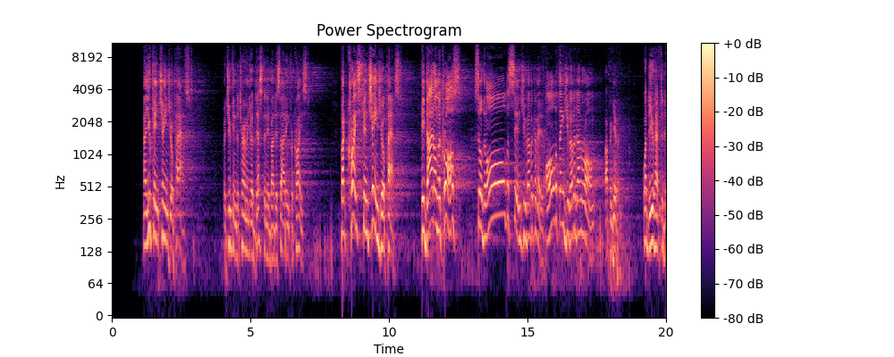
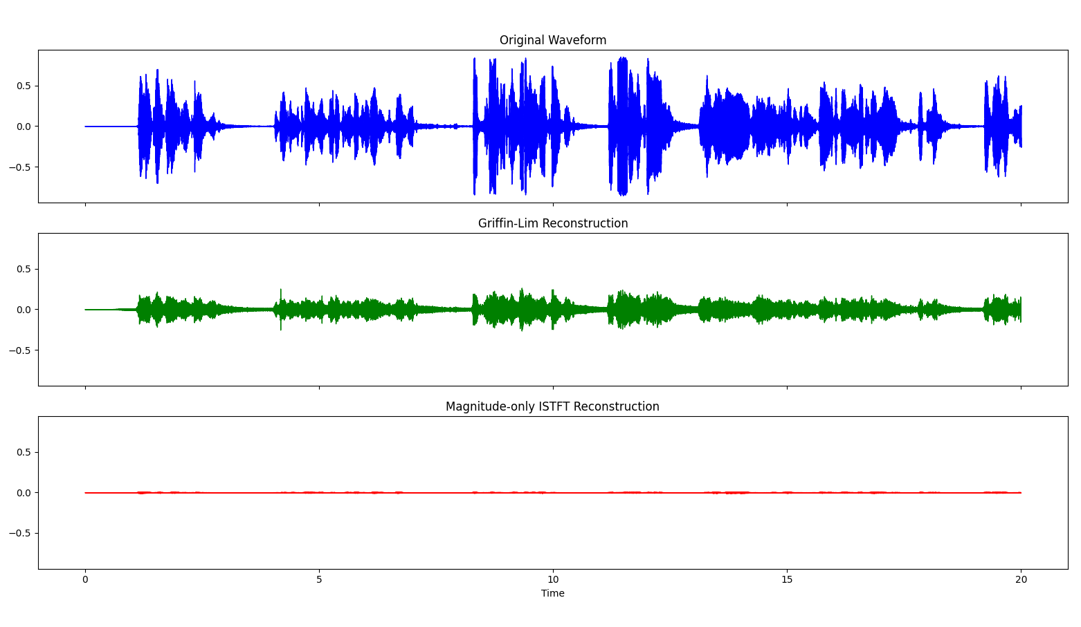
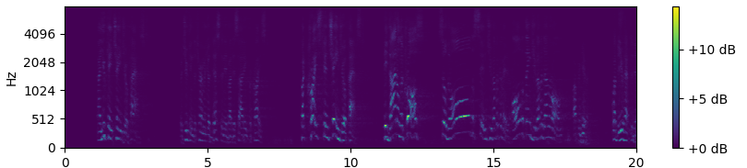
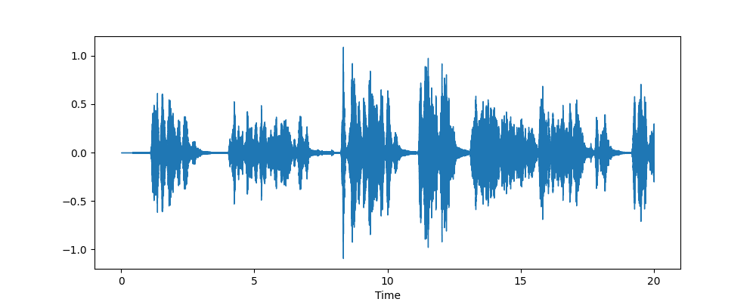
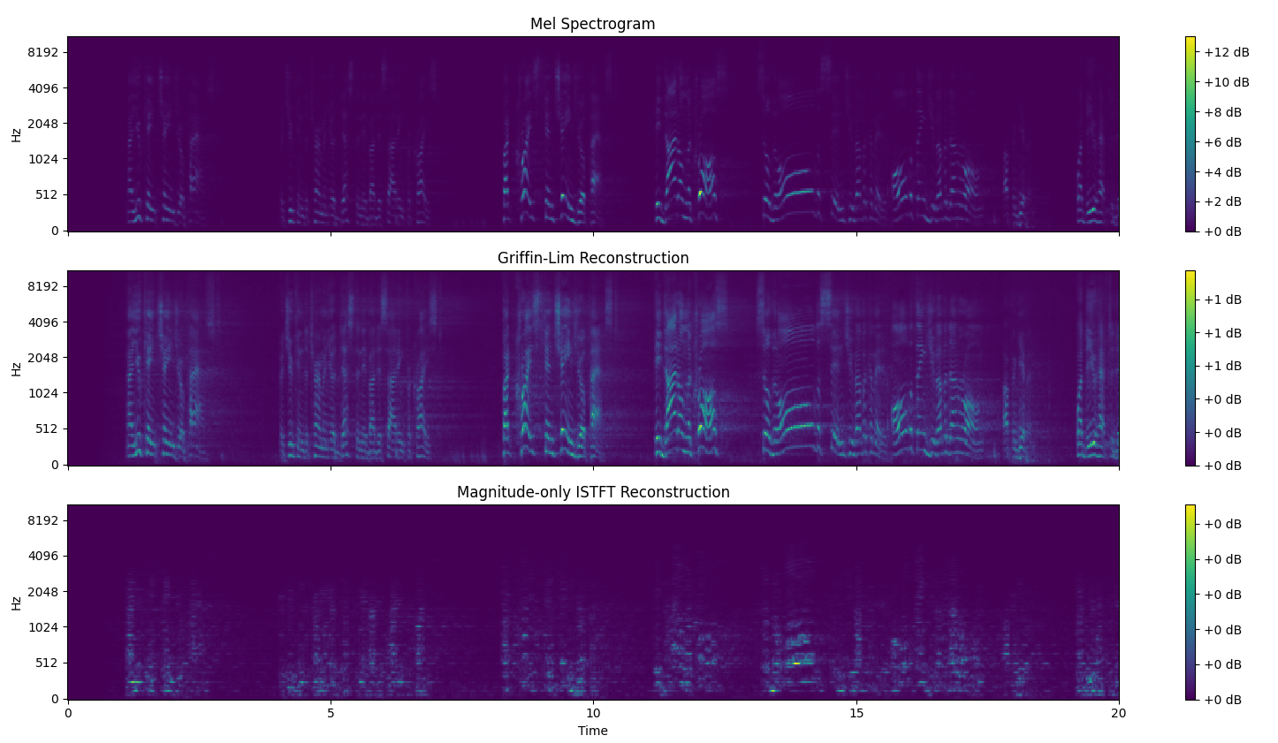
Optimized Phase-Preservative Speech Reconstruction and Enhancement
Tobiah Bower
University of Central Florida, Orlando, FL
Abstract
Results
Discussion
The signal reconstruction problem.
Loss of phase doing Mel Spectrogram.
Many try and insert “random” stochastic phase information to retain quality, but it is necessary to estimate the phase or else the waveform is bad.
Input waveforms Billy/ TBD female vocal
Mel Spectrograms of inversed
PESQ Improved by Iterative GLA
2.1 -> 3.76
Kalman Filter confidence plots
Computational benefits of local GLA vs end-to-end
Speech to Text & other applications
Methodology
Short Time Fourier Transform
Mel Spectrogram
One-shot GLA – Projections, Frobenius Norm, Optimization
Iterative GLA
PESQ
Kalman Speech Enhancement
Kalman Fusion – 3 microphones for same source
Caption
References
Masuyama et al. "Signal reconstruction from Mel-spectrogram based on bi-level consistency of full-band magnitude and phase“
Perraudin et al. “A Fast Griffin-lim Algorithm,” 2013.
Orchisama Das, “Kalman Filter in Speech Enhancement,” 2016.
Acknowledgements
Dr. Wasfy B. Mikhael gave me this project idea, and I have learned so much under his teaching and mentorship.
Dr. Chinwendu Enyioha has helped me make more sense of all the concepts in optimization and estimation.
Caption

