Slide 1

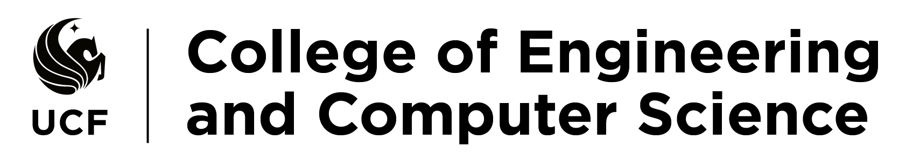
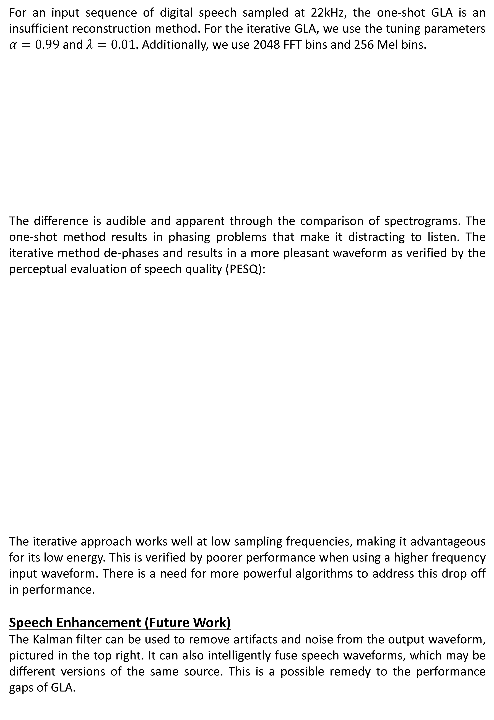
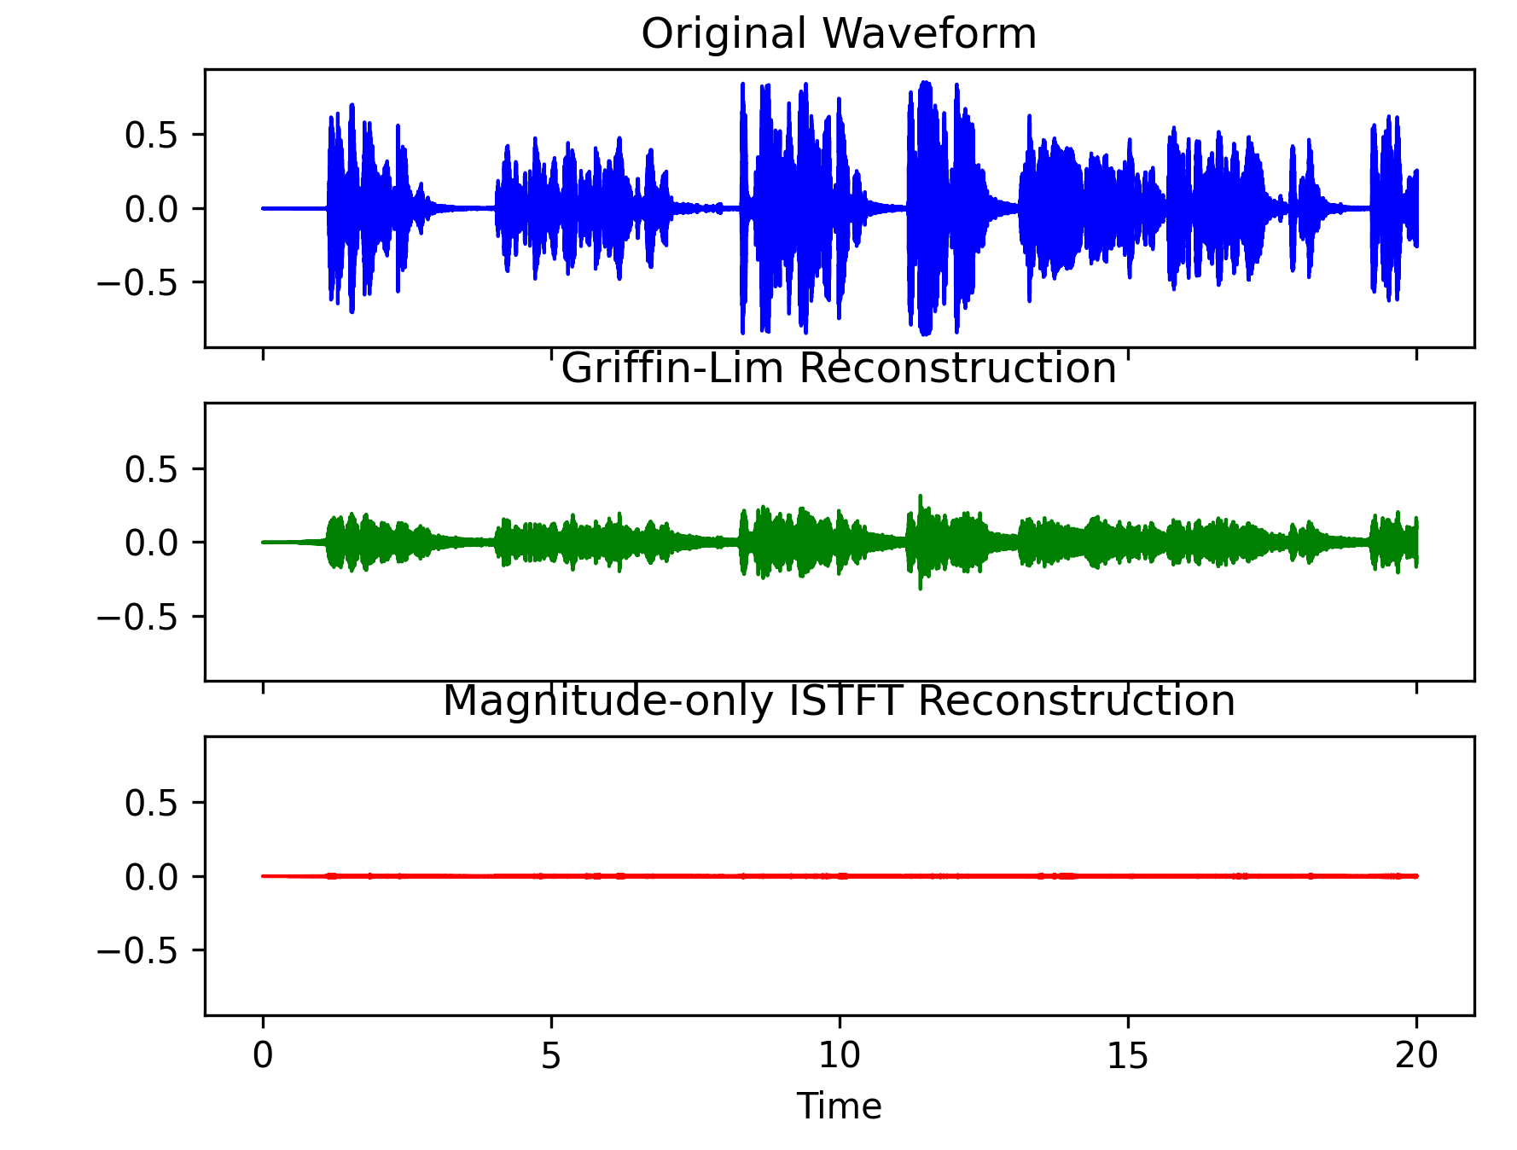
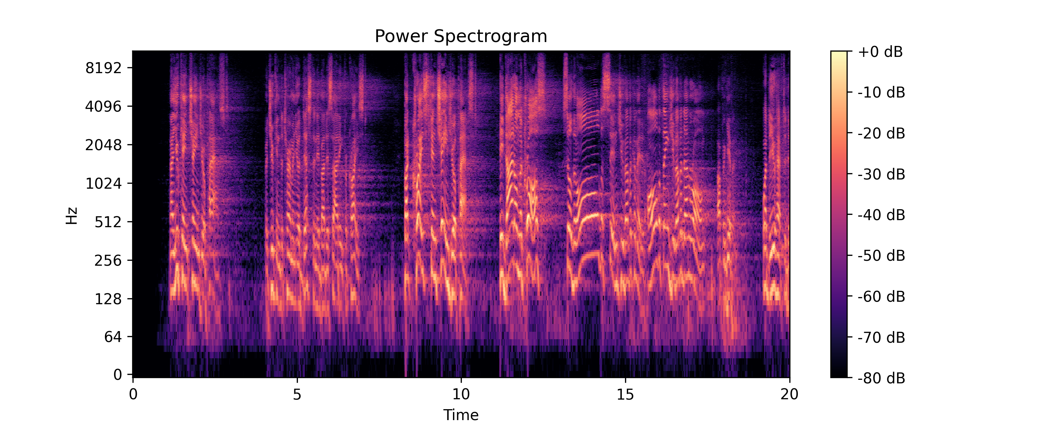
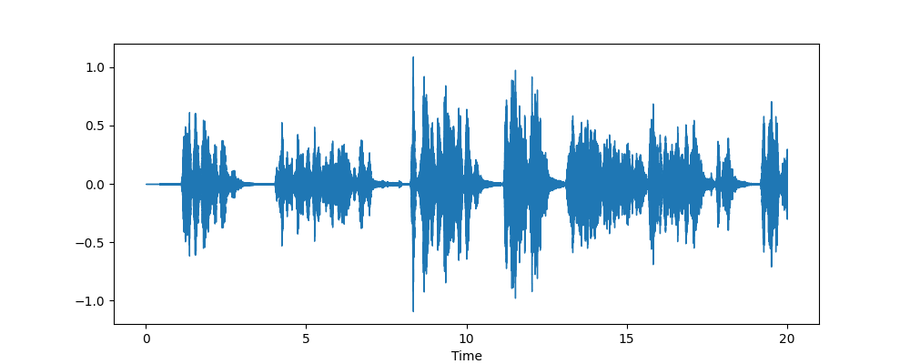
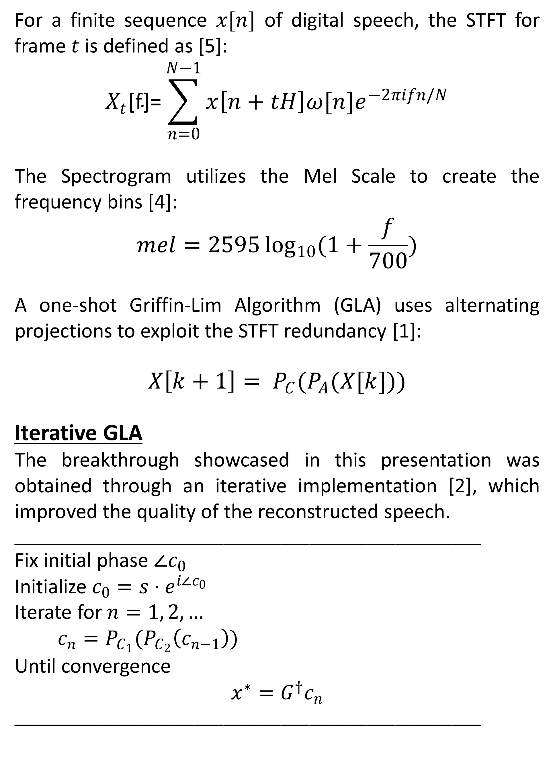
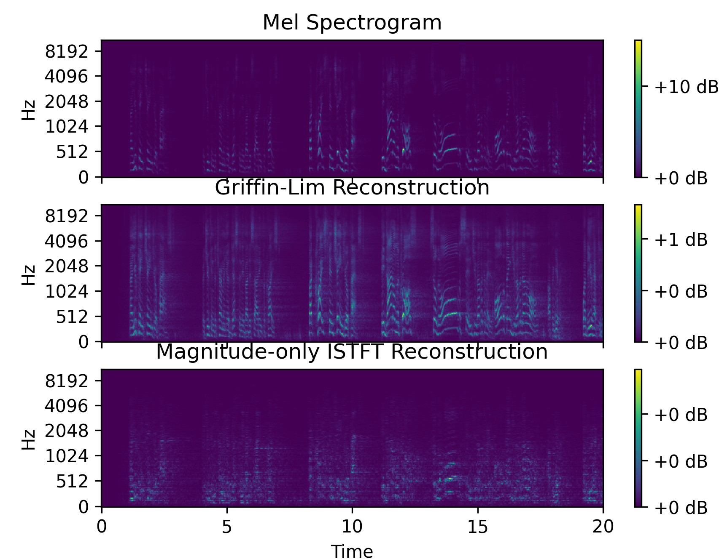
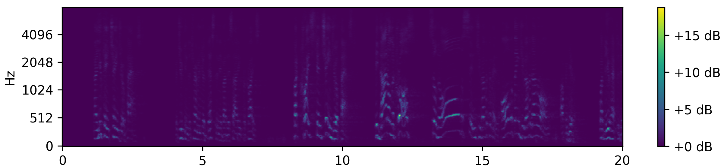
Optimized Phase-Preservative Speech Reconstruction and Enhancement
Tobiah Bower
Electrical Engineering
Abstract
Results
Discussion
The Signal Reconstruction Problem.
While Mel Spectrograms are powerful tools to visualize auditory spectral energy content, there is an unavoidable loss of phase information caused by the shortcomings of the Short-Time Fourier Transform (STFT). Many methods try to insert random stochastic phase information to retain speech quality; however, this research shows a recovery of the original phase information through optimal estimation.
As we see, the iterative GLA results in not only a higher fidelity waveform, but the phase is considerably more accurate to the original speech. It is important to note that at this complexity, higher sampling frequency may actually lead to poorer algorithm performance. More iterations may also reduce the quality of the PESQ scores
Additionally, we see the similarity in the Mel Spectrogram, as artifacts and noise have been removed. Further work will be done to refine the wideband performance for higher frequency vocals, and to allow for CNN learning to produce an output without access to the original speech.
In future studies, we will examine computational benefits of local GLA runs on multi-recordings of same source fused with Kalman speech enhancement, with end-to-end refined iterative GLA. This methodology is relevant to the speech to text effort, used by translation and home assistants.
Methodology
Male wideband
Algorithm | PESQ
One-Shot GLA | 2.816
Iterative GLA | 3.615
Female narrowband
Algorithm | PESQ
One-Shot GLA | 1.609
Iterative GLA | 1.896
References
[1] Masuyama et al. "Signal reconstruction from Mel-spectrogram based on bi-level consistency of full-band magnitude and phase“
[2] Perraudin et al. “A Fast Griffin-lim Algorithm,” 2013.
[3] Orchisama Das, “Kalman Filter in Speech Enhancement,” 2016.
[4] Natsiou, O’Leary, ‘A Sinusoidal signal reconstruction method for the inversion of the mel-spectrogram’
[5] Bruce Sharpe, “Invertibility of overlap-add processing”
Algorithms implemented in Python. There are other methods of de-phasing a waveform, but as with the inverse STFT, they are fallible.
Acknowledgements
Dr. Wasfy B. Mikhael inspired me with this project idea, and I have learned so much under his teaching and mentorship.
Dr. Chinwendu Enyioha has helped me make more sense of all the concepts in optimization and estimation.

