Slide 1

A Firefly-inspired project: Heartbeat Synchronization in Small World Networks
Swarm Intelligence for Distributed AI systems

Slide 2

Synchronous Flashing!
Some species of fireflies like Pteroptyx (South Asia) or Photinus pyralis (North America) can flash in a synchronous way.

Slide 3
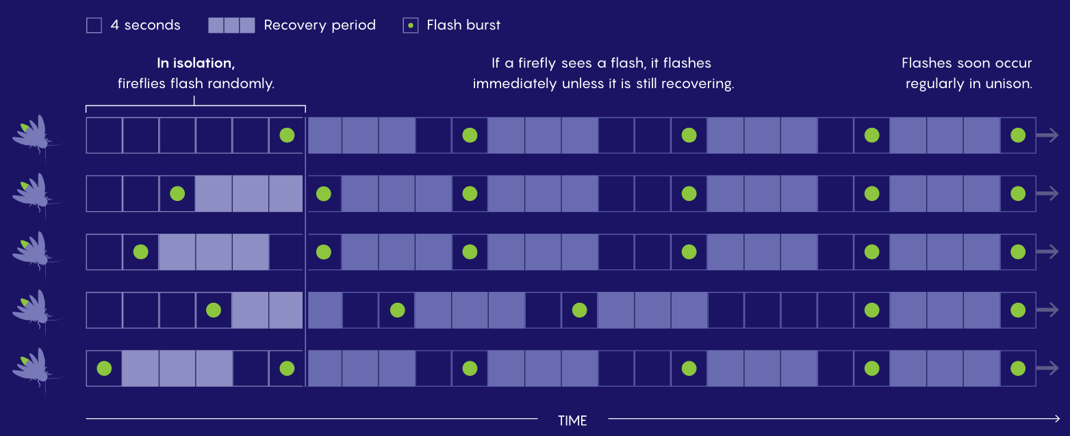
How?

Slide 4
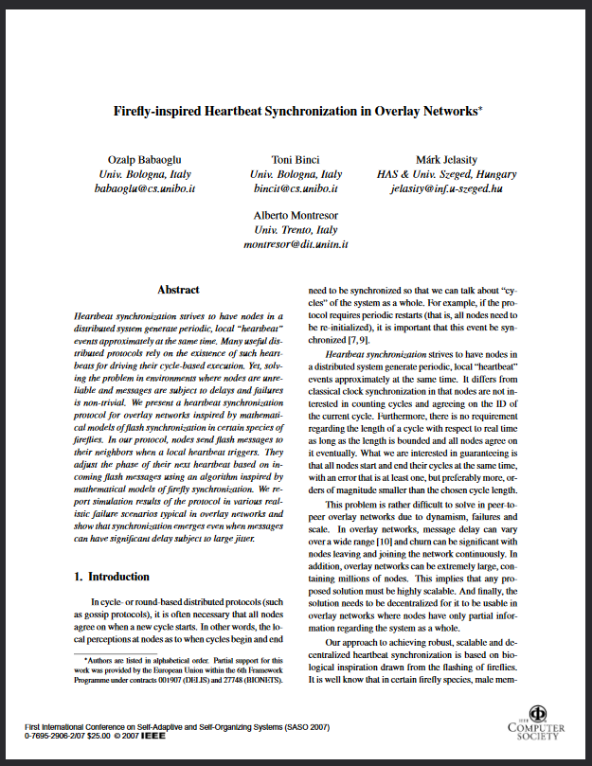
In this paper Ozalp Babaoglu took inspiration from fireflies to synchronize Overlay Networks
by exploiting the
Ermentrout Model
Let’s apply it in
Small World Networks

Slide 5


Small World Networks
Short Charateristic Path Length
High Clustering factor
Short path distance distance between any two nodes in the social network
Node’s friends in a social network tend to be friend each other.

Slide 6
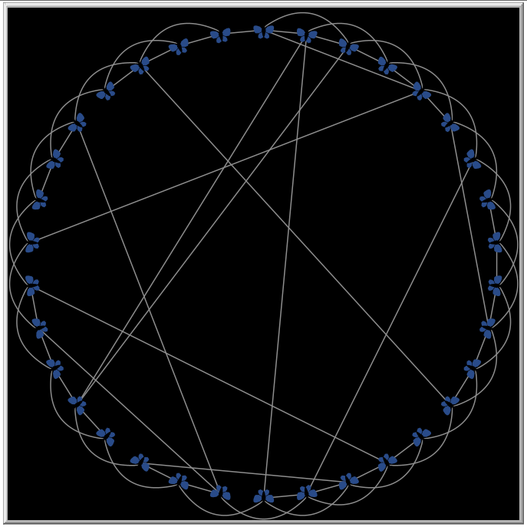
Small World Network of virtual fireflies
The program will automatically design a Small World Network, starting each time from a Lattice and checking APL and CC parameters to be in good ranges.

Slide 7
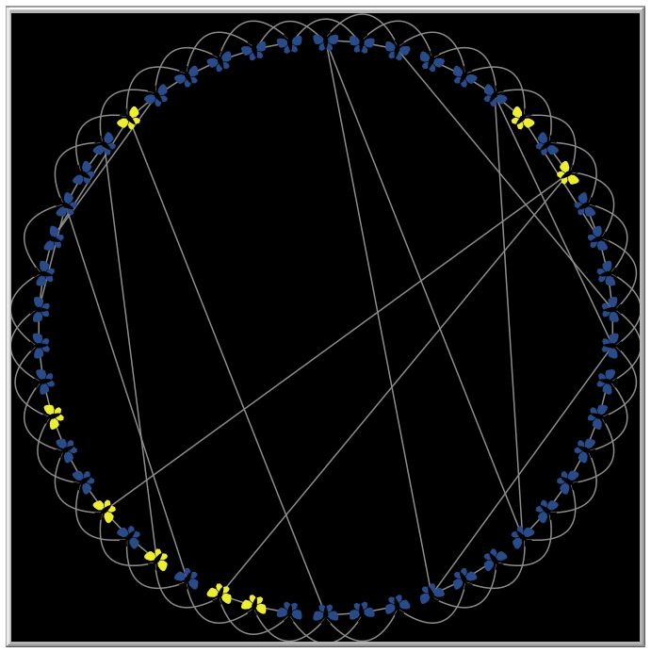
Fireflies → Nodes
Firefly’s neighborhood
becomes
Node’s adiacents

Slide 8
The Ermentrout Model
init cycle_length δi between ∆l and ∆u, initial δi corresponds to the natural cycle_length ∆.
express them in terms of frequencies: ωi = 1/δi, Ωl = 1/∆l, Ωu = 1/∆u, Ω = 1/∆.
Φ is the phase (growing excitement of each firefly).
WE NEVER CHANGE Φ! WE ONLY CHANGE ωi!
Based on another firefly that flashes in my neighborhood, I can establish if I’m flashing too late or too early!
By looking at Φ:
Φ < ½? too late | too early

Slide 9
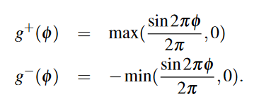
Updating ω
Lengthening Term
Shortening Term

Slide 10
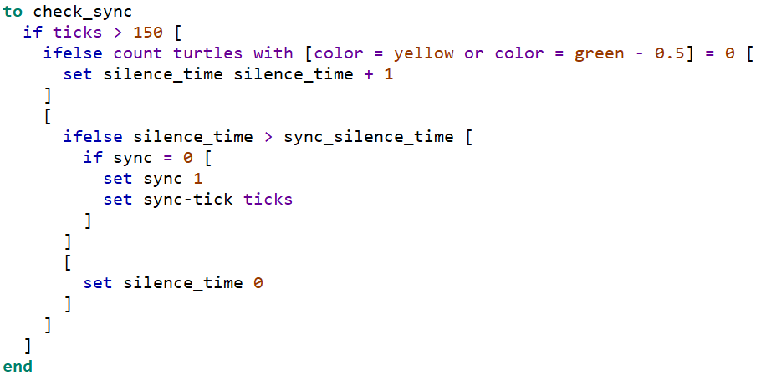
Synchronization

Slide 11
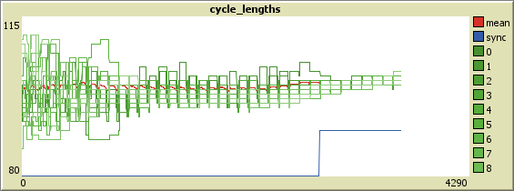
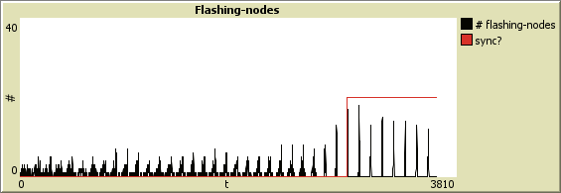
Gradually converging Cycle Length of nodes
Number of Flashes happening at the same time

Slide 12
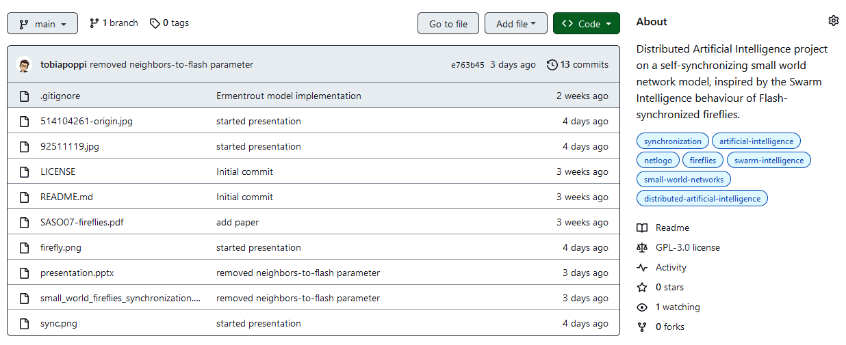
Go Open Source!
https://github.com/tobiapoppi/Firefly-inspired-heartbeat-sync-in-Small-World-Networks

Slide 13
Thanks!
Special thanks to professor Franco Zambonelli, teacher of Distributed AI course.
Tobia Poppi

