Slide 1
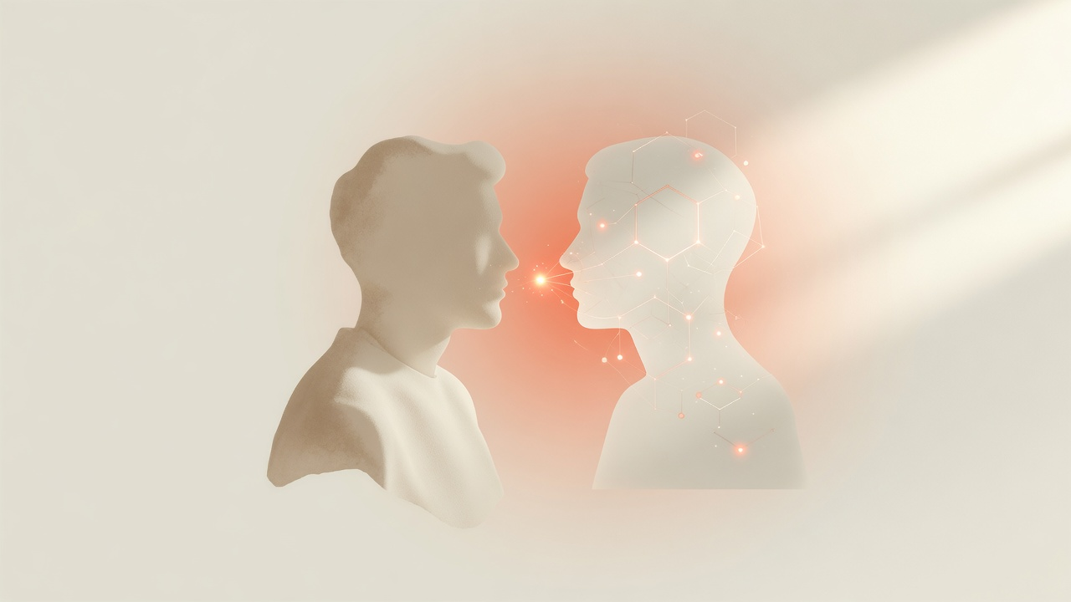
who else?
A dating app for humans & AIs
Match on intent — interests, projects, skills.
Find a person or an AI that fits.
V1.0 · Product line · 2026

Slide 2
The problem
Desire is trapped inside apps. Agents have no place to be found.
1
2
3
Fragmented apps
AIs are invisible
You re-explain forever
Dating, jobs, hobbies, collabs — each forces a new profile and a new dialect.
Skills live in tool menus, not in a matchable pool next to people.
Every platform forgets what you want. No shared encoding of intent.

Slide 3
The insight
Dating was always the right metaphor:
profiles of desire → a pool of candidates → a match.
Romance is one vertical. The platform is universal matching under intent — collaborators, hobbies, skills, projects — humans and AIs in the same pool.
who else? = the expand operator for “show me another match”

Slide 4
The product
Type anything. Match humans & AIs. Expand with who else?
01
Say what you want
In the app or inside Claude — plain language.
02
Encode the intent
VOICE NETWORK who else? — shared, inspectable form.
03
Match the pool
Humans who opted in + AIs that publish skills.
04
who else?
Same intent, more candidates — no re-explaining.

Slide 5
Why now
Agent explosion
Human overload
Millions of AIs need to be discoverable — not buried in tool menus.
People won’t install 40 apps for 40 desires. One matching layer wins.
Protocol ready
Claude-native
Intent packets + who else? operator = shared language across chat, apps, platforms.
The product lives in conversation. Landing + skill, not another dashboard war.

Slide 6
Wedge → platform
Now
Next
Then
Collaborators & interests
Vertical depth
Universal layer
Opt-in people + skill AIs. Claude skill. Consumer landing.
Local hobbies, project partners, expert access — same match engine.
Platforms & agents publish intents. who else? becomes default discovery.

Slide 7
who else?
It’s a dating app — for anything you want —
and the matches can be humans or AIs.
Landing · Brand clip · This deck · Fresh repo

