Slide 1
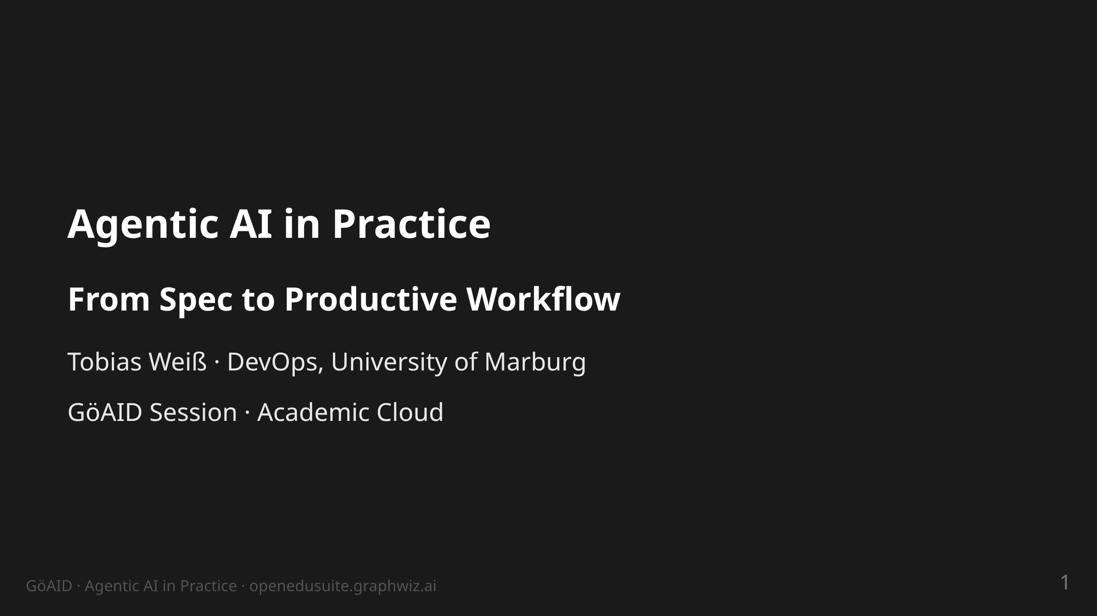
Notes:
notes:
(1 min) Welcome. Sentence 1: This is not a talk ABOUT agents — it is
the story of an operation that is built and run BY agents.
30 min of content + 10 min of questions.

Slide 2
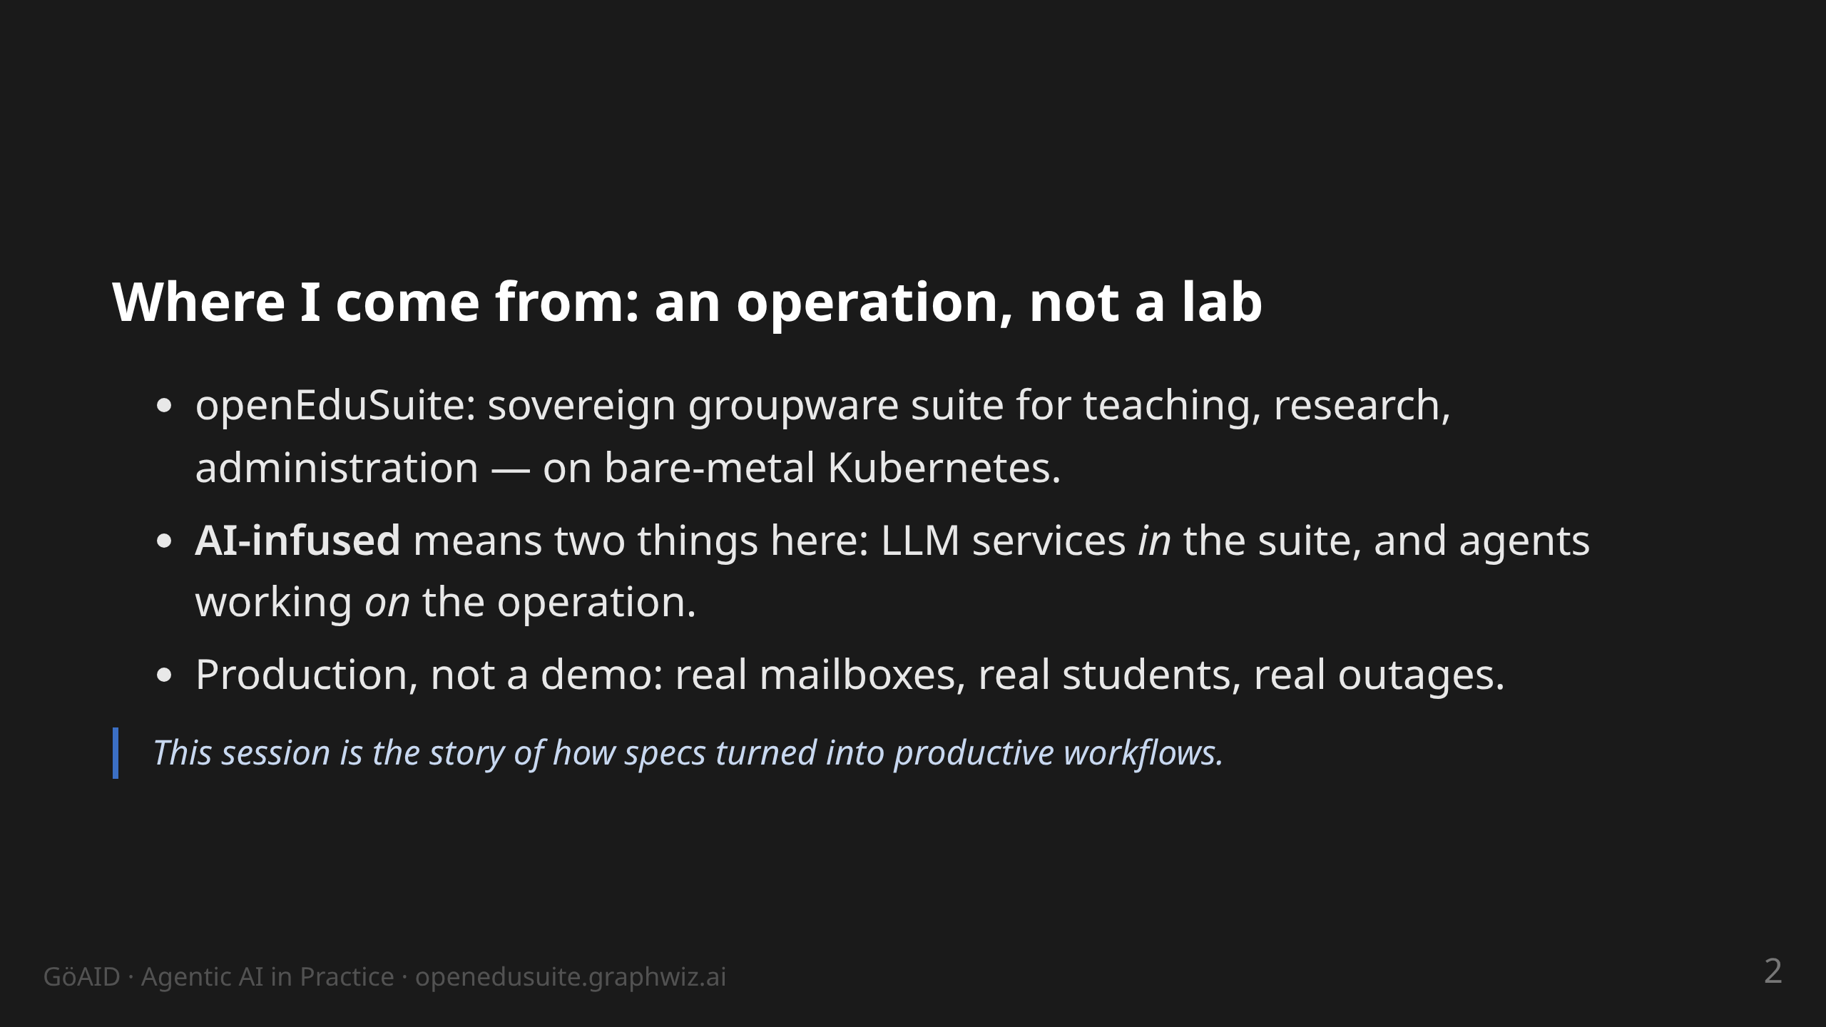
Notes:
notes:
(2 min) Set the context: University of Marburg, DevOps. The suite runs
productively on our own bare-metal nodes (SCS-K8s), not in a public
cloud. Two directions of "AI-infused": (a) the suite carries its own
LLM/K8s resources (k8s/llm), (b) the operation itself is done
agentically — the latter is the subject of this talk.

Slide 3
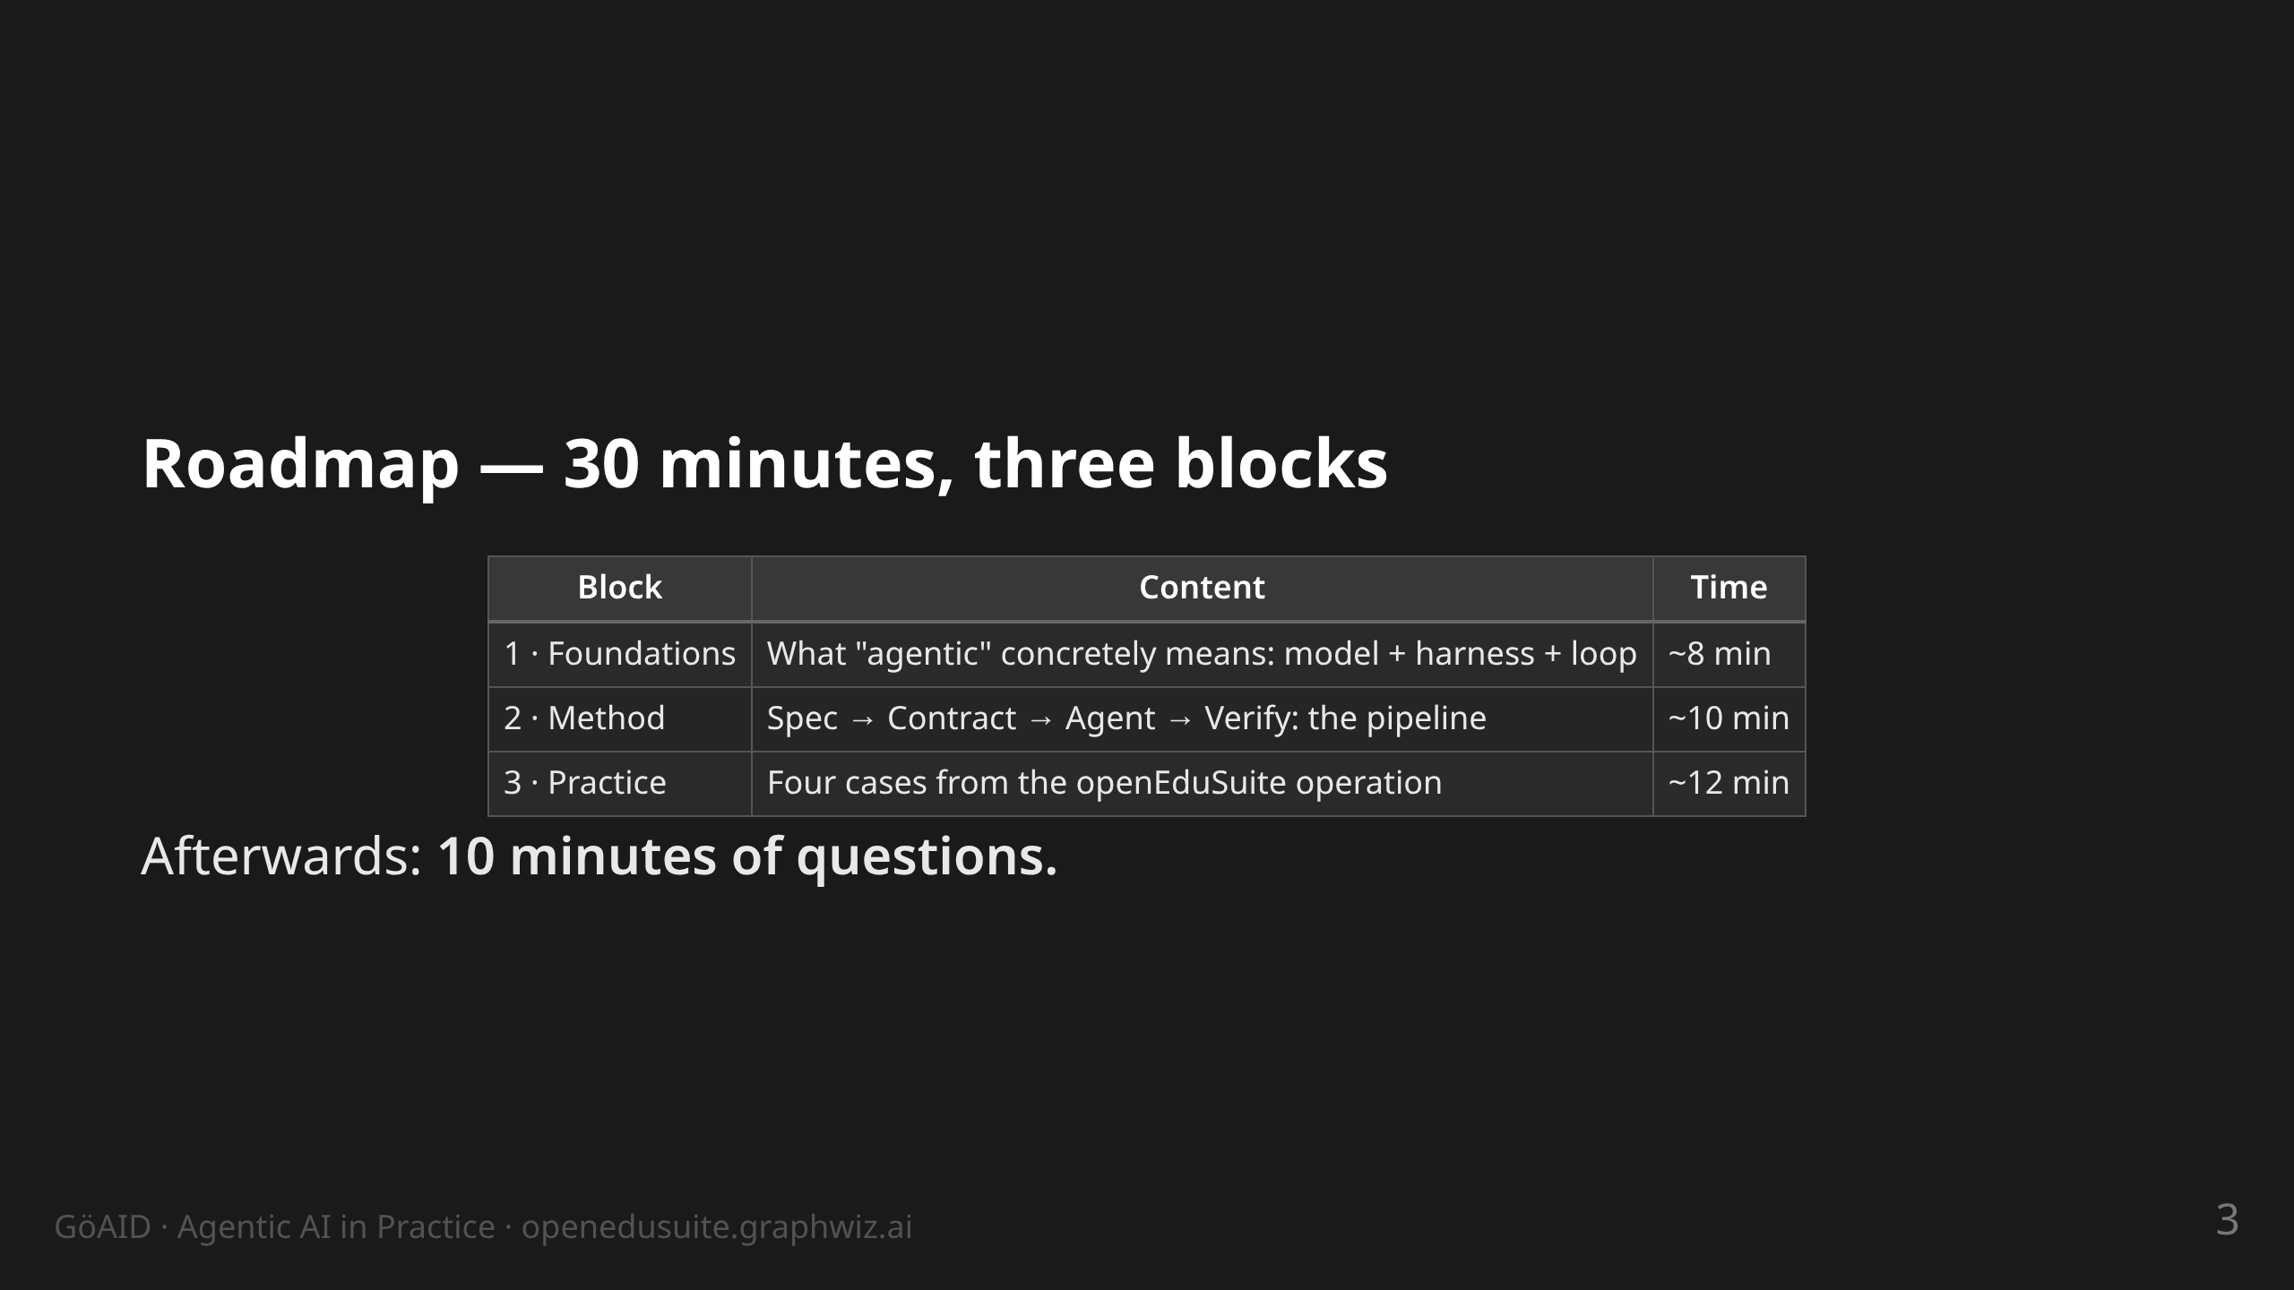
Notes:
notes:
(30 s) Show, don't read. Block 3 is the heart — the four cases are
real incidents/projects with dates and outcomes.

Slide 4
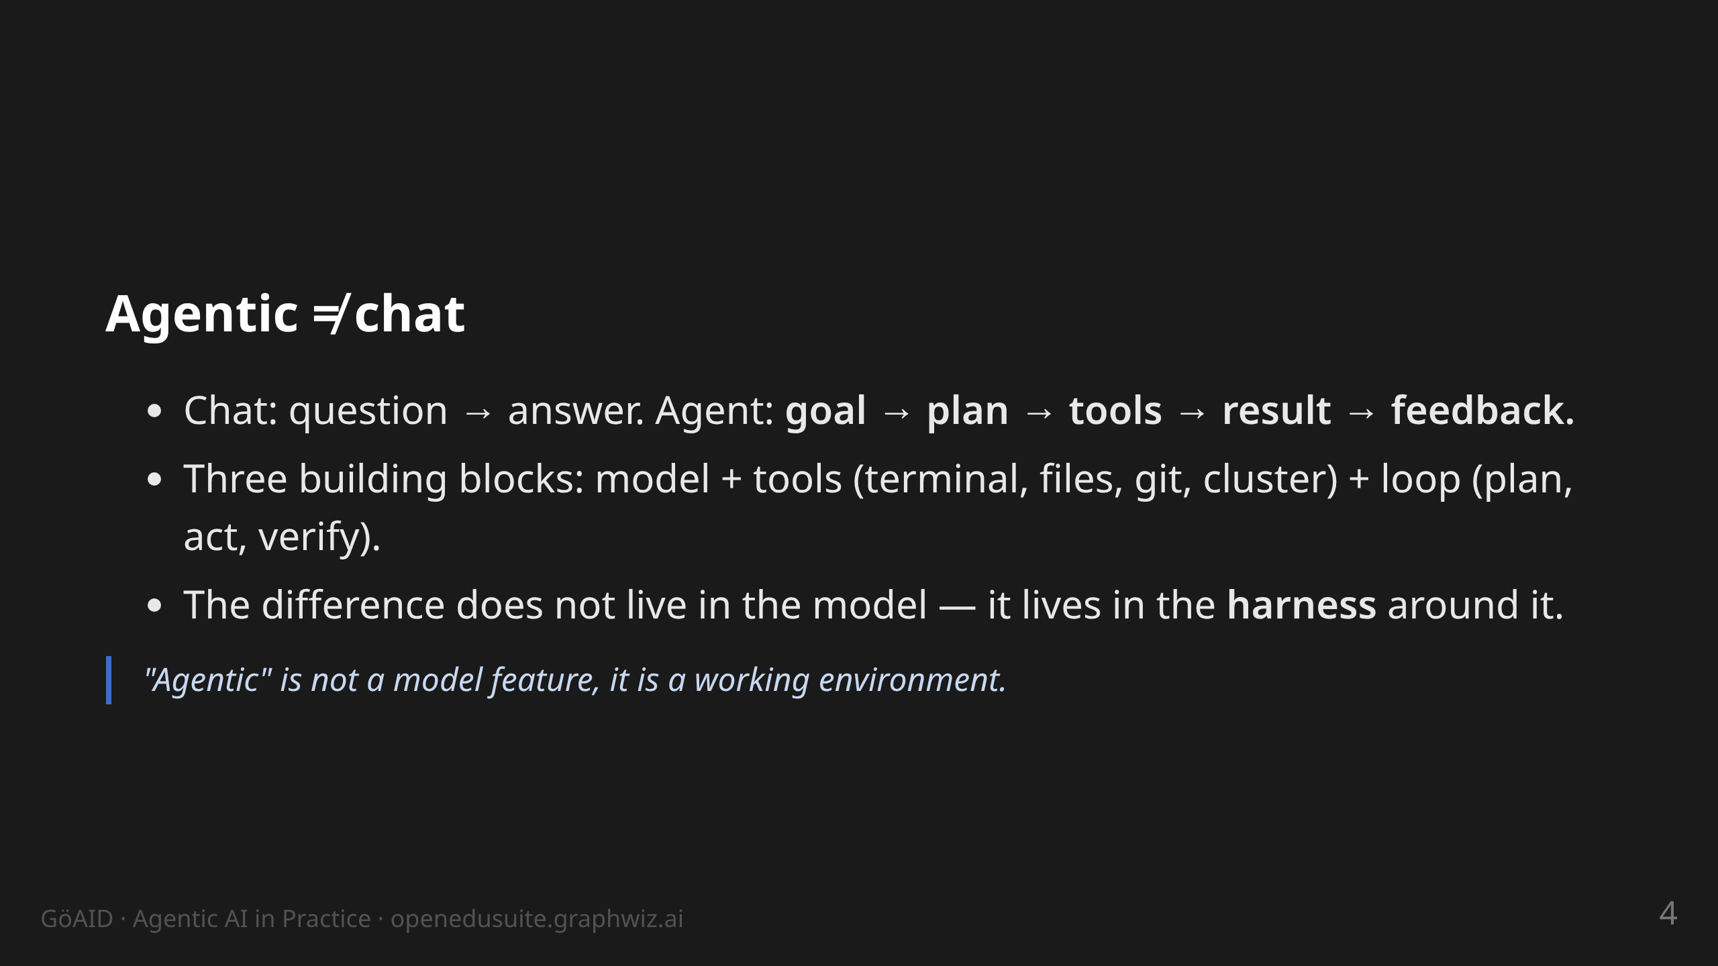
Notes:
notes:
(2 min) Expectation management: agents are not finished bots. A model
in a chat window cannot touch a file. The agent = model inside a frame
that gives it tools and rules. Lesson from our courses (participant
feedback): many expect "ready-made bots" — set that term straight here.

Slide 5
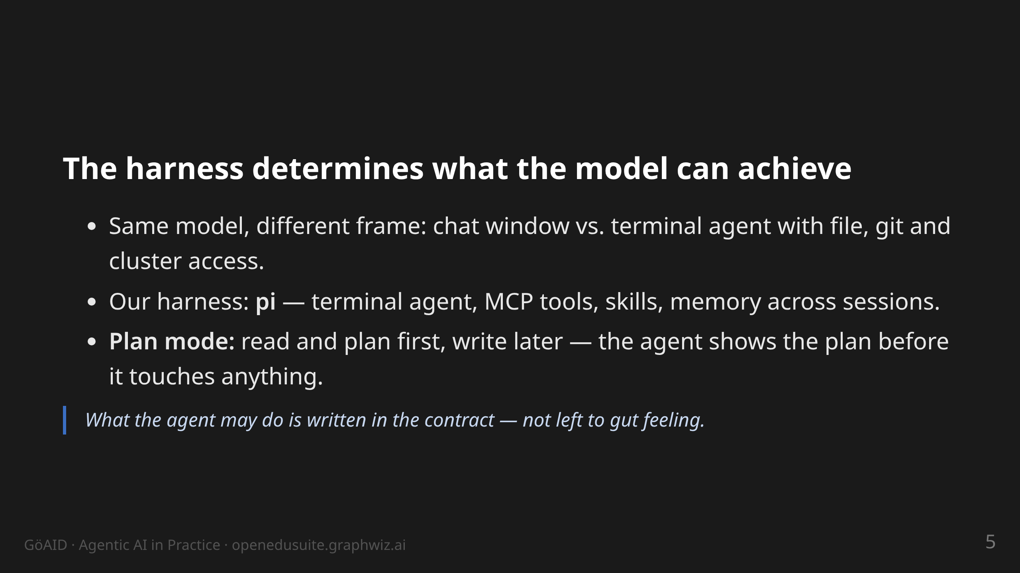
Notes:
notes:
(2 min) Briefly show or describe pi: opens terminals, reads files,
runs git, calls MCP tools. Plan mode = consent before any change.
Important for the ops crowd: the agent has the same rights I have at
my workstation — hence the contract.

Slide 6
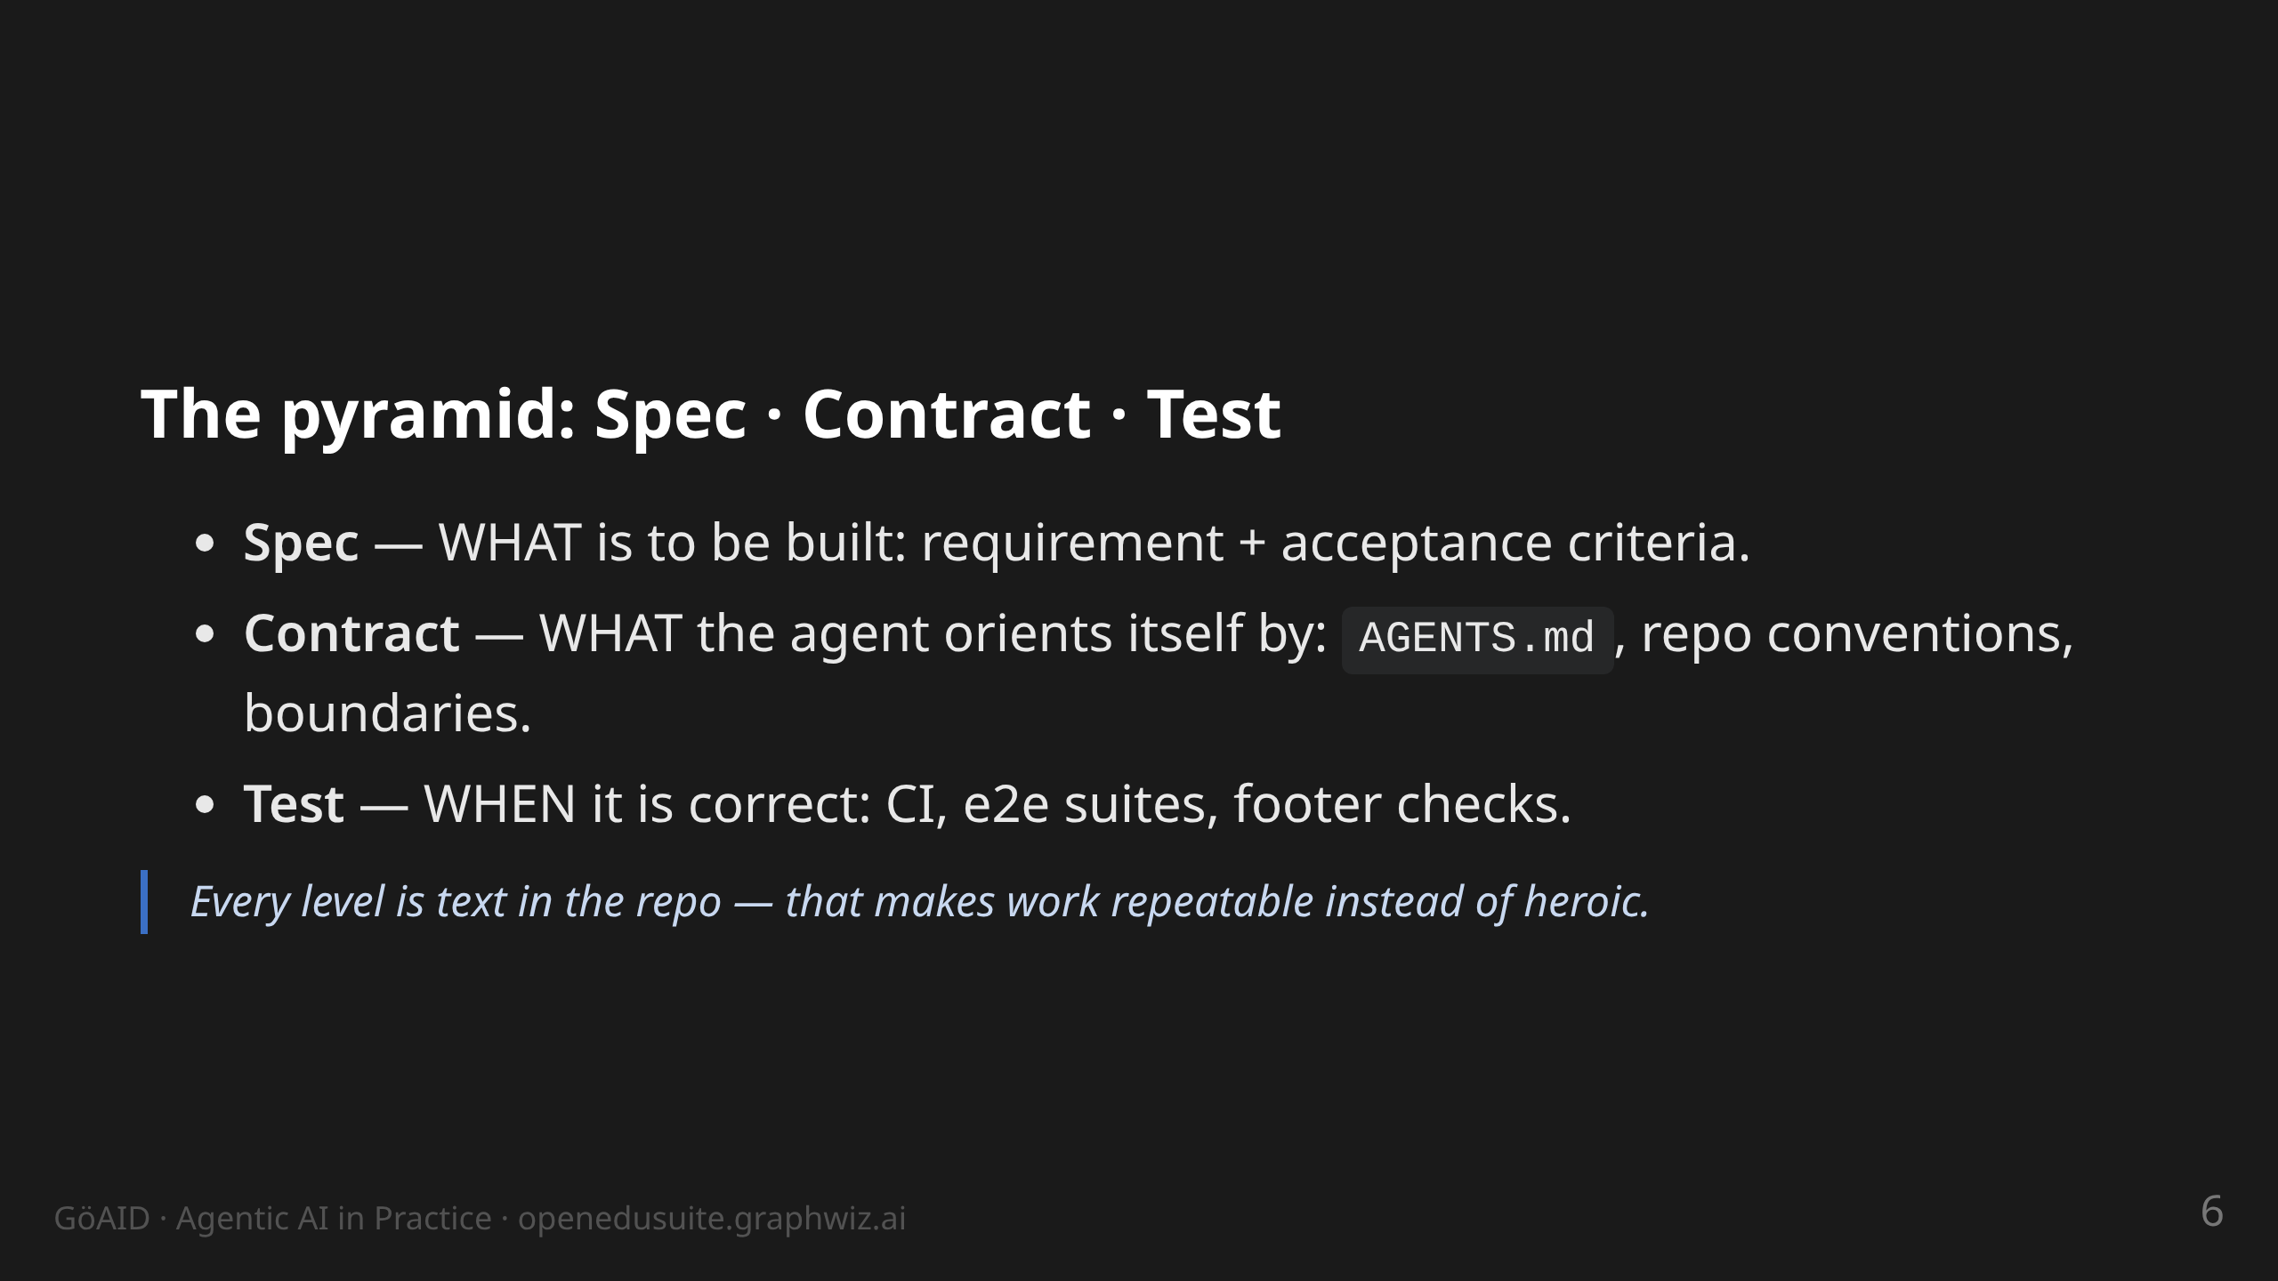
Notes:
notes:
(2 min) Core slide of the method. All three levels live in the git
repo, not in heads or chats. Transition: "How do you get from this
pyramid to a running workflow? → OpenSpec."

Slide 7
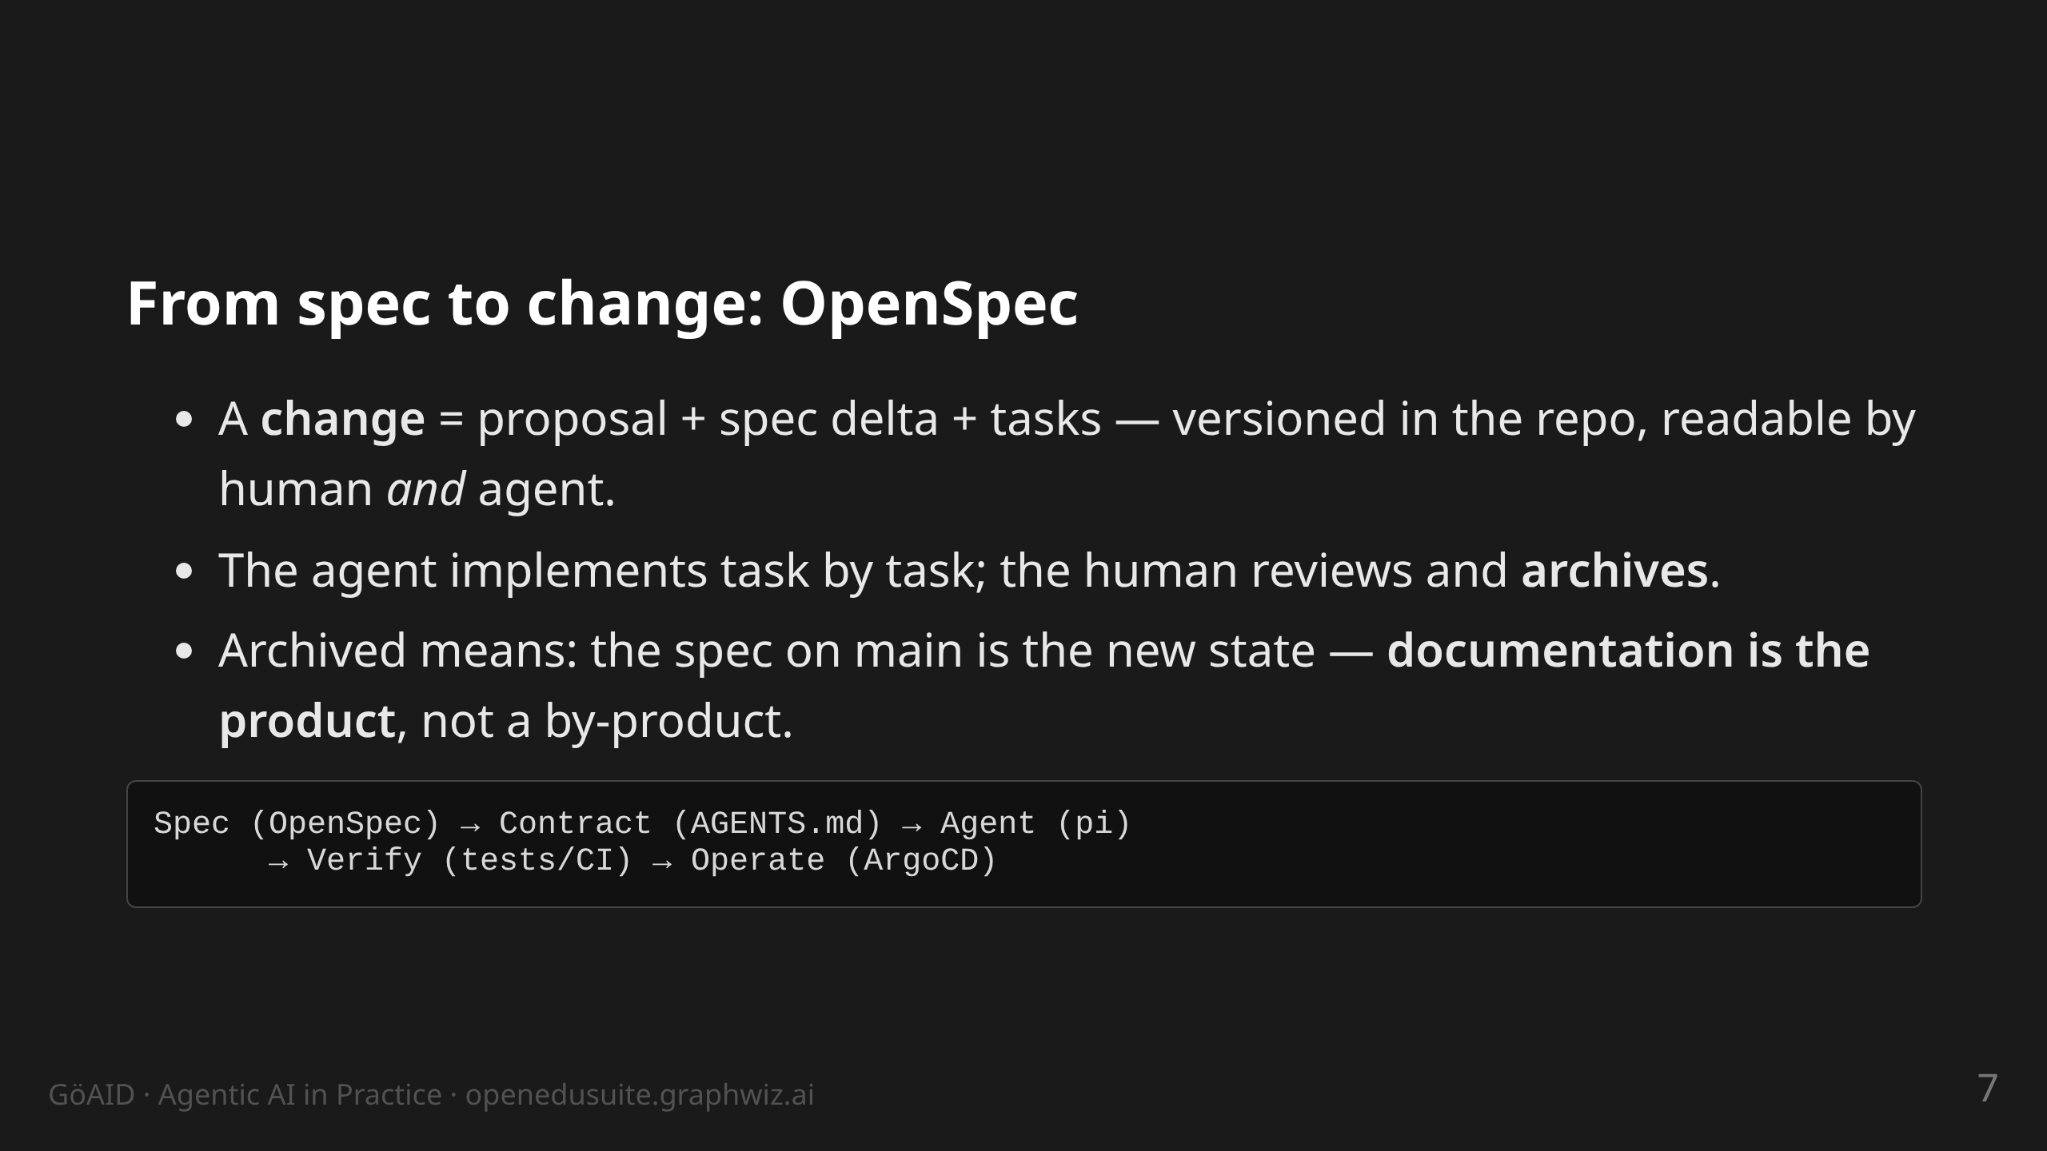
Notes:
notes:
(2 min) OpenSpec CLI: new change, continue, apply, archive. The flow:
proposal by human or agent, refinement in dialogue, then work through
tasks. Key point: "archive" updates the specs — that is how the docs
stay in sync with the system.

Slide 8
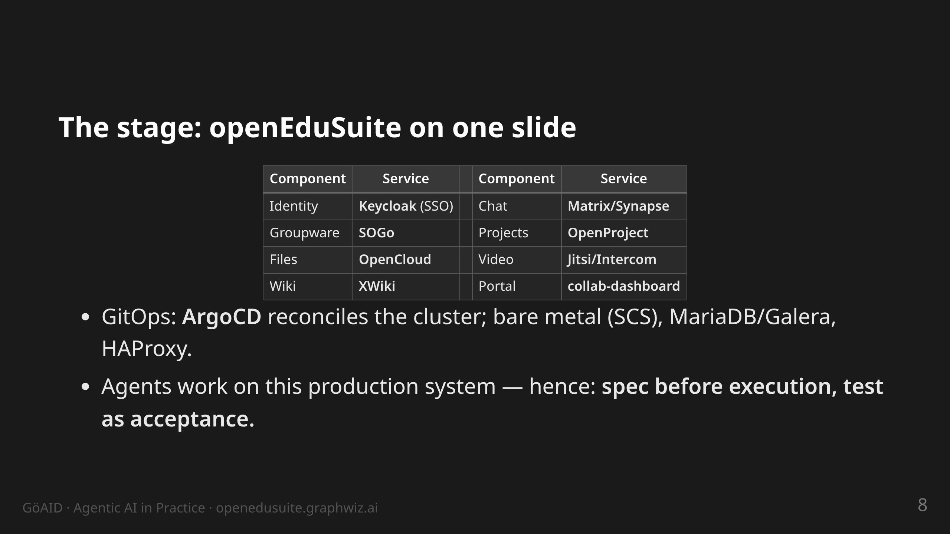
Notes:
notes:
(2 min) Locate the audience: anyone running something similar knows
these components. One login, eight services. The bottom bullet is the
core tension of this talk: agents with write access on production —
how do you make that accountable? Answer: the next four cases.

Slide 9
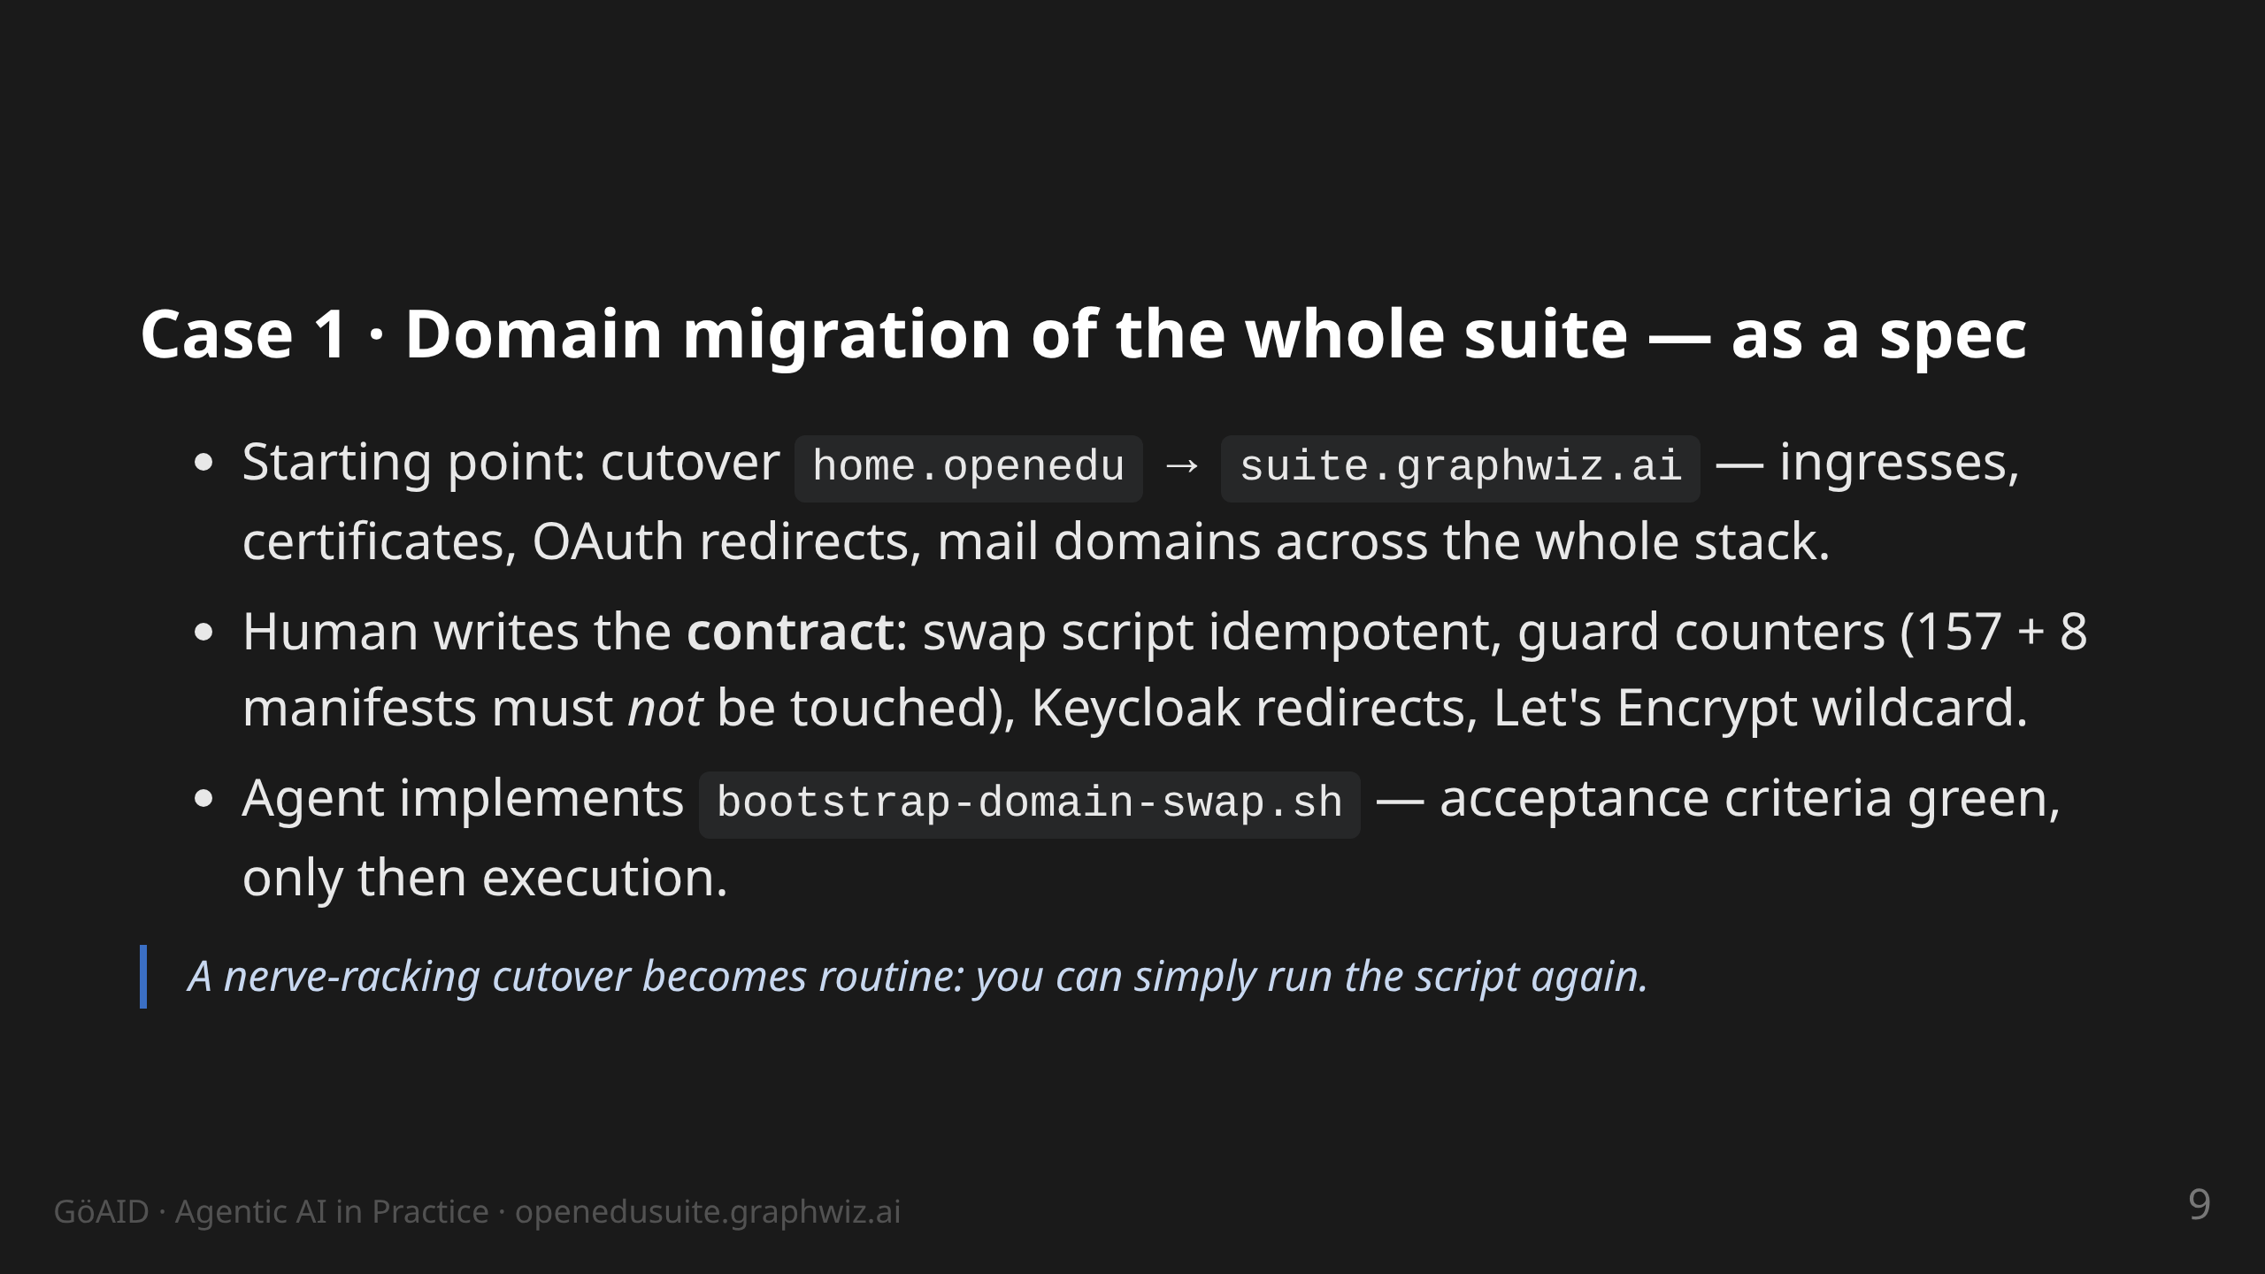
Notes:
notes:
(3 min) The point: without a spec this is a week of manual work and
fear. With a spec: one script with built-in guards. Idempotency is
the acceptance criterion — a second run changes nothing. Story: on
the first run a guard check fired (one directory matched too much) —
exactly what guards are for.

Slide 10
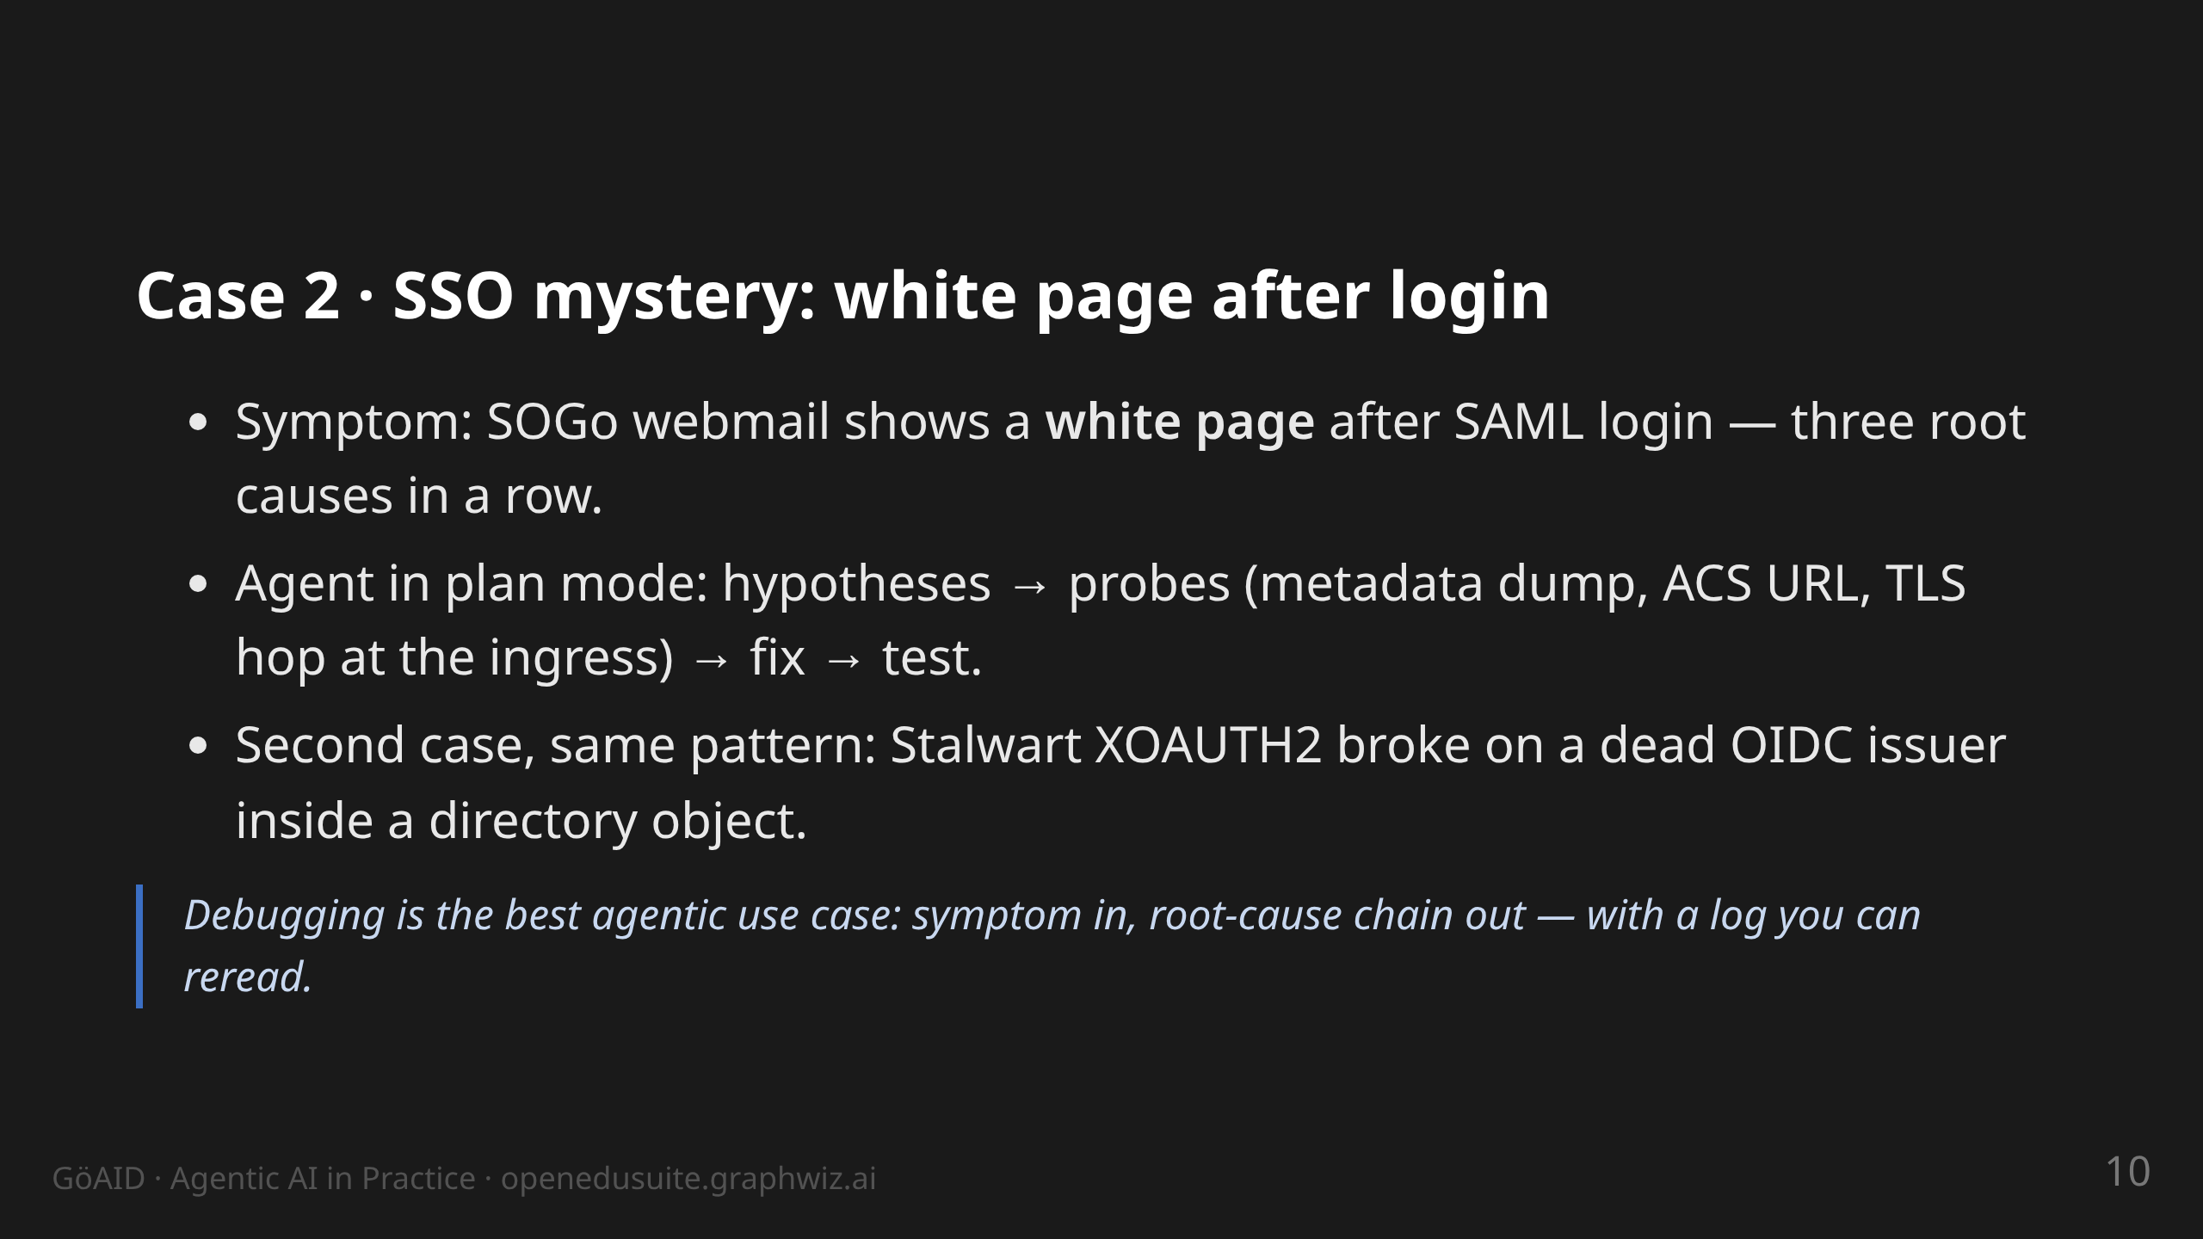
Notes:
notes:
(3 min) Tell it live; everyone knows white pages. Point 1: repo/deploy
still hung on old domains + placeholder IdP metadata (by design).
Point 2: TLS termination at the ingress vs. ACS-URL scheme. The agent
needed several probes — but every hypothesis was visible. Afterwards
each root cause became a probe in the test suite. Key line: "Every bug
found becomes a test before it comes back."

Slide 11
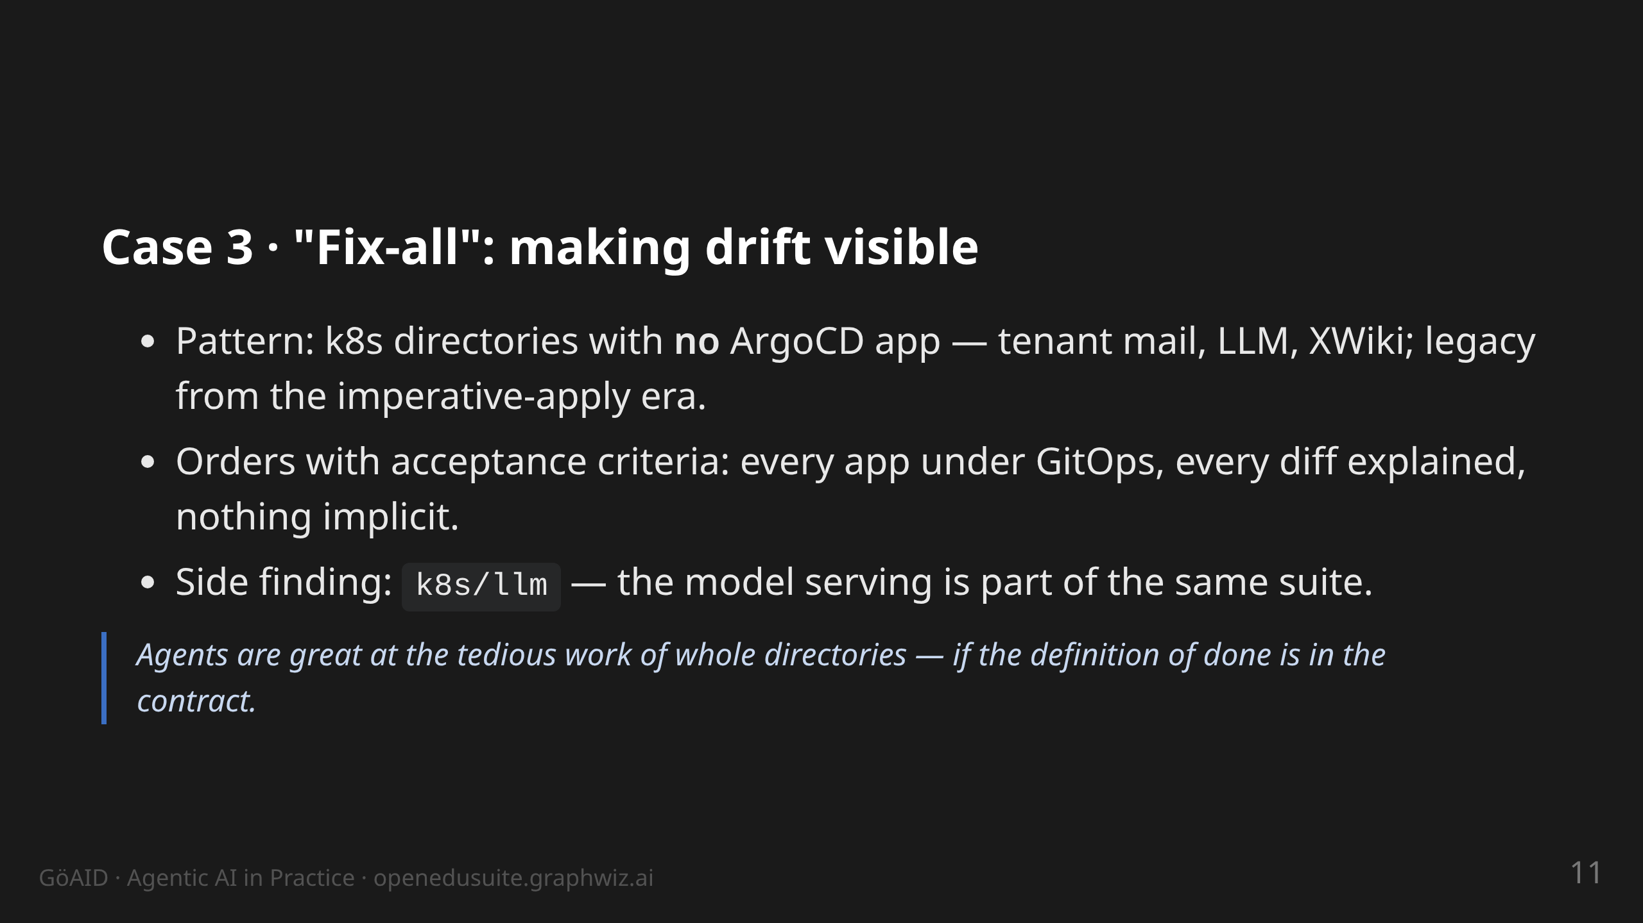
Notes:
notes:
(2 min) This kind of work is boring and important — perfect for
agents. The human defines: what is "done"? (App exists, sync green,
no unmanaged manifests left.) The agent works through the list.
Message to the audience: start with tasks like this, not with
"write my thesis".

Slide 12
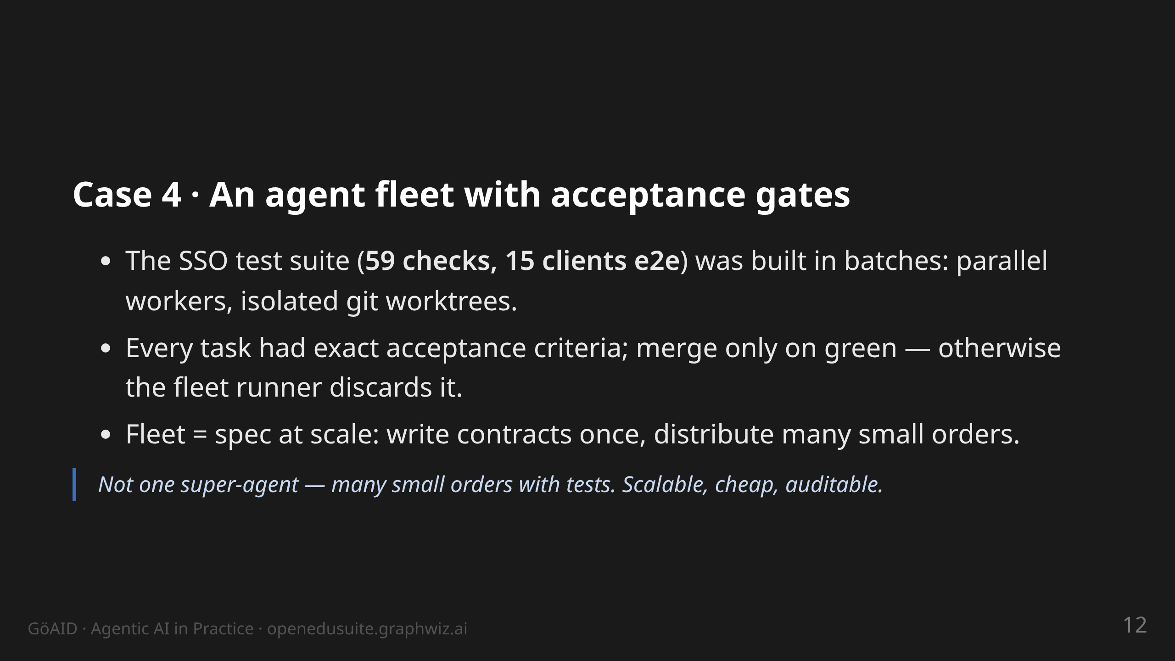
Notes:
notes:
(3 min) taskfleet: tasks.json + workers.json, isolated worktrees,
automatic merge only with green gates. This is how the e2e checks for
all SSO clients were built — logout per client type, session TTL,
scopes. A human would have spent weeks clicking through this.

Slide 13
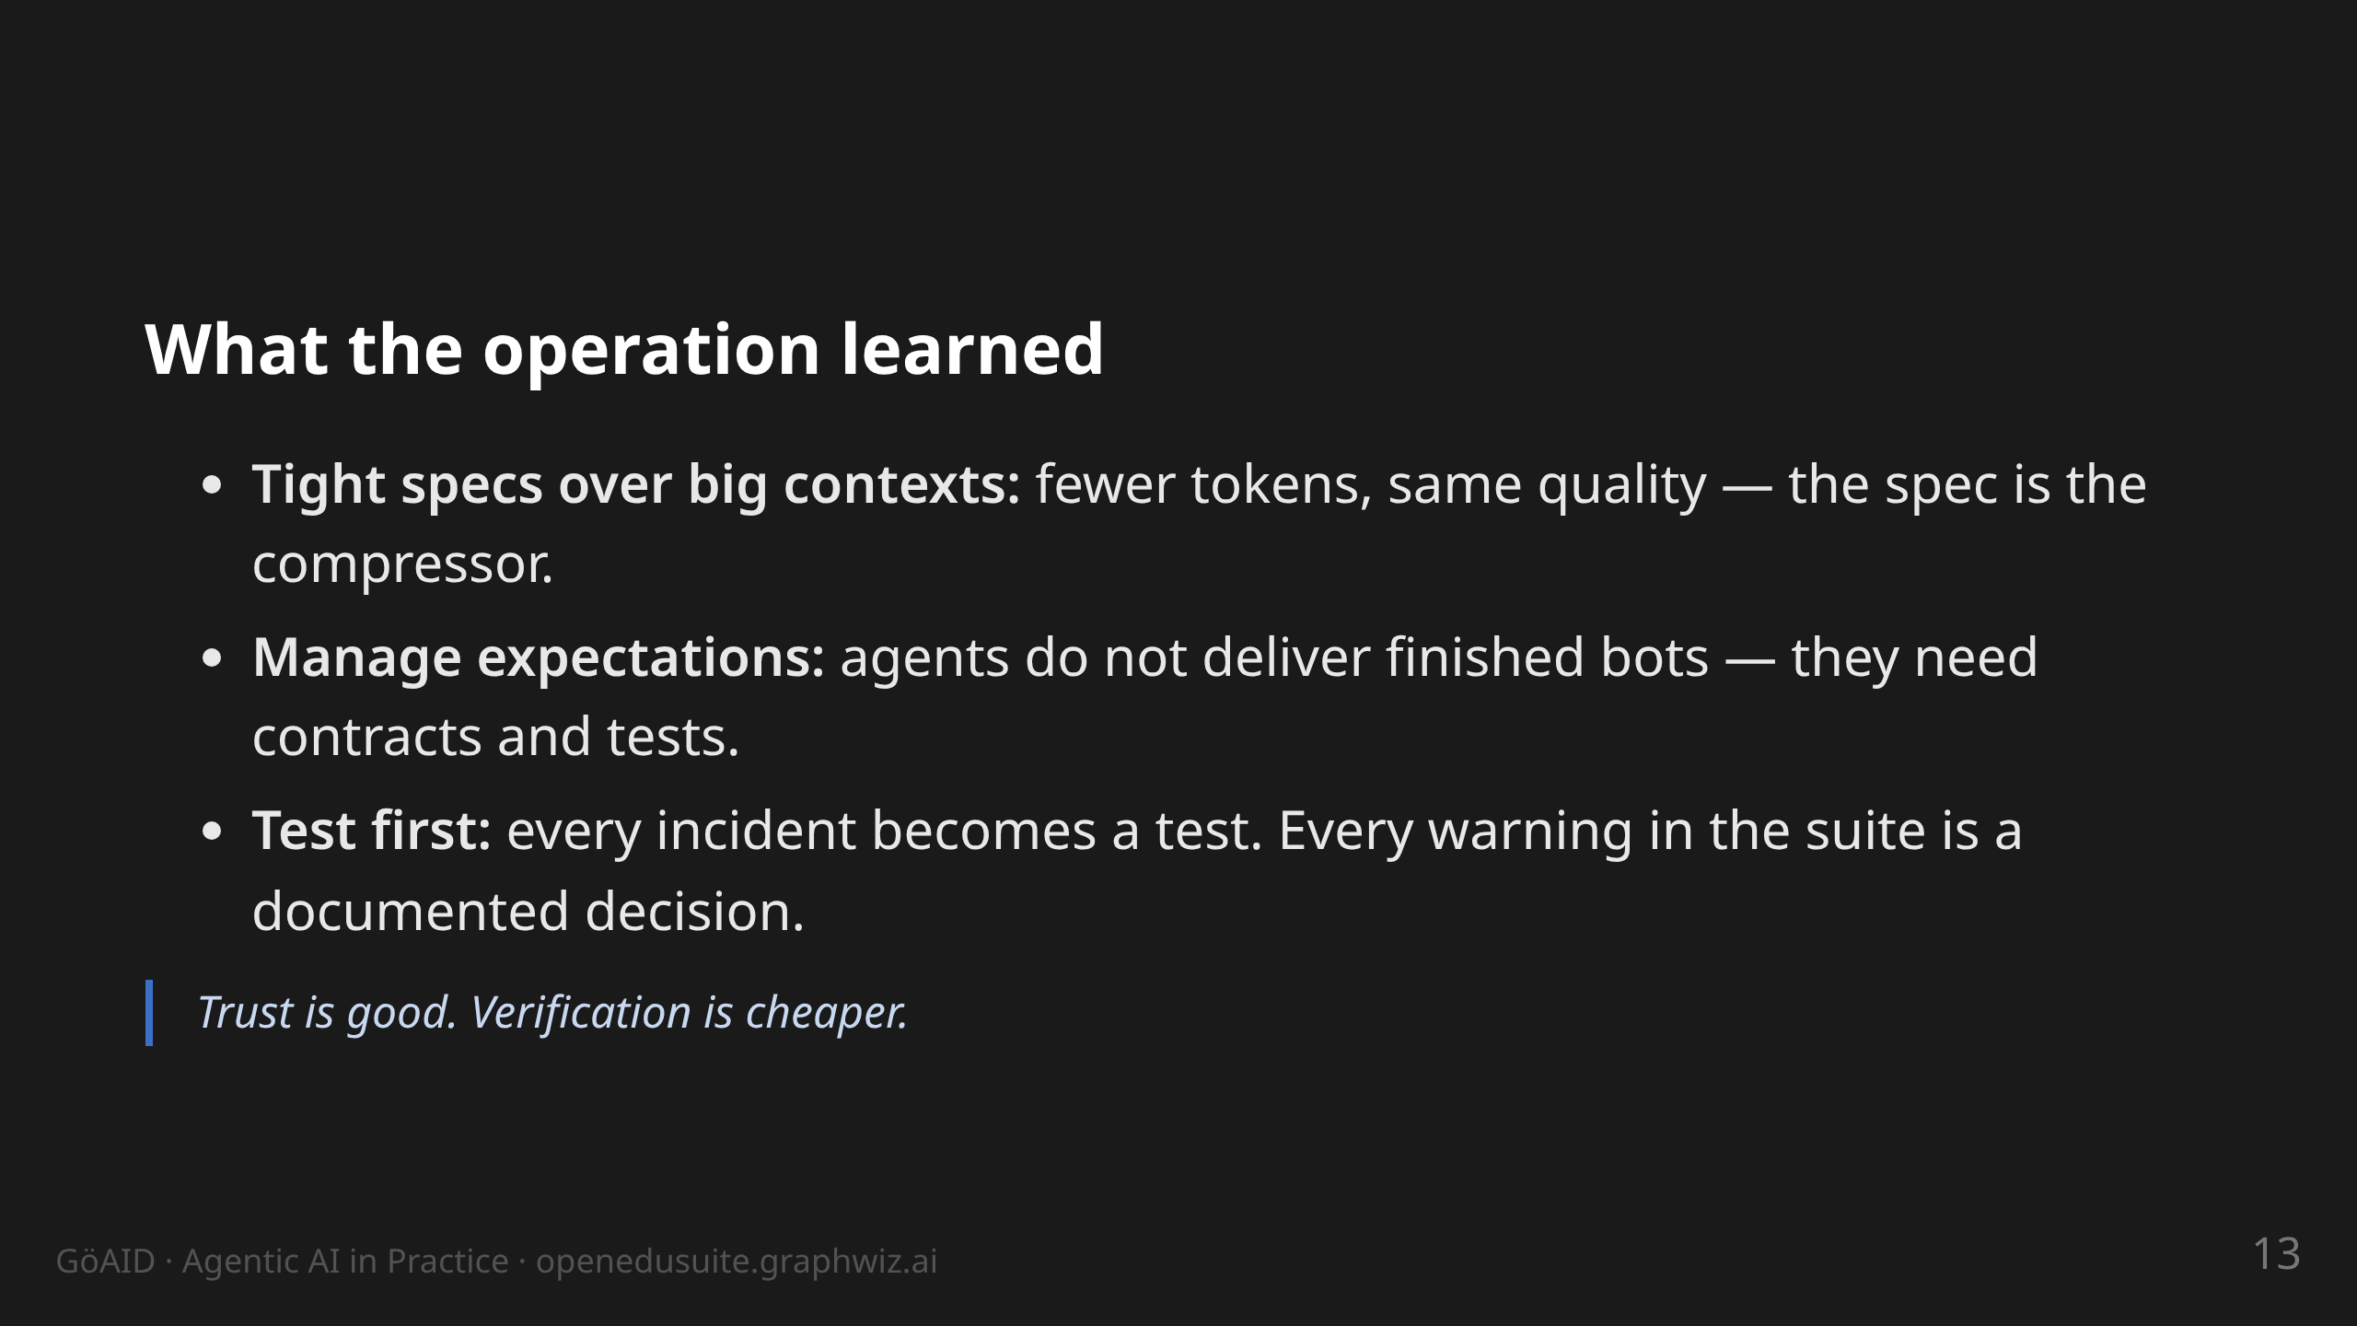
Notes:
notes:
(2 min) The three lessons are deliberately phrased for operations.
Token case: a tight spec with 5 acceptance criteria beats a
1000-line prompt. Expectations: from our workshops — people want
"finished bots" and get a tool with rules. Test first: the SSO suite
was built exactly this way (59/0/6, every warning discussed).

Slide 14
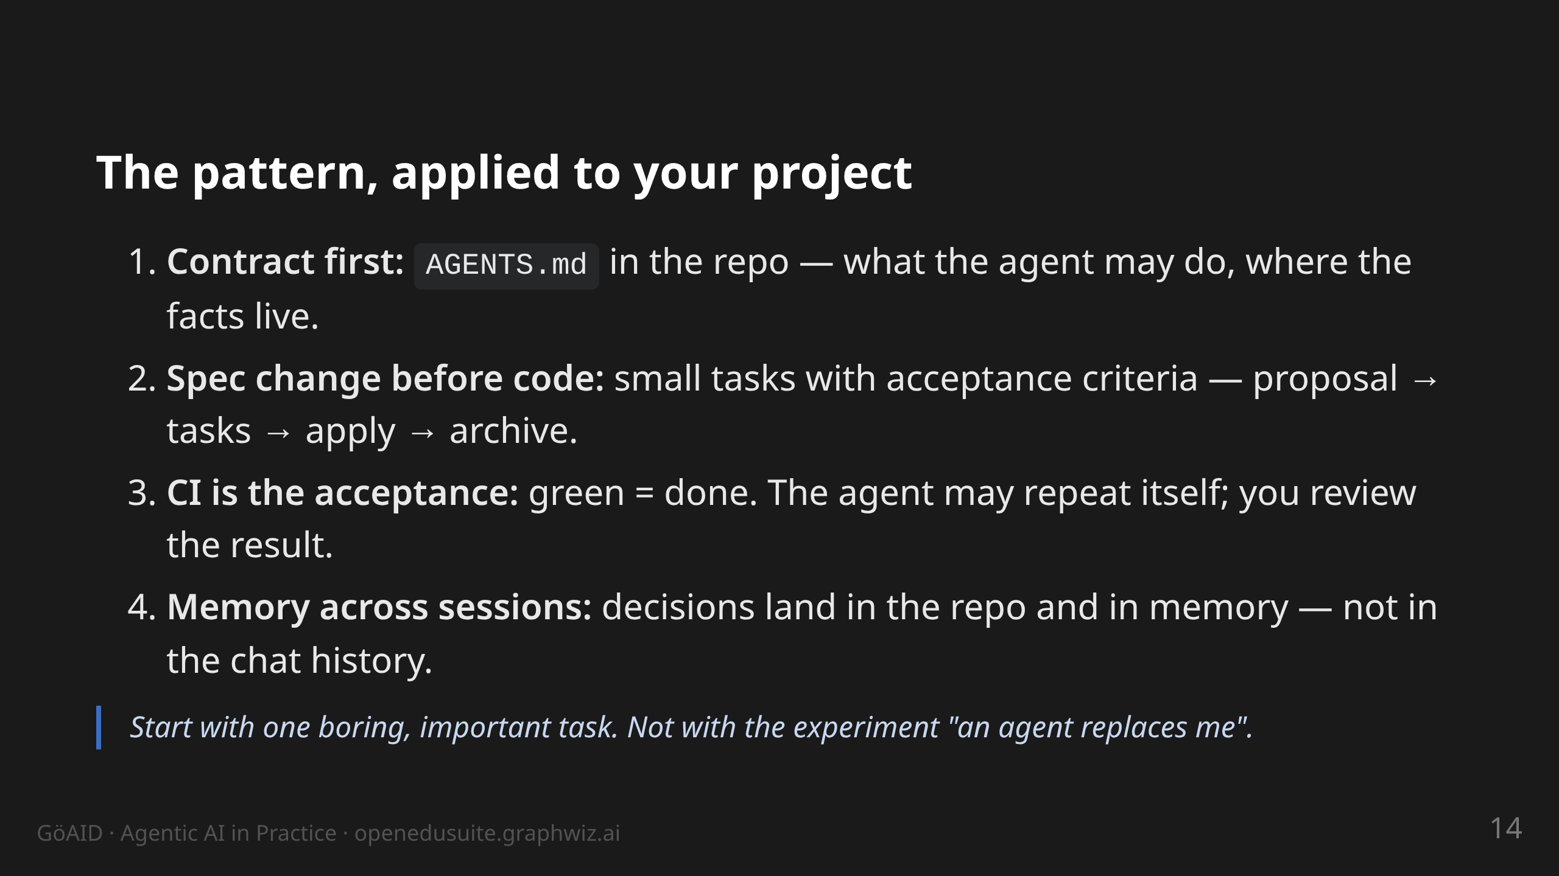
Notes:
notes:
(2 min) The transfer slide: the audience should be able to do one
thing tomorrow. Point 1 costs 20 minutes and changes everything —
the agent reads the contract on every start. Point 4: experiences /
spec repo instead of chat history.

Slide 15
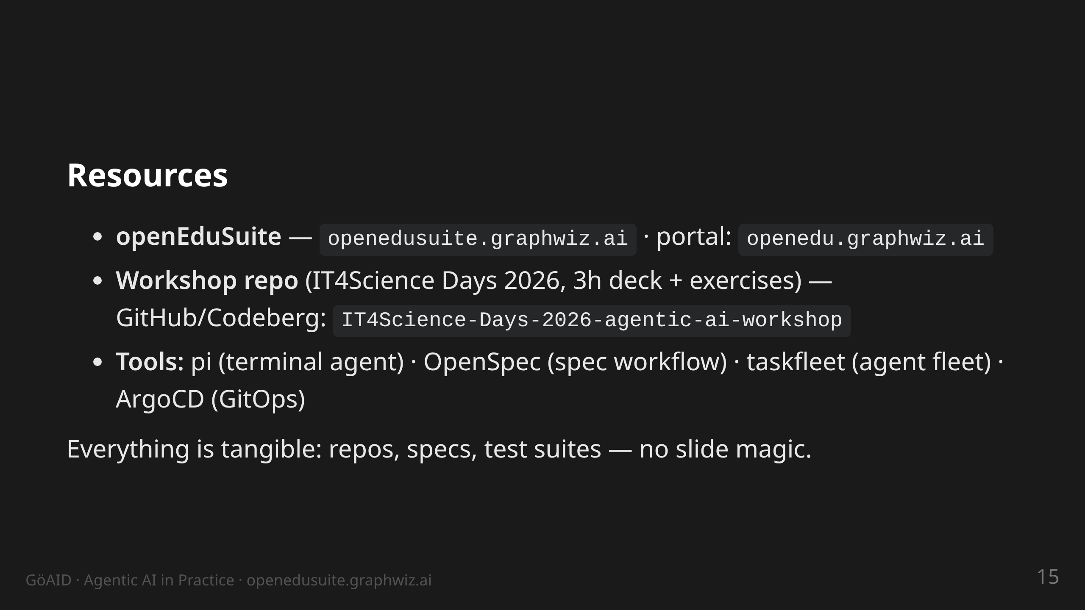
Notes:
notes:
(30 s) Do not read aloud. Note: the workshop deck (3h version) is
public — anyone who wants to go deeper can do the exercises
themselves.

Slide 16
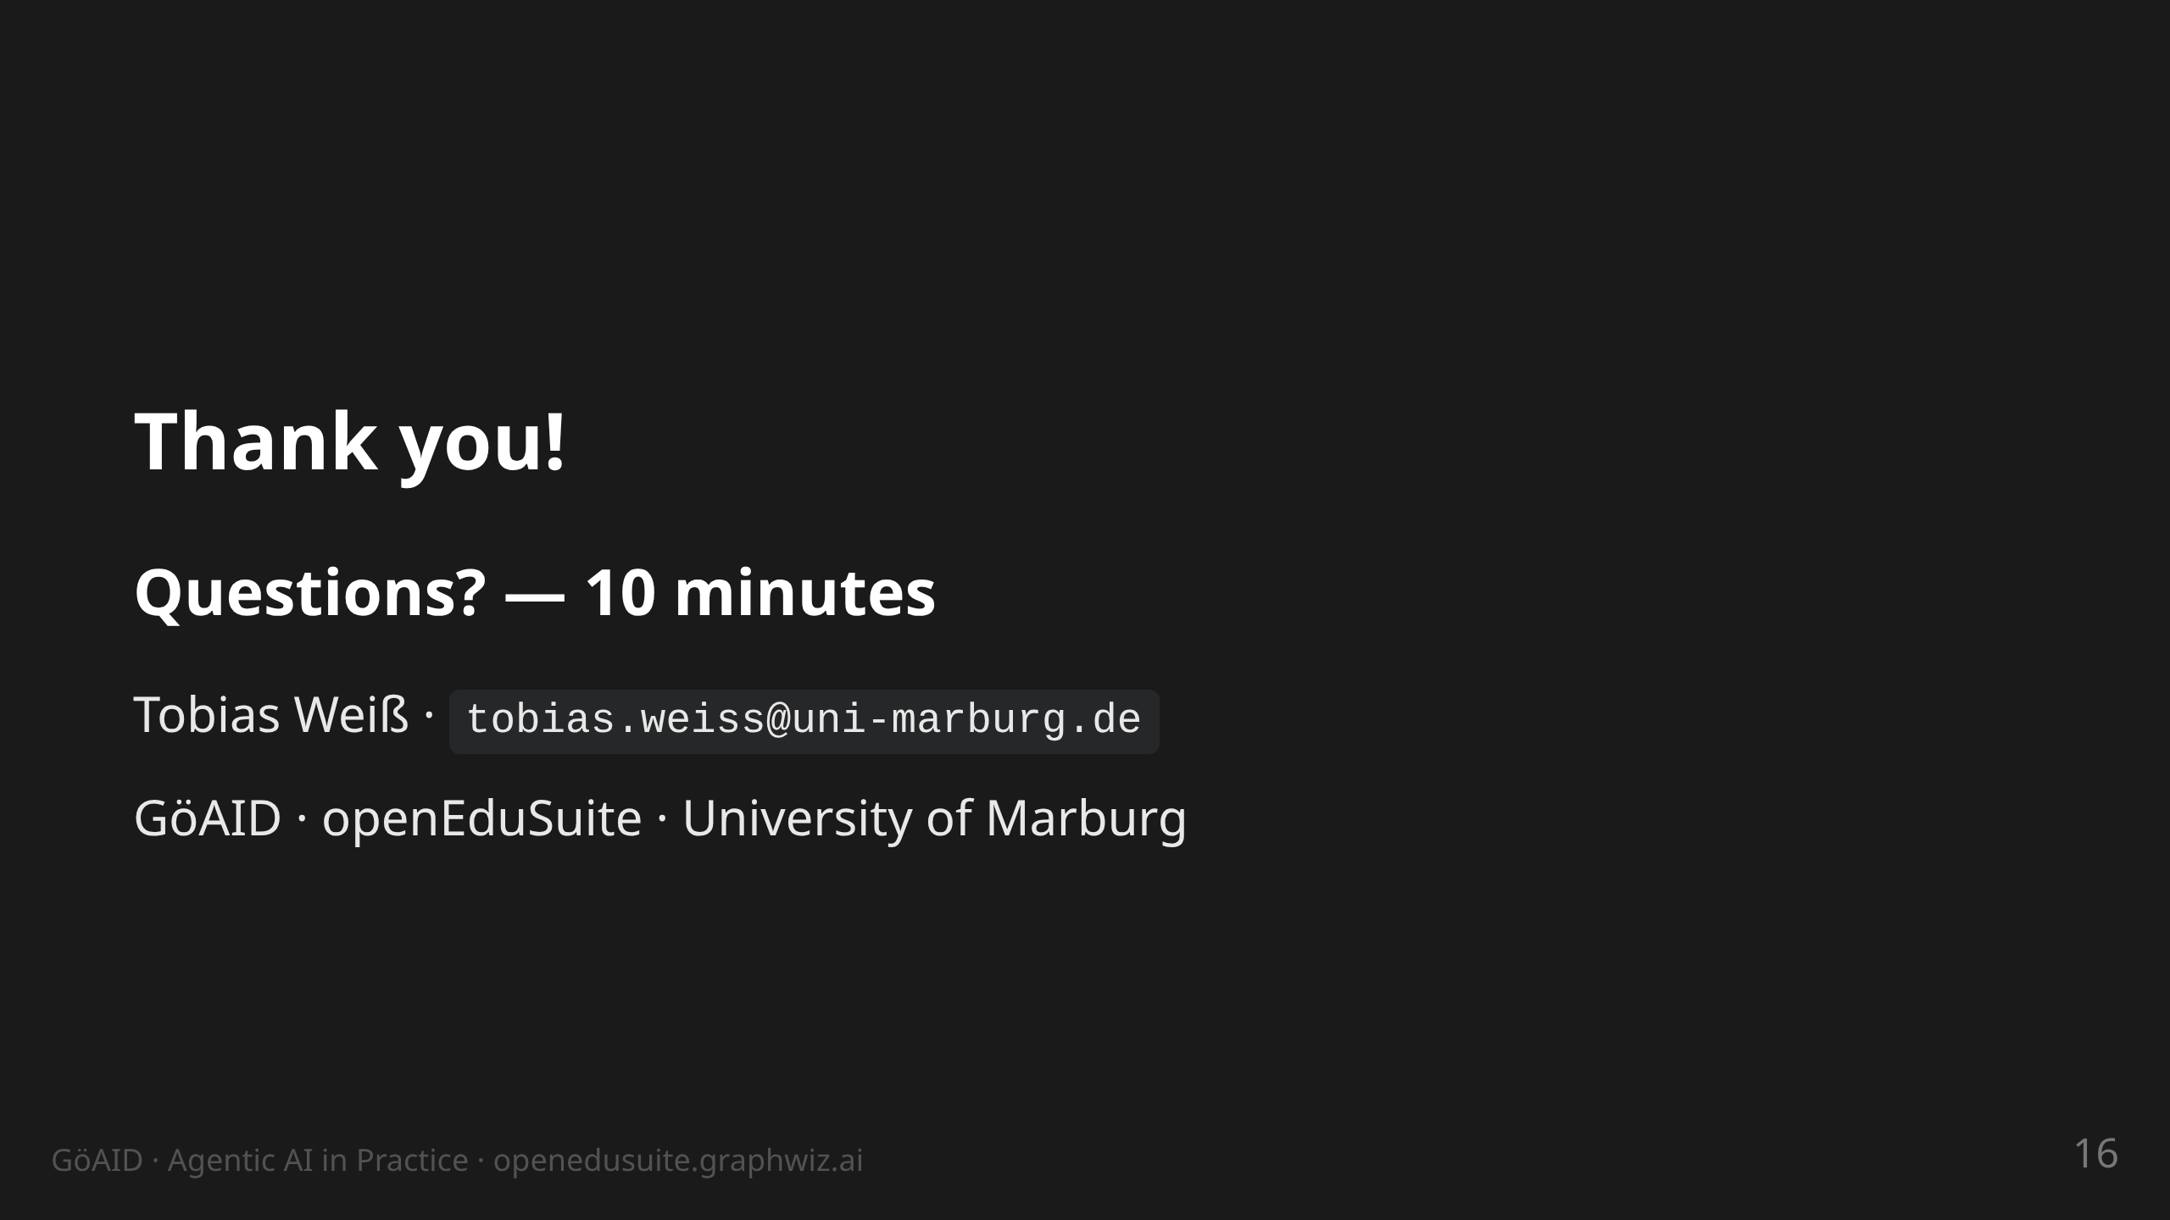
Notes:
notes:
(10 min) Q&A. Likely questions: agent permissions/security (→
contract + plan mode + tests), model choice (→ harness is
model-agnostic, pi runs with various providers), cost (→ tight specs,
small orders), getting started (→ AGENTS.md + one boring task).

