Slide 1
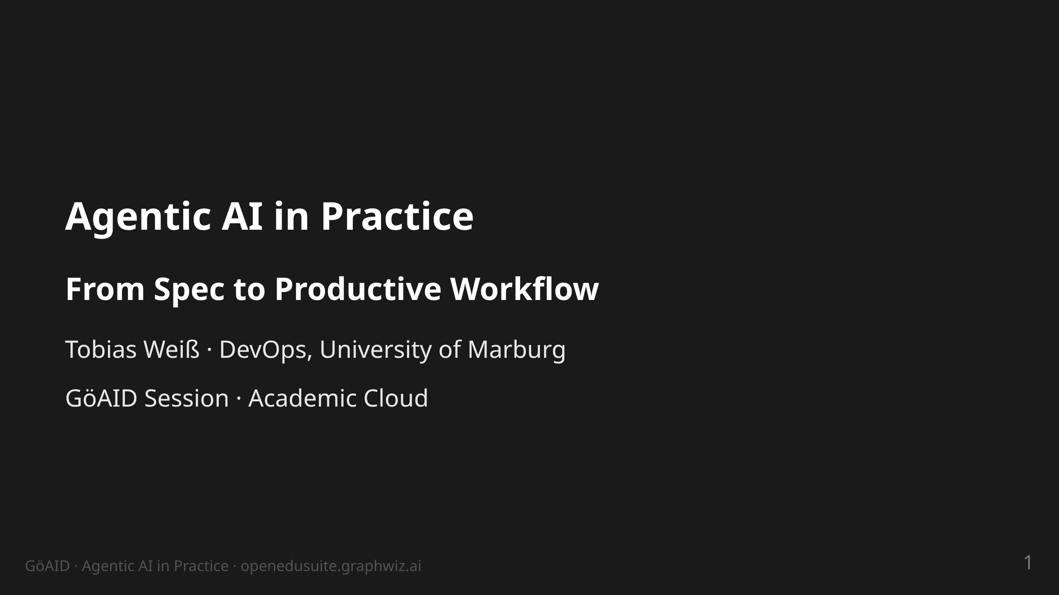
Notes:
notes:
(1 min) Welcome. Sentence 1: This is not a talk ABOUT agents — it is
the story of an operation that is built and run BY agents.
30 min of content + 10 min of questions.

Slide 2
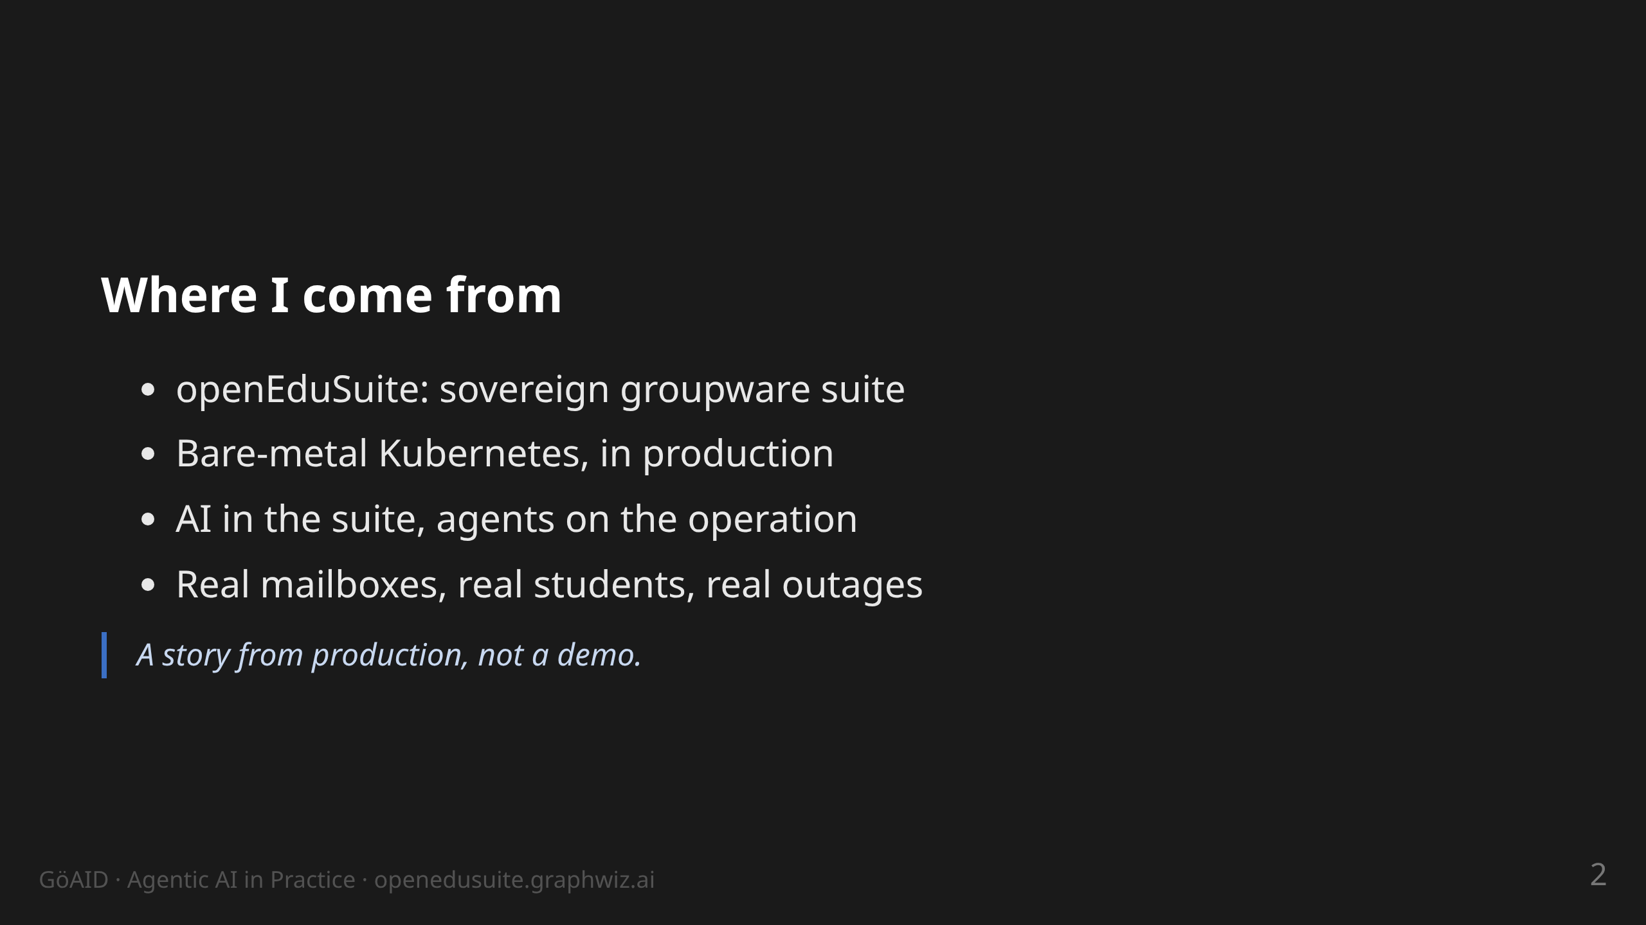
Notes:
notes:
(2 min) Context: University of Marburg, DevOps. The suite runs
productively on our own bare-metal nodes (SCS-K8s), not in a public
cloud. Two directions of "AI-infused": (a) the suite carries its own
LLM/K8s resources (k8s/llm), (b) the operation itself is done
agentically — the latter is the subject of this talk.

Slide 3
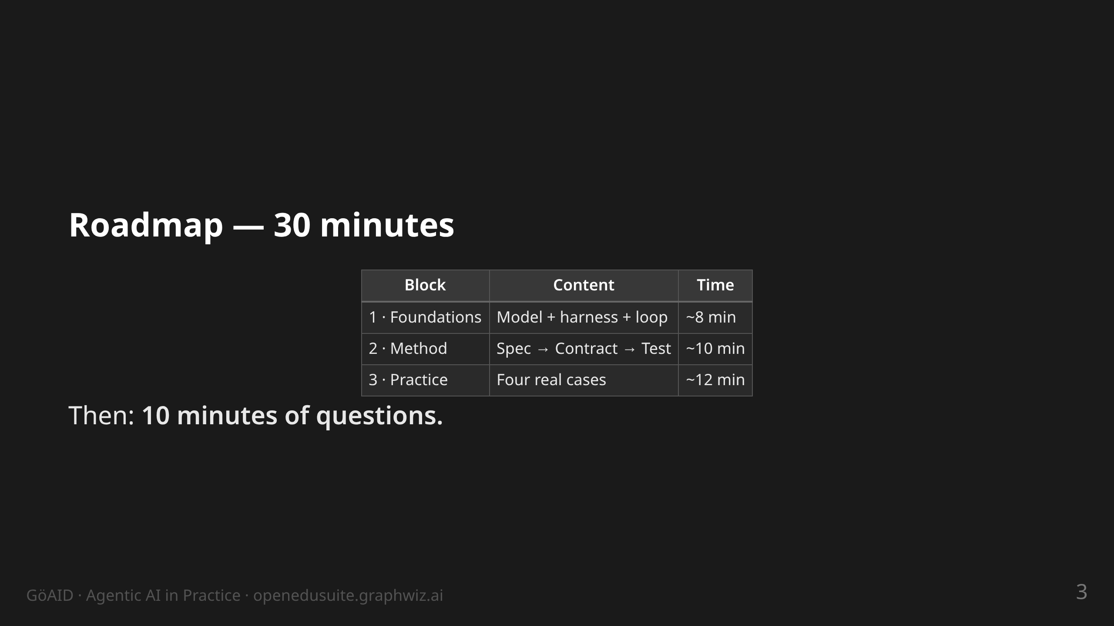
Notes:
notes:
(30 s) Show, don't read. Block 3 is the heart — the four cases are
real incidents/projects with dates and outcomes.

Slide 4
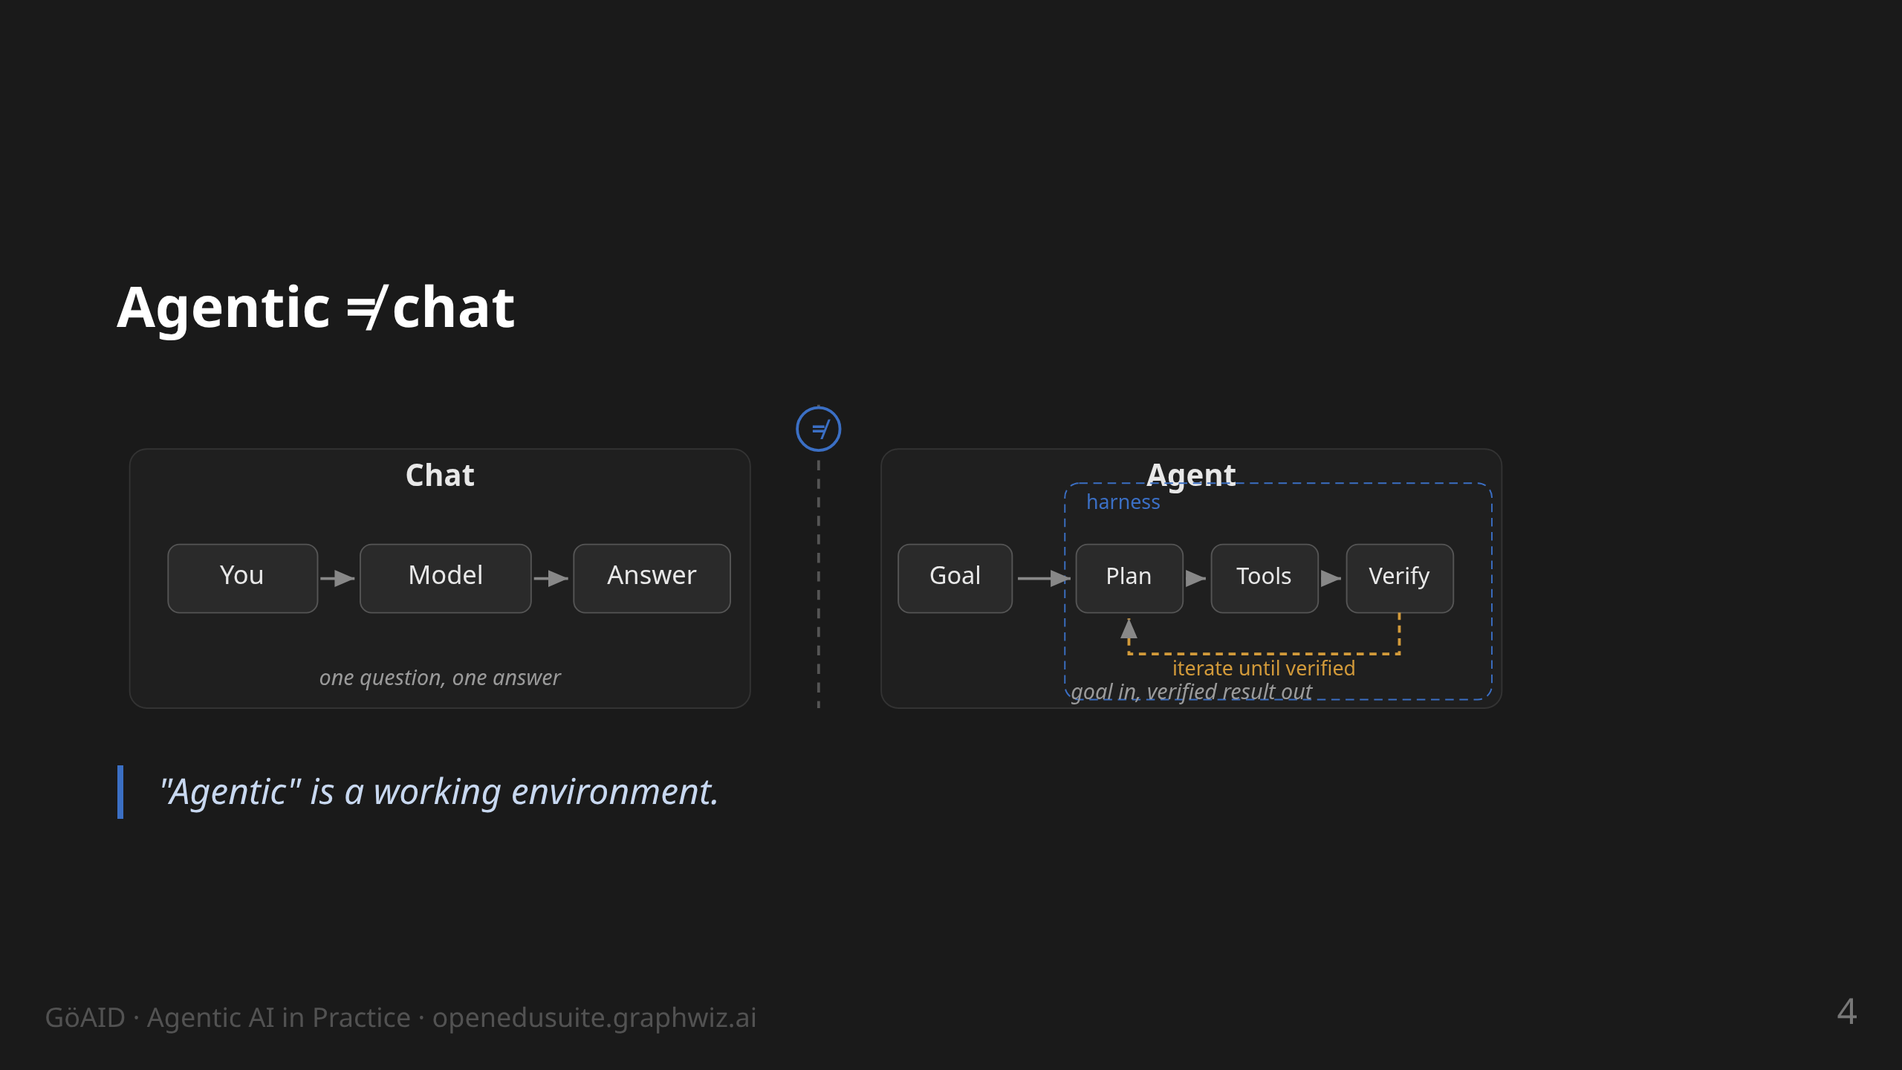
Notes:
notes:
(1.5 min) Point at the graphic, don't read it. Left: chat = one
question, one answer — the model cannot touch a file. Right: agent =
goal → plan → tools → verify, inside a harness that gives tools and
rules; the amber loop is where the work happens. Lesson from our
courses: many expect "ready-made bots" — set that term straight here.

Slide 5
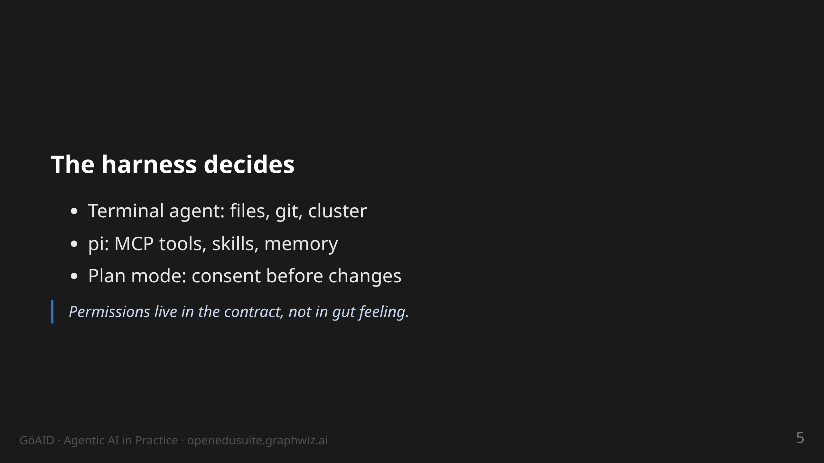
Notes:
notes:
(2 min) Same model, different frame: chat window vs. terminal agent
with file, git and cluster access. Briefly show or describe pi:
opens terminals, reads files, runs git, calls MCP tools. Plan mode =
consent before any change. Ops crowd: the agent has the same rights
I have at my workstation — hence the contract.

Slide 6
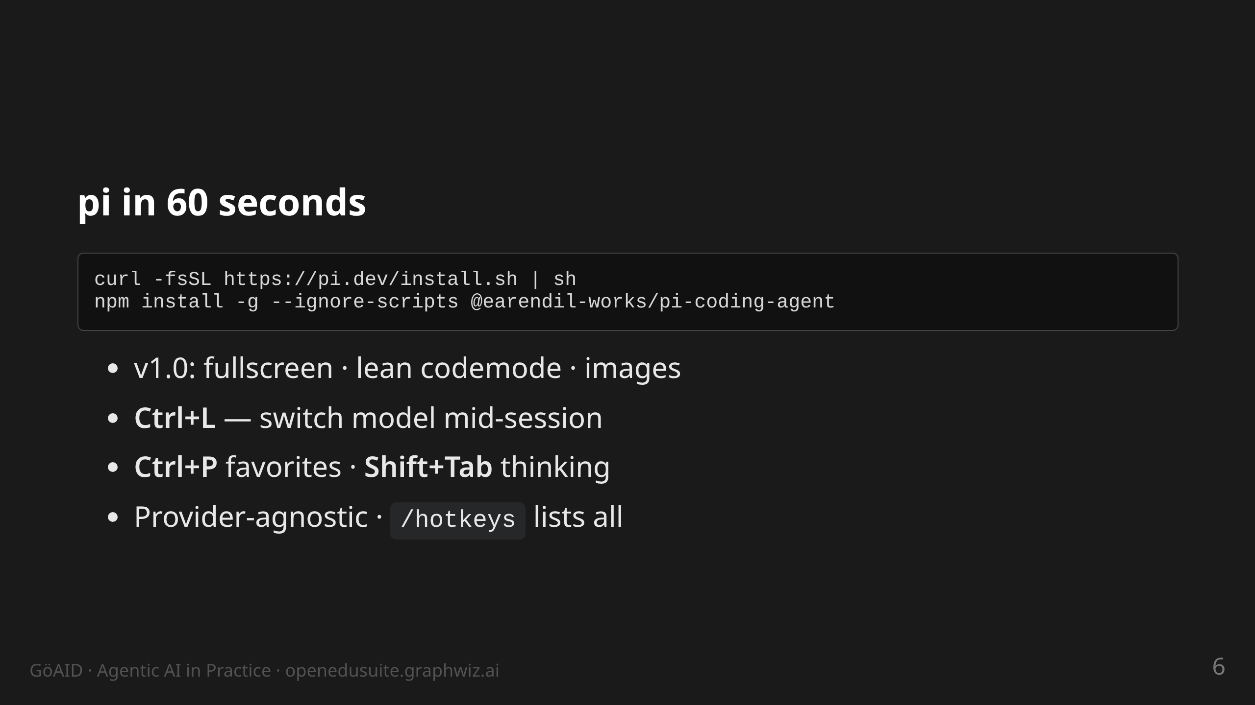
Notes:
notes:
(1.5 min) Install is two lines — live-demoable. v1.0 released
2026-10-01, currently 1.0.2. Ctrl+L is THE shortcut to demo: switch
model mid-task — cheap model for research, strong model for the fix.
If someone asks "which key does X": run /hotkeys live. Nix users:
nix run github:earendil-works/pi/stable. Radius login and MCP OAuth
hardening are also in 1.0 — mention if asked.

Slide 7
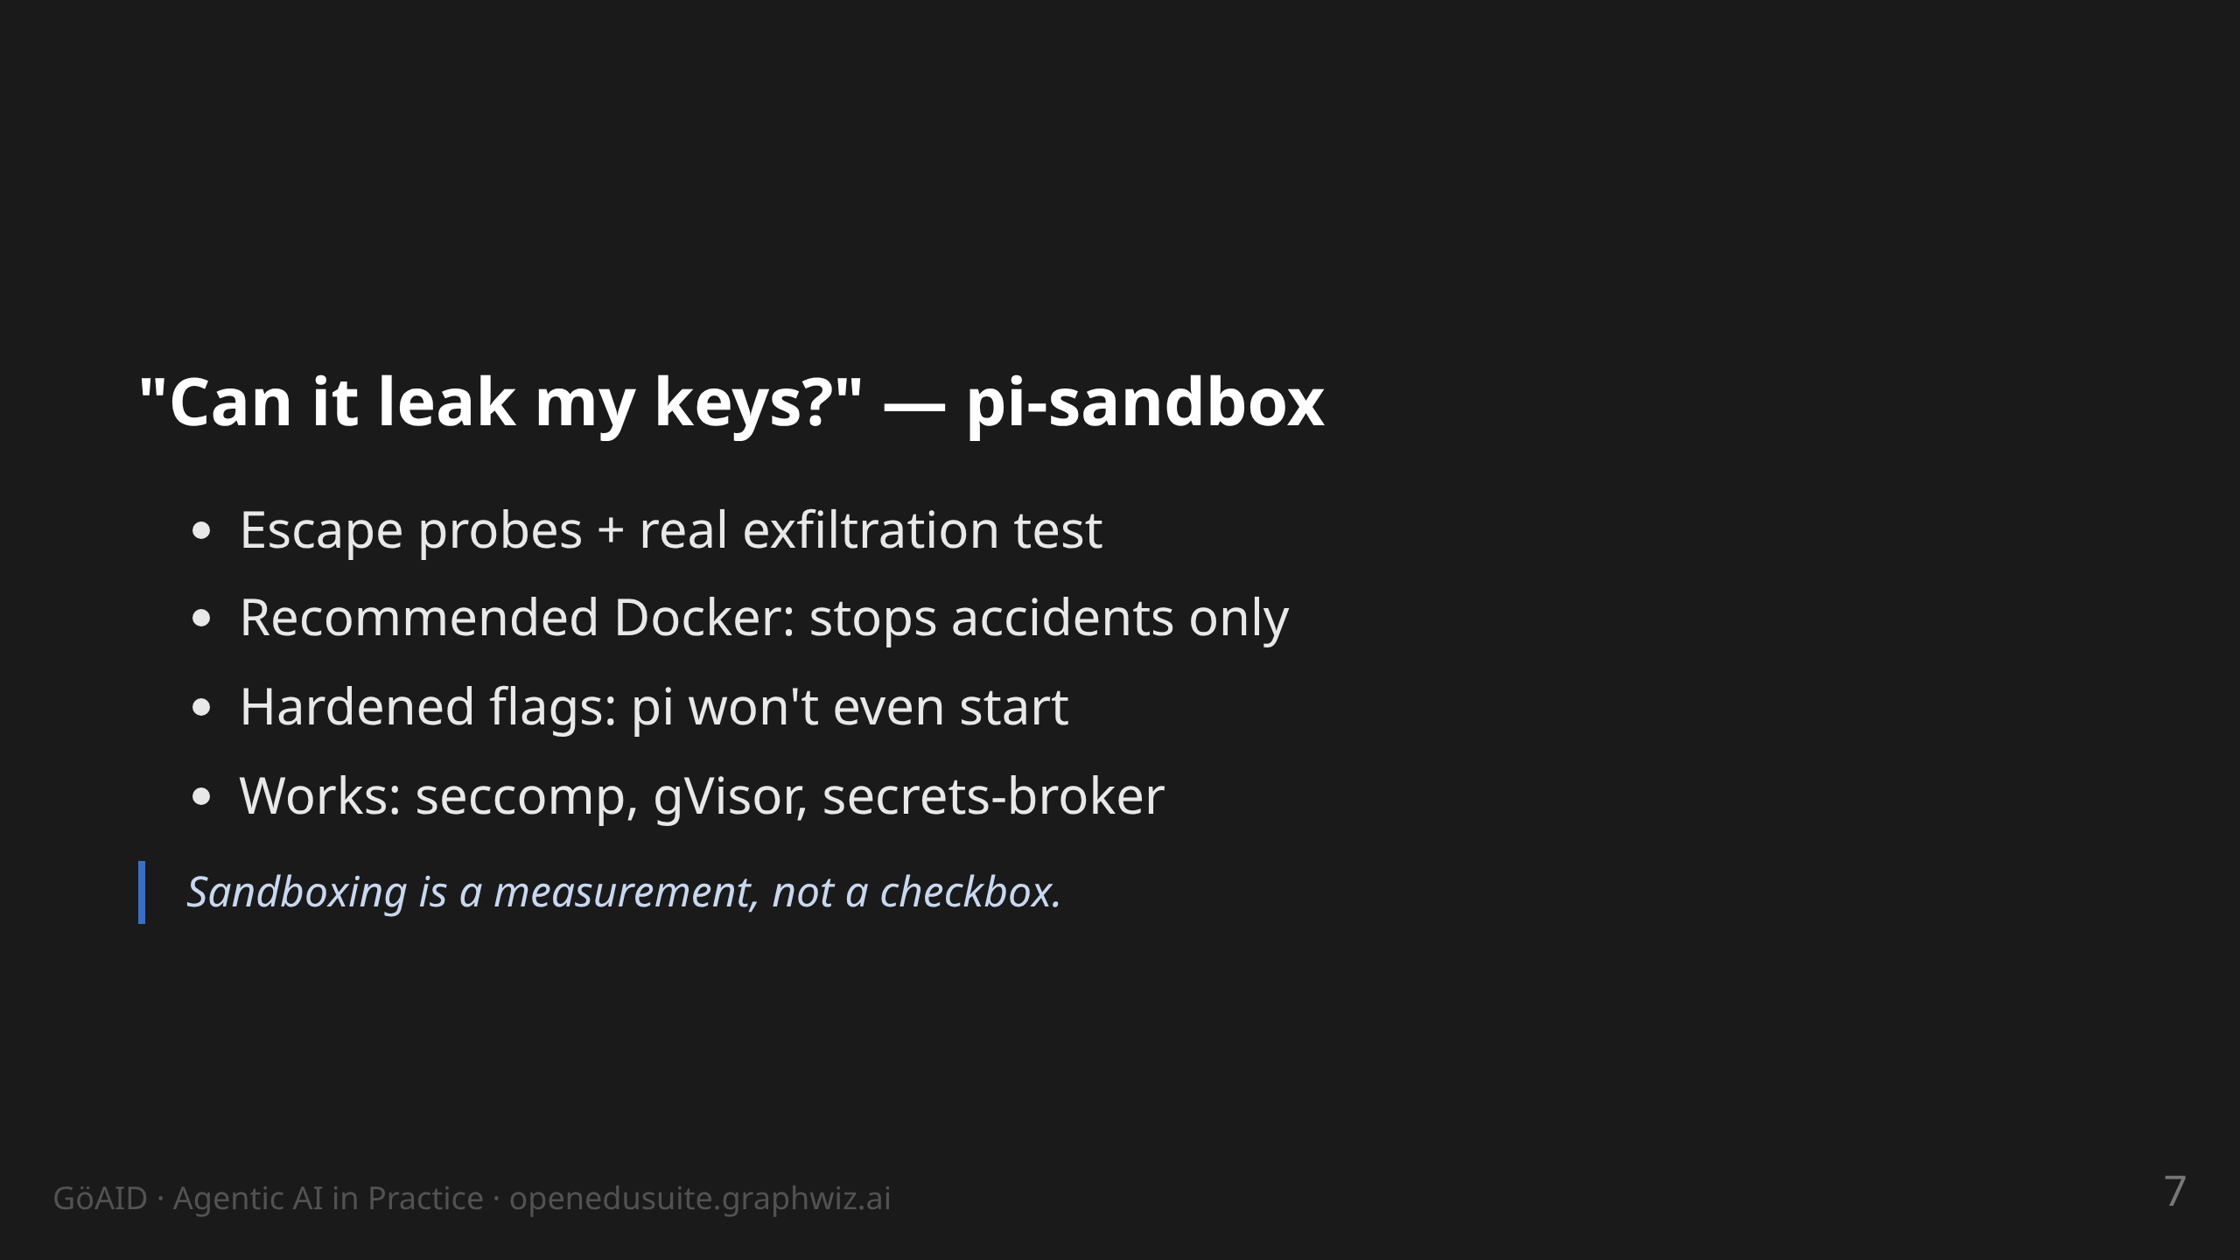
Notes:
notes:
(1.5 min) Earns trust with the ops audience: we TESTED the isolation
instead of trusting docs. Findings: (1) recommended setup = safe
against accidents only — a malicious agent exfiltrates the one key
you pass in; (2) documented hardening crashes pi (--read-only breaks
the session directory). Survivors: seccomp + noexec (egress cut),
non-root without network (local models), gVisor, secrets-broker —
the real key never enters the sandbox.
github.com/tobias-weiss-ai-xr/pi-sandbox · THREAT_MODEL.md

Slide 8
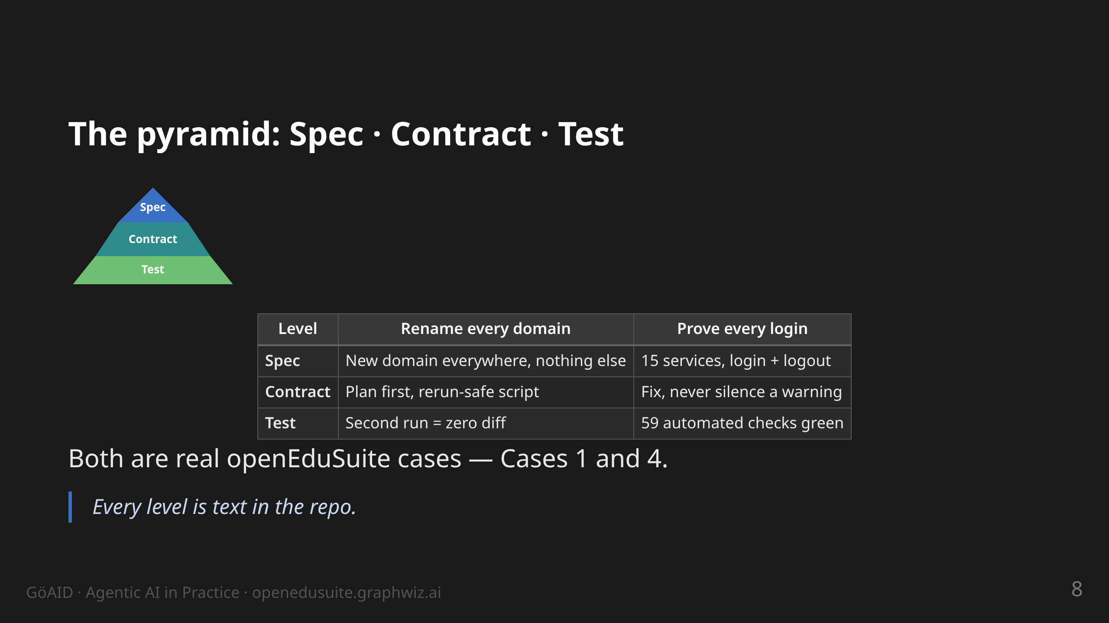
Notes:
notes:
(2.5 min) Core slide. Pyramid: Spec (WHAT) on top, Contract (HOW)
in the middle, Test (WHEN is it right) as the foundation. The two
columns are two EVERYDAY scenarios, not project jargon: a risky
one-time change (we renamed all domains in production — Case 1) and
proving a promise (login must work for all 15 services — Case 4,
the 59-check SSO suite). Read the table row by row: same three
levels, very different changes — that is why it is a method, not a
trick. All levels live in git, not in heads or chats. Transition:
"How do you get from this pyramid to a running workflow? → OpenSpec."

Slide 9
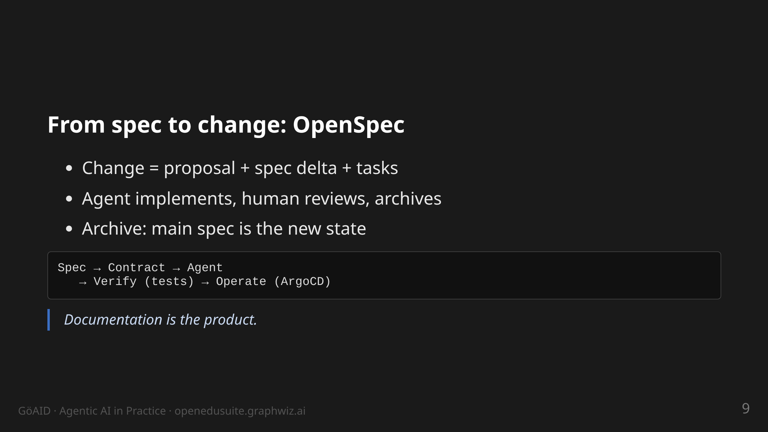
Notes:
notes:
(1.5 min) OpenSpec CLI: new change, continue, apply, archive. The
flow: proposal by human or agent, refinement in dialogue, then work
through tasks. Key point: "archive" updates the specs — that is how
the docs stay in sync with the system.

Slide 10
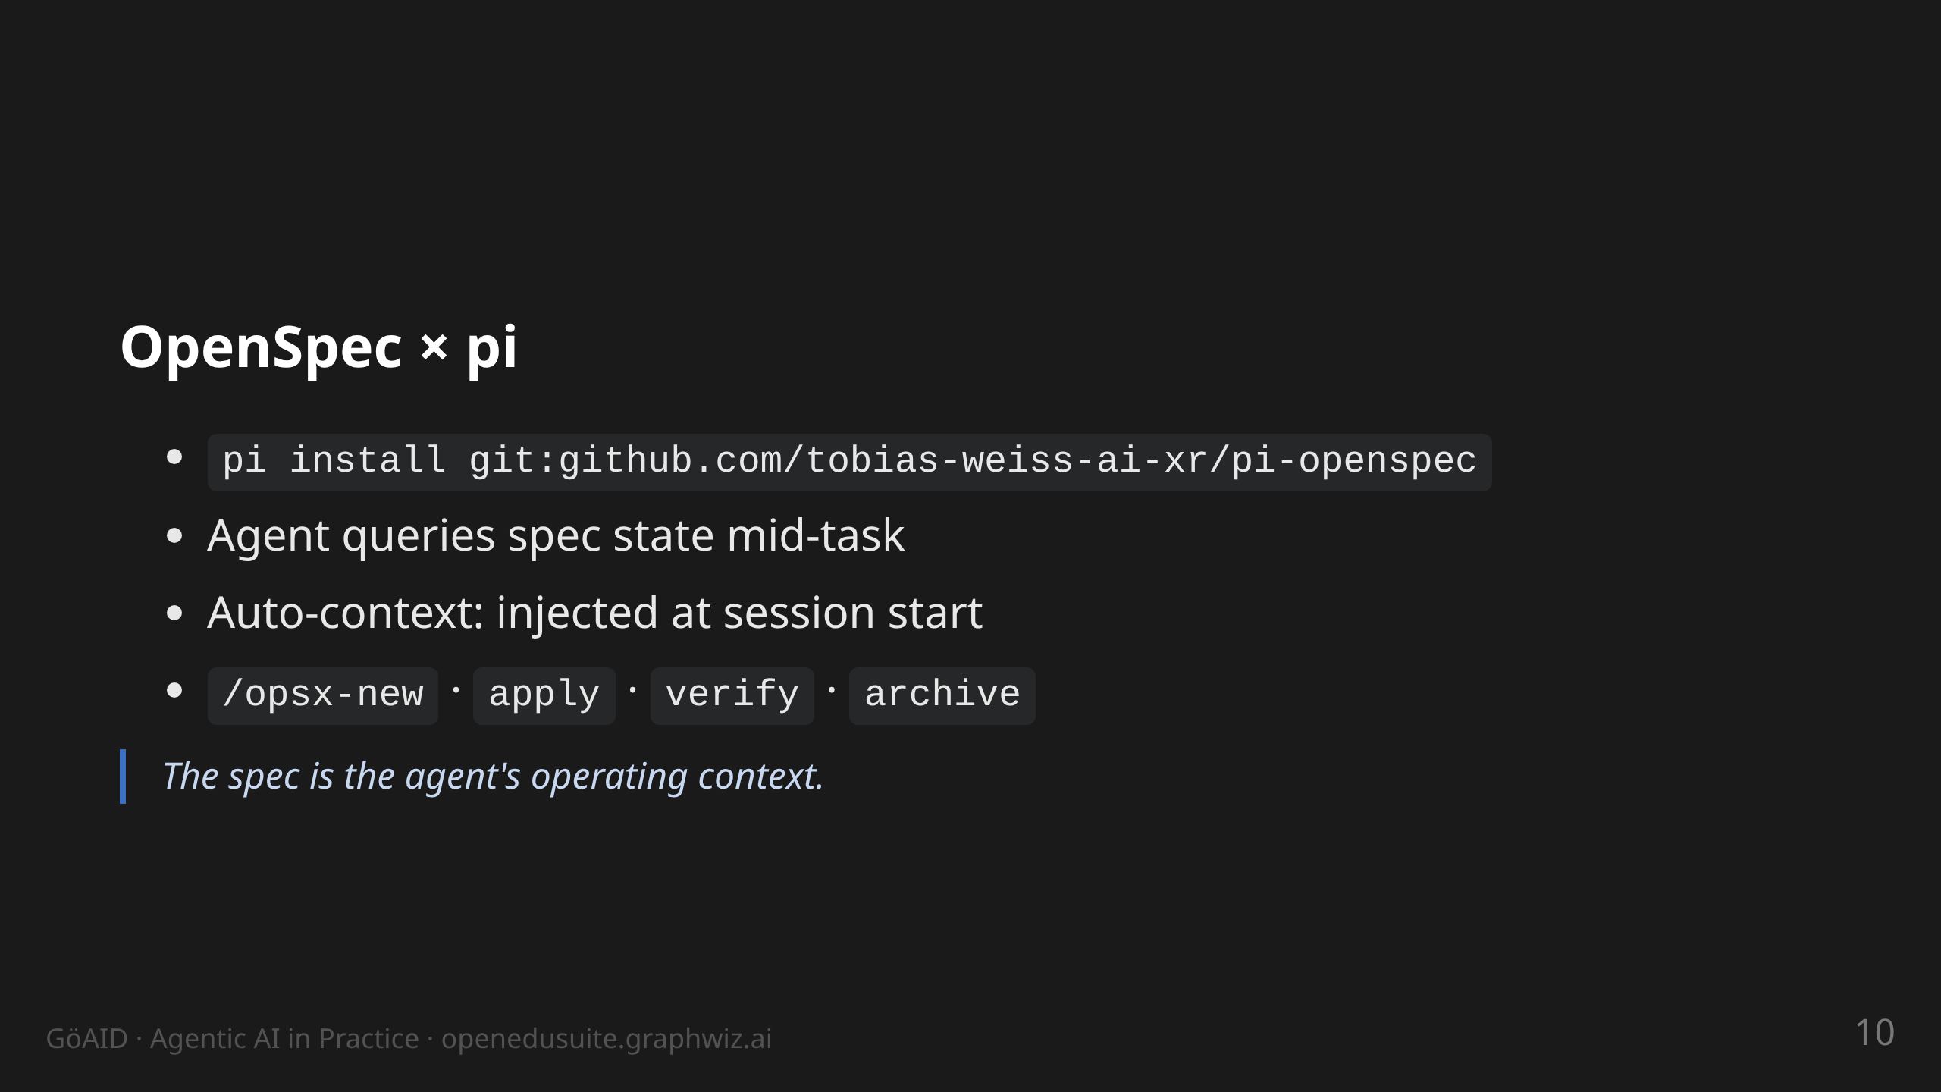
Notes:
notes:
(1 min) Closes the loop between method and harness: the Spec→
Contract workflow is wired directly into pi. Fresh session in a repo
with openspec/ starts already knowing the change state (auto-injected
context, invalidated when the spec tree changes). /opsx-verify
before commit is the habit to copy: validate + doctor sweep.
Requires OpenSpec CLI >= 1.9 on PATH.

Slide 11
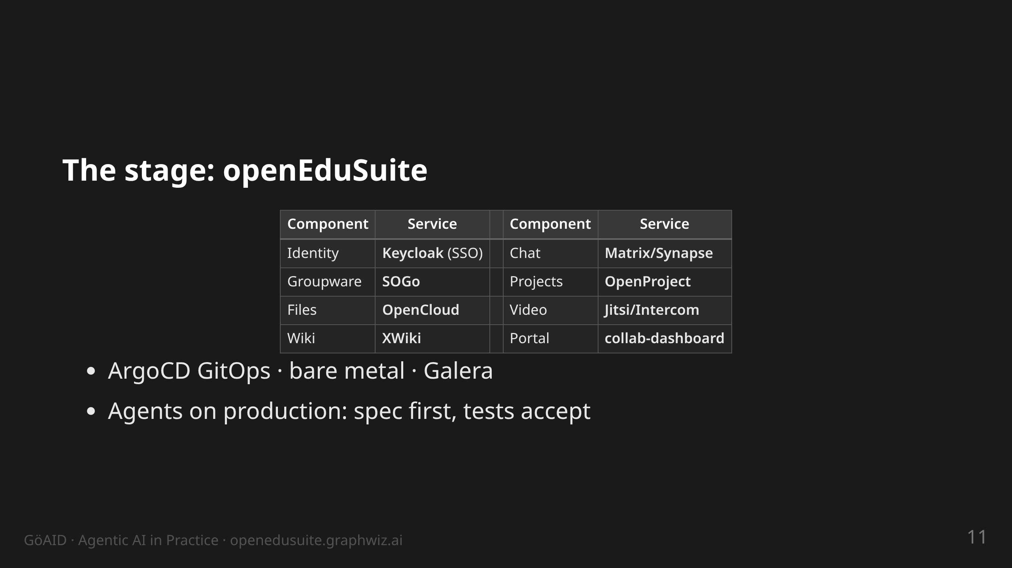
Notes:
notes:
(1.5 min) Locate the audience: anyone running something similar knows
these components. One login, eight services. The bottom bullet is the
core tension of this talk: agents with write access on production —
how do you make that accountable? Answer: the next four cases.

Slide 12
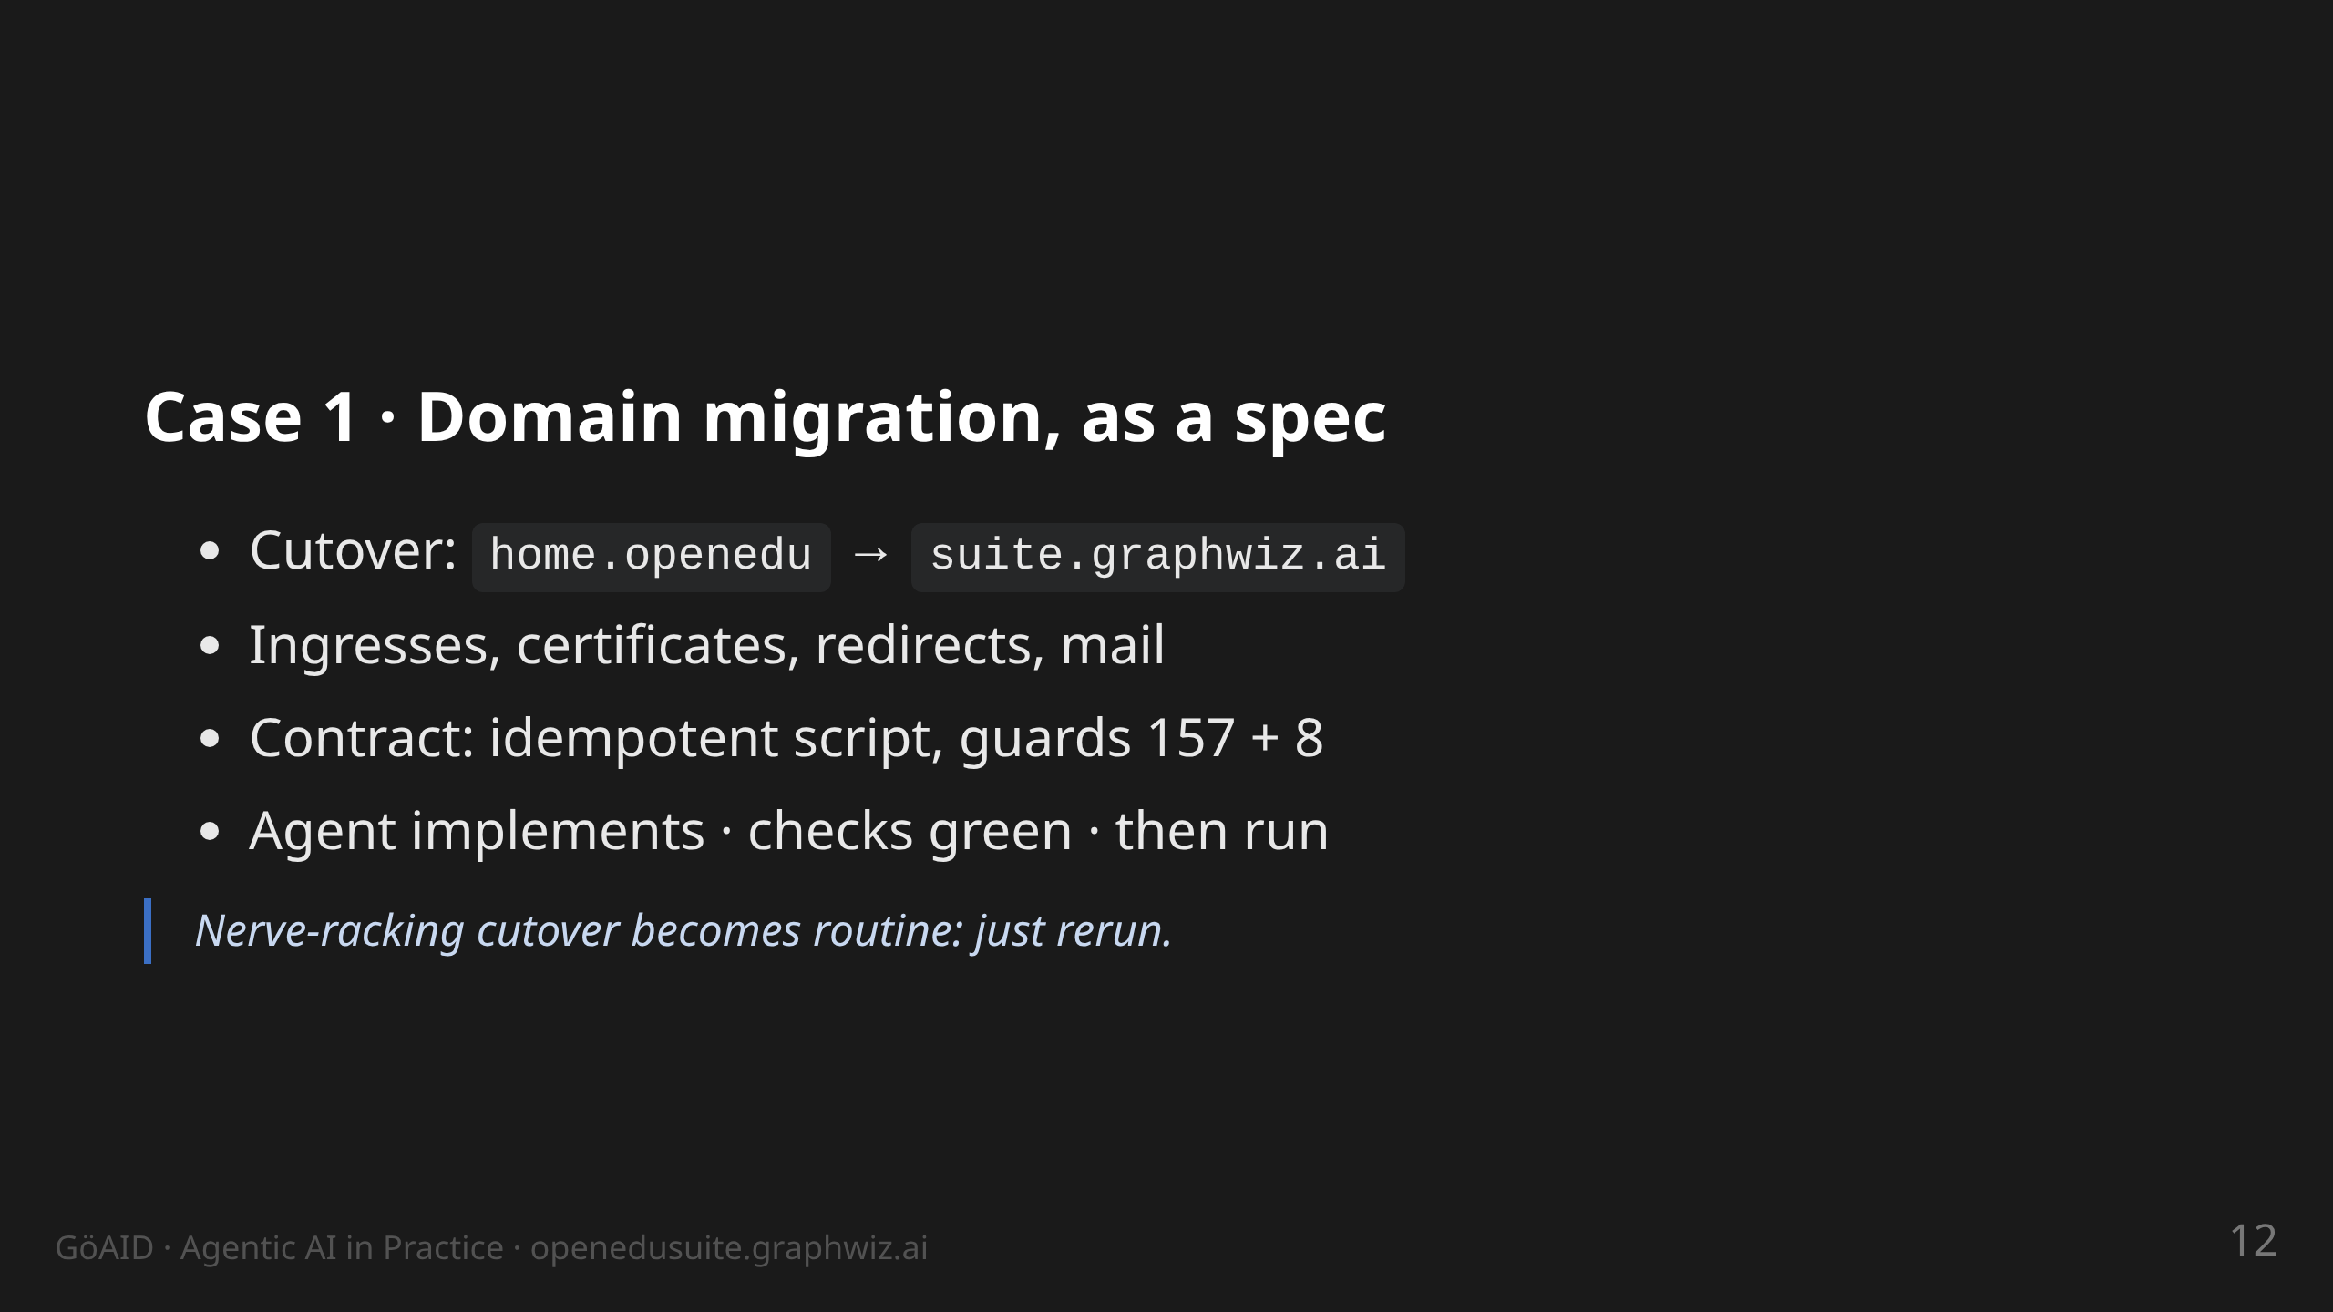
Notes:
notes:
(2.5 min) The point: without a spec this is a week of manual work and
fear. With a spec: one script with built-in guards. Idempotency is
the acceptance criterion — a second run changes nothing. Story: on
the first run a guard check fired (one directory matched too much) —
exactly what guards are for. Also in scope: Keycloak redirects,
Let's Encrypt wildcard, oauth2-proxy fixes.

Slide 13
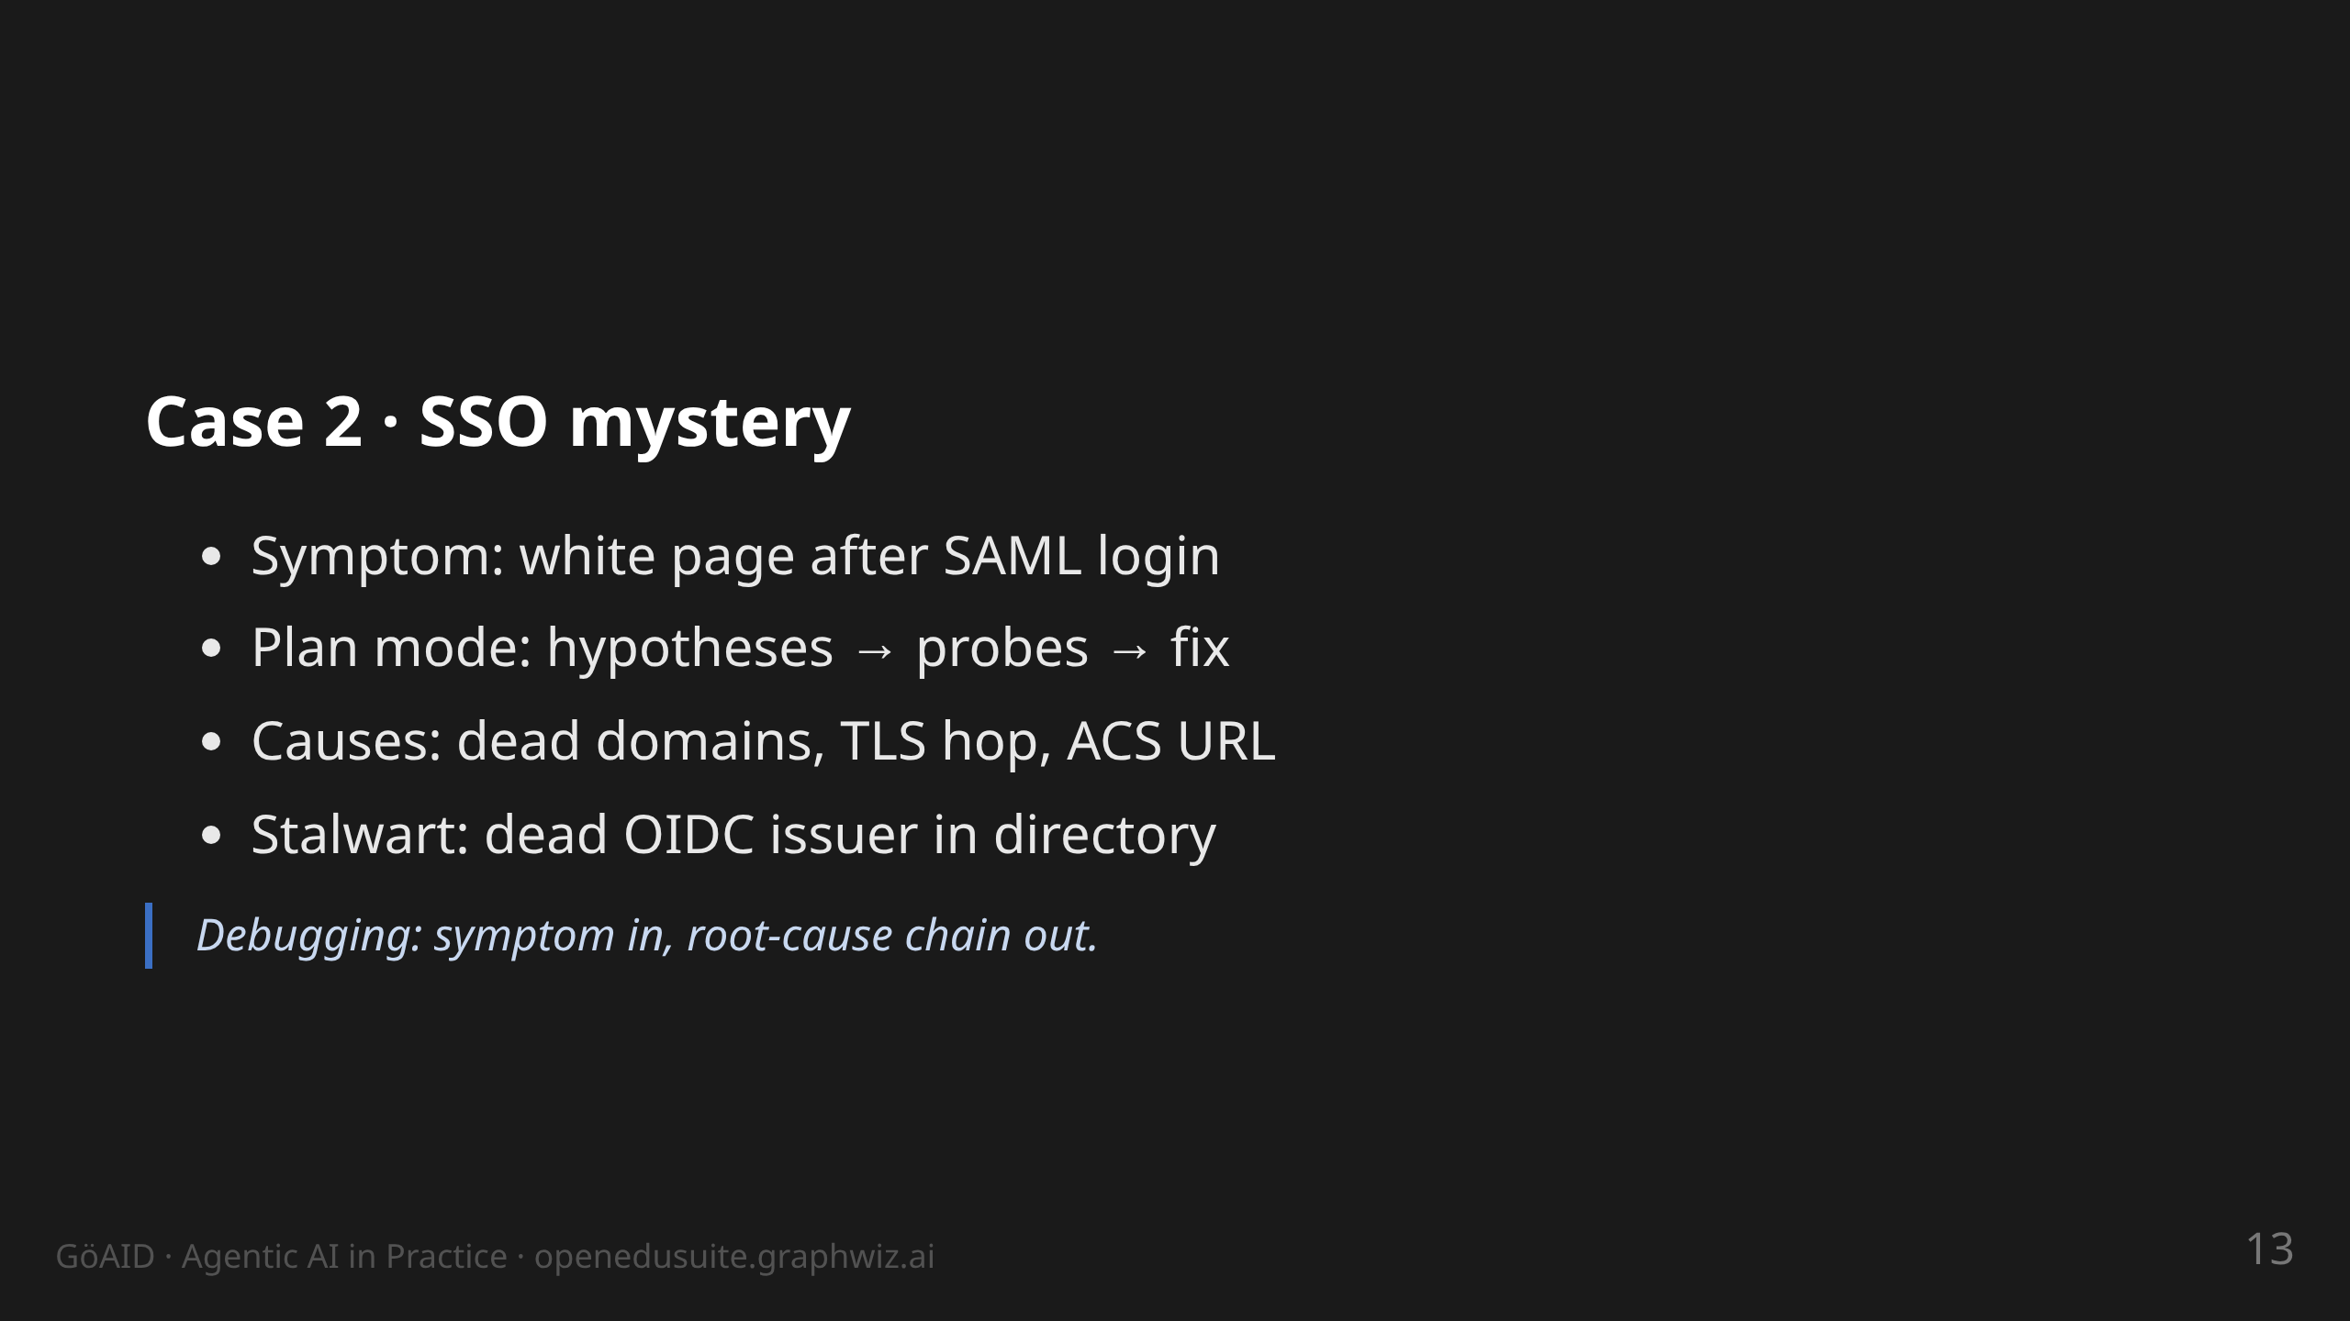
Notes:
notes:
(2.5 min) Tell it live; everyone knows white pages. SOGo webmail
after SAML login — three root causes in a row: repo/deploy still on
old domains + placeholder IdP metadata (by design); TLS termination
at the ingress vs. ACS-URL scheme. The agent needed several probes —
but every hypothesis was visible. Second case, same pattern: Stalwart
XOAUTH2 broke on a dead OIDC issuer inside a directory object.
Afterwards each root cause became a probe in the test suite. Key
line: "Every bug found becomes a test before it comes back."

Slide 14
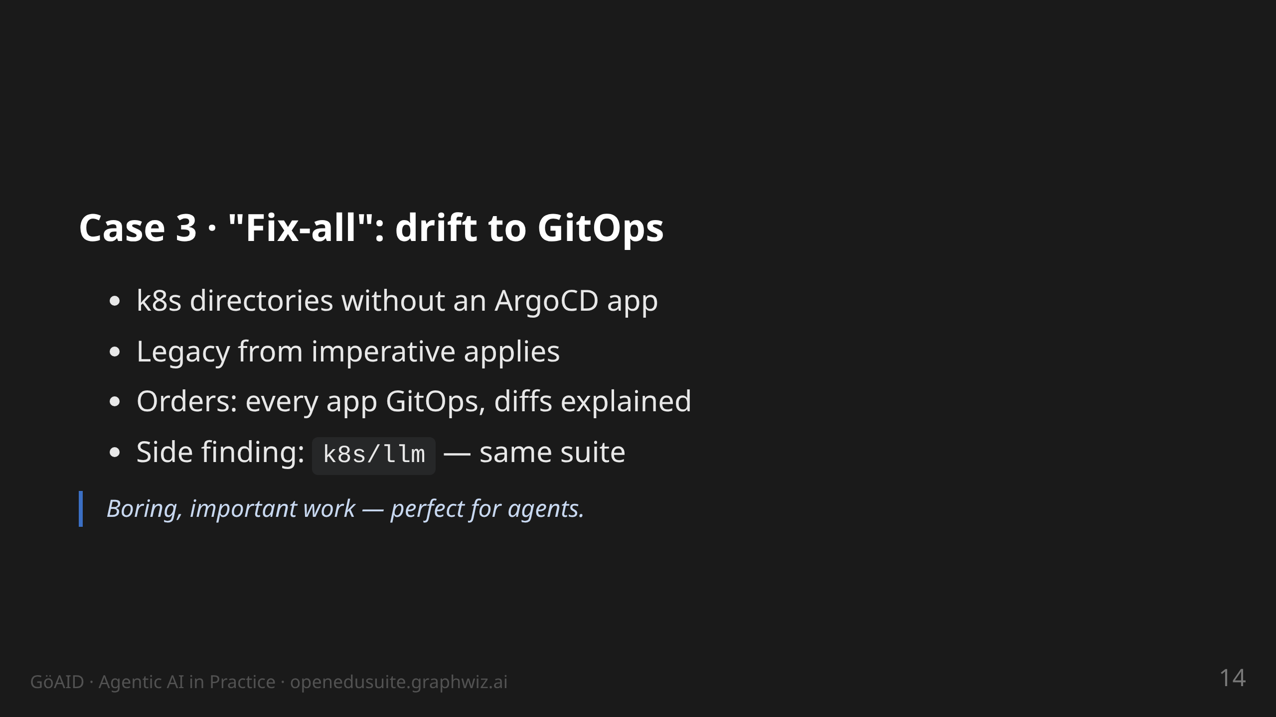
Notes:
notes:
(1.5 min) Tenant mail, LLM, XWiki directories were never under any
ArgoCD app. This work is tedious and important — perfect for agents.
The human defines what is "done": app exists, sync green, no
unmanaged manifests left. The agent works through the list. Message:
start with tasks like this, not with "write my thesis".

Slide 15
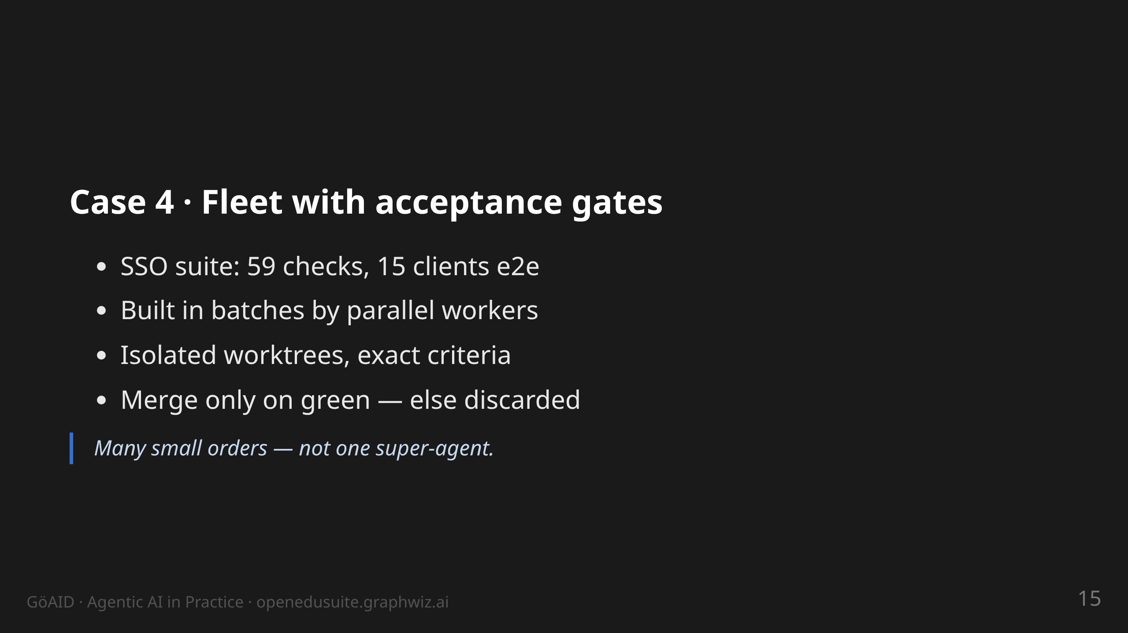
Notes:
notes:
(1.5 min) The tool here is agentflow (next slide). This is how the
e2e checks for all SSO clients were built — logout per client type,
session TTL, scopes. A human would have spent weeks clicking through
this. Scalable, cheap, auditable.

Slide 16
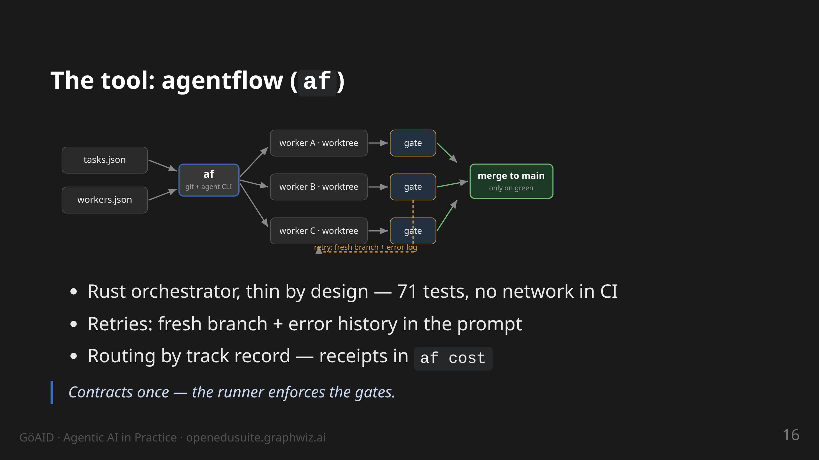
Notes:
notes:
(1.5 min) Walk the graphic: declarative tasks + workers, af fans out
into isolated worktrees, every result passes a gate (exit 0) before
merge; amber path = retry with error memory. UCB1 = workers earn
trust by track record. Demo path: af run --dry-run, af status,
af cost. github.com/tobias-weiss-ai-xr/agentflow

Slide 17
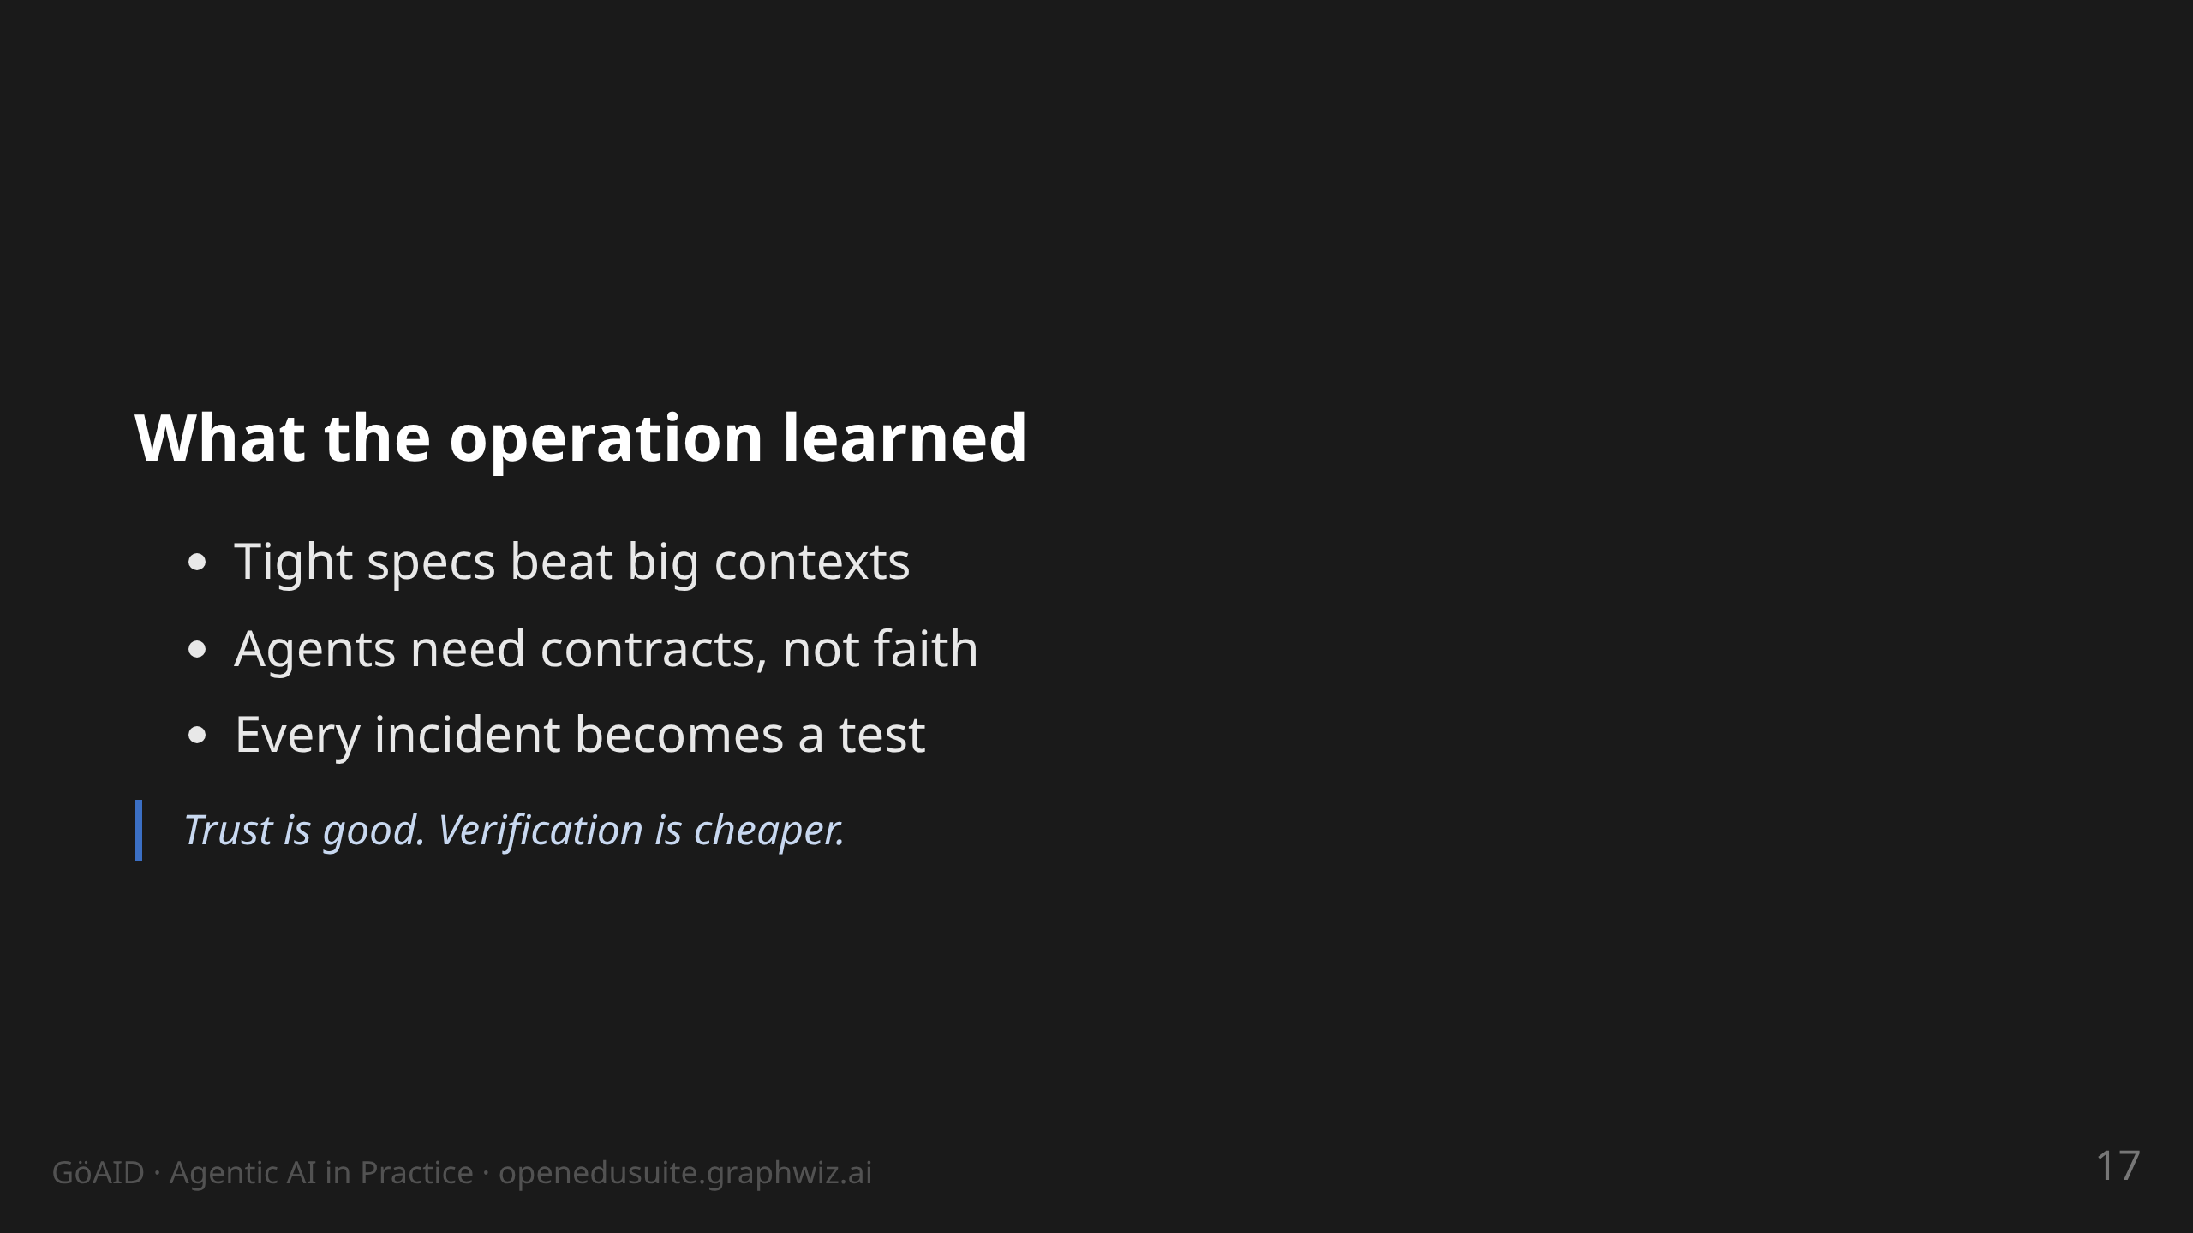
Notes:
notes:
(1.5 min) Three lessons, phrased for operations. Token case: a tight
spec with 5 acceptance criteria beats a 1000-line prompt — fewer
tokens, same quality. Expectations: people want "finished bots" and
get a tool with rules. Test first: the SSO suite was built exactly
this way (59/0/6, every warning a documented decision).

Slide 18
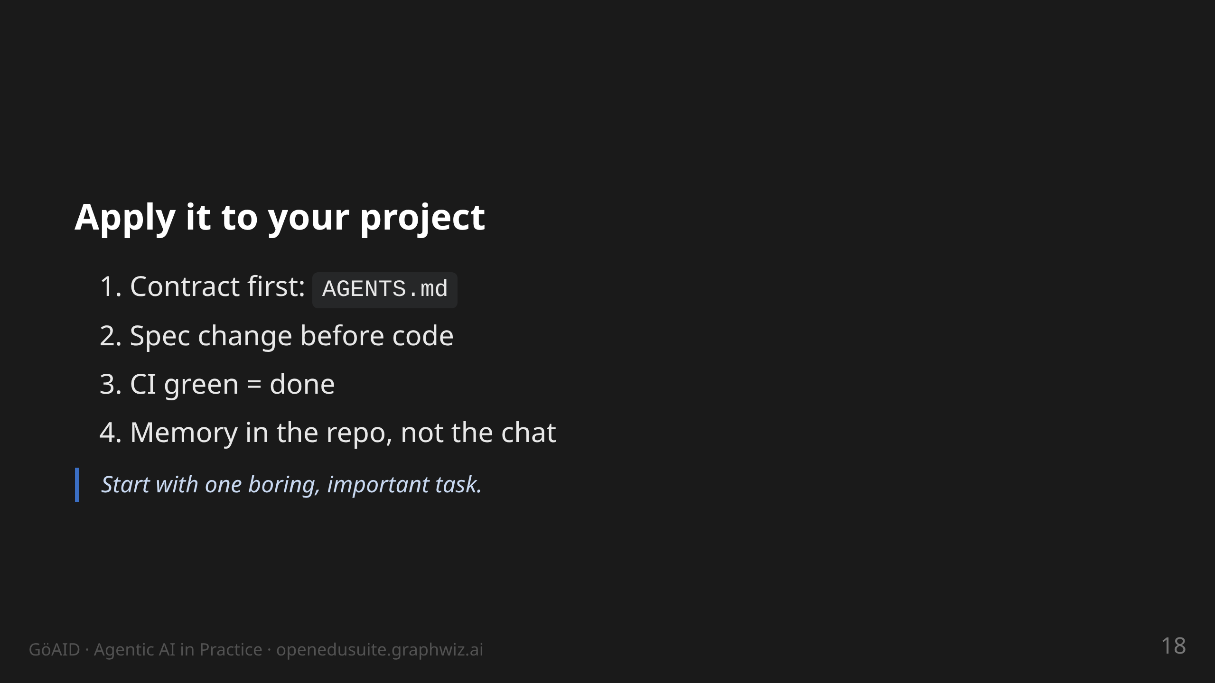
Notes:
notes:
(1.5 min) The transfer slide: the audience should be able to do one
thing tomorrow. Point 1 costs 20 minutes and changes everything —
the agent reads the contract on every start. Point 4: experiences /
spec repo instead of chat history. Not "an agent replaces me".

Slide 19
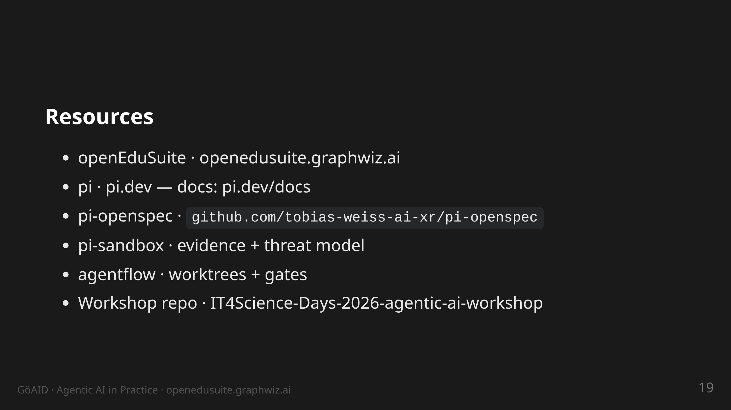
Notes:
notes:
(30 s) Do not read aloud. Everything named here is public and
tangible: repos, specs, test suites — no slide magic. GitHub user:
tobias-weiss-ai-xr. The workshop deck (3h version, IT4Science Days
2026) is public too — deeper dive = do the exercises.

Slide 20
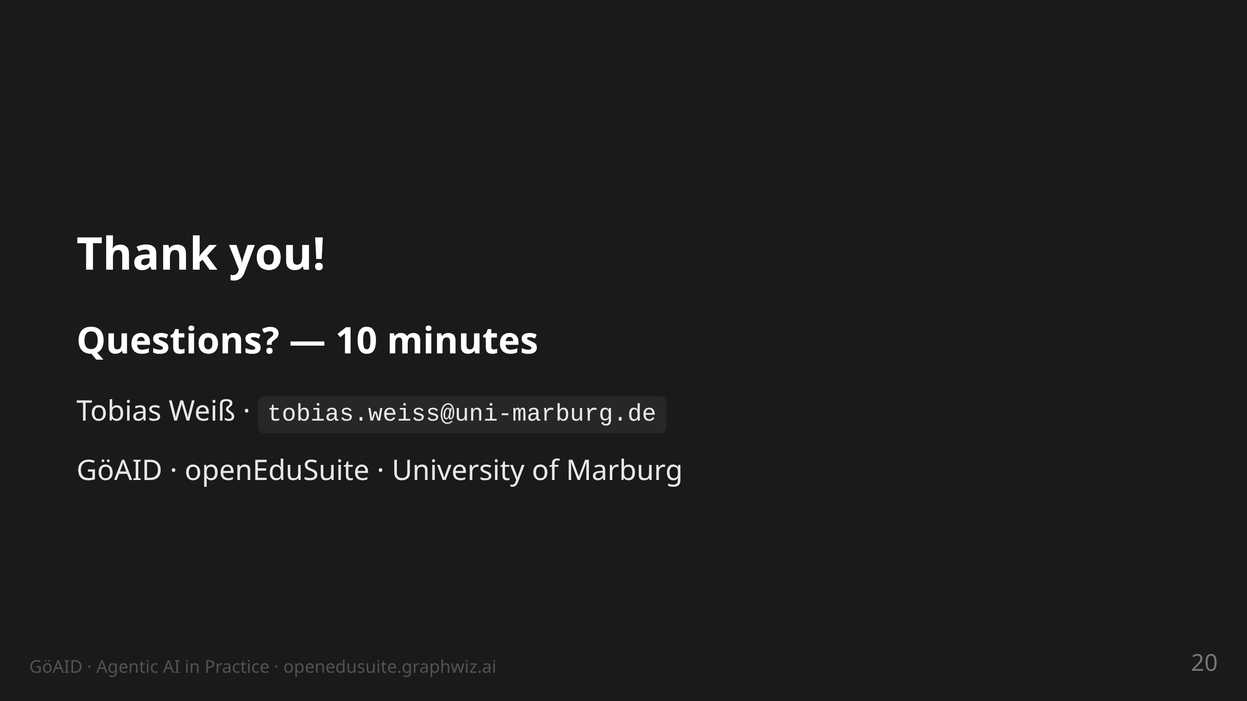
Notes:
notes:
(10 min) Q&A. Likely questions: agent permissions/security (→
contract + plan mode + tests), model choice (→ harness is
model-agnostic, Ctrl+L, pi runs with various providers), cost (→
tight specs, small orders), getting started (→ AGENTS.md + one
boring task).

