Slide 1
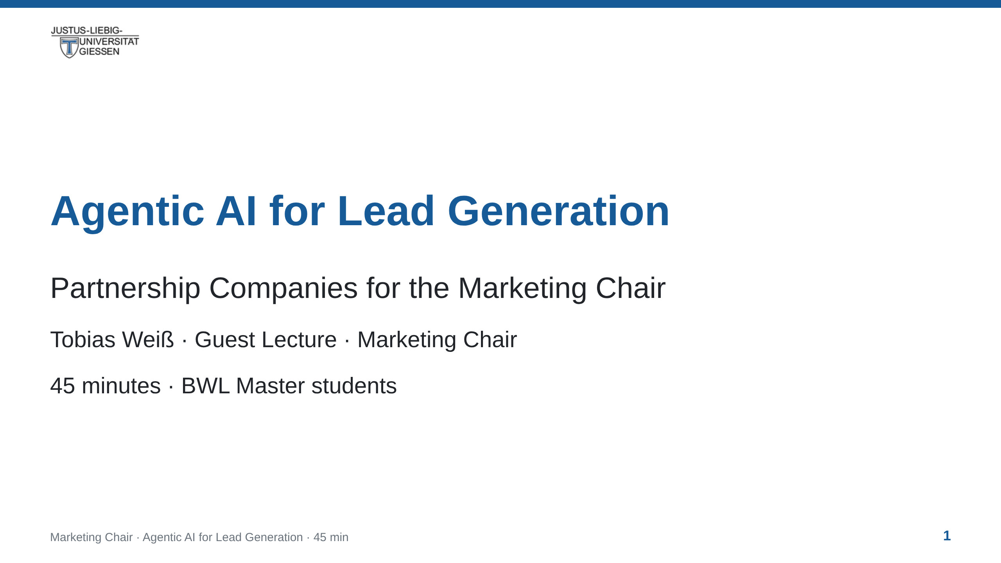
Notes:
notes:
(45 s) Welcome. What this lecture is: what agentic AI is, and how
to operate it through a harness. Everything we do maps to one real
task: helping the chair find and qualify B2B partner companies.
The output of this session is the input for the Bachelor seminar.

Slide 2
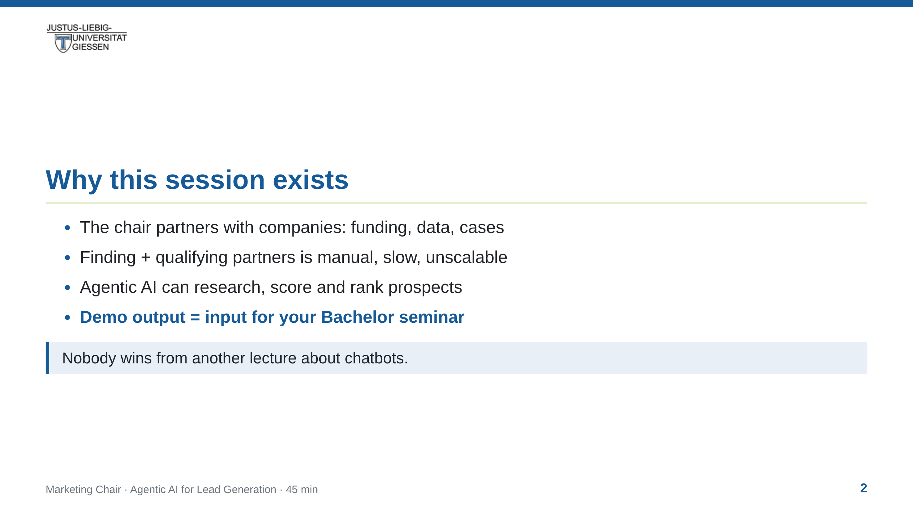
Notes:
notes:
(45 s) Concrete goal for the students: by the end you can RECOGNISE
and judge an agentic workflow — and read the contract that drives it.
The artefact shown in the walkthrough (a ranked lead list with sources)
becomes the working dataset the Bachelor students build on.

Slide 3
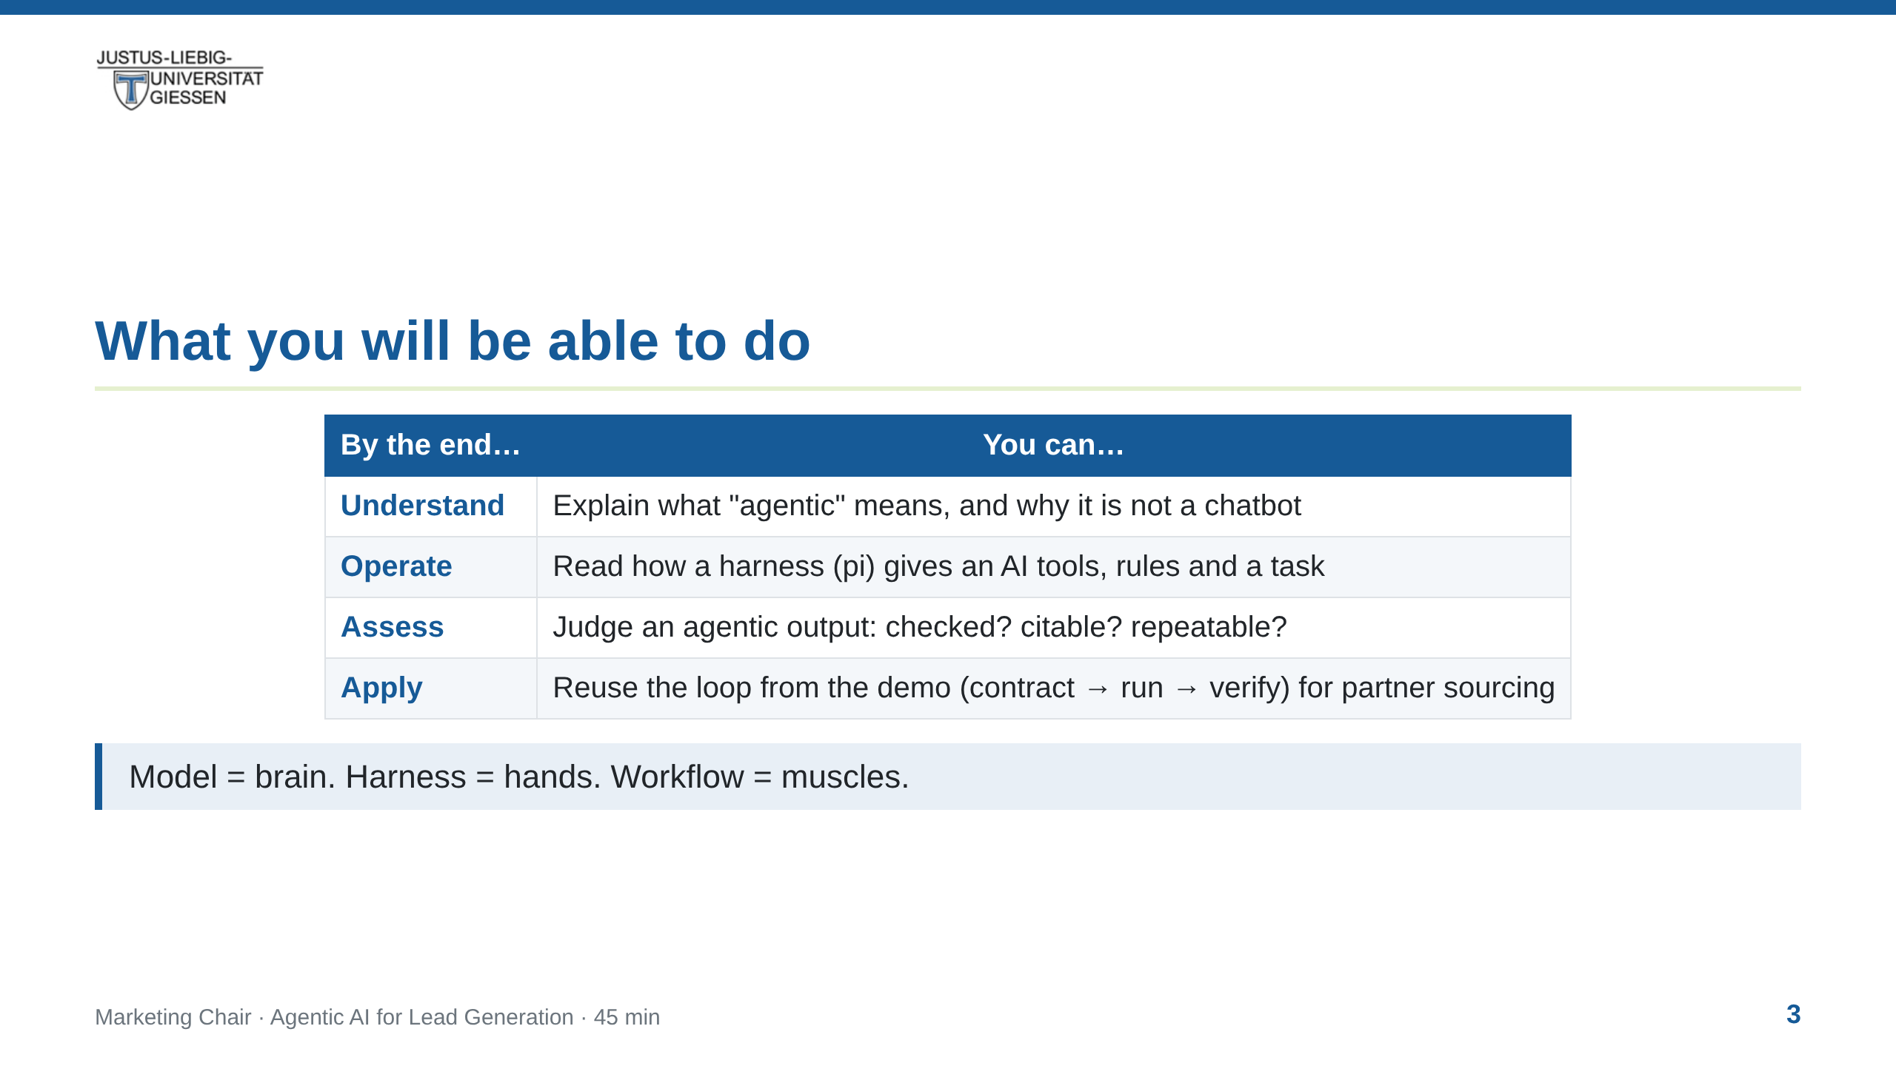
Notes:
notes:
(30 s) Read the rows top to bottom; each becomes a section of the
lecture. Row 4 notes there is no hands-on today — the walkthrough
models the method; trying it yourself is the exercise afterwards.

Slide 4
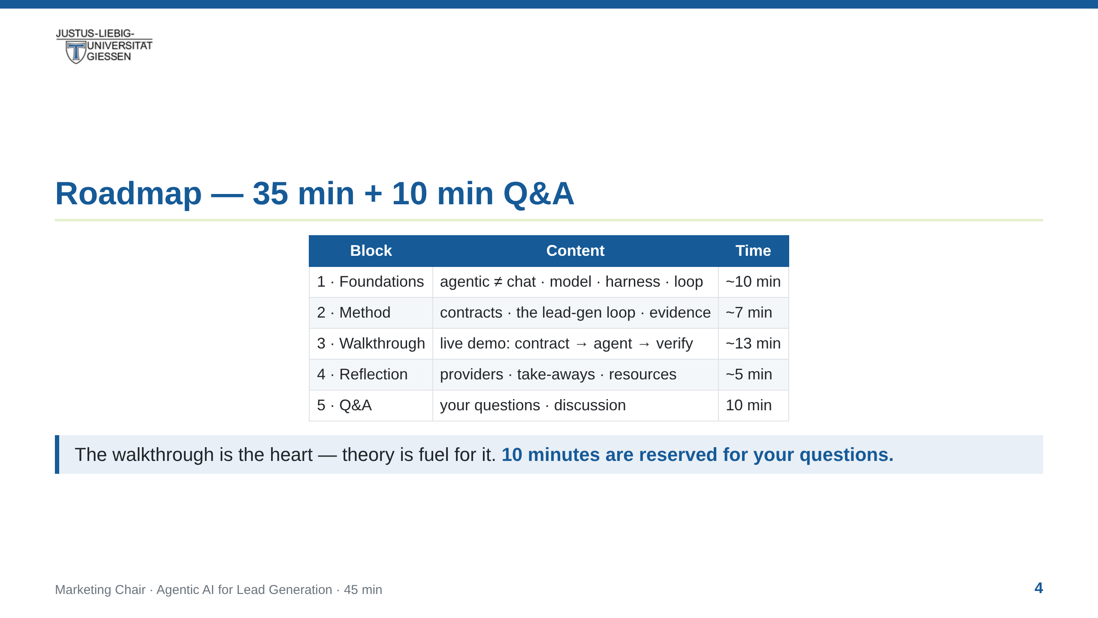
Notes:
notes:
(15 s) Show the arc; the walkthrough (block 3) is where the method
becomes visible. Q&A is a fixed 10-minute block at the end — bank
questions during the talk ("hold that for Q&A") to protect the timing.

Slide 5
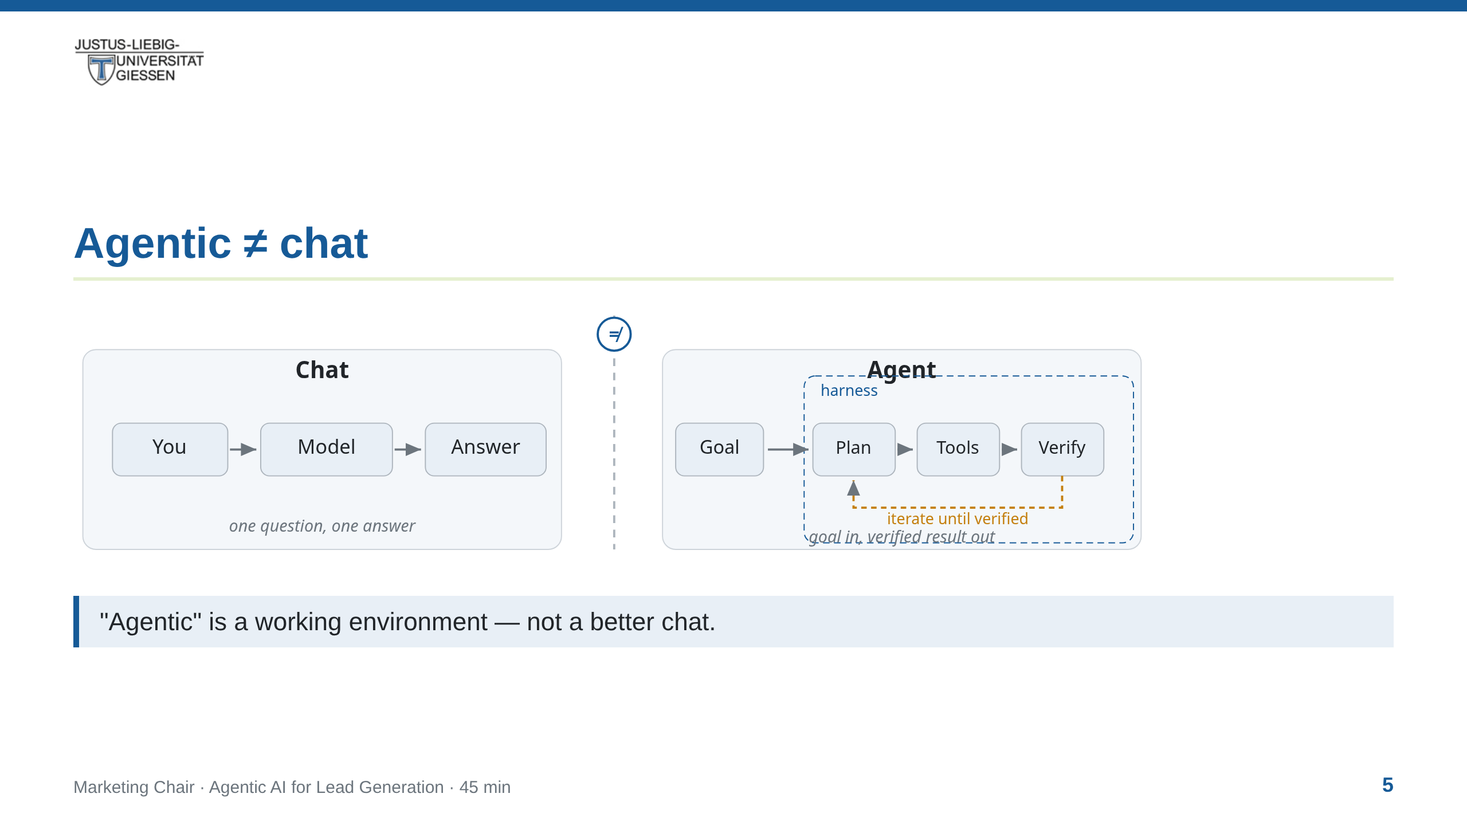
Notes:
notes:
(2.5 min) Left: chat — question in, answer out, no tools, no files.
Right: agent — a goal, a plan, tools, verification, inside a harness
that grants access. The amber loop is where the work happens.
The students' common misconception: "agentic = a smarter ChatGPT".
Set it straight here: it is a difference in kind — the model can
touch the world (browser, files, APIs) and check its own work.

Slide 6
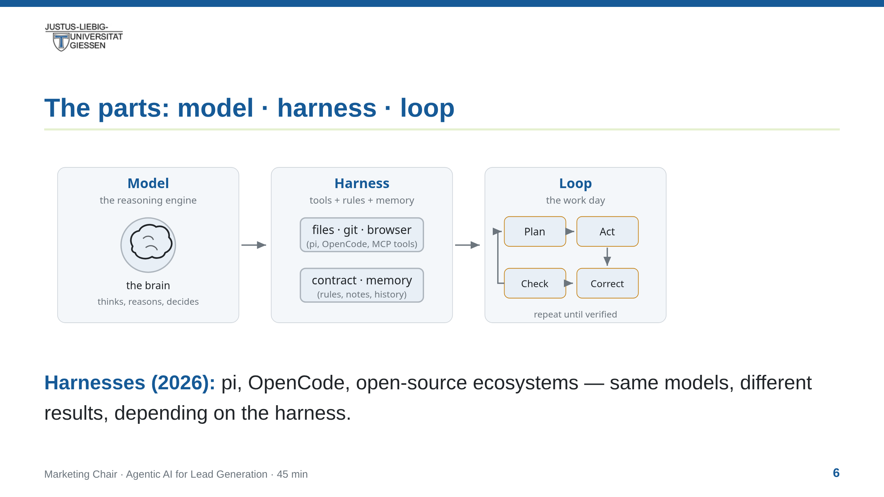
Notes:
notes:
(2.5 min) Keep it simple. The model is the part students already know.
The harness is the missing piece this lecture adds: an executable
environment (terminal, browser, files) + permissions + memory.
The loop is what makes it "agentic": it iterates, checks, corrects.

Slide 7
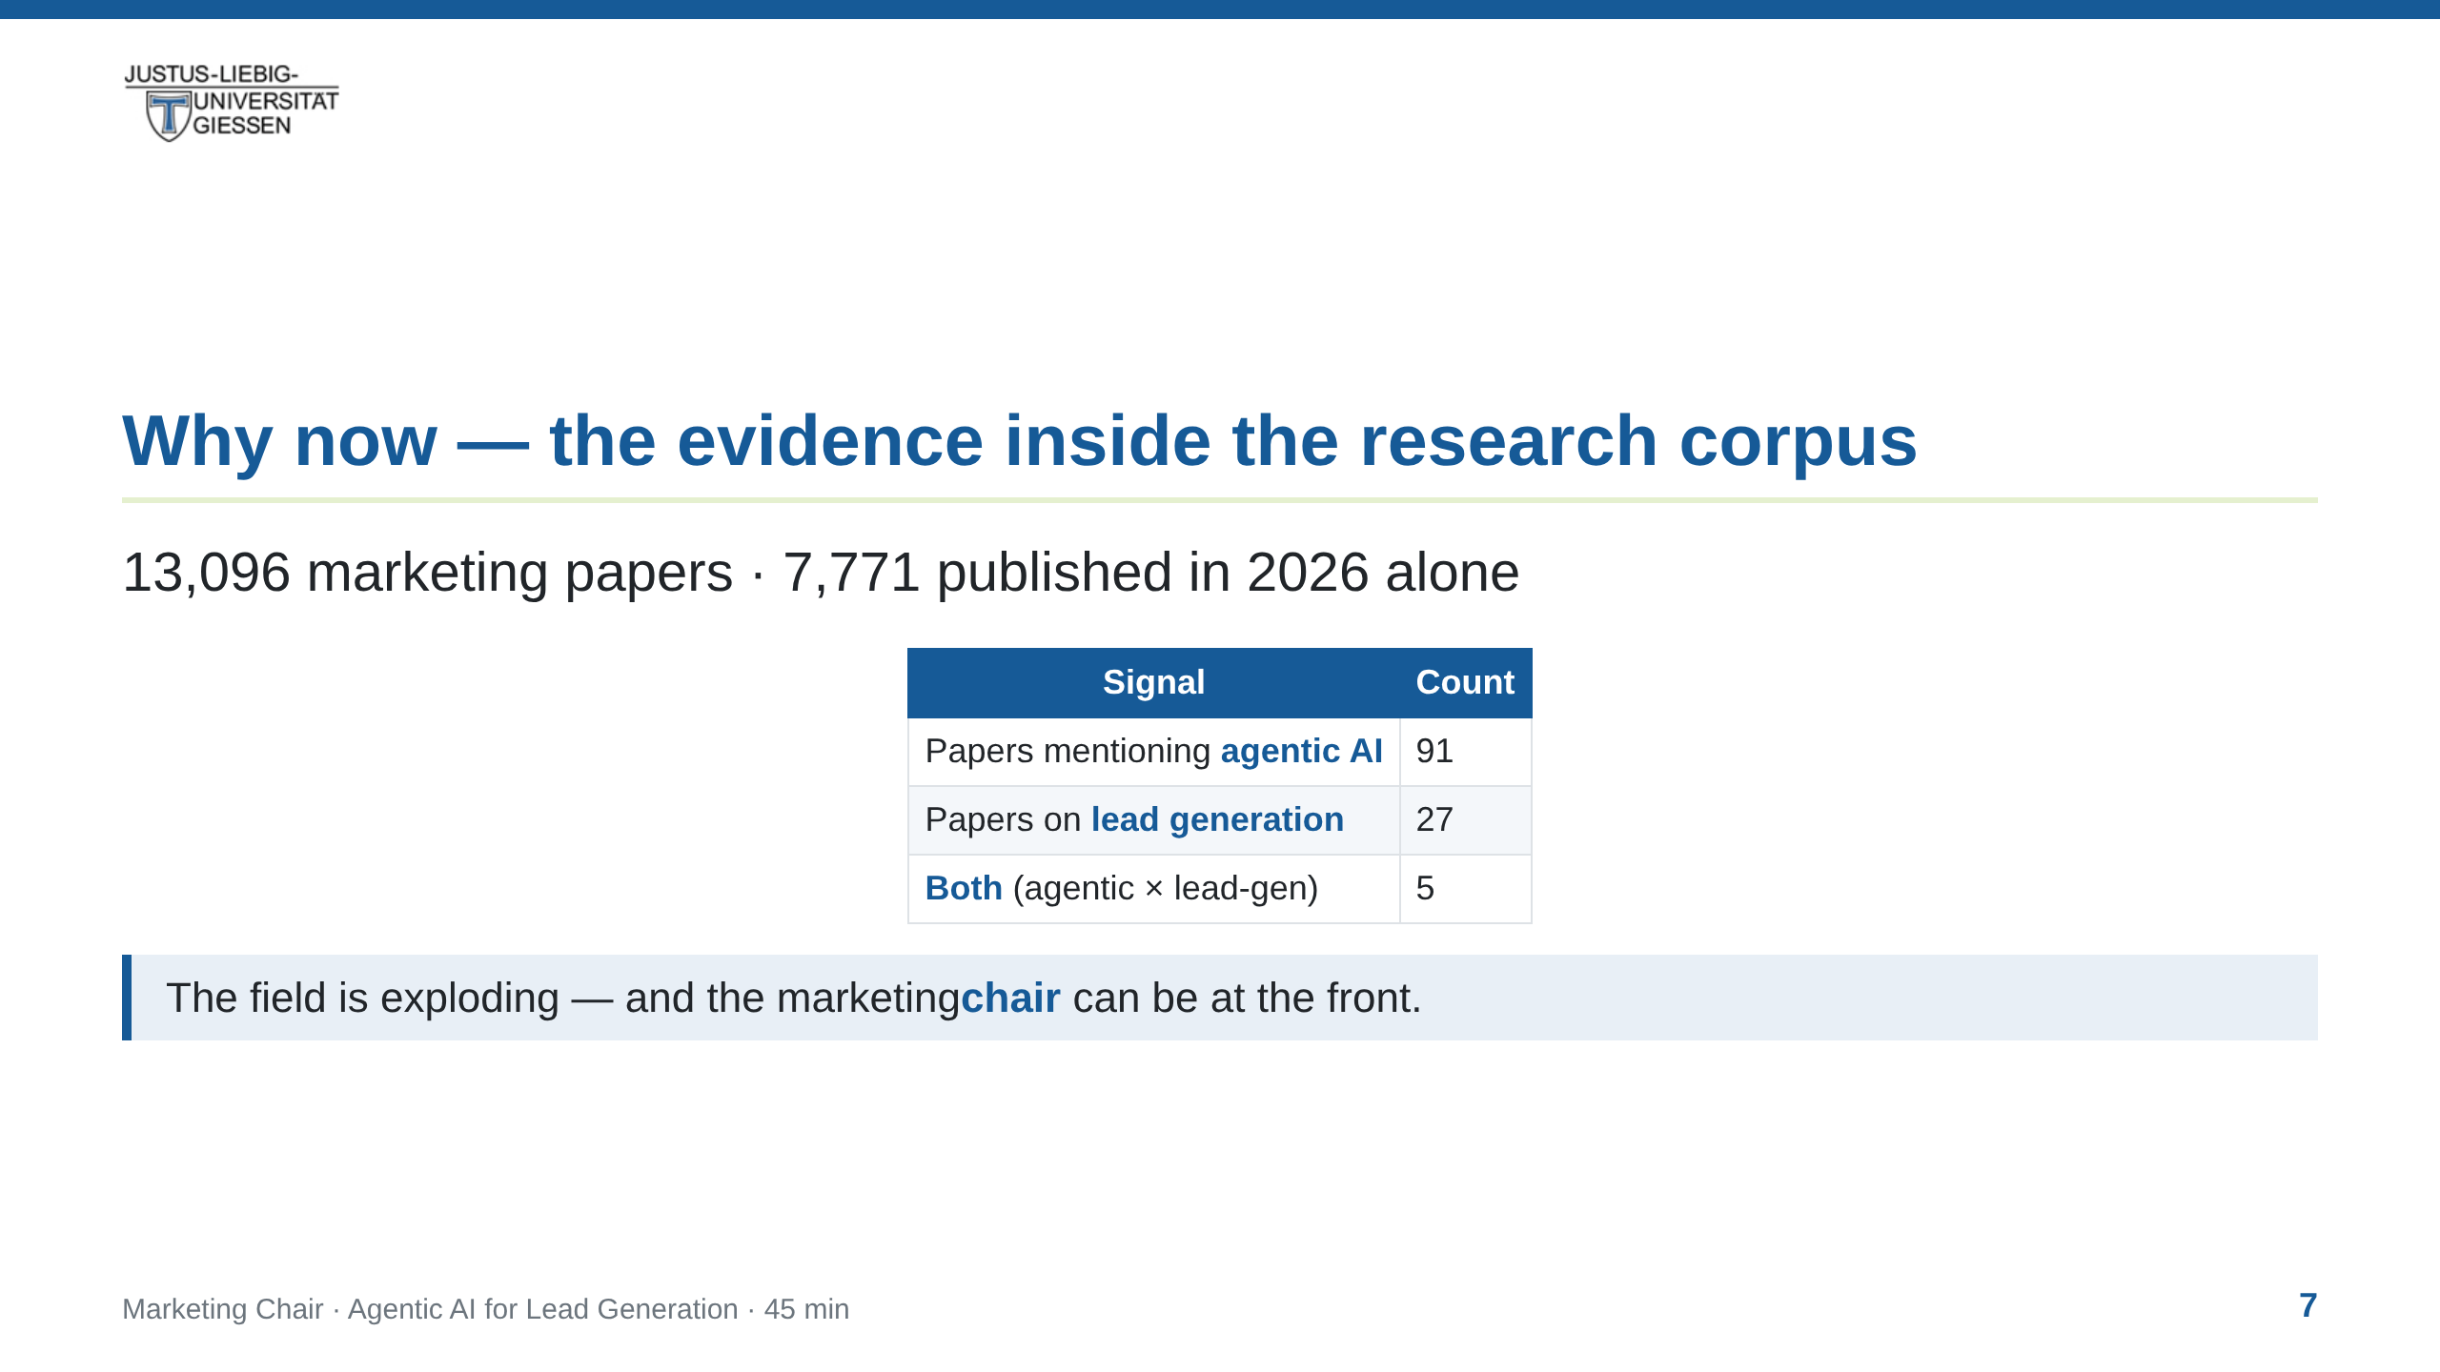
Notes:
notes:
(2 min) Ground the hype in data from the chair's own open research
corpus (marketing-research, public on GitHub). Agentic papers exist,
lead-gen papers exist, but nearly nobody connects both yet. This is
a research gap AND a practical opportunity. Number on screen: 2026
alone produced 7,771 of the 13,096 papers.

Slide 8
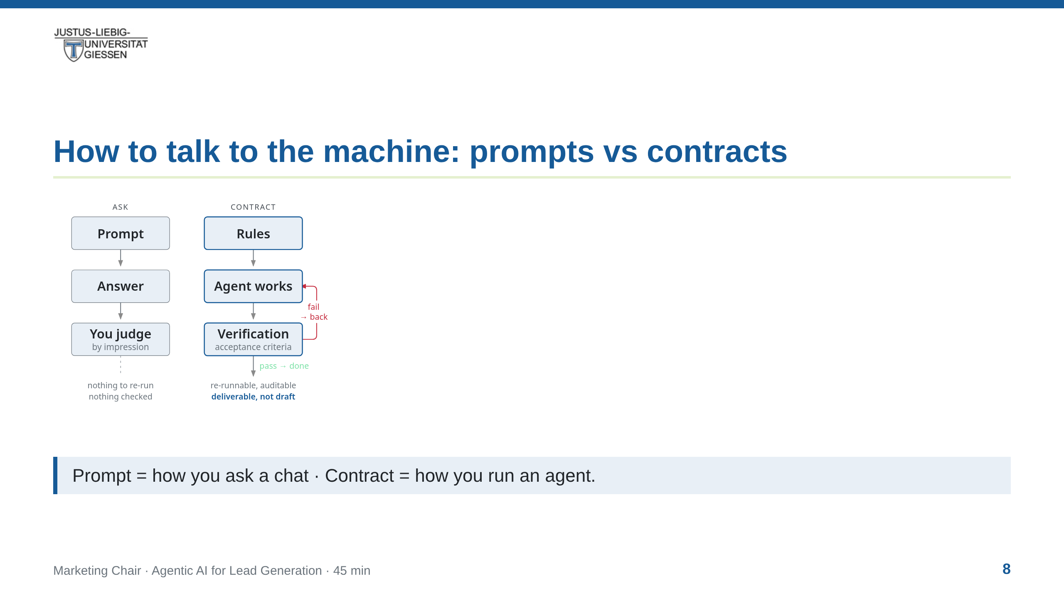
Notes:
notes:
(2 min) The central mental model of the lecture: prompts are how you
ask a chat; contracts are how you run an agent. A contract lives in
the repo, is versioned, and says what done means. This is what turns
an AI "idea generator" into a reproducible research pipeline.

Slide 9
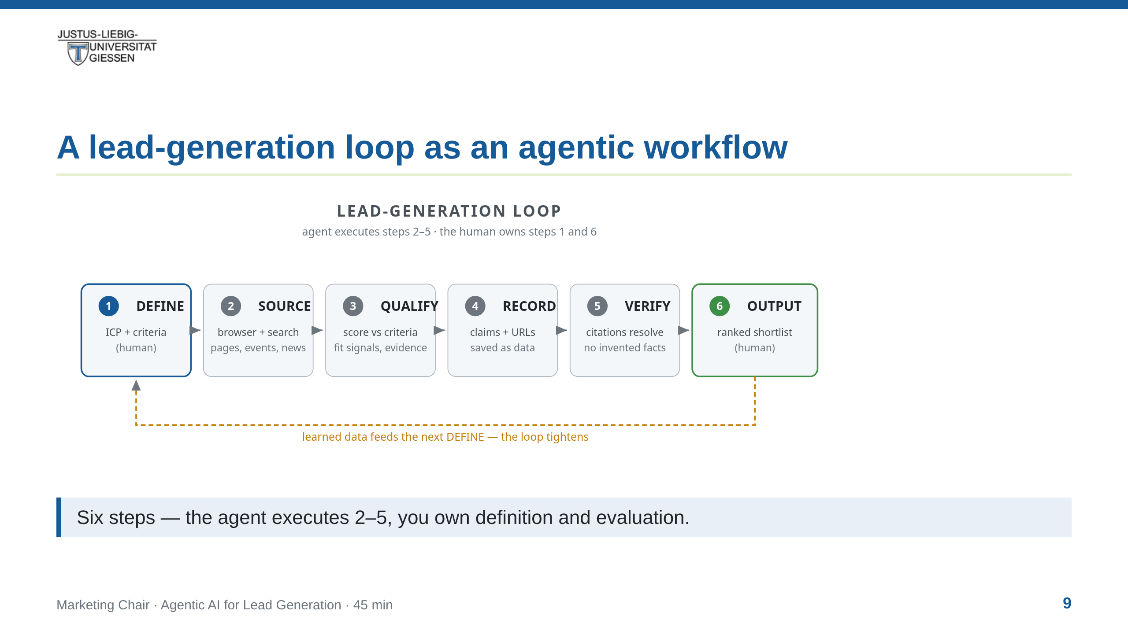
Notes:
notes:
(3 min) Walk the diagram left to right: DEFINE (human, blue) → SOURCE
→ QUALIFY → RECORD → VERIFY → OUTPUT (human, green). The agent runs
the middle four; the human sets criteria and judges the result. The
amber feedback line: learned data tightens the next iteration's
criteria. This exact pipeline is what the walkthrough demonstrates
live in the next block.

Slide 10
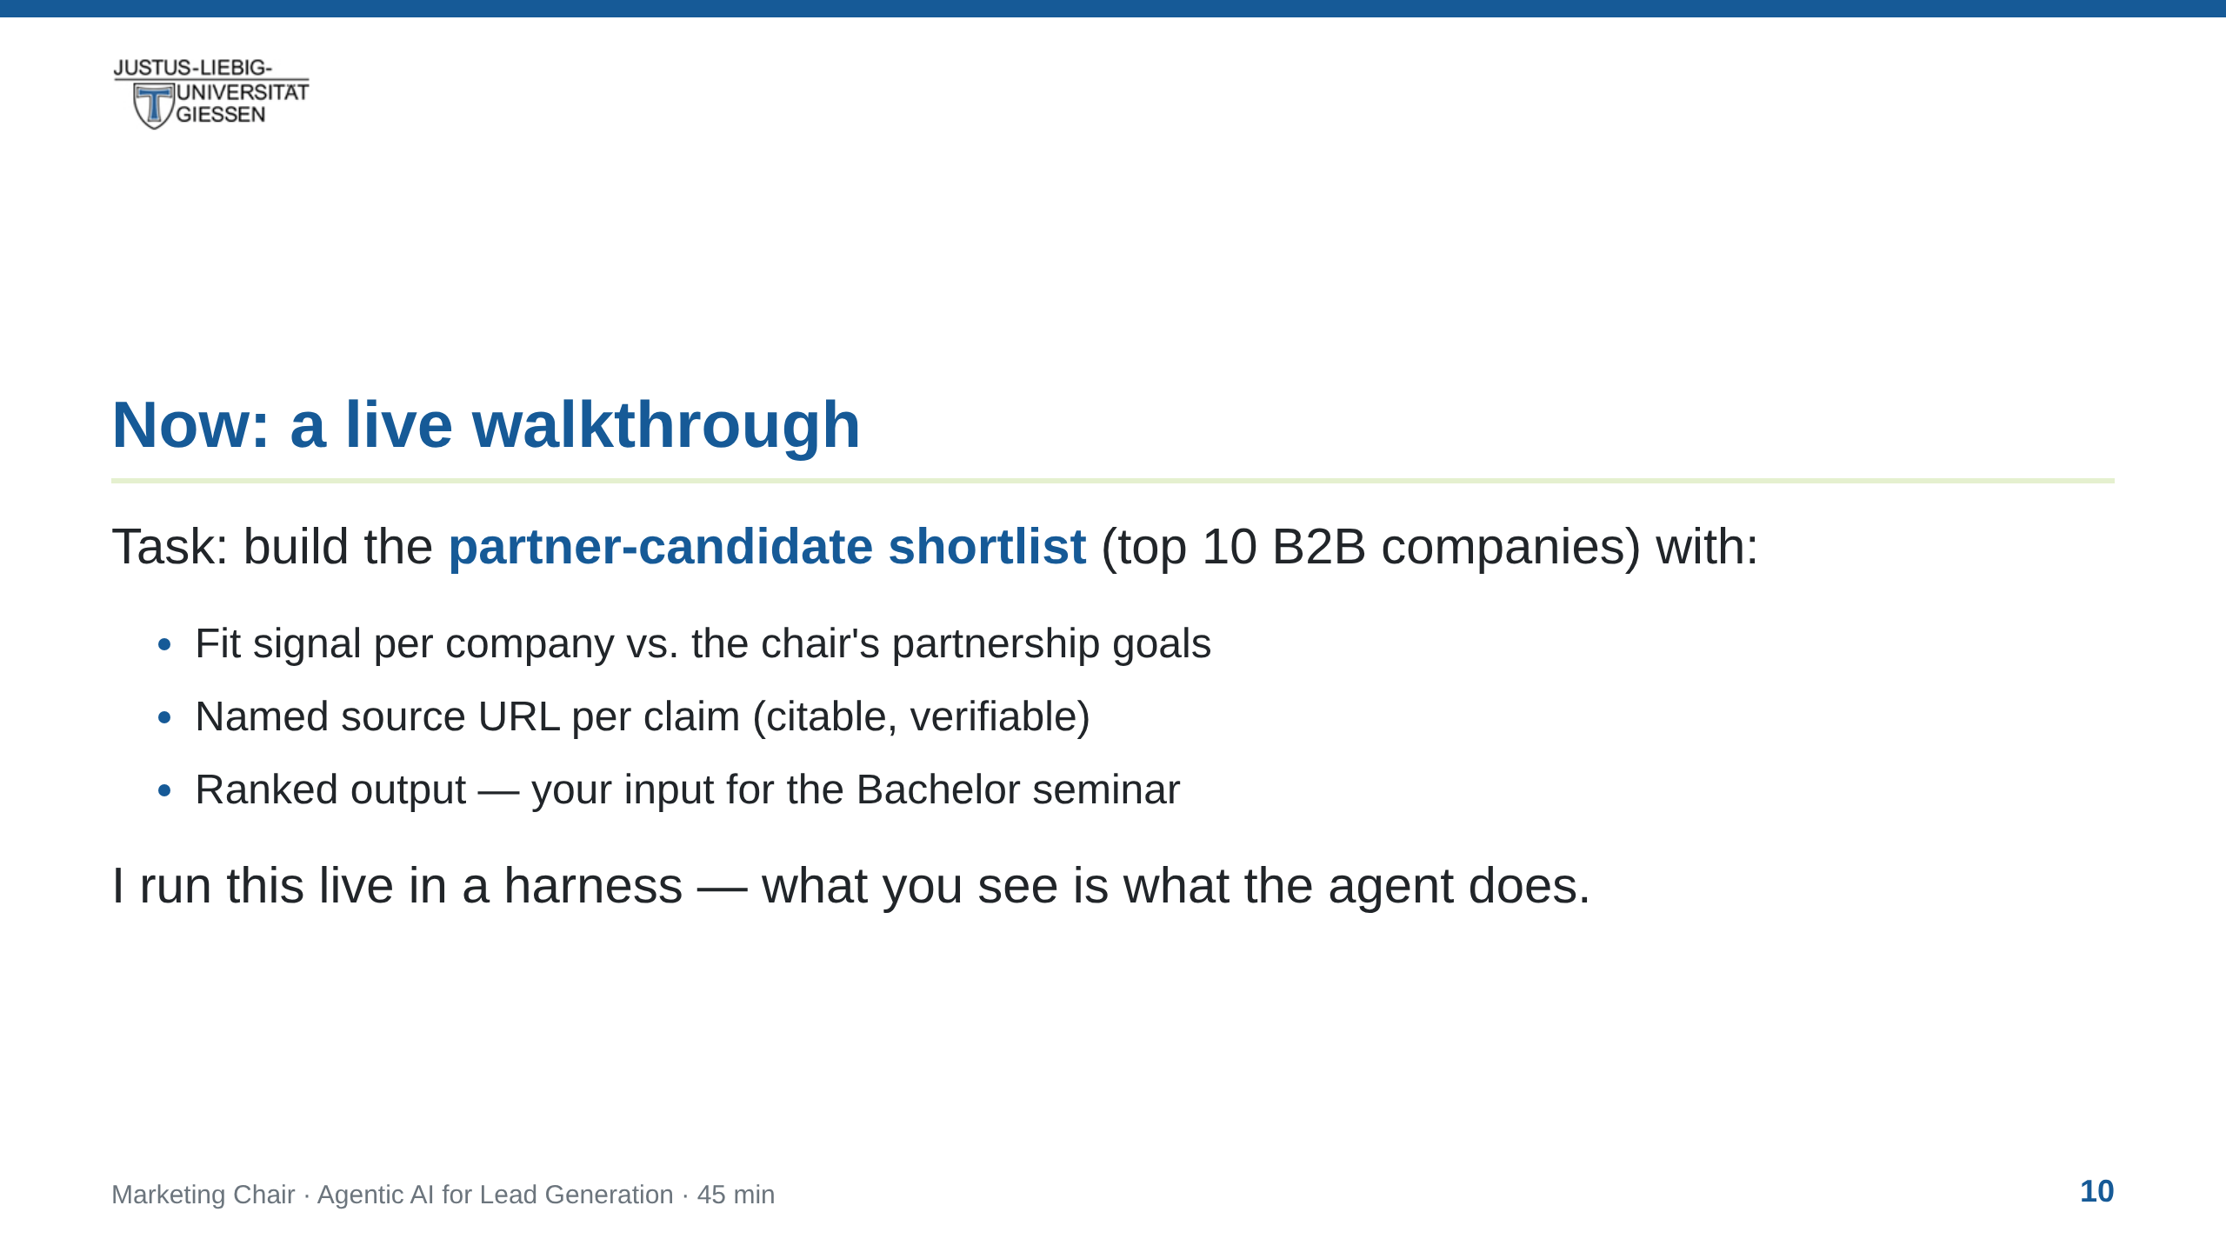
Notes:
notes:
(30 s) Frame the demo: no hands-on today, a walkthrough instead. The
task is the same one the Bachelor seminar will pick up. We watch the
harness do steps 2-5 live; I narrate what happens and why.

Slide 11
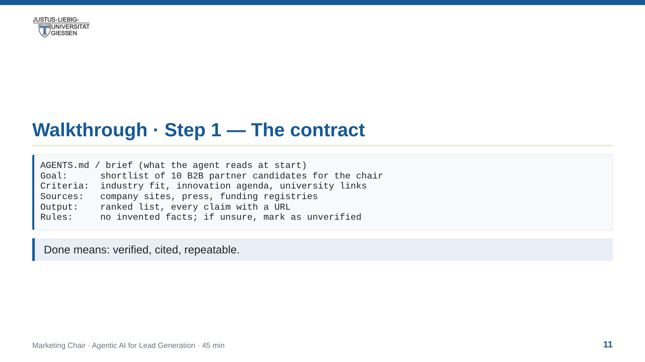
Notes:
notes:
(2 min) Show the contract as the first artifact — the live file is
lecture/demo/AGENTS.md in this repo. The students see that "prompting"
an agent starts with writing rules, not typing a question. Full demo
narration + kickoff prompt: lecture/demo/demo-script.md.

Slide 12
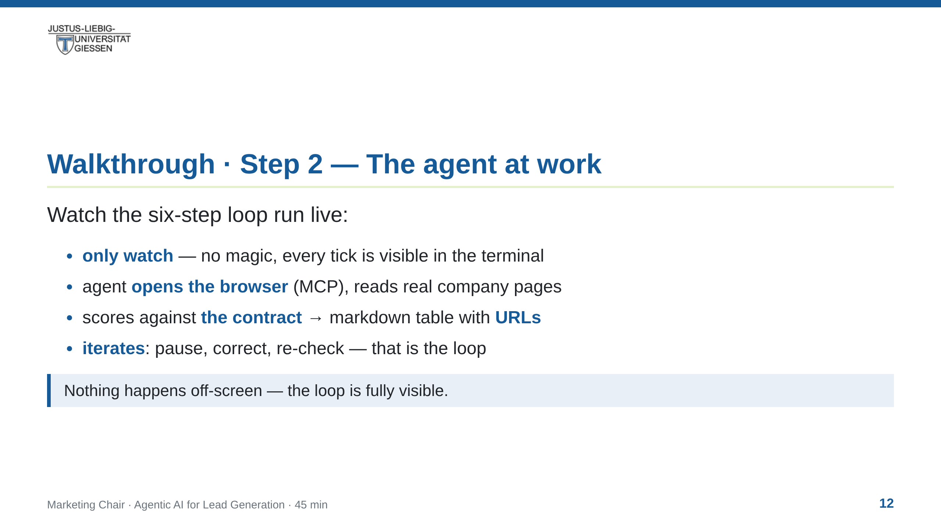
Notes:
notes:
(8 min) THE core demo. Run the analysis loop live in pi. Narrate:
(1) it opens the browser via MCP/BrowserMCP, searches for prospect
companies; (2) it reads real pages and extracts fit signals; (3) it
scores against the contract; (4) it writes a markdown table with URLs;
(5) it re-checks its own citations; (6) it produces the ranked list.
The visual loop is on the pipeline slide before — reference it so
students map what they see to the six boxes. Strategy: use a small
real example (2-3 companies, one industry) — speed beats completeness.
Show a mistake on purpose if possible: pause, let the agent correct —
that IS the "loop".

Slide 13
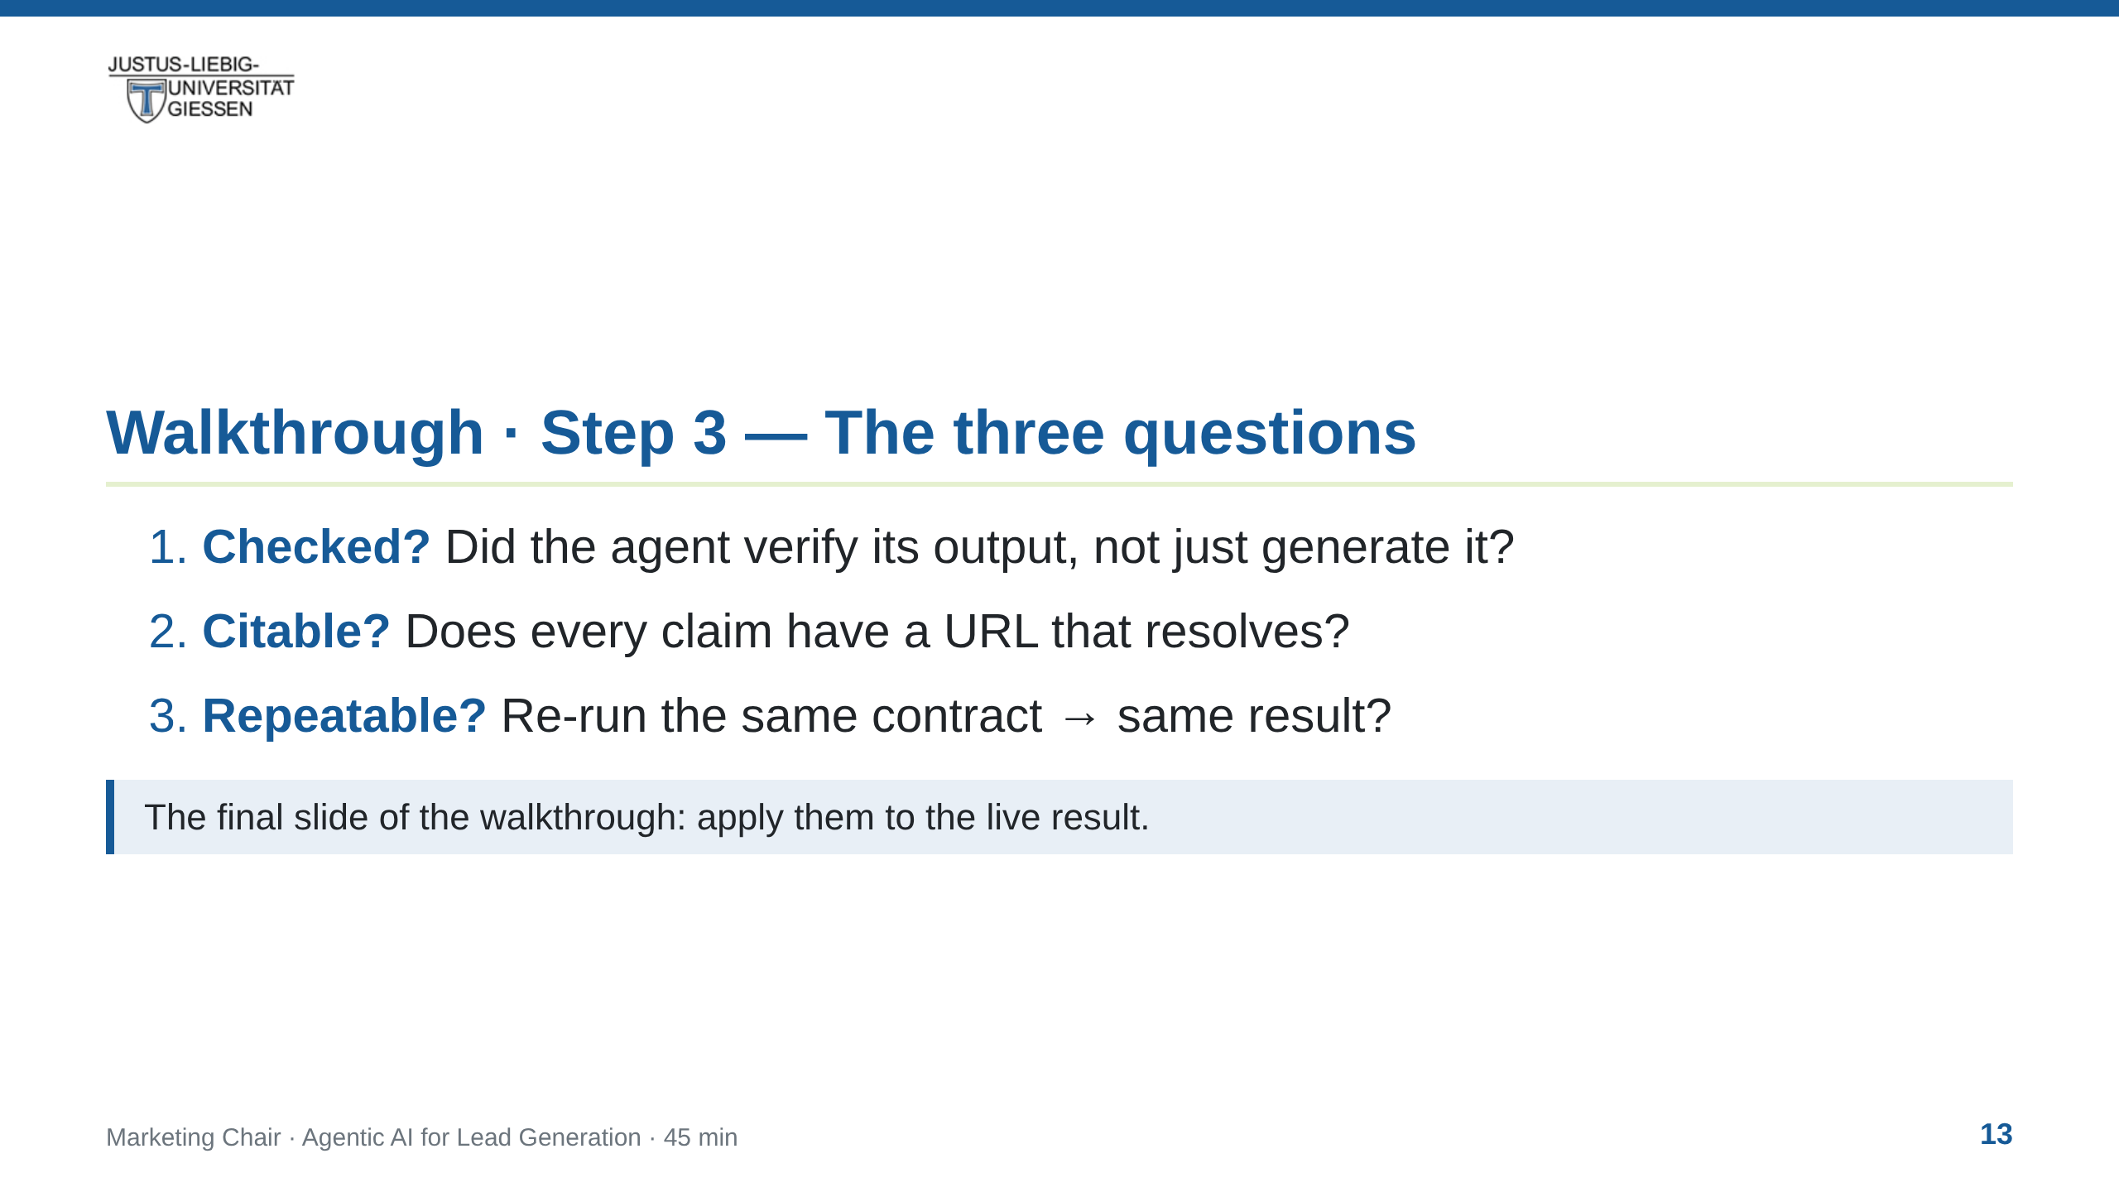
Notes:
notes:
(2 min) Apply the three-question bar to the just-seen output. If it
passes, it is a deliverable; if not, it is a draft. This turns the
demo result into the artefact the Bachelor seminar receives.

Slide 14
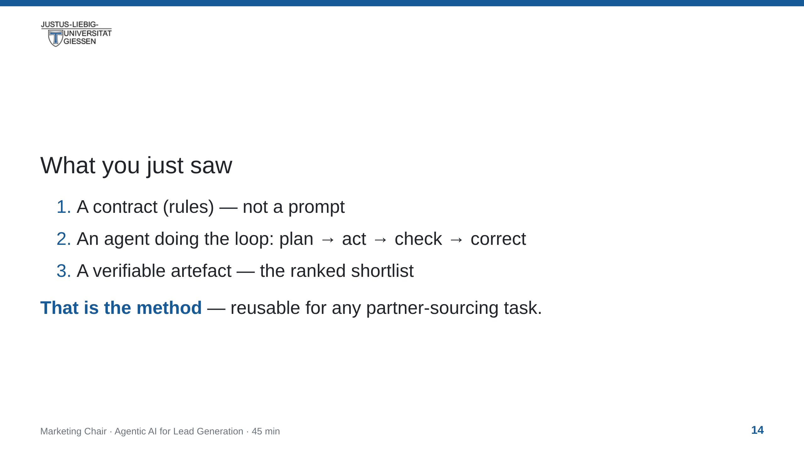
Notes:
notes:
(1 min) Close the walkthrough: the students take away the METHOD, not
just the result. The contract + three questions are the transferable
part; the harness is a tool they can try themselves afterwards.
Point to resources slide for how to start.

Slide 15
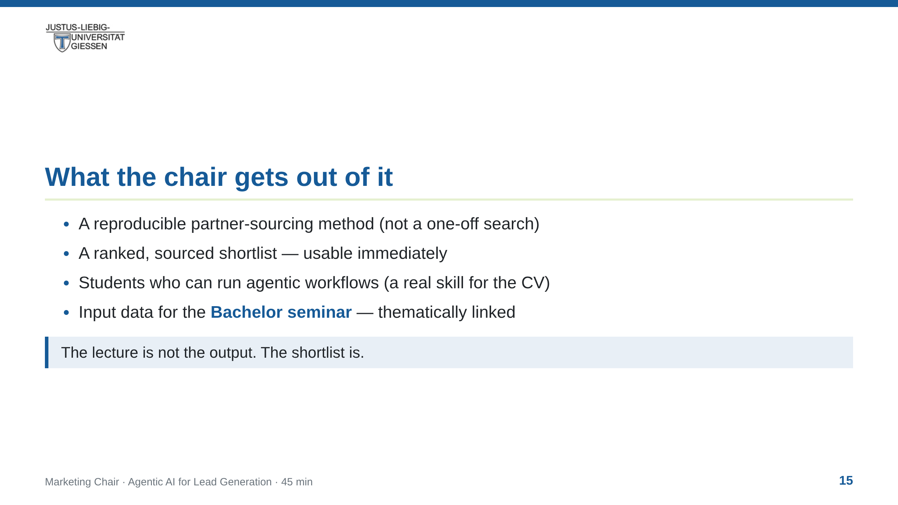
Notes:
notes:
(1.5 min) Make the value exchange explicit — why the chair invested in
this guest lecture. Also honest note: the method is open and reusable;
students may embed it in internships and theses.

Slide 16
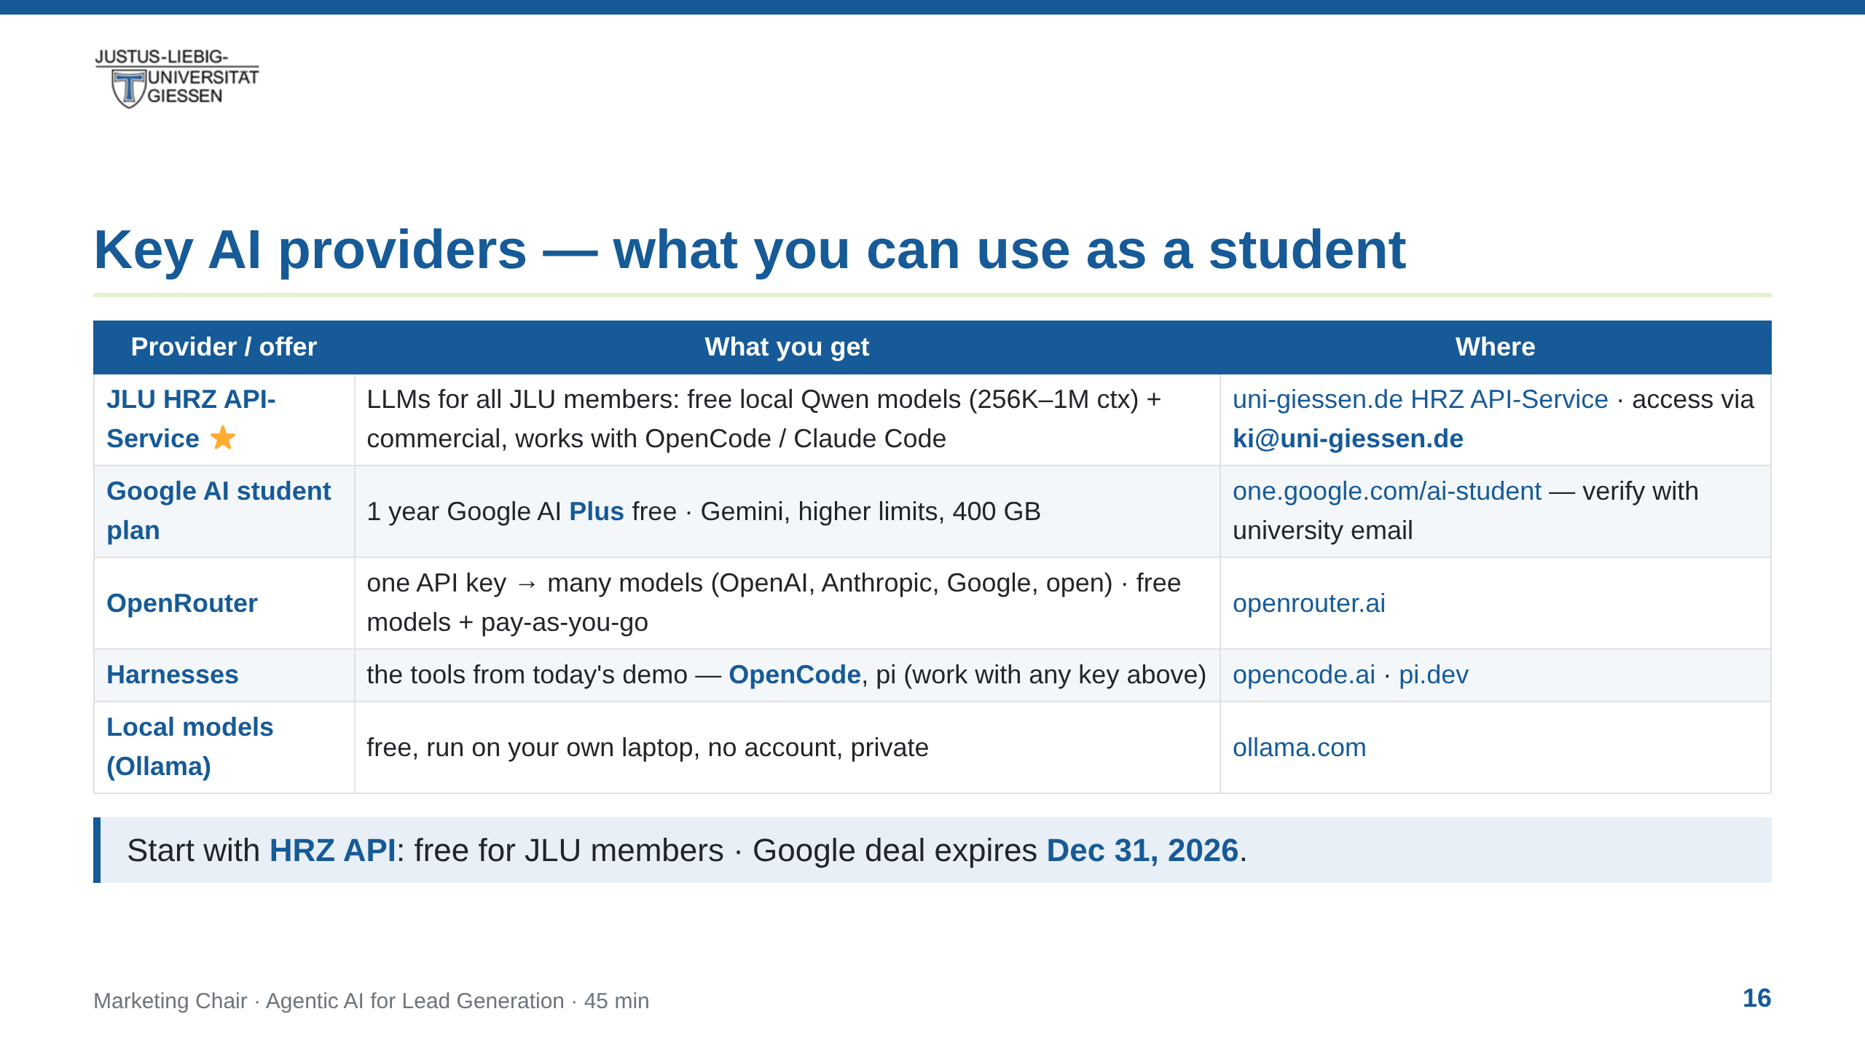
Notes:
notes:
(1.5 min) Practical slide — what students can use NOW. Lead with the
JLU HRZ API-Service: LLM endpoints for all JLU members, open-source
(qwen3-coder-next 256K, qwen3.8-27b 1M) and commercial models; access
by emailing ki@uni-giessen.de; configured in OpenCode via LiteLLM
provider block (baseURL api.hrz.uni-giessen.de) or Claude Code via
ANTHROPIC_BASE_URL. Google row: 12-month free Google AI Plus for
eligible students, verify via SheerID, redeem by Dec 31 2026.
OpenRouter: one key for many vendors, free models and pay-as-you-go
(no subscription) — good if they want a specific commercial model
without per-vendor signups. Ollama = local + free + private.
Harnesses: OpenCode (first-class with HRZ API + OpenRouter) and pi are
what the walkthrough just used.

Slide 17
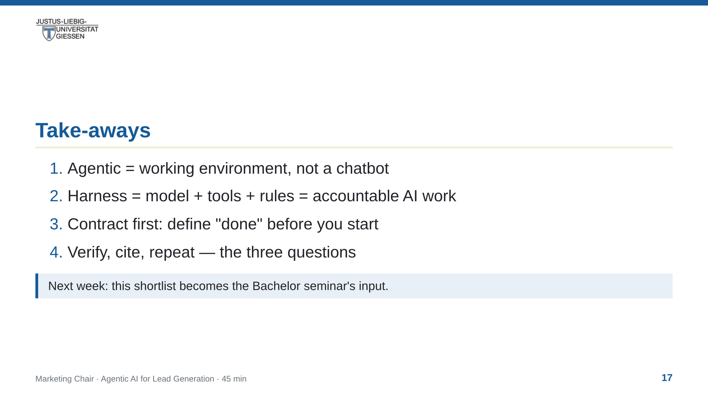
Notes:
notes:
(1 min) Recap the four take-aways. Close the loop: the artefact —
the ranked shortlist — is the handover point to the Bachelor
seminar. That is the "output as input" promise from the title slide.

Slide 18
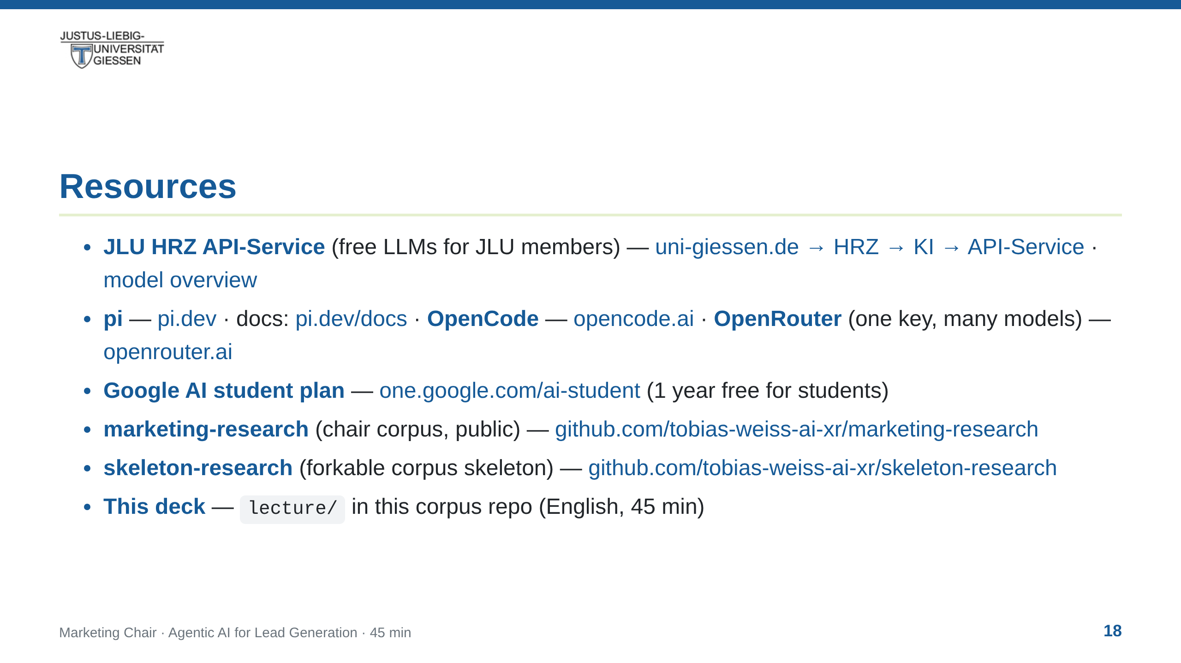
Notes:
notes:
(30 s) Do not read aloud; everything here is public and re-usable.
Lead with HRZ API-Service — it is the free, university-provided LLM
access for students (request a key via ki@uni-giessen.de; OpenCode
works with a LiteLLM provider pointing at api.hrz.uni-giessen.de).
The Google link repeats the providers slide's key offer so it
survives on its own (e.g. when the slide is shared). The
marketing-research corpus is the evidence base for the "why now"
slides; skeleton-research is what a student can fork to run their own
curated corpus.

Slide 19
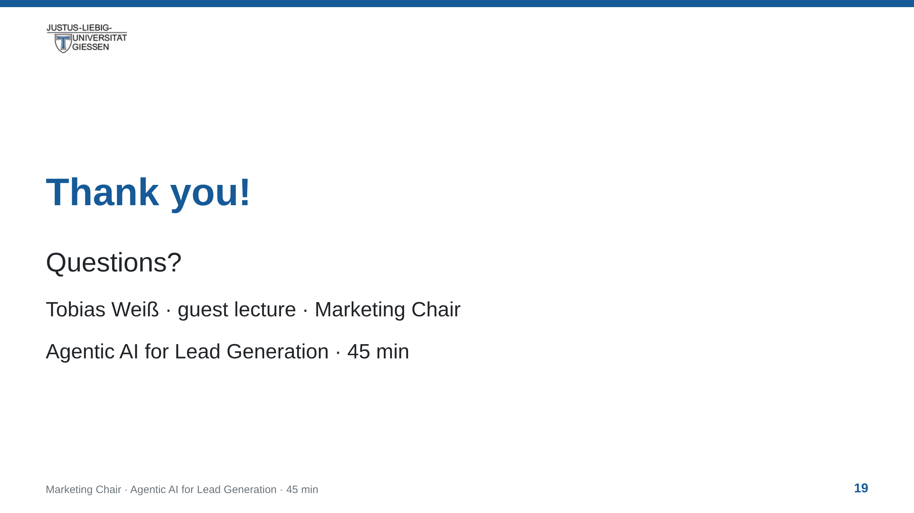
Notes:
notes:
(10 min) Q&A + apply the three questions to the walkthrough result.
Likely questions: model choice (harness is model-agnostic; pi switches
model with Ctrl+L), costs (cheap models + tight contracts), data
privacy (local models), what "qualified" means (the contract), and how
to try it themselves (resources slide).

