Slide 1
Web Development
Mini Project
E-Commerce

Slide 2
SCENARIO
After the recent success of the national E-Sports event, the event organisers want to sell merchandise to help promote the event and any future events that they might organise.
To do this they require a “prototype” e-commerce website system designing and developing.

Slide 3
CORE FUNCTIONALITY
Allow customers to register for an account
Allow customers to edit their own account information
Display a list of products that are stored in a database
Allow customers to browse and search for products
Allow customers to add products to their basket and “checkout”
Allow admins to manage customer orders
Allow admins to add new products or delete existing ones
Display a website dashboard for the admins, showing important information such as amount of orders, total income etc.

Slide 4

WHERE TO
START?

Slide 5
POSSIBLE OPTIONS
Database design?
Front end design?
Rapid prototyping?
Google?

Slide 6
1.
The Database
Let’s start with how we will tackle data storage

Slide 7
Database entities
How many tables do you think this website will need to achieve the core functionality?
Spend two minutes making a note of the tables you think you might need, and any fields that might be present.

Slide 8
POSSIBLE TABLES
Products
Product images?
Users
Orders
Order items

Slide 9
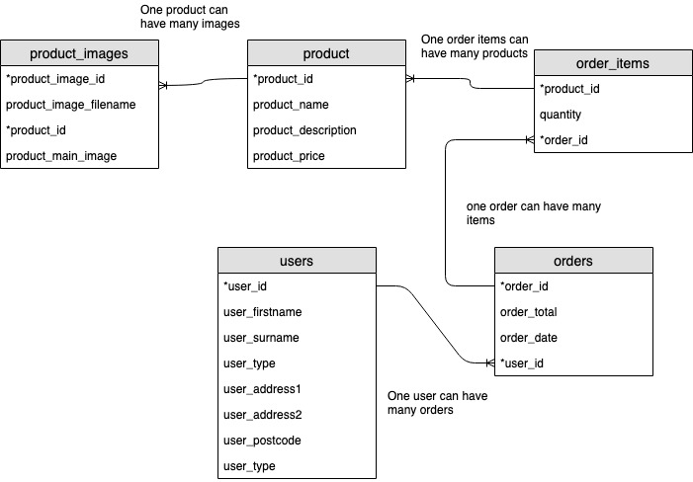
ERM

Slide 10
TASKS
TASK 1
Create your database and all of the database tables in PHPMyAdmin
TASK 2
Create a customer signup form and script so that people can register as customers for your shop

Slide 11
http://tinyurl.com/y4hfvmae

Slide 12
Part 2
We tackle creating a product and uploading images

Slide 13
Adding a product
a) Add the product
We need to add a product into the products table and catch the last inserted id to use to link the images
b) Upload the images
We pick the images, check they’re the right extension and then attempt to move them to the server
c) Record the filename
We insert the image filename and product id into the product_images table
Download Files Here

Slide 14

Things to work on over easter
Creating a login script
Allowing users to edit their information
Allow admins to edit product information
Styling your website
Mobile responsive

