Slide 1
Lab 1: Implementing a B+ Tree
Julius Oeftiger
Michael Senn
Tobias Famos

Slide 2
Overview
Design of our B+ tree structure
  1000m view, internal & leaf nodes, pages, buffer pool design
Operations
  Get & Set
Expected performance
  The good, the bad, the ugly
Q&A session

Slide 3
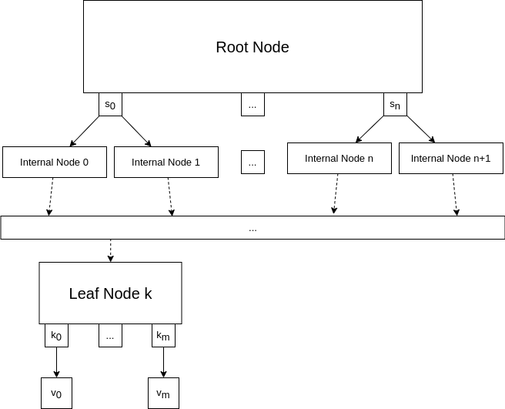
B+ Tree Design: 1000m view
Separators indicate which node to check next
Large fanout factor / small depth
Internal nodes guide to leaf node
Leaf nodes containing exact key/value pairs

Slide 4
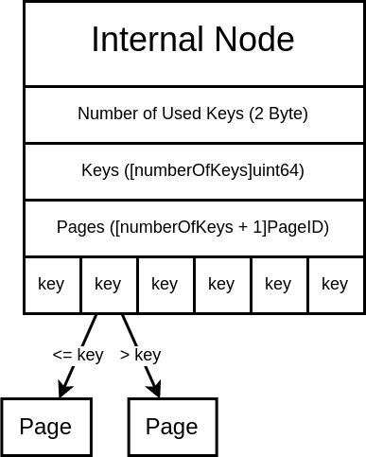
B+ Tree Design: Internal Node Structure
Keeps track of number of occupied keys
For each separator key, reference (as Page ID) to appropriate next page
Can be (de)serialized to and from page
With 4 KiB page: 340 separator keys

Slide 5
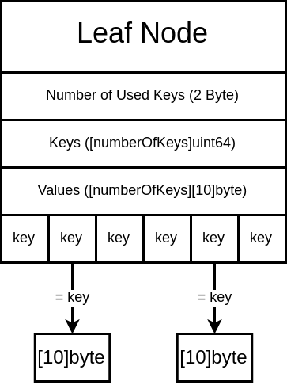
B+ Tree Design: Leaf Node Structure
Keeps track of number of occupied keys
For each key, contains valued stored at key
Can be (de)serialized to and from page
With 4 KiB page: 227 key/value pairs

Slide 6
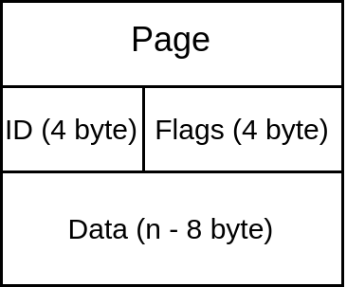
B+ Tree Design: Page Structure
Continuous region of memory
Size on the order of KiB (currently 4 KiB)
Uint32 Page ID
A few bytes for meta data
  Page dirty? Node type?
Data field contains encoded node
  1 node <=> 1 page
Accessed via buffer pool manager
Later: Pages persisted to disk

Slide 7
B+ Tree Design: Buffer Pool Manager
Buffer pool manager abstracts away access to pages
Allows retrieving page by page ID, will handle loading from memory / disk
Handles flushing of dirty pages to persistent storage
Decides which pages are kept in memory
  Pages can be pinned to keep them loaded
  Unpinned pages may be evicted by LRU mechanism

Slide 8
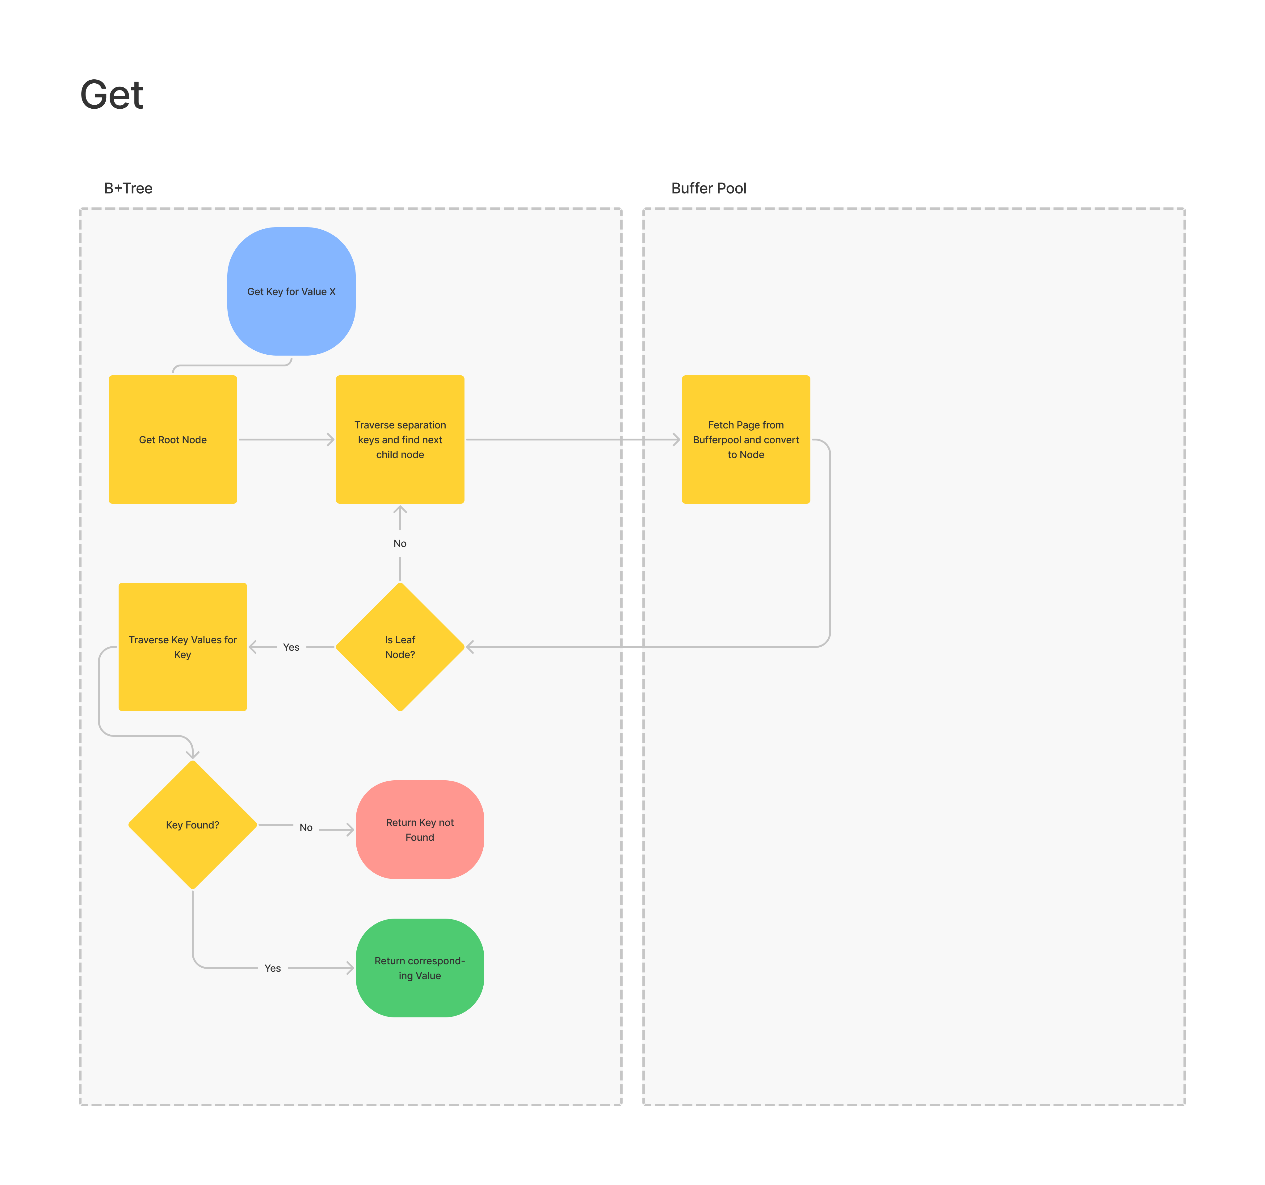
Operations: Get
Start at root node
Find next node using binary search over separator keys
  Query manager for page, deserialize node stored within
Repeat until you arrive at leaf node
If key exists, return value. Else, return key not found

Slide 9
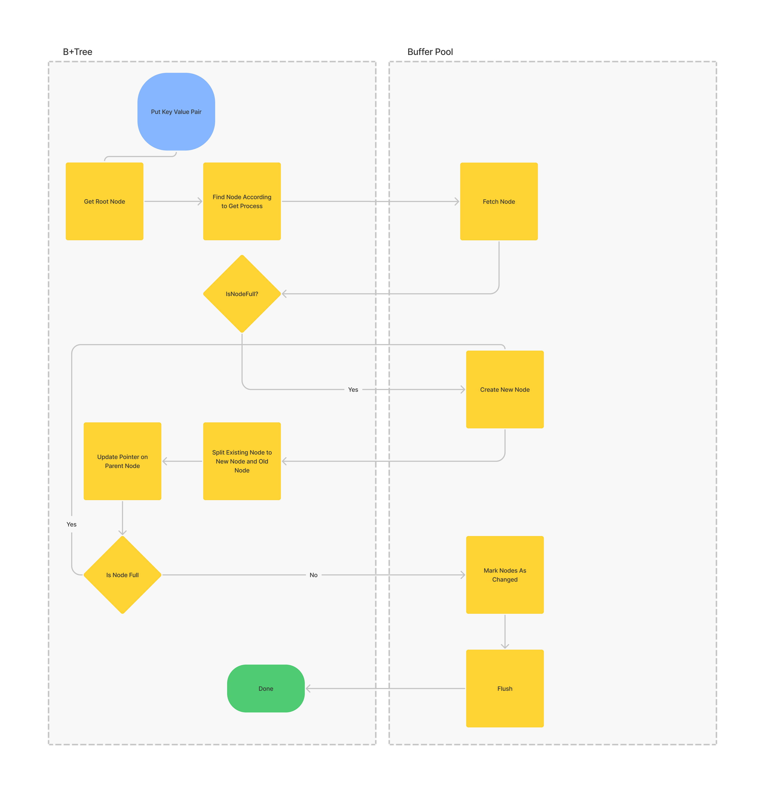
Operations: Set
Find appropriate place to insert
If space left, insert value, done
Else, split node into two, updating points in parent node
  If that one is full too, repeat
Once node with space available, insert value, done
Be sure to mark modified pages as dirty

Slide 10
Expected Performance: The Good
Read operations
  Must traverse root-to-leaf once, tree will have low depth due to large fanout, O(depth)
  Within node, binary search allows O(lg fanout) lookup

Slide 11
Expected Performance: The Bad
Insert operations
  Find place to insert => efficient, O(depth) + O(lg fanout)
  If space left => insert in appropriate place, shift other key-value pairs, O(lg fanout)
  If no space left => Split parent node, requiring rewriting of a few pages worth of nodes (two new child nodes and parent node)
  If parent node full...

Slide 12
Expected Performance: The Ugly
Insert operations if tree full
  Requires splitting of nodes up to root node
  At least expected depth is low, so it’s relatively few operations
  But still results in a lot of disk IO for large trees

Slide 13
Q&A
We’ve seen the basic structure of our tree
And the way basic operations on it work
As well as some predictions on how it’ll perform for various operations
Your turn – any questions? :)

