Slide 1
Physics of Trotterization in VQE’s

Slide 2
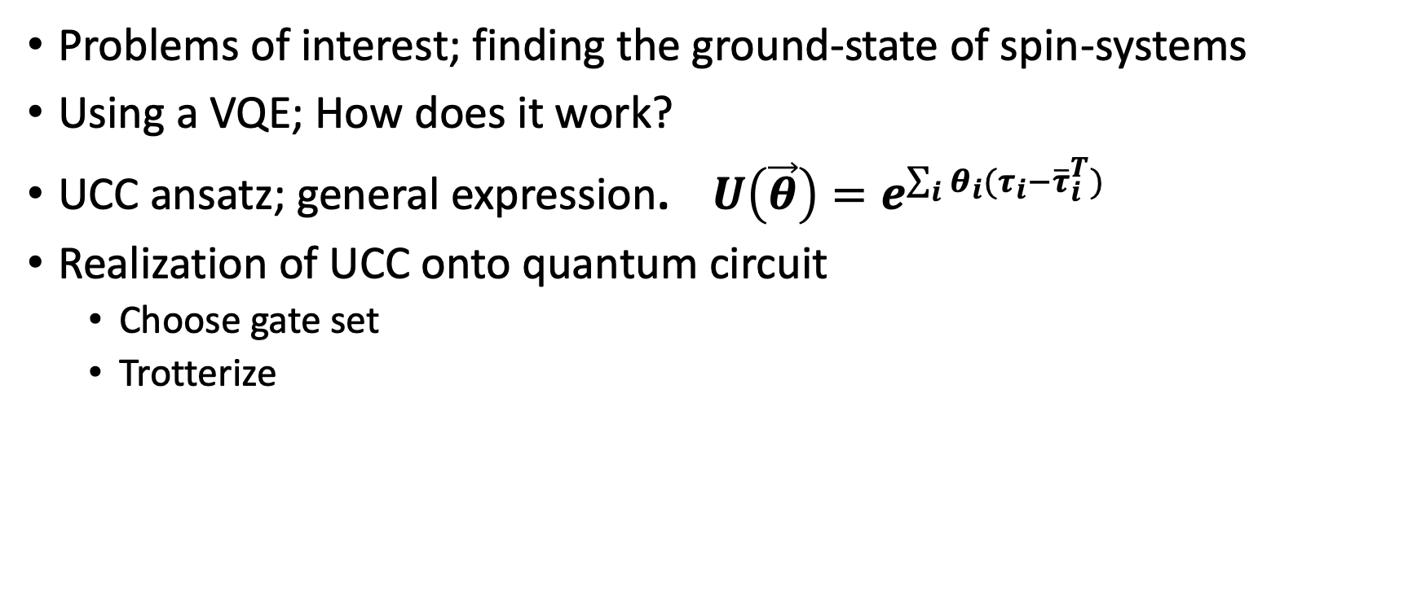
Introduction
Problems of interest; finding the ground-state of spin-systems
Using a VQE; How does it work?
UCC ansatz; general expression. ${U\left(\vec{θ}\right)=e}^{\sum_{i}{θ_{i}(τ_{i}−{\overline{τ}}_{i}^{T})}}$
Realization of UCC onto quantum circuit
Choose gate set
Trotterize

Slide 3
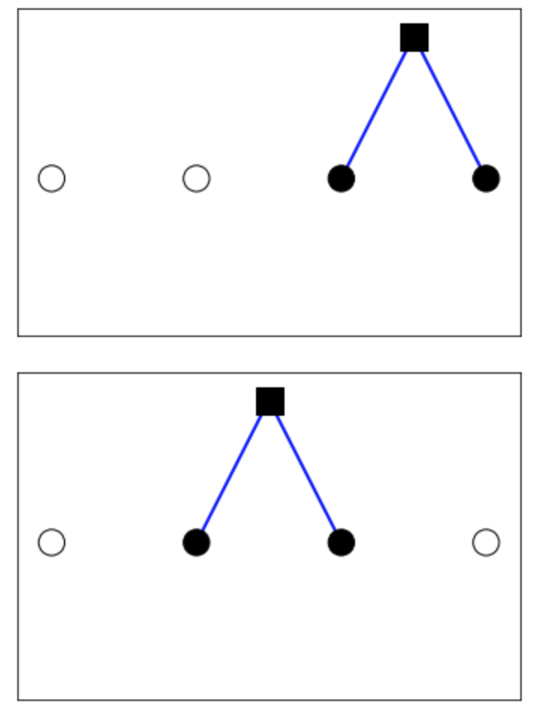
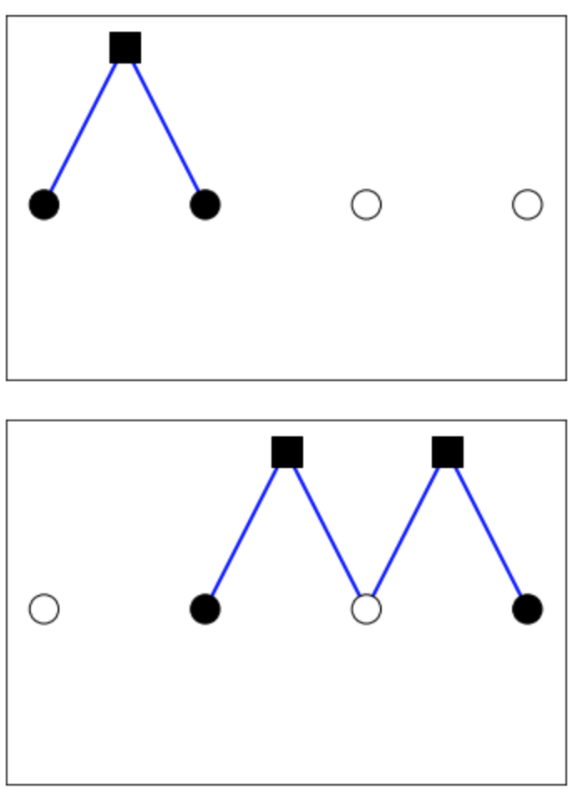
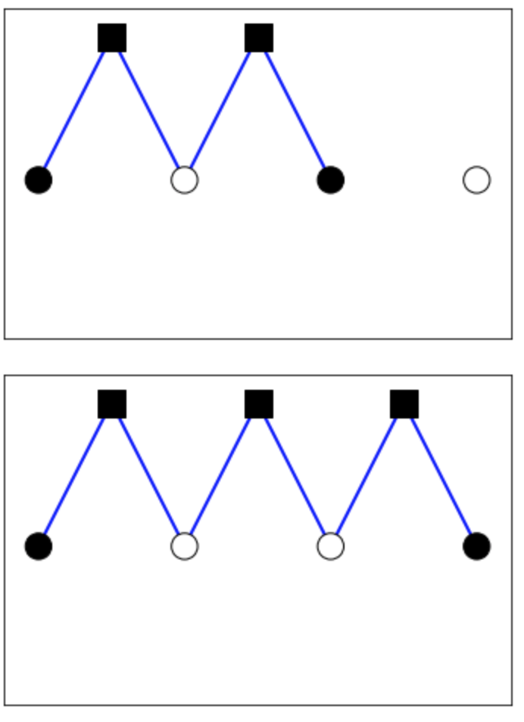
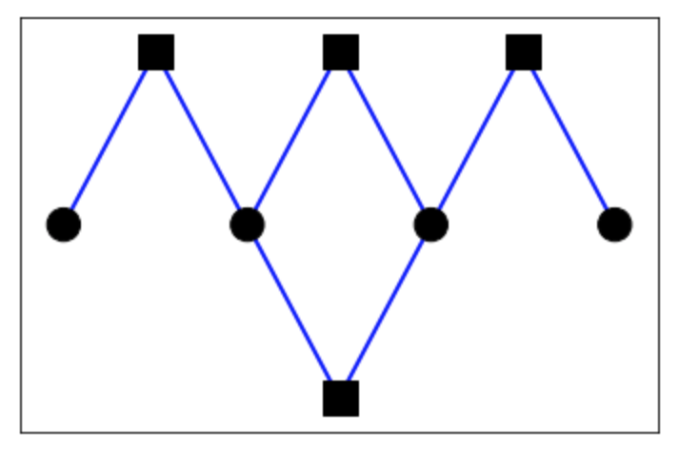
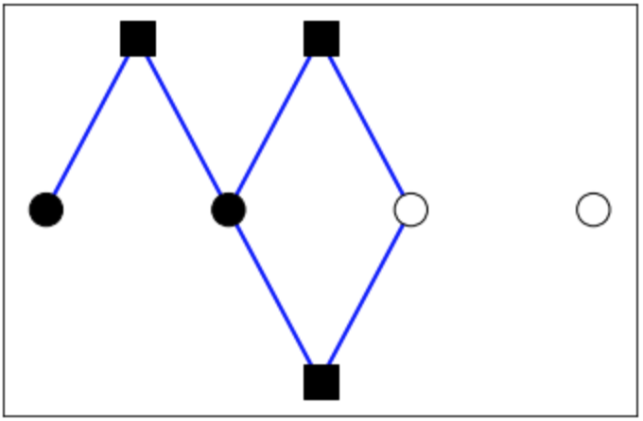
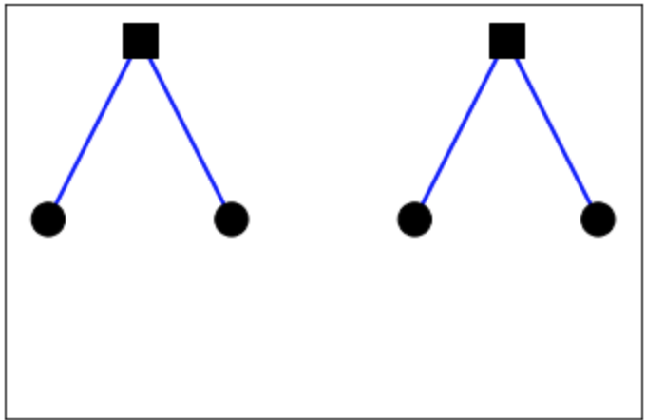
Generators along the lines of perturbation theory
Generators that produce terms according to perturbation theory
Example of N = 4 TFIM system
Due to the variational algorithm certain generators can be left out
Disconnected diagrams
Sub-leading diagrams
QCA

Slide 4
Python module
Input:
Number of qubits/spin-particles in the system
The perturbative interactions
The order of perturbation theory
The number of gates/generators
Output:
All connected & leading diagrams
Quantum circuit using Cirq module
Matrices that correspond to unitary gates

Slide 5
Example of functioning module

Slide 6
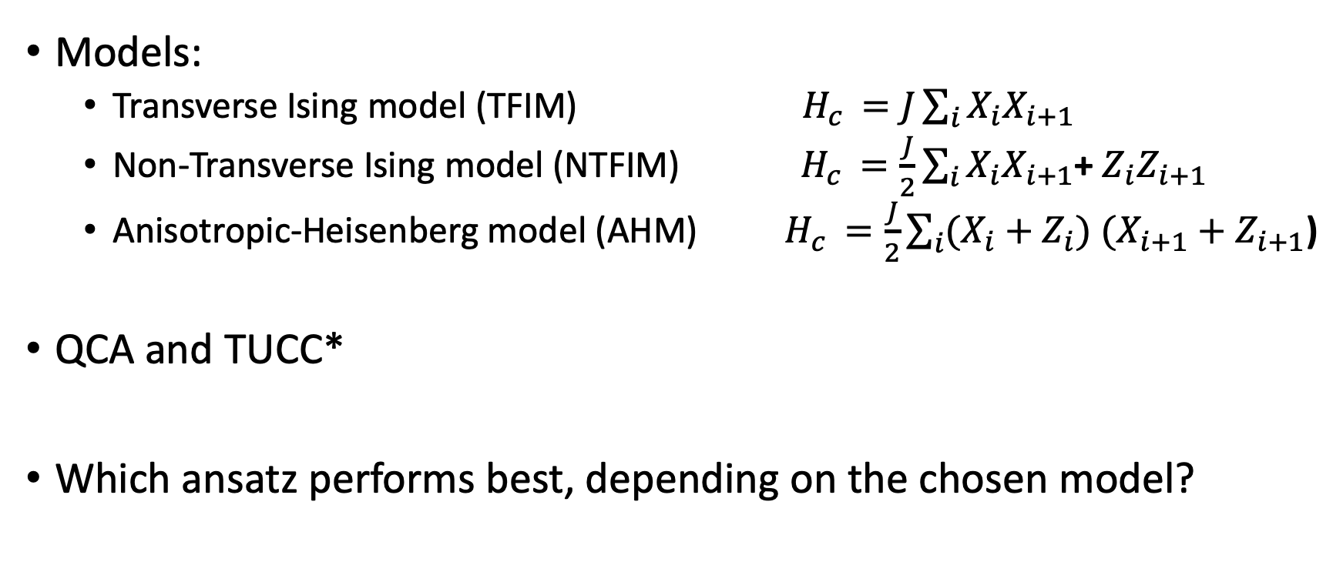
Analyzing systems using the module
Models:
Transverse Ising model (TFIM) $H_{c }=J\sum_{i}{X_{i}X_{i+1}}$
Non-Transverse Ising model (NTFIM) $H_{c }=\frac{J}{2}\sum_{i}{X_{i}X_{i+1}}$+ $Z_{i}Z_{i+1}$
Anisotropic-Heisenberg model (AHM) $H_{c }=\frac{J}{2}\sum_{i}{(X_{i}+Z_{i})}$ $(X_{i+1}+Z_{i+1}$)
QCA and TUCC*
Which ansatz performs best, depending on the chosen model?

Slide 7
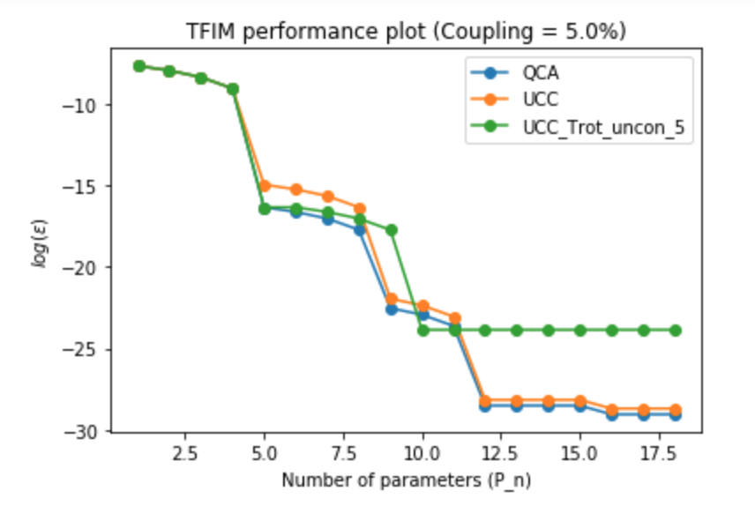
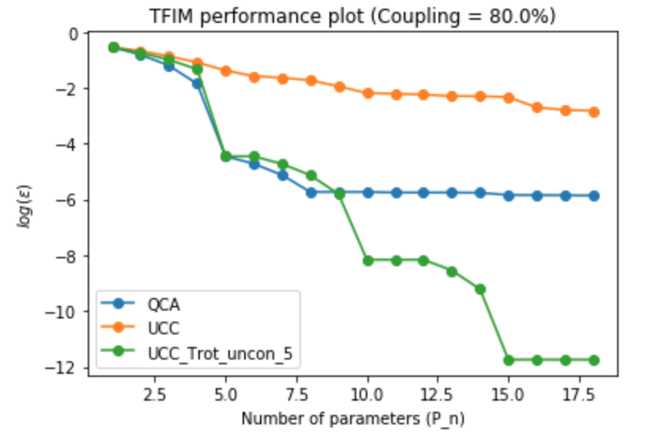
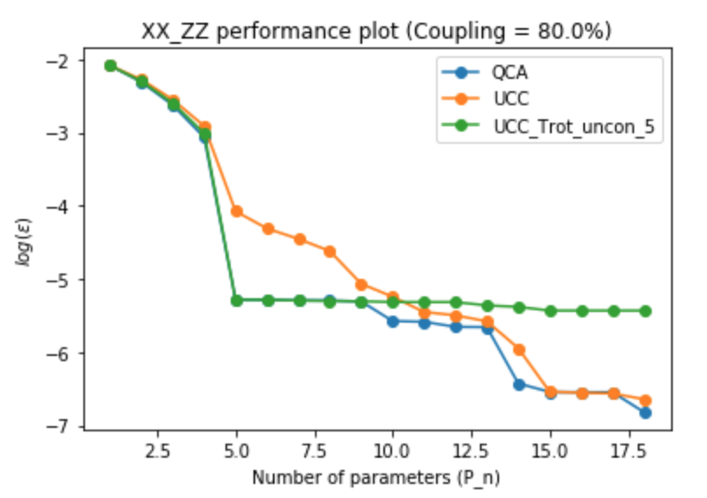
Performance comparison
Weakly-coupled model
Strongly-coupled model with gap closing
Strongly-coupled and gapless model

Slide 8
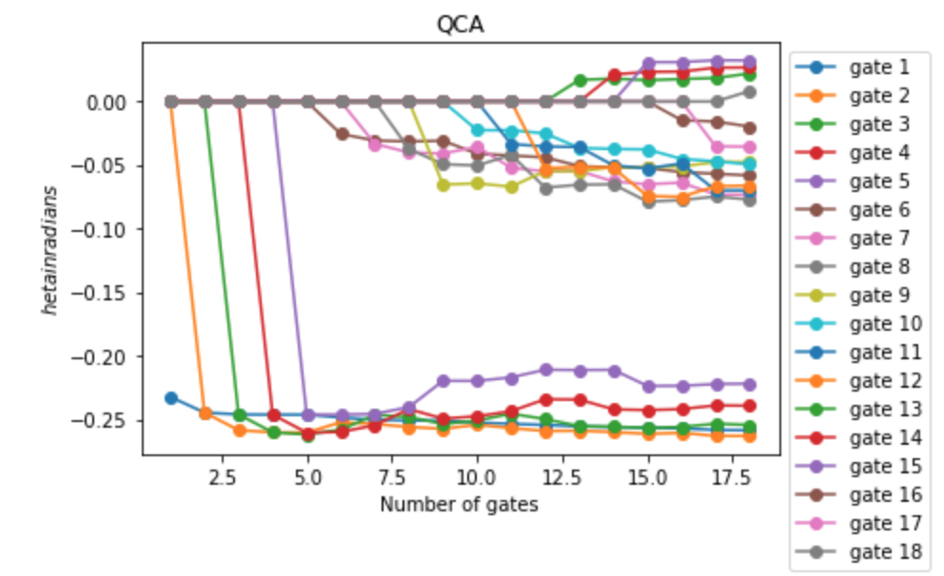
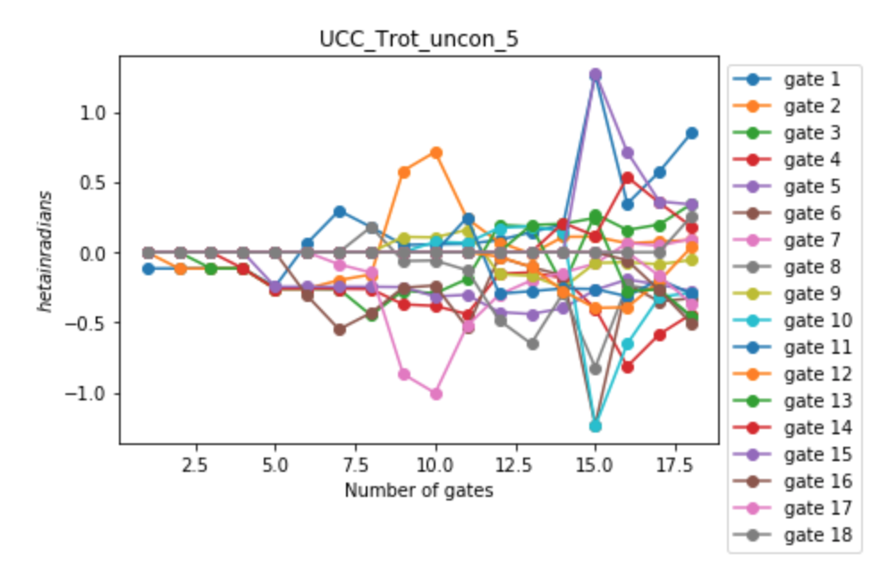
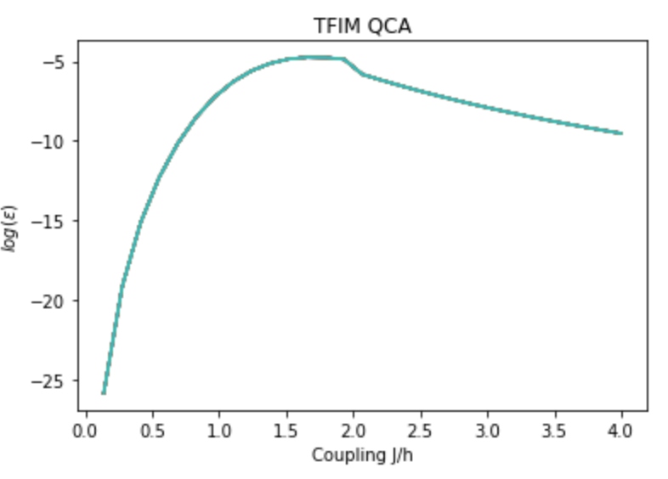
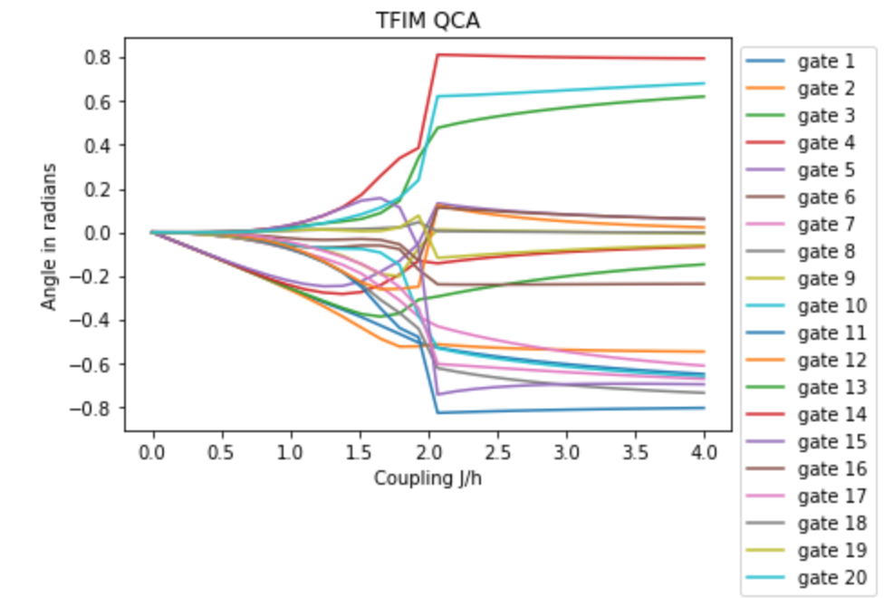
Diagnostic tools
Behavior of angles
Increasing coupling strength

Slide 9
QCA-TUCC*-Hybrid ansatz
Sharp-shooting vs chaotic search
Entanglement entropy
Performance

