Slide 1
Physics of Trotterization in VQE’s

Slide 2
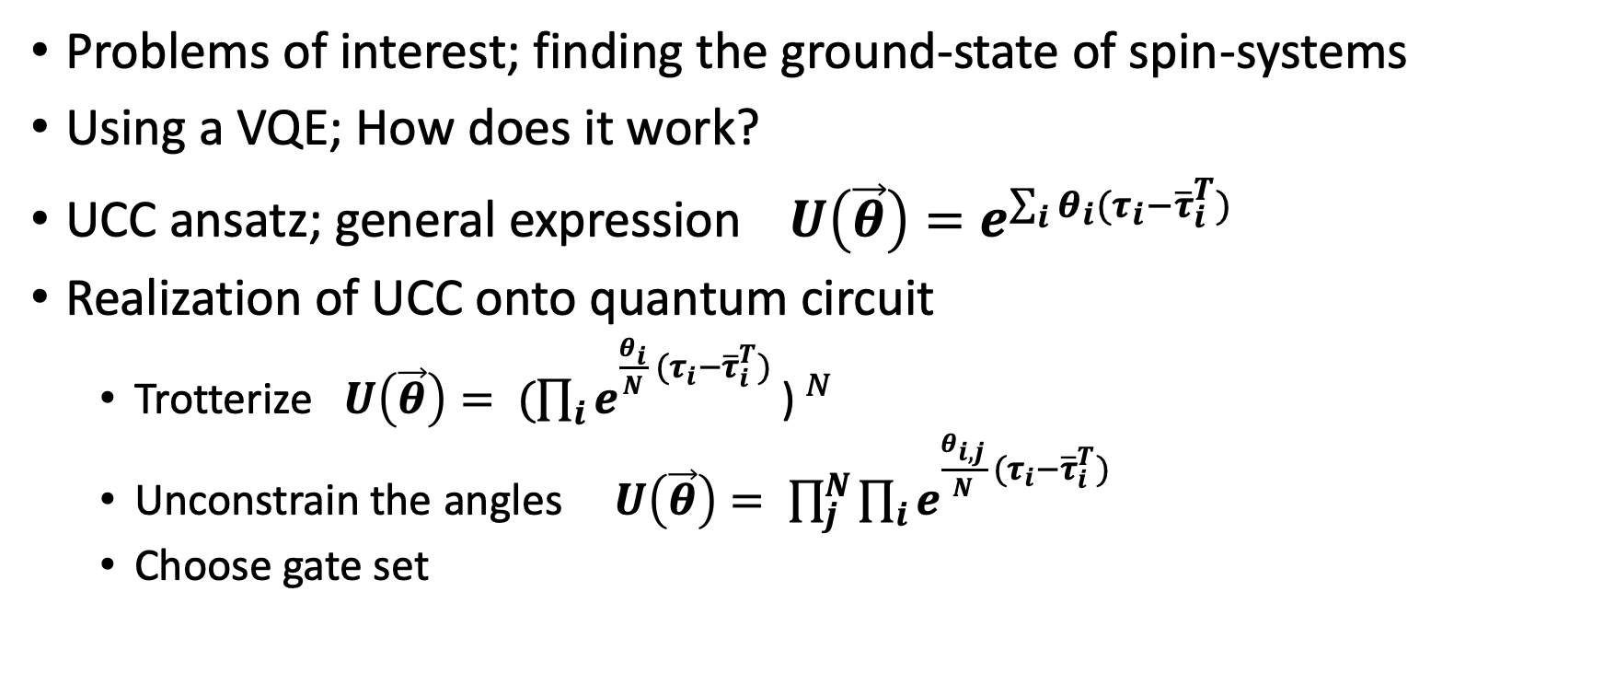
Background
Problems of interest; finding the ground-state of spin-systems
Using a VQE; How does it work?
UCC ansatz; general expression ${U\left(\vec{θ}\right)=e}^{\sum_{i}{θ_{i}(τ_{i}−{\overline{τ}}_{i}^{T})}}$
Realization of UCC onto quantum circuit
Trotterize ${{U\left(\vec{θ}\right)= (\prod_{i}{e}}^{\frac{θ_{i}}{N} (τ_{i}−{\overline{τ}}_{i}^{T})}\text{) }}^{N}$
Unconstrain the angles ${U\left(\vec{θ}\right)= \prod_{j}^{N}{\prod_{i}{e}}}^{\frac{θ_{i,j}}{N} (τ_{i}−{\overline{τ}}_{i}^{T})}$
Choose gate set

Slide 3
Overview
Result 1: Python module
Calculates generators
Produces diagrams
Result 2: Study of the physics
Two tendencies
Heuristic on how they work
Hybrid ansatz

Slide 4
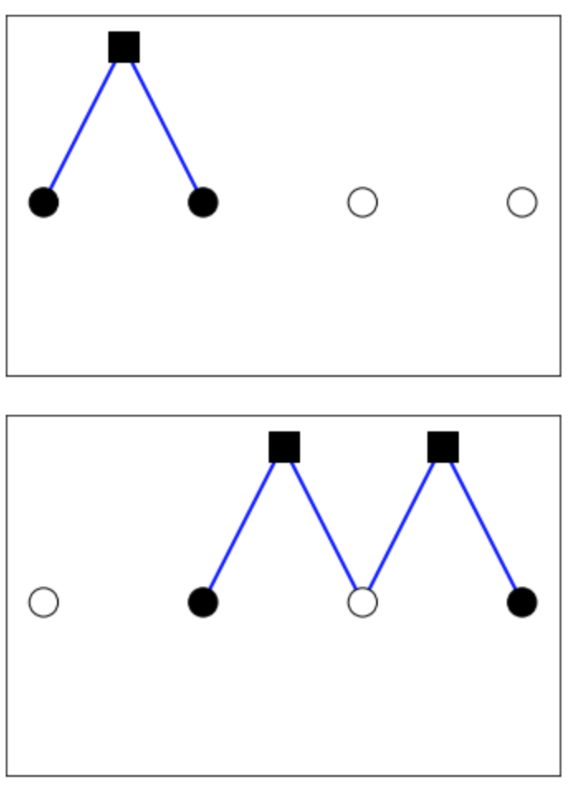
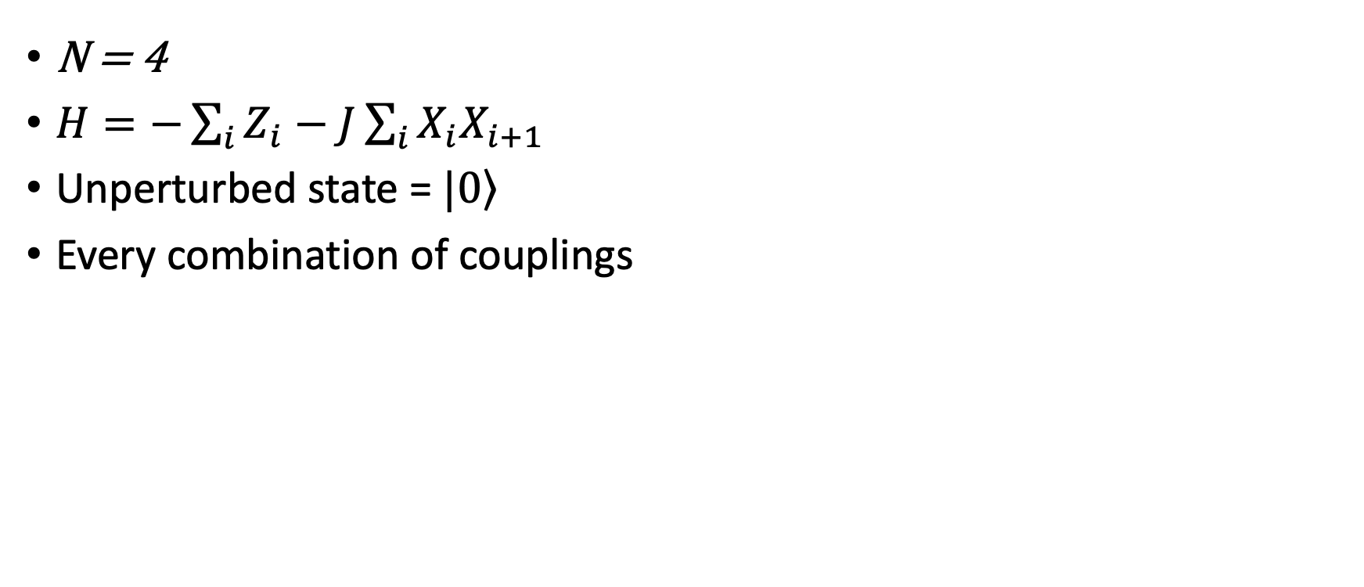


Generators
N = 4
$H=−\sum_{i}{Z_{i}−J\sum_{i}{X_{i}X_{i+1} }}$
Unperturbed state = $\left.|0\right\rangle$
Every combination of couplings
Interaction = $X_{1}X_{2}$
Corresponding unitary gate => $e^{iθY_{1}X_{2}}$

Slide 5
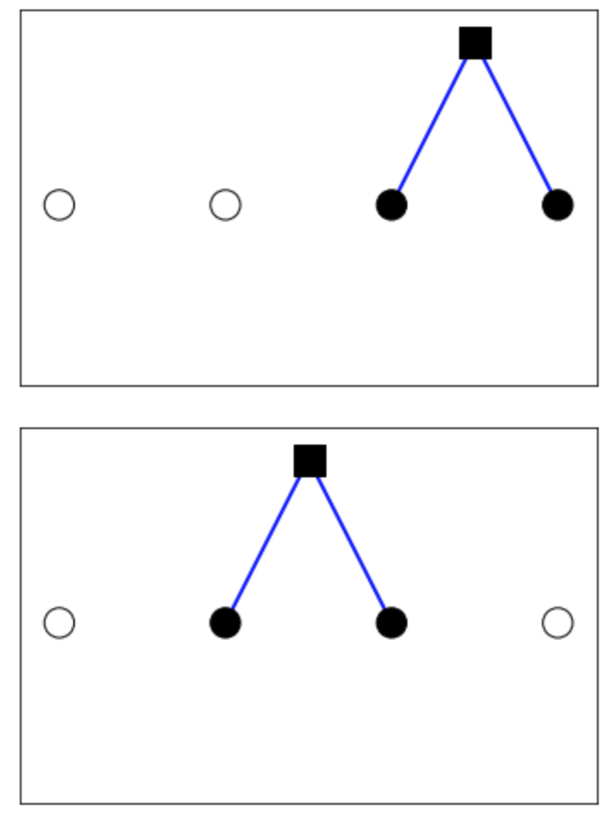
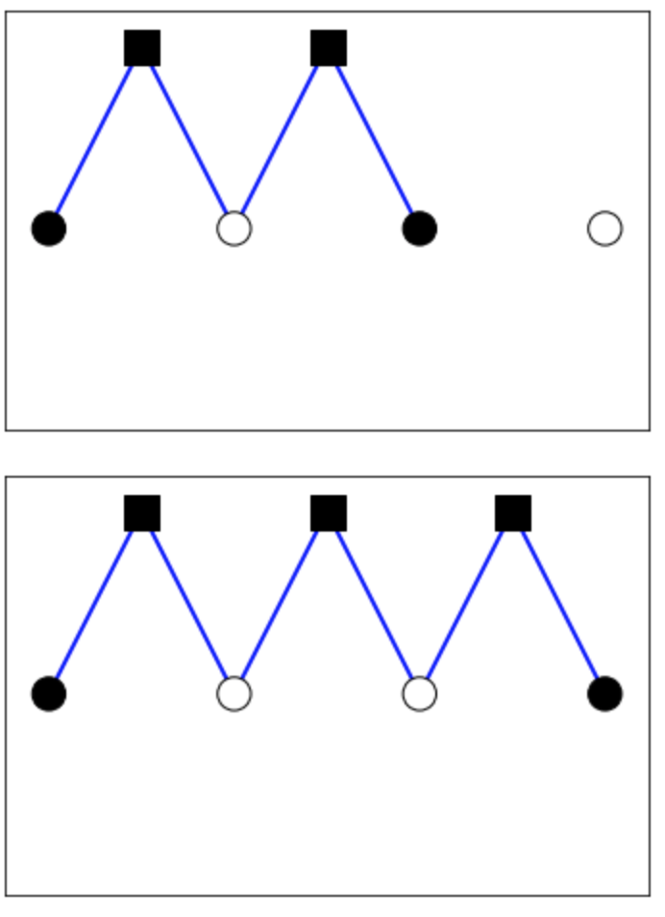
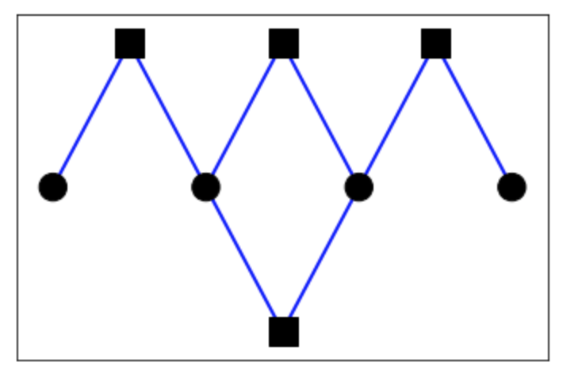
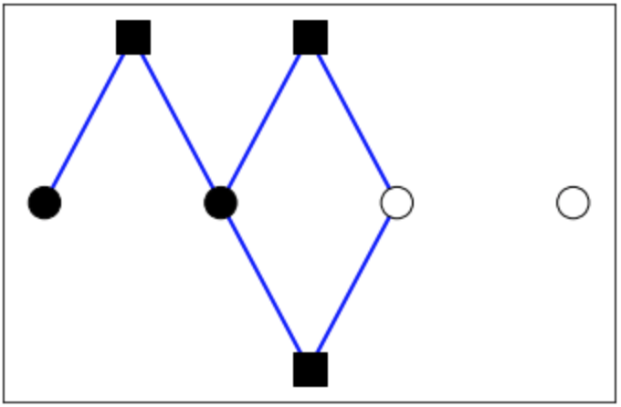
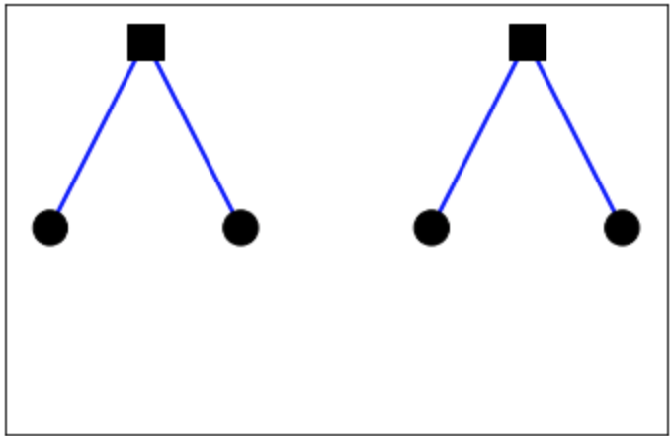
Generators along the lines of perturbation theory
Generators that produce terms according to perturbation theory
Due to the variational algorithm certain generators can be left out
Disconnected diagrams
Sub-leading diagrams

Slide 6
Python module
Input:
Number of qubits/spin-particles in the system
The Hamiltonian
The order of perturbation theory
The number of gates/generators
Output:
All connected & leading diagrams
Quantum circuit using Cirq module
Matrices that correspond to the generators

Slide 7
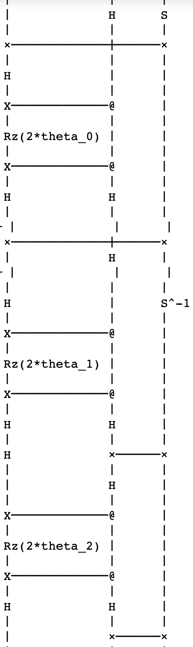
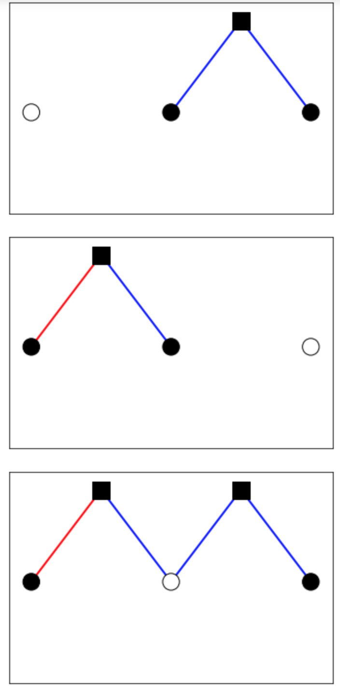
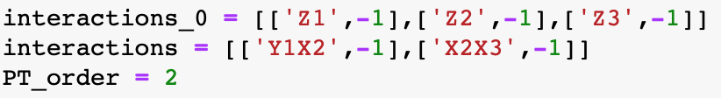
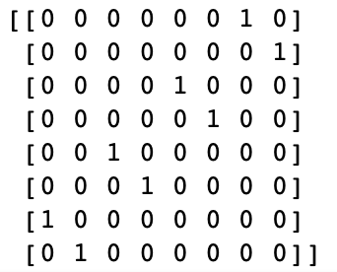
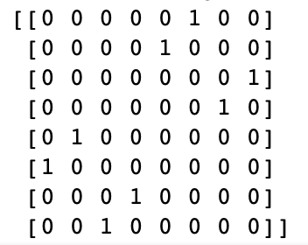
Simple Example of module

Slide 8
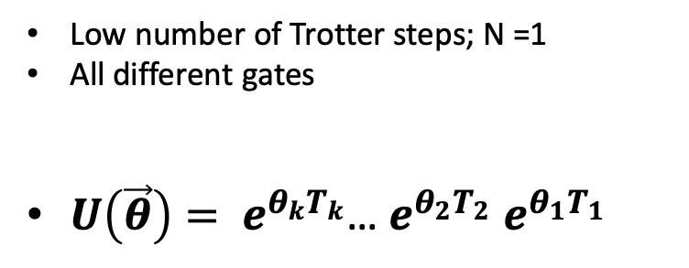

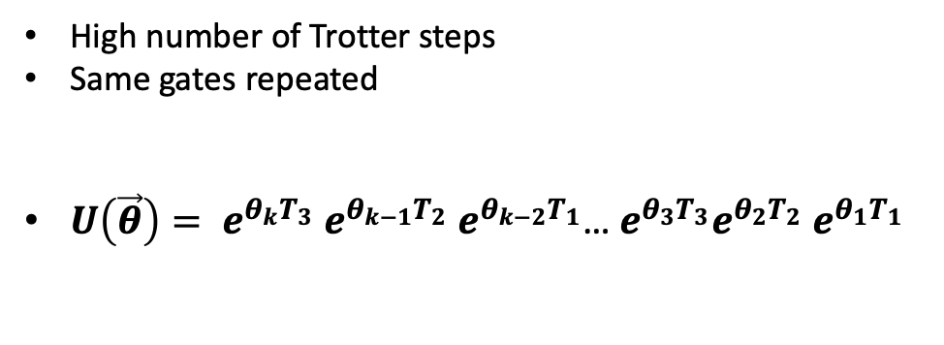
Two tendencies
${U\left(\vec{θ}\right)= \prod_{j}^{N}{\prod_{i}{e}}}^{θ_{i,j} (τ_{i}−{\overline{τ}}_{i}^{T})}$
Fixed number of gates: k
Both approximations to UCC
Low number of Trotter steps; N =1
All different gates
$U\left(\vec{θ}\right)= e^{θ_{k}T_{k}}$… $e^{θ_{2}T_{2}}$ $e^{θ_{1}T_{1}}$
High number of Trotter steps
Same gates repeated
$U\left(\vec{θ}\right)= e^{θ_{k}T_{3}}$ $e^{θ_{k−1}T_{2}}$ $e^{θ_{k−2}T_{1}}$…${ e}^{θ_{3}T_{3}}e^{θ_{2}T_{2}}$ $e^{θ_{1}T_{1}}$

Slide 9
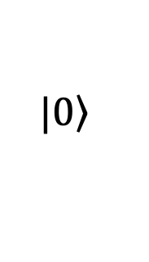
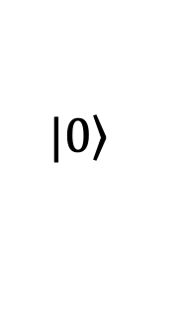
QCA and TUCC
Diagrams
QCA
TUCC
Every gate is different
1 Trotter step
More physics
Hardware inefficient
Same gate-set repeated
Multiple Trotter steps
Less physics
Hardware efficient
$$\left.|0\right\rangle$$
$$\left.|0\right\rangle$$

Slide 10
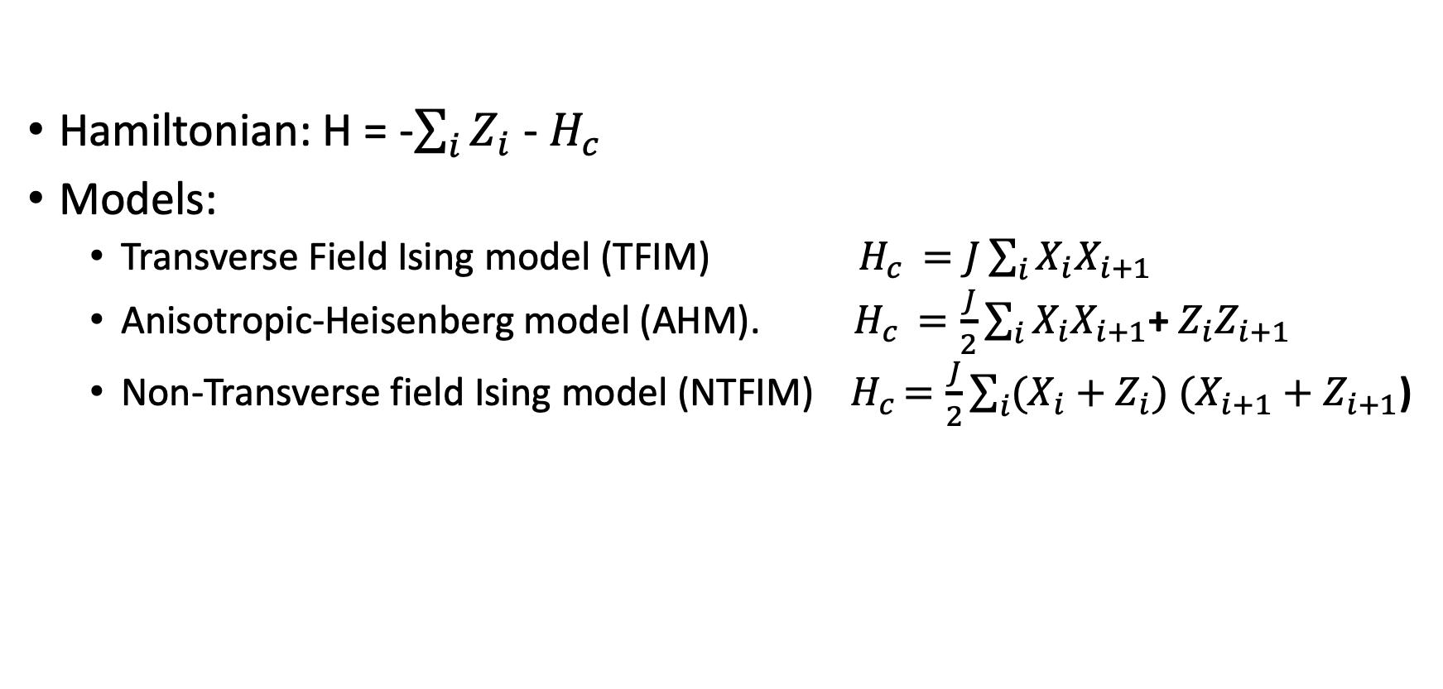
Analyzing systems using the module
Hamiltonian: H = -$\sum_{i}{Z_{i}}$ - $H_{c }$
Models:
Transverse Field Ising model (TFIM) $H_{c }=J\sum_{i}{X_{i}X_{i+1}}$
Anisotropic-Heisenberg model (AHM). $H_{c }=\frac{J}{2}\sum_{i}{X_{i}X_{i+1}}$+ $Z_{i}Z_{i+1}$
Non-Transverse field Ising model (NTFIM) ${ H}_{c }=\frac{J}{2}\sum_{i}{(X_{i}+Z_{i})}$ $(X_{i+1}+Z_{i+1}$)

Slide 11
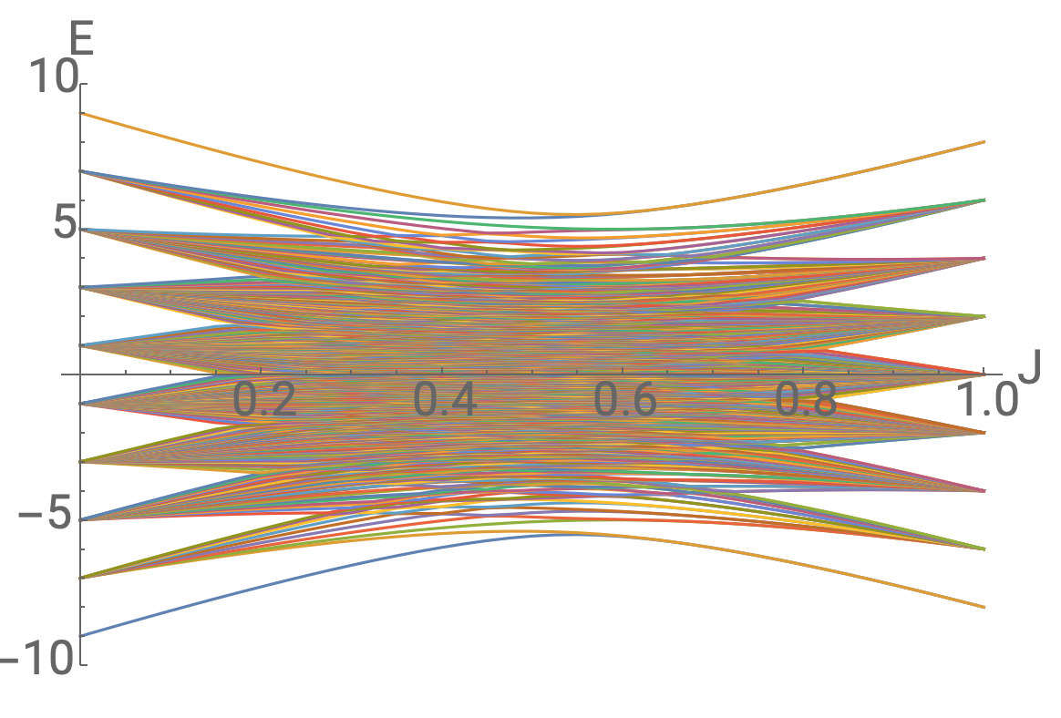
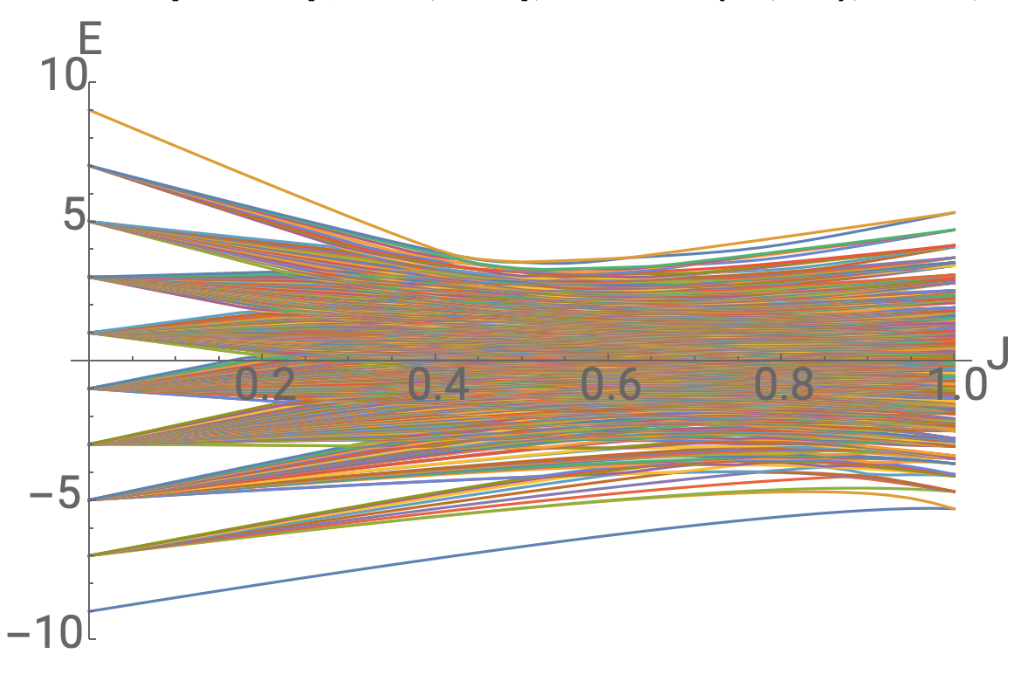
Gapped and Gapless systems
TFIM
AHM

Slide 12
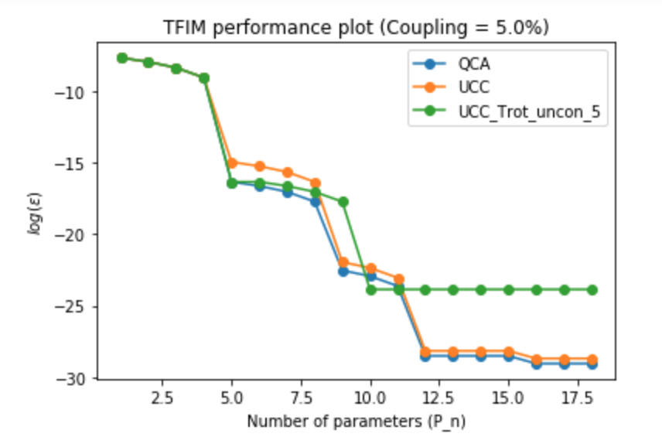
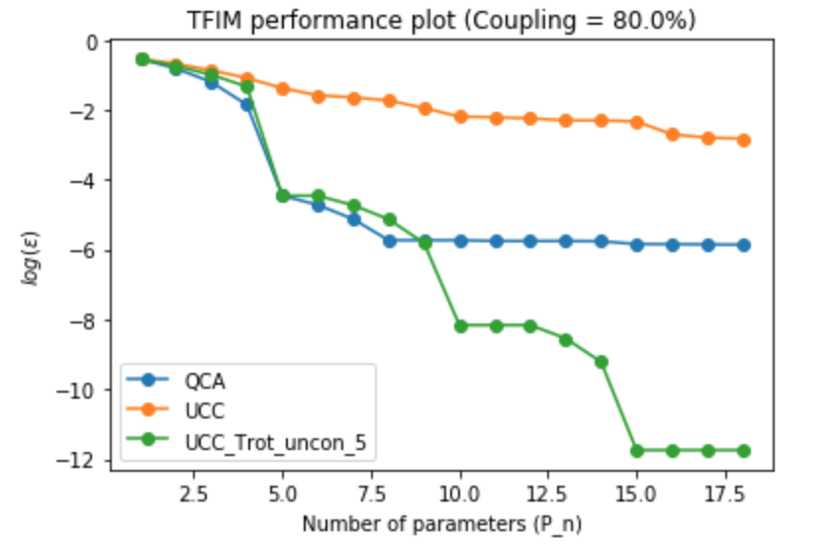
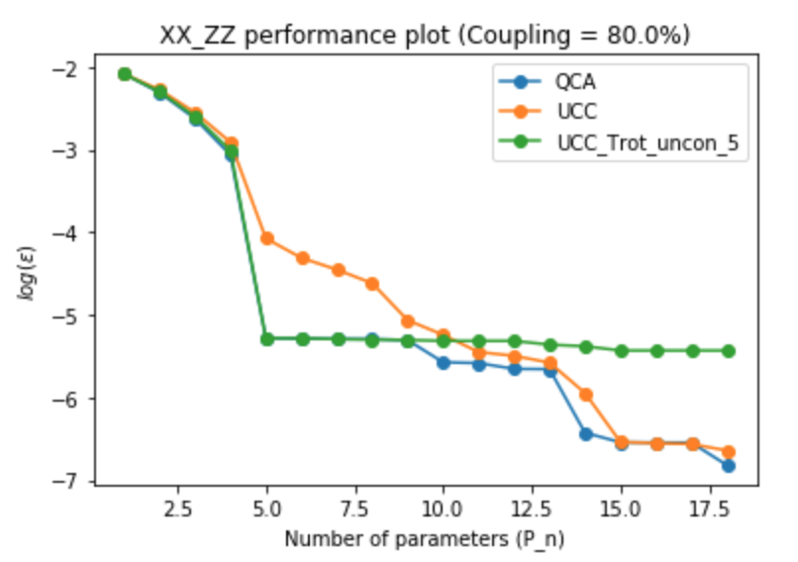
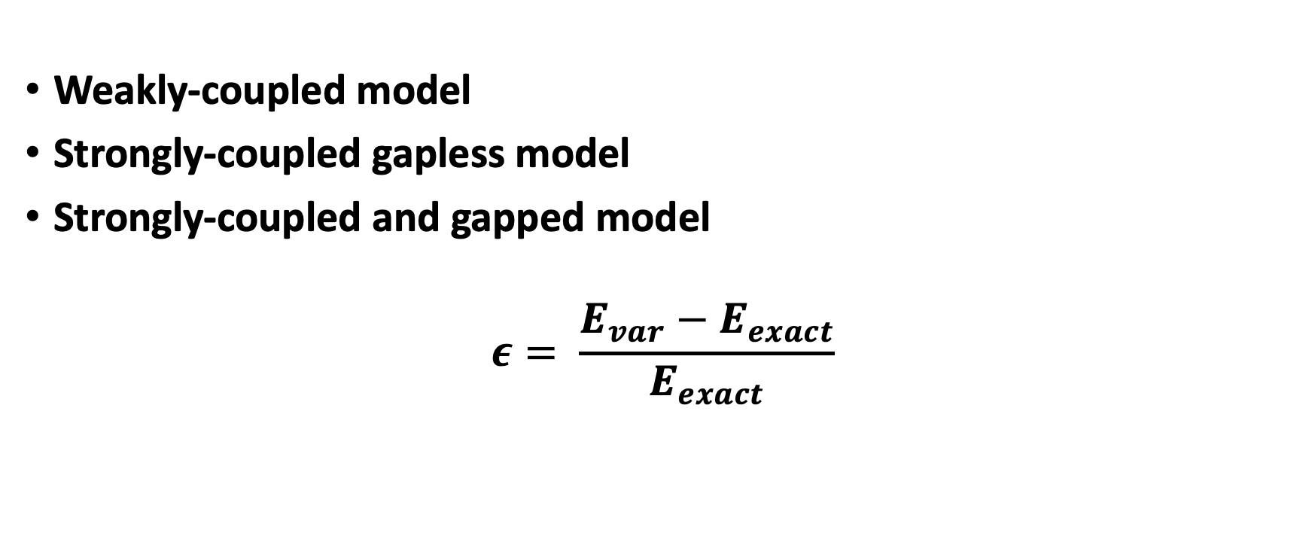
Performance comparison
Weakly-coupled model
Strongly-coupled gapless model
Strongly-coupled and gapped model
$$ε= \frac{E_{var}−E_{exact}}{E_{exact}}$$

Slide 13
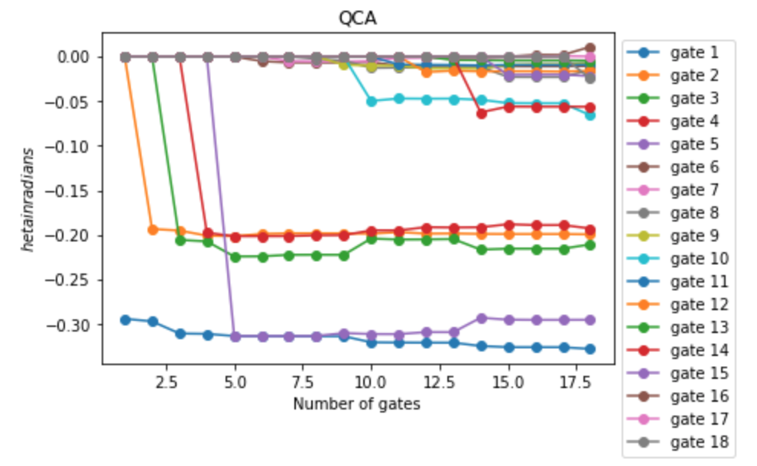
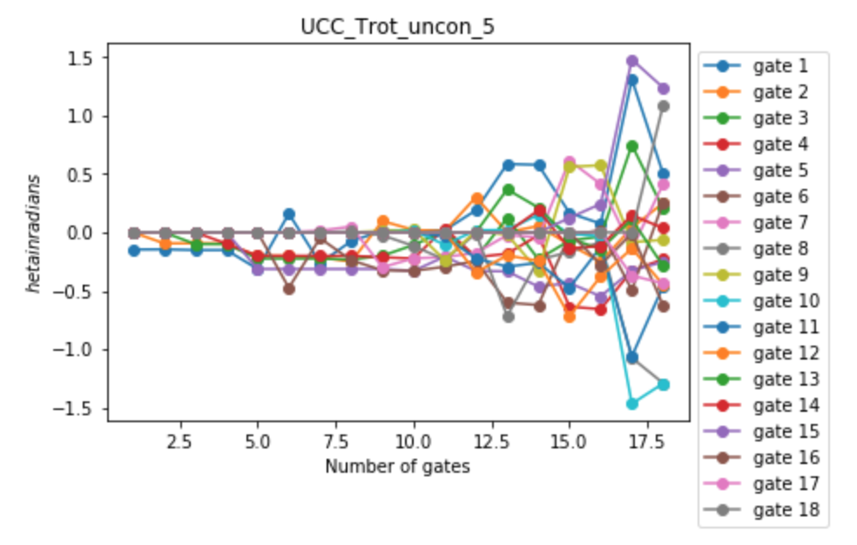
Analysis; Behavior of angles
AHM J = 80%; Strongly coupled gapped model

Slide 14
Sharp shooting vs Chaotic search
QCA:
Ordered and predictable
Well informed about the physics
TUCC:
Chaotic and nonlinear
Less informed about the physics

Slide 15
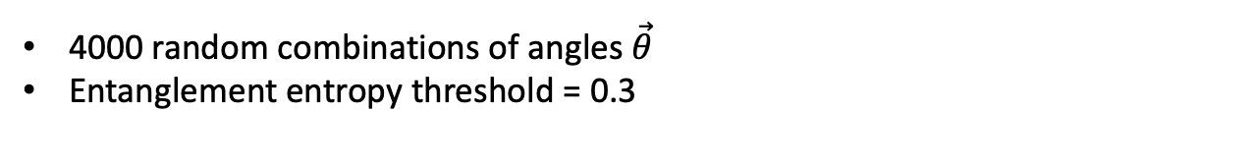


Geometric evidence
4000 random combinations of angles $\vec{θ}$
Entanglement entropy threshold = 0.3
QCA
TUCC
$$\left.|0\right\rangle$$
$$Ψ(\vec{θ)}$$
$$\left.|0\right\rangle$$
$$Ψ(\vec{θ)}$$
 | States below threshold | Average entropy | Average distance between states
QCA | 99 | 0.61 | 1.43
TUCC | 610 | 0.51 | 1.41

Slide 16
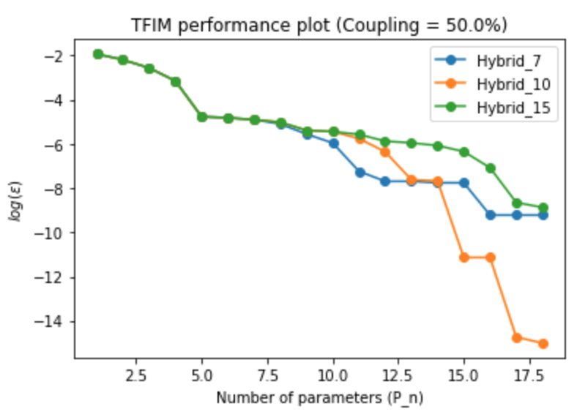
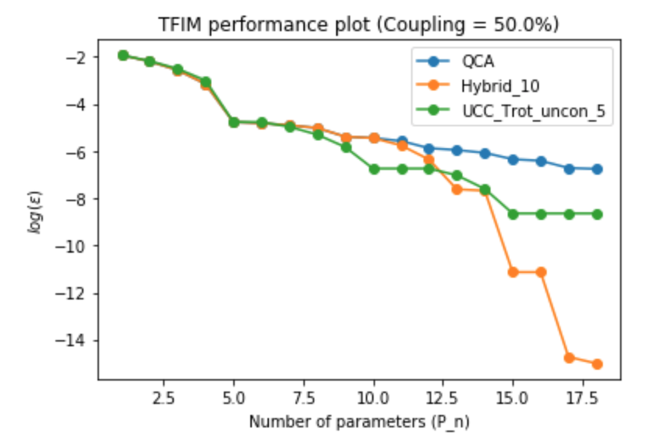
Hybrid-ansatz
Where to switch?
Performance

Slide 17
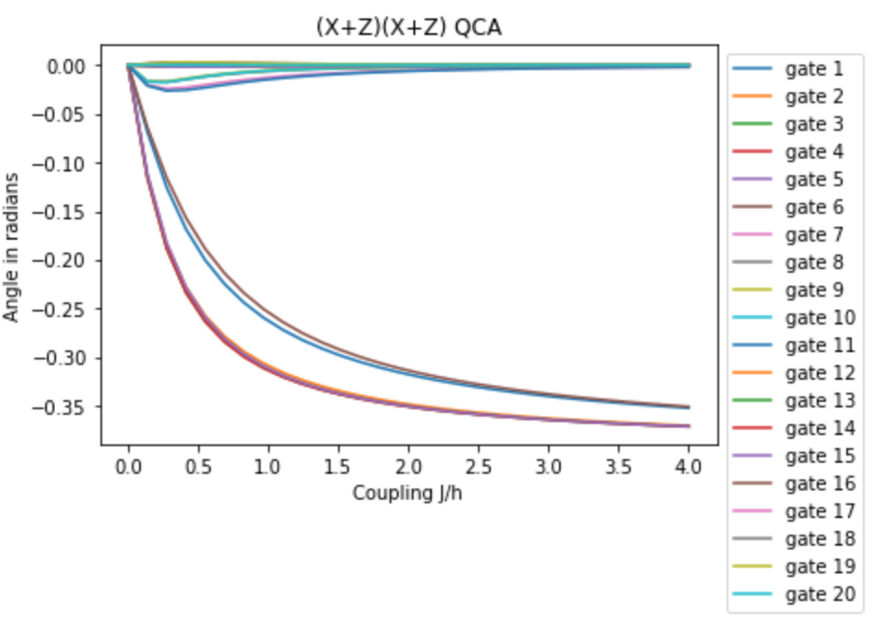
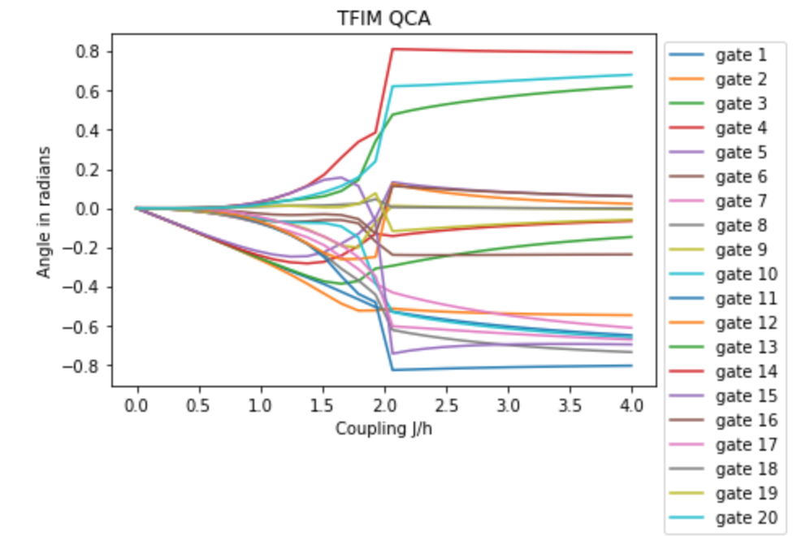
Diagnostic tool; Increasing coupling strength

Slide 18
Conclusions
The module
Two tendencies
Heuristic
Hybrid

Slide 19
Future directions
Gather more evidence; more models, larger systems
Expand analytics
Further testing of Hybrid ansatz

