Slide 1



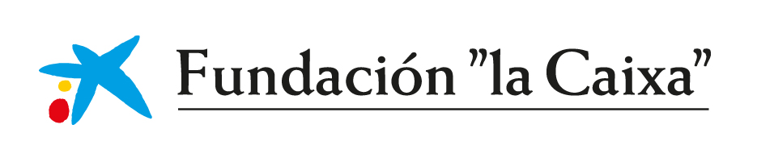
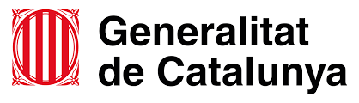



Synthesizing topological phases in atomic and electronic quantum matter
Donostia International Physics Center
25.02.2021
Seminar Talk
Tobias Grass
Notes:
First, let me thank the organizers for this invite to discuss my recent work. I ll concentrate on the work we have done during the last three years and which involves mostly people from the atomic, nuclear and molecular physics area of the department. The results I ll discuss in the second part of the talk have been done in collaboration with Dani Dagnino, …, and parts of it belong to the ongoing PhD thesis of Marina Mele-Messeguer.

Slide 2
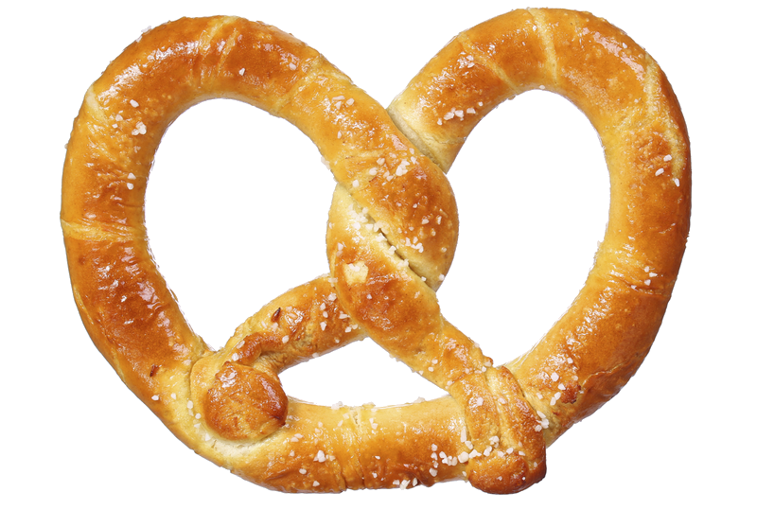
Topology and symmetry
Notes:
The outline of the talk includes the following major blocks. First, I ll give some glimpses of the kind of systems we study, which are systems of ultracold bosonic atoms. In most cases we will actually consider the zero temperature limit altough in experiments the actual temperatures are on the order of the micro to nanoKelvin.
Secondly I ll list some open physical questions which are being scrutinized, emphasizing the broad amount of problems which are currently being studied within this field.
In the third block I ll provide some of our own recent results, specially those which deal with the Josephson dynamics of BECs, first introducing the BJJ and secondly discussing the case of a binary mixture. Last I ll comment on spinor condensates. In the last slide I ll give some conclusions.

Slide 3
Topology and symmetry
Notes:
The outline of the talk includes the following major blocks. First, I ll give some glimpses of the kind of systems we study, which are systems of ultracold bosonic atoms. In most cases we will actually consider the zero temperature limit altough in experiments the actual temperatures are on the order of the micro to nanoKelvin.
Secondly I ll list some open physical questions which are being scrutinized, emphasizing the broad amount of problems which are currently being studied within this field.
In the third block I ll provide some of our own recent results, specially those which deal with the Josephson dynamics of BECs, first introducing the BJJ and secondly discussing the case of a binary mixture. Last I ll comment on spinor condensates. In the last slide I ll give some conclusions.

Slide 4
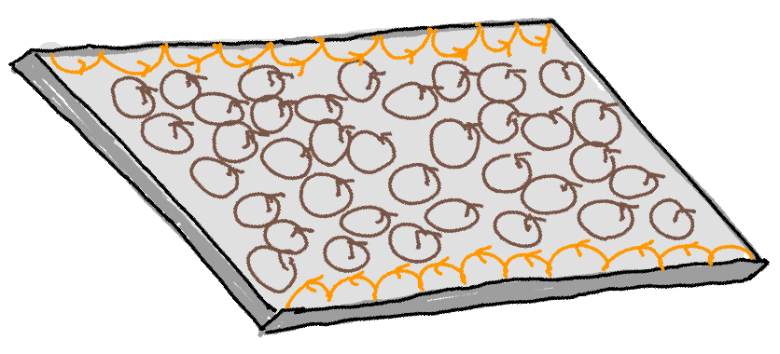
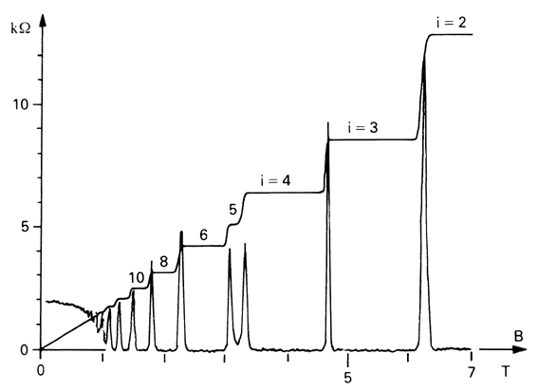
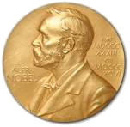
Quantum Hall Systems
Robust transport property:
quantized Hall resistance
Magnetic field defines topology→ chiral motion leads to robust edge transport
© Royal Society
[von Klitzing, Dorda, Pepper, PRL (1980)]
1985
Topological invariant from band curvature:
Kubo formula:
[Thouless, Kohmoto, Nightingale, den Nijs, PRL (1982)]
2016

Slide 5

Anyons and non-Abelions
Topological band structure (in 1d or 2d) + interactions:
→ Emergence of exotic quasiparticle (“anyons”)
In 3d:
In 2d:
Double Exchange = Identity
Bosons or Fermions
Double Exchange non-trivial
Anyons
If anyonic states are degenerate, exchange corresponds to rotations within the degenerate space
Non-Abelions
[Leinaas & Myrheim, Il Nuovo Cimento B (1977)]
[Nayak, Simon, Stern, Freedman, Das Sarma, RMP (2008)]

Slide 6
Fractional Quantum Hall Effect
Tsui, Stoermer, Laughlin
1998
Hall conductance quantized to fractional values:
Integer Quantum Hall Effect
Fractional Quantum Hall Effect
In general: (Landau level filling)
→ integer filling: HUGE single-particle gap
→ fractional filling: NO single-particle gap
Laughlin wave function: Anyonic quasihole excitations:
strong anticorrelations!
Fixes filling factor (within lowest Landau level):
where
[Julia-Diaz, Grass, Barberan, Lewenstein, New J. Phys. 14, 055003 (2012)]

Slide 7
Outline of the talk
FQH physics in synthetic matter:
      Engineering of Hamiltonian: synthetic gauge fields
      Preparation of ground state: adiabatic scheme
      Reward of this effort:
          enhanced detection opportunities (e.g. of anyons)
          exotic new phases (e.g. fractional Wigner crystal)
Design of FQH physics in electronic matter:
      Optical driving: synthetic bilayer → Fibonacci phase

Slide 8
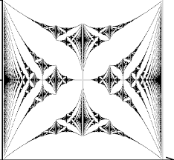
Synthetic gauge fields
Mimic effect of magnetic field in charge-neutral systems:
( cold atoms, photons, etc.)
    Optical techniques
    Mechanical techniques
Single-particle physics: edge states, Chern numbers
Hofstadter butterfly, …
Many-body physics: would/could support anyons,
but little explored yet!
Cold atoms in trap: [Lin,…, Spielman, Nature (2009)]
Cold atoms in lattice: [Aidelsburger,…, Bloch, PRL (2013)]
[Miyake,…,Ketterle, PRL (2013)]
Coupled resonators: [Hafezi …,Taylor, Nat. Phys. (2011)]
Modulated SC qubits: [Roushan, …, Martinis, Nat. Phys. (2016)]
Modulated ions: [Grass, …, Lewenstein, PRA (2018)]
Optomechanical lattices: [Schmidt,…,Marquardt, Optica (2015)]
Lattice shaking: [Struck,…,Sengstock, PRL (2012)]
Rotating gases: [Matthews, …, Cornell, PRL (1999)]
[Madison,…, Dalibard, PRL (2000)]
[Abo-Shaeer,…, Ketterle, Science (2001)]
Rotating lattices: [Gemelke, Sarajlic, Chu, arXiv, (2010)]
Twisted cavities: [Clark,…,Simon, Nature (2020)]

Slide 9

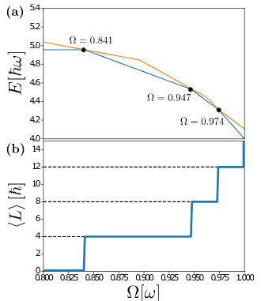
Preparation of atomic Laughlin droplet
Ingredients: - Interactions (Contact interaction)
- Synthetic gauge fields (Rotation)
But:
having the Hamiltonian having the state
Way to Laughlin:
Rotation produces Landau levels spectrum
Behavior of N=4 bosons with contact repulsion (g=1)
Rotating faster flattens the Landau levels
Repulsive interactions in a flat band: strongly anticorrelated ground states (vortices, vortex lattices, FQH states)
Condensate
Vortex
Laughlin
[Popp, Paredes, Cirac, PRA (2004)]
[Dagnino, Barberan, Lewenstein, Dalibard, Nat. Phys. (2009)]
[Andrade, Kasper, Lewenstein, Weitenberg, Grass, arXiv 2009.08943]

Slide 10
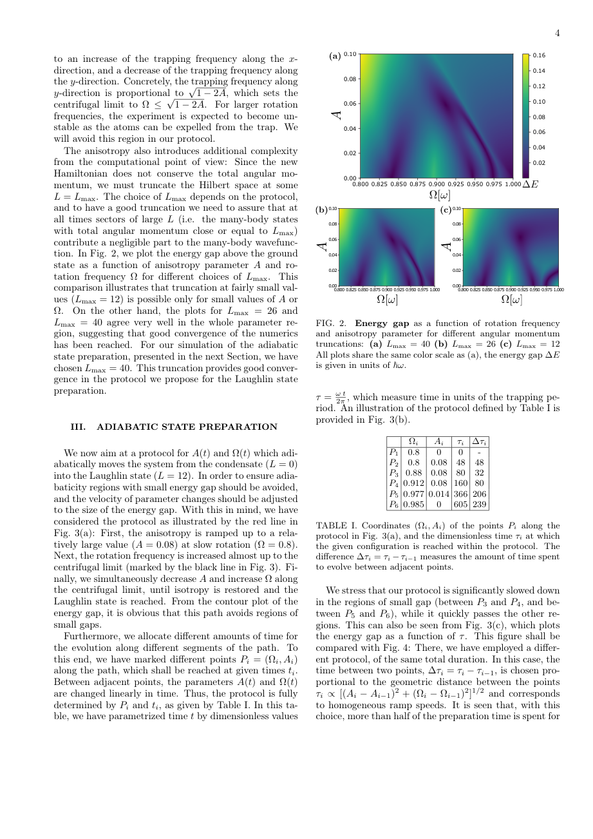


Preparation of atomic Laughlin droplet
Ingredients: - Interactions (Contact interaction)
- Synthetic gauge fields (Rotation)
But:
having the Hamiltonian having the state
Way to Laughlin: Adiabatic path via anisotropy-induced gaps
Behavior of N=4 bosons with contact repulsion (g=1)
Condensate
Vortex
Laughlin
[Popp, Paredes, Cirac, PRA (2004)]
[Dagnino, Barberan, Lewenstein, Dalibard, Nat. Phys. (2009)]
[Andrade, Kasper, Lewenstein, Weitenberg, Grass, arXiv 2009.08943]

Slide 11
Impurities in a Laughlin liquid
Probe system with impurity particles binding to anyonic quasiholes
[Zhang, Sreejith, Gemelke, Jain, PRL (2014)]
[Lundholm and Rougerie, PRL (2016)]
[Grusdt, ..., Demler, Nat. Commun. (2016)]
[Yakaboylu and Lemeshko, PRB, (2018)]
Screening of magnetic field due to the liquid:
Effective Landau level wave functions for the impurities:
with average angular momentum:
In contrast, the original LL wave function, , has .
Same angular momentum is found from many-body wave function:
Excitation of impurity
Impurity bound to quasihole
Laughlin state
[Grass, Julia-Diaz, Baldelli, Bhattacharya, Lewenstein, Phys. Rev. Lett. 125, 136801 (2020)]

Slide 12
Angular momentum of anyonic impurities
Angular momentum of single impurity:
→ Fermi sea:
→ Bose condensate:
→ Anyonic interpolation:
        with α=ν the anyons’ statistical parameter.
No braiding or interference needed, only density measurement!
[Grass, Julia-Diaz, Baldelli, Bhattacharya, Lewenstein, Phys. Rev. Lett. 125, 136801 (2020)]

Slide 13
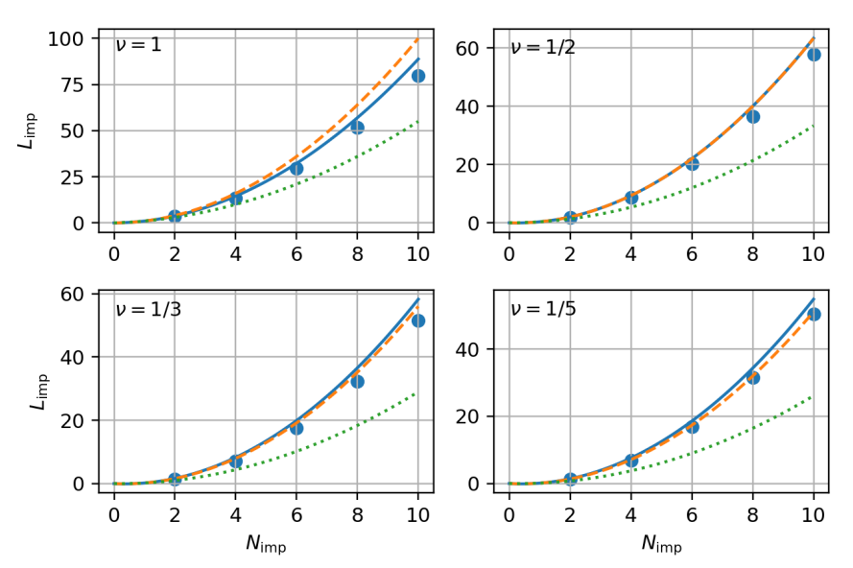
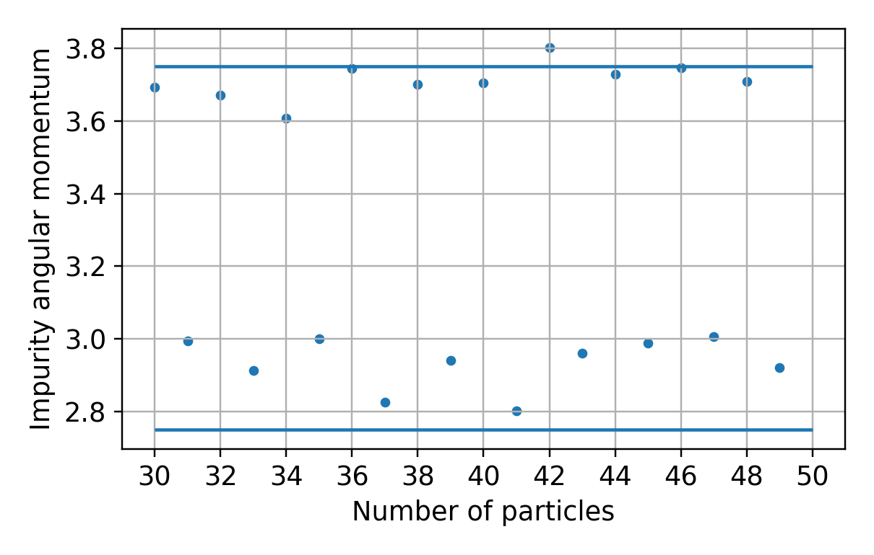
Generalization to non-Abelian impurities
Similar behavior is obtained for impurities in Pfaffian state:
But the statistical parameter of non-Abelian anyons depends on the parity P of the number of particles in the liquid:
[Macaluso, Comparin, Mazza, and Carusotto, PRL (2019)]
[Bonderson, Gurarie, Nayak, PRB (2011)]
Such dependence is clearly seen in the angular momentum of two impurities (within a Pfaffian liquid at ν=1)
[Baldelli, Julia-Diaz, Bhattacharya, Lewenstein, Grass, arXiv 2102.02072]

Slide 14
Exotic phase: symmetry-broken + topological
Symmetry-breaking
Topology
Ordered phases of matter
Ordered phases of matter
Nematic order in FQH state:
[Xia, Eisenstein, Pfeiffer, West, Nat. Phys. (2011)] [Samkharadze, ..., Fradkin, Csáthy, Nat. Phys (2016)]
Symmetry-broken phases surrounding the Laughlin liquid:
[Grass, Bienias, Lundgren, Gullans, Maciejko, Gorshkov, Phys. Rev. Lett. 121, 253403 (2018)]

Slide 15
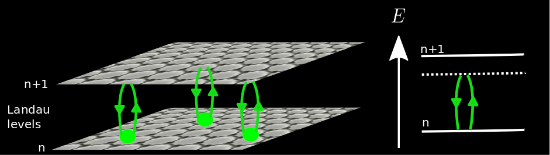
Driven graphene: From Tis to synthetic bilayer
Optical engineering of electronic Hamiltonians:
- Floquet topological insulator in graphene
- Breaking of time-reversal symmetry
through circularly polarized or twisted light
[Oka & Aoki, PRB (2009)]
[McIver, …, Cavalleri, Nat. Phys. (2020)]
[Bhattacharya, Chaudhary, Grass, Lewenstein arXiv:2006.10688]
In quantum Hall regime: Optically coupled Landau levels form synthetic bilayer.
“chemical potential” “interlayer tunneling”
[Ghazaryan, Grass, Gullans, Ghaemi, Hafezi, Phys. Rev. Lett. 119, 247403 (2017)]

Slide 16
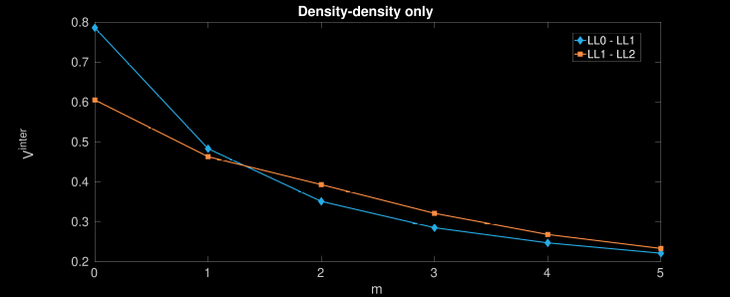
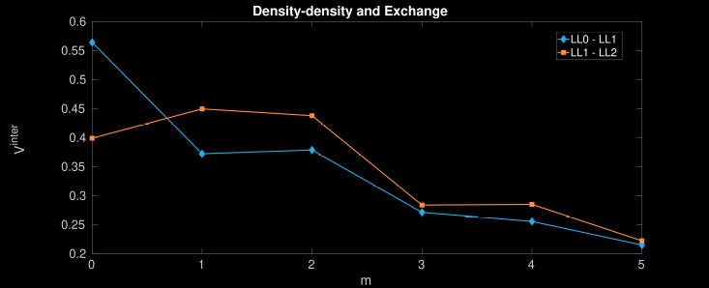
Exotic interactions and Fibonacci phase
Synthetic bilayer exhibits exotic structure of Haldane pseudopotentials:
Normal bilayer: Monotonic decay.
Synthetic bilayer interactions: non-monotonic behavior favoring singlets at m=0
[Cian, Grass, Vaezi, Liu, Hafezi, Phys. Rev. B 102, 085430 (2020)]
[Ghazaryan, Grass, Gullans, Ghaemi, Hafezi, Phys. Rev. Lett. 119, 247403 (2017)]

Slide 17
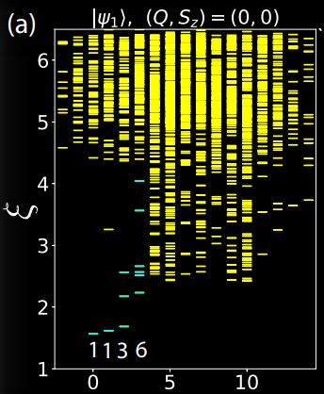
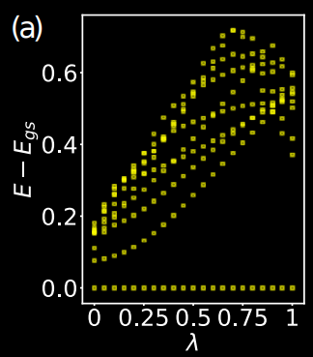
Exotic interactions and Fibonacci phase
Synthetic bilayer exhibits exotic structure of Haldane pseudopotentials:
Normal bilayer: Monotonic decay.
Synthetic bilayer interactions: non-monotonic behavior favoring singlets at m=0
These interaction give rise to a non-Abelian Fibonacci phase
→ candidate for universal
topological quantum computing
[Cian, Grass, Vaezi, Liu, Hafezi, Phys. Rev. B 102, 085430 (2020)]
[Ghazaryan, Grass, Gullans, Ghaemi, Hafezi, Phys. Rev. Lett. 119, 247403 (2017)]
Adiabatic connection to parent Hamiltonian
Entanglement spectrum

Slide 18
Thank you!
@ ICFO:
Barbara Andrade
Niccolo Baldelli
Utso Bhattacharya
Alexandre Dauphin
Joana Fraxenet
Valentin Kasper
Bernhard Irsigler
Maciej Lewenstein
Debrah Rakshit
Leticia Tarruell
@ JQI/UMD/NIST:
Przemek Bienias
Bin Cao
Ze-Pei Cian
Alexey Gorshkov
Mohammad Hafezi
Rex Lundgren
Glenn Solomon
Synthetic matter
Electronic matter
+ synthesized features
FQH Hamiltonians
Conventional ones: GS is a Laughlin-like state
Exotic ones: non-Abelian phases, fractional Wigner,...
Preparation
of GS
Nuria Barberan (UBarcelona)
Alessio Celi (UA Barcelona)
Ovidiu Cotlet (ETH Zurich)
Michael Gullans (Princeton)
Walter Hofstetter (U Frankfurt)
Tobias Huber (U Wuerzburg)
Atac Imamoglu (ETH Zurich)
Bruno Julia-Diaz (UBarcelona)
Joseph Maciejko (Alberta)
Guido Pagano (RICE)
David Raventos (IFF Madrid)
Christoph Weitenberg (U Hamburg)
Abolhassan Vaezi (Sharif)
Detection

