Slide 1
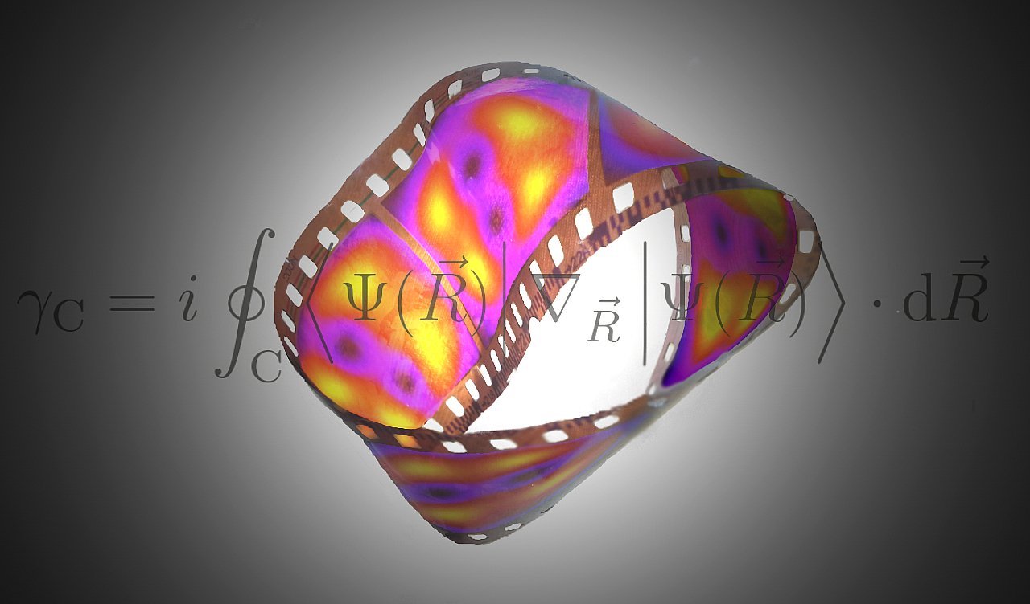


PhD Defense
Ultracold Atoms in
Artificial Gauge Fields
Tobias Grass
23.04.2013
Advisor: Co-Advisor:
Maciej Lewenstein Bruno Julia-Diaz

Slide 2
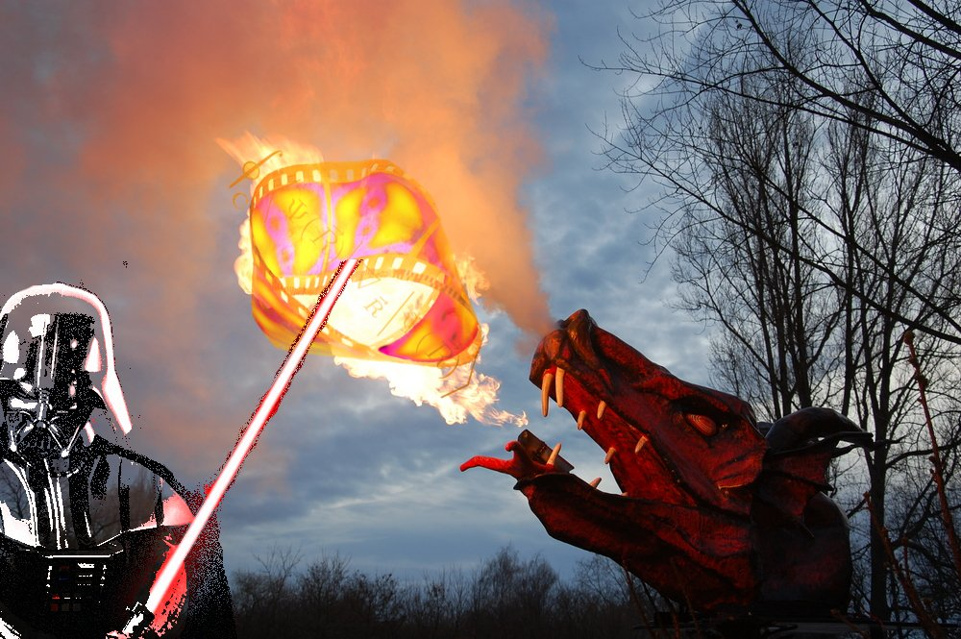
PhD Defense
Ultracold Atoms in
Artificial Gauge Fields
Thesis Advisors:
Maciej Lewenstein
Bruno Julia-Diaz
Thesis Committee:
Jean Dalibard
Nigel Cooper
Frank Koppens
Andrea Trombettoni
Darrick Chang
Tobias Grass
23.04.2013
Jordi

Slide 3

YES
Ultracold?
Do we still study nature?
Artificial?
Clean and controllable quantum many-body system
Manipulated to test/study important concepts of physics
Ultracold Atoms in
Artificial Gauge Fields
Tobias Grass @ ICFO 23.04.2013

Slide 4
YES
Ultracold?
Do we still study nature?
Artificial?
Clean and controllable quantum many-body system
Manipulated to test/study important concepts of physics
Macroscopic
Behavior
Microscopic
Order
Ultracold Atoms in
Artificial Gauge Fields
Tobias Grass @ ICFO 23.04.2013

Slide 5
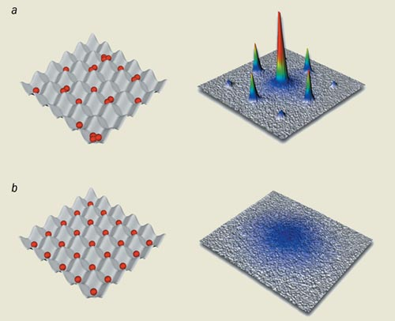
YES
Ultracold?
Do we still study nature?
Artificial?
Clean and controllable quantum many-body system
Manipulated to test/study important concepts of physics
Superfluidity (e.g. of cold bosons in optical lattices)
Macroscopic
Behavior
Microscopic
Order
Greiner et al., Nature 415, 39 (2002)
Spontaneous Symmetry breaking:
Quantum Phase Transition
Ultracold Atoms in
Artificial Gauge Fields
Tobias Grass @ ICFO 23.04.2013

Slide 6
YES
Ultracold?
Do we still study nature?
Artificial?
Clean and controllable quantum many-body system
Manipulated to test/study important concepts of physics
Quantized Hall conductance (in 2D electron gas)
Superfluidity (e.g. of cold bosons in optical lattices)
Macroscopic
Behavior
Microscopic
Order
Paalanen et al., PRB 25, 5566 (1982)
Greiner et al., Nature 415, 39 (2002)
Phases with the same symmetry, but
different topological order
Spontaneous Symmetry breaking:
Quantum Phase Transition
Ultracold Atoms in
Artificial Gauge Fields
Tobias Grass @ ICFO 23.04.2013

Slide 7
OUTLINE
Ultracold Atoms in Artificial Gauge Fields
I. Synthesizing gauge fields for atoms
Laser-induced Berry phases and non-Abelian gauge fields
Order in many-body systems
II. Mott transition of bosons in a gauge field
Symmetry-breaking order
III. Bose-Einstein condensates with spin-orbit coupling
Order-by-disorder
IV. Fractional Quantum Hall Effect in Bose gases
Topological order
- Generation and detection of spin-polarized FQH states
- Spinful FQH states - with and without spin-orbit coupling
Ultracold Atoms in
Artificial Gauge Fields
Tobias Grass @ ICFO 23.04.2013

Slide 8
OUTLINE
Ultracold Atoms in Artificial Gauge Fields
I. Synthesizing gauge fields for atoms
Laser-induced Berry phases and non-Abelian gauge fields
Order in many-body systems
II. Mott transition of bosons in a gauge field
Symmetry-breaking order
III. Bose-Einstein condensates with spin-orbit coupling
Order-by-disorder
IV. Fractional Quantum Hall Effect in Bose gases
Topological order
- Generation and detection of spin-polarized FQH states
- Spinful FQH states - with and without spin-orbit coupling
Ultracold Atoms in
Artificial Gauge Fields
Tobias Grass @ ICFO 23.04.2013

Slide 9
OUTLINE
Ultracold Atoms in Artificial Gauge Fields
I. Synthesizing gauge fields for atoms
Laser-induced Berry phases and non-Abelian gauge fields
Order in many-body systems
II. Mott transition of bosons in a gauge field
Symmetry-breaking order
III. Bose-Einstein condensates with spin-orbit coupling
Order-by-disorder
IV. Fractional Quantum Hall Effect in Bose gases
Topological order
- Generation and detection of spin-polarized FQH states
- Spinful FQH states - with and without spin-orbit coupling
Ultracold Atoms in
Artificial Gauge Fields
Tobias Grass @ ICFO 23.04.2013

Slide 10
SYNTHESIZING GAUGE FIELDS
Electroneutral atoms do not feel real magnetic fields
Ultracold Atoms in
Artificial Gauge Fields
Tobias Grass @ ICFO 23.04.2013

Slide 11
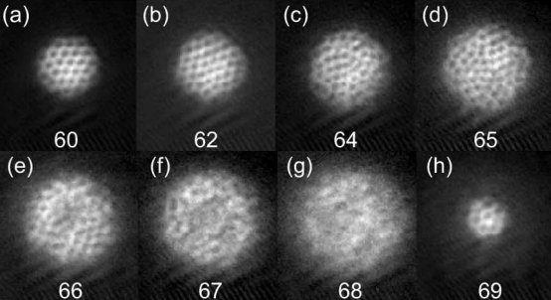
SYNTHESIZING GAUGE FIELDS
Electroneutral atoms do not feel real magnetic fields
Rotating systems: Coriolis force mimicks Lorentz force
[N. Cooper, AiP 57, 539 (2008)]
Vortices as magnetic flux lines
[V. Bretin et al., PRL 92, 050403 (2004)]
PROBLEM:
Reaching strong fields difficult!
Ultracold Atoms in
Artificial Gauge Fields
Tobias Grass @ ICFO 23.04.2013

Slide 12
SYNTHESIZING GAUGE FIELDS
Electroneutral atoms do not feel real magnetic fields
Rotating systems: Coriolis force mimicks Lorentz force
[N. Cooper, AiP 57, 539 (2008)]
Vortices as magnetic flux lines
[V. Bretin et al., PRL 92, 050403 (2004)]
PROBLEM:
Reaching strong fields difficult!
Magnetic fields couple the phase of the wave function to the external motion (Berry connection)
Laser-induced Berry phase [J. Dalibard et al., RMP 83, 1523 (2011)]
Ultracold Atoms in
Artificial Gauge Fields
Tobias Grass @ ICFO 23.04.2013

Slide 13

SYNTHESIZING GAUGE FIELDS
Beyond magnetic fields: non-Abelian gauge fields
Gauge fields connect internal with external degrees of freedom: they can also couple to (pseudo)spin
For a spinor :
Ultracold Atoms in
Artificial Gauge Fields
Tobias Grass @ ICFO 23.04.2013

Slide 14
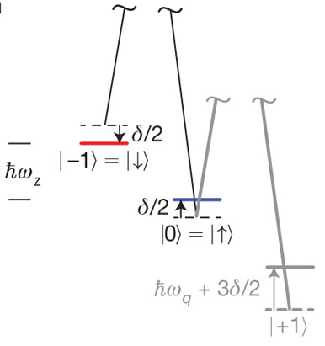
SYNTHESIZING GAUGE FIELDS
Beyond magnetic fields: non-Abelian gauge fields
Gauge fields connect internal with external degrees of freedom: they can also couple to (pseudo)spin
For a spinor :
Non-Abelian gauge potential = spin-orbit coupling
Naturally:
- Fine structure of an atom
- Rashba-Dresselhaus coupling in solids
(Topological insulators)
Artificially:
- BEC with Raman coupling
[Y.-J. Lin et al., Nature 471, 83 (2011)]
Ultracold Atoms in
Artificial Gauge Fields
Tobias Grass @ ICFO 23.04.2013

Slide 15
OUTLINE
Ultracold Atoms in Artificial Gauge Fields
I. Synthesizing gauge fields for atoms
Laser-induced Berry phases and non-Abelian gauge fields
Order in many-body systems
II. Mott transition of bosons in a gauge field
Symmetry-breaking order
III. Bose-Einstein condensates with spin-orbit coupling
Order-by-disorder
IV. Fractional Quantum Hall Effect
Topological order
- Generation and detection of spin-polarized FQH states
- Spinful FQH states - with and without spin-orbit coupling
Ultracold Atoms in
Artificial Gauge Fields
Tobias Grass @ ICFO 23.04.2013

Slide 16
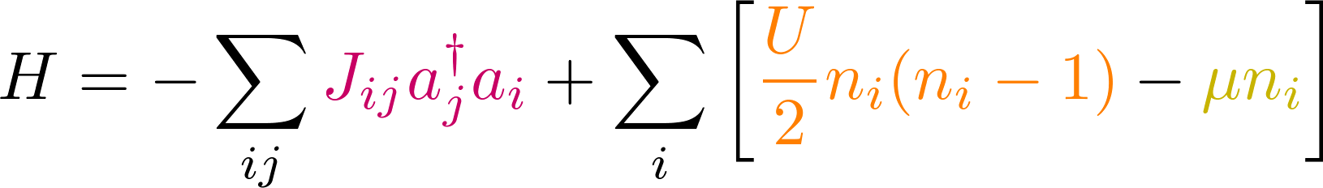
NON-ABELIAN OPTICAL LATTICES
Bose-Hubbard model in optical lattices:
Tunneling vs. interaction: SF-MI transition
[Greiner et al., Nature 415, 39 (2002)]
Optical lattices with Abelian gauge fields:
Munich: M. Aidelsburger et al., PRL 107, 255301 (2011)
Maryland: K. Jimenez-Garcia et al., PRL 108, 225303 (2012)
Hamburg: J. Struck et al., PRL 108, 225304 (2012)
Ultracold Atoms in
Artificial Gauge Fields
Tobias Grass @ ICFO 23.04.2013

Slide 17
NON-ABELIAN OPTICAL LATTICES
Bose-Hubbard model in optical lattices:
Tunneling vs. interaction: SF-MI transition
[Greiner et al., Nature 415, 39 (2002)]
Optical lattices with Abelian gauge fields:
Munich: M. Aidelsburger et al., PRL 107, 255301 (2011)
Maryland: K. Jimenez-Garcia et al., PRL 108, 225303 (2012)
Hamburg: J. Struck et al., PRL 108, 225304 (2012)
With two-component bosons: Extension to non-Abelian gauge fields. [K. Osterloh et al., PRL 95, 010403 (2005)]
Spin-orbit coupling
Magnetic flux
Ultracold Atoms in
Artificial Gauge Fields
Tobias Grass @ ICFO 23.04.2013

Slide 18
NON-ABELIAN OPTICAL LATTICES
Bose-Hubbard model in optical lattices:
Tunneling vs. interaction: SF-MI transition
[Greiner et al., Nature 415, 39 (2002)]
Optical lattices with Abelian gauge fields:
Munich: M. Aidelsburger et al., PRL 107, 255301 (2011)
Maryland: K. Jimenez-Garcia et al., PRL 108, 225303 (2012)
Hamburg: J. Struck et al., PRL 108, 225304 (2012)
With two-component bosons: Extension to non-Abelian gauge fields. [K. Osterloh et al., PRL 95, 010403 (2005)]
Spin-orbit coupling
Magnetic flux
Ultracold Atoms in
Artificial Gauge Fields
Tobias Grass @ ICFO 23.04.2013

Slide 19
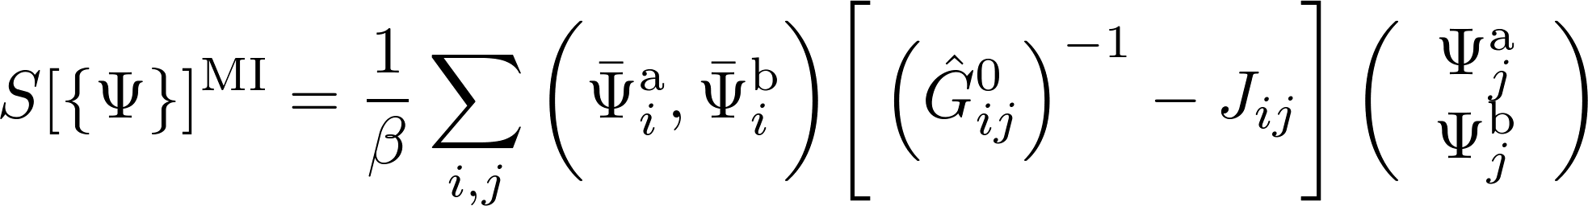

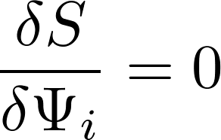
EFFECTIVE ACTION
Gauge fields influence the quantum phase transition
Ginzburg-Landau theory for 2nd order phase transition
[E. dos Santos et al., PRA 79, 013614 (2009)]
Equations of motion yield excitation spectra, phase boundary ...
[T. Grass, K. Saha, K. Sengupta, M. Lewenstein, PRA 84 053632 (2011)]
Order parameter:
Inverse of Green function
obtained by resumming hopping processes:
G
=
G⁰
+
G⁰
J
G⁰
+ ...
Ultracold Atoms in
Artificial Gauge Fields
Tobias Grass @ ICFO 23.04.2013

Slide 20
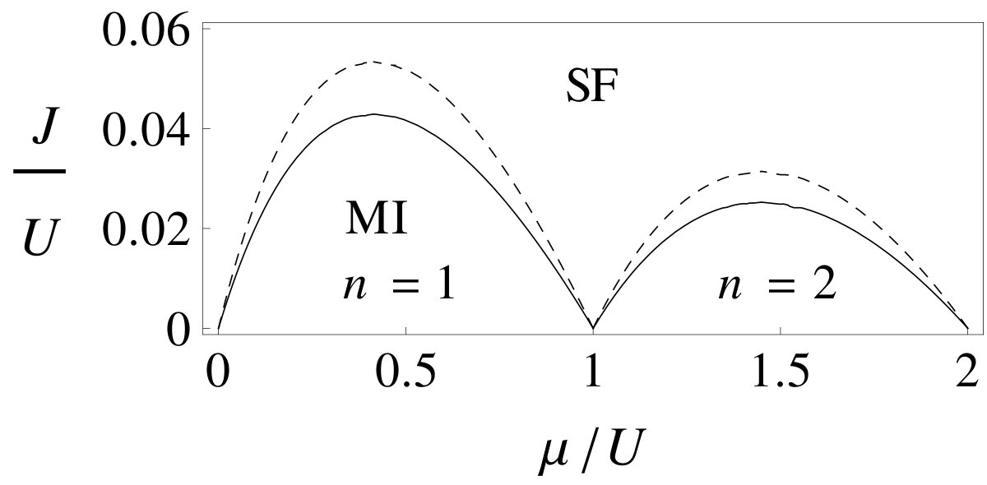
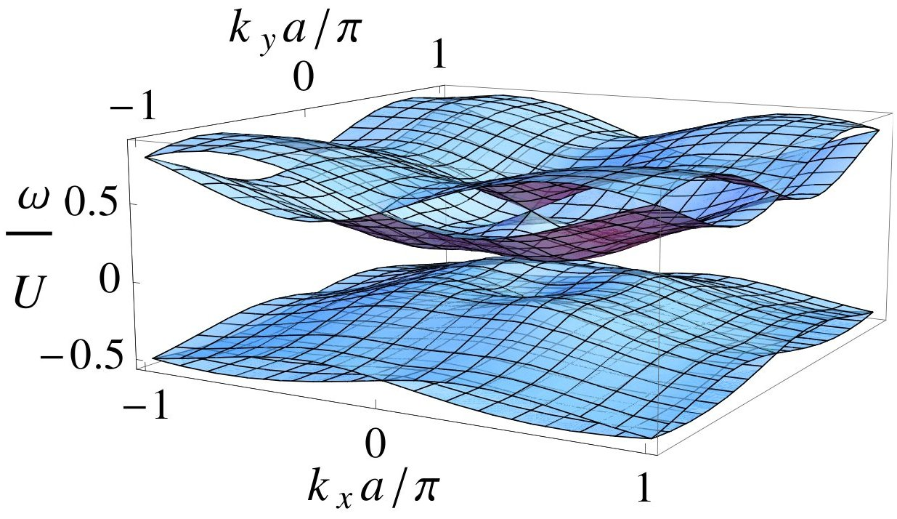
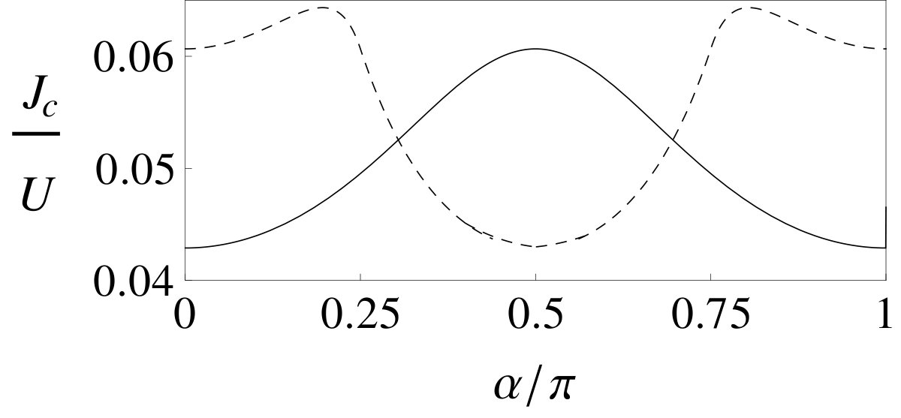
RE-ENTRANT SUPERFLUIDITY
Gauge fields influence the quantum phase transition
Ginzburg-Landau theory for 2nd order phase transition
[E. dos Santos et al., PRA 79, 013614 (2009)]
Equations of motion yield excitation spectra, phase boundary ...
[T. Grass, K. Saha, K. Sengupta, M. Lewenstein, PRA 84 053632 (2011)]
Excitation spectra :
(without magnetic flux)
Phase boundary:
(indicated by gapless Goldstone modes)
G
2 particle bands
(positive energy)
Order parameter:
Inverse of Green function, obtained by resumming hopping processes:
=
G⁰
+
G⁰
J
G⁰
+ ...
Height of the lobes strongly depends
on the gauge field strength:
½ magnetic flux
2 hole bands
(negative energy)
No magnetic flux
Spin-orbit coupling strength
Ultracold Atoms in
Artificial Gauge Fields
Tobias Grass @ ICFO 23.04.2013

Slide 21




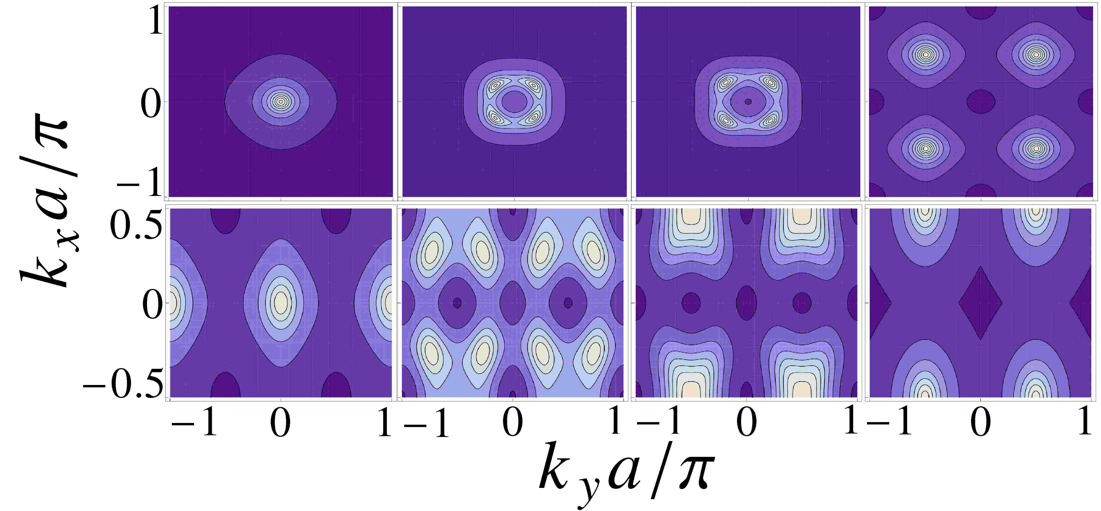


EXCITED STATE PHASE TRANSITION
Momentum distribution modified by gauge fields
Ginzburg-Landau theory for 2nd order phase transition
[E. dos Santos et al., PRA 79, 013614 (2009)]
Equations of motion yield excitation spectra, phase boundary ...
[T. Grass, K. Saha, K. Sengupta, M. Lewenstein, PRA 84 053632 (2011)]
At the tip, particle-hole bands will touch at some momentum k
G
Order parameter:
Gives rise to peaks in the momentum distribution:
Inverse of Green function, obtained by resumming hopping processes:
=
G⁰
+
G⁰
J
G⁰
+ ...
Ultracold Atoms in
Artificial Gauge Fields
Tobias Grass @ ICFO 23.04.2013

Slide 22

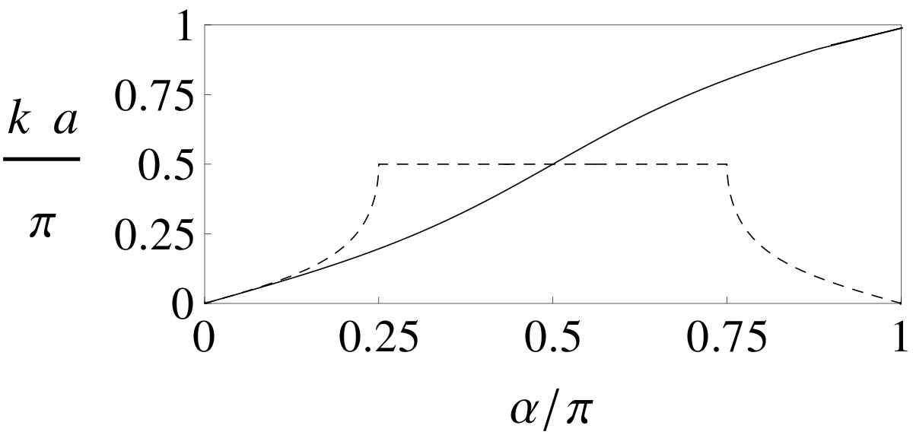
EXCITED STATE PHASE TRANSITION
Momentum distribution modified by gauge fields
Ginzburg-Landau theory for 2nd order phase transition
[E. dos Santos et al., PRA 79, 013614 (2009)]
Equations of motion yield excitation spectra, phase boundary ...
[T. Grass, K. Saha, K. Sengupta, M. Lewenstein, PRA 84 053632 (2011)]
At the tip, particle-hole bands will touch at some momentum k
G
Order parameter:
Gives rise to peaks in the momentum distribution:
Inverse of Green function, obtained by resumming hopping processes:
=
G⁰
+
G⁰
J
G⁰
Level crossing of low-lying excitations!
+ ...
Spin-orbit coupling strength
Ultracold Atoms in
Artificial Gauge Fields
Tobias Grass @ ICFO 23.04.2013

Slide 23
OUTLINE
Ultracold Atoms in Artificial Gauge Fields
I. Synthesizing gauge fields for atoms
Laser-induced Berry phases and non-Abelian gauge fields
Order in many-body systems
II. Mott transition of bosons in a gauge field
Symmetry-breaking order
III. Bose-Einstein condensates with spin-orbit coupling
Order-by-disorder
IV. Fractional Quantum Hall Effect in Bose gases
Topological order
- Generation and detection of spin-polarized FQH states
- Spinful FQH states - with and without spin-orbit coupling
Ultracold Atoms in
Artificial Gauge Fields
Tobias Grass @ ICFO 23.04.2013

Slide 24
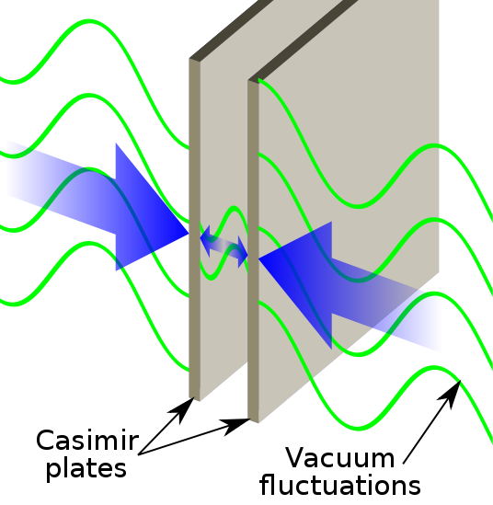
ORDER BY DISORDER
An analogy: Casimir effect
Boundary conditions on the vacuum determine vacuum fluctuations.
This can result in an effective force.
Ultracold Atoms in
Artificial Gauge Fields
Tobias Grass @ ICFO 23.04.2013

Slide 25
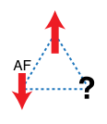
ORDER BY DISORDER
An analogy: Casimir effect
Boundary conditions on the vacuum determine vacuum fluctuations.
This can result in an effective force.
Frustration:
Degeneracy of the mean-field ground state does not correspond to a symmetry in the many-body system.
Frustration in an antiferromagnetic triangular lattice
Ultracold Atoms in
Artificial Gauge Fields
Tobias Grass @ ICFO 23.04.2013

Slide 26
ORDER BY DISORDER
An analogy: Casimir effect
Boundary conditions on the vacuum determine vacuum fluctuations.
This can result in an effective force.
Frustration:
Degeneracy of the mean-field ground state does not correspond to a symmetry in the many-body system.
Frustration in an antiferromagnetic triangular lattice
Order by disorder:
Different mean field ground states ( = different realizations of the vacuum) have different (quantum/thermal) fluctuations.
→ Fluctuations choose one ground state.
[J. Villain et al., J. Phys. (France) 41 1263 (1980)]
Ultracold Atoms in
Artificial Gauge Fields
Tobias Grass @ ICFO 23.04.2013

Slide 27
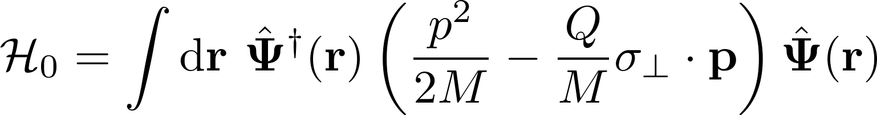

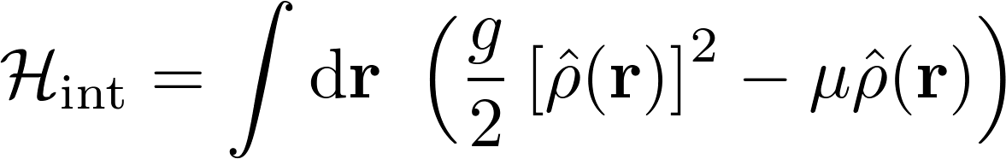

RASHBA COUPLED BEC
Non-interacting system:
Large GS degeneracy at
Density-density interactions:
Mean field solution:
constant density superposition of 2 opposite momenta
(selected by spontaneous symmetry breaking)
Remaining degeneracy does not correspond to a symmetry: Removed by fluctuations?
[R. Barnett, S. Powell, T. Grass, M. Lewenstein, and S. Das Sarma, PRA 85 023615 (2012)]
Ultracold Atoms in
Artificial Gauge Fields
Tobias Grass @ ICFO 23.04.2013

Slide 28
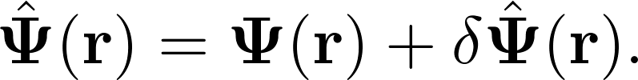
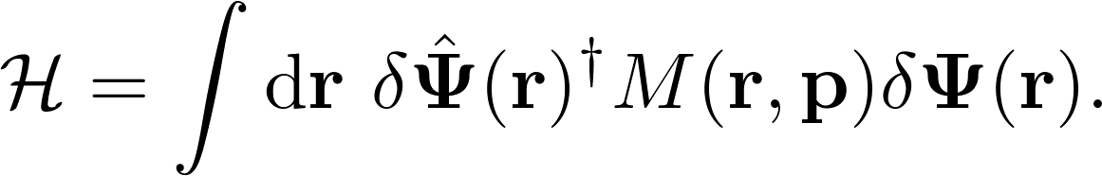
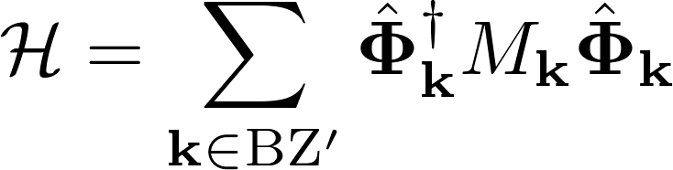

BOGOLIUBOV APPROACH
Variation around one mean-field state:
Consider quadratic Hamiltonian:
Fourier transform: with coupled modes:
Bogoliubov-de Gennes equations:
→ yield excitations spectra
→ can be solved numerically after truncation for large n
[R. Barnett, S. Powell, T. Grass, M. Lewenstein, and S. Das Sarma, PRA 85 023615 (2012)]
Ultracold Atoms in
Artificial Gauge Fields
Tobias Grass @ ICFO 23.04.2013

Slide 29
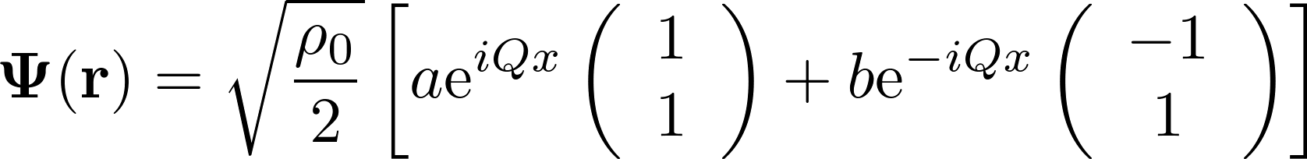
BOGOLIUBOV APPROACH
Low-lying excitation bands:
(depending on mean
field ground state)
On average, the excitations
above the ϑ=0 mean field
state have lower energy.
→ Selected state:
?
[R. Barnett, S. Powell, T. Grass, M. Lewenstein, and S. Das Sarma, PRA 85 023615 (2012)]
Ultracold Atoms in
Artificial Gauge Fields
Tobias Grass @ ICFO 23.04.2013

Slide 30

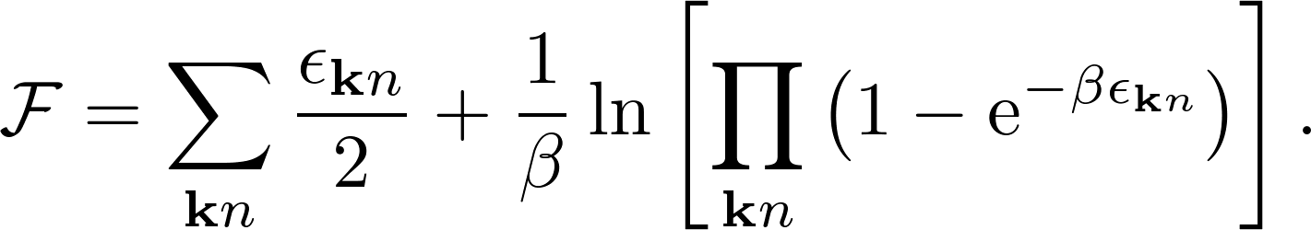
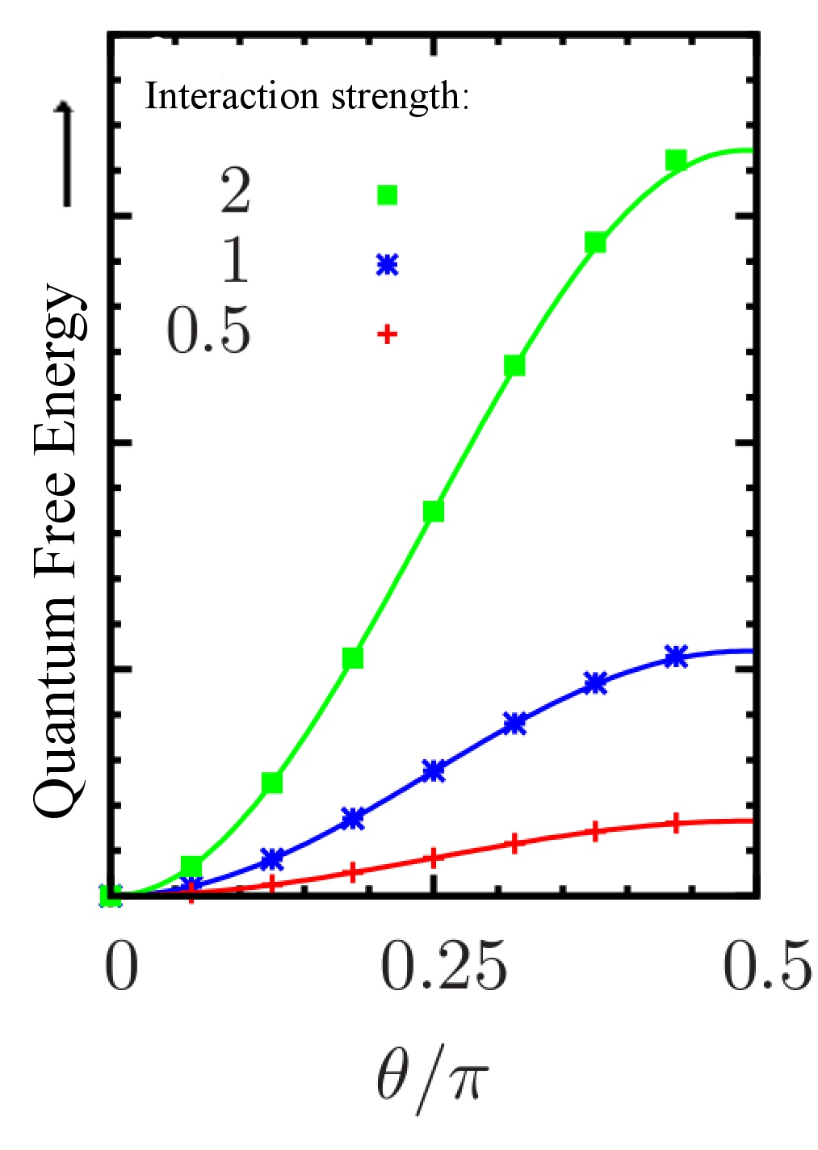
FREE ENERGY
More quantitatively: Free energy
(Divergent terms cancel)
quantum fluctuations thermal fluctuations
prefer ϑ=0
→ Selected state:
!
[R. Barnett, S. Powell, T. Grass, M. Lewenstein, and S. Das Sarma, PRA 85 023615 (2012)]
Ultracold Atoms in
Artificial Gauge Fields
Tobias Grass @ ICFO 23.04.2013

Slide 31
FREE ENERGY
More quantitatively: Free energy
(Divergent terms cancel)
quantum fluctuations thermal fluctuations
prefer ϑ=0
prefer ϑ=π/2
→ Selected state:
High temperature: quantum and thermal fluctuations cancel each other
Cooling: selection by quantum fluctuations
!
[R. Barnett, S. Powell, T. Grass, M. Lewenstein, and S. Das Sarma, PRA 85 023615 (2012)]
Ultracold Atoms in
Artificial Gauge Fields
Tobias Grass @ ICFO 23.04.2013

Slide 32
OUTLINE
Ultracold Atoms in Artificial Gauge Fields
I. Synthesizing gauge fields for atoms
Laser-induced Berry phases and non-Abelian gauge fields
Order in many-body systems
II. Mott transition of bosons in a gauge field
Symmetry-breaking order
III. Bose-Einstein condensates with spin-orbit coupling
Order-by-disorder
IV. Fractional Quantum Hall Effect in Bose gases
Topological order
- Generation and detection of spin-polarized FQH states
- Spinful FQH states - with and without spin-orbit coupling
Ultracold Atoms in
Artificial Gauge Fields
Tobias Grass @ ICFO 23.04.2013

Slide 33
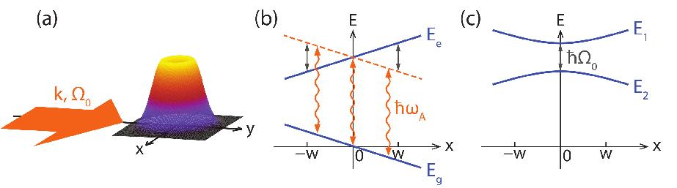
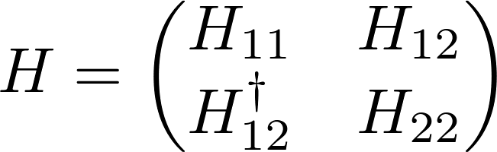
GEOMETRIC GAUGE FIELDS
(a) Laser coupling of atomic states
(b) Tilting of energy levels
(c) Space-dependent dressed states
[B. Juliá-Díaz, D. Dagnino, K. J. Günter, T. Grass, N. Barberán, M. Lewenstein, J. Dalibard, PRA 84 053605 (2011)]
Ultracold Atoms in
Artificial Gauge Fields
Tobias Grass @ ICFO 23.04.2013

Slide 34
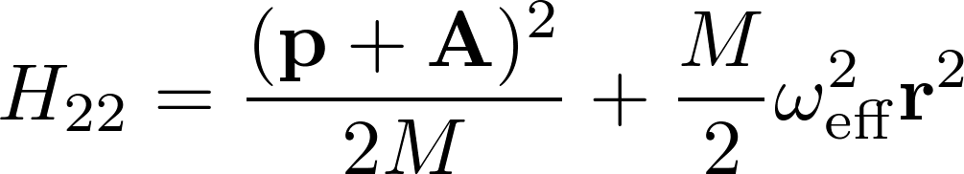
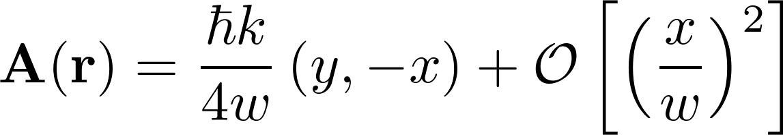
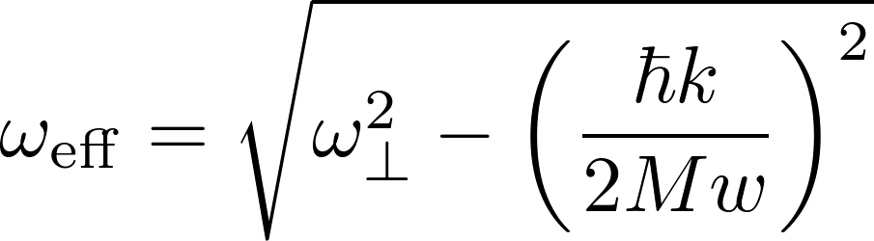
GEOMETRIC GAUGE FIELDS
(a) Laser coupling of atomic states
(b) Tilting of energy levels
(c) Space-dependent dressed states
with
[B. Juliá-Díaz, D. Dagnino, K. J. Günter, T. Grass, N. Barberán, M. Lewenstein, J. Dalibard, PRA 84 053605 (2011)]
Ultracold Atoms in
Artificial Gauge Fields
Tobias Grass @ ICFO 23.04.2013

Slide 35
GEOMETRIC GAUGE FIELDS
(a) Laser coupling of atomic states
(b) Tilting of energy levels
(c) Space-dependent dressed states
Landau level structure:
Energy
2LL
1LL
LLL
Angular momentum
with
[B. Juliá-Díaz, D. Dagnino, K. J. Günter, T. Grass, N. Barberán, M. Lewenstein, J. Dalibard, PRA 84 053605 (2011)]
Ultracold Atoms in
Artificial Gauge Fields
Tobias Grass @ ICFO 23.04.2013

Slide 36


GEOMETRIC GAUGE FIELDS
(a) Laser coupling of atomic states
(b) Tilting of energy levels
(c) Space-dependent dressed states
Lowest Landau level approximation:
Energy
Angular momentum
with
[B. Juliá-Díaz, D. Dagnino, K. J. Günter, T. Grass, N. Barberán, M. Lewenstein, J. Dalibard, PRA 84 053605 (2011)]
Ultracold Atoms in
Artificial Gauge Fields
Tobias Grass @ ICFO 23.04.2013

Slide 37
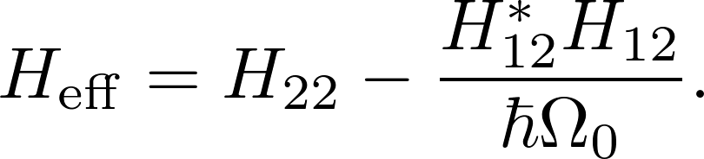
GEOMETRIC GAUGE FIELDS
(a) Laser coupling of atomic states
(b) Tilting of energy levels
(c) Space-dependent dressed states
Lowest Landau level approximation:
Off-diagonal elements provide coupling to higher dressed state.
Considering only virtual transitions, 2nd order perturbation theory yields:
Energy
Angular momentum
with
[B. Juliá-Díaz, D. Dagnino, K. J. Günter, T. Grass, N. Barberán, M. Lewenstein, J. Dalibard, PRA 84 053605 (2011)]
Ultracold Atoms in
Artificial Gauge Fields
Tobias Grass @ ICFO 23.04.2013

Slide 38
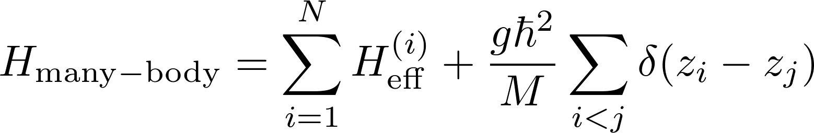
GEOMETRIC GAUGE FIELDS
(a) Laser coupling of atomic states
(b) Tilting of energy levels
(c) Space-dependent dressed states
Lowest Landau level approximation:
Off-diagonal elements provide coupling to higher dressed state.
Considering only virtual transitions, 2nd order perturbation theory yields:
Energy
Angular momentum
[B. Juliá-Díaz, D. Dagnino, K. J. Günter, T. Grass, N. Barberán, M. Lewenstein, J. Dalibard, PRA 84 053605 (2011)]
Ultracold Atoms in
Artificial Gauge Fields
Tobias Grass @ ICFO 23.04.2013

Slide 39
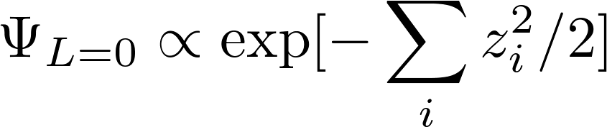
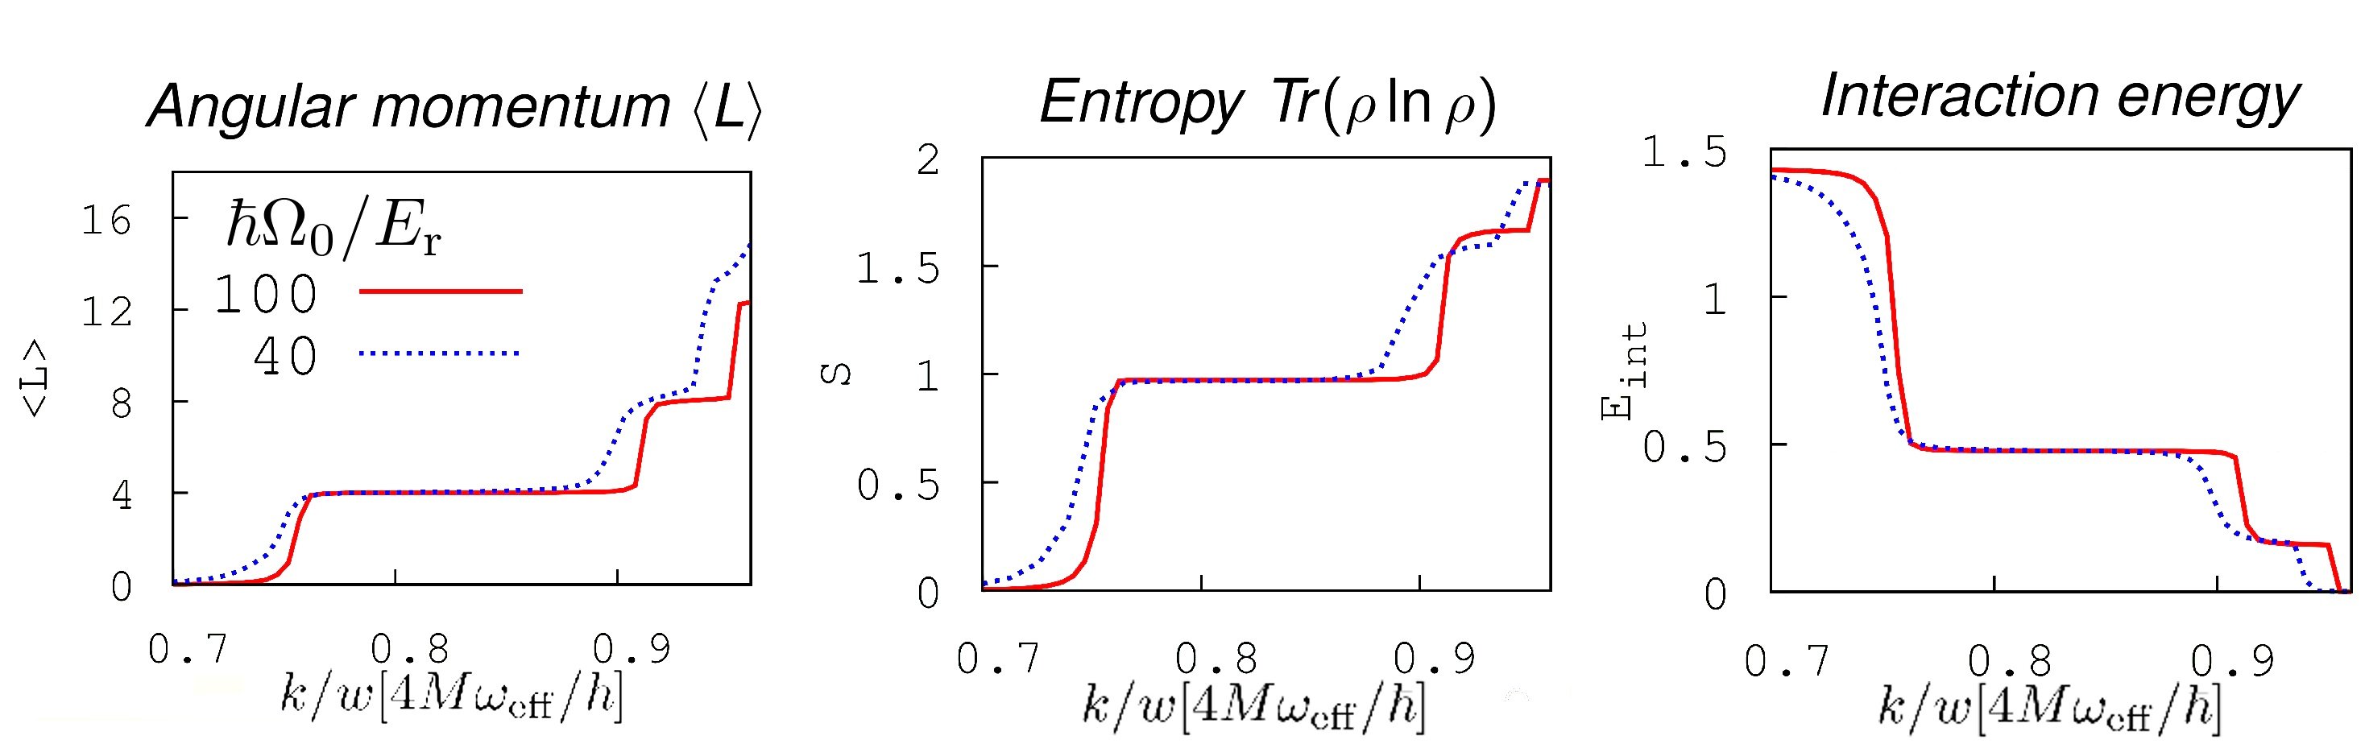
EXACT DIAGONALIZATION STUDY
Weak field: Trap wins
Condensate at L=0.
Increasing the field:
Trap vs. Interactions
Strong field: Interactions win
Anticorrelations
Gauge Field Strength →
Gauge Field Strength →
B. Juliá-Díaz, D. Dagnino, K. J. Günter, T. Grass, N. Barberán, M. Lewenstein, J. Dalibard, PRA 84 053605 (2011)
Ultracold Atoms in
Artificial Gauge Fields
Tobias Grass @ ICFO 23.04.2013

Slide 40
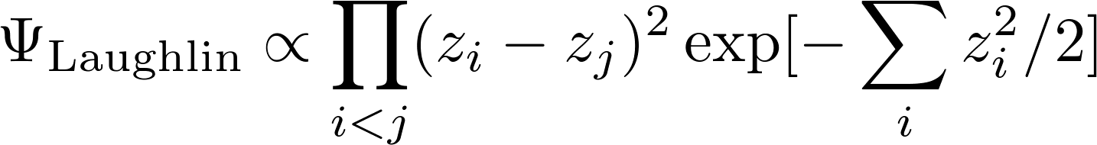
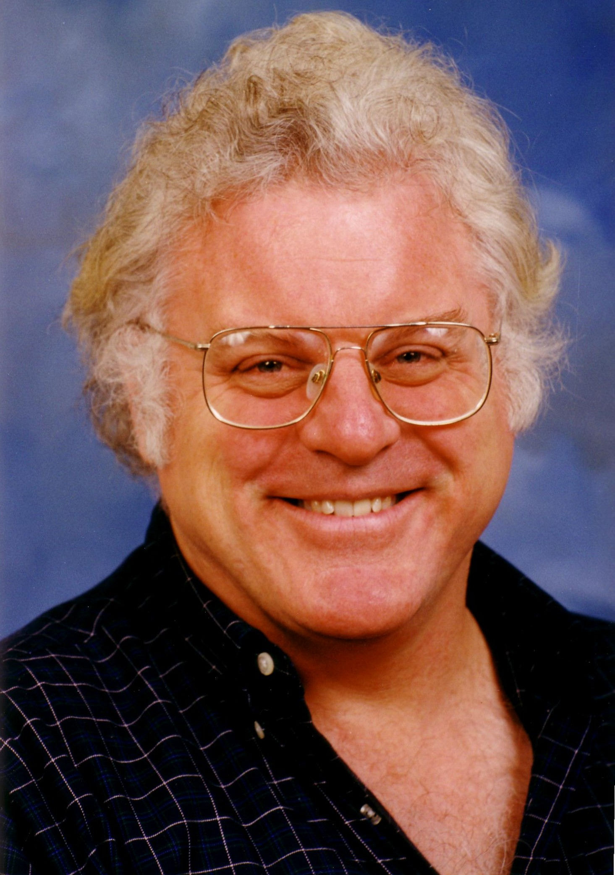

EXACT DIAGONALIZATION STUDY
Weak field: Trap wins
Condensate at L=0.
Increasing the field:
Trap vs. Interactions
Strong field: Interactions win
Anticorrelations
Robert B. Laughlin, Horst L. Störmer and Daniel C. Tsui
(1998)
Gauge Field Strength →
Gauge Field Strength →
B. Juliá-Díaz, D. Dagnino, K. J. Günter, T. Grass, N. Barberán, M. Lewenstein, J. Dalibard, PRA 84 053605 (2011)
Ultracold Atoms in
Artificial Gauge Fields
Tobias Grass @ ICFO 23.04.2013

Slide 41
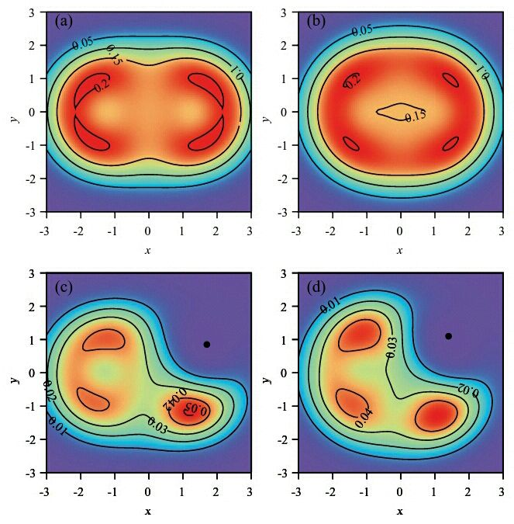


EXACT DIAGONALIZATION STUDY
Weak field: Trap wins
Condensate at L=0.
Increasing the field:
Trap vs. Interactions
Strong field: Interactions win
Anticorrelations
Gauge Field Strength →
Gauge Field Strength →
Density:
Pair-correlation function:
B. Juliá-Díaz, D. Dagnino, K. J. Günter, T. Grass, N. Barberán, M. Lewenstein, J. Dalibard, PRA 84 053605 (2011)
Ultracold Atoms in
Artificial Gauge Fields
Tobias Grass @ ICFO 23.04.2013

Slide 42
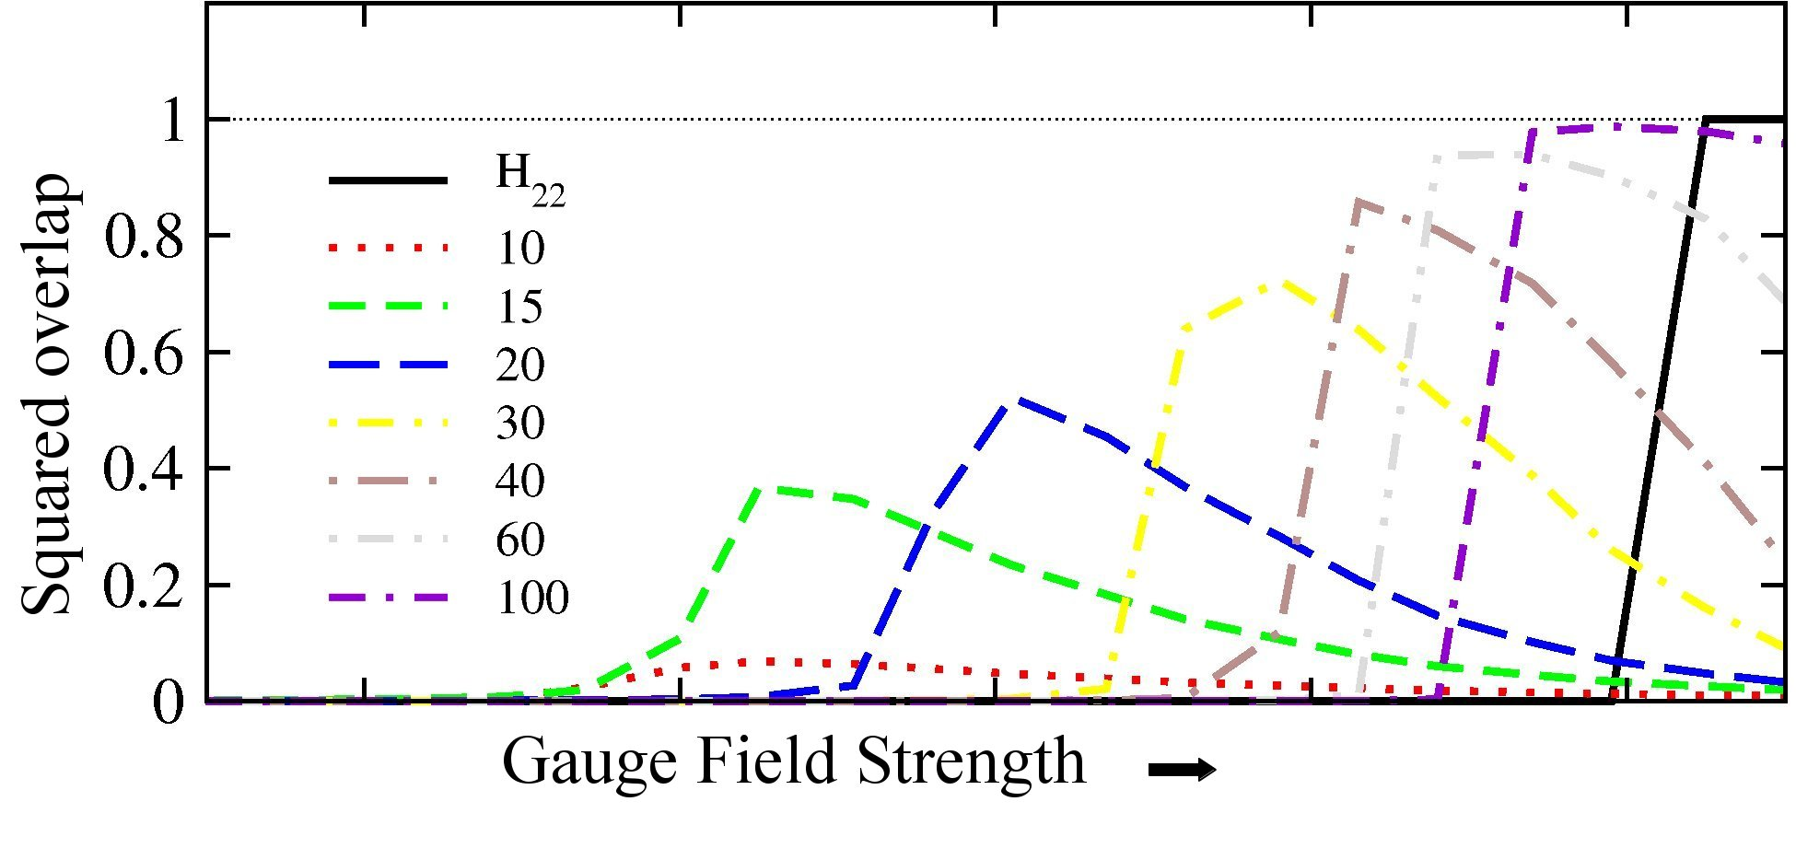
EXACT DIAGONALIZATION STUDY
Weak field: Trap wins
Condensate at L=0.
Increasing the field:
Trap vs. Interactions
Strong field: Interactions win
Anticorrelations
Laughlin core with correlations
+ edge excitations
Gauge Field Strength →
Gauge Field Strength →
Density:
Pair-correlation function:
B. Juliá-Díaz, D. Dagnino, K. J. Günter, T. Grass, N. Barberán, M. Lewenstein, J. Dalibard, PRA 84 053605 (2011)
Ultracold Atoms in
Artificial Gauge Fields
Tobias Grass @ ICFO 23.04.2013

Slide 43
LAUGHLIN EXCITATIONS
Anyons - only in 2D: Neither Fermions Nor Bosons
Ultracold Atoms in
Artificial Gauge Fields
Tobias Grass @ ICFO 23.04.2013

Slide 44
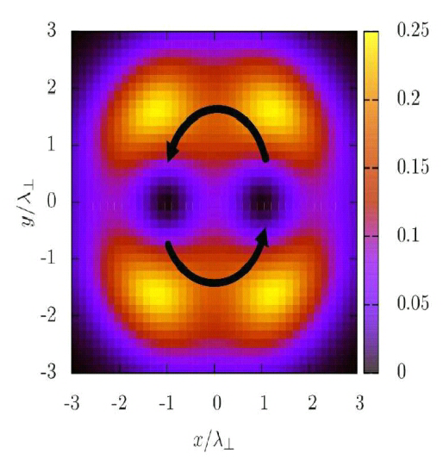

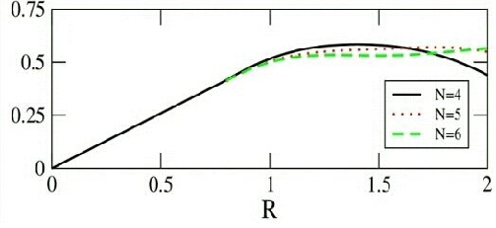

LAUGHLIN EXCITATIONS
Anyons - only in 2D: Neither Fermions Nor Bosons
Exchange of quasiholes
→ statistical phase
Fractional statistical phase becomes robust even in small systems → topological order
R (distance of quasiholes from the center)
[B. Juliá-Díaz, T. Grass,
N. Barberán, M. Lewenstein,
New J Phys 14, 055003 (2012)]
Ultracold Atoms in
Artificial Gauge Fields
Tobias Grass @ ICFO 23.04.2013

Slide 45
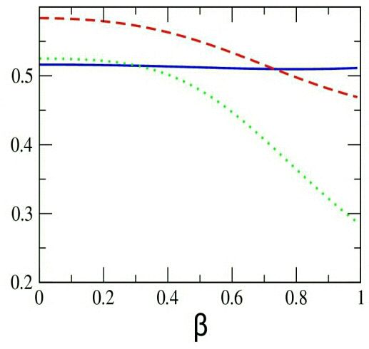
LAUGHLIN EXCITATIONS
Anyons - only in 2D: Neither Fermions Nor Bosons
Exchange of quasiholes
→ statistical phase
Fractional statistical phase becomes robust even in small systems → topological order
R (distance of quasiholes from the center)
In the deformed Laughlin state: topological order is maintained.
R=1.4
R=1.8
R=1
Deviation from ½:
Quasiholes touch the edge of the deformed cloud
[B. Juliá-Díaz, T. Grass,
N. Barberán, M. Lewenstein,
New J Phys 14, 055003 (2012)]
β (deformation parameter)
Ultracold Atoms in
Artificial Gauge Fields
Tobias Grass @ ICFO 23.04.2013

Slide 46
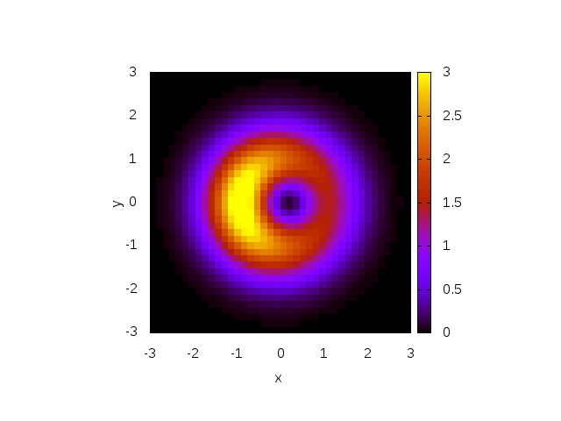
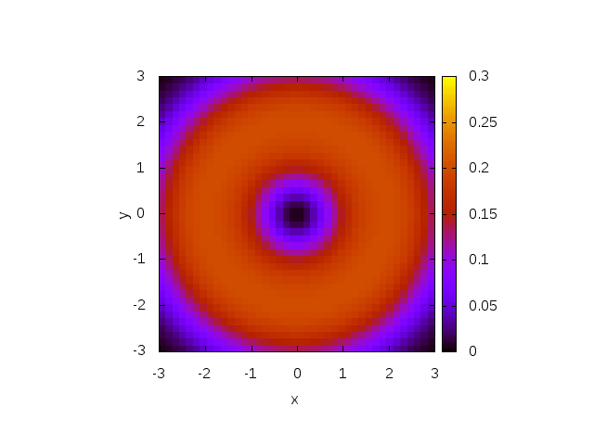
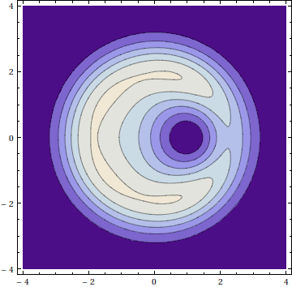
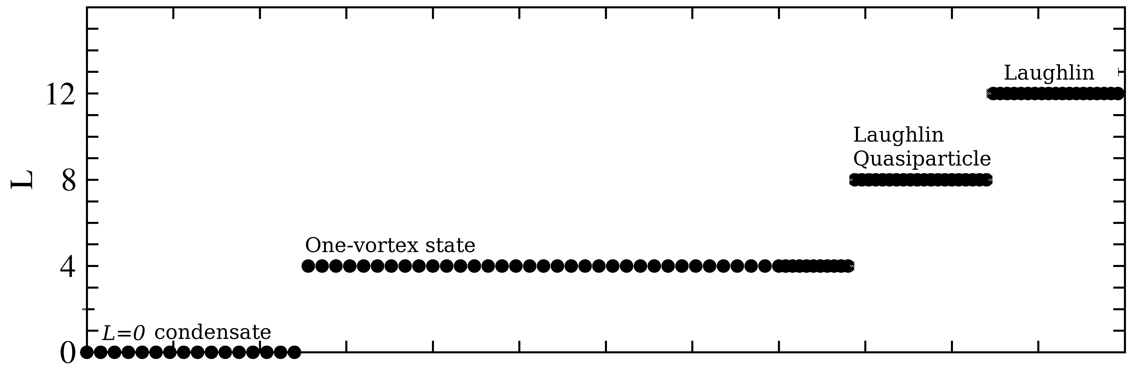

PHASE DETECTION
Via the dynamical response after piercing a hole
Finite interactions: Collapse of
the hole and quantum revivals
No interactions:
coherent motion
(quasi)hole
in Laughlin state
(N=7)
in condensate (N=20) in qp state(N=6)
0.7 0.8 0.9 1
[T. Grass, B. Juliá-Díaz, M. Lewenstein, Phys. Rev. A 86 053629 (2012)]
Ultracold Atoms in
Artificial Gauge Fields
Tobias Grass @ ICFO 23.04.2013

Slide 47
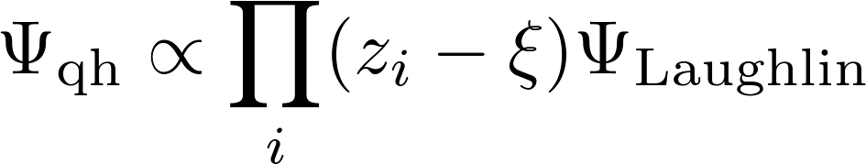



PHASE DETECTION
Coherent motion of quasiholes in the Laughlin state
Laughlin qh wave function:
Zero interaction energy
Kinetic energy given by angular momentum
mth order in :
Time-dependent hole
0.7 0.8 0.9 1
[T. Grass, B. Juliá-Díaz, M. Lewenstein, Phys. Rev. A 86 053629 (2012)]
Ultracold Atoms in
Artificial Gauge Fields
Tobias Grass @ ICFO 23.04.2013

Slide 48

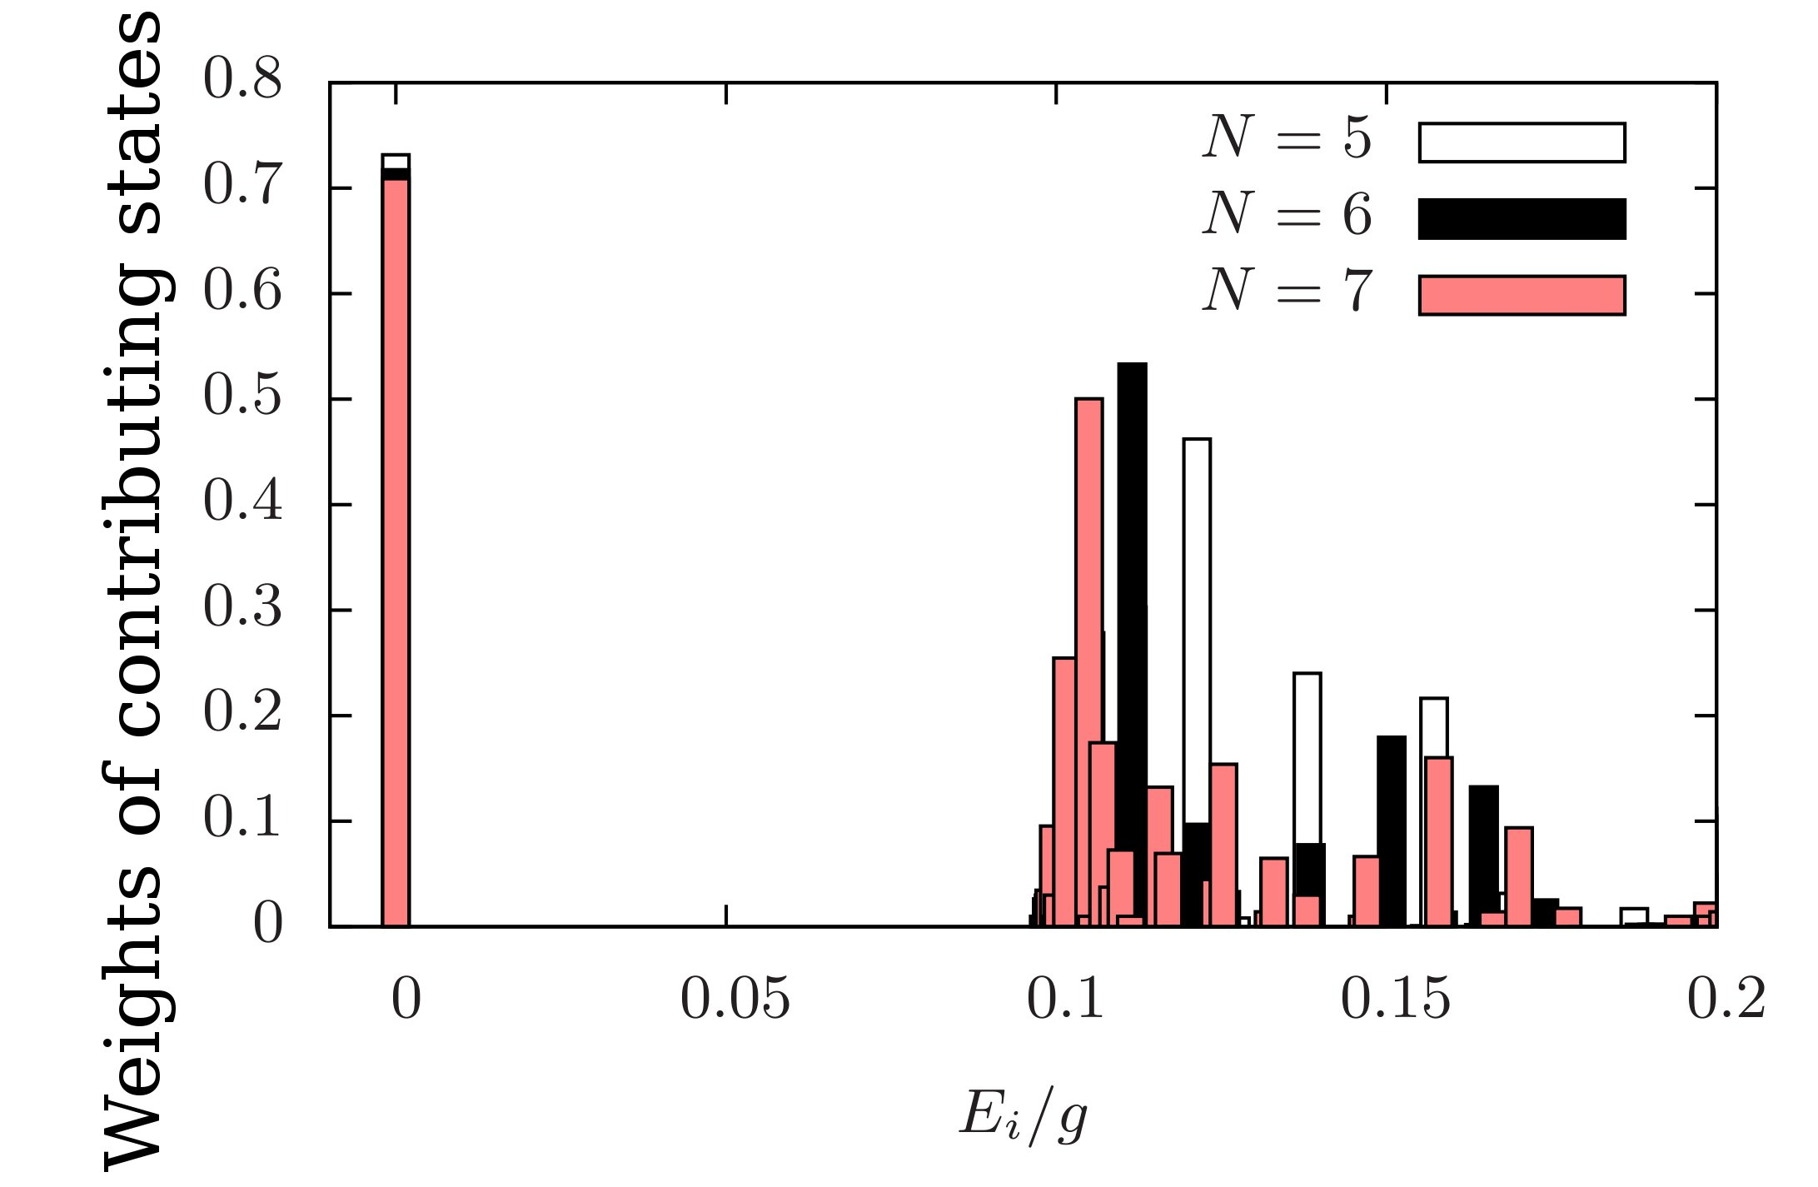

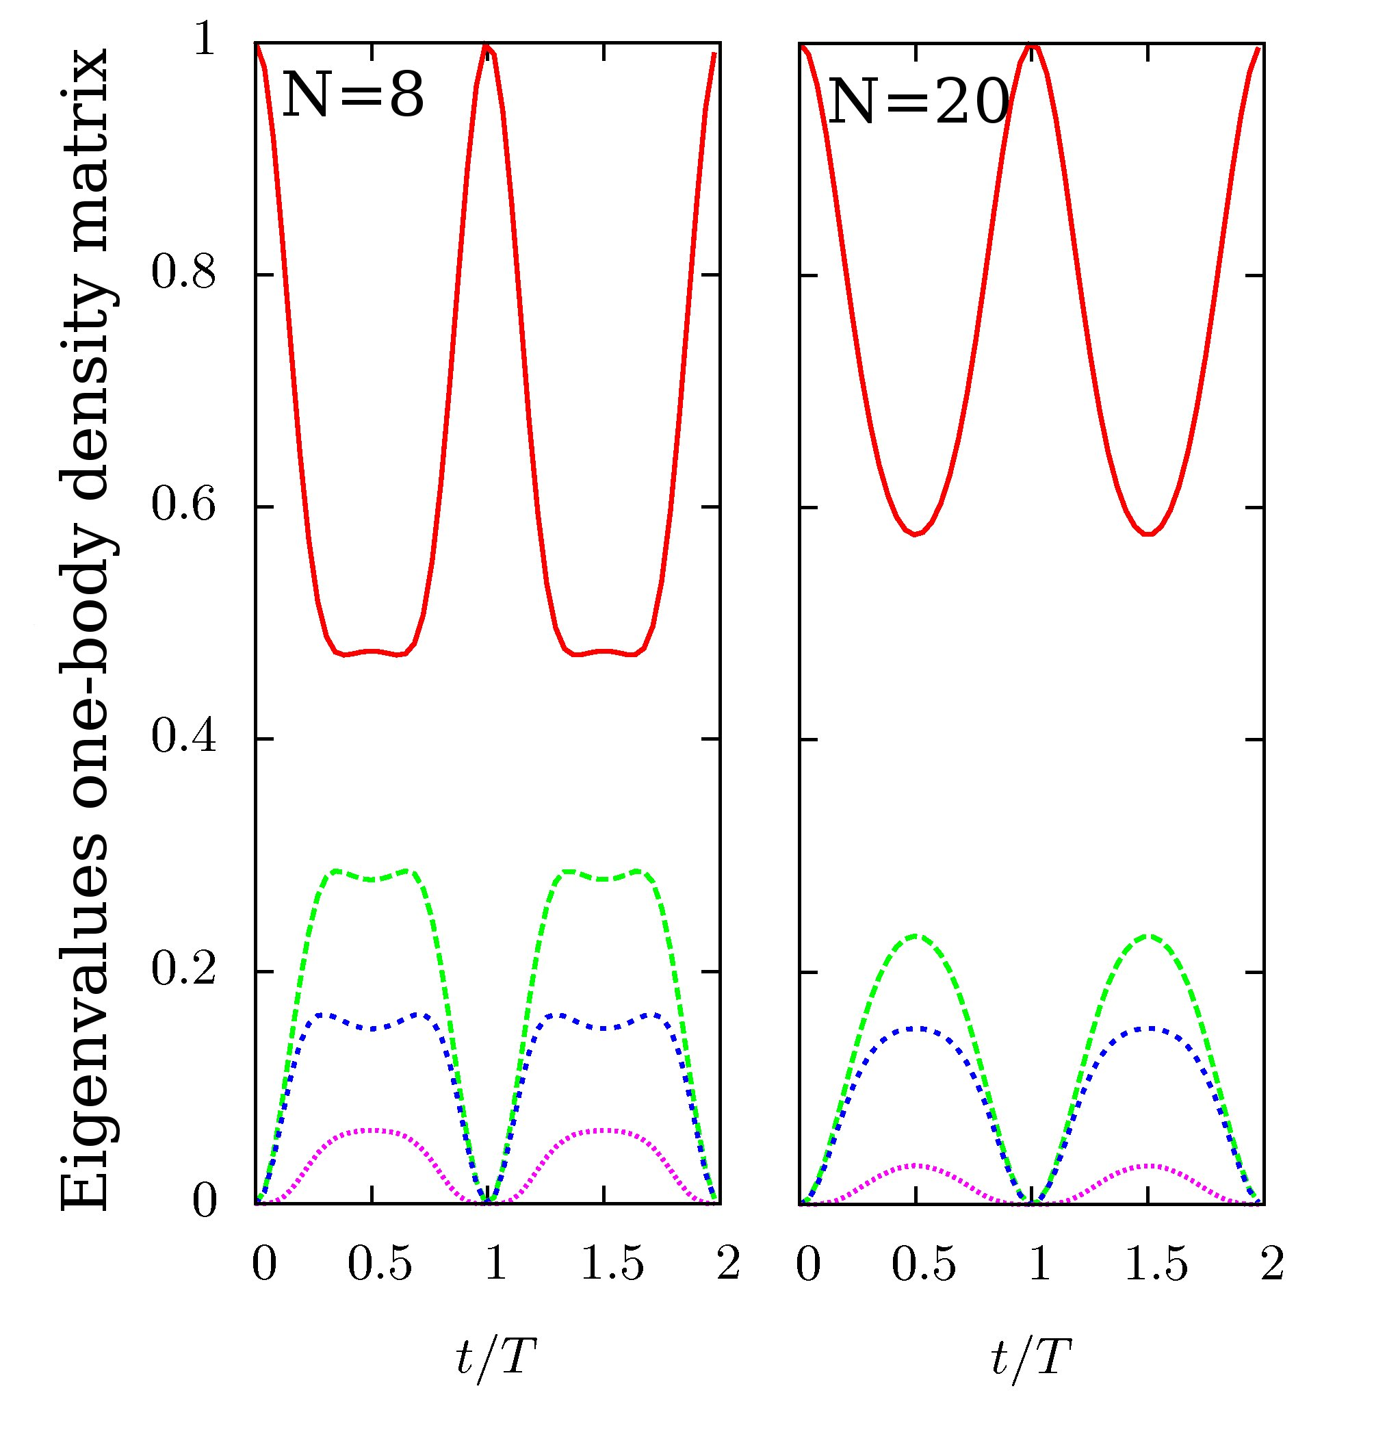

PHASE DETECTION
Collapse and revival in not/less correlated states
Energy of contributing states (ED):
Dephasing with sharp revivals:
Hole in center
becomes stable
one-vortex state
in thermo-
dynamic limit
[Bertsch & Papenbrock, PRL 83 5412 (1999), Smith &
Wilkin, PRA 62 061602 (1999), Jackson & Kavoulakis PRL 85 2854 (2000)]
Hole in center: Time evolution according to Laughlin spectrum:
Gap determines
the time for
approximate
revivals.
0.7 0.8 0.9 1
[T. Grass, B. Juliá-Díaz, M. Lewenstein, Phys. Rev. A 86 053629 (2012)]
Ultracold Atoms in
Artificial Gauge Fields
Tobias Grass @ ICFO 23.04.2013

Slide 49
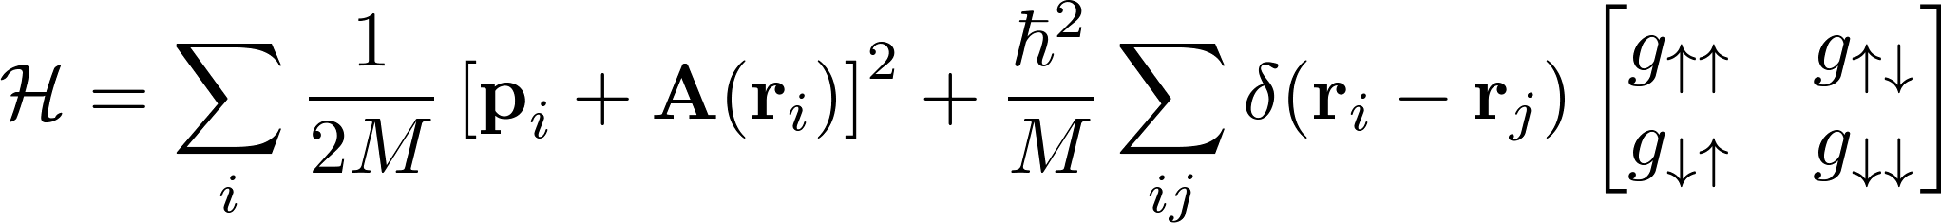


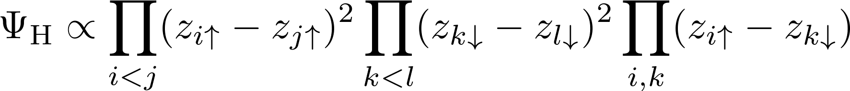
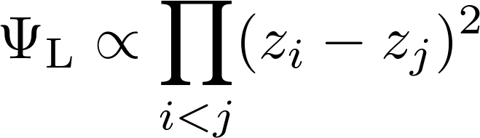




TWO-COMPONENT BOSONS
"Magnetic" field
"Spin-orbit coupling"
NASS SERIES
READ-REZAYI SERIES
(221) Halperin state:
Zero-energy state of two-body contact potential. Singlet,
Divide particles into k clusters and put each cluster into a Halperin state (and symmetrize)
→ Maximally k particles at the same position
→ Spin singlet zero-energy state of (k+1)-body contact potential,
→ For k>1: non-Abelian excitations
[Ardonne & Schoutens, PRL 82 5096 (1999)]
1/2-Laughlin state:
Zero-energy state of two-body contact potential. Spinless,
Divide particles into k clusters and put each cluster into a Laughlin state (and symmetrize)
→ Maximally k particles at the same position
→ Spinless zero-energy state of (k+1)-body contact potential,
→ For k>1: non-Abelian excitations
[Read & Rezayi, PRB 59 8084 (1999)]
Ultracold Atoms in
Artificial Gauge Fields
Tobias Grass @ ICFO 23.04.2013

Slide 50
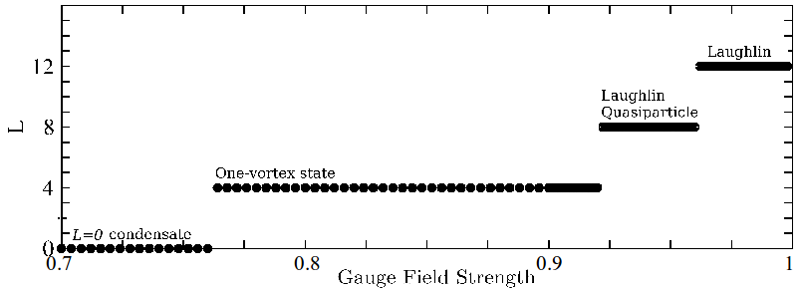

FQH SERIES
Quantum Hall phases in the spinless Bose gas:
Overlap with Moore-Read (Pfaffian) state: >0.95
Laughlin state, Moore-Read state, and (for larger N) even more phases from the Read-Rezayi series.
[N. Cooper et al., PRL 87 120405 (2001)]
Spinless state | Zero-energy eigenstate of
Laughlin state | 2-body contact interaction
Read-Rezayi series [Read & Rezayi, PRB 59 8084 (1999)] | k-body contact interaction
Ultracold Atoms in
Artificial Gauge Fields
Tobias Grass @ ICFO 23.04.2013

Slide 51

FQH SERIES
Quantum Hall phases in the spinless Bose gas:
Overlap with Moore-Read (Pfaffian) state: >0.95
Laughlin state, Moore-Read state, and (for larger N) even more phases from the Read-Rezayi series.
[N. Cooper et al., PRL 87 120405 (2001)]
Spinless state | Zero-energy eigenstate of | Pseudospin ½
Laughlin state | 2-body contact interaction | Halperin state
Read-Rezayi series [Read & Rezayi, PRB 59 8084 (1999)] | k-body contact interaction | Non-Abelian Spin Singlet (NASS) series [Ardonne & Schoutens, PRL 82 5096 (1999)]
Ultracold Atoms in
Artificial Gauge Fields
Tobias Grass @ ICFO 23.04.2013

Slide 52
FQH SERIES
Quantum Hall phases in the spinless Bose gas:
Overlap with Moore-Read (Pfaffian) state: >0.95
Laughlin state, Moore-Read state, and (for larger N) even more phases from the Read-Rezayi series.
[N. Cooper et al., PRL 87 120405 (2001)]
Spinless state | Zero-energy eigenstate of | Pseudospin ½
Laughlin state | 2-body contact interaction | Halperin state
Read-Rezayi series [Read & Rezayi, PRB 59 8084 (1999)] | k-body contact interaction | Non-Abelian Spin Singlet (NASS) series [Ardonne & Schoutens, PRL 82 5096 (1999)]
Topological states with non-Abelian anyons
Will NASS states show up if we allow for a pseudospin-½ degree of freedom?
Ultracold Atoms in
Artificial Gauge Fields
Tobias Grass @ ICFO 23.04.2013

Slide 53
FQH SERIES
Quantum Hall phases in the spinless Bose gas:
Overlap with Moore-Read (Pfaffian) state: >0.95
Laughlin state, Moore-Read state, and (for larger N) even more phases from the Read-Rezayi series.
[N. Cooper et al., PRL 87 120405 (2001)]
Spinless state | Zero-energy eigenstate of | Pseudospin ½
Laughlin state: v=1/2 | 2-body contact interaction | Halperin state: v=2/3
Read-Rezayi series: v=(k-1)/2 [Read & Rezayi, PRB 59 8084 (1999)] | k-body contact interaction | Non-Abelian Spin Singlet (NASS) series: v=2(k-1)/3 [Ardonne & Schoutens, PRL 82 5096 (1999)]
FROM NOW: Work on a torus (periodic boundaries)!
* Topological order is characterized by ground state degeneracies.
* Edge effects are removed.
* Translational symmetry → New quantum number: Pseudomomentum
* Angular momentum → Filling factor v
Ultracold Atoms in
Artificial Gauge Fields
Tobias Grass @ ICFO 23.04.2013

Slide 54
TWO-COMPONENT BOSONS
[T. Grass, B. Julia-Diaz, N. Barberan, M. Lewenstein,
PRA 86 021603(R) (2012), S. Furukawa & M. Ueda, ibid. 031604]
Ultracold Atoms in
Artificial Gauge Fields
Tobias Grass @ ICFO 23.04.2013

Slide 55
TWO-COMPONENT BOSONS
HUND RULE: BOSE FQH SYSTEMS FAVOR SINGLETS
Anticorrelation of opposite-spin pairs requires less angular momentum, cf. Halperin state
[T. Grass, B. Julia-Diaz, N. Barberan, M. Lewenstein,
PRA 86 021603(R) (2012), S. Furukawa & M. Ueda, ibid. 031604]
Ultracold Atoms in
Artificial Gauge Fields
Tobias Grass @ ICFO 23.04.2013

Slide 56


TWO-COMPONENT BOSONS
HUND RULE: BOSE FQH SYSTEMS FAVOR SINGLETS
Anticorrelation of opposite-spin pairs requires less angular momentum, cf. Halperin state
INCOMPRESSIBLE PHASES AT NASS FILLING
Incompressibility signaled by a (relatively) high energy cost for particle-hole pairs
[T. Grass, B. Julia-Diaz, N. Barberan, M. Lewenstein,
PRA 86 021603(R) (2012), S. Furukawa & M. Ueda, ibid. 031604]
Ultracold Atoms in
Artificial Gauge Fields
Tobias Grass @ ICFO 23.04.2013

Slide 57





NASS PHASES
Three-body contact interaction
Four-body contact interaction
Pseudomomentum
Pseudomomentum
Two-fold
degeneracy
Ten-fold
degeneracy
[T. Grass, B. Julia-Diaz, N. Barberan, M. Lewenstein,
PRA 86 021603(R) (2012), S. Furukawa & M. Ueda, ibid. 031604]
Ultracold Atoms in
Artificial Gauge Fields
Tobias Grass @ ICFO 23.04.2013

Slide 58

NASS PHASES
Three-body contact interaction
Four-body contact interaction
Overlap:
0.89 and 0.73
Pseudomomentum
Pseudomomentum
Two-fold
degeneracy
Split two-fold
degeneracy
Ten-fold
degeneracy
[T. Grass, B. Julia-Diaz, N. Barberan, M. Lewenstein,
PRA 86 021603(R) (2012), S. Furukawa & M. Ueda, ibid. 031604]
Ultracold Atoms in
Artificial Gauge Fields
Tobias Grass @ ICFO 23.04.2013

Slide 59

NASS PHASES
Three-body contact interaction
Four-body contact interaction
Overlap:
0.89 and 0.73
Overlap:
0.33 – 0.83
Pseudomomentum
Pseudomomentum
Two-fold
degeneracy
Split two-fold
degeneracy
Ten-fold
degeneracy
“Should-be” ground states and “should-be” excited states mix up.
[T. Grass, B. Julia-Diaz, N. Barberan, M. Lewenstein,
PRA 86 021603(R) (2012), S. Furukawa & M. Ueda, ibid. 031604]
Ultracold Atoms in
Artificial Gauge Fields
Tobias Grass @ ICFO 23.04.2013

Slide 60
NASS PHASES
Three-body contact interaction
Four-body contact interaction
Overlap:
0.89 and 0.73
Overlap:
0.33 – 0.83
YES WE CAN:
realize the v=4/3 NASS phase
with two-body contact
interaction!
NO WE CANNOT:
realize the v=2 NASS phase!
Pseudomomentum
Pseudomomentum
Two-fold
degeneracy
Split two-fold
degeneracy
Ten-fold
degeneracy
“Should-be” ground states and “should-be” excited states mix up.
[T. Grass, B. Julia-Diaz, N. Barberan, M. Lewenstein,
PRA 86 021603(R) (2012), S. Furukawa & M. Ueda, ibid. 031604]
Ultracold Atoms in
Artificial Gauge Fields
Tobias Grass @ ICFO 23.04.2013

Slide 61

RASHBA SPIN-ORBIT COUPLED SYSTEM
Modified Landau levels:
Degeneracy points in the spectrum
[M. Burrello & A. Trombettoni, PRL 105 125304 (2010)]
Spin-polarized Regions:
Read-Rezayi like states
[R. Palmer & J. Pachos, NJP 13 065002 (2011)
S. Komineas & N. Cooper, PRA 85 053623 (2012)]
Spin-orbit coupling strength
Ultracold Atoms in
Artificial Gauge Fields
Tobias Grass @ ICFO 23.04.2013

Slide 62


RASHBA SPIN-ORBIT COUPLED SYSTEM
Modified Landau levels:
Degeneracy points in the spectrum
[M. Burrello & A. Trombettoni, PRL 105 125304 (2010)]
Spin-polarized Regions:
Read-Rezayi like states
[R. Palmer & J. Pachos, NJP 13 065002 (2011)
S. Komineas & N. Cooper, PRA 85 053623 (2012)]
ED in LLL+ 1st excited LL:
Spin-orbit coupling strength
Ground state of two-body contact potential in 1st excited Landau level
Laughlin
Shifted
Laughlin
Spin-orbit coupling strength
[T. Grass, B. Julia-Diaz, M. Burrello, M. Lewenstein, to appear in J. Phys. B]
Ultracold Atoms in
Artificial Gauge Fields
Tobias Grass @ ICFO 23.04.2013

Slide 63







RASHBA SPIN-ORBIT COUPLED SYSTEM
Minimize single-particle and interaction energy: LLL+no interaction
Possible in the n=0 Landau level up to v=1/2 (Laughlin state)
Raising LLL zeros to higher levels:
Remains a zero for
critical filling:
critical filling:
Laughlin state!
At the degeneracy
point:
NOT critical, as
additional states
show up
[T. Grass, B. Julia-Diaz, M. Burrello, M. Lewenstein arXiv 1210.8035]
Ultracold Atoms in
Artificial Gauge Fields
Tobias Grass @ ICFO 23.04.2013

Slide 64

YES
Ultracold?
Do we still study nature?
Artificial?
Clean and controllable quantum many-body system
Manipulated to test/study any concepts of physics
Quantized Hall conductance (in 2D electron gas)
Superfluidity (e.g. of cold bosons in optical lattices)
Macroscopic
Behavior
Microscopic
Order
Willett et al., PRL 59, 1776 (1987)
Greiner et al., Nature 415, 39 (2002)
Phases with the same symmetry, but
different topological order
Spontaneous Symmetry breaking:
Quantum Phase Transition
Ultracold Atoms in
Artificial Gauge Fields
Tobias Grass @ ICFO 23.04.2013

Slide 65
YES
Ultracold?
Do we still study nature?
Artificial?
Clean and controllable quantum many-body system
Manipulated to test/study any concepts of physics
Quantized Hall conductance (in 2D electron gas)
Condesates with spin-orbit coupling: MI-SF transition
at finite momenta
Macroscopic
Behavior
Microscopic
Order
Order by disorder in
Rashba coupled BEC
Willett et al., PRL 59, 1776 (1987)
Phases with the same symmetry, but
different topological order
Ultracold Atoms in
Artificial Gauge Fields
Tobias Grass @ ICFO 23.04.2013

Slide 66
YES
Ultracold?
Do we still study nature?
Artificial?
Clean and controllable quantum many-body system
Manipulated to test/study im-portant concepts of physics
Quantum Hall transitions
in Bose gases
Condensates with spin-orbit coupling: MI-SF transition at finite momenta
Microscopic
Order
in Many-Body
Systems
Order by disorder in
Rashba coupled BEC
Detection of topological order
Ultracold Atoms in
Artificial Gauge Fields
Tobias Grass @ ICFO 23.04.2013

Slide 67
SUMMARY I: BOSE-CONDENSED SYSTEMS
Bosons in optical lattices with
non-Abelian gauge fields:
Re-entrant superfluidity
Mott transition at finite momenta
Phase transition in excited bands
[T. Grass, K. Saha, K. Sengupta, M. Lewenstein, PRA 84 053632 (2011)]
Rashba-coupled Bose-Einstein condensates:
Degeneracy on the mean-field level
Bogoliubov excitations
Order by disorder through cooling
[R. Barnett, S. Powell, T. Grass, M. Lewenstein, and S. Das Sarma, PRA 85 023615 (2012)]
Ultracold Atoms in
Artificial Gauge Fields
Tobias Grass @ ICFO 23.04.2013

Slide 68
SUMMARY II: FQH SYSTEMS
One-component Bose gases
Quantum Hall states in geometric gauge field
Deformation by laser dressing
[B. Juliá-Díaz, D. Dagnino, K. J. Günter, T. Grass, N. Barberán,
M. Lewenstein, J. Dalibard, PRA 84 053605 (2011)]
Anyons in (deformed) Laughlin state
[B. Juliá-Díaz, T. Grass, N. Barberán, M. Lewenstein, New J Phys 14, 055003 (2012)]
Detection of phases by hole dynamics
[T. Grass, B. Juliá-Díaz, M. Lewenstein, PRA 86 053629 (2012)]
Two-component Bose gases
NASS phase
[T. Grass, B. Juliá-Díaz, N. Barberan, M. Lewenstein, PRA 86 021603(R) (2012)]
Spin-Orbit Coupling: Higher LL physics
[T. Grass, B. Juliá-Díaz, M. Burrello, M. Lewenstein, to appear in J. Phys. B]
Not discussed:
FQHE with dipolar Fermi gases: [T. Grass, M. A. Baranov, M. Lewenstein, PRA 84 043605 (2011)]
Mathematica code: [B. Juliá-Díaz, T. Grass, Comp. Phys. Comm. 183 737 (2012)]
Ultracold Atoms in
Artificial Gauge Fields
Tobias Grass @ ICFO 23.04.2013

Slide 69

Collaborators:
Instituut-Lorentz
Michele Burrello
JQI:
Ryan Barnett
Stephen Powell
Sankar Das Sarma
ENS:
Jean Dalibard
Kenneth Guenter
IQOQI:
Mikhail Baranov
ICFO & UB:
Bruno Julia-Diaz
Maciej Lewenstein
Nuria Barberan
Daniel Dagnino
Indian Association the Cultivation of Science:
Krishnendu Sengupta
Kush Saha
THANK YOU!
Ultracold Atoms in
Artificial Gauge Fields
Tobias Grass @ ICFO 23.04.2013

