Slide 1
Coursera Capstone Project:
Applied Data Science

Slide 2
Overview
Business Problem
Data
Data Preparation
Machine Learning (Unsupervised Clustering)
Result

Slide 3
Business Problem
Finding a good place for an open air restaurant:
A good place to place a open air restaurant (german Biergarten) might be a location with high throughput of people locals as well as tourists and might be marked as a place with several parks in urban area and som other outdoor takeaway stuff like cafes or icecream shops etc. An other option could be also that there are several metro stations nearby.

Slide 4
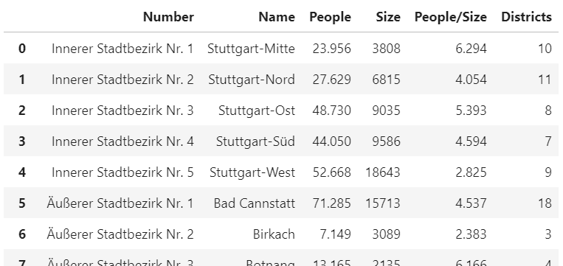
Data
Districts of Stuttgart (Wikipedia)

Slide 5
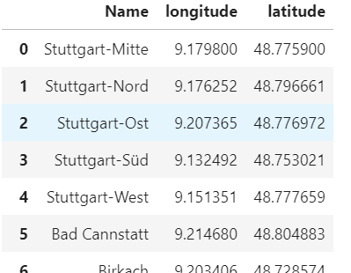
Data
Geocoding API

Slide 6
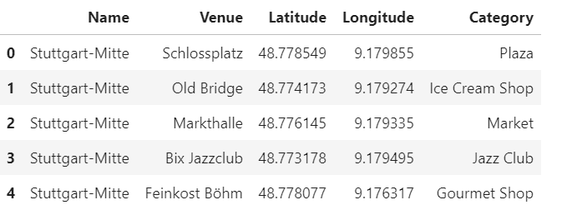
Data
Foursquare Venues API

Slide 7
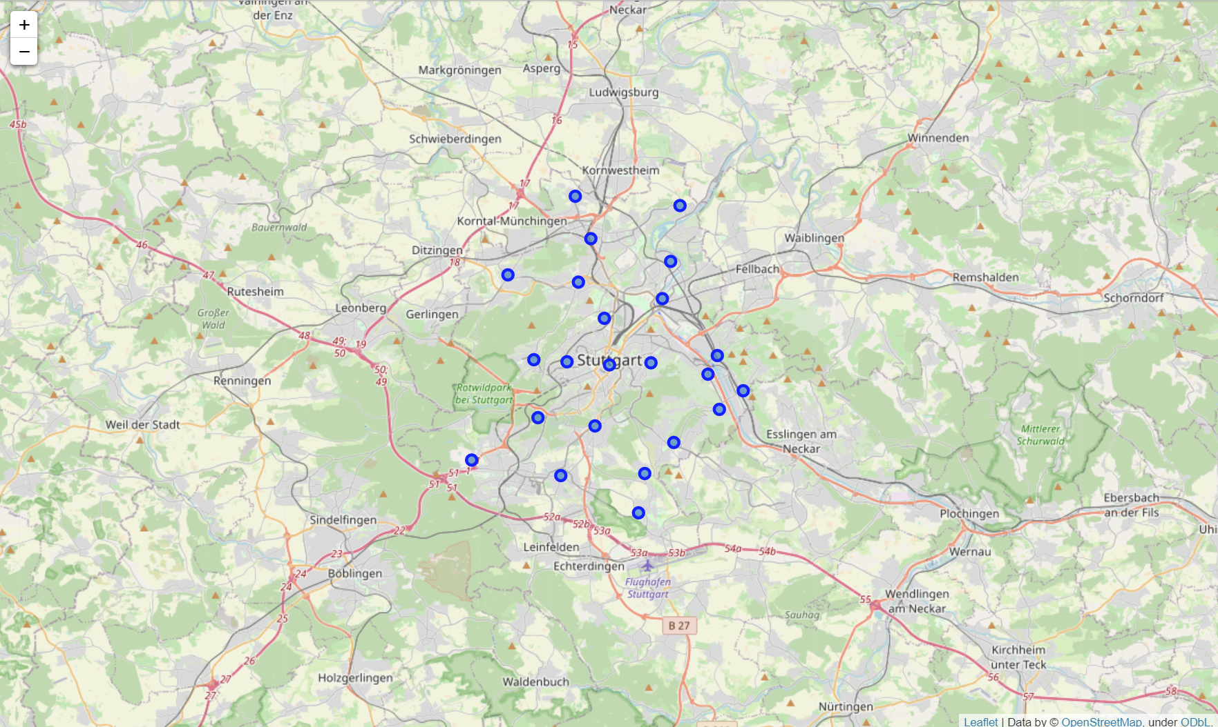
Data Preparation
Visualization Stuttgart Districts

Slide 8
Data Preparation Steps Venues
One Hot Encoding
  To support machine learning algorithms there is a column created per category and the data is marked with one if venue is assigned to that category
Top 10 most common venues
  Grouping the one hot encoded dataframe by district and then calculating the frequency of the venue category per district after that the most common venues per district can be extracted

Slide 9
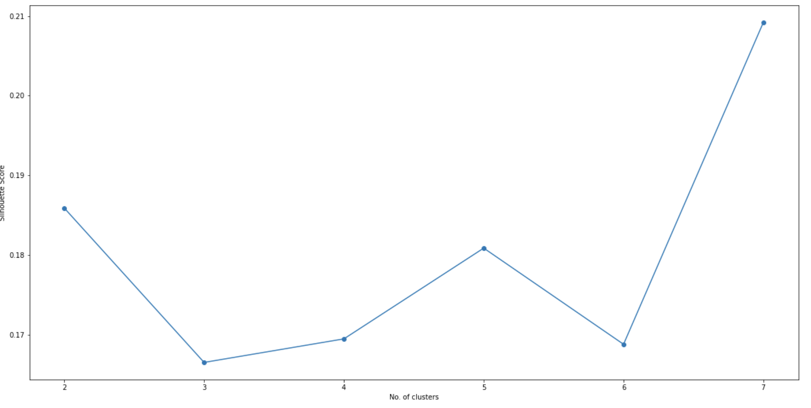
Data Preparation Steps Machine Learning
Ideal Number of Clusters
  To get the the ideal number of clusters the „Silhoutte Score“ was chosen. It calculats the cohesion inside the same cluster and separation to other clusters.

Slide 10
Clustering
K-Means Clustering
  Fast computation
  Huge number of categories
  Labeling output data with the computed K-Means Labels

Slide 11
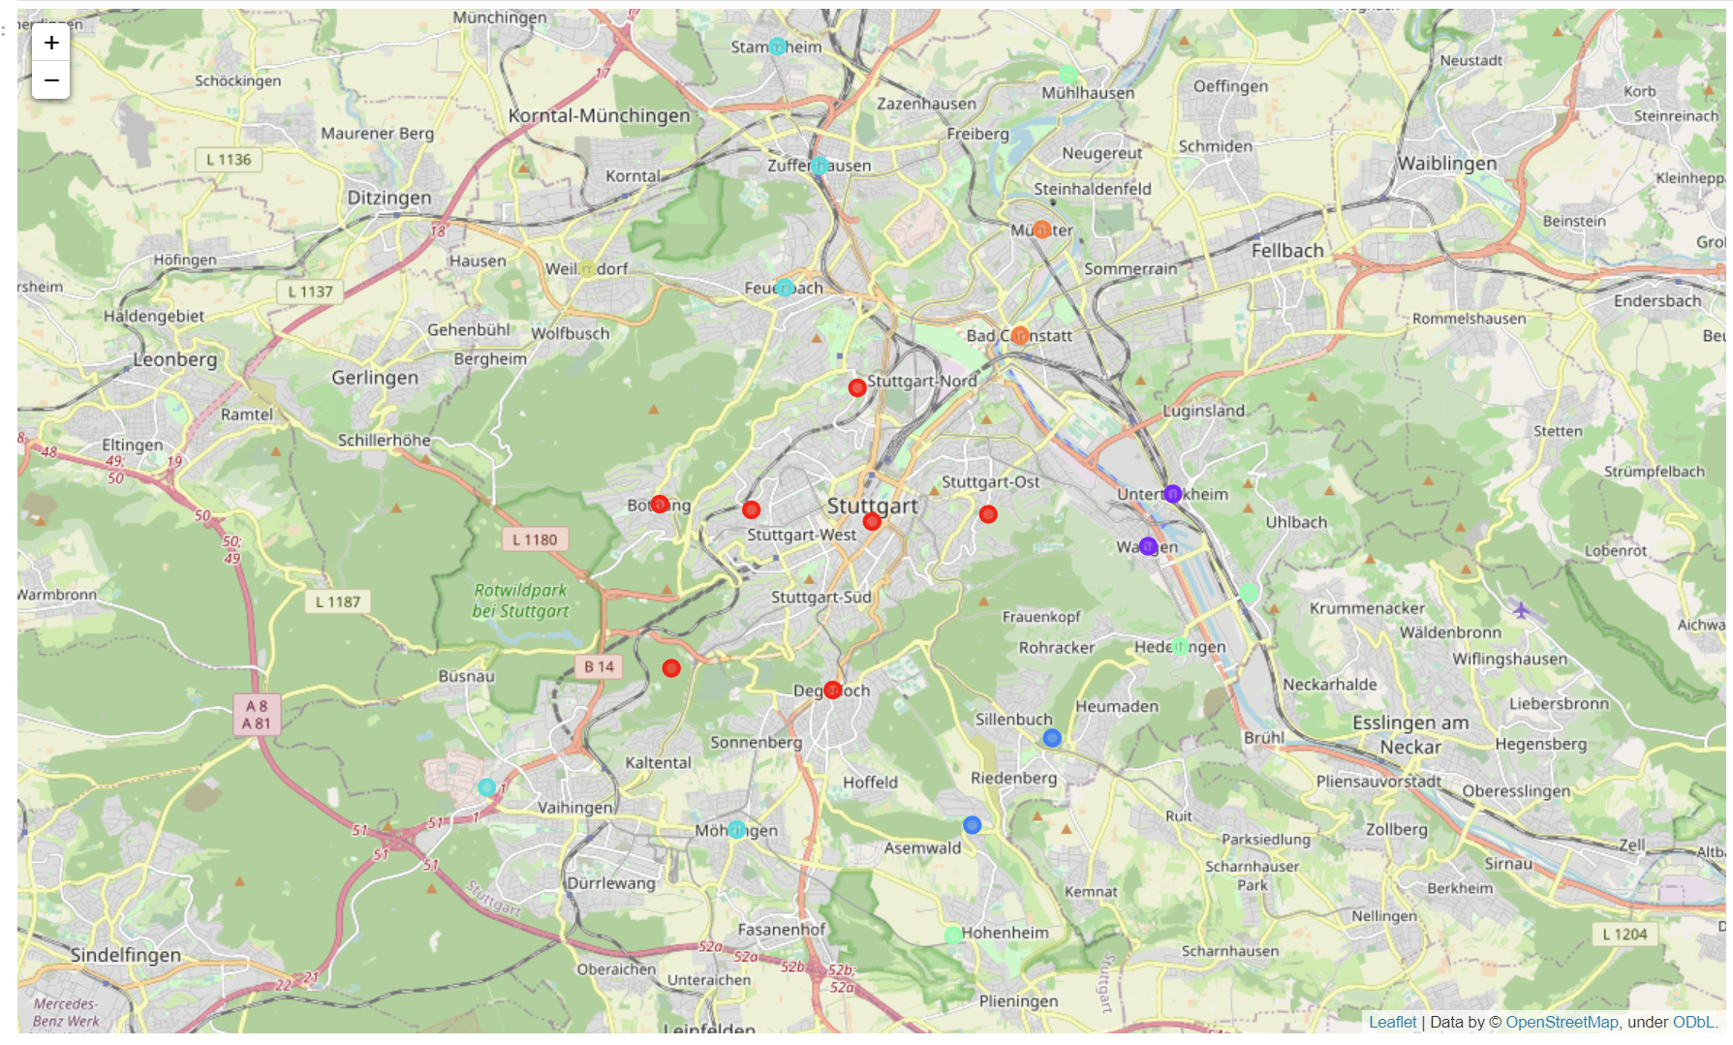
Visualization of Clusters

Slide 12
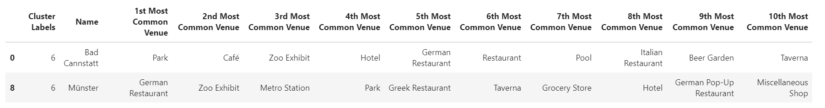
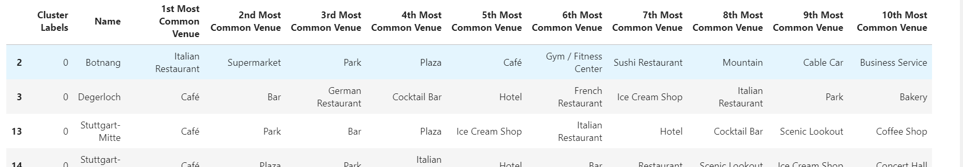
Discussion
Relevant Clusters
  Families (Cluster 7)
  Tourists (Cluster 1)

Slide 13
Discussion
As shown in the previous slide it depends on the focus group if my focus group would be tourists and business people on their way home I would chose the City Center (Cluster 1)
The other option if my focus group are the locals and families which bring a more consistent revenue stream but are on the other side more price sensitive I would look for alocation near one of the zoos.

