Slide 1
CsCu2I3 fiber v2
M. Danang Birowosuto

Slide 2
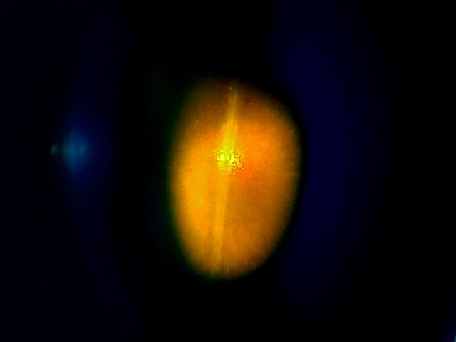
Microscopes, photoluminescence, and decay (excitation = 266 nm (0.5 MHz))
Under microscope
Little bit smaller bandgap
And Stokes shift.

Slide 3
Photoluminescence at different temperatures
Please compare the results with
Bladeeren et al., Chem Mater. 2023 Nov 28; 35(22): 9623–9631

Slide 4
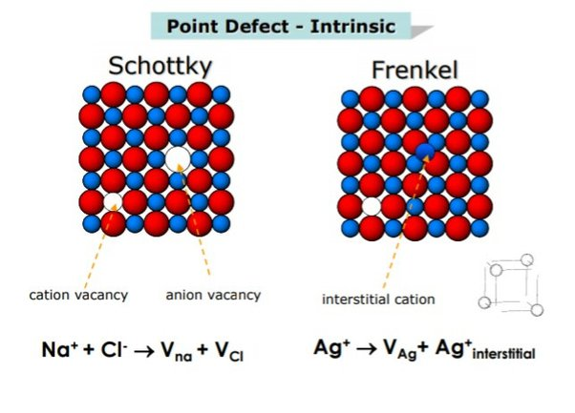
Decay times as function of temperatures
T | 1st (ns, %) | 2nd (ns, %) | 3rd (ns, %)
100 | - | 207.1 (2%) | 1018.7 (98%)
150 | 3.9 ns (1%) | 57.5 ns (5%) | 913.1 ns (94%)
200 | 3.6 ns (1%) | 56.4 (15%) | 887.7 ns (84%)
250 | 3.3 ns (2%) | 54.4 ns (43%) | 667.7 ns (55%)
300 | 2.9 ns (5%) | 44.0 ns (57%) | 154.4 ns (38%)
350 | 1.7 ns (7%) | 25.2 ns (52%) | 82.1 (41%)
Please compare the results with
Bladeeren et al., Chem Mater. 2023 Nov 28; 35(22): 9623–9631

