Slide 1
ACu₂X₃ (A = Cs, Rb, organics; X = I, Br)
Pre-project meeting 16/11/2023

Slide 2
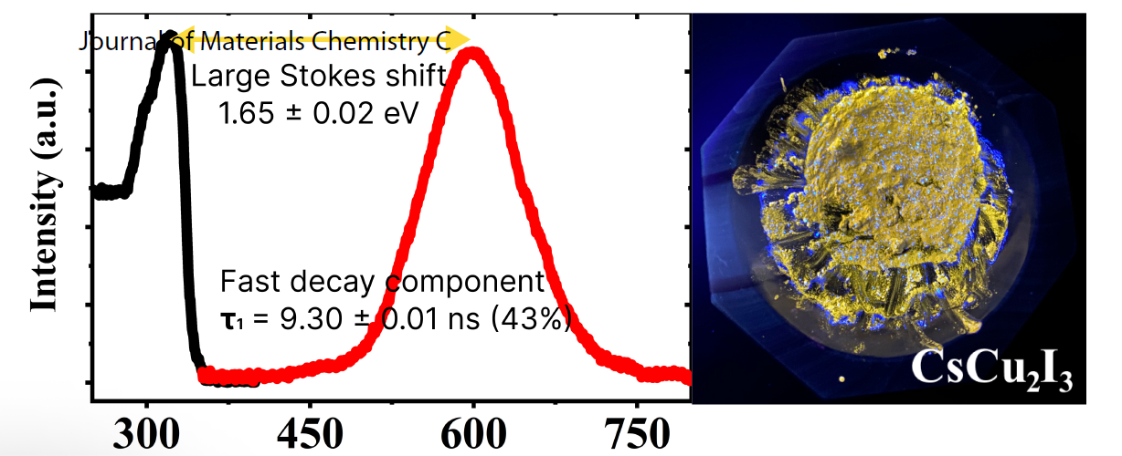
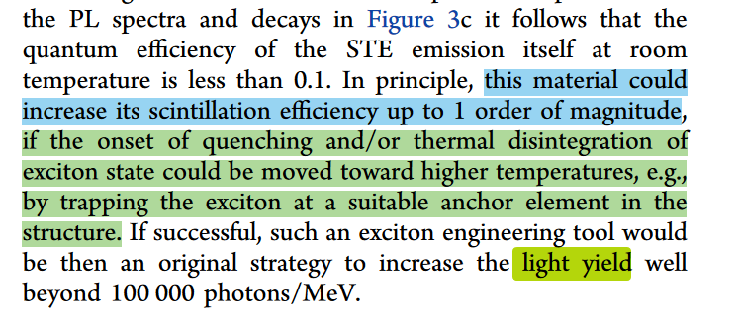
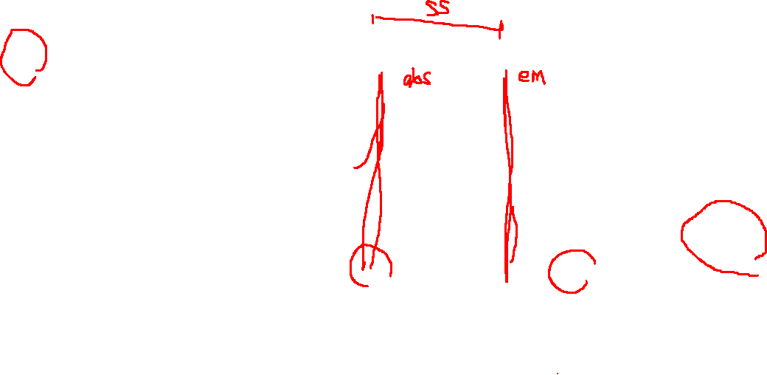
1D ACu₂X₃ mechanochemically-synthesised powder
Large Stokes shift, fast-nanosecond PL/RL decay
Relatively low LY and QY
Tested methods to increase LY:
Doping of Tl
Incorporation of K and/or Rb for A-site
Cheng et al., ACS Appl. Mater. Interfaces 2021, 13, 12198−12202

Slide 3
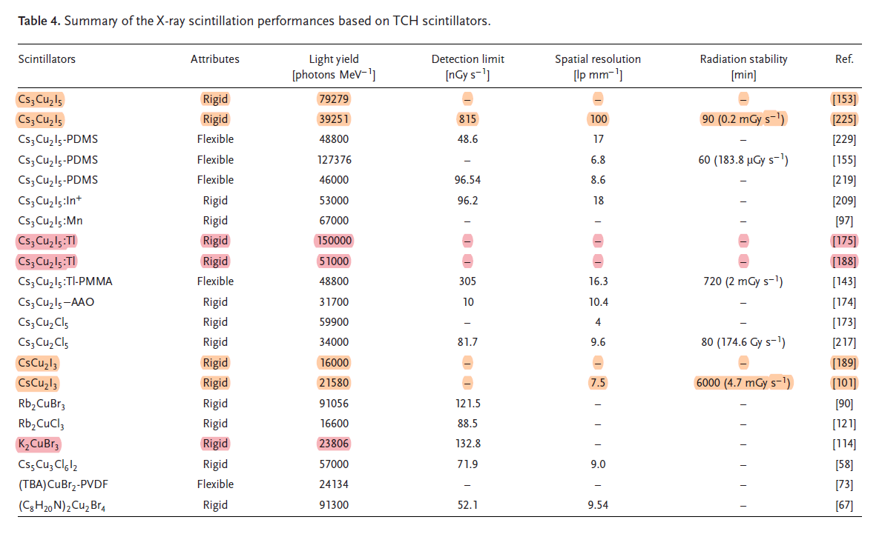

Rb →
⁸⁷Rb is radioactive
Limited gamma-ray application
(Yang et al., Adv. Mater. 2019; Zhao et al., J. Phys. Chem. Mater. 2020)
Ma, Z.; Ji, X.; Lin, S.; Chen, X.; Wu, D.; Li, X.; Zhang, Y.; Shan, C.; Shi, Z.; Fang, X.
Recent Advances and Opportunities of Eco‐Friendly Ternary Copper Halides: A New Superstar in Optoelectronic Applications.
Adv. Mater. 2023, 2300731. https://doi.org/10.1002/adma.202300731.

Slide 4


ACu₂X₃
Precursors
Possibilities
CsI
CsBr
CuI
CuBr (being shipped)
RbBr (being shipped)
KI (CSL-owned)
KBr (CSL-owned)
TlI (being shipped)
PEAI
MABr
BAI
FABr
CsCu₂X₃
ACsCu₂X₃
ACu₂X₃
RbCu₂X₃
ARbCu₂X₃
(A = Cs, Rb, organics; X = I, Br)

Slide 5

https://www.rsc.org/journals-books-databases/about-journals/rsc-mechanochemistry/ Gold open access at no APC until 2026

