Slide 1
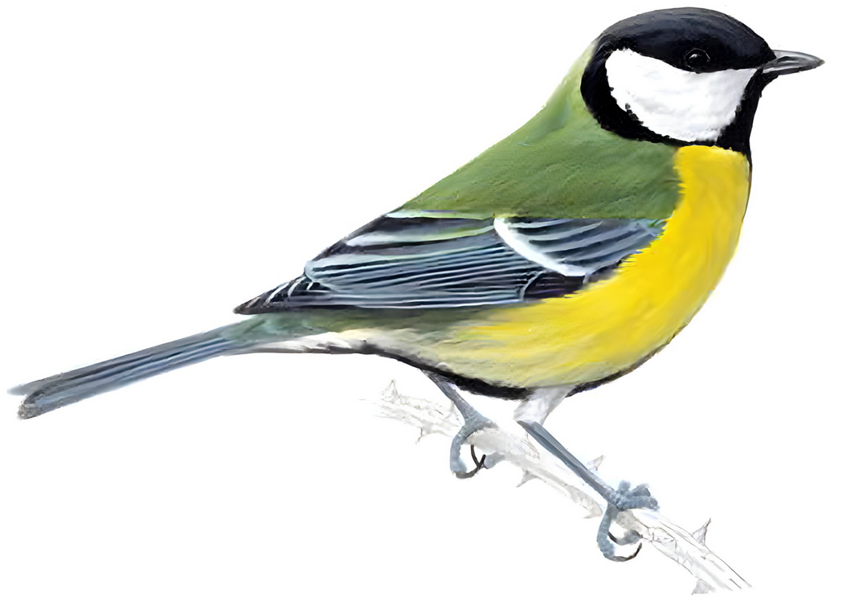
Anthropogenic effects on bird song in great tits
Photo from RSPB website
By: bïrb (song)
[Tobias, Jude, Alfie, Chloe, Daniel, Evelyn and Lore]

Slide 2
Importance (background)
ID leaflet?
[the importance of birds to the UK ecosystems]
[potential impacts of birds when interacting with humans / past events or extinctions?]
[something about globalisation and trying to understand it’s effects on wildlife]

Slide 3
Our hypothesis and past science we are building on (Introduction)
A model species
Wytham Tit Project
Resident / territorial / cope well with monitering
Defining urban vs rural
Our hypothesis: The constant low frequency urban noise causes pitch of song in great tits to increase accordingly
Studies we are building on:

Slide 4
Methods 1 - setup
Integrate map. Maybe make the table one of areas of highest density, it would be hard, but fun and fucking metal
Choosing a location:
Ebird API map
Major cities / forests
Random sampling
Repeats
Buying equipment:
Trail cams, speakers and sound recorders

Slide 5
Methods 2 – experimental design
1 main experiment with two control groups
Speakers and recorders in woods
City observations
Forest observations
Manipulative and observational
Repeats [how many?]
Multiple sites across UK
Over 70 calls: tee-cher…tee-cher…?
Recording of the call we wanna hear

Slide 6
Methods 3 – Statistical Analysis
Using R to construct tables and graphs from the data
The output of the recorders is a “spectrogram”
Taking the average of each group and measuring highest – lowest, not just peak
[something?]
Smol spectrogram

Slide 7
limitations
No catch and release means we cannot weigh birds (Jarman. 2020).
Hard to estimate the distance a call is heard from [physics: wavelength decays and spreads out over distance, also have to account for blue / red shifting of sound if bird is moving]

Slide 8
Results
Examples of these
Tables of the raw data
Boxplot with ANOVA[?]
Look at papers for plots tailored to this kind of work, shouldn’t be hard

Slide 9
Conclusion
Should our hypothesis be found correct, it implies that these birds can learn and change, others cannot so may be at risk from cities
{?}

Slide 10
references
Jarman, S. (2020) ‘Pitch of birdsong is determined by body size’, Physics World, 33(5), p. 6. Available at: https://doi.org/10.1088/2058-7058/33/5/9.

