Slide 1
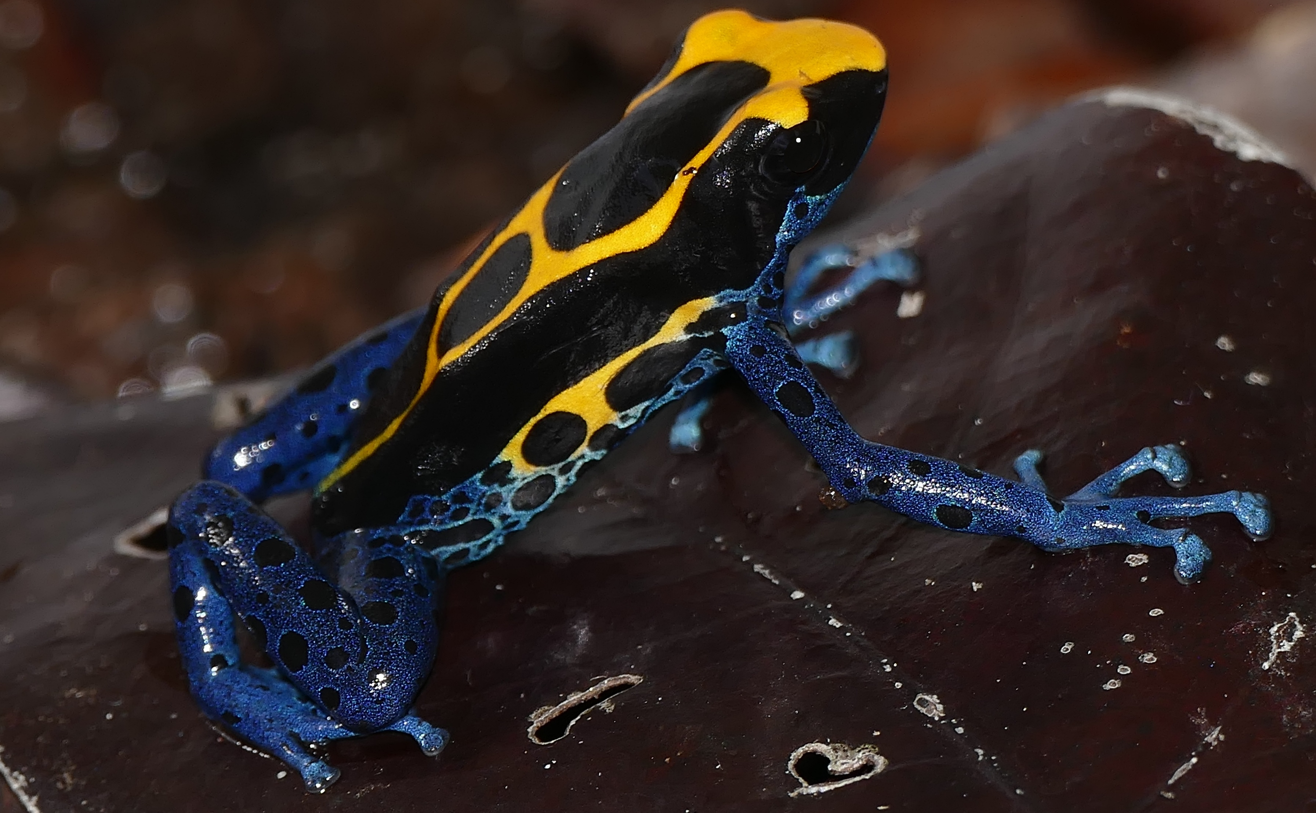
Project help file
The file you go to when you are stuck that explains what things are, what they do and how they relate
By Bernard DUPONT from FRANCE - Dyeing Poison Frog (Dendrobates tinctorius), CC BY-SA 2.0, https://commons.wikimedia.org/w/index.php?curid=65305644

Slide 2
What things are/do - table
File name | File type | Brief description
Notebook_.Rmd | R Markdown files | There are multiple of these files, but they all do the same thing, they give accounts of what I have done(1 and 2 are general, 3 and 4 are for the big heatmap-generating analyses and there is one for the literature reading)
KEGG_pipeline___.R | R scripts | How I go from the .xlsx files output from eggnog to the heatmaps, I split it into 3 stages for efficiency and simplicity (titled: enrich, aggregate and heatmap)
NCBI___collector.R | R scripts | Two files, they both call the NCBI REST API to get different things off of the NCBI website, one gathers the fasta files to be ran through eggnog-mapper, the other gets the JSON files for metadata that can be added to heatmaps and phylogenetic trees.

Slide 3
output
Script
folder
process
NCBI website
API call
Local Machine / R studio
SCW hawk
NCBImetadatacollector.R
NCBIfastacollector.R
Slurmsquared.sh
GTDB-TK
Fasta_files
Eggnog V2.1.12
Eggnogslurmrunner.sh
02…/ncbi_stuff/json
02…/ncbi_stuff/fasta
eggnog_annotations
02…/eggnog_stuff/eggnog_outputs
KEGG_pipeline_pt1_enrich
KEGG_pipeline_pt2_aggregate
KEGG_pipeline_pt3_heatmap
heatmaps

Slide 4



Prototype - flowchart
key
NCBI
Frog
samples
Fly
samples
Sources
KEGG
Script
folder
Source files
process
Middle-pipeline files
output
End-pipeline files
outputs

Slide 5
Complex common things
API call – non-computer experts won’t know what this means, and that is ok. An API call is basically running commands on a database from a code file. In R I do this with the package httr2(look it up). I pass in a URL with the command I want to use, (i.e. pull file down*).
KEGG pathways and map IDs – [explain]
* Exact command I used is seen in Notebook.R, as is a link to the NCBI REST API to see the full list of things that can be done

Slide 6
How they relate
output
Script
folder
process
NCBI website
Heatmap pipeline
API call
Local Machine / R studio
SCW hawk
NCBImetadatacollector.R
NCBIfastacollector.R
Slurmsquared.sh
GTDB-TK
Fasta_files
Eggnog V2.1.12
Eggnogslurmrunner.sh
02…/ncbi_stuff/json
02…/ncbi_stuff/fasta
eggnog_annotations
02…/eggnog_stuff/eggnog_outputs
KEGG_pipeline_pt1_enrich
KEGG_pipeline_pt2_aggregate
KEGG_pipeline_pt3_heatmap
heatmaps

