Slide 1
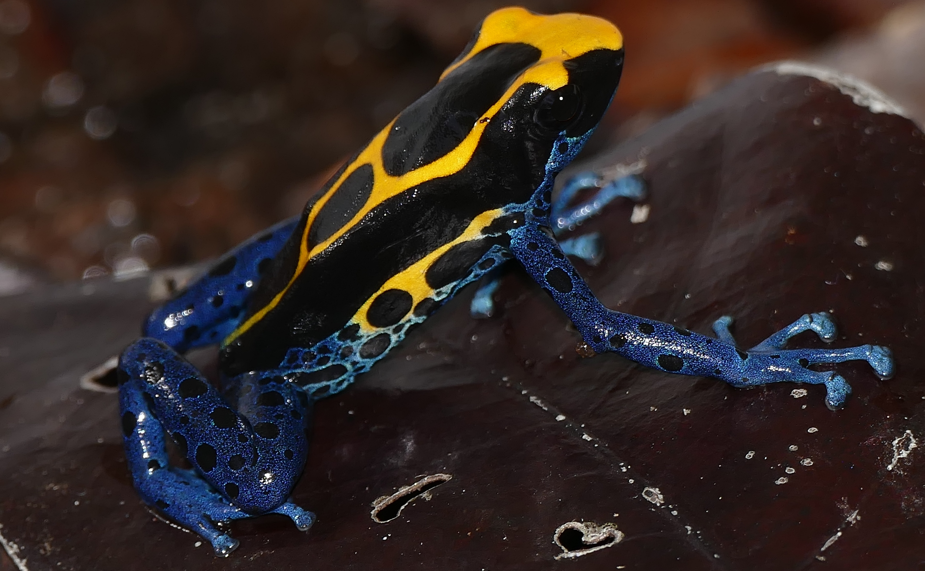
Project help file
The file you go to when you are stuck that explains what things are, what they do and how they relate
By Bernard DUPONT from FRANCE - Dyeing Poison Frog (Dendrobates tinctorius), CC BY-SA 2.0, https://commons.wikimedia.org/w/index.php?curid=65305644

Slide 2
What things are/do - table
File name | File type | Brief description

Slide 3
How they relate
Flow chart of files in a path, with the heading like “Heatmap pipeline”

Slide 4
Complex common things
API call – non-computer experts won’t know what this means, and that is ok. An API call is basically running commands on a database from a code file. In R I do this with the package httr2(look it up). I pass in a URL with the command I want to use, (i.e. pull file down*).
KEGG pathways and map IDs – [explain]
* Exact command I used is seen in Notebook.R, as is a link to the NCBI REST API to see the full list of things that can be done

