Slide 1
Bakery sales predictions
Karolina and Tobias Saegner
09 01 2025
Kiel

Slide 2
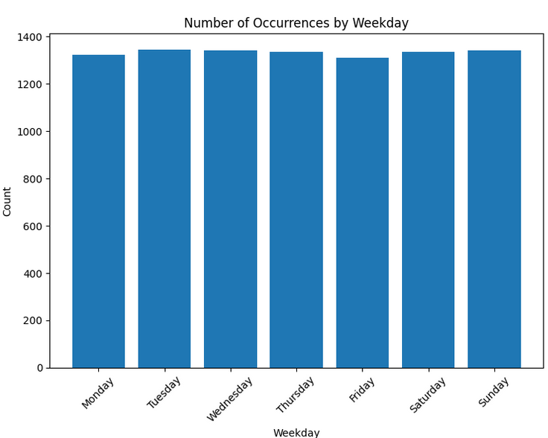
Derived variables
Day of the week (Monday – Sunday)
Day_0 … Day_7; type – Boolean

Slide 3
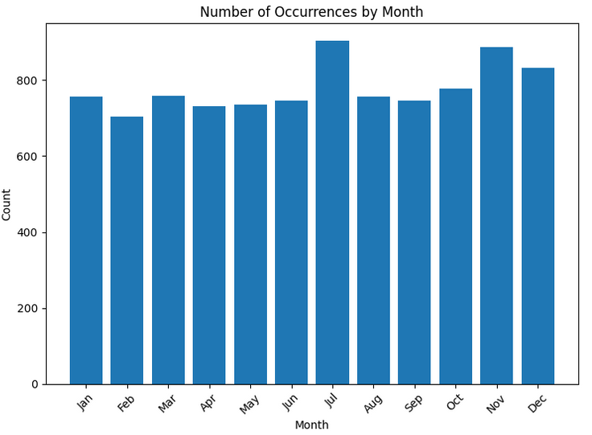
Derived variables
Month (January – December)
Month_1 … Month_12; type – Boolean

Slide 4
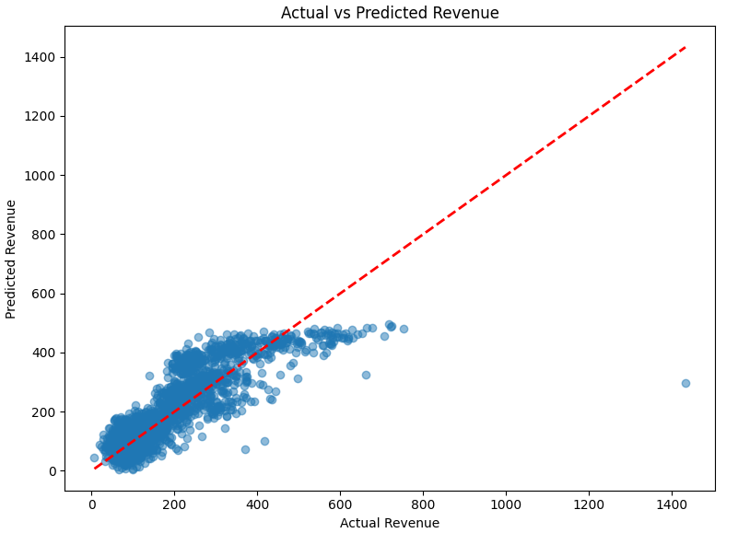
Optimierung des linearen Modells: Modellgleichung und adjusted r²
Umsatz = 191.44 + 27.53*Temperatur - 0.85*Bewoelkung + 1.10*Windgeschwindigkeit + 0.12*Wettercode + 2.41*KielerWoche + 19.36*DayOfWeek + 1.18*Month - 70.76*Warengruppe_1 + 218.50*Warengruppe_2 - 27.95*Warengruppe_3 - 103.67*Warengruppe_4 + 88.80*Warengruppe_5 - 104.93*Warengruppe_6
Adjusted R²: 0.69

Slide 5
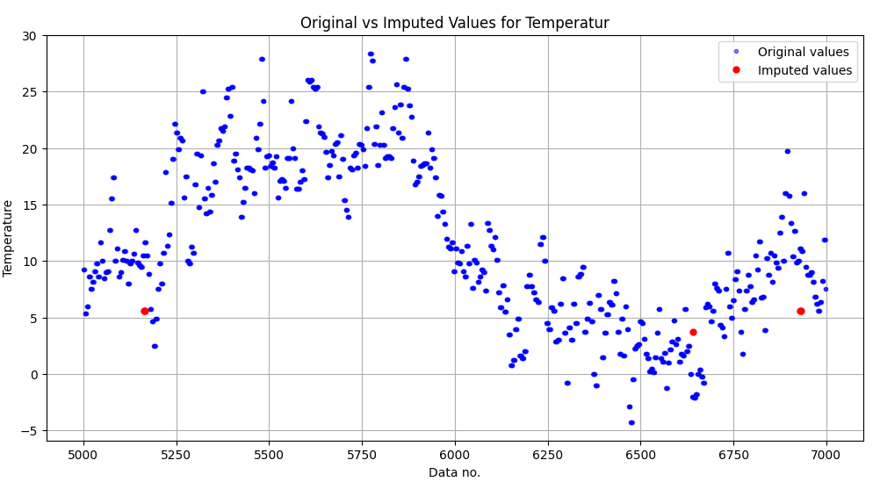
Art der Missing Value Imputation - KNN
# Replace NaNs using KNN Imputer
numerical_cols = ['Temperatur', 'Windgeschwindigkeit', 'Bewoelkung', 'Wettercode', 'IsWeekend']
knn_imputer = KNNImputer(n_neighbors=5)
data[numerical_cols] = knn_imputer.fit_transform(data[numerical_cols])

Slide 6
Optimierung des neuronalen Netzes
Source Code zur Definition des neuronalen Netzes:
model = tf.keras.Sequential([
# Long Short-Term Memory (LSTM) layer w/ 128 units and a ReLU activation function
LSTM(128, activation='relu', input_shape=(1, X_train_seq.shape[2])),
# Dropout layer
Dropout(0.3),
# Final output: predicted sales value
Dense(1)
])
Notes:
LSTM(128, activation='relu', input_shape=(1, X_train_seq.shape[2])): This defines the first layer, which is a Long Short-Term Memory (LSTM) layer with 128 units and a ReLU activation function. The input shape is set to (1, X_train_seq.shape[2]), which means the model expects a sequence of length 1 with the same number of features as the training data.
Dropout(0.3): This adds a dropout layer with a dropout rate of 0.3 to the model, which helps prevent overfitting.
Dense(1): The final dense layer with a single output unit, which represents the predicted sales value.

Slide 7
Optimierung des neuronalen Netzes
Darstellung der Loss-Funktionen für Trainings- und Validierungsdatensatz
# loss function: mean squared error
model.compile(optimizer='adam', loss='mse', metrics=['mean_absolute_percentage_error’])
# patience=20 monitors the validation loss and stops the training if the validation loss does not improve for 20 epochs monitors the validation loss and stops the training if the validation loss does not improve for 20 epochs callbacks = [
EarlyStopping(monitor='val_loss', patience=20, restore_best_weights=True),
ModelCheckpoint('best_model.keras', monitor='val_loss', save_best_only=True)]
history = model.fit(
X_train_seq, y_train_seq,
epochs=150,
batch_size=32,
validation_data=(X_val_seq, y_val_seq),
callbacks=callbacks,
verbose=1)
Notes:
The model is compiled with the following settings:
optimizer='adam': The Adam optimization algorithm is used to update the model's weights during training.
loss='mse': The mean squared error (MSE) loss function is used to measure the difference between the predicted and actual sales values.
metrics=['mean_absolute_percentage_error']: (MAPE) metric is used to evaluate the model's performance during training and validation.
The callbacks list includes two important callbacks:
EarlyStopping(monitor='val_loss', patience=20, restore_best_weights=True): This callback monitors the validation loss and stops the training if the validation loss does not improve for 20 epochs. It also restores the weights of the best-performing model.
ModelCheckpoint('best_model.keras', monitor='val_loss', save_best_only=True): This callback saves the best-performing model (based on the validation loss) to the file 'best_model.keras'.
The model.fit() function is called to train the model. It takes the following arguments:
X_train_seq and y_train_seq: The training input and target data.
epochs=150: The number of training epochs.
batch_size=32: The batch size used during training.
validation_data=(X_val_seq, y_val_seq): The validation input and target data.

Slide 8
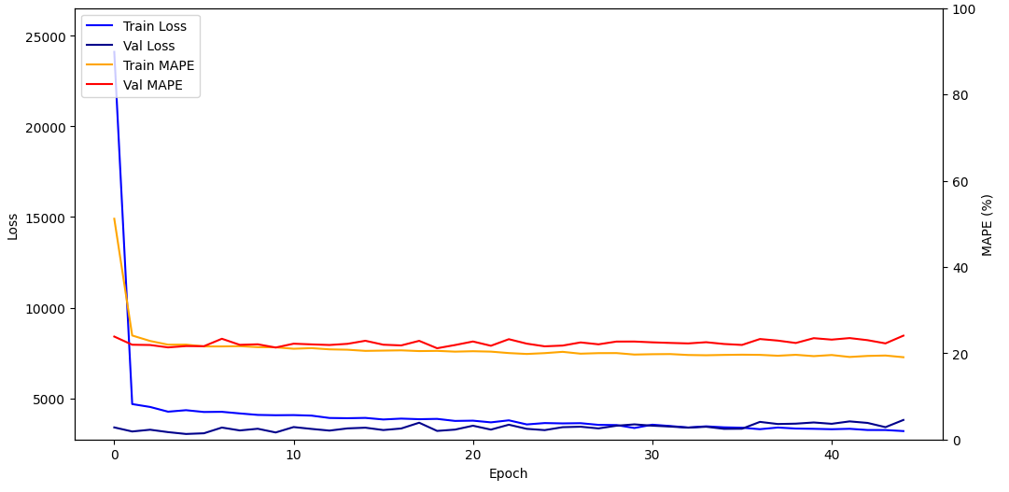
Optimierung des neuronalen Netzes
Validation dataset MAPE = 21.65%

Slide 9
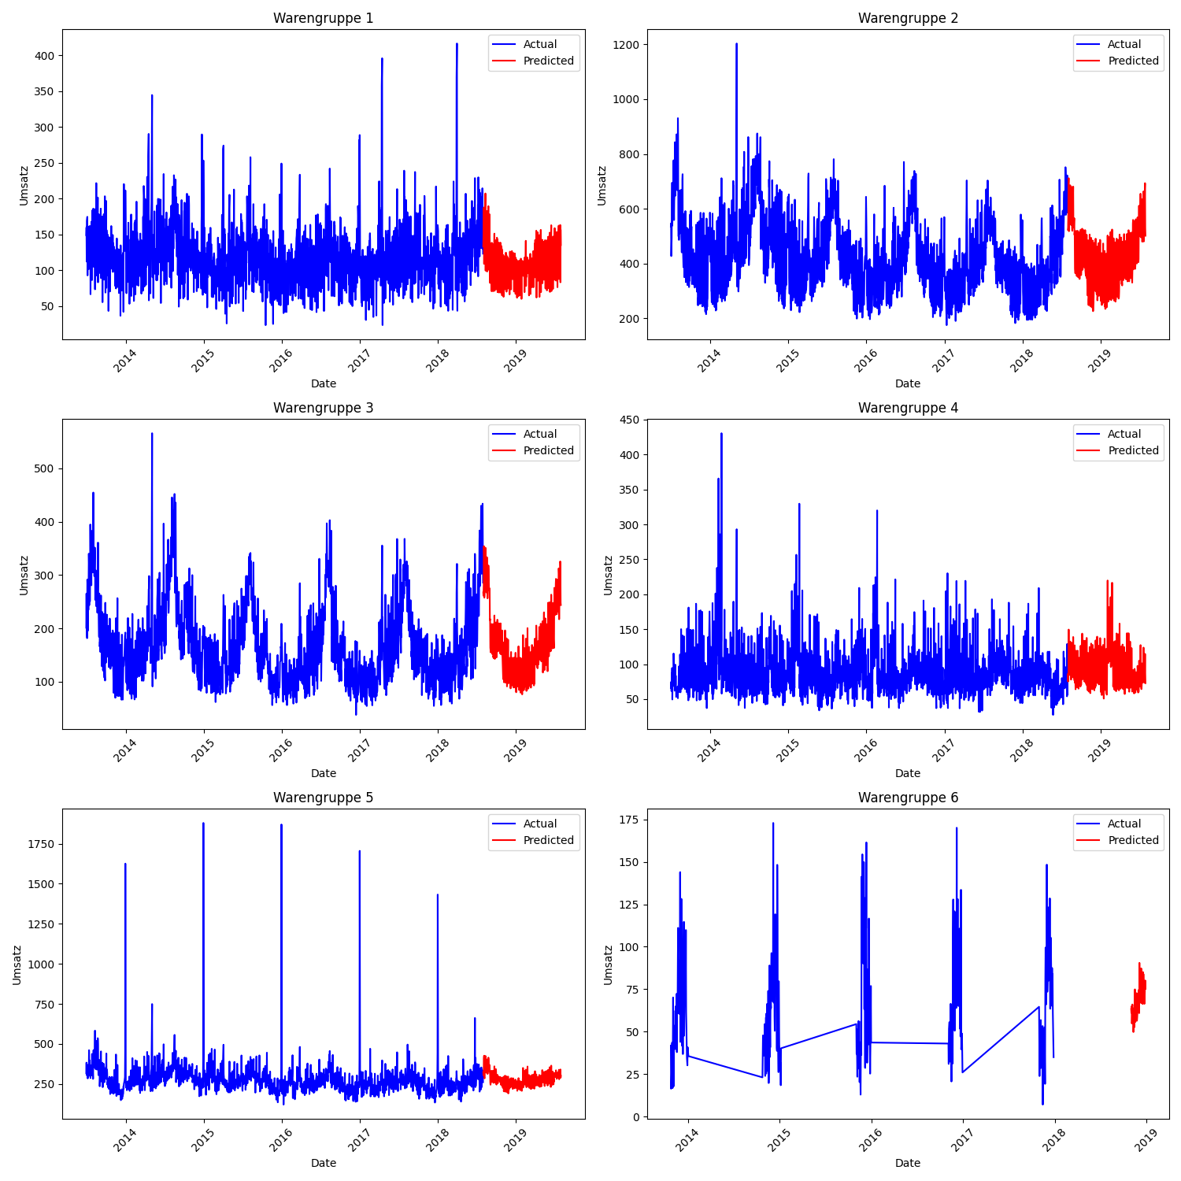
Warengruppen MAPEs
20.9%
18.6%
19.4%
25.4%
17.2%
50.1%

Slide 10
Worst Fail / Best Improvement
Worst fail: insufficient data inspection/visualization
“Hey Steffen, kann es sein, dass da Daten fehlen?”
Warengruppe 6 (MAPE 50%)
Best improvement:
learning rate scheduler:
def lr_schedule(epoch, lr):
initial_lr = 0.01 # Start with this learning rate
decay_rate = 0.1 # Decay rate
decay_steps = 10 # Epochs after which to decay
return initial_lr * np.exp(-decay_rate * (epoch / decay_steps))

