Slide 1
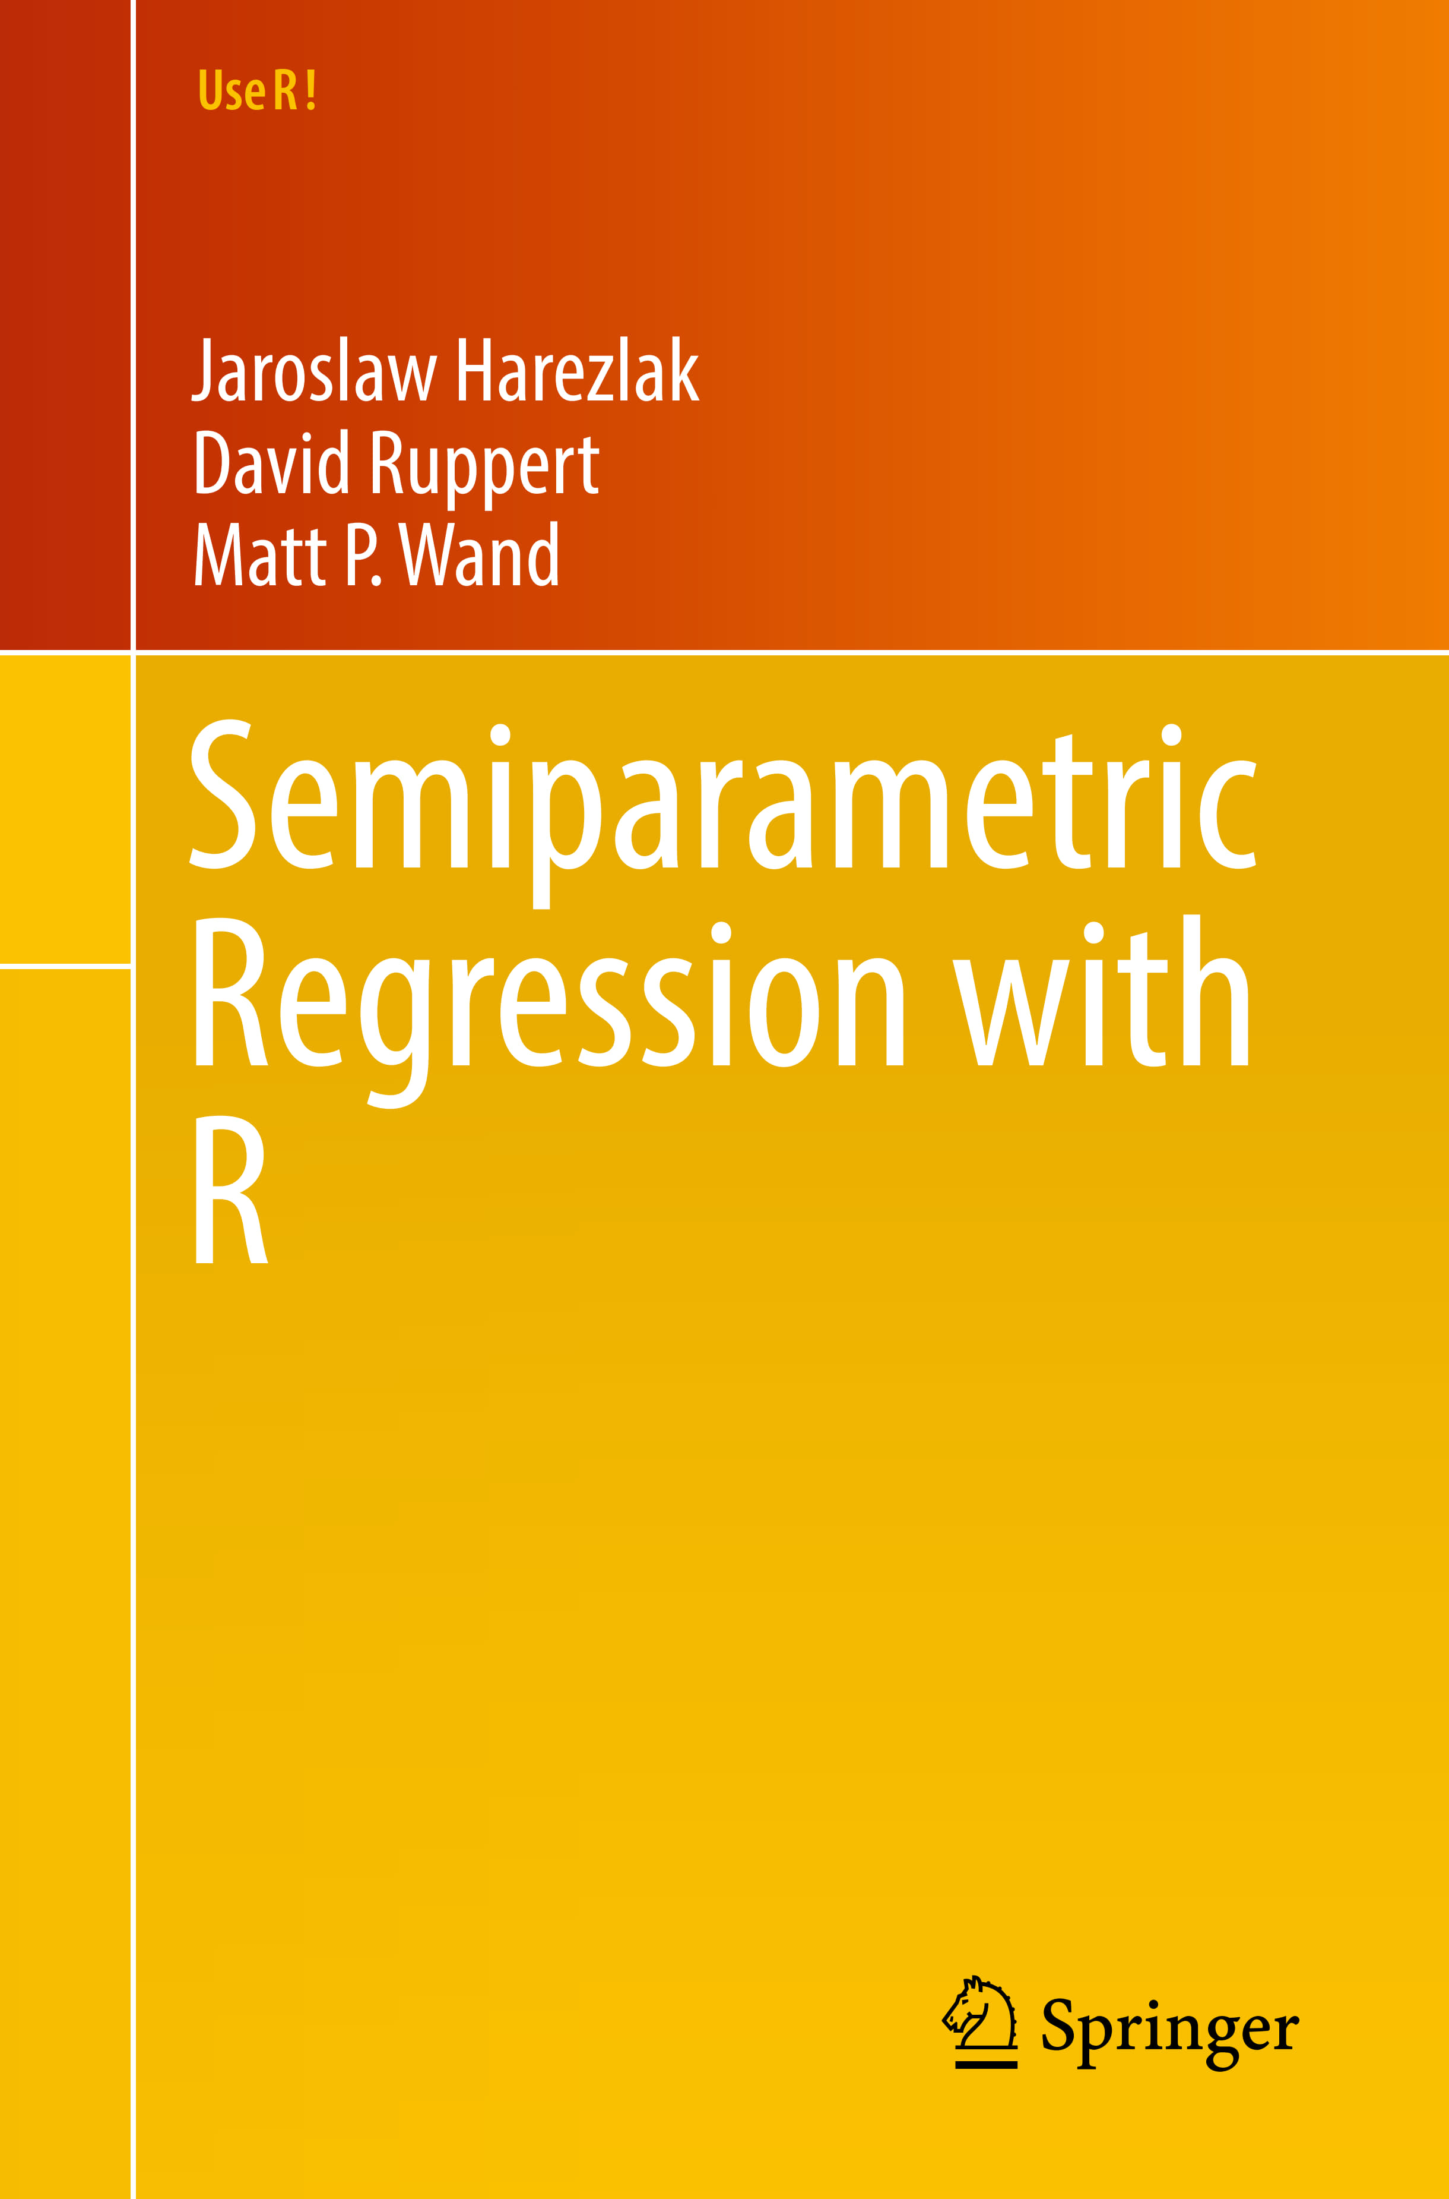

Slide 2
Use R!
Beat Hulliger
Tobias Schoch
Robust Survey
Methods in R

