Slide 1
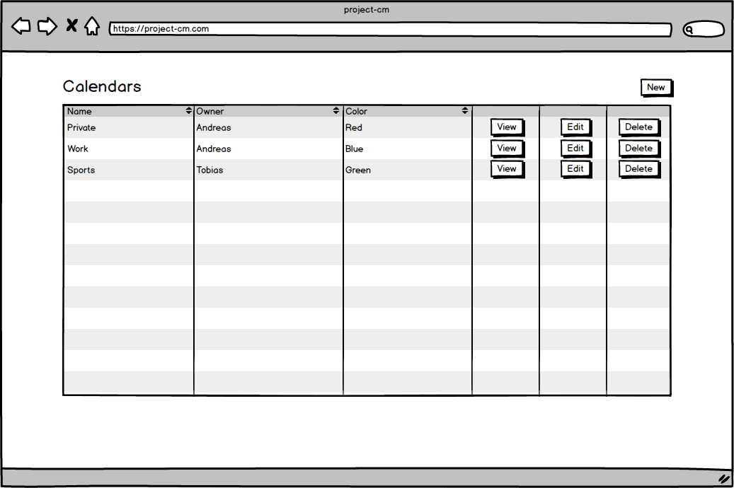

Slide 2
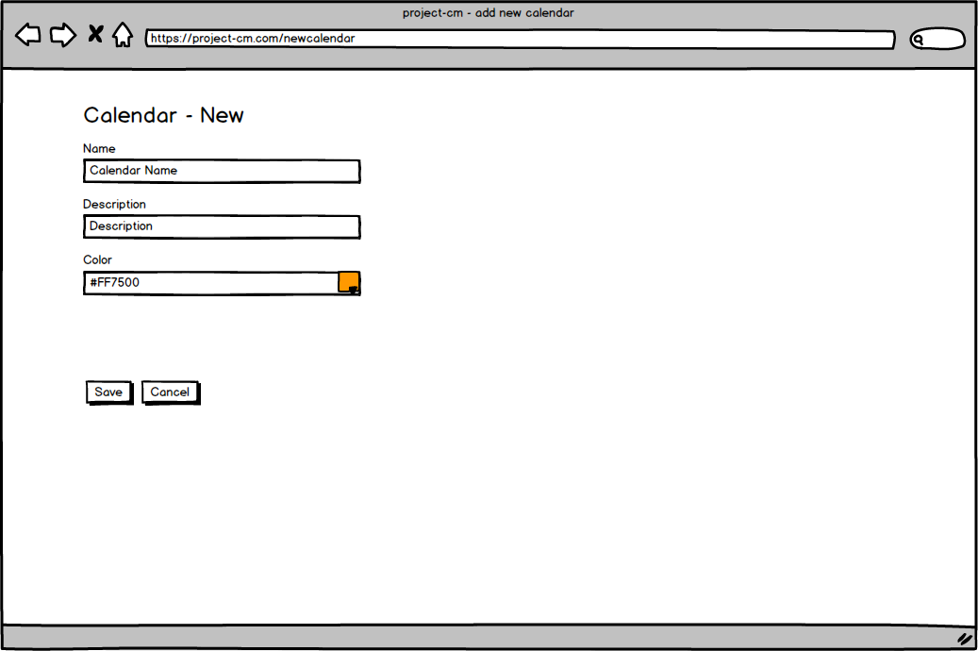

Slide 3
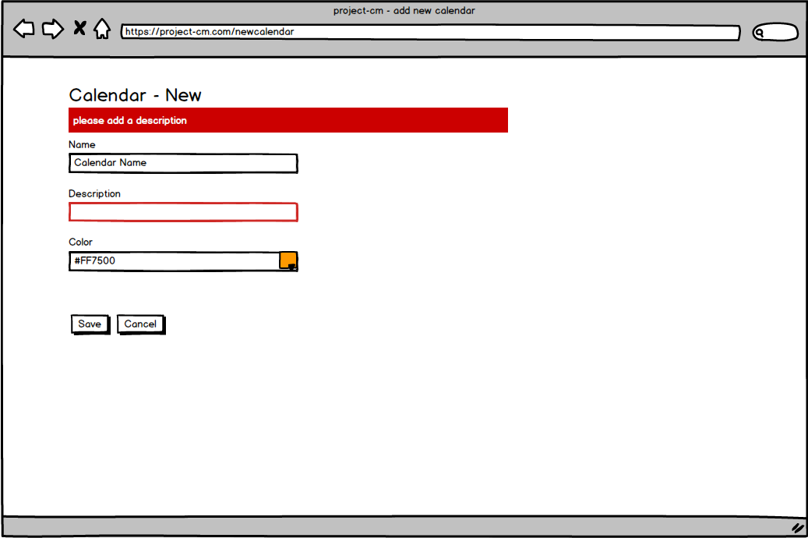

Slide 4
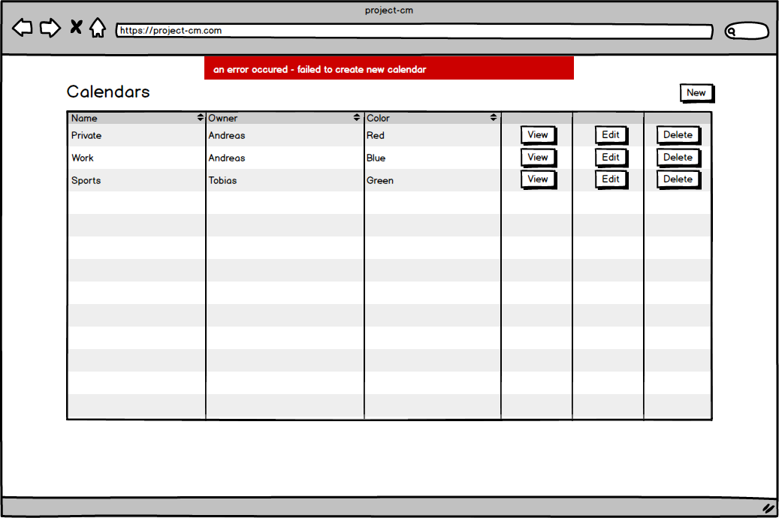

Slide 5
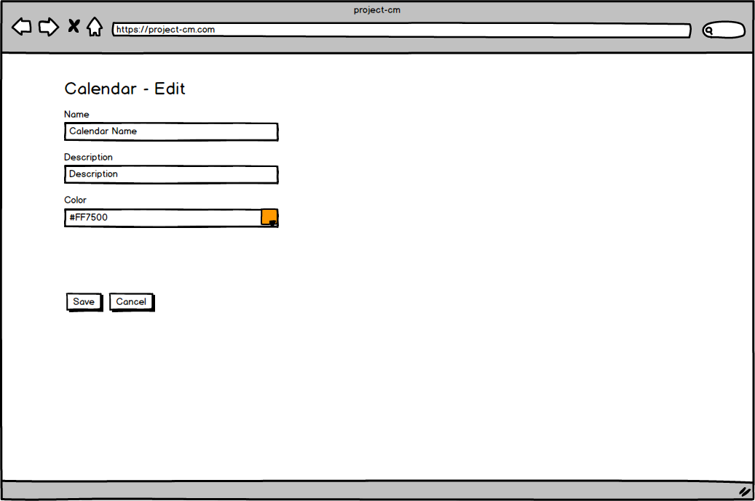

Slide 6


Slide 7
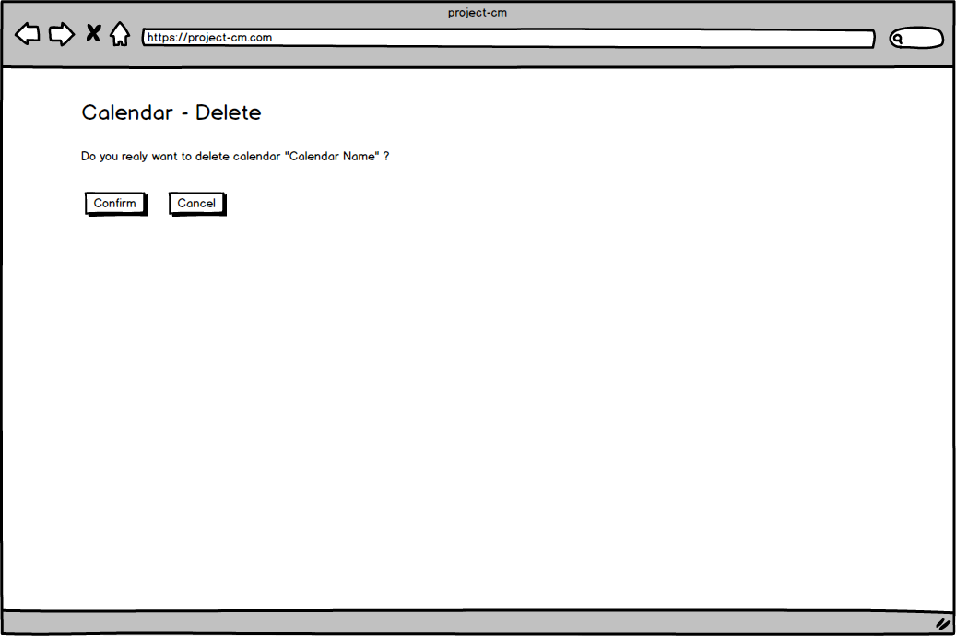

Slide 8
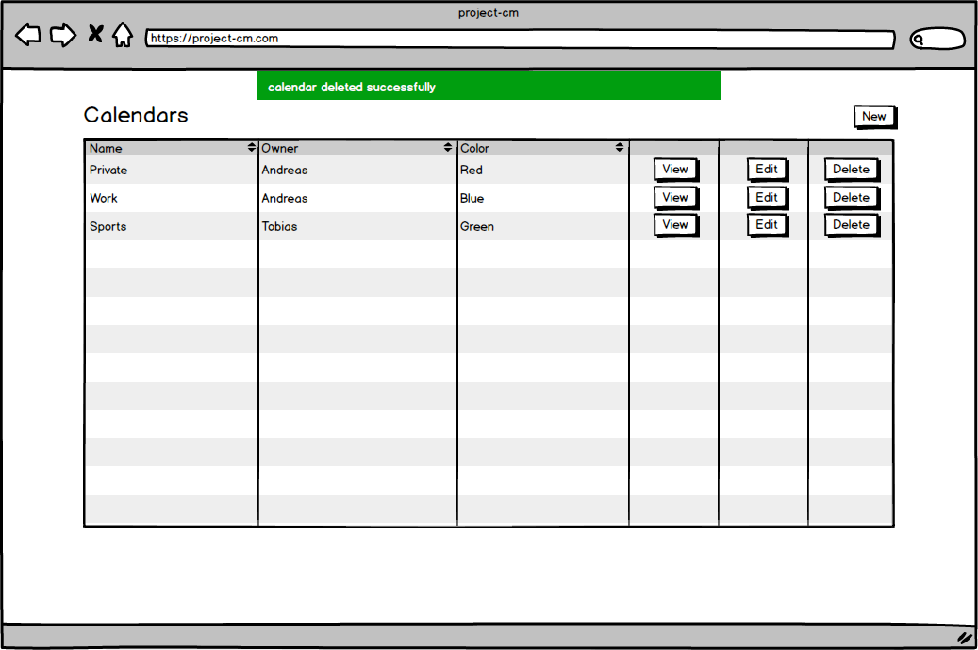

Slide 9
Feature: manage calendars
As an user
I want to manage calendars
So that I can create and manage my calendars
Scenario: create calendar
Given I am logged in
And I am on the "calendar list"
And I clicked "create calendar"
When I type in the correct calendar data
And I click "create"
Then I should see a confirmation message
Scenario: delete calendar
Given I am logged in
And I am on the "calendar list"
And I clicked "delete calendar"
When I confirm the deletion
Then I should see a confirmation message

