Slide 1
Applied Modeling of Hydrological Systems in Central Asia
Dr. Tobias Siegfried, hydrosolutions GmbH, 2021

Slide 2
Key Catchment-Scale Hydrological Processes
Tuesday, May 04, 2021

Slide 3
Catchment Water Balance

Slide 4
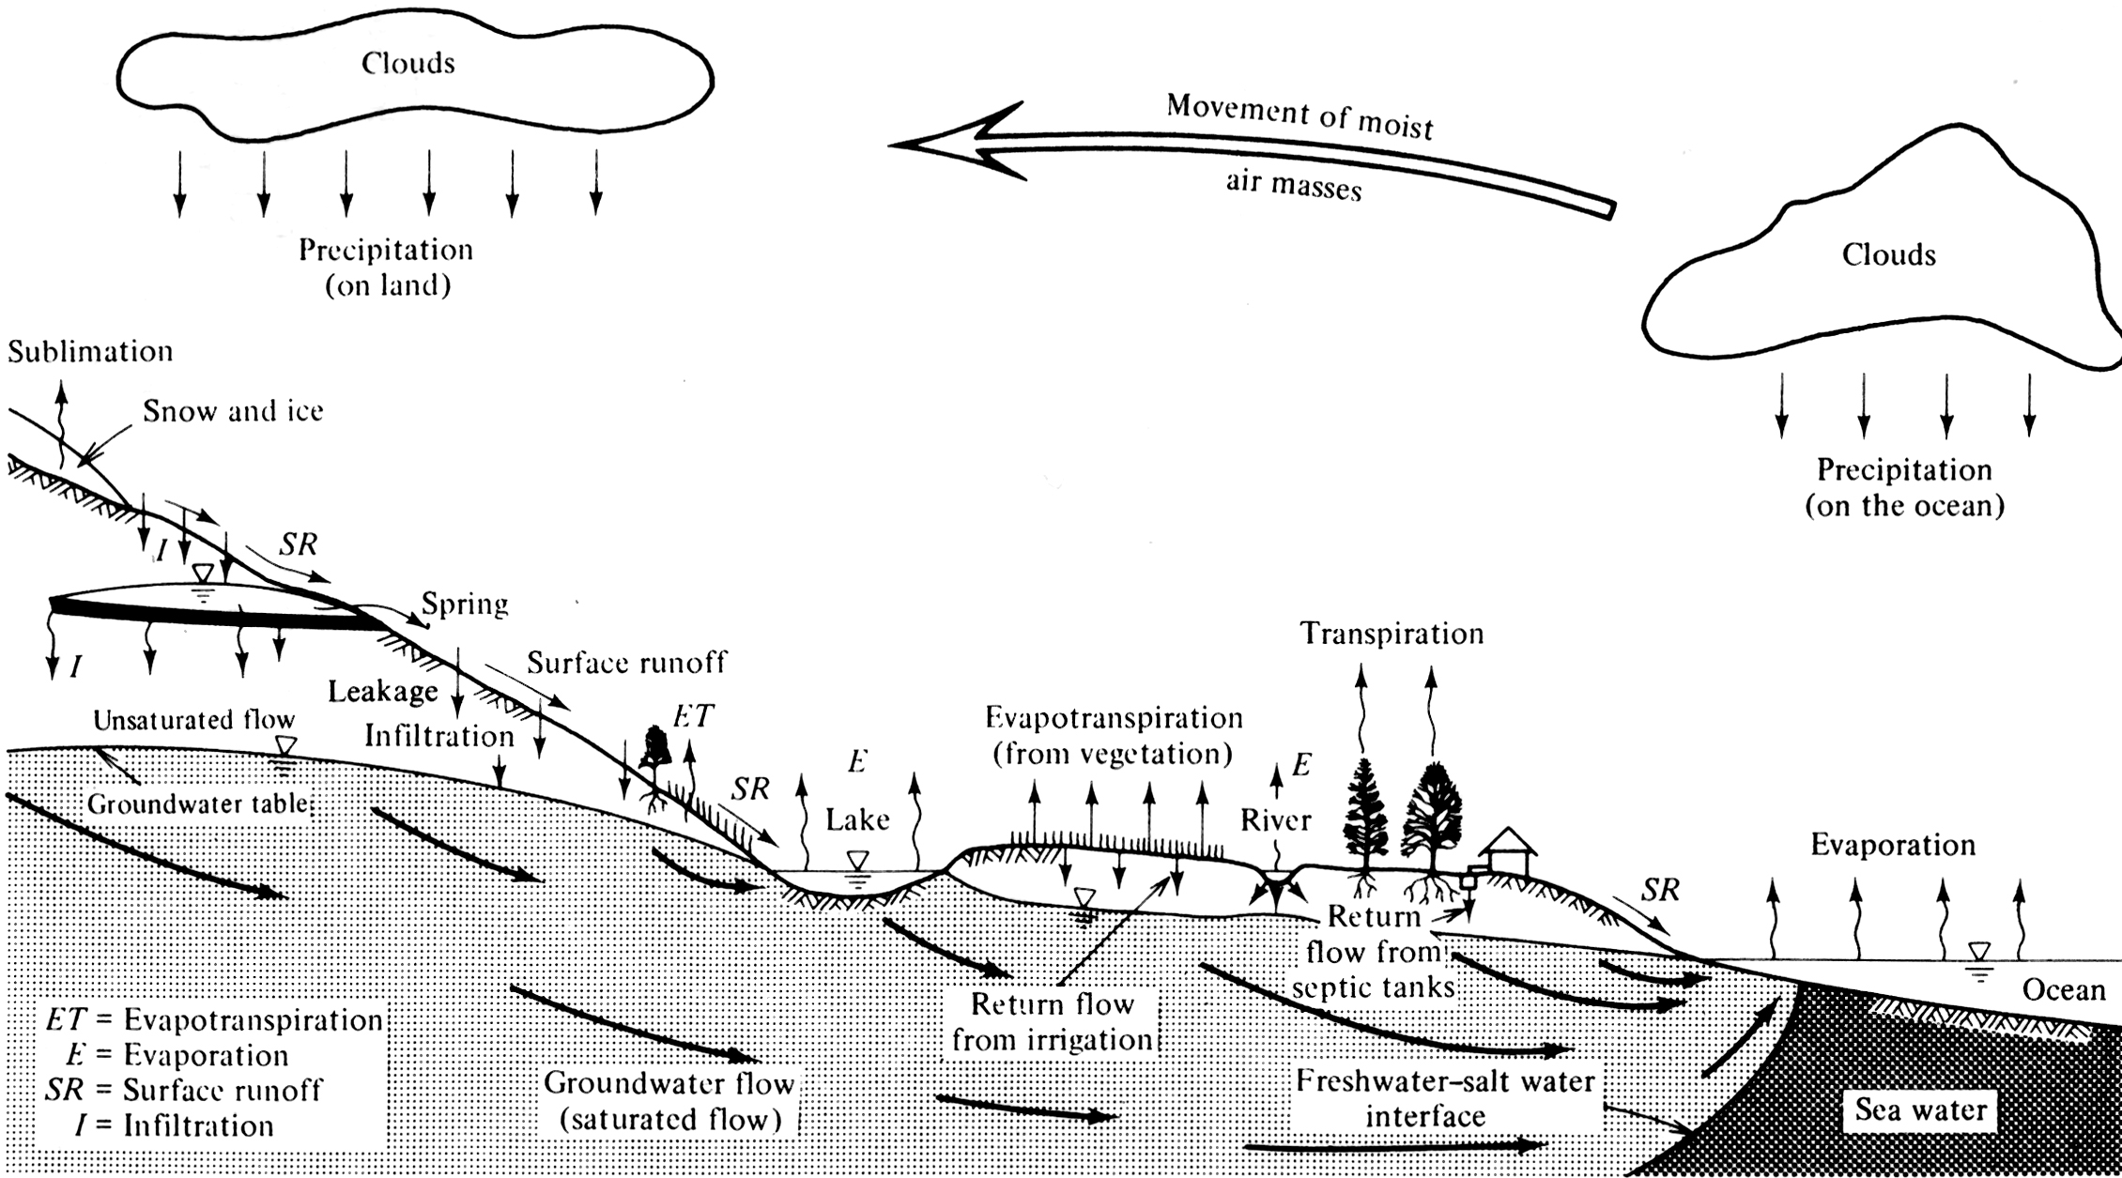
Global Water Balance
111
24’064
17
65 = (44+21)
391
15, 2
1.3
41, 1’338’000
30, 23’400
2.4, 175
5

Slide 5
Bla
Notes:
Globally, groundwater represents about 90% of available freshwater resources, excluding the resources locked in polar ice.
Nearly half of all freshwater used for drinking and irrigation worldwide is groundwater, linking the sustainability of groundwater resources to sustainable human development.
About 20% of irrigation worldwide, producing 40% of the food supply, is dependent upon groundwater.
It is estimated that nearly 10% of global food production may be dependent upon irrigation water extracted from fossil or non-renewable aquifers.
According to the Food and Agriculture Organization (FAO), the use of groundwater for irrigation over the last several decades probably has delayed the next food crisis.
(Link: http://www.iaea.org/Publications/Magazines/Bulletin/Bull471/h20_know_how.html)
Comparison: Lake Michigan Volume = 5‘000 km³
Soil moisture = 17
-> Calculate residence times!
VW flux estimated for the period 1995-1999 (HoekstraGlobalSummary.pdf)

Slide 6
Catchment Energy Balance

Slide 7
Catchment Characterization Excercise
Tuesday, May 04, 2021

