Slide 1
Applied Modeling of Hydrological Systems in Central Asia
Dr. Tobias Siegfried, hydrosolutions GmbH, 2021

Slide 2
How Does a Hydrological Model Work?
Thursday, May 06, 2021

Slide 3
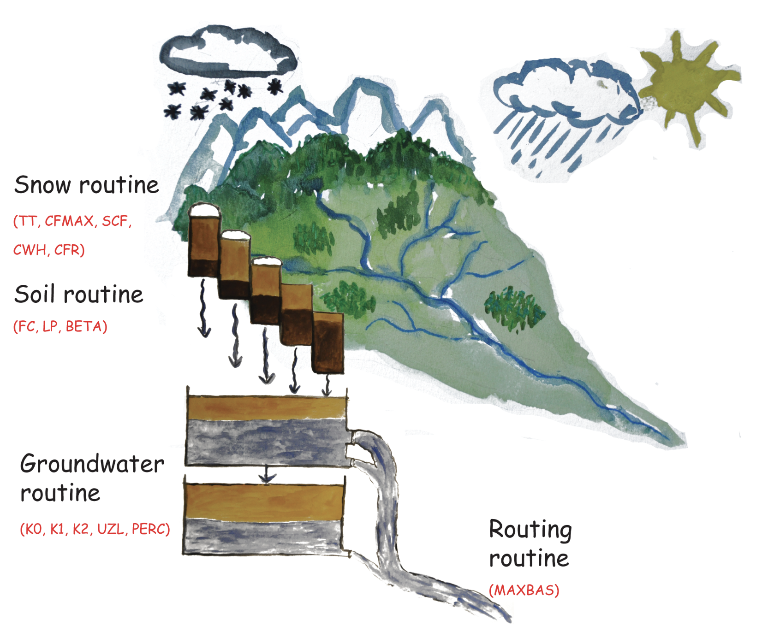
Intro HBV Model
Snow /
Rain
Conceptual model
Soil Moisture
Groundwater
Rounting

