Slide 1
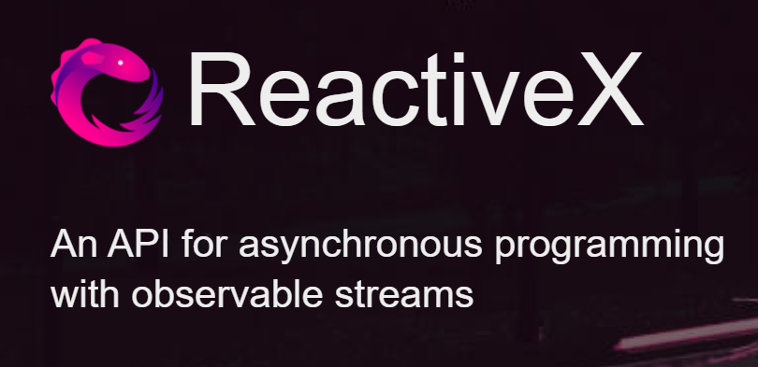
Source: https://reactivex.io/

Slide 2
Super Quick Intro
The Base of it all „IObservable<T>“

Slide 3
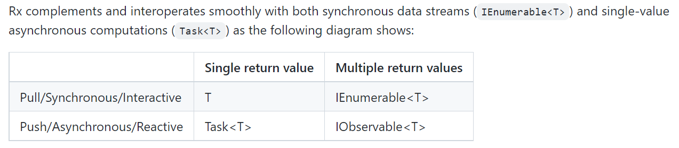
Source: https://github.com/dotnet/reactive

Slide 6
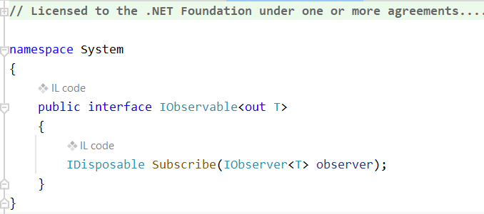

Slide 7
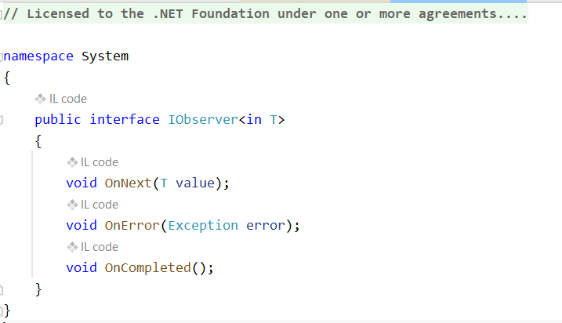

Slide 8
This was already the new kid in Rx.NET…
… the „x“ comes from dotnet package add System.Reactive

Slide 9
Whats the fuzz about? Lets create a super simple asynchronous stream:
--> a Timer which ticks once ever 1/10th second and
outputs „one random long value (1-100 ) per Tick“
But its NOT about Timers or even Time. These Timers are only examples of asynchronous data streams for this tutorial.
Think also of
Application Monitoring Events
Stock Tickers
Mouse Clicks
…

Slide 10
Not convinced? Try implement the following:
Suppose the „long values“ coming from the timers are „# of errors which occured during a build run“. Every „event“ is a „build failure“.
Now a couple of tasks…

Slide 11
2.1 After each build calculate the running avarage of the #of errors for the last 3 builds and publish those as events again.
2.2 Since we do not want to overwhelm our downstream services: Throttle the rate of published averages to a maximum of 1 every 2 seconds no matter of how many „builds“ did run in these 2 seconds. This means calculate all running averages but only publish once per 2 seconds.
2.3 On second thought your PO pops up and says: Sorry, I meant do calculate and publish the average of all builds during the last 2 seconds, not only the last 3 builds…

Slide 12
2.4 What about some „equivalency classes“ ☺.
Less than 10 errors is OK (well its NOT, but for this tutorial lets assume ist OK).
11 – 70 Errors is a WARNING
71+ Errors are a BIGPROBLEM
We want to generate a warning, if more than 11 builds within the last 2 seconds are Warnings.
We want to generate a BIGPROBLEM notifcation if more than 5 builds withing the last 2 seconds are ERRORS
Imagine someone „subscribes“ to this Observable to then push some message to Slack –ahm I mean Teams-

Slide 13
Lets combine some streams
Suppose we are monitoring several things on a virtual machine: The memory, the CPU and the disk space.
Now we want to combine these into a single value „SYSTEMSTATE“ which only is „OK“ if everything is OK, else it is a warning. We only want to see changes to the state, so no duplicated „WARN“, „WARN“, „WARN“, „OK“,…
Being good ReactiveX programmers, we wrapped the polling / Event mechanisms into Observables which already produce a state „OK“ or „WARN“ based on some Thresholds.

Slide 14
This was only a very quick intro
It‘s kind of like teaching a new developer the basic concepts like loops, etc. and expect him to grasp what can be „constructed“ out of these building blocks.
Or explain someone a biological „cell“ and expect her to derive the concept of a complex organism from this.
Or a neuron vs the brain.
You know what I mean.
I have seen some people create some real ingenious software around these reactive patterns. Alas I never reached that level, so I am not the one to teach this in depth.
But its a fantastic tool to have in ones belt anyways
Cheerio

Slide 15
Resources
https://reactivex.io/ (ReactiveX Website)
https://docs.microsoft.com/en-us/shows/rx-workshop/ (Some old Channel 9 workshops)
http://introtorx.com/Content/v1.0.10621.0/00_Foreword.html (Great e-Book by Lee Campbell)
https://github.com/dotnet/reactive
(Rx.NET → the code for the .NET port)

