Slide 1

FINAL RESULTS
KPI Robustness in
On-Time Performance
Measurement
How sensitive is OTP to defensible methodological choices?
Tobias Bussiek
West Chester University of Pennsylvania
April 2026

Slide 2
THE PROBLEM
OTP is reported as a single percentage.
But computing OTP from public GTFS-RT data requires methodological choices
and reasonable choices produce dramatically different numbers.
1
2
3
Hidden choices
Invisible upstream
Same data, different number
Computing OTP from GTFS-RT requires picking lateness windows, handling early arrivals, selecting stops, and deduplicating overlapping real-time predictions.
Some choices are recognizable as methodology (e.g., the 5-minute window). Others happen earlier, during stop-event reconstruction, and rarely appear in published reports.
Across reasonable choices, the same underlying data can be reported as 20% on-time, 99% on-time, or anywhere in between. The reader cannot tell which methodology produced the number.

Slide 3
WHERE THE CHOICES LIVE
GTFS-RT pipeline choices are part of KPI methodology
Each step in reconstructing a stop event from real-time predictions involves a methodological choice.
STEP 1
STEP 2
STEP 3
STEP 4
STEP 5
Archive feed
>
Match to schedule
>
Assign service date
>
Reconstruct stop event
>
Apply OTP definition
Poll GTFS-RT every
60 seconds
Trip ID + stop
sequence
Rolling 4 AM Eastern
boundary
Pick which prediction
represents the stop
Lateness window,
early treatment
STEP 4 GETS MUCH LESS ATTENTION
Snapshot selection: which prediction represents the stop event?
GTFS-RT is a stream of overlapping live predictions, not a finished historical record.
A single scheduled stop appears in many snapshots as the bus approaches. The analyst must pick one.
This study compares three rules: closest (prediction nearest scheduled time), last_before (last prediction before scheduled time), and latest (chronologically last, treated here as the closest GTFS-RT-only proxy).

Slide 4
METHOD
Six specification dimensions, fully crossed
Adapting specification-curve and multiverse analysis (Simonsohn et al. 2020; Steegen et al. 2016) to descriptive KPI measurement.
Dimension | Variants | What it controls
Snapshot rule | closest · last_before · latest | Which prediction represents each stop event
Lateness window | 0/+3 · −1/+5 · −2/+7 | Schedule-deviation range counted as on time
Early treatment | count_early_as_late · ignore_early | Whether early arrivals count as failures
Stop selection | all_stops · timepoints · terminals | Which stops contribute to route-level OTP
Time of day | AM peak · midday · PM peak · evening · all | Time window of analysis
Delay basis | arrival · departure | Scheduled time used as the reference
3 × 3 × 2 × 3 × 5 × 2 = 540 specifications per route · 1,080 total across both routes

Slide 5
RESULT 1: THE SPREAD
Reasonable choices produce ~80 percentage points of variation
Distribution of OTP across high-sample specifications, 432 per route.
Route 23
Route 47
79.5 pp
79.0 pp
spread of OTP values
spread of OTP values
MIN
MEDIAN
MAX
MIN
MEDIAN
MAX
20.3%
67.0%
99.8%
20.3%
60.0%
99.3%
the same data · 432 high-sample specs
the same data · 432 high-sample specs

Slide 6
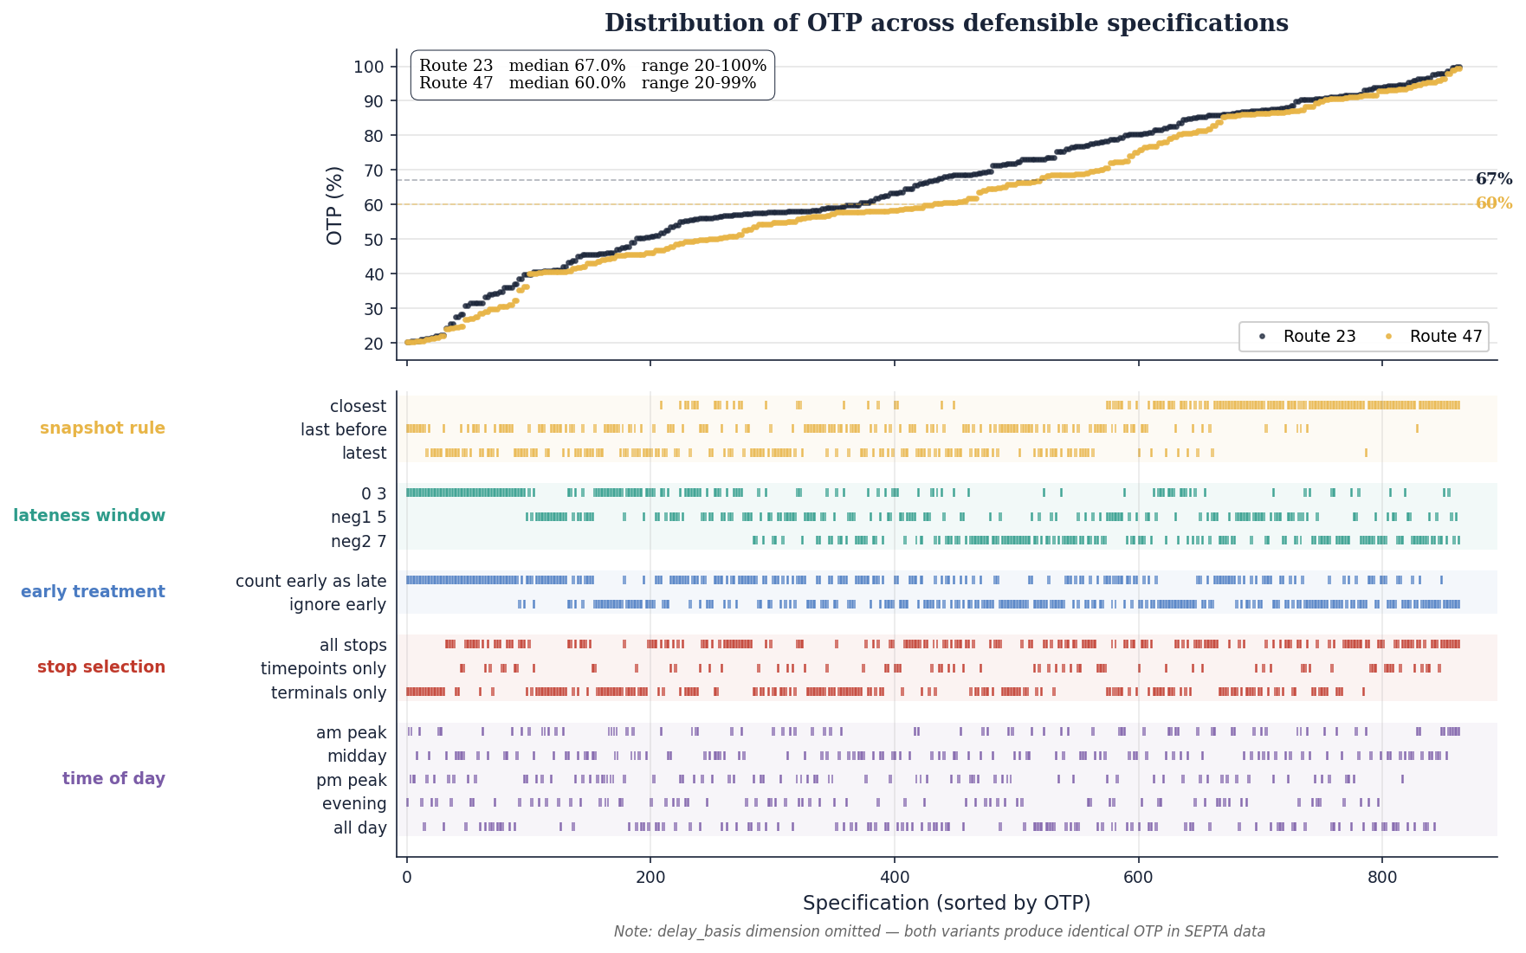
RESULT 1: THE SPREAD (VISUALIZED)
The specification curve
Each point is one high-sample OTP estimate, sorted from lowest to highest.
TAKEAWAY The curve is the answer. No single point is “correct”.

Slide 7
RESULT 2: PIPELINE CHOICES MATTER
Sensitivity by specification dimension
Mean OTP range when varying each dimension while holding all others fixed.
THE FINDING
Snapshot selection is largest
30.7 pp mean range
Largest dimension, even above the well-studied lateness window.
Less visible because it happens upstream during event reconstruction.

Slide 8
RESULT 3: A CLOSER LOOK AT SNAPSHOT SELECTION
Snapshot selection alone shifts OTP by 30+ percentage points
All other dimensions held fixed at one reference specification (−1/+5 window, count early as late, all stops, all day, arrival).
Snapshot rule | What it does | Route 23 | Route 47
closest | Prediction nearest scheduled time | 87.4% | 86.2%
last_before | Last prediction before scheduled time | 60.7% | 55.9%
latest | Chronologically last prediction (GTFS-RT-only proxy) | 56.0% | 48.8%
WHY THIS HAPPENS — SELECTION BIAS
The closest rule selects the prediction nearest scheduled time. OTP rewards closeness to scheduled time.
The selection rule and the metric measure overlapping properties since the rule biases toward predictions that already look on time.

Slide 9
THE EXTREMES EXPLAINED
Extreme values come from combinations of methodological choices
Neither endpoint is the single 'correct' value since each answers a different question.
THE HIGH END ~ 99%
THE LOW END ~ 20%
Specs that produce very high OTP
Specs that produce low OTP
closest snapshot rule
last_before snapshot rule
ignore_early arrivals
count_early_as_late
wider lateness window (−2/+7)
strict 0/+3 lateness window
AM peak only
terminals only
Morning buses run early in light traffic. Combined with ignore_early, those early arrivals get classified as on-time.
Stricter reconstruction, strict symmetric window, treats early as failure, focuses on high-variability stops on a route.

Slide 10
PRACTICAL CONTRIBUTION
Minimum disclosure checklist for GTFS-RT-based OTP
If you publish OTP from public GTFS-RT data, disclose these alongside the number.
✓
Snapshot-selection rule — Often missing
✓
Time period and service filters — Scope of the reported KPI
✓
Lateness window — What counts as on time
✓
Sample size — How many observations support the value
✓
Early-arrival treatment — Whether early service is a failure
✓
Excluded trips/records — Filtering choices (Owl, cancellations)
✓
Stop-selection rule — All stops, timepoints, or terminals
✓
GTFS-RT feed type and interval — What real-time data is available
✓
Service-date boundary — How midnight-crossing trips are assigned
✓
Static GTFS version — Schedule benchmark
✓
Trip-matching rule — How real-time updates map to scheduled events

Slide 11
SCOPE AND NEXT STEPS
Limitations & future work
LIMITATIONS
FUTURE WORK
Two routes, one agency
Cross-agency comparison
Routes 23 and 47, SEPTA. Magnitudes may differ across feeds.
Does the snapshot-rule effect generalize beyond SEPTA?
Three weeks of data
AVL ground-truth comparison
Apr 4 to Apr 25, 2026. Weekday day-service only.
Which GTFS-RT reconstruction rule best approximates actual arrivals?
No AVL ground truth
Headway-based reliability
latest is treated as the closest GTFS-RT-only proxy for actual arrivals — but it remains a proxy.
Apply the same robustness protocol to high-frequency service metrics.
Six dimensions, not all
Dashboard/reporting interface
Trip matching, missing-data thresholds, weekend/Owl scope could matter.
Interactive visualization of the spec curve and disclosure choices.
OTP, not headway
Reproducible pipeline
For high-frequency service, headway regularity may better represent rider experience.
Public GitHub repo: tobibussiek/TransitKPIFramework

Slide 12
THANK YOU
Questions?
OTP cannot be reported as a single unqualified number when computed from public GTFS-RT data.
Disclose how stop events were reconstructed, how on-time was defined, and how sensitive the result is to reasonable alternatives.
Tobias Bussiek
West Chester University of Pennsylvania · M.S. Computer Science
github.com/tobibussiek/TransitKPIFramework

