Slide 1
Using an Amazon Cloud virtual machine for
Prosit peptide MS/MS and retention time prediction
Tobias Kind
UC Davis Genome Center
2019

Slide 2
General steps and URLs
VM Setup
Utility installation
Prosit installation
Benchmarks
Prosit
https://github.com/kusterlab/prosit
Prosit data files
https://figshare.com/projects/Prosit/35582
Amazon AWS Cloud Console
https://console.aws.amazon.com/
…estimated time for setup ca 20 min

Slide 3
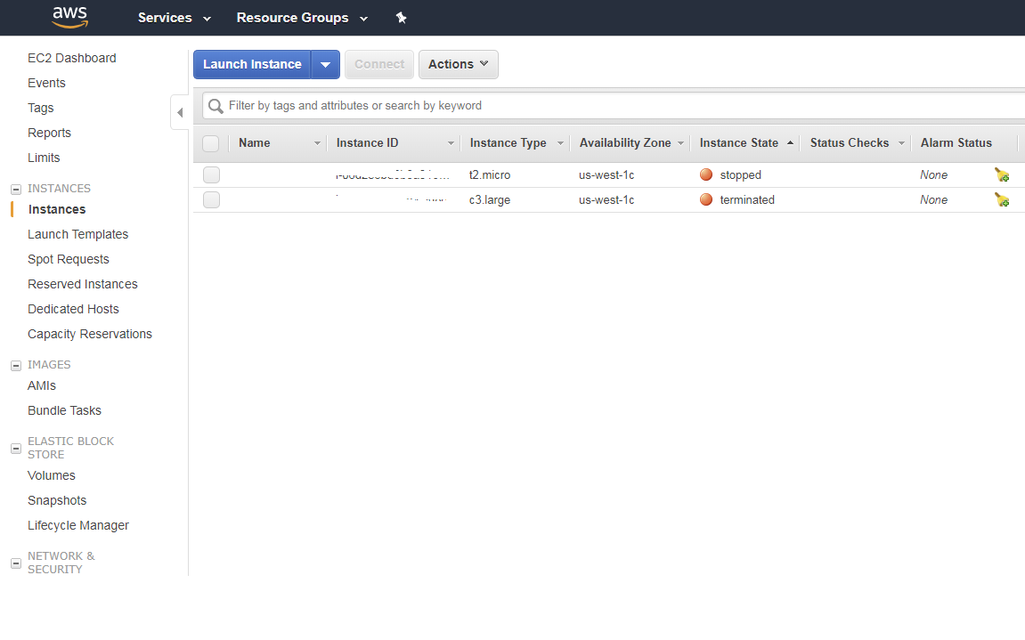
Visit the AWS cloud console (billing has to be enabled)
https://console.aws.amazon.com/
Launch an instance

Slide 4
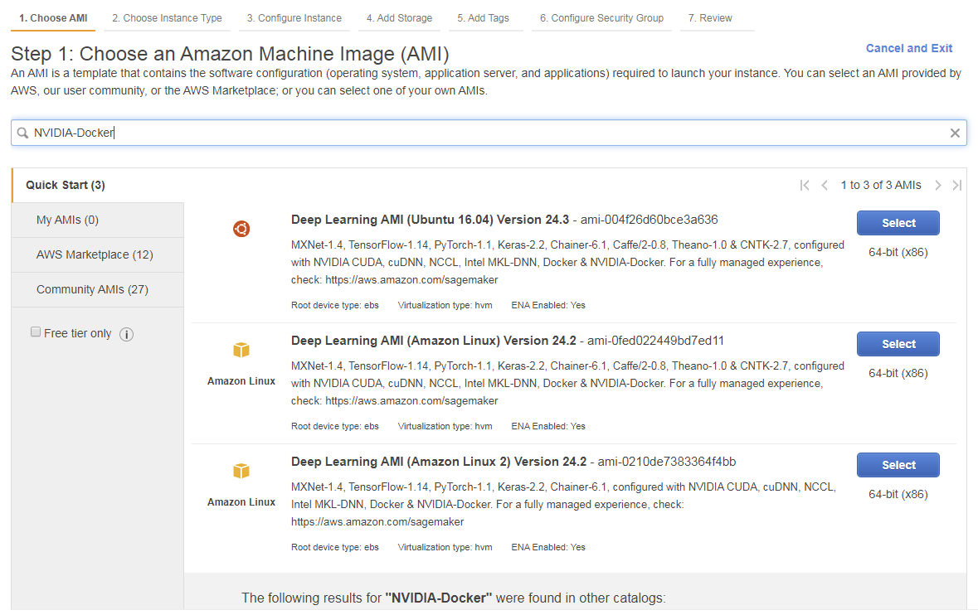
Search for an image that has NVIDA-Docker installed
In the search bar type: NVIDA-Docker

Slide 5
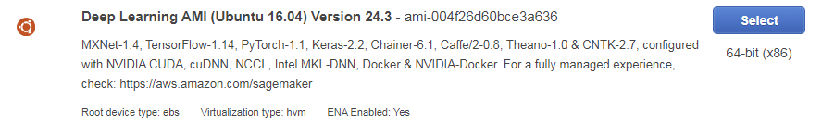
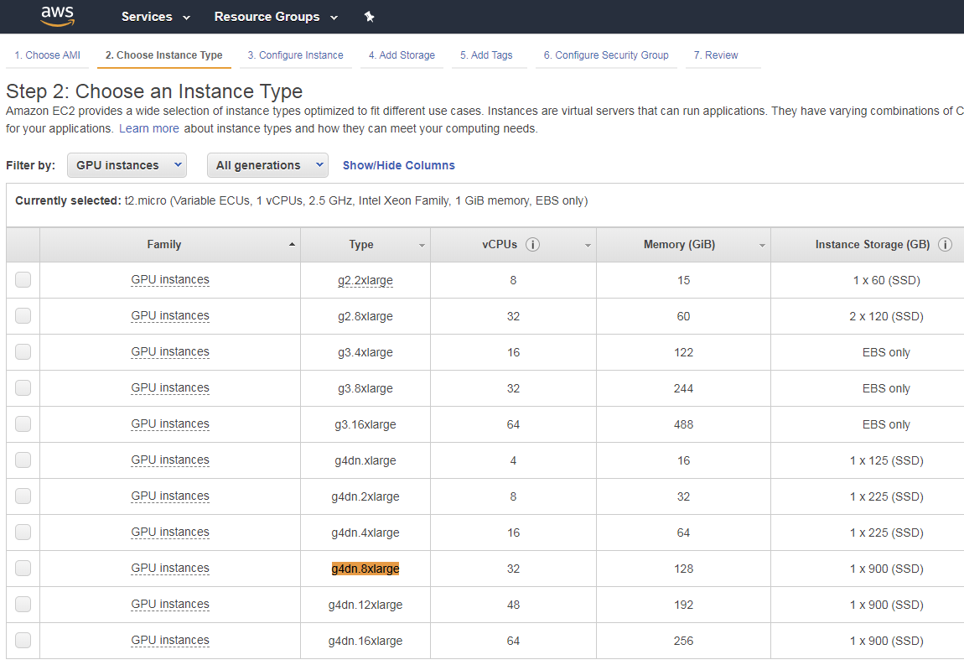
Launch the NVIDIA VM on GPU compute Engine
Select GPU
instance

Slide 6
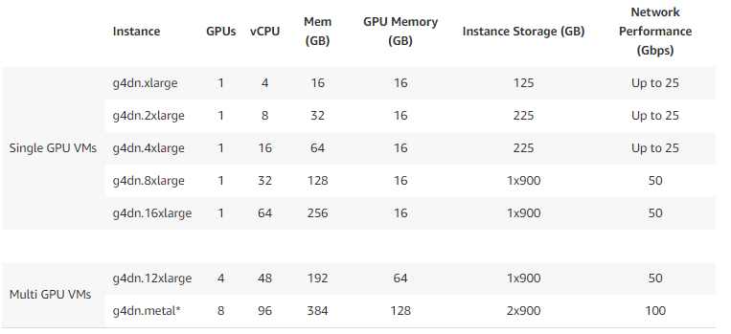
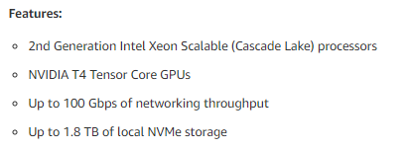
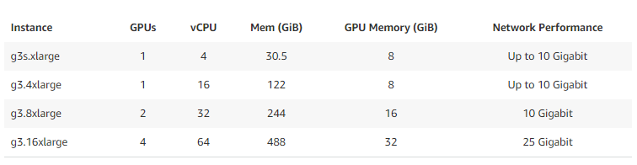

ASW GPU compute optimized instances (selection)
Tesla M60 is much slower than a Nvidia Geforce1080 TI
See: https://aws.amazon.com/ec2/instance-types/

Slide 7
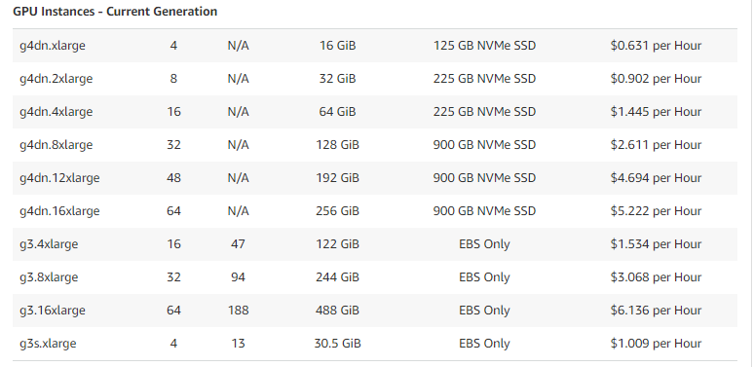

Check prices and select memory and CPU type
Larger Prosit input file require between 50 – 100 GByte RAM
High CPU clock speed is important for the instance
Check GPU types: https://aws.amazon.com/ec2/instance-types/
Check pricing: https://aws.amazon.com/ec2/pricing/on-demand/

Slide 8
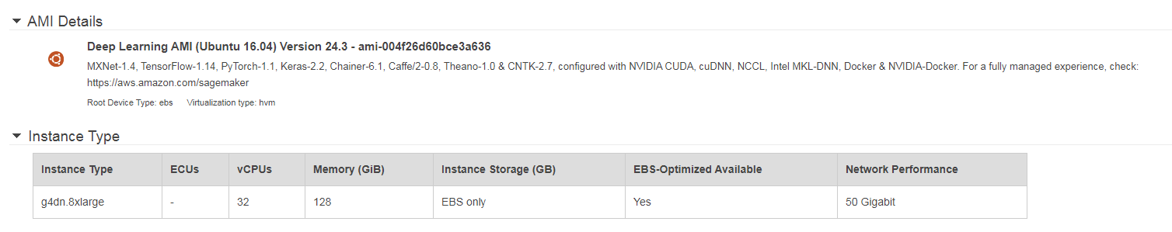


Launch the instance
When running into launch errors, adjust quotas or request increase.
See: http://aws.amazon.com/contact-us/ec2-request

Slide 9
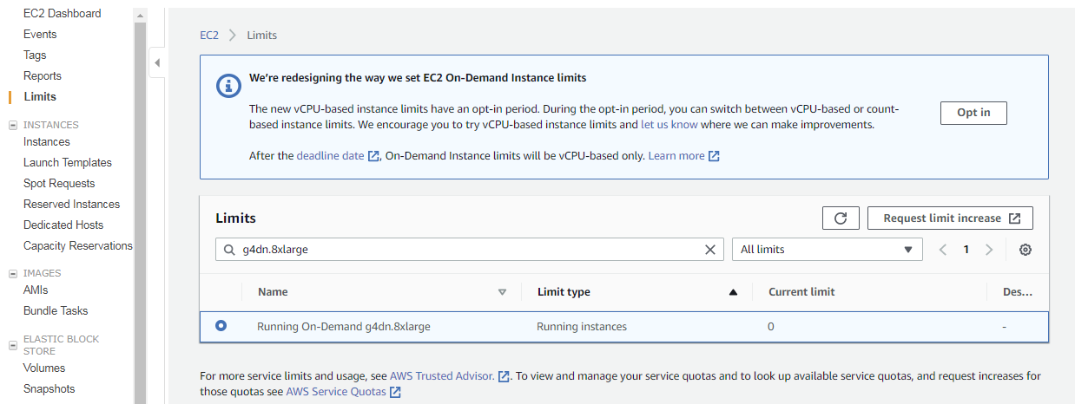
Launch errors for first time users
When running into launch errors, adjust quotas or request increase.
This will take or three days, AWS also denies requests based on use and account age.
adjust limits
See: http://aws.amazon.com/contact-us/ec2-request

Slide 10
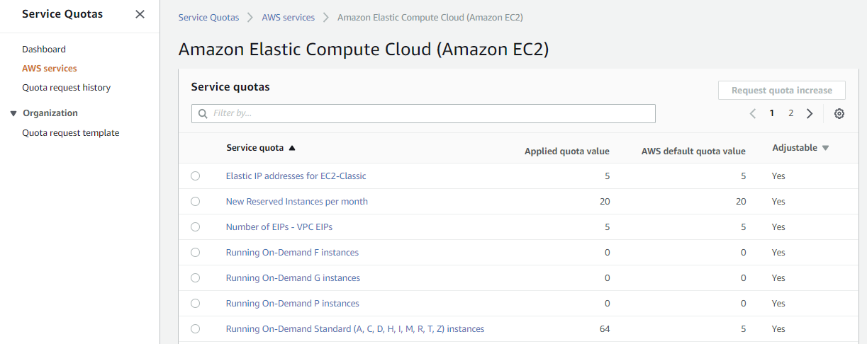
Service limit increases can take several days to resolve
based on support level currently quotas are based on vCPUS

Slide 11
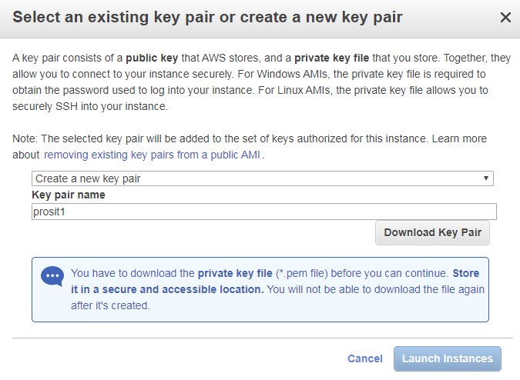
Select old SSH key or create new key
The key file is needed for SSH connections including putty, filezilla, mobaXterm

Slide 12
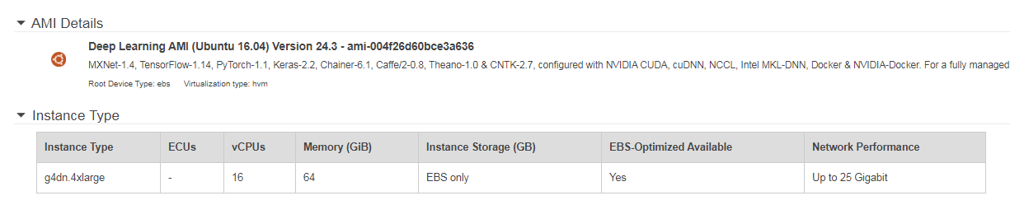
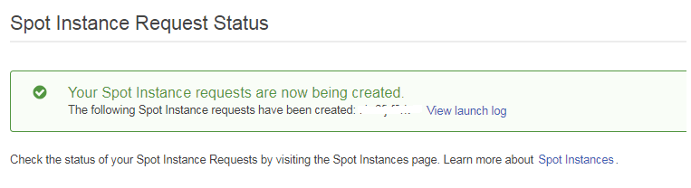

To save money request spot instances for very short jobs only
Such instances may be terminated any given time

Slide 13
Utility installations
htop is for monitoring CPU use {sudo apt install htop}
nvidia-smi is for monitoring GPU use
mc (Midnight Commander) is for file based processes
They should be run in independent windows to monitor behavior in real-time.

Slide 14
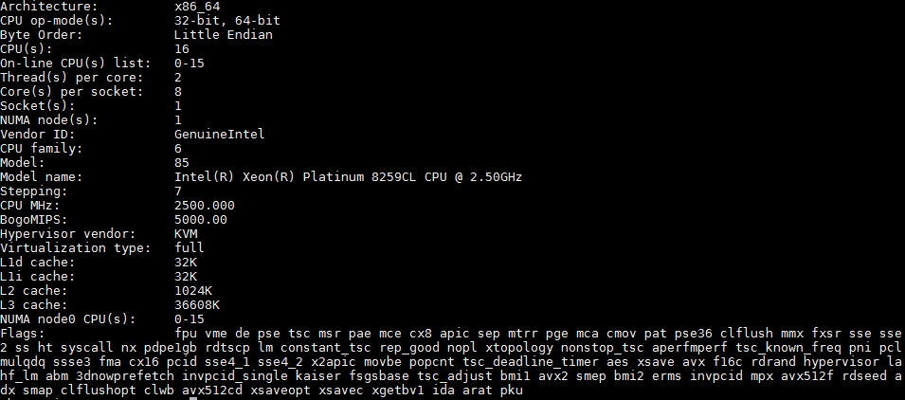
lscpu for AWS g4dn.4xlarge

Slide 15
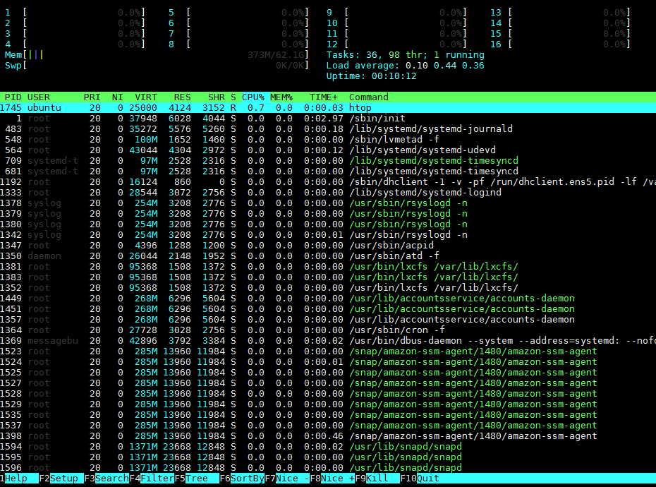
Go back to console and open another ssh window then type: htop

Slide 16
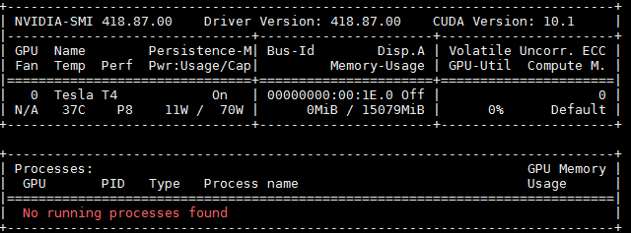
Go back to console and open another ssh window then type: nvidia-smi -l
Tesla T4 (16 Gbyte) is installed
If the GPU shows up we have successfully deployed the engine with CUDA 10.1
and Tensorflow and all other related dependencies

Slide 17
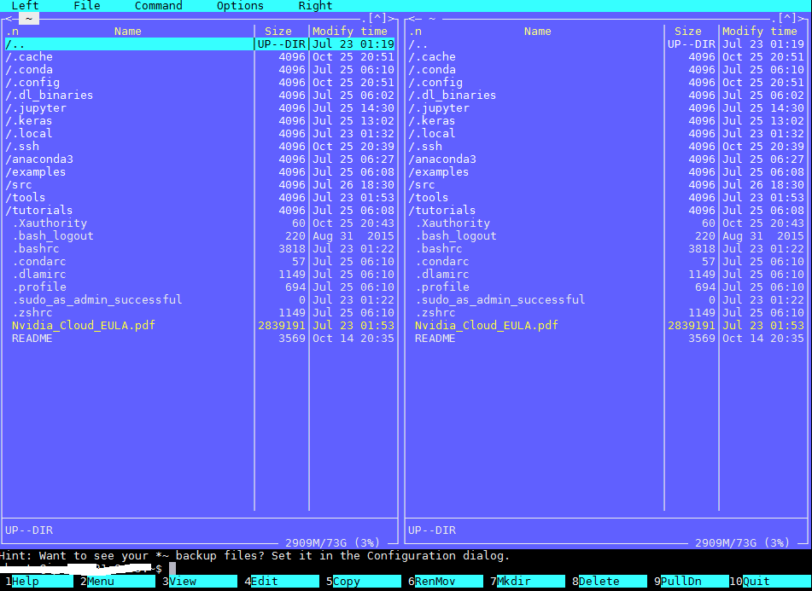
Install mc (Midnight Commander)
on console type: sudo apt install mc
on console type: sudo mc (files copied will have root permission)

Slide 18
Prosit installation

Slide 19
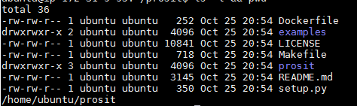
Prosit cloning from Github
In console type: git clone https://github.com/kusterlab/prosit.git
Type: cd prosit && ls –l && pwd

Slide 20
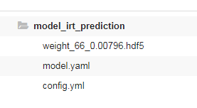
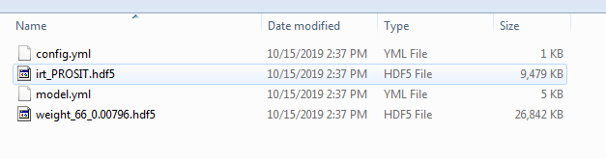
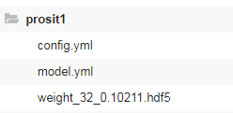
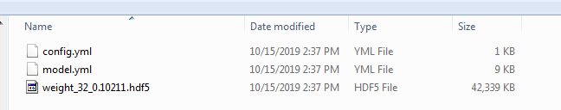
Upload of learning files from Figshare
1) Goto https://figshare.com/projects/Prosit/35582
and download the RT and MS/MS prediction files
a) RT models https://figshare.com/articles/Prosit_-_Model_-_iRT/6965801
b) MS/MS models: https://figshare.com/articles/Prosit_-_Model_-_Fragmentation/6965753
It is recommended to process and pack those locally and then move
a ZIP file to the cloud VM or follow the next slide to extract directly to VM
make sure config.yml and model.yml files + weight hdf5 files are there.

Slide 21
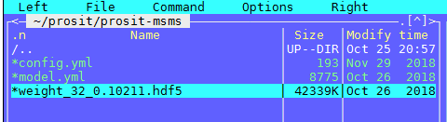
Load and install trained models for MS/MS from Figshare
On cloud command line type:
cd prosit
ls –l
mkdir prosit-msms
cd prosit-msms
wget https://ndownloader.figshare.com/files/13687205 -O msms.zip
unzip msms.zip
mv * ../
ls –l
Check the three files config.yml, mode.yml and weight_32_0.10211.hdf5
rm msms.zip

Slide 22
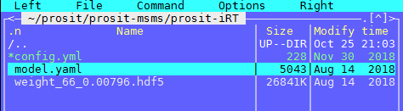
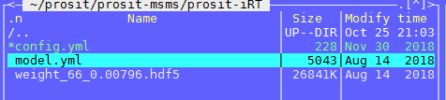
Load and install trained models for retention times (RT) from Figshare
On cloud command line type:
We need to go back to prosit main, type: cd.. && pwd ls –l
mkdir prosit-iRT
cd prosit-iRT/
wget https://ndownloader.figshare.com/files/13698893 -O iRT.zip
unzip iRT.zip
cp model_irt_prediction/* .
ls –l
Check the three files config.yml, mode.yml and weight_66_0.00796.hdf5
If not rename model.yaml to model.yml with: mv model.yaml model.yml
rm iRT.zip
wrong!
rename to
model.yml
OK

Slide 23
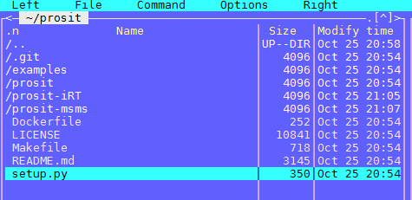
Calling prosit for the first time
to get docker image and install prosit
1) Check that prosit-irt and prosit-msms are in the main prosit folder
2) Check user name with whoami and pwd commands
3) Create prosit server installation:
make server MODEL_SPECTRA=/home/ubuntu/prosit/prosit-msms/ MODEL_IRT=/home/ubuntu/prosit/prosit-iRT/
4) In case of space error, delete anaconda3 and examples and other preinstalled
software or increase space of SSD during installation

Slide 24
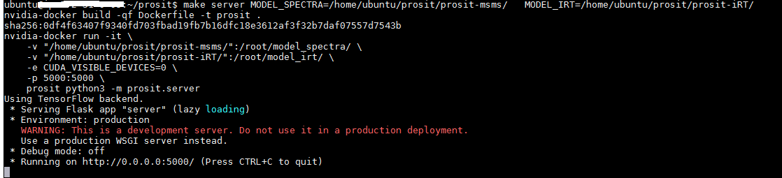
Checking that prosit is running
The webservice should show the log
The flask webserver is running!
Open another ssh terminal and execute jobs from there. The server window above
stays open as logging window and for viewing of potential errors

Slide 25
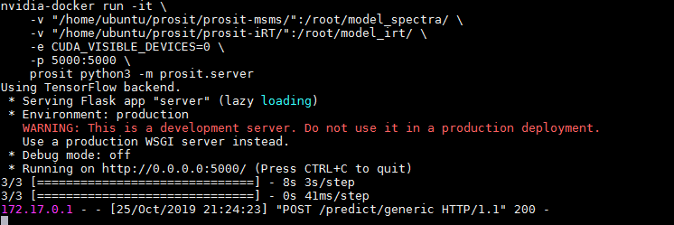
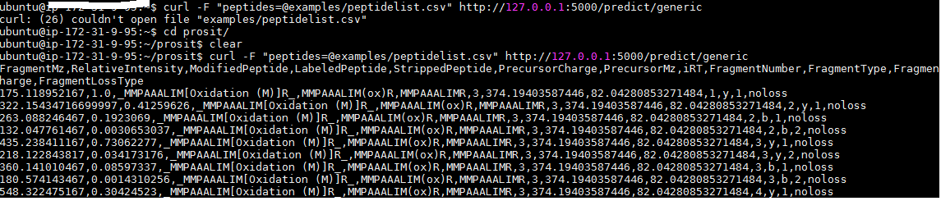
Run the Prosit example
in new ssh terminal go to the prosit folder and type: cat README.md
then copy/paste: curl -F "peptides=@examples/peptidelist.csv" http://127.0.0.1:5000/predict/generic
The server should receive the data and inform about the progress
4) The output window should list all the data
5) Prosit is ready to roll!

Slide 26
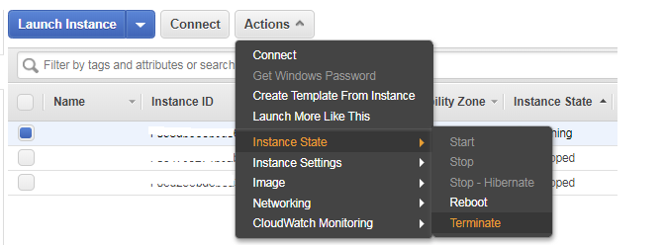
WARNING
Cloud VMs can accumulate costs very fast, it is imperative to stop the VM
in the cloud console and to remove it. Also storage costs can accumulate
even when the engine is stopped.
Spot instances may not be good for production runs on larger CSV input files.

Slide 27
General use

Slide 28
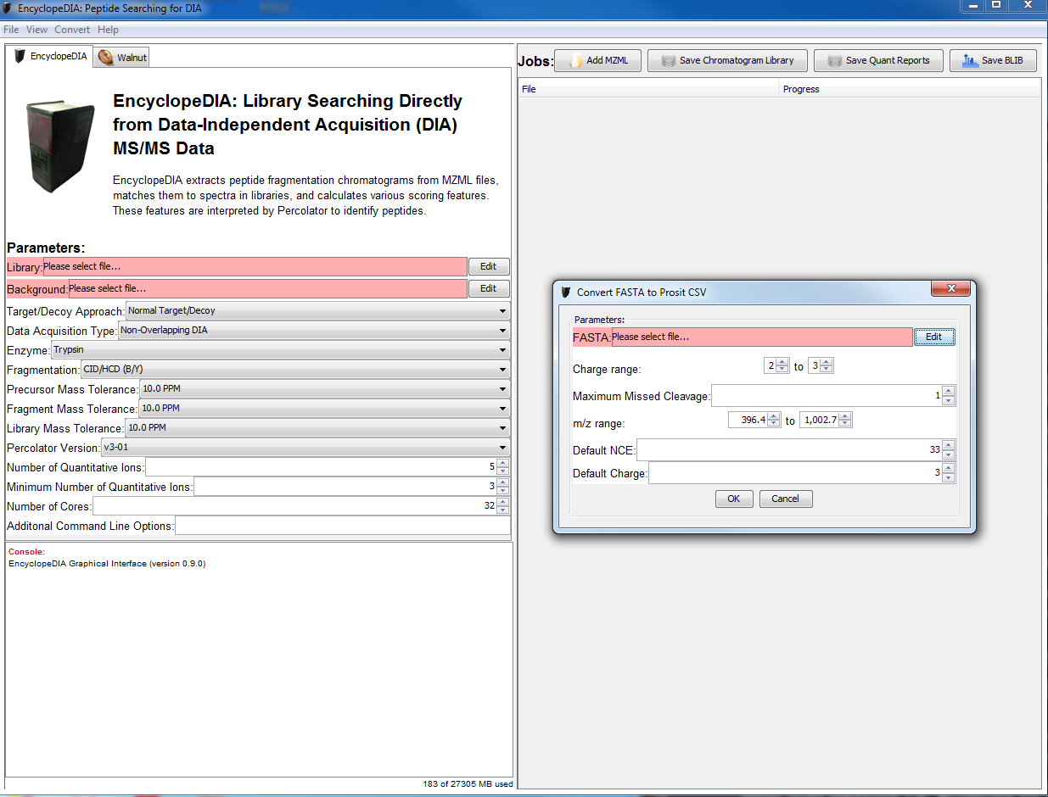
General use and preparation of digested FASTApeptide data
using Encyclopedia
Download Encyclopedia (current version 9.0): encyclopedia-0.9.0-executable.jar
Link: https://bitbucket.org/searleb/encyclopedia/downloads/
Download FASTA files from Uniprot via: https://www.uniprot.org/proteomes/
Convert >> Create Prosit CSV from FASTA

Slide 29
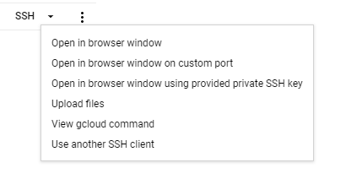
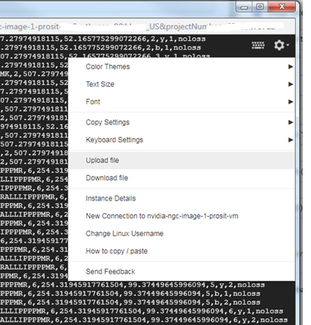
Upload and download of own data
via the ssh google upload button
via the terminal upload download
other ways (Cloud storage, FileZilla)
Recommendation:
All data should be compressed
via zip and unzip
Link: https://www.cloudbooklet.com/6-ways-to-transfer-files-in-google-cloud-platform/

Slide 30
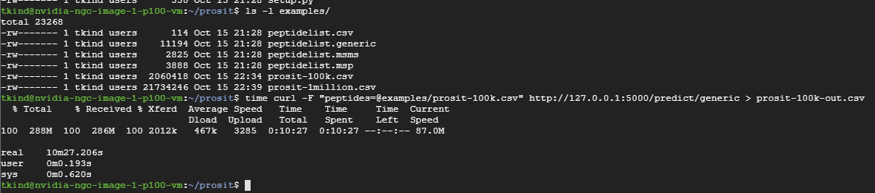
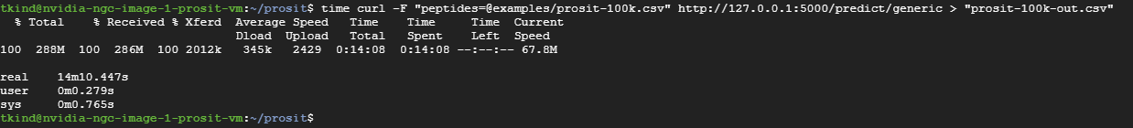
Benchmark of 100k CSV data set
(100,000 digested peptides)
AWS Tesla T4 (8 core Intel(R) Xeon(R) Platinum 8259CL CPU @ 2.50GHz: 6 min
Google Tesla P100 instance (8 cores CPU): 10 min
Google Tesla V100 instance (16 cores CPU): 14 min
Local Geforce 2080 Ti and 8 core Intel(R) Core(TM) i7-6900K CPU @ 3.20GHz: 9 min
curl -F "peptides=@examples/prosit-100k.csv" http://127.0.0.1:5000/predict/generic > "prosit-100k-out.csv"

Slide 31
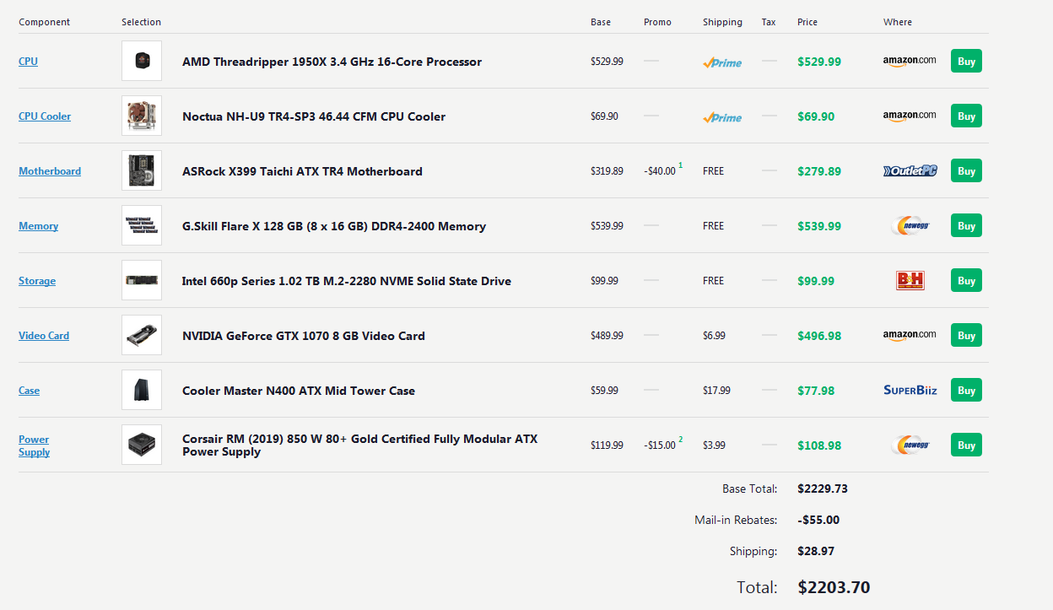
File size and compute considerations
A FASTA input file containing 40,000 proteins will be around 150 KByte large.
The tryptic digest file with one voltage (z=2,3) will have 4 million lines and will be 100 kByte in size.
The Prosit prediction file will have 130 million lines and a size of 18 Gbyte large.
Around 100 GByte main memory are needed on the prosit server or the input file has to be split
100k tryptic digests are processed in 10 min; 1 million tryptic digests can be processed in 100 min
1 million tryptic digests will cost $2.25 on the cloud, easy to deploy, easy to scale
A new local LINUX PC with fast CPU and 8 Gbyte GPU and 100 GByte RAM ~ $2,200

Slide 32
The end

