Slide 1
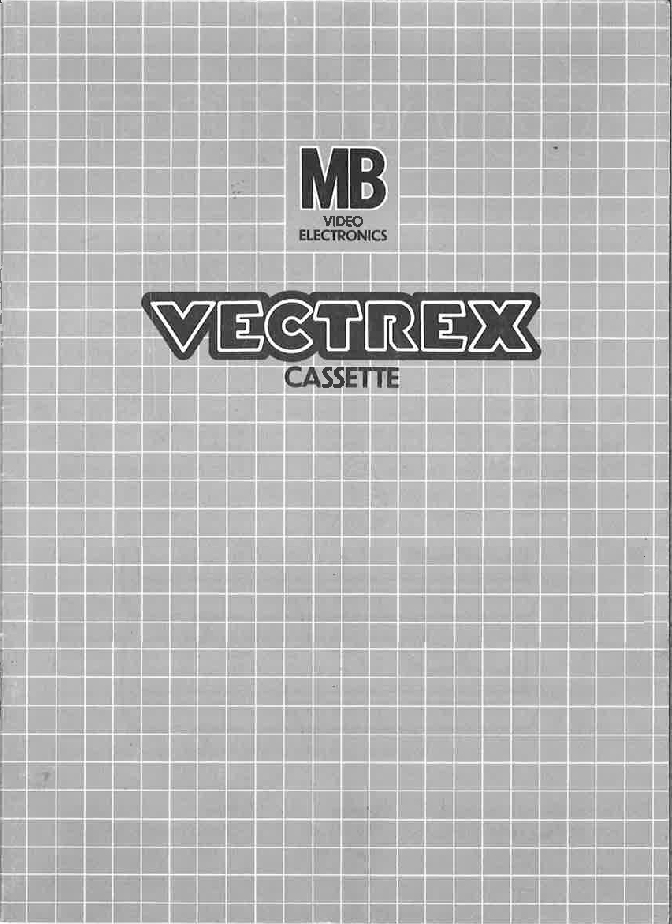

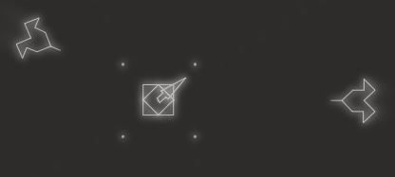

Slide 2
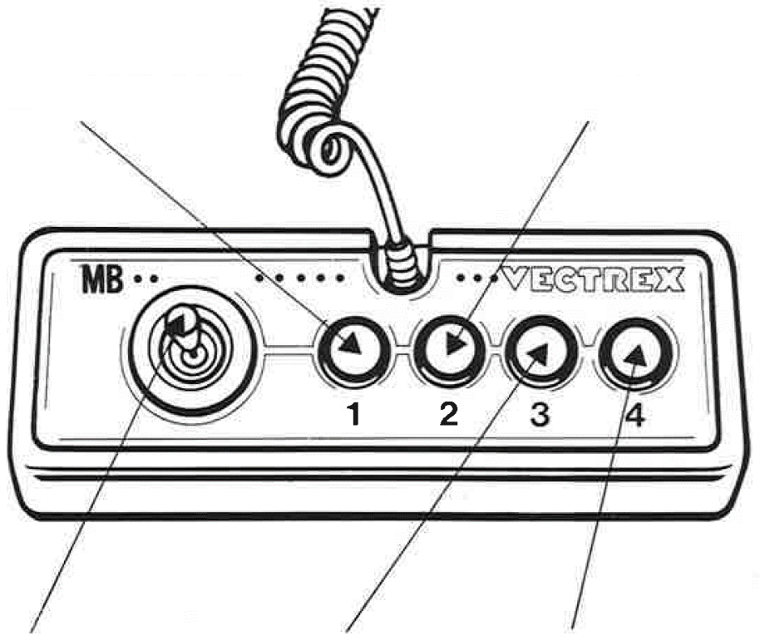
MY GAME
GAME CONTROLS
MY GAME is designed to be played with the built-in control panel only. The functions of the controls are:
Button 1
Close menu
Button 2
Level up your items at menu
Joystick
Rotate the player in any direction
Button 3
- Not used -
Button 4
Shot

Slide 3
HOW TO PLAY
PLAYER SELECTION
Only one Player can play this game.
OPTION SELECTION
Only one game mode.
GAME PLAY
You can only win this game if you defend all Waves of enemy attacks.
Each Wave can be divided into three phases, in each phase, up to 5 Enemies try to destroy your tower. Each Enemy that you or your tower destroy gives you money. After you alive on Wave you can Upgrade your Player or Tower.
Player Upgrades:
-> Player Level:
-> 1: On Direction to Shoot Bulltes
-> 2: Two Directions to Shoot Bullets
-> 3: Tree Direction to Shoot Bullets
-> Player Fire rate:
-> 1: Fire rate 1
-> 2: Fire rate 2
-> 3: Fire rate 5
Tower Upgrades:
-> Tower Level:
-> 1: Shoot in one Direction
-> 2: Shoot in two Directions
-> 3: Shoot in three Directions
-> 4: Shoot in four Directions
-> Tower Fire rate:
-> 1: Fire rate 1
-> 2: Fire rate 2
-> 3: Fire rate 5

Slide 4
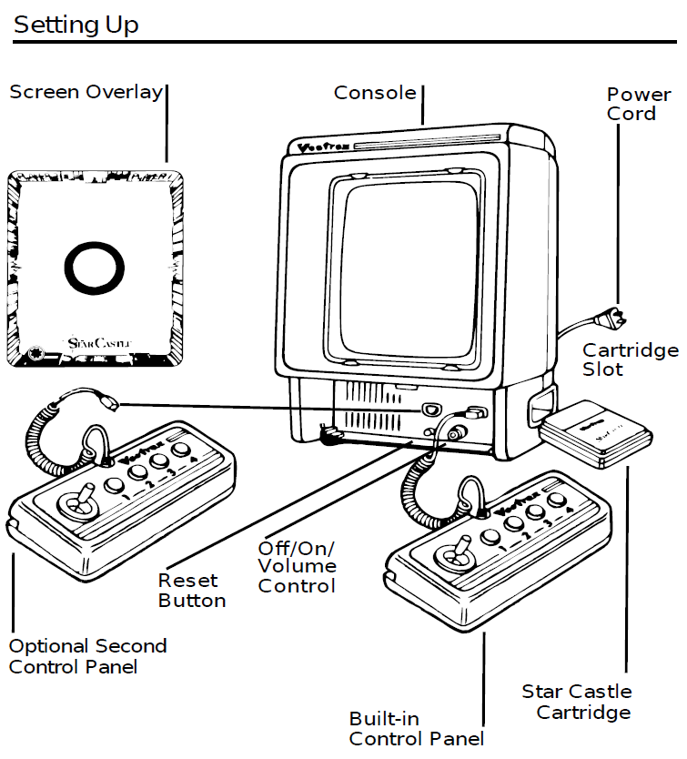
SETTING UP
CREDITS
This game was developed by Tobias Kükelheim and programmed in C and MC6809 assembly language. It is the outcome of a student project which was part of the elective course “Advanced hardware-oriented C and Assembly Language Programming” at Pforzheim University, Germany, in spring term 2019, supervised and tutored by Prof. Dr. rer. nat. Peer Johannsen.

Slide 5
