Slide 1
Vishwakarma Application ID
VISHWAKARMA AWARDS 2026-27
VK26-IITH-SC-0172
Acoustic Canopy Pest Detection Collar (ACPDC)
An autonomous micro-acoustic bio-scouting array for early detection of sub-surface tree infestation
Track: Technological Innovation for Rural Sustainability

Slide 2
Problem Context
25–30%
80%
≤48 h
24/7
CROP LOSS MITIGATED (EST.)
LESS CHEMICAL EXPOSURE (EST.)
TARGET DETECTION WINDOW
AUTONOMOUS MONITORING
Project overview
Problem statement & beneficiaries
Title: ACPDC – clamp-on acoustic collar for boring-pest detection
Team ID: VK26-IITH-SC-0172
Track: Technological Innovation for Rural Sustainability
Core innovation: a piezo collar that hears larval boring at the edge and sends LoRa alerts per tree
Boring larvae (Red Palm Weevil, Emerald Ash Borer) feed inside the trunk, invisible to drones, satellites and visual scouting until canopy collapse.
Result: reactive, calendar-based blanket spraying that pollutes water, kills beneficial insects, raises cost and breeds resistance.
Target users: commercial orchard owners, cooperative unions, forestry bureaus and biosecurity agencies.
Figures are Stage 1 proposal estimates; to be validated in Stage 3 field trials.

Slide 3
User Journey: Before vs After
Before: reactive scouting
After: ACPDC autonomous pipeline
1. Larvae feed inside the trunk – no visible sign
1. Collar listens on a duty-cycled schedule for larval boring impulses
2. Weeks later canopy chlorosis / wilt appears
2. Edge classifier flags sustained activity (≤48 h)
3. Manual checks + blanket spraying of the whole orchard
3. LoRa alert with tree ID reaches the dashboard
4. Tree already lost; runoff, mortality, resistance
4. Targeted micro-injection on the flagged tree only
Detection only after vascular collapse
~80% less chemical exposure; 25–30% less crop loss (est.)

Slide 4
System Architecture & Specs
Mechanical
clamp + Al plate
Sensing
PZT + analog AFE
Edge MCU
ADC, DSP, classifier
Telemetry
LoRa P2P 865 MHz
Receiver +
dashboard
Power: 6 V 1 W solar → CN3791 charger (NTC + protection) → NCR18650B → 3.3 V low-Iq regulator
Parameter | Target spec | Selected hardware / protocol
Sensing band | Bench-test A 1–14 kHz vs B 20–60 kHz | PZT-5H disc [P/N TBD], rigid Al-6061 contact
Analog front-end | 30 dB gain; LPF set per band | TLV9062S (shutdown); TLV9002S if low band
Sampling / DSP | 48 kS/s (A) vs 200 kS/s (B), 12-bit | STM32WLE5 (Cortex-M4) on Seeed Wio-E5
Power | ≤100 µA avg via scheduled capture | CN3791 + NCR18650B + 6 V 1 W solar
Telemetry | LoRa point-to-point, 865–867 MHz | Wio-E5 node → Wio-E5 Mini + laptop
Detection logic | Alert ≤48 h from onset | Adaptive threshold + N-of-M burst voting
Mechanical | IP67 (to be tested), <350 g | ASA housing, SS304 band, EPDM liner

Slide 5
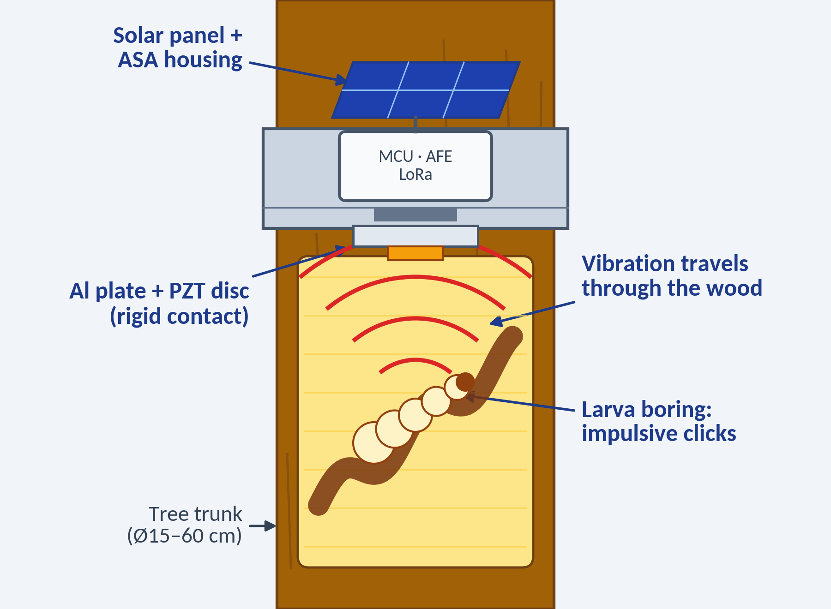
How the Collar Works (1/2): Hearing the Larva
1
Larva boring makes vibration
Feeding larvae chew inside the trunk, producing short impulsive clicks that travel through the wood.
2
Rigid contact picks it up
The Al-6061 plate presses the PZT disc onto the trunk; vibration becomes a tiny voltage. No rubber in this path.
3
Front end conditions the signal
TLV9062S adds ~30 dB gain; a per-band low-pass filter feeds the ADC. Band is set after bench tests.
Illustration of the sensing principle (not to scale)

Slide 6
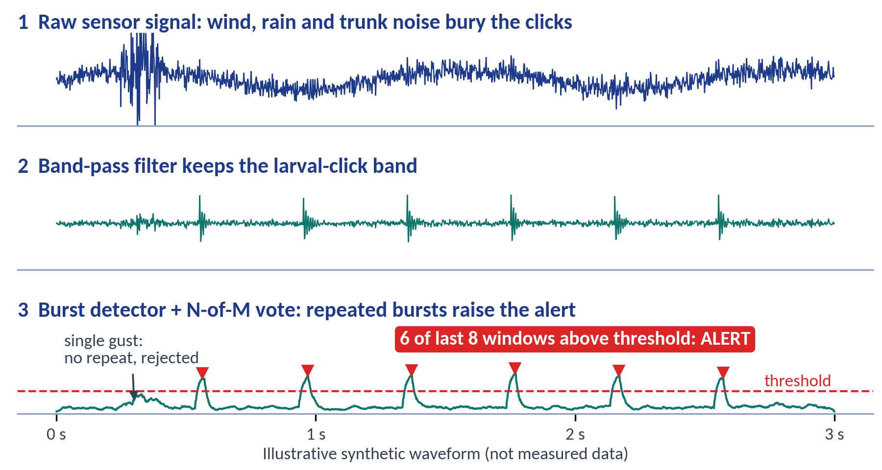
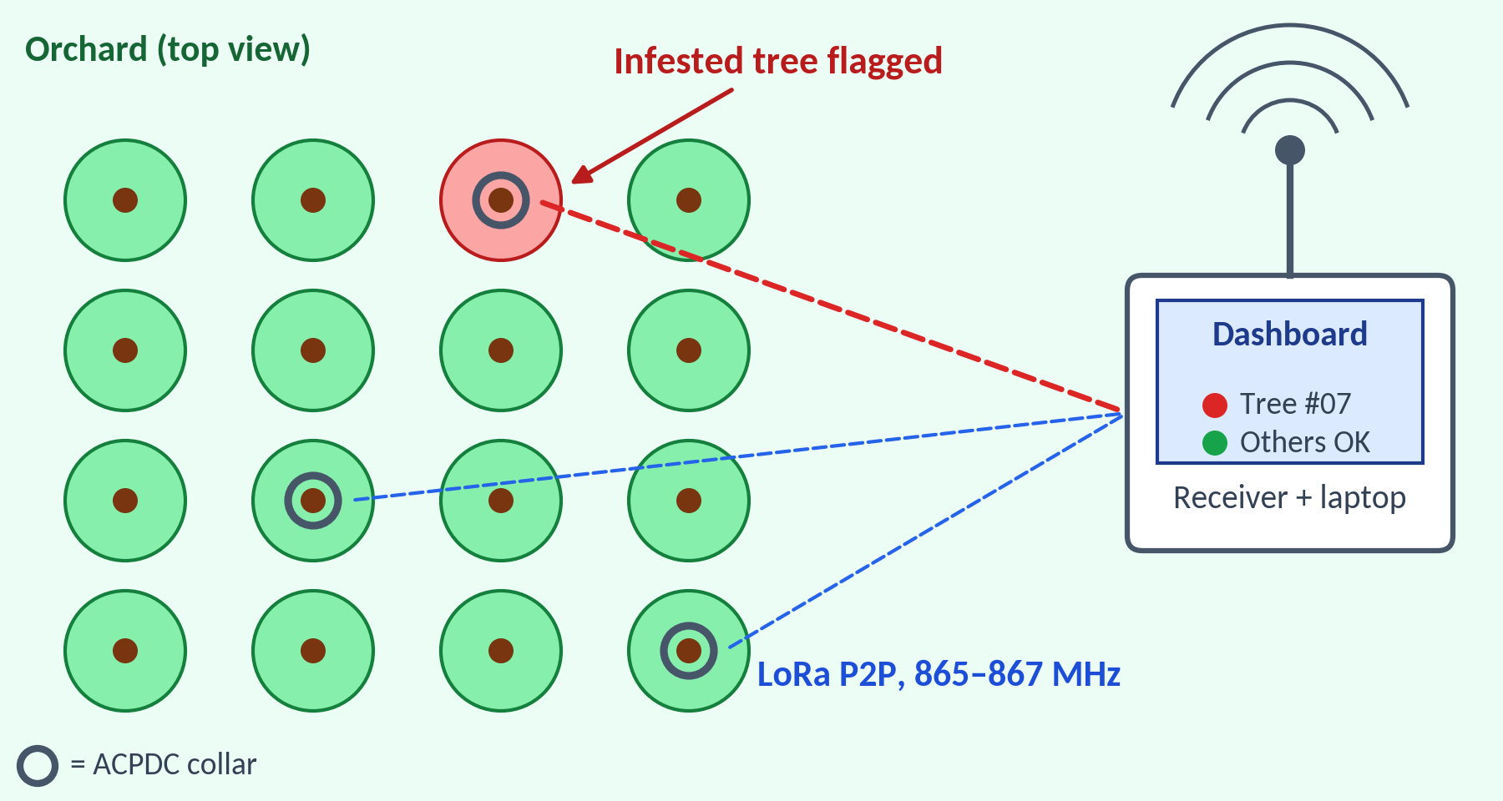
How the Collar Works (2/2): From Sound to Alert
Signal path inside the collar (synthetic, illustrative)
Alert path from collar to dashboard (illustrative)
1
Wake & capture
2
Filter & vote
3
Send LoRa alert
4
Treat that tree
Duty-cycled: MCU wakes, powers the AFE and records a short burst.
Band-pass plus adaptive threshold and N-of-M voting reject wind and rain.
Tree ID goes out over LoRa P2P with ack + retry; target alert ≤48 h.
Dashboard flags the tree, so spraying is targeted, not blanket.

Slide 7
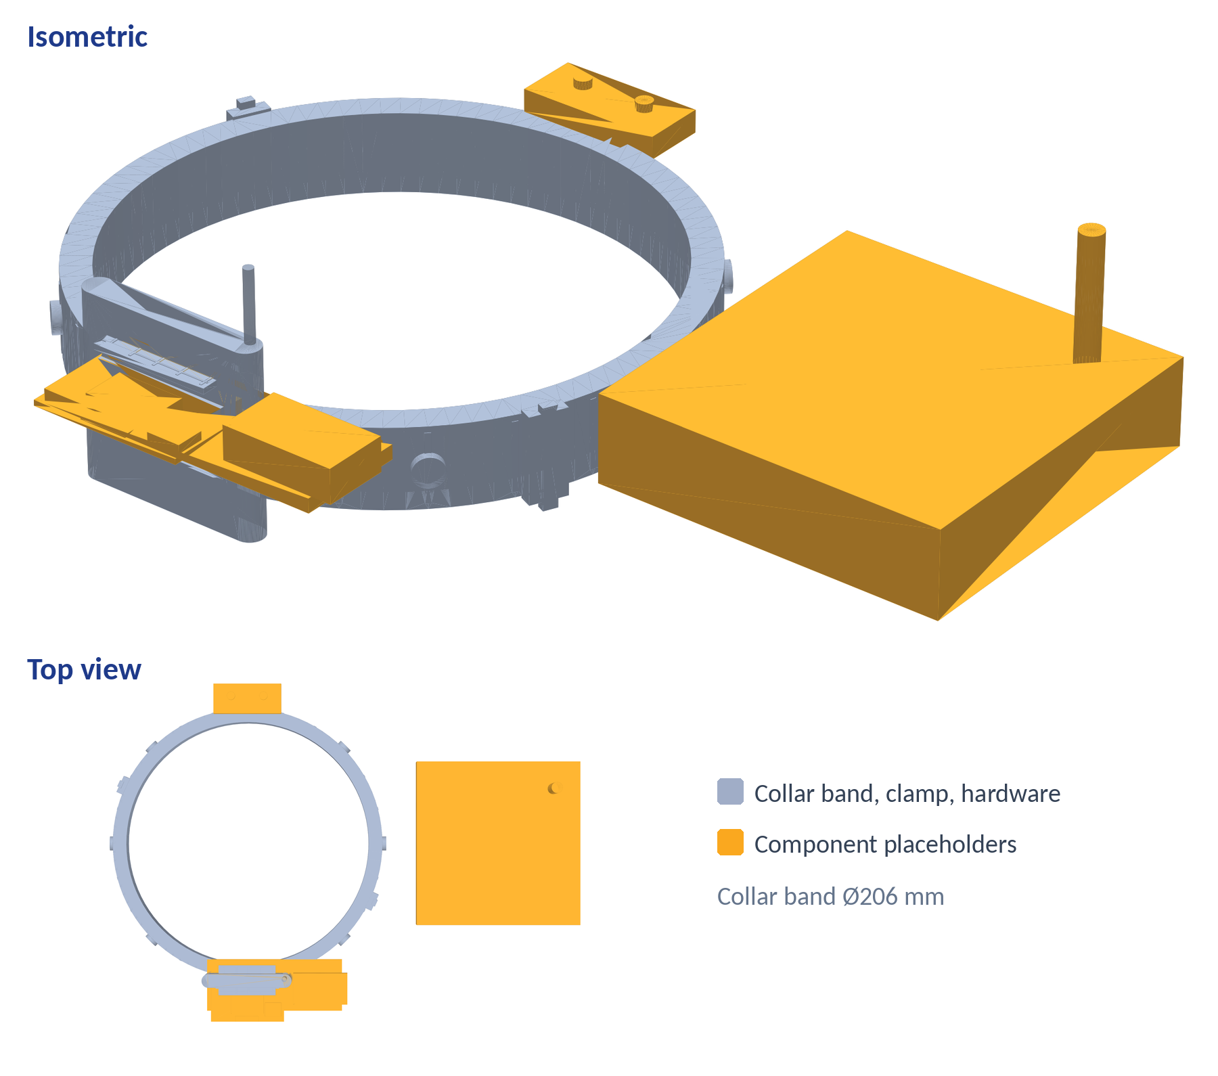
CAD Design & Mechanical Specs
Material selection
Housing: ASA (UV-stable) over PETG/PC; light grey limits solar heating
Sensing path: Al 6061-T6 plate in rigid, direct trunk contact; no rubber between plate and bark
Clamp: SS304 band + spring tensioner (no girdling); EPDM only isolates housing and clamp
FEA / stress plan
Load cases: clamp preload, wind drag, 70 °C thermal soak
Hand calc: wind drag ≈ 7 N at 40 m/s (Cd 1.2, A 0.006 m²); mount FoS target ≥ 3
ACPDC collar CAD model (STL export): isometric and top view

Slide 8
Electronics Signal Chain & BOM
PZT-5H disc
Ø12 mm
Pre-amp
TLV9062S ×31
Anti-alias LPF
set per band
ADC + DMA
48 / 200 kS/s
IIR band-pass
+ N-of-M vote
LoRa P2P TX
865–867 MHz
Component | Part / specification | Qty | Lead time | Est. cost
LoRa node module | Seeed Wio-E5 bare module (STM32WLE5JC) | 3 | Imported, 10–14 d | ₹3,186
LoRa dev + receiver | Seeed Wio-E5 Mini dev board | 2 | Imported, 10–14 d | ₹5,184
Piezo sensor | PZT-5H disc Ø12 mm [ADD mfr P/N] | 6 | Local, 5 d | ₹900
Analog front-end | TLV9062S ×6 + FR4 2-layer PCB ×5 | — | Local, 7 d | ₹2,340
Charger & protection | CN3791 module, NTC, Li-ion protection, 3.3 V reg | 3 sets | Local, 3–5 d | ₹1,272
Cell & solar | NCR18650B (genuine) + 6 V 1 W panel | 3 sets | Local, 5 d | ₹2,100
Enclosure | IP67 gasketed enclosure + printed bracket (quote) | 3 | Local, 5 d | ₹2,100
Clamp & coupling | Al-6061 plate, SS304 band, EPDM liner | 3 | Local, 7 d | ₹1,800
Misc. | Connectors, passives, wire, coating | lot | Local, 3 d | ₹1,500
Total (3 nodes + receiver) |  |  |  | ₹20,382
.

Slide 9
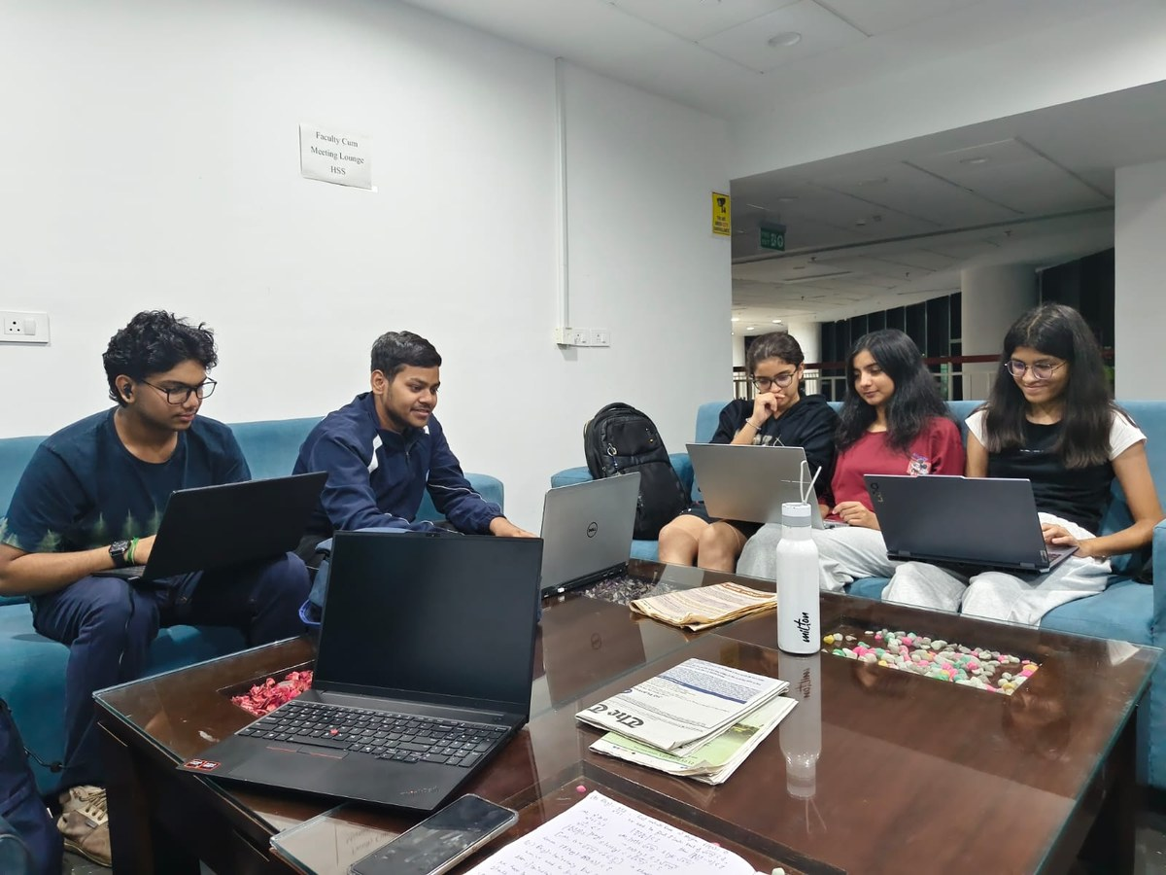
Your Maker Journey
Authenticity verification
Raw repository linkage
https://github.com/tobiocat/ACPDC
*https://1drv.ms/p/c/2e7b3fc7bcb40db0/IQC7Q1St8HDHTrJO5VEVXUEjAaHzmrqYc0-vIMAZ9zX0f5I?e=F90D15*
Collaborating on the design and development of the ACPDC project

Slide 10
Safety & Hazard Mitigation
Failure mode | Effect | Embedded fail-safe
Wind / rain / vehicle noise | False alarm, needless treatment | Band-pass + N-of-M burst voting; broadband-burst rejection
Loose clamp / detached sensor | Missed detection | Daily coupling self-test; alert on fail
Battery under-voltage / cold | Brown-out, cell damage | Protection-board UV cutoff; NTC charge inhibit <0 °C; low-battery beacon
LoRa link loss | Alert never arrives | Flash store-and-forward; ack + retry; 24 h heartbeat
Firmware hang | Silent node | Hardware watchdog reset + OTA rollback image
Physical fail-safes
IP67 gasketed enclosure + vent
PTC fuse + reverse-polarity guard
Non-girdling spring tensioner
Rounded edges, no exposed live parts
Standards (design targets)
IEC 60529 (IP67, tested on final unit)
IEC 62133-2 / IS 16046, UN 38.3 (Li-ion)
WPC ETA for 865–867 MHz LoRa
IEC 61000-4-2 ESD, CISPR 32
ASTM G154 UV (ASA housing)

Slide 11
Roadmap: 4-Month Fabrication Plan
Nov 2026: Fabricate
Dec 2026: Assemble & bring-up
Jan 2027: Integrate
Feb 2027: Validate
Band test on wood: 48 vs 200 kS/s
Coupling test: rigid vs rubber contact
Freeze KiCad schematic + CAD
Fab PCBs; populate and test AFE
Measure bare-module current (no devkit LEDs/USB)
ADC-DMA capture + band-pass firmware
LoRa P2P link to laptop receiver
Adaptive-threshold classifier
Dashboard MVP; bench test on wood
3-node orchard trial
Log false alarms; tune clamp + power
Stage 3 demo prep
Stage 3 commitment: a working 3-node prototype with laptop receiver demonstrating live acoustic detection → LoRa alert → dashboard, with bench and orchard detection / false-alarm logs.

Slide 12
Technical Challenges & Risks
1. Unproven band + ambient noise
2. Coupling and attenuation in wood
A published RPW study found features near 2–14 kHz; 20–60 kHz may miss signal
Wind, rain and traffic set the false-alarm rate
Species, bark, moisture and clamp force change sensitivity
High-frequency energy fades quickly along the trunk
Rubber in the sensing path weakens the signal
3. Power vs continuous operation
4. Ground truth and permits
TLV9062 draws ~538 µA per channel (~1.1 mA per IC)
Reaching ≤100 µA needs scheduled capture + shutdown
Live quarantine pests are tightly regulated
Few labelled larval recordings to train the classifier

Slide 13
Potential Solutions & Risk Mitigation
Risk | Primary mitigation | Backup / fallback
Band & noise | Bench-compare 1–14 kHz @48 kS/s vs 20–60 kHz @200 kS/s; N-of-M voting | Dual-band firmware, OTA-selectable; TinyML classifier
Coupling | Rigid Al-plate contact; rubber only on housing/clamp | Coupling gel; per-tree baseline; coupling test
Attenuation | Mount on main trunk; node density by tree size | Second collar on limbs
Power budget | Scheduled capture; TLV9062S shutdown between recordings | TLV9002S (~60 µA/ch) if low band works
Data and permits | Piezo exciter on wood + public recordings | Partner with a state research station for live samples
Link loss | Elevated antenna; ack + retry; flash store-and-forward | Add LoRaWAN gateway for scale-up

Slide 14
References & Sources
ACPDC Stage 1 Project Proposal, Vishwakarma Award submission (Sept 2026)
Source: internal
STM32WLE5 datasheet; Seeed Wio-E5 module documentation
Source: www.st.com, www.seeedstudio.com
TLV9062 and TLV9002 datasheets
Source: www.ti.com
USDA-ARS red palm weevil acoustic detection study (2–14 kHz features)
Source: www.ars.usda.gov
IEC 60529 (IP codes); IEC 62133-2 (Li-ion cells)
Source: webstore.iec.ch
Diagrams in this deck are original illustrations; no third-party images used
Peer-reviewed literature: acoustic detection of boring larvae (RPW / EAB)
Larval bursts are broadband (1–20 kHz); background noise peaks below ~3.5 kHz [1]. Burst and pulse-rate rules detect larvae [3, 4].
[1] Mankin RW, Al-Ayedh HY, Aldryhim Y, Rohde B (2016) Acoustic detection of Rhynchophorus ferrugineus and Oryctes elegans in Phoenix dactylifera trees and offshoots in Saudi Arabian orchards. J. Econ. Entomol. 109(2): 622–628. doi:10.1093/jee/tov398
[2] Herrick NJ, Mankin RW (2012) Acoustical detection of early instar Rhynchophorus ferrugineus in Canary Island date palm, Phoenix canariensis. Fla. Entomol. 95(4): 983–990. doi:10.1653/024.095.0425
[3] Mankin RW, Mizrach A, Hetzroni A, Levsky S, Nakache Y, Soroker V (2008) Temporal and spectral features of sounds of wood-boring beetle larvae: identifiable patterns of activity enable improved discrimination from background noise. Fla. Entomol. 91: 241–247

